Slide 1
Faster Maximum Inner Product Search in High Dimensions
IT 550 : Reproducibility
202311033 Parth
202311040 Sarthak
202311011 Dhairya
202311069 Viraj

Slide 2
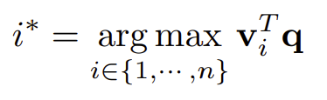
MIPS
Given a query vector q ∈ R^{d}, and n atom vectors v₁, . . . , v_{n} ∈ R^{d}, MIPS aims to find the atom most similar to the query:

Slide 3
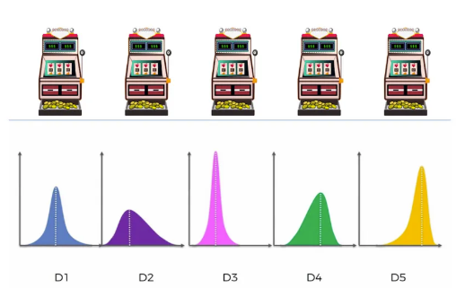
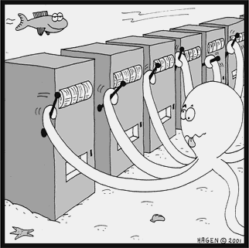
Multi-Armed Bandits
Scenario:
Pull machine k → sample from unknown reward distribution D_{k} → observe reward.
The goal is to optimize the winnings given a finite number of pulls T.
Problem:
Given a finite number of pulls T, how can you optimize the winnings?
Questions to Address:
How much should you explore? How much should you exploit?

Slide 4
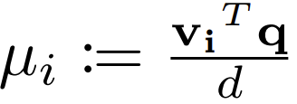


Objective
Normalized Inner Product of atom v_{i} with q
arg max_{i∈[n]} v_{i}^{T}q = arg max_{i∈[n]} µ_{i}
For i != i*

Slide 5
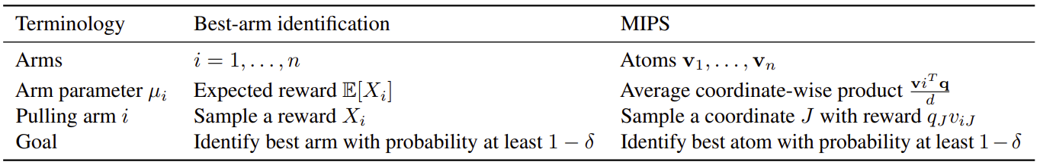
MIPS as a Best-Arm Identification Problem
n arms, each with expected reward μ_{i}
At each time step, pull an arm A_{t} and receive reward X_{t} with E[X_{t}] = μ_{At}
Objective is to identify the arm with the largest reward using the fewest number of arm pulls

Slide 6
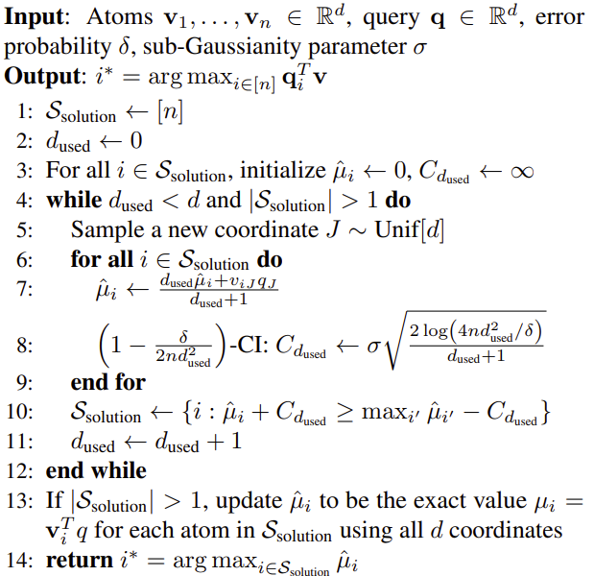
BanditMIPS
Initialize a set of potential optimal atoms. [1]
For each potential atom:
Estimate the mean inner product value. [7]
Compute an upper confidence bound on the inner product. [8]
Eliminate any atoms whose upper confidence bound is below the maximum lower confidence bound. [10]
Repeat steps 2-3 until only one atom remains, which is returned as the solution. [4]

Slide 7
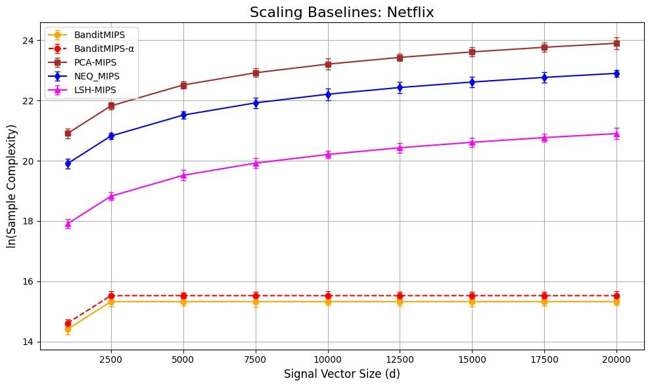
Results

Slide 8
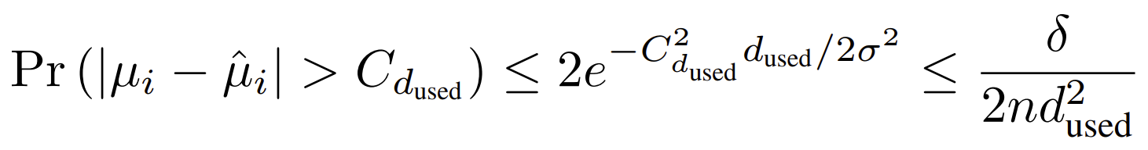
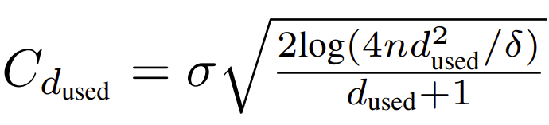
Appendix
Theorem 4.1
Hoeffding’s Inequality

Slide 9
Dataset
Netflix :
Subset Details: 6,000 movies, 400,000 customers (Netflix Prize dataset).
Imputation Method for missing values: Low-rank approximation using 100-factor SVD decomposition.
Query Vectors: Movie vectors derived from SVD.
Dimensionality: Based on the number of sampled users (d).
Can form n = 1, 000, and d = 100, 000

