Slide 1
Embedding based approach for ad-hoc retrieval
IT550 : INFORMATION RETRIEVAL
Team 20 - Retrieval Kings:
Ayush Hirdani (202101139)
Bhavan Bhatt (202311021)
Samarth Motka (202311023)
Harshneel Soni (202311024)
Guided by :
Prof. Parth Mehta

Slide 2
AGENDA
Introduction
Methodology
Dataset
Evaluation Metrics
Results
Future Scope

Slide 3
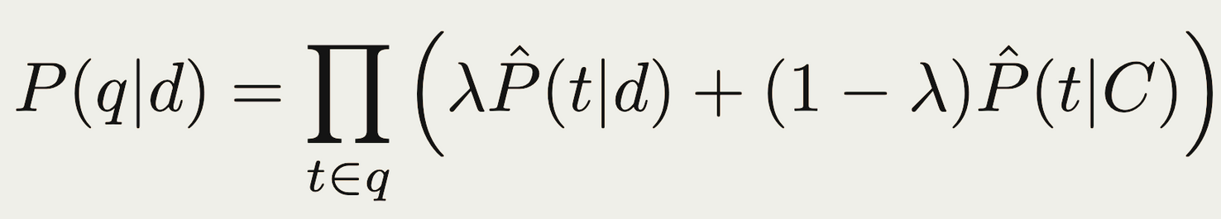
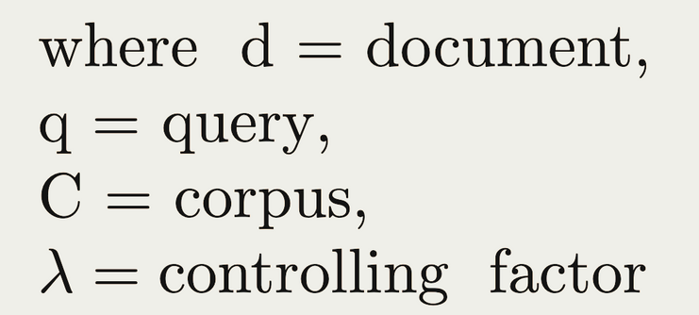
INTRODUCTION
As we have seen so far this is Language Modelling,

Slide 4
METHODOLOGY
Direct term sampling: Standard LM term sampling, i.e. sampling a term t (without transformation) either from the document d or from the collection.
Transformation via Document Sampling: Sampling a term t’ (t’ != t) from document which is then transformed to t by a noisy channel.
Transformation via Collection Sampling: Sampling a term t’ (t’ != t) from the collection which is then transformed to t by a noisy channel.

Slide 5
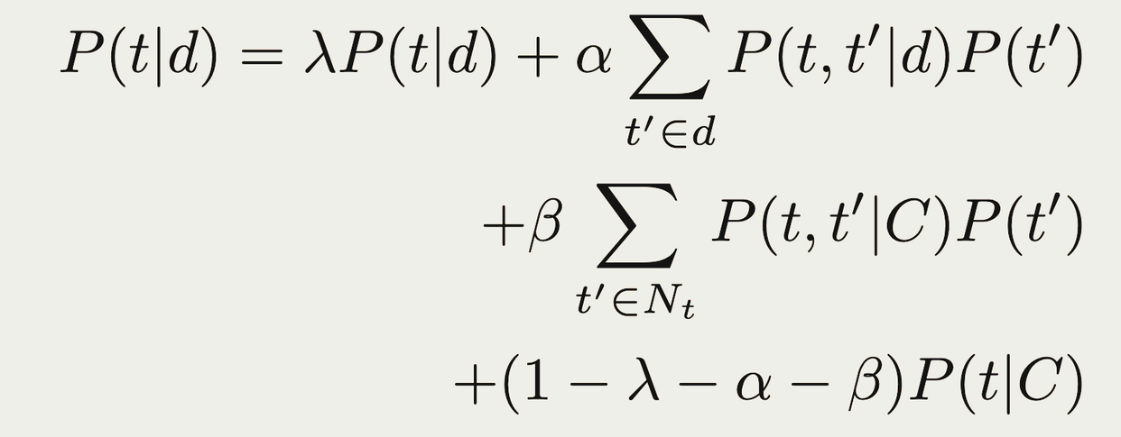
METHODOLOGY
Equation for Generalised Language Model (GLM)

Slide 6
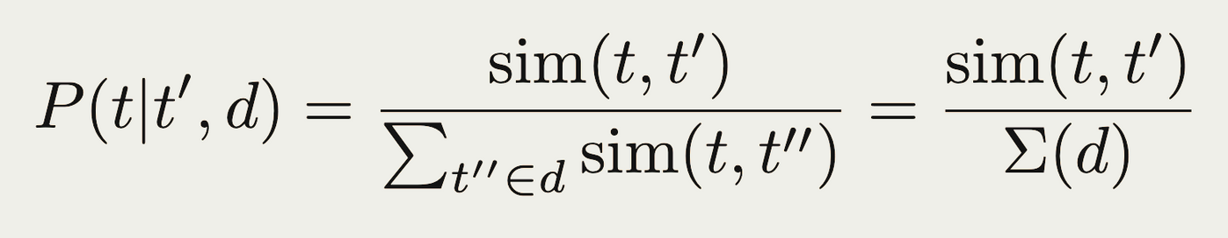
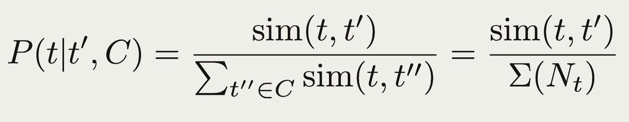
METHODOLOGY
Calculation of Transformation via Document Sampling
Calculation of Transformation via Collection Sampling

Slide 7
METHODOLOGY
In order to calculate similarity between t and t’ we have incorporated following models:
Pre-trained Word2Vec
Word2Vec (trained on this corpus)
RoBERTa (Fine-tuned)

Slide 8
DATASET
We have used Robust04 dataset, which have the following statistics
Queries - 250
Documents - 528k
Relevance Judgements - 1245.65 doc / query
- 69.65 relevant doc / query

Slide 9
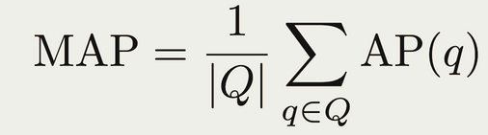
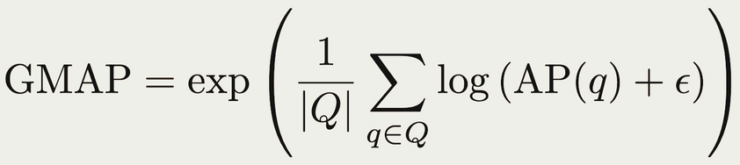
EVALUATION METRICS
We have used following evaluation metrics,
Mean Average Precision
Geometric Mean Average Precision
Recall

Slide 10
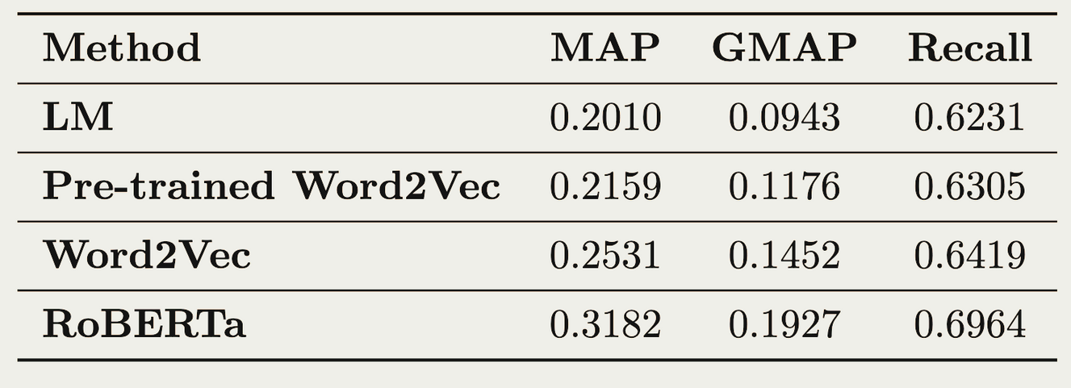
RESULTS

Slide 11
FUTURE SCOPE
These are the following points to work upon in future,
Investigate compositionality of terms from the vector embeddings of words.
Instead of matching a single term we can treat query as a sentence and work with sentence embeddings to improve the results.

Slide 12
Thank you!

