Slide 1
Question generation System

Slide 2
AGENDA
Problem Statement
Dataset
Data Preprocessing
ParaQG System Architecture
Model
Evaluation Metrics
Results

Slide 3
Problem Statement
Generating meaningful questions from large text data is a critical need in education, content creation, and knowledge assessment, but the process remains manual and time-consuming.
Current automated solutions focus on single sentences, making them impractical for real-world use cases where understanding and generating questions from entire paragraphs or documents is essential.

Slide 4
Dataset
SQuAD 1.1 contains 107,785 question-answer pairs from 536 articles.
SQuAD 2.0 (open-domain SQuAD, also known as SQuAD-Open), the latest version, combines the 100,000 questions in SQuAD 1.1 with over 50,000 unanswerable questions written adversarially by crowdworkers in forms similar to the answerable ones.
We have used the dev-v2.0 dataset, which consists of 1,204 unique contexts and 11,873 unique questions.

Slide 5
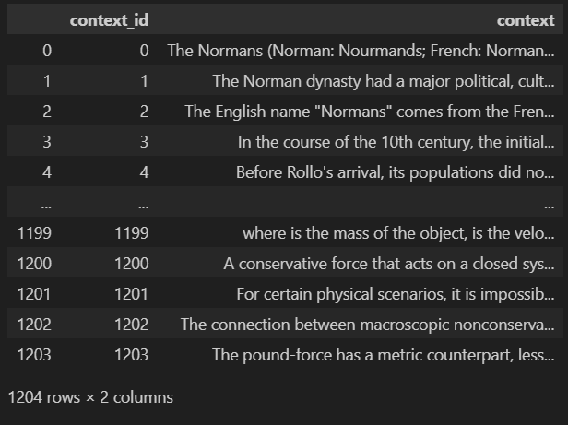
Context data
SQuAD 1.1 contains 107,785 question-answer pairs on 536 articles.
SQuAD2.0 (open-domain SQuAD, SQuAD-Open), the latest version, combines the 100,000 questions in SQuAD1.1 with over 50,000 un-answerable questions written adversarially by crowdworkers in forms that are similar to the answerable ones.

Slide 6
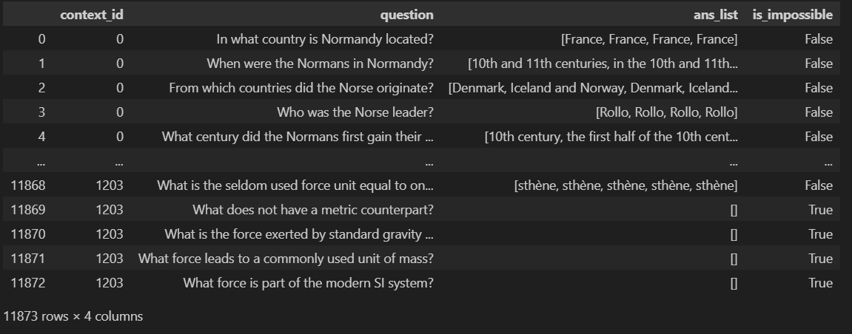
Question & Answer Dataset
SQuAD 1.1 contains 107,785 question-answer pairs on 536 articles.
SQuAD2.0 (open-domain SQuAD, SQuAD-Open), the latest version, combines the 100,000 questions in SQuAD1.1 with over 50,000 un-answerable questions written adversarially by crowdworkers in forms that are similar to the answerable ones.

Slide 7
Data pre-processing
Lowercasing: Converted all text to lowercase for uniformity.
Punctuation Handling: ( . ? " ' [] () {} ) added spaces to distinguish punctuation from words.
Emoji & URL Removal: Removed emojis, URLs, and non-ASCII characters to maintain clean text data.
No Stopword Removal: Retained stopwords to preserve the contextual meaning of questions.

Slide 8
Data pre-processing
Tagging: Added starttag and endtag at the beginning and end of all questions for structure.
Example : 'starttag what year did bskyb and microsoft announce their settlement ? endtag’
BIO Notation: Converted the context into BIO notation to label entities corresponding to each answer in the ans_list.
Example : The First epoch is Always Hard, We are the Chaotic bans Noob ians, project Git Link : https://github.com/SiddharthKadam/Question-Generation-

Slide 9
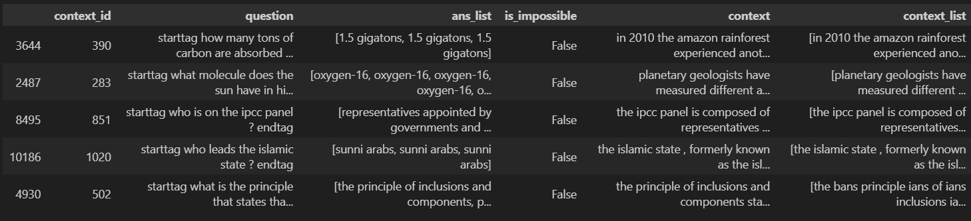
Processed data
Tagging: Added starttag and endtag at the beginning and end of all questions for structure.
BIO Notation: Converted questions into BIO notation to label entities.
No Stopword Removal: Retained stopwords to preserve the contextual meaning of questions.

Slide 10
TensorFlow tokenizer
Using TensorFlow tokenizer to tokenize the text data (questions and contexts).
Setting vocabulary size to 20000 and handles out-of-vocabulary words with <unk> token.
Example: dict_items([('<unk>', 1), ('the', 2), ('of', 3), ('and', 4), ('in', 5), ('to', 6), ('a', 7), ('is', 8), ('ians', 9)])

Slide 11
Glove Embedding Matrix
Build a GloVe embedding matrix for all the terms in the tokenizer, with rows corresponding to the tokenizer's word index.
Filled the matrix with GloVe word embeddings if they exist, based on the tokenizer's word index.
Special tokens like <unk>, starttag, and endtag are assigned random embeddings.

Slide 12
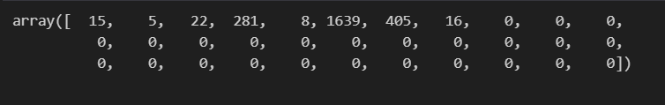
Sequences
Created sequences for questions and context based on their tokenizer indices.
Padded the sequences with zeros to ensure all sequences are of uniform length.

Slide 13
paraQG system Architecture
Paragraph Review
Answer Selection
Question Generation
BERT-Based Filtering
Faceted Views of Questions

Slide 14
Model
Seq2Seq (Sequence-to-Sequence) model augmented with:
Dynamic dictionaries: Handle out-of-vocabulary words.
Copy mechanism: Copies words directly from the paragraph.
Sparse-max attention: Focuses on high-attention text.
Generates syntactically correct and meaningful questions from paragraphs.

Slide 15
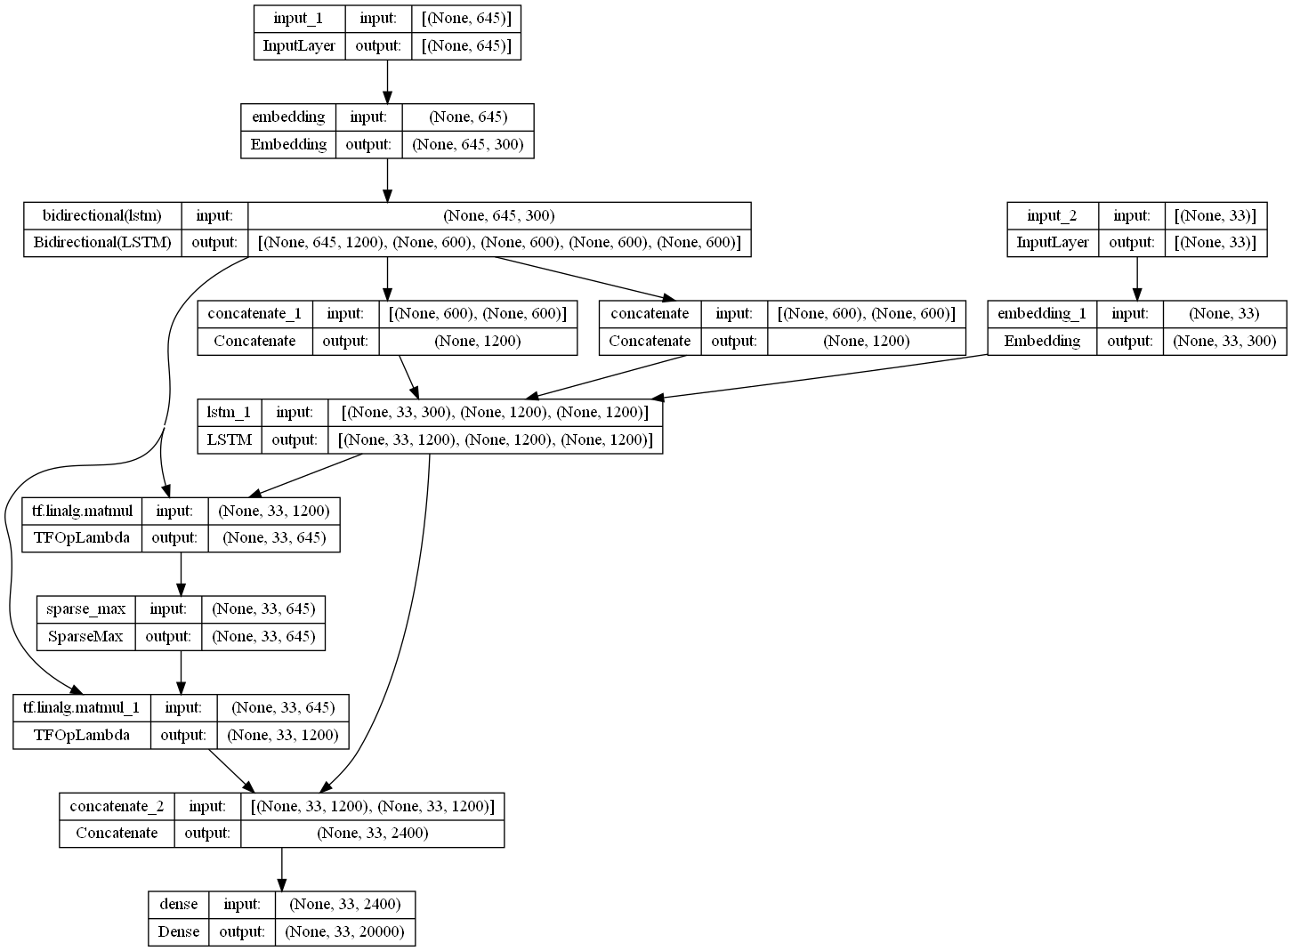
paraQG system Architecture
Paragraph Review
Answer Selection
Question Generation
BERT-Based Filtering
Faceted Views of Questions

Slide 16
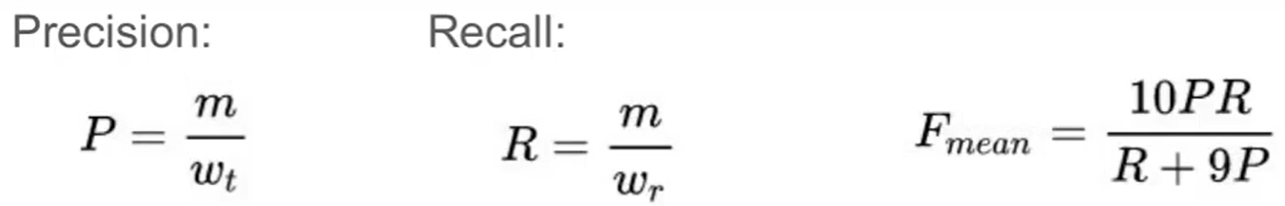
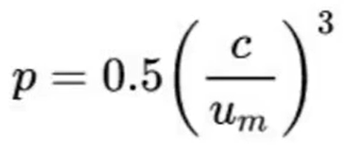
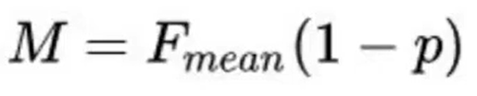
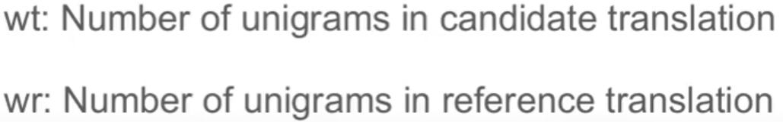
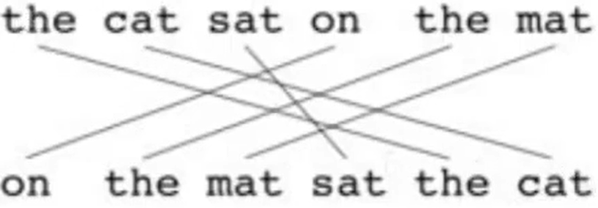
Evaluation Metrics
METEOR: Measures precision and recall between generated and reference questions.
Um = number of unigrams in candidate (6)

Slide 17
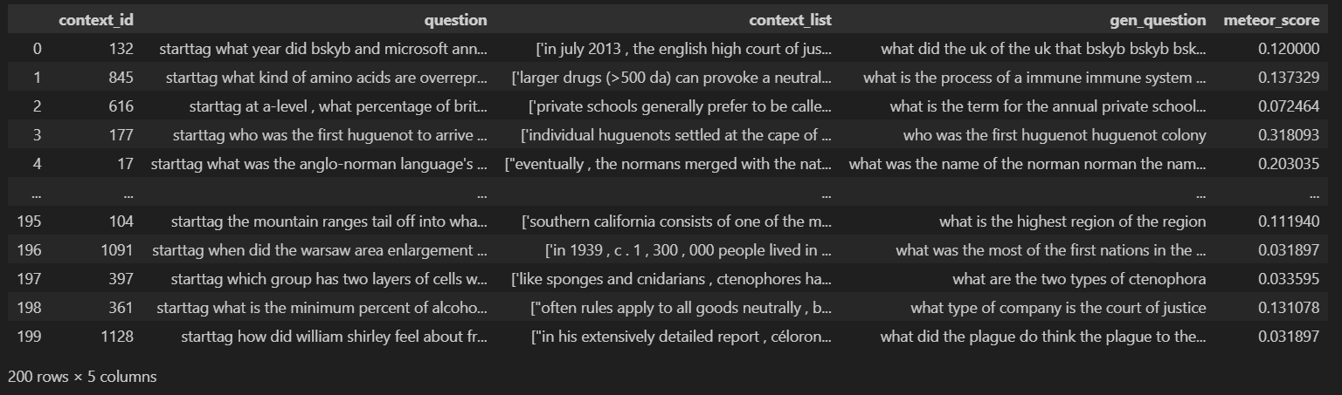
Results
Average Meteor Score : 0.482800565847217

Slide 18
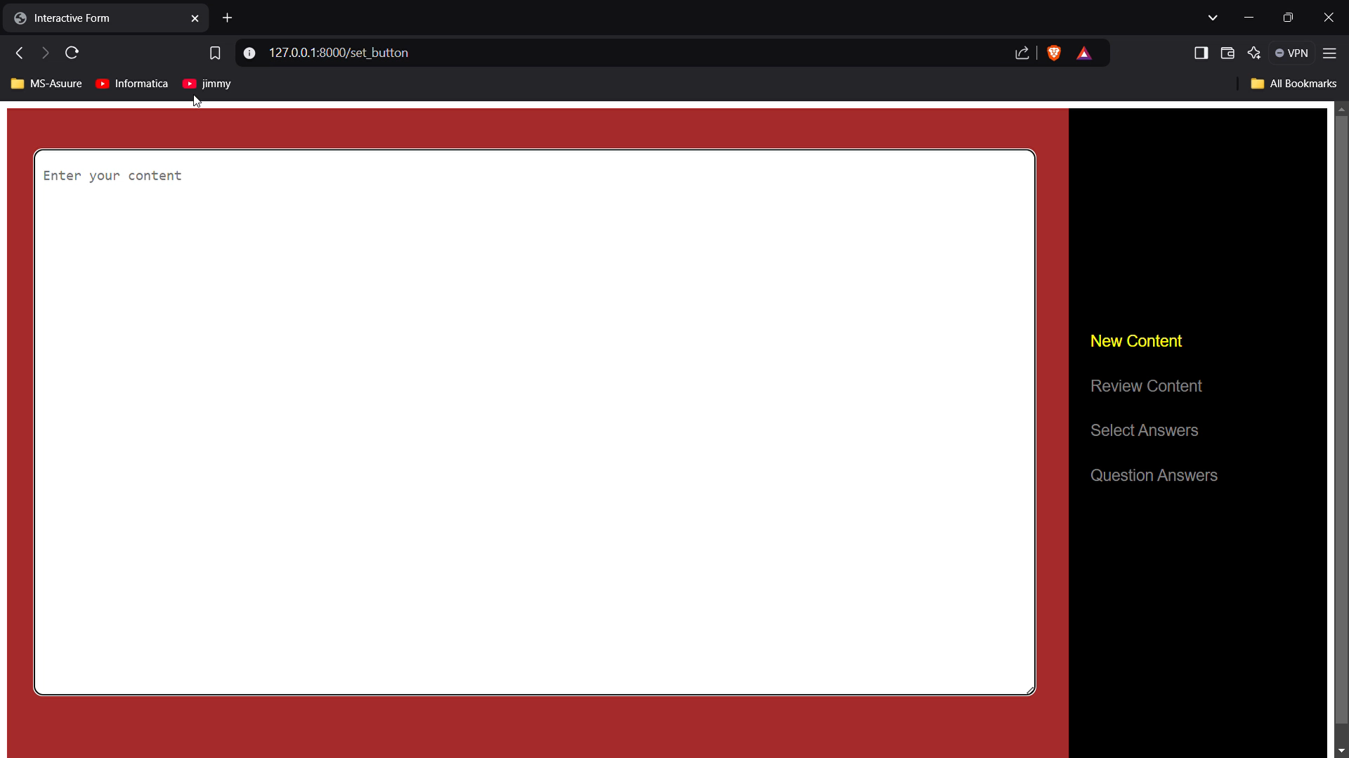

Slide 19
THANK YOU
Chaotic NOOBS
MSc. DS
{202318015, 202318025, 202318027, 202318045}@daiict.ac.in

