Slide 1

Causal Analysis of Mental Health Issues in Social Media Posts
Presented by:
Kushal (202318006) Aayush (202318023) Harshil (202318033) Sobhan(202318040)

Slide 2
Introduction
Mental health challenges are rising, yet identifying their root causes remains a challenge. Social media provides valuable insights for detecting mental health issues through user-generated content.
This project focuses on automating causal analysis to categorize causes of mental health issues, enabling better intervention strategies and advancing mental health research.

Slide 3
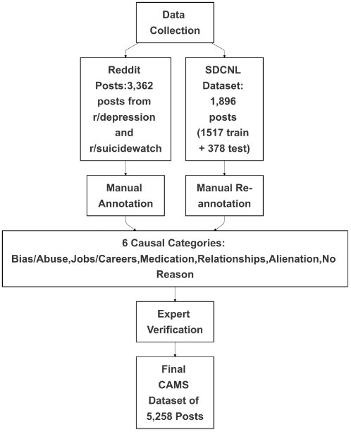
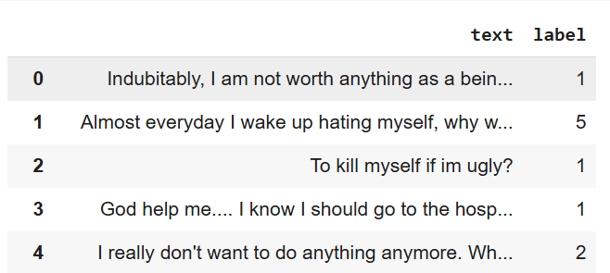
Dataset Collection

Slide 4
Challenges faced in Annotation
Informal and Noisy Text:
Social media language includes slang, abbreviations, and inconsistent grammar.
Ambiguity in Causes:
Overlapping categories like Bias/Abuse and Relationship.
Subjectivity in annotators' interpretations.
Multiple Reasons in Posts:
Identifying a root cause from multiple mentioned causes.
Dataset Imbalance:
Some categories (e.g., Bias/Abuse) have significantly fewer posts.

Slide 5
Solution for Challenges
Annotation Guidelines:
Developed detailed instructions with examples for annotators.
Expert Supervision:
Clinical psychologists and counselors reviewed and validated annotations.
Majority Rule:
Used annotator consensus to reduce subjectivity.
Augmentation:
Added samples to underrepresented categories to balance the dataset.
Statistical Validation:
Measured consistency using Fleiss’ Kappa for inter-annotator agreement.

Slide 6
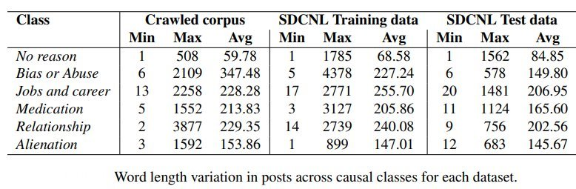
Additional Insights from Dataset

Slide 7
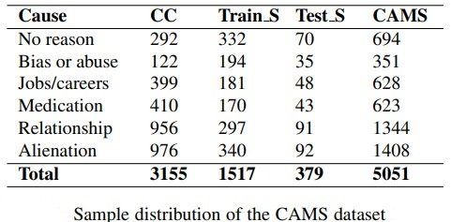
Additional Insights from Dataset

Slide 8
Flowchart
Evaluation
Data Collection
Annotation
Preprocessing
Model Selection
Model Training

Slide 9
Data Pre-Processing
Cleaning the Text:
Removed irrelevant posts and non-English entries.
Eliminated special characters, URLs, and stopwords.
Tokenization & Normalization::
Split posts into words for further analysis.
Standardized text by converting to lowercase.
Handling Class Imbalance:
Augmented underrepresented categories with additional samples.
Feature Extraction:
Used GloVe embeddings (100 dimensions) to convert words into meaningful vector representations for machine models.
Removing Irrelevant Posts:
Filter out posts not related to mental health.

Slide 10
Models
Logistic Regression:
A simple yet effective model for multi-class classification of textual data.
Support Vector Machine (SVM):
Utilizes hyperplanes to classify text into distinct causal categories.
LSTM (Long Short-Term Memory):
Captures sequential relationships in posts to understand context over time.
GRU (Gated Recurrent Unit):
A simplified recurrent model that efficiently handles sequential data.
CNN (Convolutional Neural Network):
Extracts significant patterns and features from text using convolution layers.
Hybrid Models (CNN+LSTM, CNN+GRU):
Combine CNN's feature extraction with LSTM/GRU's sequence learning capabilities.

Slide 11
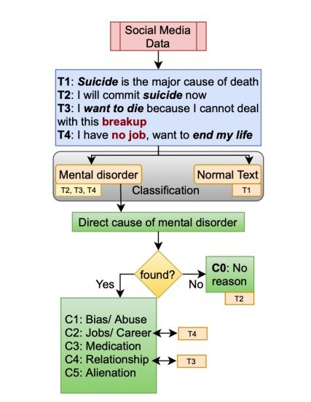
Framework for Causal Analysis

Slide 12
Evaluation Policy
Accuracy: Measures the overall correctness of model predictions.
Precision: The proportion of true positive predictions out of all predicted positives.
Recall: The proportion of true positive predictions out of all actual positives.
F1 Score: Balances precision and recall

Slide 13
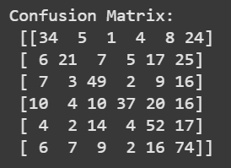
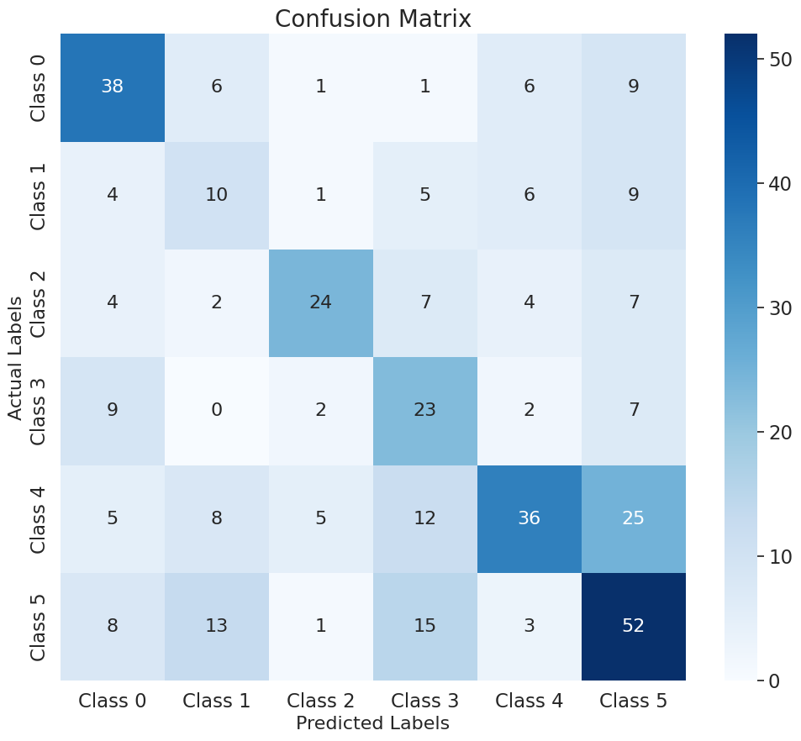
Result
Classifier | Accuracy
LR | 0.4881
SVM | 0.4826
LSTM | 0.4405
CNN | 0.4730
GRU | 0.3865
Bi-LSTM | 0.4946
Bi-GRU | 0.4243
CNN+LSTM | 0.4946
CNN+GRU | 0.4054

Slide 14
Conclusion
This project demonstrates the application of machine learning and deep learning models for causal analysis of mental health issues in social media posts, addressing annotation challenges and showcasing the potential of automated approaches in advancing mental health research.

Slide 15

Thank You

