Slide 1

Document Expansion by Query Prediction
A Project by
Deepak Khatri (202311042)
Nirmal Shah (202311043)
Keyur Dhanani (202311045)
Rameez Raja (202311068)
Guided by
Dr. Parth Mehta
Nogueira, Rodrigo, et al. "Document expansion by query prediction." arXiv preprint arXiv:1904.08375 (2019).

Slide 2
Challenges in IR
Vocabulary Mismatch
High Computational Cost of Neural Models.

Slide 3

Abstract
Approach
Introduces Doc2query for document expansion using a sequence-to-sequence transformer model.
Predicts potential queries a document might answer, enriching document representation before indexing.
Innovation
First successful application of neural network-based document expansion.

Slide 4
Dataset (MS MARCO)
Passage re-ranking dataset comprising 8.8 million passages from the top-10 results retrieved by Bing for 1 million queries.
Each query typically has one relevant passage, averaging 500,000 query-passage pairs in the training set.
Bajaj, Payal, et al. "Ms marco: A human generated machine reading comprehension dataset." arXiv preprint arXiv:1611.09268 (2016).

Slide 5
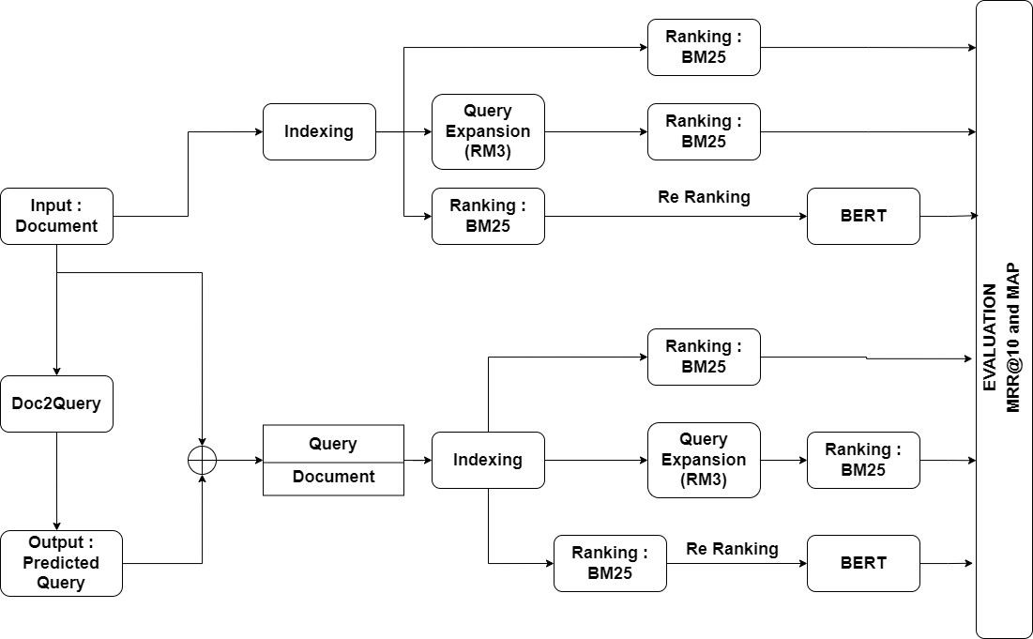
Detailed Approach

Slide 6
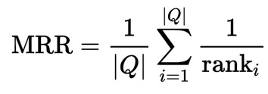
Evaluation Metrics
Mean Reciprocal Rank (MRR @ 10)
where :-
|Q| = Number of Queries.
Rank_{i} = Rank of relevant document for i^{th} query.

Slide 7
Experiments
To Use better Neural Network Architecture that can perform better that Doc2Query’s Architecture.
Architectures Explored:
T5
Bart

Slide 8
Results Reproducibility
 | MRR@10 | Our MRR@10
BM25 | 18.4 | 18.74
BM25+RM3 | 16.7 | 16.46
BM25+BERT(Reranking) | 37.5 | 34.85
Doc2Query+BM25 | 21.5 | -
Doc2Query+BM25+RM3 | 20.3 | -
Doc2Query+BM25+BERT(Reranking) | 37.5 | -

Slide 9
Our Results and Experiments
 | Our MRR@10
BART + BM25 | 19.33
BART + BM25 + RM3 | 17.42
BART + BM25 + BERT(Reranking) | 35.2
T5+BM25 | 27.6
T5+BM25+RM3 | 21.5
T5+BM25+BERT(Reranking) | 37.5

Slide 10
Thank You
Any Questions ? 🤔

Slide 11
Appendix

Slide 12
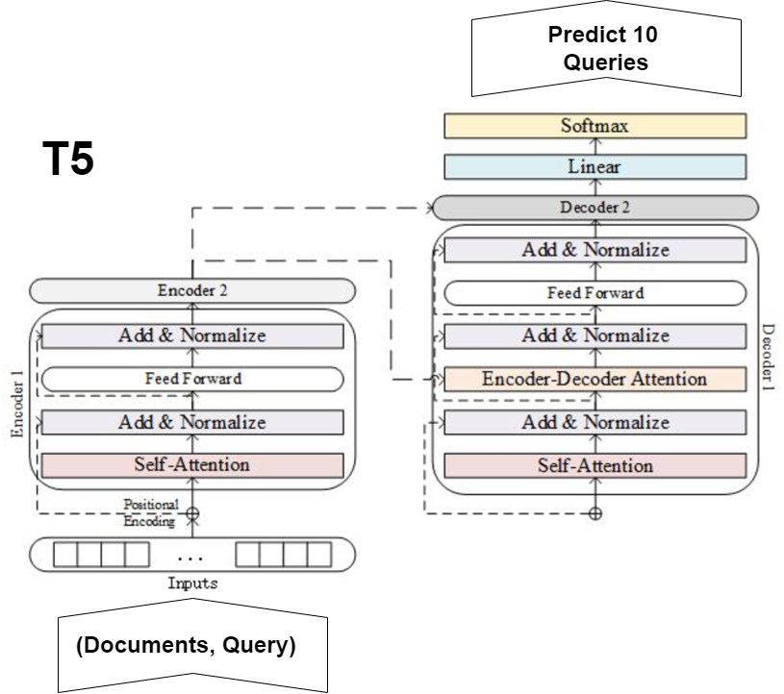
Doc2Query (T5):-
Source :-

Slide 13
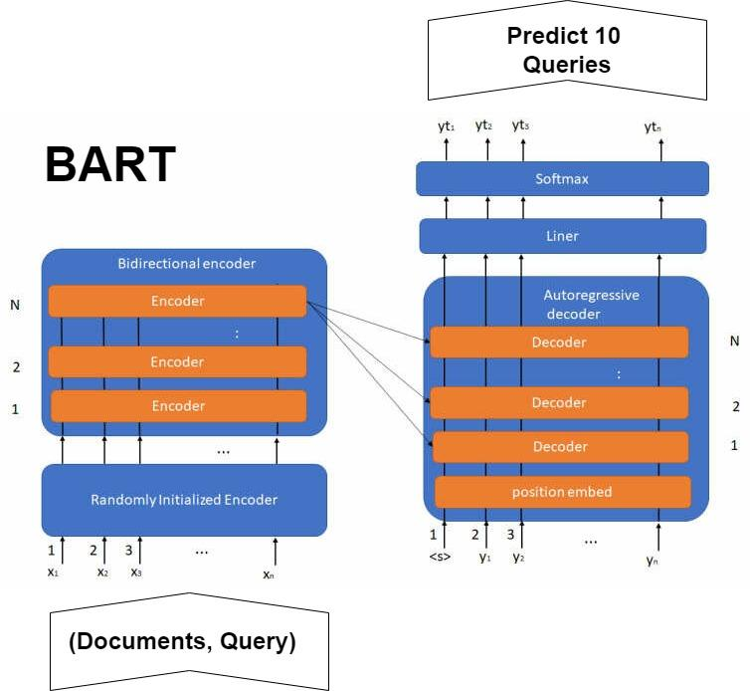
Doc2Query (BART):-
Source:-

Slide 14
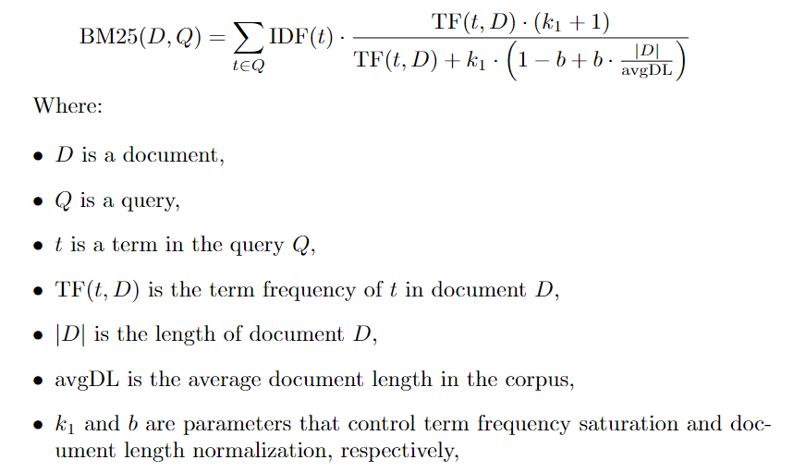
BM25
BM25 is used to rank documents based on their relevance to a query using a probabilistic approach.

Slide 15
Re-ranking
Prepare MS marco dataset.
Fine tune the BERT model.
Do testing on BM25 output dataset.
Got rerank list.

