Slide 1
Latent Semantic Indexing
Issue: 17
Vishva Bhavsar (202318019) Kandarp Malkan(202318021) Srinibas Masanta (202318054) Ghotra Jaspreet Kaur (202318058)

Slide 2
Problem Statement
Singular Value Decomposition (SVD) is a widely used technique for Latent Semantic Indexing (LSI).
However, when applied to large datasets, it becomes computationally expensive in terms of both memory and time, posing significant challenges for scalability in information retrieval tasks.
The challenge is to explore alternative low-rank approximation algorithms that can efficiently compute LSI on large-scale datasets. The goal is to develop methods that reduce computational complexity and memory requirements while maintaining the effectiveness of LSI in capturing the latent structure of the data.

Slide 3
Dataset
Dataset Used: CNN/Daily Mail Dataset
Split Used: Train Split
Number of Articles: 2,87,113 articles
Columns: articles, highlights, ID

Slide 4
Randomized SVD
Randomized Singular Value Decomposition (SVD) is a technique used to efficiently approximate the singular values and vectors of large matrices.
By projecting the original matrix onto a lower-dimensional subspace using random projections, it significantly reduces the computational complexity compared to traditional SVD.

Slide 5
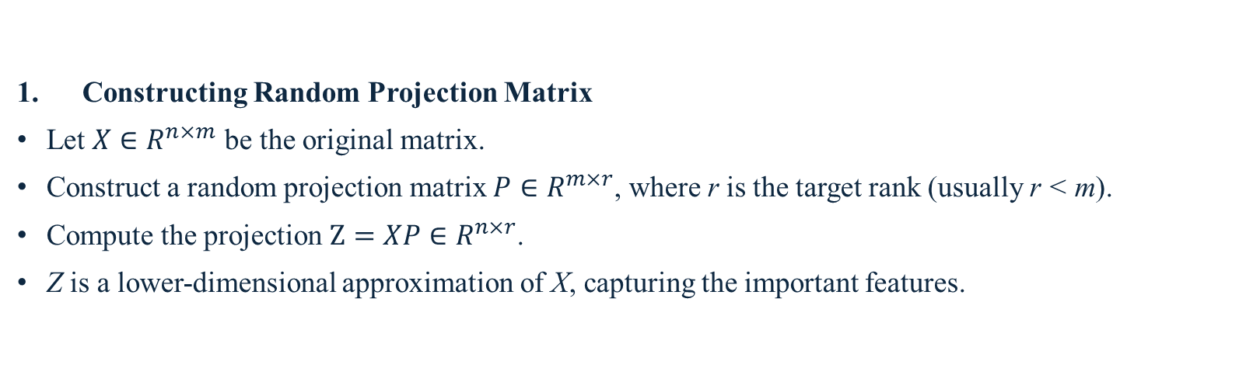
Randomized SVD Workflow
Constructing Random Projection Matrix
Let $X∈R^{n×m}$ be the original matrix.
Construct a random projection matrix $P∈R^{m×r}$, where r is the target rank (usually r < m).
Compute the projection $Z=XP∈R^{n×r}$.
Z is a lower-dimensional approximation of X, capturing the important features.

Slide 6
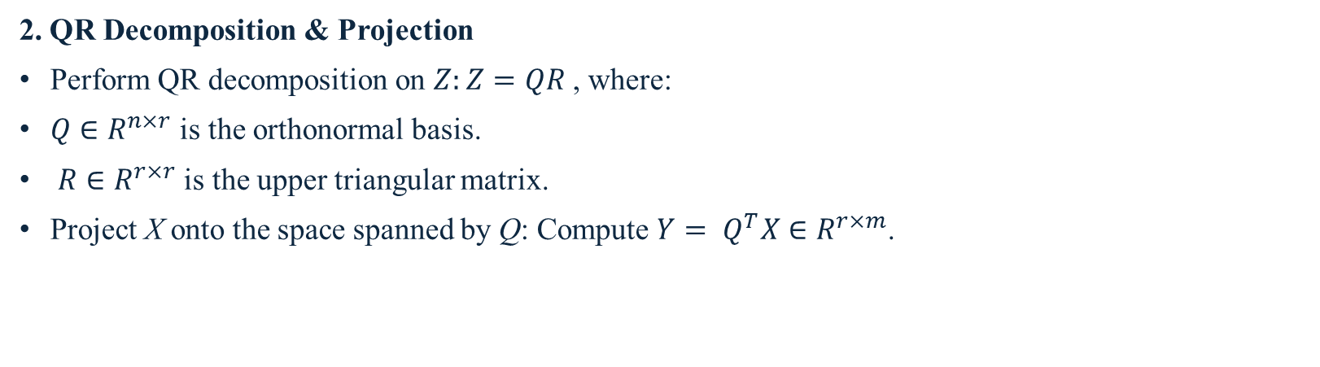
Randomized SVD Workflow
2. QR Decomposition & Projection
Perform QR decomposition on $Z:Z=QR$ , where:
$Q∈R^{n×r}$ is the orthonormal basis.
$R∈R^{r×r}$is the upper triangular matrix.
Project X onto the space spanned by Q: Compute $Y= Q^{T}X∈R^{r×m}$.

Slide 7
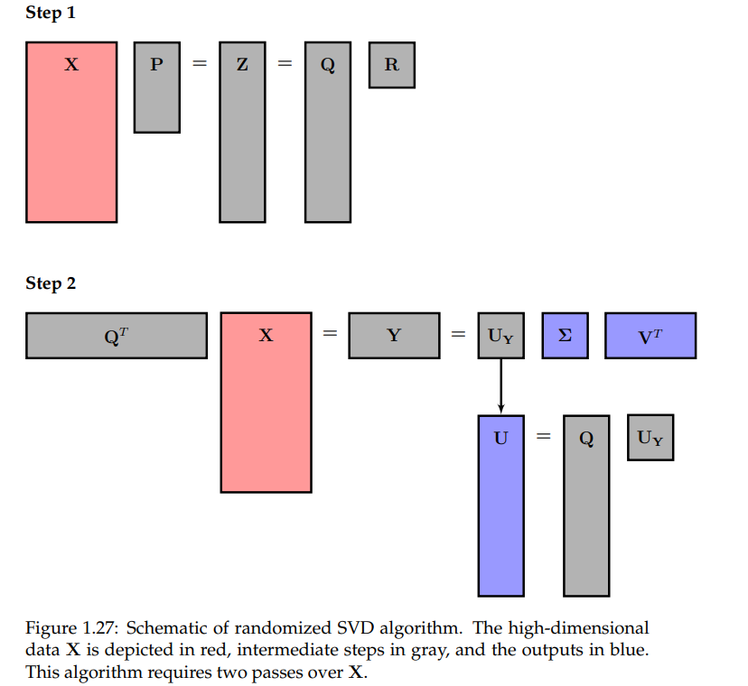
Randomized SVD Workflow

Slide 8
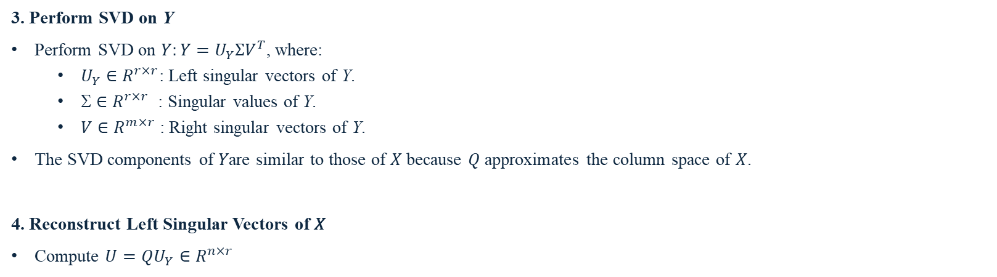
Randomized SVD Workflow
3. Perform SVD on Y
Perform SVD on $Y:Y=U_{Y}ΣV^{T}$, where:
$U_{Y}∈R^{r×r}$: Left singular vectors of Y.
$∈R^{r×r}$ : Singular values of Y.
$V∈R^{m×r}$: Right singular vectors of Y.
The SVD components of 𝑌are similar to those of 𝑋 because 𝑄 approximates the column space of 𝑋.
4. Reconstruct Left Singular Vectors of 𝑋
Compute $U=QU_{Y}∈R^{n×r}$

Slide 9
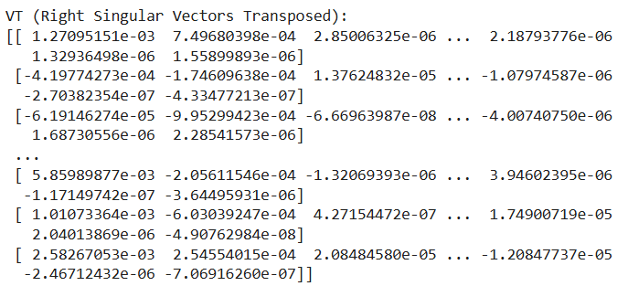
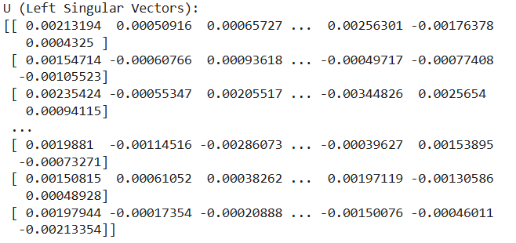
Randomized SVD Results
TF-IDF Matrix Shape: (287,113, 639,030)
U (Document-Concept Similarity Matrix) Shape: (287,113, 100)
VT (Term-Concept Similarity Matrix)Shape: (100, 639,030)

Slide 10
Lanczos Algorithm
The Lanczos algorithm is an iterative method for computing the singular value decomposition of large, sparse matrices.
It works by constructing a sequence of orthogonal vectors through matrix-vector multiplication, reducing the problem to a smaller, tridiagonal matrix.
The eigenvalues and eigenvectors of this matrix are then used to approximate the singular values and vectors of the original matrix, making it efficient for large-scale computations.

Slide 11
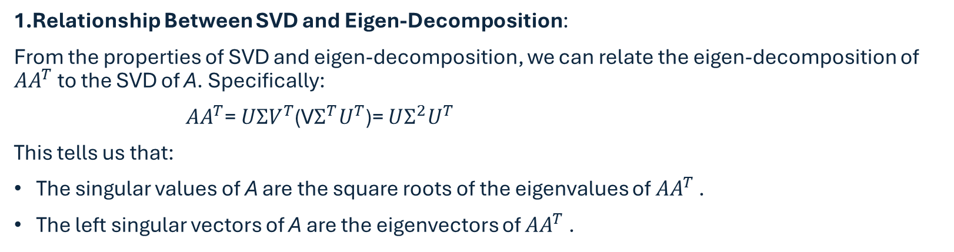
Lanczos Algorithm Workflow
1.Relationship Between SVD and Eigen-Decomposition:
From the properties of SVD and eigen-decomposition, we can relate the eigen-decomposition of ${AA}^{T}$ to the SVD of A. Specifically:
$AA^{T}$= $UΣV^{T}$(V$Σ^{T}U^{T}$)= $UΣ^{2}U^{T}$
This tells us that:
The singular values of A are the square roots of the eigenvalues of ${AA}^{T}$ .
The left singular vectors of A are the eigenvectors of ${AA}^{T}$ .

Slide 12
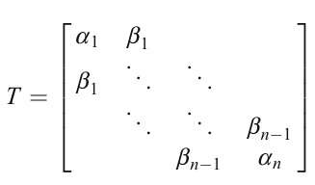

Lanczos Algorithm Workflow
2.Triangularization: We perform triangularization on ${AA}^{T}$ , which transforms it into a tridiagonal matrix T. The tridiagonal matrix has the following form:
This tridiagonal matrix T is easier to work with for computing eigenvalues and eigenvectors..

Slide 13

Lanczos Algorithm Workflow
3.Lanczos Recursion: The Lanczos algorithm produces the tridiagonal matrix $T$ by recursively applying the following relation:
${AA}^{T}q_{j}$= $b_{j−1}q_{j−1}+a_{j}q_{j}+b_{j}q_{j+1}$
where $q_{j}$​ is the vector obtained at step j, and $a_{j}$​and $b_{j}$are computed as follows:
$$a_{j}=q_{j}^{T}AA^{T}q_{j}$$
$$b_{j}= ∥{AA}^{T}q_{j}−a_{j}q_{j}−b_{j−1}q_{j−1}∥$$
We initialize with a random vector $q_{1}$​, and through recursion, we generate the next $q_{j}$and the coefficients $a_{j}$and $b_{j}$​.

Slide 14

Lanczos Algorithm Workflow
4.Eigen-Decomposition of $T$:
Once the Lanczos algorithm has produced the tridiagonal matrix $T$, we can find its eigenvalues and eigenvectors. These eigenvalues correspond to the square of the singular values of A, and the eigenvectors correspond to the left singular vectors of A.
5. Reconstructing the SVD:
From the eigen-decomposition of T, we can find the singular values $Σ$and the left singular vectors U. The relation between A, ${AA}^{T}$ and T gives us:
${ AA}^{T}$ =$Q_{1}TQ_{1}^{T}$
where $Q_{1}$​ is the matrix of orthogonal vectors obtained from the Lanczos recursion.
6.Final SVD Computation:
The singular values of A are the square roots of the eigenvalues of ${AA}^{T}$, and the left singular vectors of A are the eigenvectors of ${AA}^{T}$, which are contained in $Q_{1}$.

Slide 15
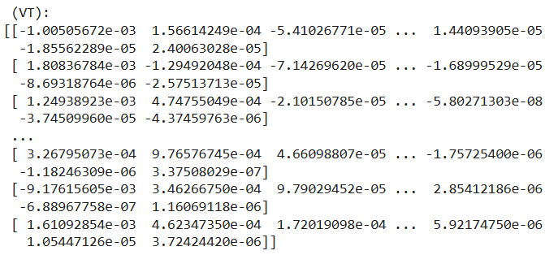
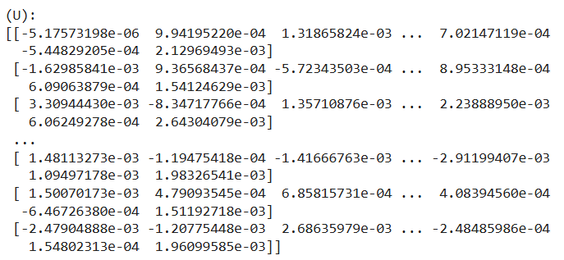
Lanczos Result

Slide 16
References
Brunton, Steven L., and J. Nathan Kutz. Data Driven Science & Engineering: Machine Learning, Dynamical Systems, and Control. Cambridge: Cambridge University Press, 2019.
Olney, A. M. Large-scale latent semantic analysis.

Slide 17
Thank you

