Slide 1

Document Ranking with a Pretrained Sequence-to-Sequence Model
Presented By: Team DSSM
Ayushi Mehta: 202311008
Pratham Patel: 202311022
Nishit Munjani: 202311026
Rohit Rathod: 202311039

Slide 2
Content
Problem Statement
Challenges Faced
Methodology
Evaluation Metric
Dataset
Conclusion
Reproducibility Results

Slide 3
What: Problem Statement
Examines if a sequence-to-sequence model (T5) can be used for document ranking and perform better than traditional classification models like BERT.
Improving ranking accuracy using a T5 sequence-to-sequence model.

Slide 4
How: Methodology
Input Sequence
Target Words
Logits and Ranking
Query: q, Document: d, Relevant: (True/False), where the model predicts if the document is relevant to the query.
During training, the model outputs 'true' or 'false' to show if the document is relevant.
The model calculates raw scores (logits) for 'true' and 'false.' These scores are converted into probabilities using softmax and used to reorder the documents based on relevance.

Slide 5

Dataset
The authors used the MS-Marco passage ranking dataset to fine-tune the BERT and T5 models.
Key features of Dataset:
Queries
Documents
Relevance Labels
Data Splits:
Training Set
Development set
Test Set
The authors tested the models on the development set of the MS-Marco passage ranking dataset because the testing set's ground truth qrels are not publicly available.

Slide 6
Here are the numbers of queries and document of the MS-Marco passage ranking dataset.
Total Passages: 88,41,823
Training Set
Development Set
Queries
8,08,731
6,980
QRels
5,32,761
7,437

Slide 7
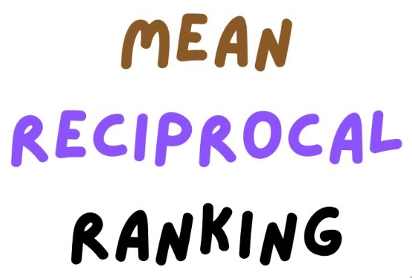
Evaluation Metric
img source: https://www.youtube.com/watch?v=8y9bi2vIG4U

Slide 8
Reproducibility Results
Here are the results from the authors:
Here are the reproduced results from our end:
MRR@10
MRR@10
BM25
0.184
BM25
0.183
+ BERT - Large
0.372
+ BERT - Base
0.331
+ T5 - Base
0.363
+ T5 - Base
0.356
+ T5 - large
0.383

Slide 9

Challenges Faced
Dataset size and processing: Working with the MS MARCO Passage dataset was a significant challenge due to its massive size. Preprocessing and managing such a large dataset required careful planning and considerable time.
Computational Limitations: Fine-tuning large models like BERT and T5 on this dataset was extremely resource-intensive. The process took several days to complete, which tested our patience and perseverance. With limited access to high-performance GPUs, we had to break the training into smaller chunks, saving checkpoints frequently to ensure progress wasn’t lost—a workaround that added extra steps and complexity.

Slide 10

Challenges Faced (cont.)
Resource Constraints: Our hardware capabilities fell short of the demands of these large-scale models. The GPUs we had access to lacked the memory and power to handle the training in a single session, forcing us to adapt and extend our timeline to accommodate these constraints.

Slide 11
Conclusion
The main contribution of this paper is to show that the Seq-to-Seq model i.e. ‘T5’ outperforms the Classification based model like ‘BERT’.
Also as a Reproducibility challenge we’re able to generate the similar results as the author has generated.

Slide 12
Thank You

