Slide 1
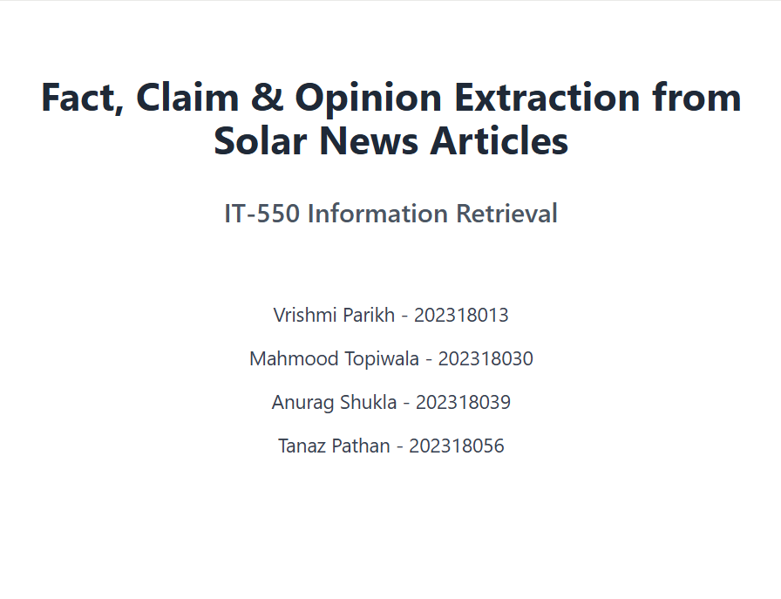

Slide 2
A quick recap
PROBLEM STATEMENT
Fact, Claim & Opinion Extraction
DATASET
57k solar energy related news articles filtered from 100k+ RE articles
METHODOLOGY
Data Annotation: LLM Annotations followed by Manual Verification
Model Training: Iteration Based Active Learning Framework
EVALUATION
ClaimBuster: Claim detection model
CONCORD: COVID-19 Numerical Claim Dataset

Slide 3
Dataset Extraction
Original Dataset: 103,000 renewable energy news articles spanning from 2014 to present scrapped from various sources (Economic Times, Mercom India, PV-Mag India, PV-Mag Global, Saur India)
Extracting Solar Articles
Trained distilled-bert-uncased on 2000 news headlines (488 in test set)
Threshold = 0.70
Precision = 0.97058
Recall = 0.87301
Accuracy = 0.94057
PR Curve AUC = 0.97665
Extracted 57k news articles on Solar Energy after inference
Final dataset - 9 million + unique sentences extracted from 57k solar articles

Slide 4
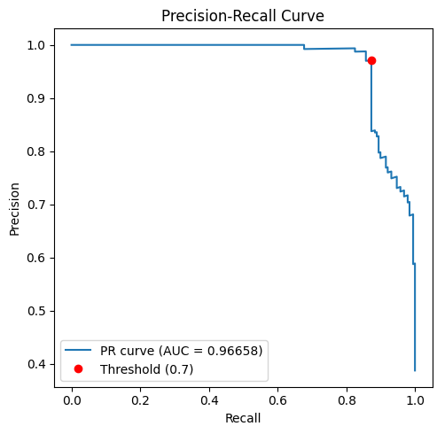
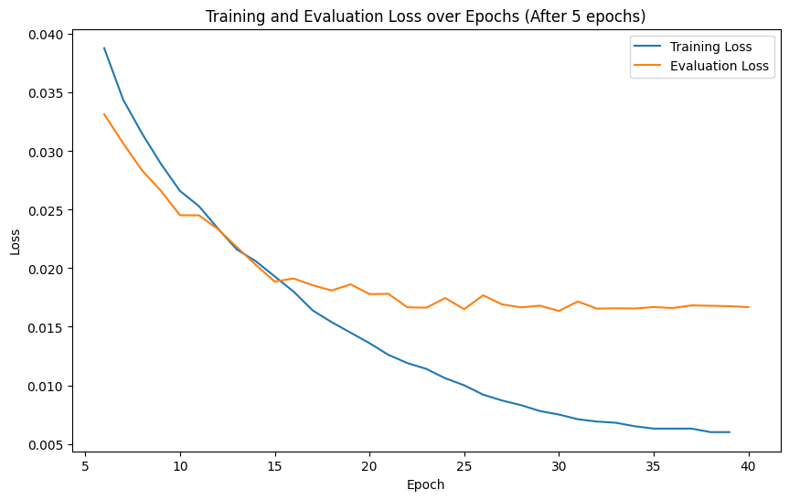

Slide 5
Annotation Guideline
Facts
1. Past or present statements that can be objectively verified
2. Contains specific numerical data (prices, measurements, dates, quantities)
3. Reports completed actions or established events
Examples:
1. Conergy has concluded solar PV contracts in SE Asia worth 231 MW in the last three months.
2. LDK Solar on Tuesday reported a 10% boost in revenue to $114.7 million in the second quarter
3. Reliance has invested over Rs 1.50 lakh crore in its KG D-6 assets, developing and supporting gas pipelines.

Slide 6
Annotation Guideline
Claims
1. Future-oriented statements about expected outcomes
2. Often include predictions, projections, or interpretations of data
3. Statements that assert something as true but require verification
Examples:
1. The company would invest INR 22 billion over the time period of five years.
2. Macedonia is aiming to draw 28% of its power from renewables by 2025.
3. This will include four separate cables and will be the longest subsea power transmission link in the world.

Slide 7
Annotation Guideline
Opinion
1. Subjective statements reflecting personal beliefs or judgments
2. Contains evaluative language ("unique," "better," "competitive")
3. Cannot be definitively proven true or false
Examples:
1. From the government's point of view, even five years should not be long enough.
2. The scientists believe that the transmission loss for below-gap photons can be used for producing additional photocurrent, thus increasing the efficiency of the solar cell.
3. I would not be surprised if California, for instance, is going to go the same route that NY state and Washington state have gone, which requires extended producers' responsibility, so basically a take back and collection scheme for PV.

Slide 8
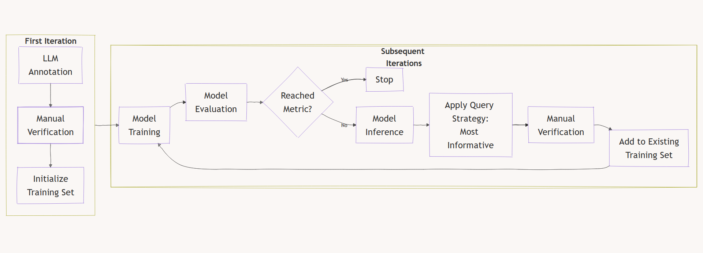
Active Learning Framework

Slide 9
Model Training
First Iteration
Used Llama 3.1 70B Instruct API to annotate 1500 random sentences
Post manual verification, 1200 were added to test set and 300 to train set.
Subsequent Iterations
Model Training: distilledbert-base-uncased (30 epochs with 0.000025 LR)
Model Evaluation
Precision, Recall, F1 Score
Micro-averaged
Macro-averaged
Weighted-average
Decider Metric - Macro-averaged F1 score
Query Strategy: 200 random samples from bottom 10 percentile of confidence

Slide 10
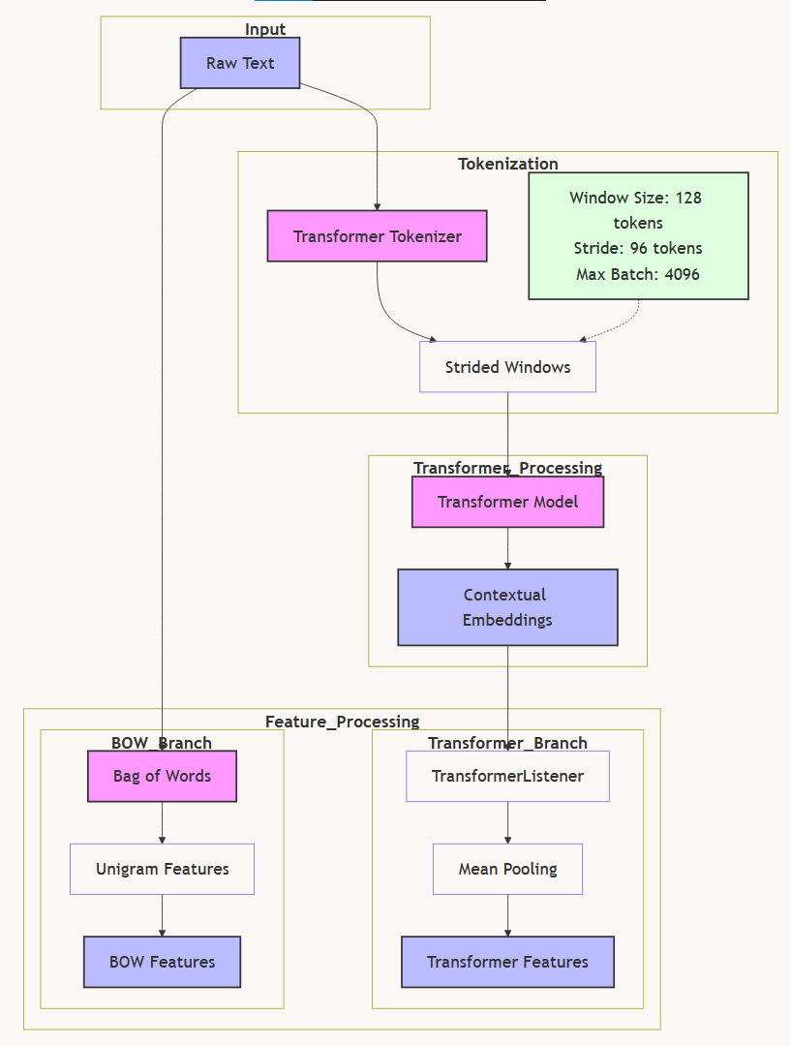
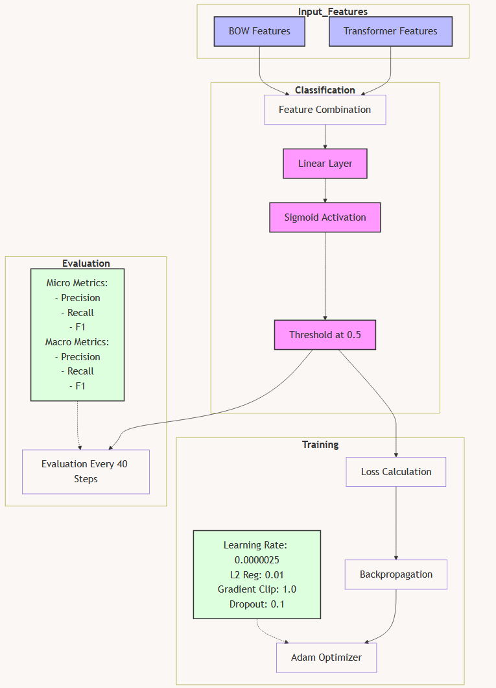

Slide 11
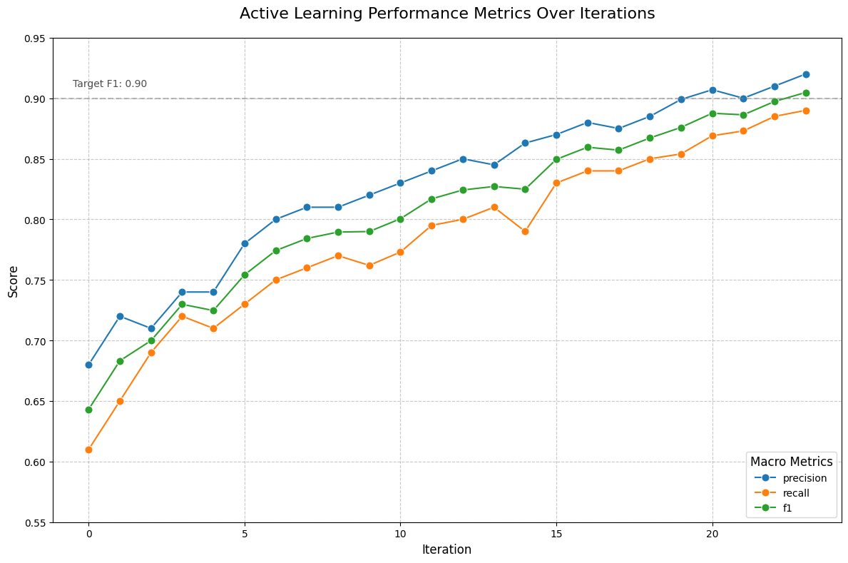

Slide 12
Evaluation & Comparison
ClaimBuster: A system designed to automate the detection of check-worthy factual claims, particularly in political discourses and other narrative contexts.
CONCORD
Open-source collection of numerical claims from academic papers related to COVID-19.
Contains more than 200k numerical claims from 48k research papers
Points to note
Our test-set comprises of 417 “Claims”. We’ll add 200 non-claims as False samples and test ClaimBuster against this set
Threshold of ClaimBuster for True label is set at 0.50
Sampled 1000 claims from CONCORD as True samples and 1000 titles for False non-claim samples, totalling 2000 test samples.

Slide 13
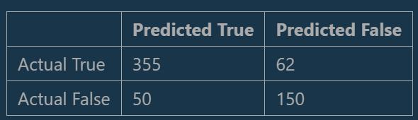
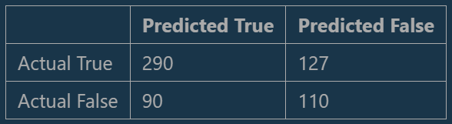
Evaluation & Comparison: ClaimBuster
Our Model
Precision = 0.8765
Recall = 0.85131
F1 Score = 0.8637
ClaimBuster
Precision = 0.7631
Recall = 0.6954
F1 Score = 0.7275

Slide 14
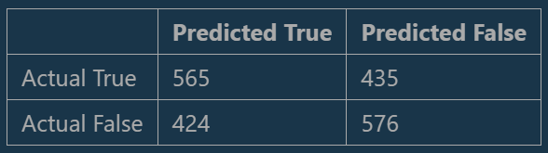
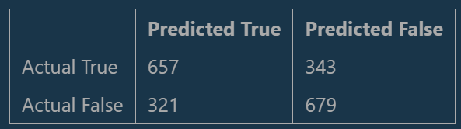
Evaluation & Comparison: CONCORD
Our Model
Precision = 0.5712
Recall = 0.565
F1 Score = 0.5680
ClaimBuster
Precision = 0.671
Recall = 0.657
F1 Score = 0.6639

Slide 15
Extension of the project
Original Goal: Classify solar news articles into Facts, Claims, and Opinions for better content understanding.
Extension: Enabled processing of article URLs to extract and classify all claims, facts, or opinions.
Key Features:
Advanced Retrieval: Use semantic embeddings (Google PaLM) to extract and classify relevant content from articles.
FAISS Integration: Efficiently search and retrieve articles or specific content (e.g., all claims or facts).
Dynamic Capability: Supports both classification and contextual Q&A from uploaded articles.

Slide 16
