Slide 1
CROSS-LINGUAL CONTEXTUALIZED TOPIC MODELS WITH ZERO-SHOT LEARNING

Slide 2
RECAP….
Cross-lingual Contextualized Topic Models replace the traditional Bag-of-Words (BoW) with contextualized embeddings (e.g., SBERT) to capture semantic richness and context in text data and predict topics.
PROBLEM STATEMENT
Existing topic models face two key limitations:
Vocabulary Dependence: They rely on language-specific BoW representations, making cross-lingual application impractical.
Scalability Issues: Training on multilingual corpus leads to a vast, sparse vocabulary, causing overfitting and computational inefficiency.

Slide 3
ZeroShotTM addresses these challenges by:
Replacing BoW with multilingual embeddings(SBERT) to create language-independent topic representations.
Enabling zero-shot cross-lingual topic modeling, where topics learned in one language (e.g., English) can be applied to unseen documents in other languages.

Slide 4
DATASET
DBpedia dataset consists of 100,000 English documents, with 99,700 used for training and 300 reserved for testing.
The 300 test documents are collected in Portuguese, Italian, French,and German.
Each test document corresponds to the same entity across languages, allowing for cross-lingual evaluation.
This dataset was obtained directly from the authors of the original paper.

Slide 5
METHODOLOGY
ZeroShotTM builds upon Neural-ProdLDA, a neural variational topic model, and incorporates the following innovations:
Input Representation: Multilingual contextualized embeddings (SBERT) replace BoW, capturing word order and contextual information.
Variational Autoencoder (VAE): The architecture generates latent document-topic representations, with a decoder reconstructing the BoW layer.
Zero-Shot Learning: Multilingual embeddings ensure the model can predict topics in unseen languages without retraining.

Slide 6
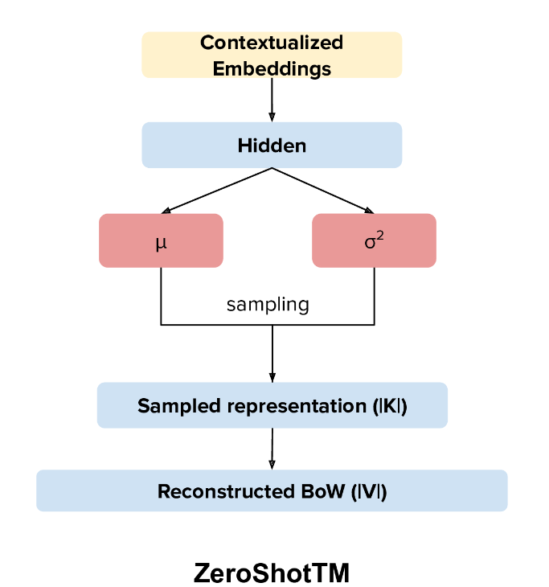
ZeroShotTM ARCHITECTURE

Slide 7
ENCODER
Function: Converts input documents (SBERT embeddings) into topic representations.
Components:
Input Layer: Takes SBERT embeddings as input.
Hidden Layers: Refines the representation.
Output: Produces mu (mean) and log_sigma (log variance) for topic distribution.
Purpose: Encodes documents into topic probabilities for further processing.

Slide 8
LATENT SPACE
Function: Represents documents as distributions over topics in a lower-dimensional space.
Process:
Reparameterization Trick: Samples a topic distribution z from mu and log_sigma.
Purpose: Ensures the model can learn and generalize across documents by sampling topic distributions.
Example: A document about art and poetry might have
z = [0.7, 0.25, 0.05].

Slide 9
DECODER
Purpose: Generates a word distribution based on the latent representation.
Components:
Topic-Word Matrix: Represents the probability distribution of words given each topic.
Prediction Layer: Uses z to predict word distributions.
Key Idea: Ensures topics are coherent and related words are predicted based on the latent representation.

Slide 10
MODEL TRAINING SUMMARY
Objective: Train the model to learn meaningful topics and reconstruct documents accurately.
Loss Components:
KL Divergence: Ensures topic distributions are smooth and aligned with a prior.
Reconstruction Loss: Compares predicted words to actual document words.
Training Steps:
Input SBERT embeddings through the encoder, sample z, and pass to the decoder.
Update model weights using backpropagation.
Stopping Criteria: Stop when validation loss stops improving or starts to increase.
Output: A model that accurately predicts topics for unseen documents.

Slide 11
EVALUATION METRICS
The model is evaluated on three metrics:
1. Match Score (Mat): Percentage of times the predicted topic in a test language matches the English topic.
2. KL Divergence (KL): Measures the difference between the topic distributions of English and non-English documents. Lower divergence scores indicate that the model's topic distributions across languages are well-aligned​.
3. Centroid Distance (CD): Cosine similarity between centroid embeddings of predicted topic descriptors in different languages.

Slide 12

RESULTS

Slide 13
THANK YOU
(Team Tatakae)
Issue No. 10
MSc. DS
Prince Titiya 202318010
Mitul Dudhat 202318024
Ayush Patel 202318036
Hiten Gondaliya 202318063

