Slide 1
Depth estimation from stereo images using Census Transform and Hamming Distance
Neagu Lorena
Gr: 30431
Supervisor : Varga Robert

Slide 2
DEPTH ESTIMATION
The project is aimed to create a mapping of the disparities between the pixels from two different perspectives. Two images are given as input, one from right angle and one from a left angle.
Depth estimation determines the disparity of each pixel from two images and creates a disparity map of the pixels. That is the horizontal displacement between the same two points in the two images given. The disparity map is computed using Census transform and Hamming distance.

Slide 3

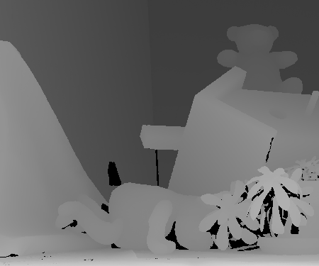
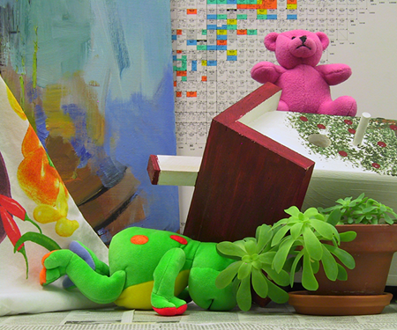
Ground Truth
Right angle
image
Left angle
image

Slide 4
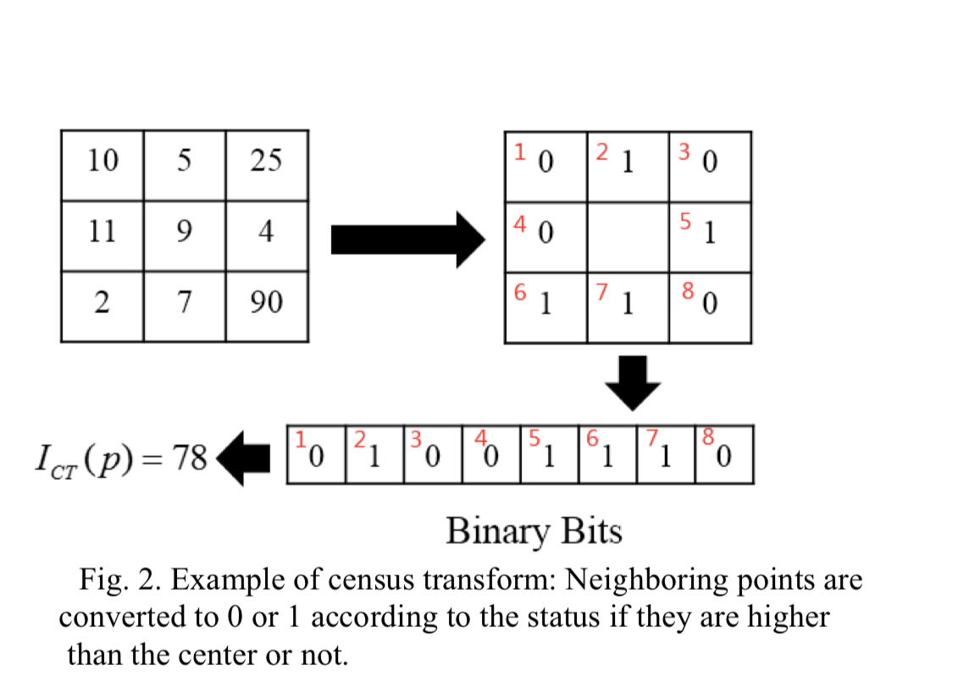
Census transform
An example of the census transform of image with respect to the centre pixel of the window. Census transform translates relative intensity variation to 1 or 0 in one dimensional vector structure.
Thus using census transform every pixel within an image is transformed into a sequence of bit representing the intensity relations between the centre and its neighboring pixels.

Slide 5
CENSUS TRANSFORM
Census transform makes use of relative intensity of input images leading to robustness under different absolute intensities of input images and noises. Census transform is applied on both filtered images for disparity estimation. Census transform can be divided into two steps: transform step and correlation step. Calculation of a bit string, which summarizes local texture of the current corresponding pixel pair from left and right window centre is done in transform step. Comparison of two strings using the hamming distance by counting of differing bits is accomplished in correlation step.

Slide 6
Stereo matching
Matching is done to find corresponding points between stereo image pairs. Two image points Pl in left image and Pr in right image match if they result from the projection of the same point P in the scene, for example, Pl and Pr will have similar intensity or color. The difference in the location of the two corresponding points in their respective images is called disparity.

Slide 7
Hamming distance
The hamming distance is computed between census-transformed pixels by performing XOR operation between two binary strings and counting the number of set bits in the output string for finding the matching value for each pixel. The costs are computed and stored in a three-dimensional data structure Disparity space image (DSI), with size width × height x disparity :
where the left image is the reference image and the right image shifts horizontally from right to left, looking for the correspoing pixel.

Slide 8
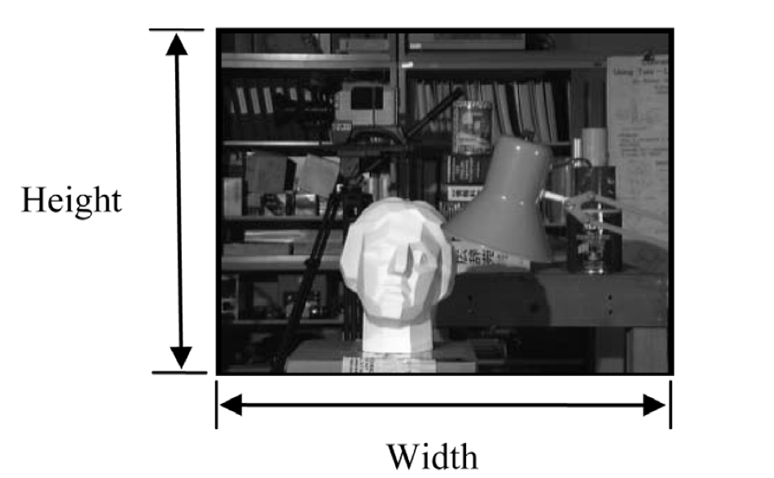
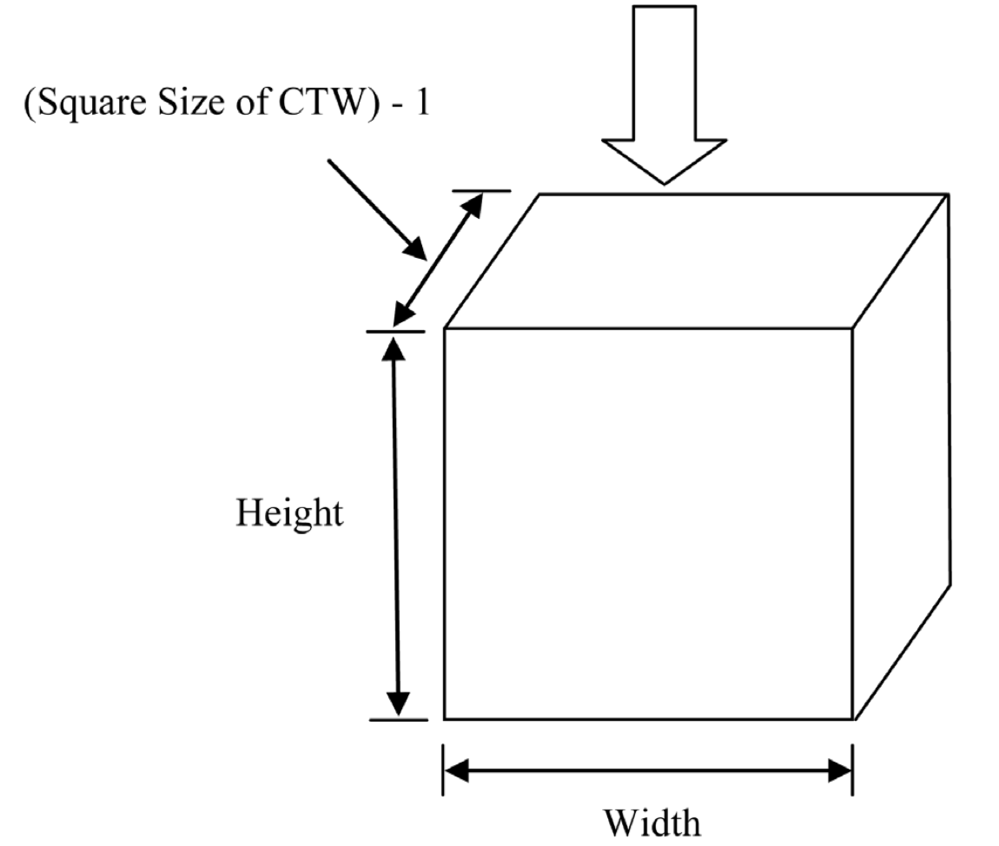
DISPARITY SPACE IMAGE (DSI) DEFINED BY THE DIMENSIONS OF THE LEFT IMAGE AND THE DISPARITY SEARCH RANGE.
IMAGE
DSI

Slide 9
disparity
The hamming distance is minimized after applying the census transform to calculate the matching value by computing for each disparity the sum of hamming distances from the DSI in a window of 100. For each pixel, the disparity with the minimum sum is chosen and stored in the disparity map. The result in normalized between 0 and 255 by interpolation.

Slide 10
Noise filtering
Median filter is applied on disparity map obtained to remove some outliers. This filter is popular method for removing salt-and-pepper noise from images. It is also used to remove noise generated occasionally because of sub pixel refinement. Filtering of disparity map can increase the accuracy of output. Thus in this way, coarse disparity map is generated.

Slide 11
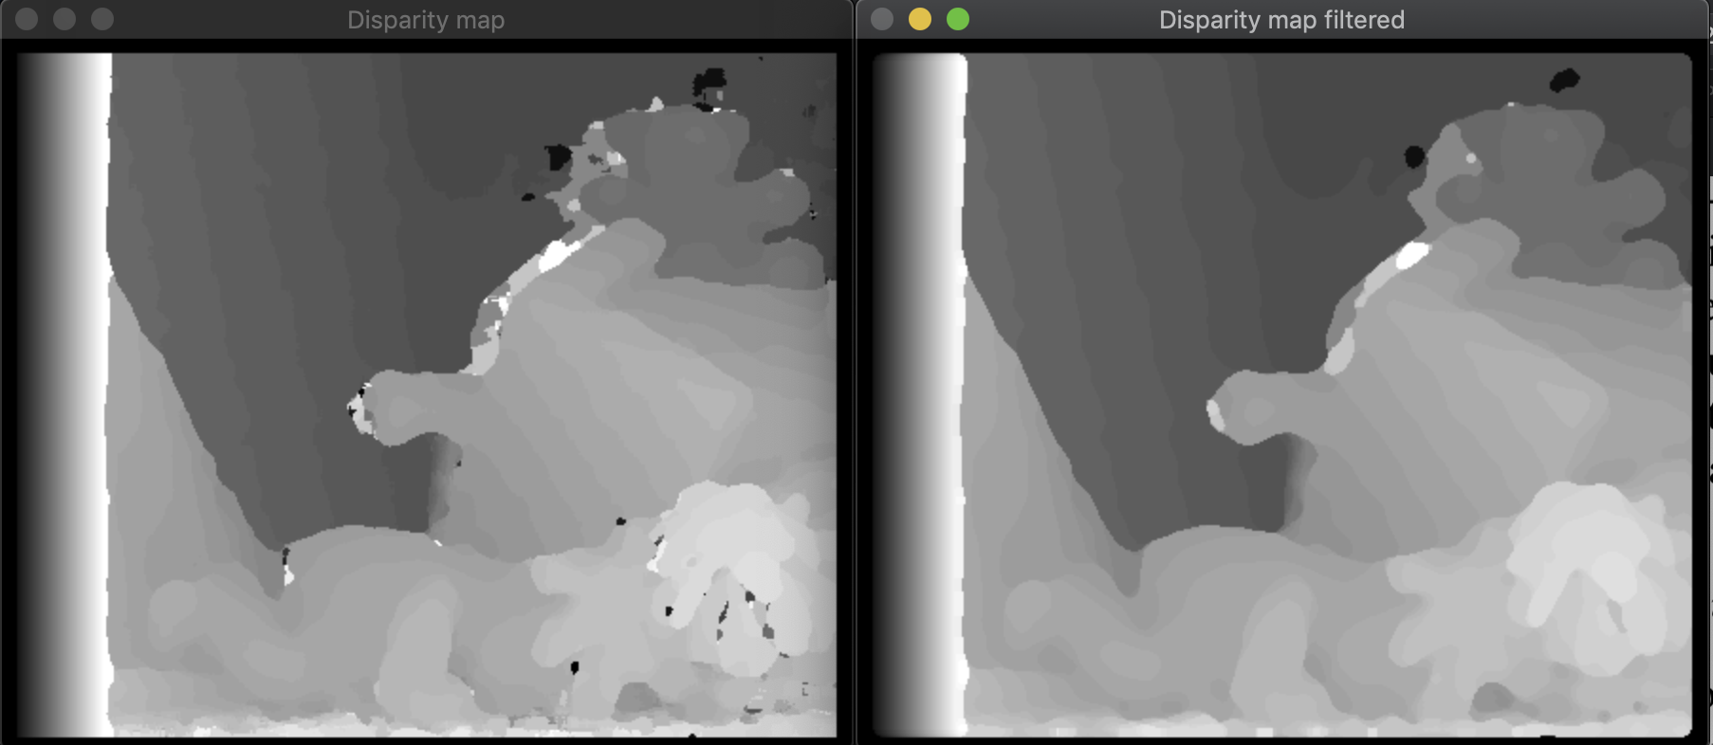
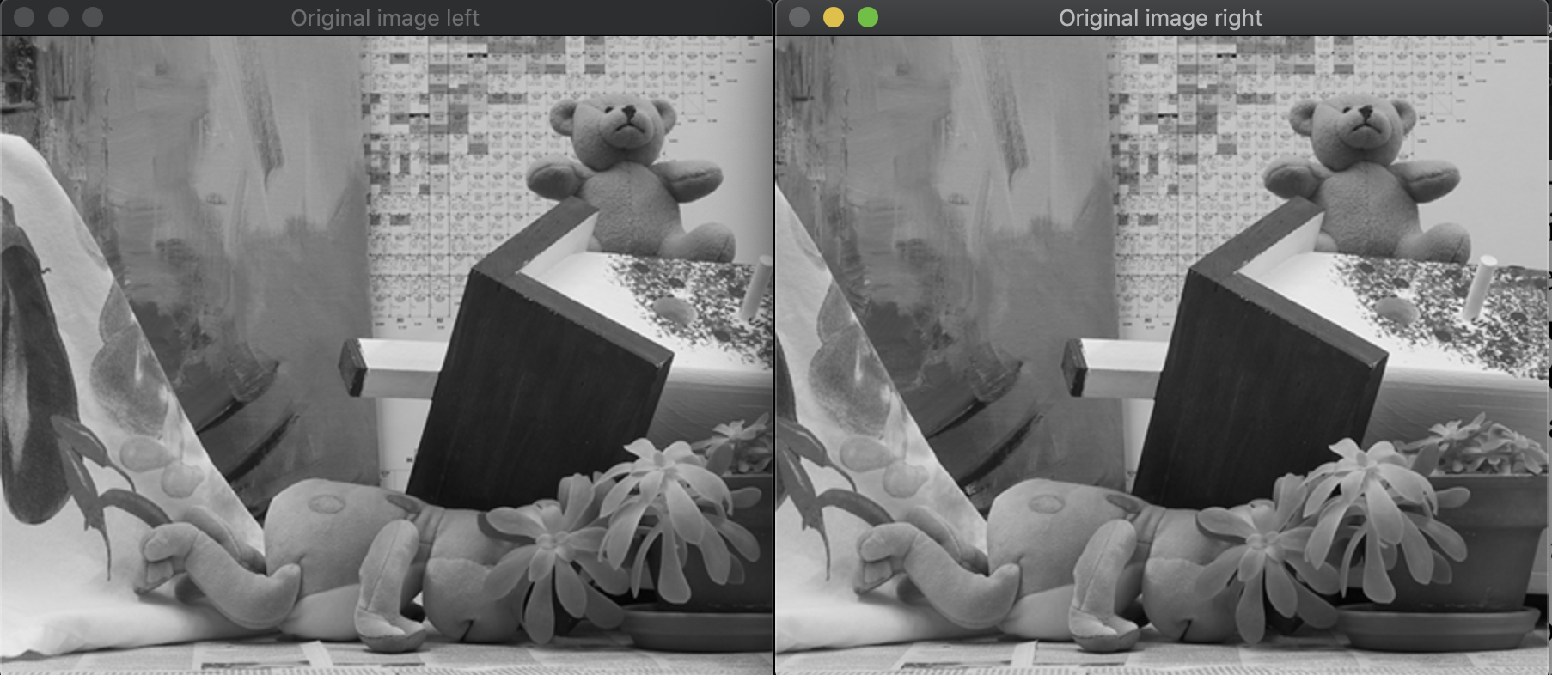
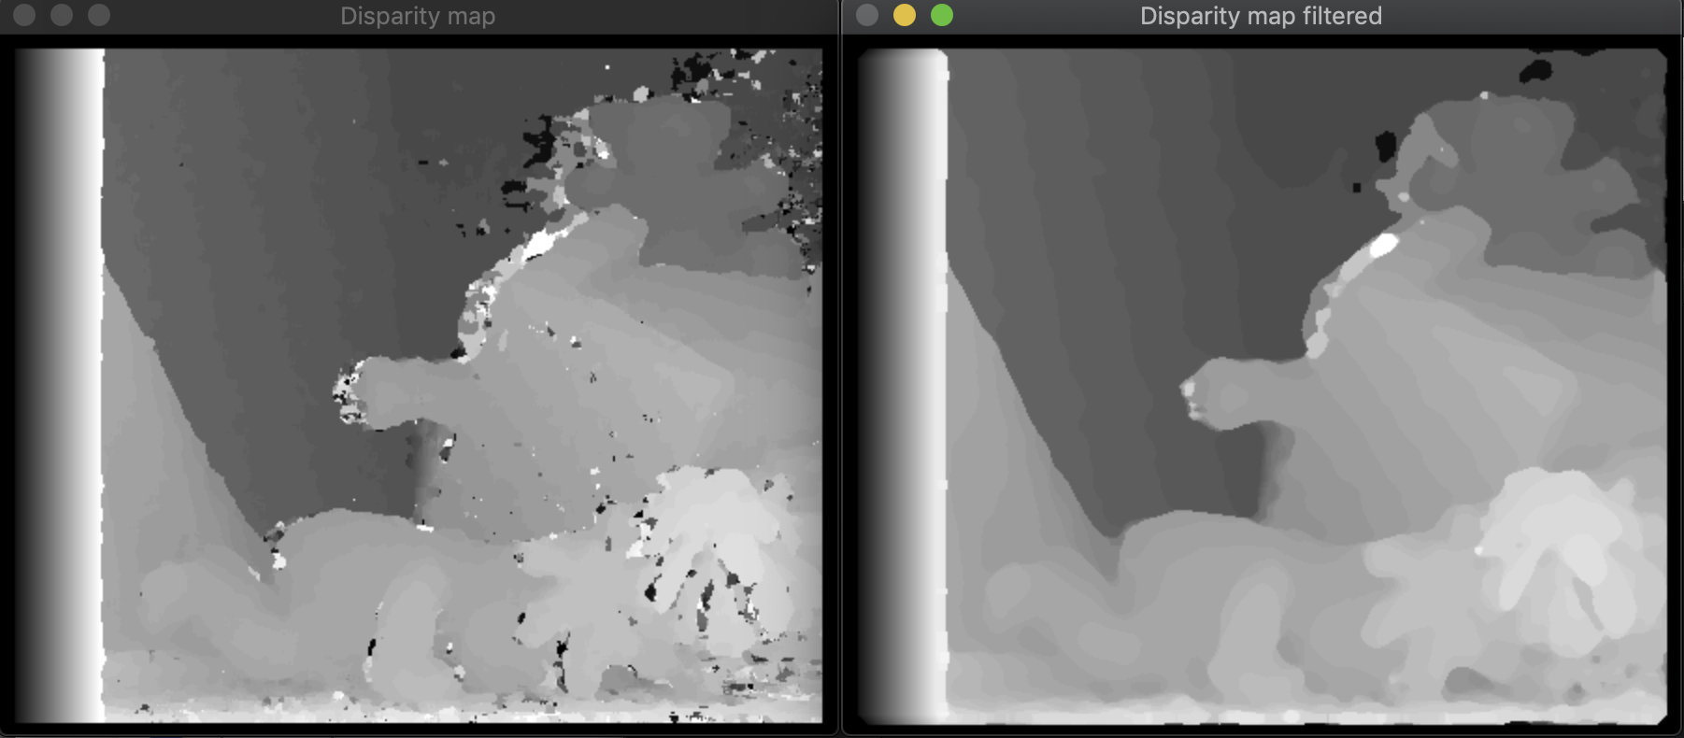
Results
Results with sum on DSI window of 100, max disparity 50
Results with sum on DSI window of 50, max disparity 50
Input images

Slide 12
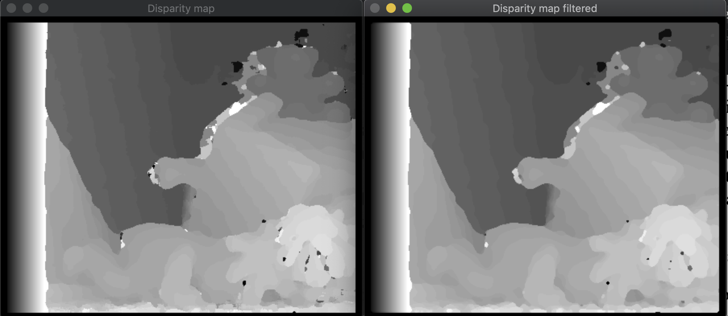
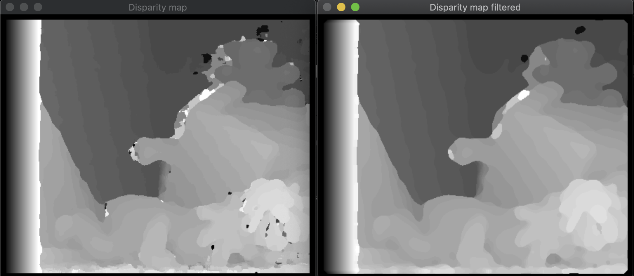
Results after noise filtering
Median filter kernel size 5
Median filter kernel size 10

Slide 13
Error calculation
The error is computed by taking each pixel from the disparity map and the ground truth and counting the pixels that differ in intensity with more than a value set (in this case: 2) and dividing by the image sizes in order to get a percentage representing the error.
Error: ~0.98

Slide 14
Bibliography
http://www.apsipa.org/proceedings_2016/HTML/paper2016/290.pdf
https://www.cs.cornell.edu/~rdz/Papers/ZW-ECCV94.pdf
https://pdfs.semanticscholar.org/1e0c/2c8535684f0b6293418e148b4f6d04829dce.pdf
https://www.sciencedirect.com/science/article/pii/S1877050915021377
https://www.tandfonline.com/doi/pdf/10.1080/00051144.2018.1503137
http://www.apsipa.org/proceedings_2016/HTML/paper2016/277.pdf
https://books.google.ro/books?id=ouyeBQAAQBAJ&pg=PA309&lpg=PA309&dq=Depth+estimation+from+stereo+images+using+Census+Transform+and+Hamming+Distance+-+medium&source=bl&ots=i88_Ra-kpB&sig=ACfU3U22fbkCGVarV9Jbqq_LoBnsY9_5nA&hl=ro&sa=X&ved=2ahUKEwj-zuDBrKfpAhX4ShUIHY_BBCgQ6AEwAXoECAsQAQ#v=onepage&q=Depth%20estimation%20from%20stereo%20images%20using%20Census%20Transform%20and%20Hamming%20Distance%20-%20medium&f=false

