Slide 1
Get Started with Power BI

Slide 2
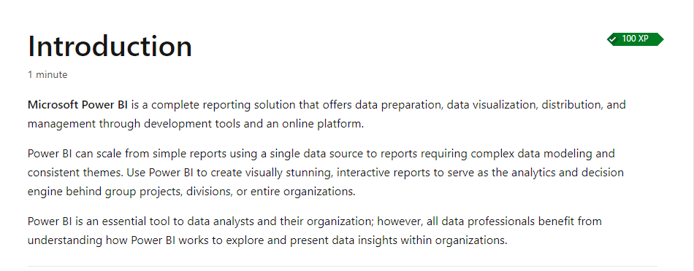
https://learn.microsoft.com/en-us/training/modules/get-started-with-power-bi/1-introduction

Slide 3
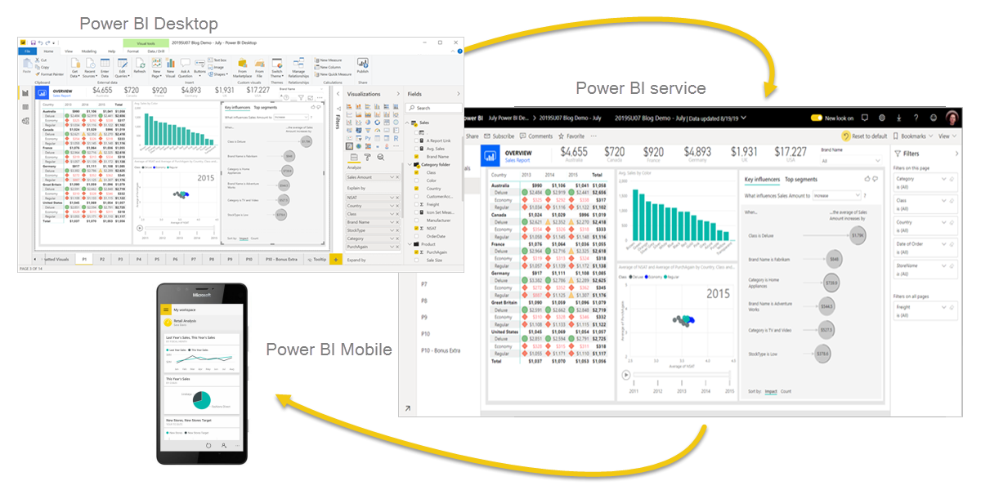
Use Power BI
In order to create reports with Power BI, you must first understand the tools necessary. There are three primary components to Power BI:
Power BI Desktop (desktop application)
Power BI service (online platform)
Power BI Mobile (cross-platform mobile app)

Slide 4
Explore the flow of Power BI
There's a common flow when creating reports with Power BI. First, you start with Power BI Desktop to connect to data and create the report. Then you publish the report to the Power BI service and distribute to consumers.
The flow of Power BI is:
Connect to data with Power BI Desktop.
Transform and model data with Power BI Desktop.
Create visualizations and reports with Power BI Desktop.
Publish report to Power BI service.
Distribute and manage reports in the Power BI service.

Slide 5
Building blocks of Power BI
The building blocks of Power BI are semantic models and visualizations.
Create a semantic model
A semantic model consists of all connected data, transformations, relationships, and calculations. To follow the flow of Power BI, you first connect to data, transform data, and create relationships and calculations to create a semantic model.
Semantic data models describe objects in a database and their relationship to one another in their specific application environment.
https://learn.microsoft.com/en-us/training/modules/get-started-with-power-bi/3-building-blocks-of-power-bi

Slide 6
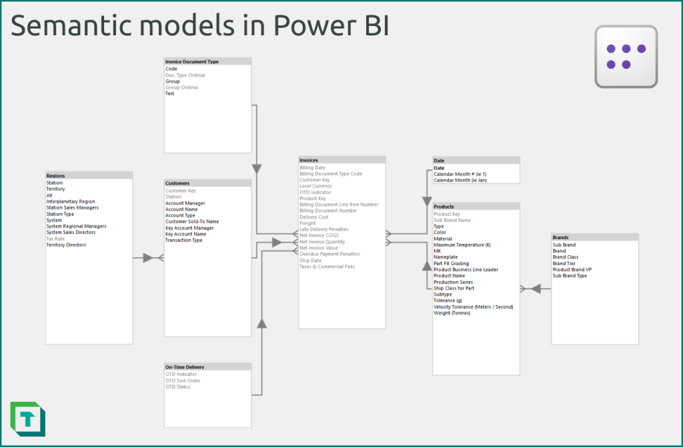
In Power BI, a semantic model refers to the way data is structured and represented to allow users to analyze and understand the data more easily. The goal of a semantic model is to transform raw data into a meaningful and user-friendly form, making it easier for non-technical users to explore and gain insights from the data.

Slide 7
Create visualizations in a report
In Power BI Desktop, when you create a visualization (also called visual), you add it to the canvas for a report page. Choose your visualizations to build pages in your report. It's ideal to keep each page simple with related data, so consumers can easily see the insights.
Power BI is a low-code solution, which means that you can "drag and drop" data field directly onto the canvas. Power BI will choose a visual for your data field. You can easily change between visuals for the same fields, and add or remove data fields to the visual.
One of the most valuable features of Power BI reports is the interactivity between visuals. Consumers can select different data points in the visual and see how that affects the other visuals. Depending on your design, they can also drillthrough from one visual to more detail or filter based on different fields in the report.

Slide 8
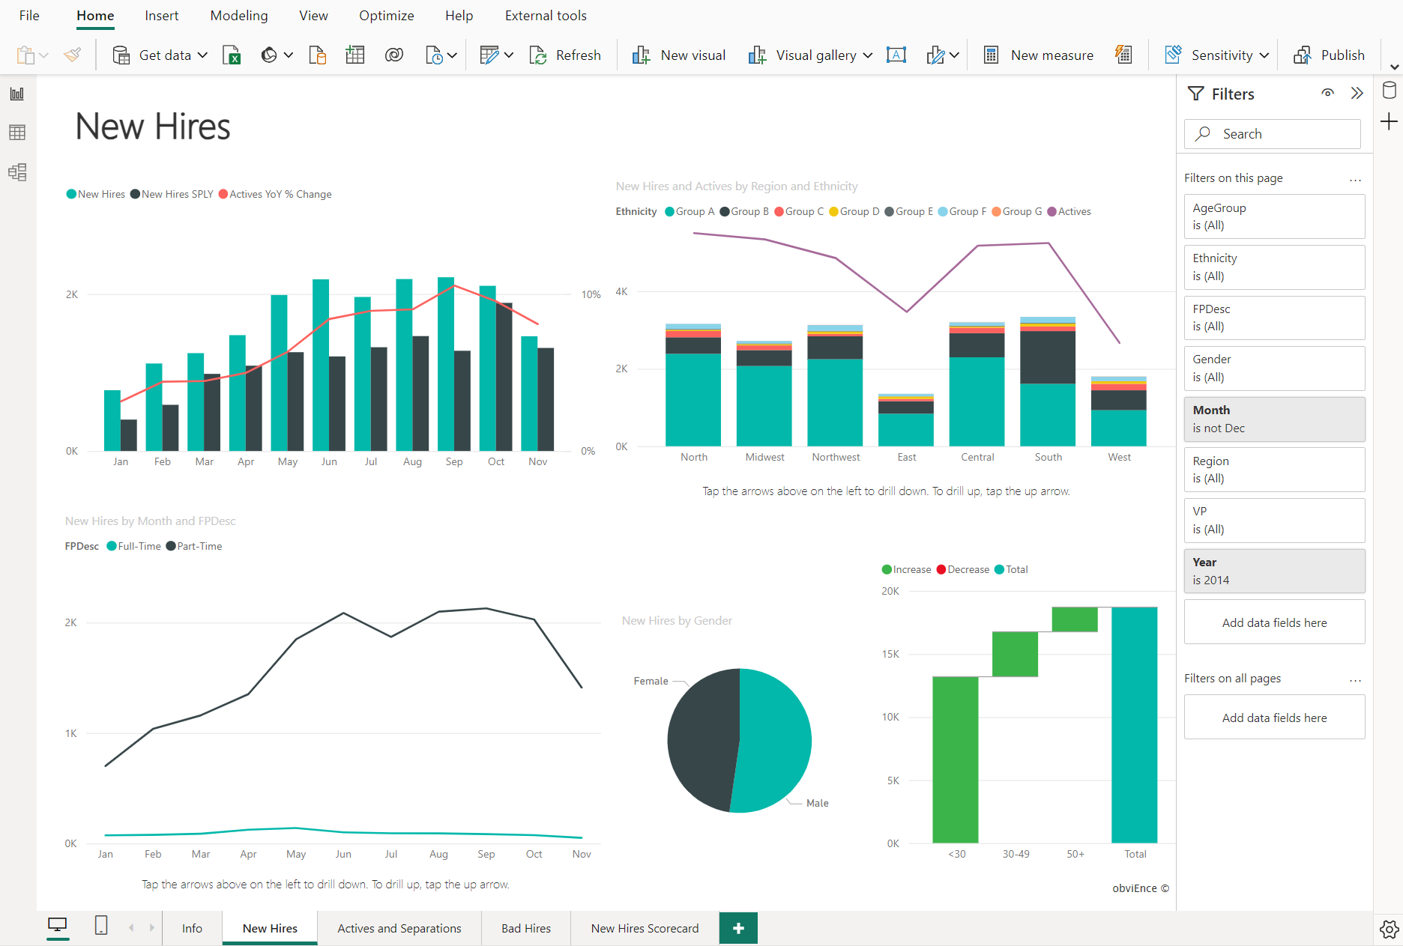
Once you're satisfied with your report, you publish it to the Power BI service

Slide 9
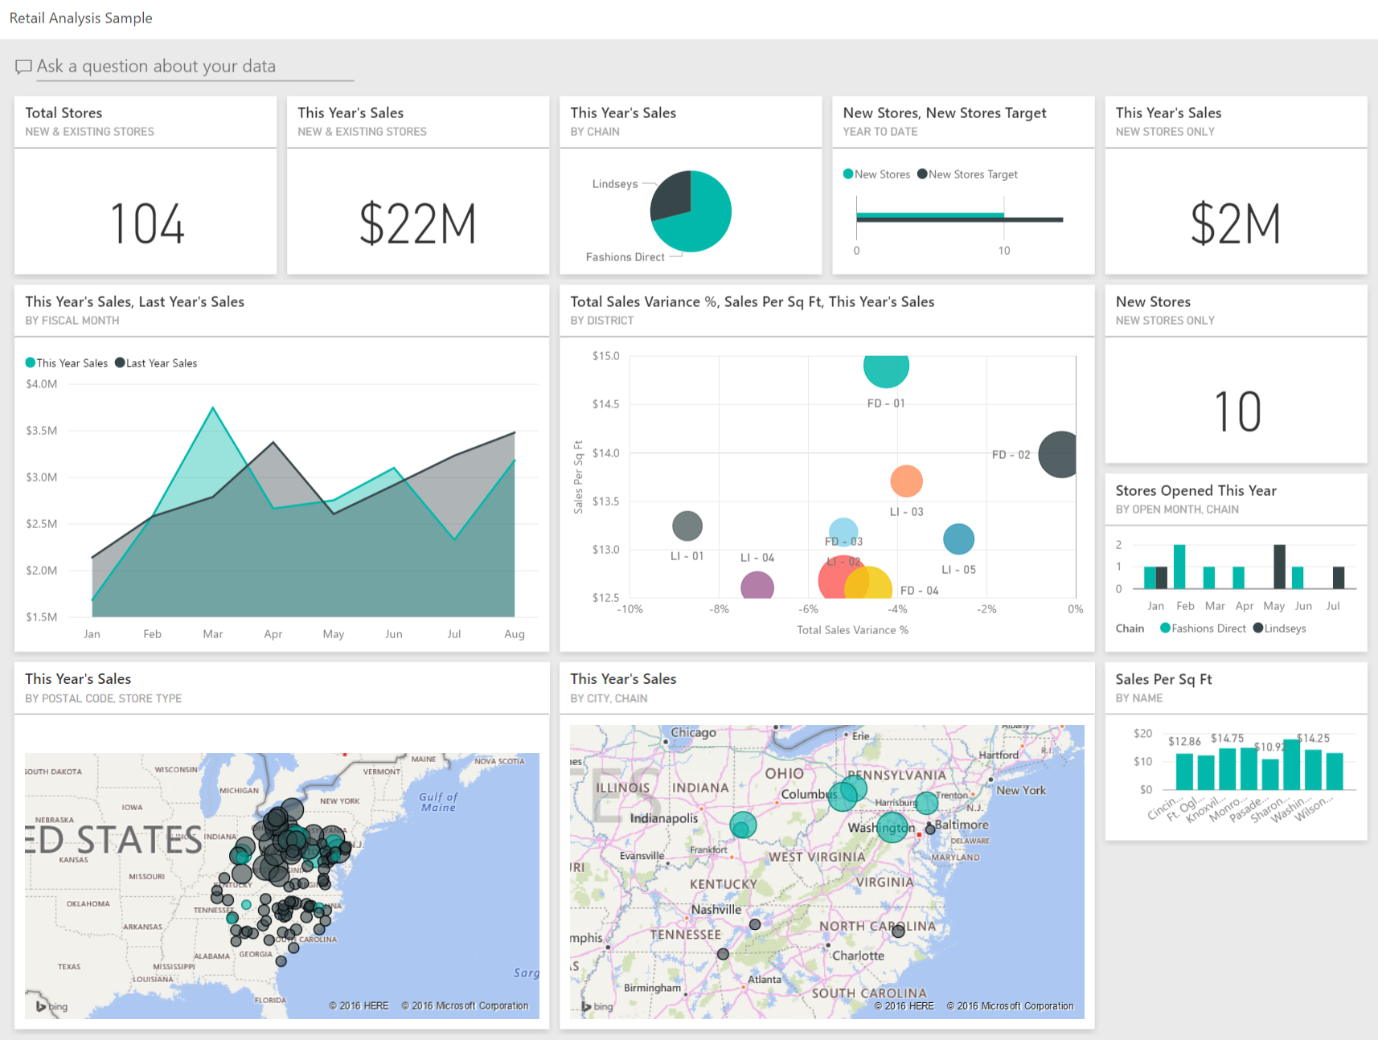
Create a dashboard
In the Power BI service, you can also create dashboards after you've published a report. Dashboards consist of a single page made up of tiles. Add tiles to a dashboard by pinning a visual in a report to the dashboard. Tiles aren't interactive like visuals, so when a user interacts with the tile, they go to the underlying report for more information.
Dashboards are an excellent way to provide high-level information to consumers. Similar to a dashboard in a vehicle, include the most important information in a dashboard. Then consumers can go to the report for more details.

Slide 10
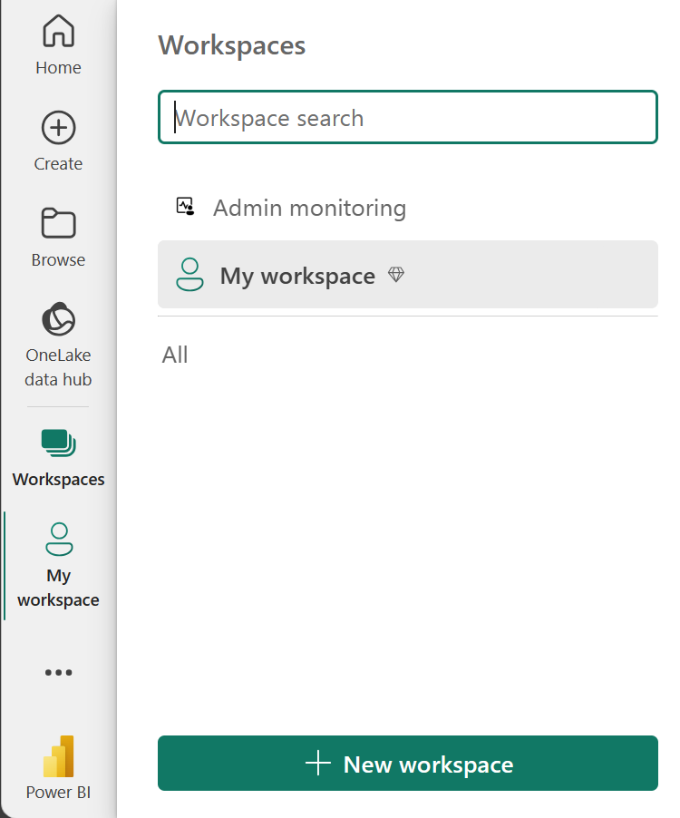
Tour and use the Power BI service
Organize items with workspaces
Workspaces are the foundation of the Power BI service. When publishing any report, you must choose a workspace. By default, every user has access to My workspace, which is ideal only for testing. When you want to share content with others, always create and use a shared workspace.

Slide 11
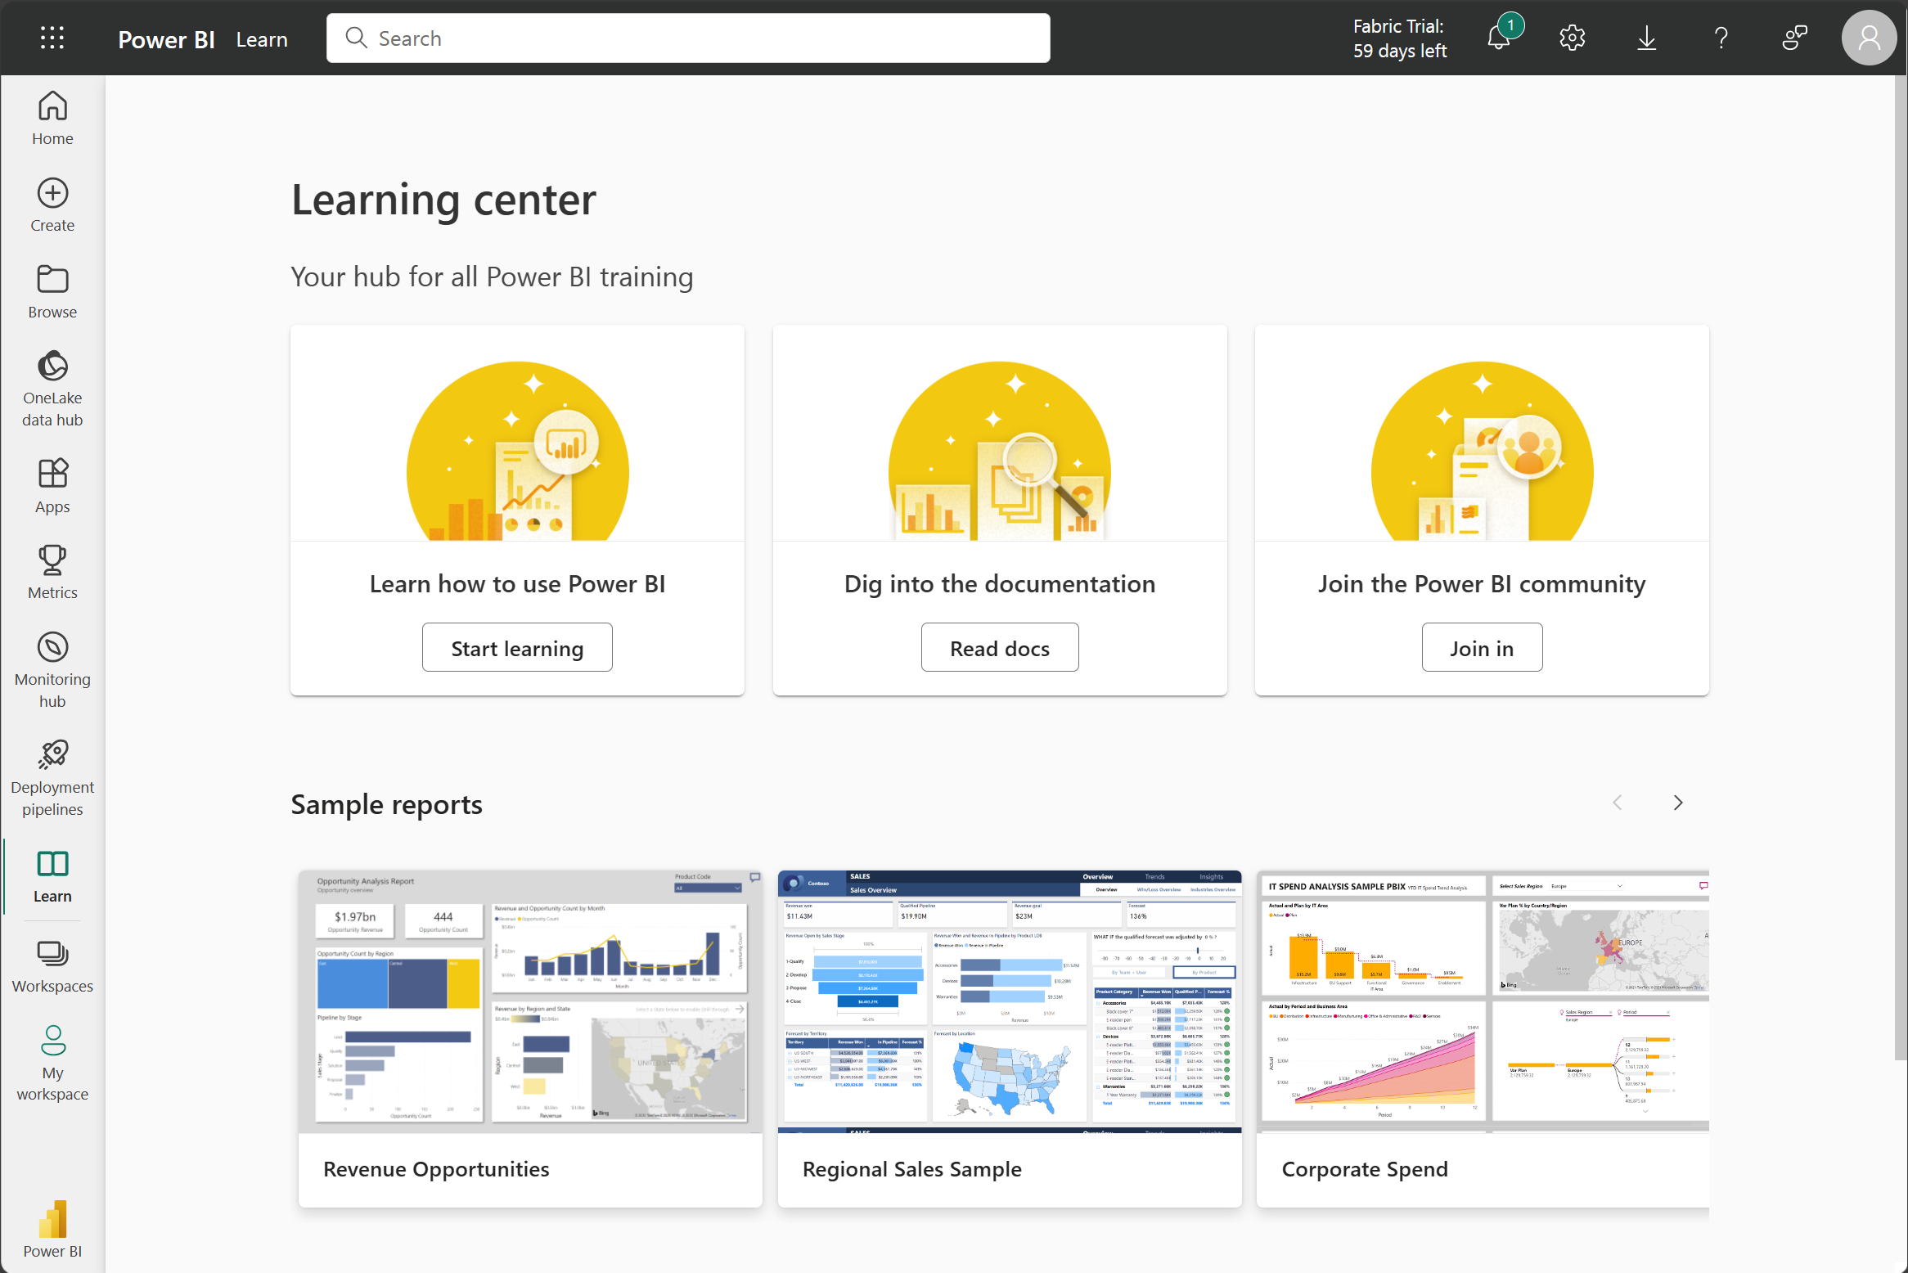
Explore sample reports
If you haven't created a report yet, Power BI offers several sample reports for you to explore. These reports load to My workspace so you can explore privately. You can access sample reports in the Learn section of the navigation pane

Slide 12
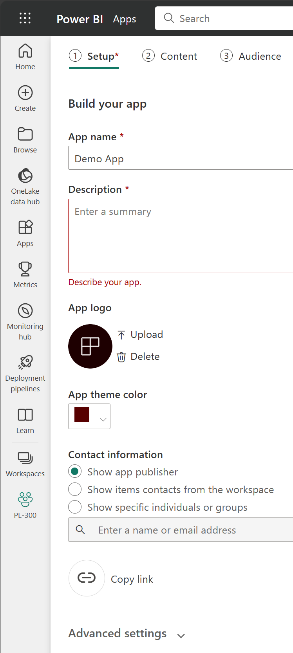
Distribute content
In a workspace, you can create an app, which provides consumers a simplified interface to access reports and dashboards. In the app configuration, you set up the app, select the content to include (limited to the current workspace), and choose your audience.
Once you create an app, you must update the app after each change to items in the workspace. The requirement to update the app allows you to control what version of the content is visible to your audience.

Slide 13
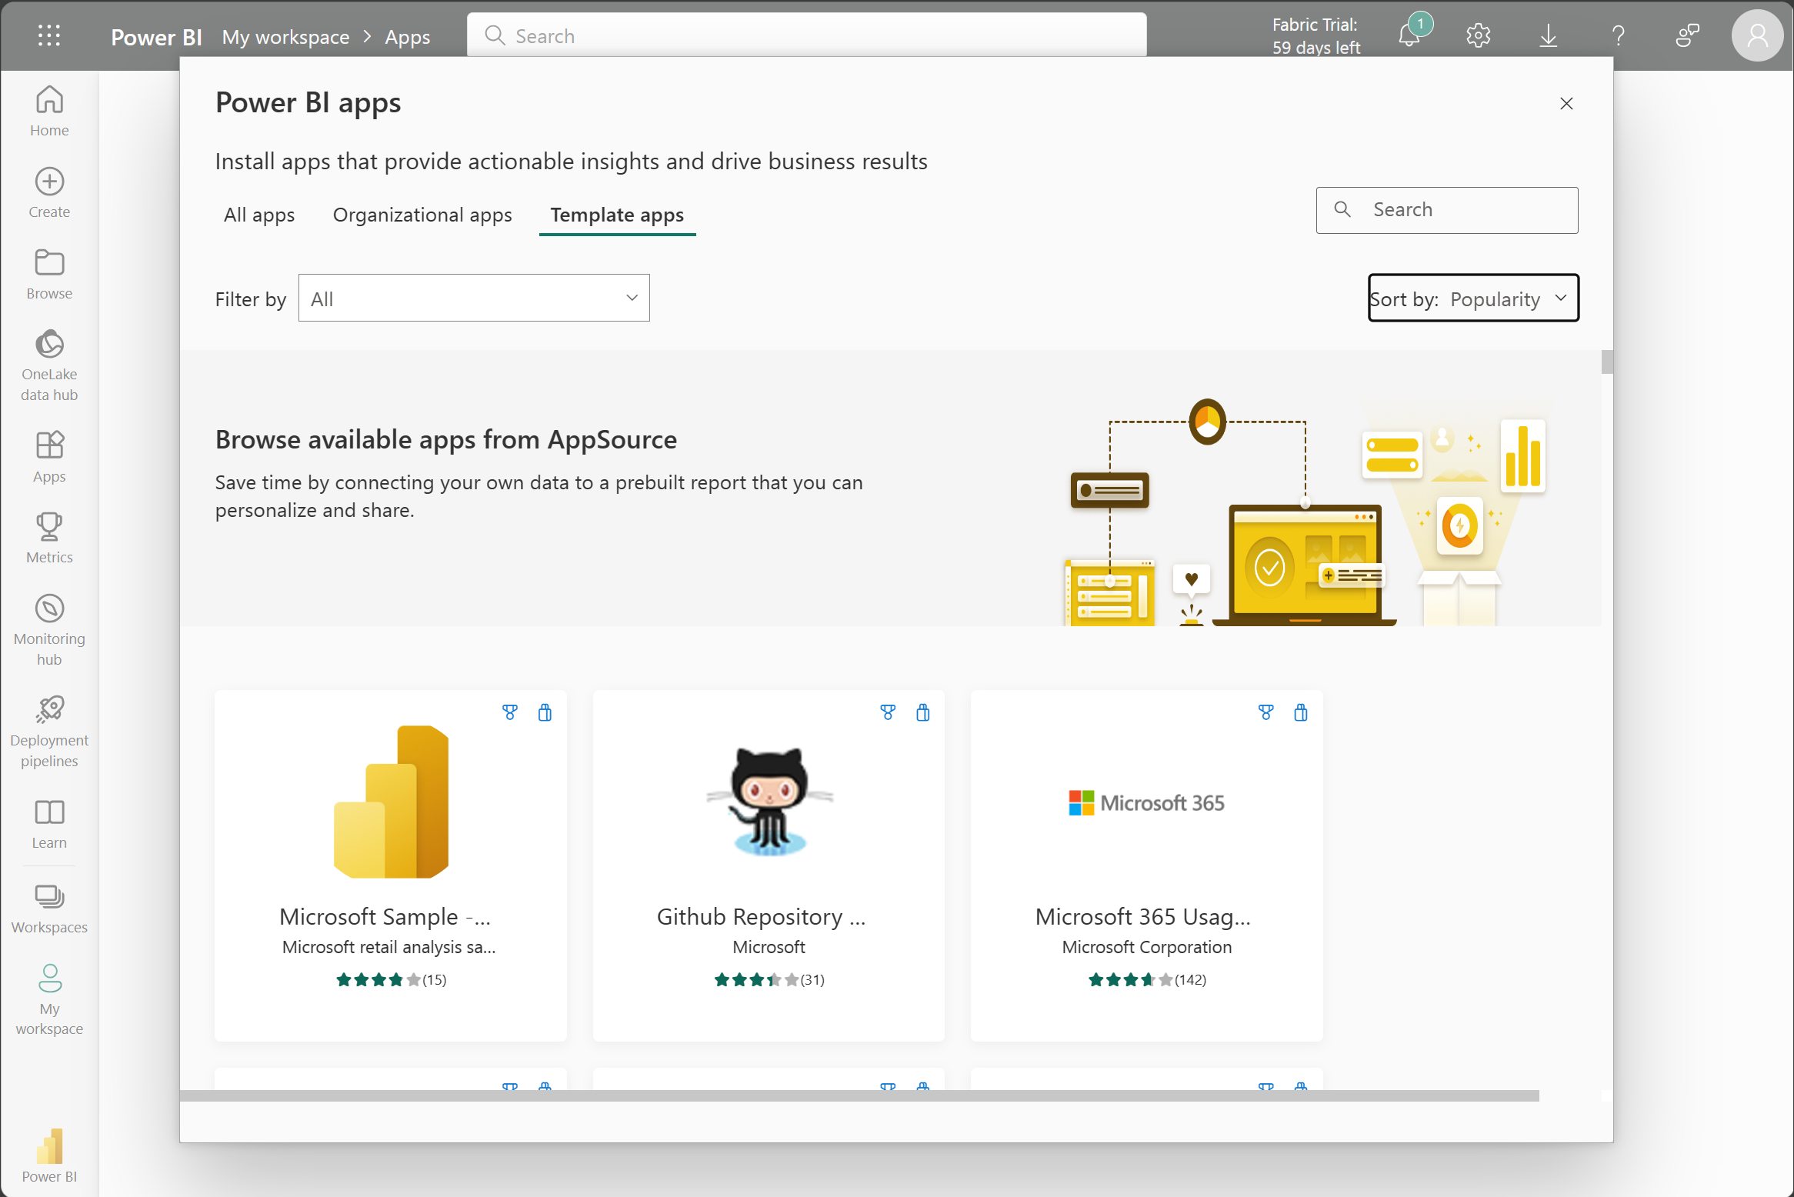
Explore template apps
Now that you understand what an app is, let's look at template apps. Template apps allow you to find an existing app that suits your needs and then you connect your data. These apps can be a great way to quickly share insights with minimal effort.

Slide 14
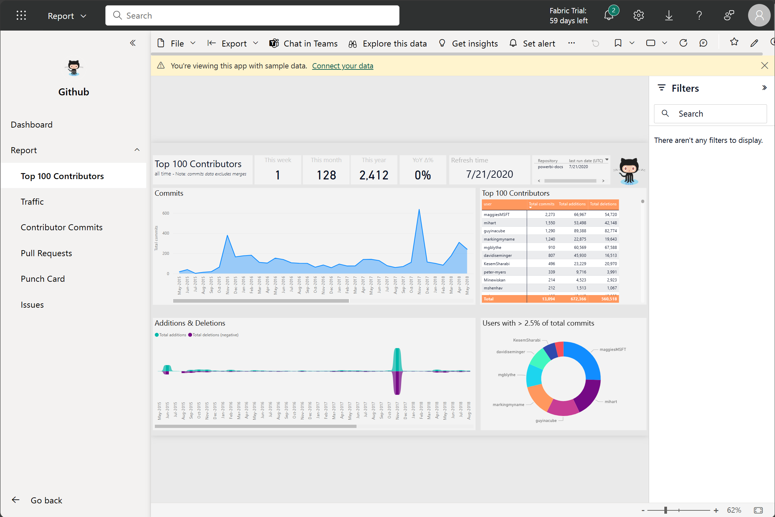

Slide 15
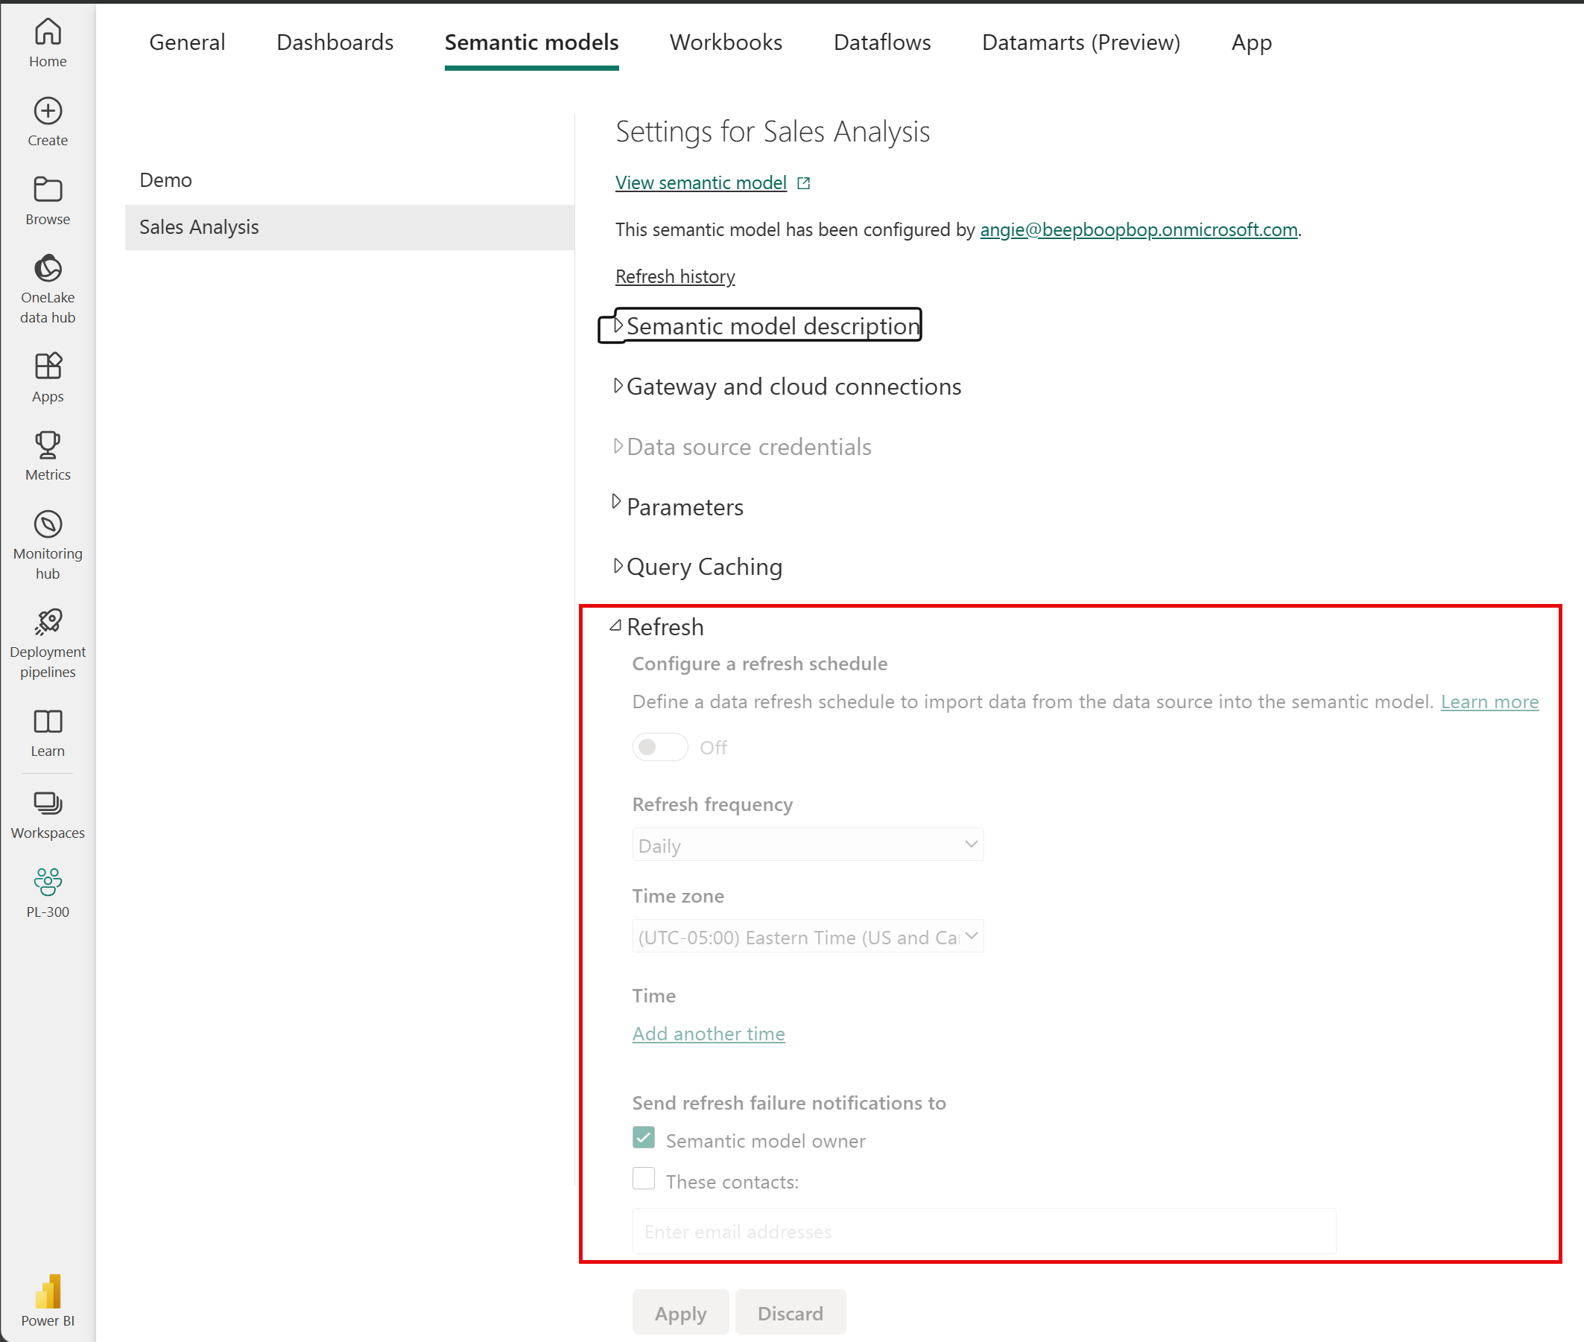
Refresh a semantic model

Slide 16
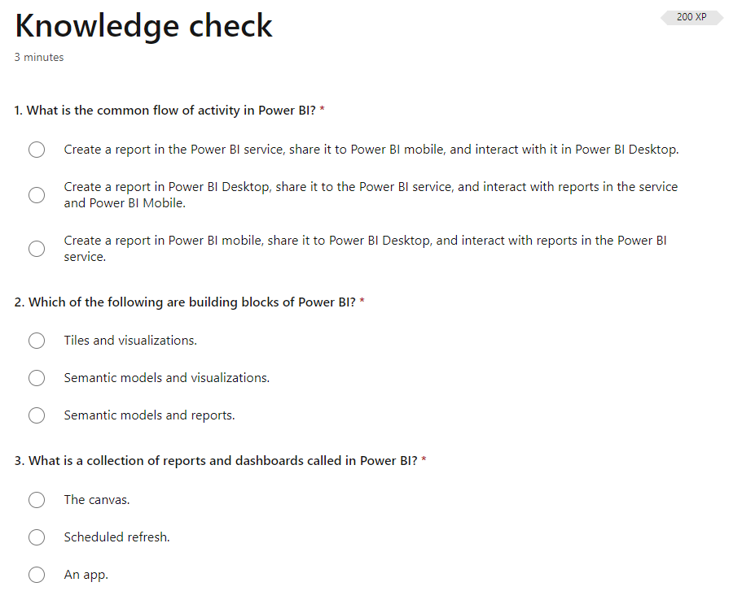

Slide 17
