Slide 1
SolarJEPA
Solar X-ray
time-series analysis
GOES-16 XRS-A / XRS-B
May–August 2024
Objective: characterize solar observations and demonstrate
reproducible 30-minute classical forecasting
SolarJEPA
01 / 20
Notes:
SolarJEPA is a solar X-ray research project with a broader interest in joint embedding predictive representation learning. This presentation focuses on the completed classical time-series analysis of GOES-16 XRS observations. The objective is to characterize the observations, diagnose quality and dependence, compare appropriate classical candidates, and demonstrate reproducible local inference. The analysis concerns continuous irradiance. Event-level solar-flare labels, alert thresholds and operational warning skill have not been established. Evidence terms throughout: DOCUMENTED describes method definitions, OBSERVED describes actual file or execution evidence, INFERRED describes interpretation, and UNKNOWN describes unestablished claims.
Sources at pinned analysis commit abe4b79d2fe7549552b0a1f467be1cd949b652a7:
https://github.com/Neal-Salian/SolarJEPA/blob/abe4b79d2fe7549552b0a1f467be1cd949b652a7/docs/PRESENTATION_TIME_SERIES_GUIDE.md
https://github.com/Neal-Salian/SolarJEPA/blob/abe4b79d2fe7549552b0a1f467be1cd949b652a7/docs/PRESENTATION_TIME_SERIES_VERIFICATION.md

Slide 2
Data collection
GOES-16 EXIS/XRS science products at one-minute cadence
123
177,120
pinned daily files
recorded minute bins
Month (2024) | May | June | July | August
Daily files | 31 | 30 | 31 | 31
Minute bins | 44,640 | 43,200 | 44,640 | 44,640
UTC bin starts / Irradiance in W/m² / Four manifest-pinned collections
SolarJEPA
02 / 20
Notes:
OBSERVED: four explicit manifests pin 123 daily NetCDF files, totaling 36,535,474 bytes. The native loader validates identities, platform, instrument, clock and units. The observed grid spans May 1 through August 31, 2024, with end-exclusive September 1 at 00:00 UTC. There are 177,120 unique minute bins. This is the number of recorded time bins before channel QC rejection, not the valid sample count for both channels. The product supplies primary electron-corrected irradiance in W/m². These are GOES observations, not Aditya-L1 observations. The analysis assumes retrospective availability at bin end. Actual operational delivery latency is UNKNOWN. Raw scientific files remain immutable and outside Git.
Sources at pinned analysis commit abe4b79d2fe7549552b0a1f467be1cd949b652a7:
https://github.com/Neal-Salian/SolarJEPA/blob/abe4b79d2fe7549552b0a1f467be1cd949b652a7/data/manifests/goes_v1_202405.json
https://github.com/Neal-Salian/SolarJEPA/blob/abe4b79d2fe7549552b0a1f467be1cd949b652a7/data/manifests/goes_v1_202406.json
https://github.com/Neal-Salian/SolarJEPA/blob/abe4b79d2fe7549552b0a1f467be1cd949b652a7/data/manifests/goes_p2_july2024.json
https://github.com/Neal-Salian/SolarJEPA/blob/abe4b79d2fe7549552b0a1f467be1cd949b652a7/data/manifests/goes_v1_202408.json
https://github.com/Neal-Salian/SolarJEPA/blob/abe4b79d2fe7549552b0a1f467be1cd949b652a7/src/solar_flare_jepa/data/goes.py

Slide 3
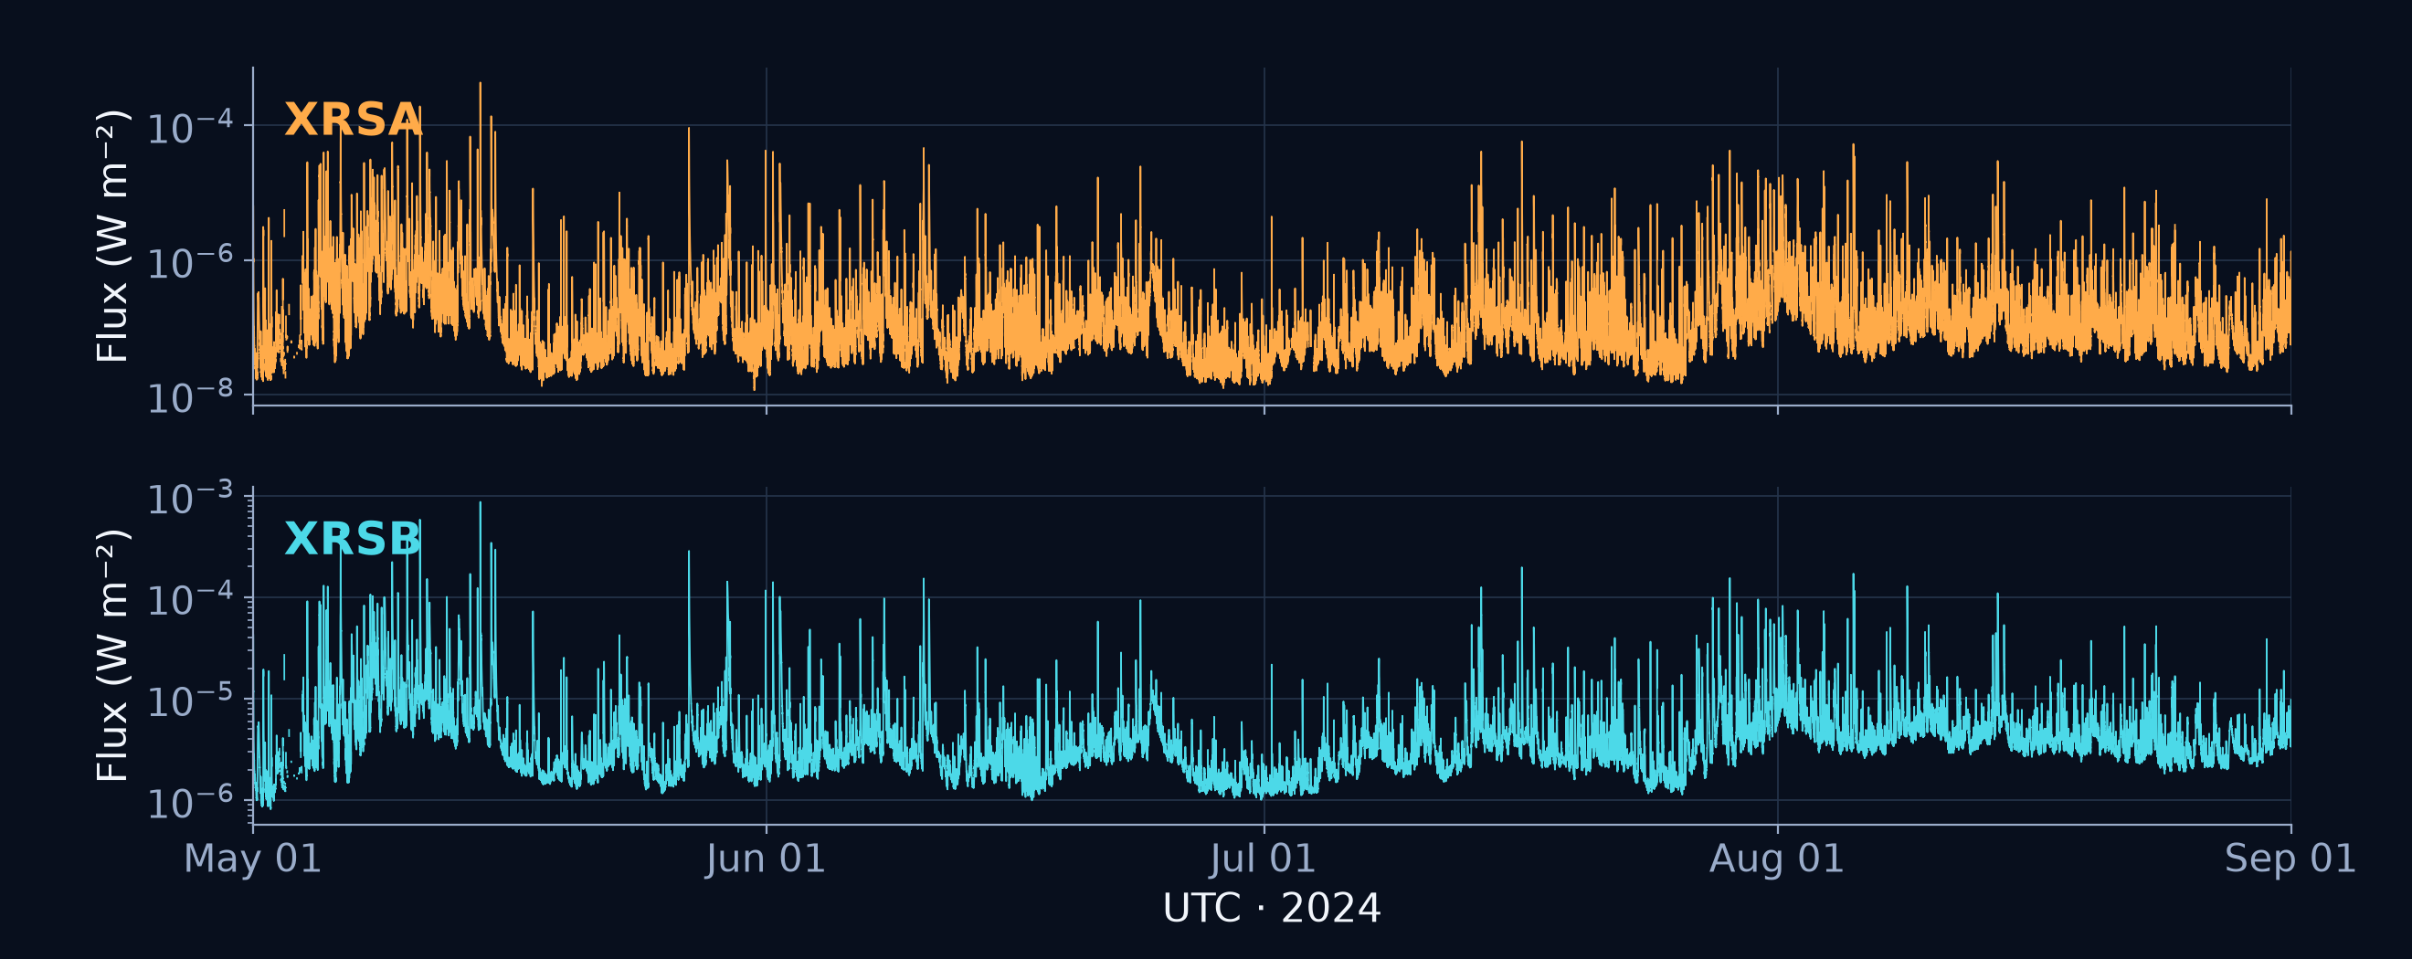
Solar X-ray flux over time
Full May–August archive with QC-rejected values retained as gaps
Transient peaks and a changing background motivate local diagnostics
SolarJEPA
03 / 20
Notes:
OBSERVED: this line graph uses the full manifest-validated minute grid and channel-specific QC-valid irradiance. The vertical axis displays native irradiance in W/m² on a logarithmic scale. Every native minute is supplied to the plotted series, with missing/rejected values preserved as NaN gaps and no imputation. Channel colors remain orange for A and cyan for B. Transient peaks and changing background levels motivate distributional and local dependence analysis. They are continuous observations and are not counted as labeled flares. INFERRED: the strong variation makes a single global stationary model questionable. A local diagnostic block provides controlled comparisons on complete support.
Sources at pinned analysis commit abe4b79d2fe7549552b0a1f467be1cd949b652a7:
https://github.com/Neal-Salian/SolarJEPA/blob/abe4b79d2fe7549552b0a1f467be1cd949b652a7/docs/presentation/time_series_evidence.json
https://github.com/Neal-Salian/SolarJEPA/blob/abe4b79d2fe7549552b0a1f467be1cd949b652a7/docs/presentation/eda_evidence.json
https://github.com/Neal-Salian/SolarJEPA/blob/abe4b79d2fe7549552b0a1f467be1cd949b652a7/src/solar_flare_jepa/presentation/eda.py

Slide 4
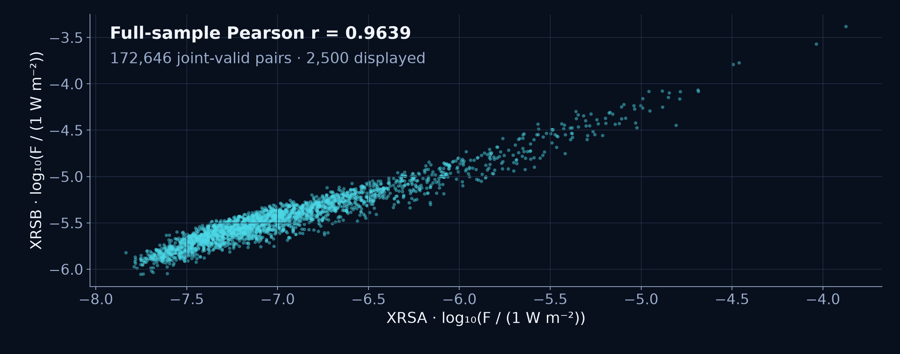
Paired channel behavior
Log irradiance scatter from jointly valid one-minute observations
0.9639
Pearson correlation
172,646 paired minutes
2,500 pairs displayed
Full-sample statistic
SolarJEPA
04 / 20
Notes:
OBSERVED: the Pearson correlation is 0.963905768 on all 172,646 jointly QC-valid log-space pairs. The scatter displays 2,500 chronologically evenly spaced pairs for legibility. Display thinning does not change the correlation population and is not a statistical resample. The positive relationship reflects paired channel observations on shared timestamps. INFERRED: both channels respond to common changing solar activity, with channel-specific amplitude and spectral response. Correlation does not identify causal effects, predictive skill or independent flare events. The two channel validity masks are intersected explicitly for this chart.
Sources at pinned analysis commit abe4b79d2fe7549552b0a1f467be1cd949b652a7:
https://github.com/Neal-Salian/SolarJEPA/blob/abe4b79d2fe7549552b0a1f467be1cd949b652a7/docs/presentation/time_series_evidence.json
https://github.com/Neal-Salian/SolarJEPA/blob/abe4b79d2fe7549552b0a1f467be1cd949b652a7/docs/presentation/eda_evidence.json
https://github.com/Neal-Salian/SolarJEPA/blob/abe4b79d2fe7549552b0a1f467be1cd949b652a7/src/solar_flare_jepa/presentation/eda.py

Slide 5
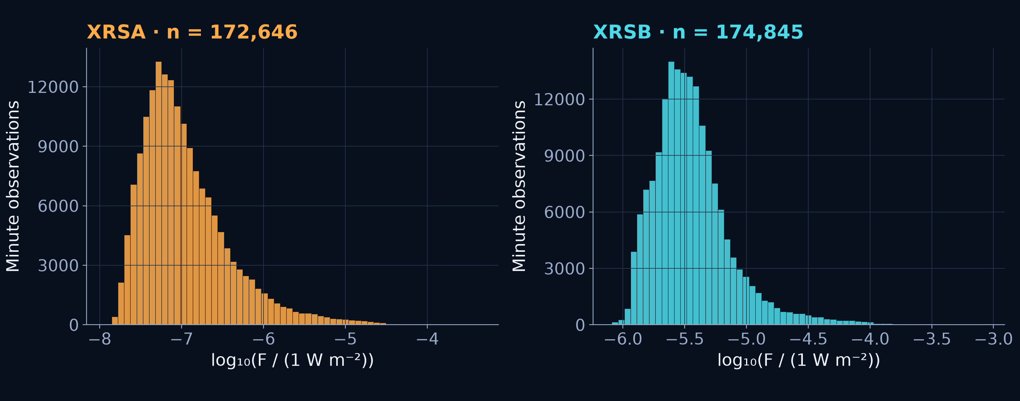
Flux distributions
Histograms use each channel’s full QC-valid May–August population
Log scaling makes the dynamic range easier to inspect
SolarJEPA
05 / 20
Notes:
OBSERVED: these histograms count all valid minute bins, 172,646 for XRS-A and 174,845 for XRS-B. They display log10 irradiance in equally spaced log bins. Thus a bar describes a log-space interval and cannot be read as an equal-width interval of native irradiance. Native irradiance has a pronounced right tail, and the log transformation spreads the dynamic range. INFERRED: log space offers a useful numerical scale for diagnostics and error reporting. It does not make the series Gaussian, stationary or independent. Counts are minute bins, not independent events or flare classes.
Sources at pinned analysis commit abe4b79d2fe7549552b0a1f467be1cd949b652a7:
https://github.com/Neal-Salian/SolarJEPA/blob/abe4b79d2fe7549552b0a1f467be1cd949b652a7/docs/presentation/time_series_evidence.json
https://github.com/Neal-Salian/SolarJEPA/blob/abe4b79d2fe7549552b0a1f467be1cd949b652a7/docs/presentation/eda_evidence.json
https://github.com/Neal-Salian/SolarJEPA/blob/abe4b79d2fe7549552b0a1f467be1cd949b652a7/src/solar_flare_jepa/presentation/eda.py

Slide 6
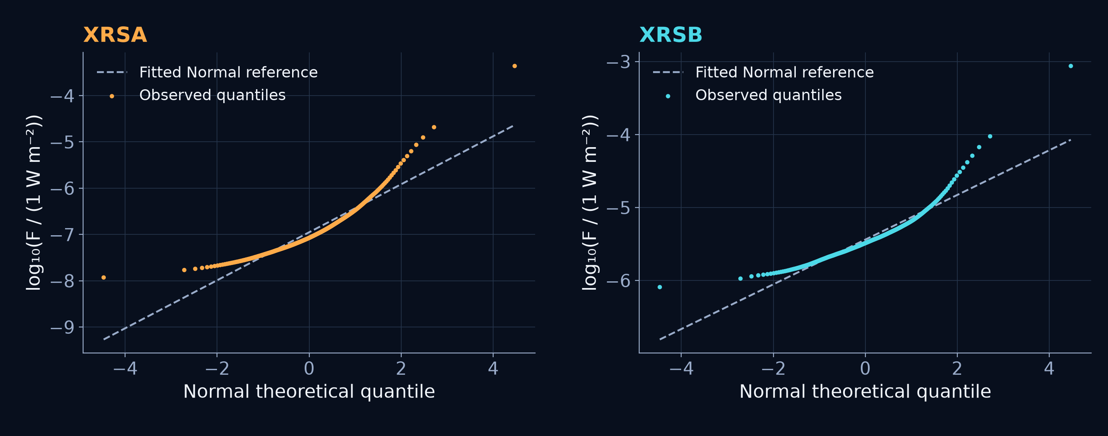
Normal Q–Q diagnostics
Marginal log distributions show departures from a fitted normal reference
Tail departures caution against a simple Gaussian marginal assumption
SolarJEPA
06 / 20
Notes:
OBSERVED: the normal Q–Q curves use the saved 301 theoretical/observed order-statistic display ranks per channel. Fitted reference lines use the full channel-specific valid log samples, not only the displayed ranks. Departures in the tails show that the marginal distribution does not follow the fitted normal reference exactly. INFERRED: treating rare extreme observations as a Gaussian sample needs caution. This chart assesses marginal shape. It does not test innovation normality after model fitting and does not establish independence because neighboring minutes are correlated. No normality p-value or residual-normality claim is invented.
Sources at pinned analysis commit abe4b79d2fe7549552b0a1f467be1cd949b652a7:
https://github.com/Neal-Salian/SolarJEPA/blob/abe4b79d2fe7549552b0a1f467be1cd949b652a7/docs/presentation/time_series_evidence.json
https://github.com/Neal-Salian/SolarJEPA/blob/abe4b79d2fe7549552b0a1f467be1cd949b652a7/docs/presentation/eda_evidence.json
https://github.com/Neal-Salian/SolarJEPA/blob/abe4b79d2fe7549552b0a1f467be1cd949b652a7/src/solar_flare_jepa/presentation/eda.py

Slide 7
Descriptive statistics and missing values
Unlogged QC-valid irradiance in W/m², May–August 2024
Statistic | XRS-A | XRS-B
Valid bins | 172,646 | 174,845
Mean | 5.245e-7 | 5.663e-6
Median | 8.462e-8 | 3.252e-6
Sample std. | 4.178e-6 | 1.416e-5
Minimum | 1.177e-8 | 8.122e-7
Maximum | 4.365e-4 | 8.688e-4
0 absent timestamps
QC-rejected values
A: 4,474 (2.53%)
B: 2,275 (1.28%)
No imputation
NaN gaps and masks persist
Complete timestamp coverage still includes unusable measurements
SolarJEPA
07 / 20
Notes:
OBSERVED: the table summarizes native-unit, unlogged QC-valid irradiance. Here unlogged does not mean raw detector counts or unfiltered measurements. Standard deviation uses sample ddof=1. Mean exceeds median in both channels, consistent with a right tail. There are zero absent timestamps and zero duplicate timestamps. QC rejects 4,474 A values and 2,275 B values. Each channel has 2,153 nonfinite original values already included inside those rejection counts, so the counts must not be added. Missing/rejected measurements retain NaN and false validity masks. The workflow applies no imputation. Local stationarity, dependence and STL diagnostics use a contiguous jointly valid training segment and never bridge a rejected gap.
Sources at pinned analysis commit abe4b79d2fe7549552b0a1f467be1cd949b652a7:
https://github.com/Neal-Salian/SolarJEPA/blob/abe4b79d2fe7549552b0a1f467be1cd949b652a7/docs/presentation/time_series_evidence.json
https://github.com/Neal-Salian/SolarJEPA/blob/abe4b79d2fe7549552b0a1f467be1cd949b652a7/src/solar_flare_jepa/presentation/time_series.py
https://github.com/Neal-Salian/SolarJEPA/blob/abe4b79d2fe7549552b0a1f467be1cd949b652a7/src/solar_flare_jepa/data/goes.py

Slide 8
Stationarity: ADF and KPSS
10,149 consecutive June training minutes, with 5% decision threshold
Series | ADF statistic | ADF p | KPSS statistic | KPSS p
A: log level | −8.763 | 2.64 × 10⁻¹⁴ | 0.554 | 0.02944
A: Δlog | −22.395 | ≈ 0* | 0.00245 | > 0.10
B: log level | −8.224 | 6.32 × 10⁻¹³ | 0.658 | 0.01734
B: Δlog | −21.191 | ≈ 0* | 0.00273 | > 0.10
ADF null: unit root
KPSS null: level stationarity
First differences support the local d = 1 demonstration
* Numerical p-value cutoff. Non-rejection does not prove global stationarity.
SolarJEPA
08 / 20
Notes:
DOCUMENTED: ADF tests a unit-root null, while level KPSS tests a stationarity null. OBSERVED: ADF uses constant regression, 30 fixed lags and no autolag. KPSS uses a constant and automatic bandwidth. The common segment spans June 11 16:38 through June 18 17:46 UTC. Log levels reject both nulls, which is mixed evidence rather than proof of stationarity. First log differences reject the ADF null and do not reject KPSS, supporting a bounded d=1 demonstration. Stored ADF p=0 for differenced series is a numerical approximation cutoff and is shown as approximately zero, not exact probability zero. KPSS p>0.10 is a bound. Tests on one segment do not prove stationarity across the four-month archive. Raw numerically scaled levels also reject ADF and do not reject KPSS, illustrating sensitivity to transformation and assumptions.
Sources at pinned analysis commit abe4b79d2fe7549552b0a1f467be1cd949b652a7:
https://github.com/Neal-Salian/SolarJEPA/blob/abe4b79d2fe7549552b0a1f467be1cd949b652a7/docs/presentation/stationarity.csv
https://github.com/Neal-Salian/SolarJEPA/blob/abe4b79d2fe7549552b0a1f467be1cd949b652a7/src/solar_flare_jepa/presentation/eda.py

Slide 9
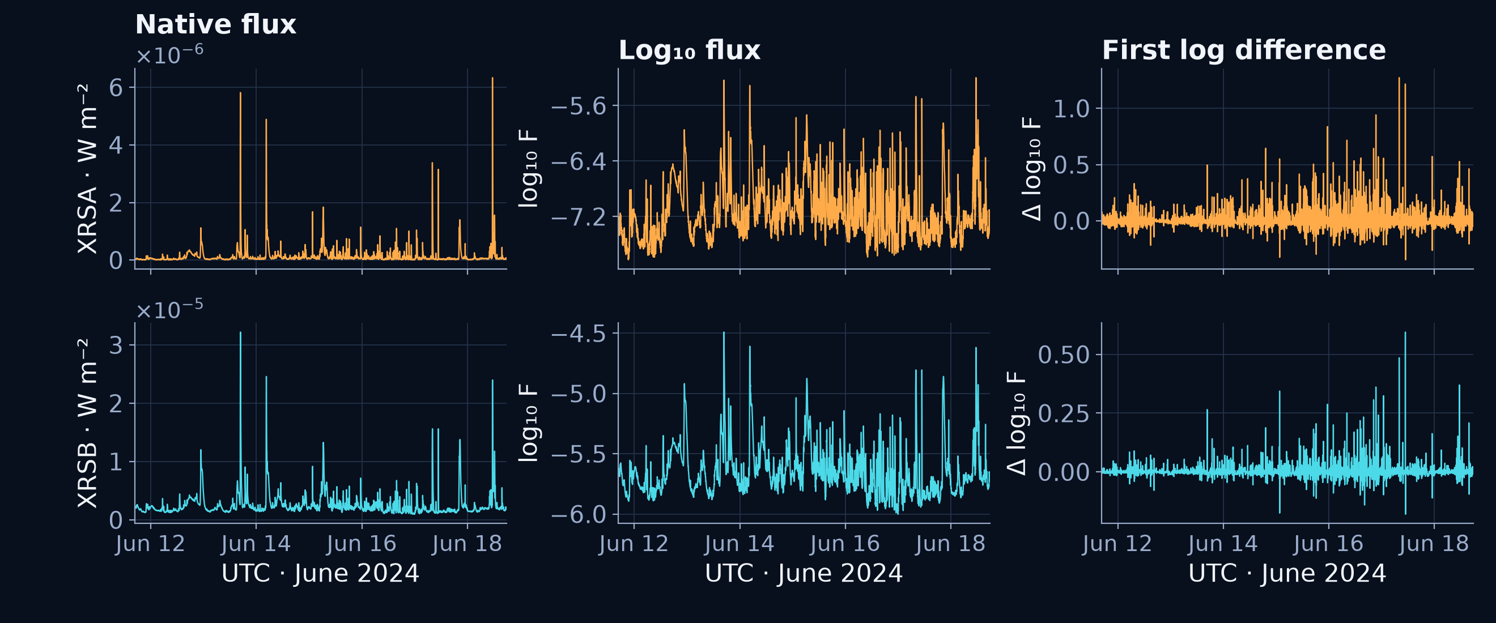
Log transformation and differencing
Before and after views use the same complete June training segment
yₜ = log₁₀(Fₜ / (1 W m⁻²))
Δyₜ = yₜ − yₜ₋₁
SolarJEPA
09 / 20
Notes:
DOCUMENTED: define y_t = log10(F_t / (1 W/m²)); y is dimensionless and its differences are expressed in dex. The first difference Δy_t = y_t − y_(t−1) describes one-minute multiplicative change. OBSERVED: native irradiance, log levels and first log differences use the same 10,149-row contiguous June block, with one fewer differenced value. The log transformation compresses scale. Differencing removes local level persistence but may preserve correlated changes and changing variability. Neither operation invents missing measurements. INFERRED: differencing supports a bounded d=1 model of log irradiance levels given the local ADF/KPSS results. This is a modeling decision, not proof that every solar regime is stationary.
Sources at pinned analysis commit abe4b79d2fe7549552b0a1f467be1cd949b652a7:
https://github.com/Neal-Salian/SolarJEPA/blob/abe4b79d2fe7549552b0a1f467be1cd949b652a7/docs/presentation/time_series_evidence.json
https://github.com/Neal-Salian/SolarJEPA/blob/abe4b79d2fe7549552b0a1f467be1cd949b652a7/docs/presentation/eda_evidence.json
https://github.com/Neal-Salian/SolarJEPA/blob/abe4b79d2fe7549552b0a1f467be1cd949b652a7/src/solar_flare_jepa/presentation/eda.py

Slide 10
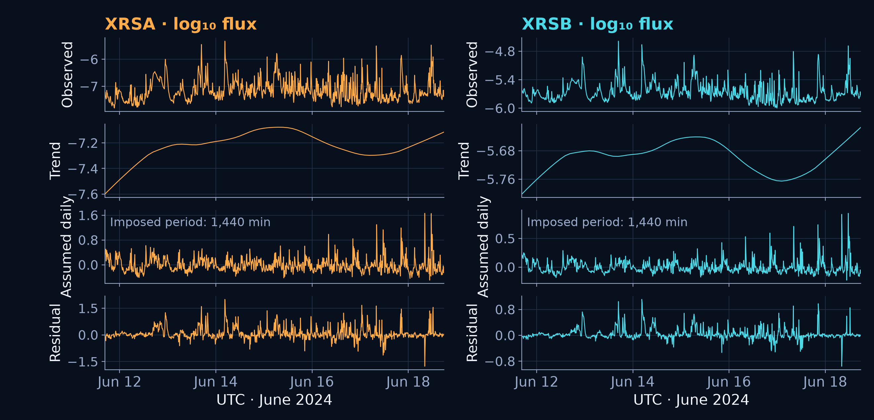
Exploratory STL decomposition
Robust STL with an assumed period of 1,440 minutes
An imposed daily component does not establish stable solar seasonality
SolarJEPA
10 / 20
Notes:
OBSERVED: robust STL decomposes log flux on the full 10,149-minute June segment. The plotting arrays retain 1,100 chronological display positions and the component values evaluated at those positions. Settings are period=1440, seasonal=7, robust=True, seasonal_jump=1, trend_jump=144, low_pass_jump=144. The reconstruction maximum error is 8.88e−16 dex. LOESS jump interpolation approximates smoothing and is unrelated to filling missing observations. DOCUMENTED: STL returns a seasonal component for the supplied period. INFERRED: approximately seven days of data and weak differenced daily-lag correlations, A 0.0142 and B 0.00816, do not establish stable physical daily seasonality. The daily component shown is exploratory and imposed. UNKNOWN: a defensible stable seasonal period for SARIMA. No genuine SARIMA fit or score exists.
Sources at pinned analysis commit abe4b79d2fe7549552b0a1f467be1cd949b652a7:
https://github.com/Neal-Salian/SolarJEPA/blob/abe4b79d2fe7549552b0a1f467be1cd949b652a7/docs/presentation/time_series_evidence.json
https://github.com/Neal-Salian/SolarJEPA/blob/abe4b79d2fe7549552b0a1f467be1cd949b652a7/src/solar_flare_jepa/presentation/time_series.py

Slide 11
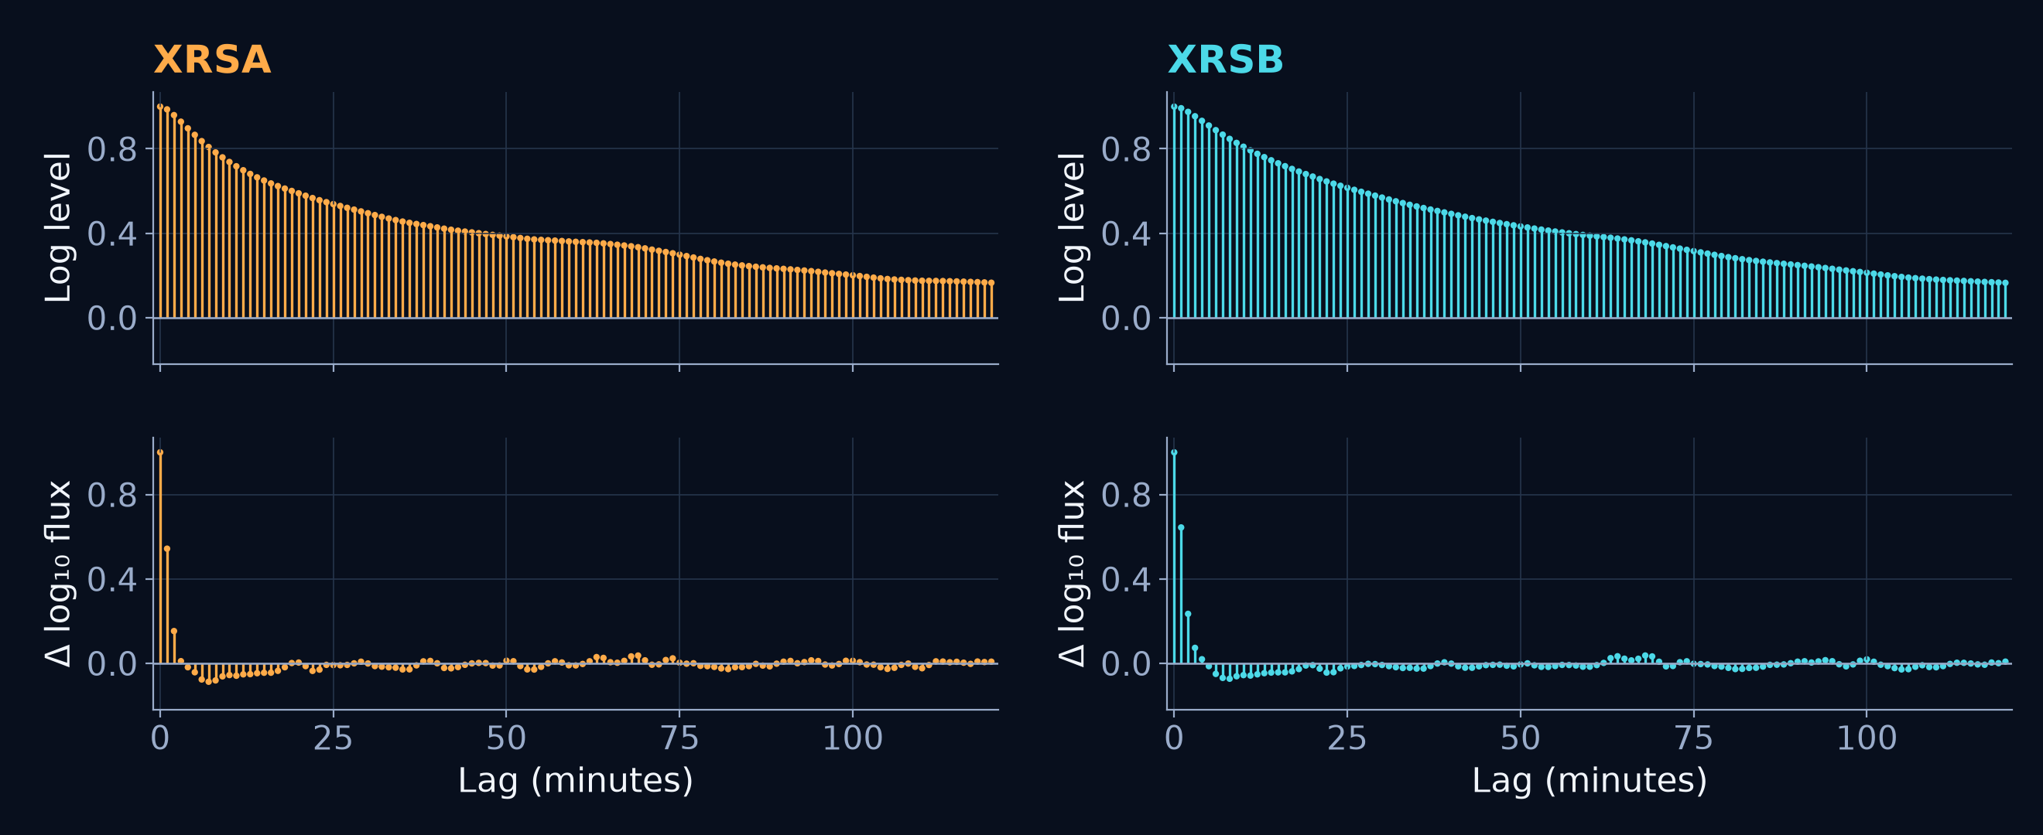
Autocorrelation
ACF of log levels and first log differences, with lag units in minutes
Differencing reduces level persistence but leaves short-lag structure
SolarJEPA
11 / 20
Notes:
OBSERVED: the saved ACF uses FFT with biased covariance normalization on the same complete June training segment. The display reaches 120 minutes. Log levels are highly persistent: lag-one ACF is about 0.987 for A and 0.992 for B. First differences retain short-lag correlation, with lag-one ACF 0.543 and 0.644. By lag 60 the differenced ACF is near zero, −0.00986 and −0.0160. INFERRED: this motivates a small short-memory candidate set rather than a seasonal model. High autocorrelation can arise from persistent levels or trends and alone does not imply seasonality. No iid confidence bands are plotted, because minute observations and changing regimes need careful interpretation.
Sources at pinned analysis commit abe4b79d2fe7549552b0a1f467be1cd949b652a7:
https://github.com/Neal-Salian/SolarJEPA/blob/abe4b79d2fe7549552b0a1f467be1cd949b652a7/docs/presentation/time_series_evidence.json
https://github.com/Neal-Salian/SolarJEPA/blob/abe4b79d2fe7549552b0a1f467be1cd949b652a7/docs/presentation/eda_evidence.json
https://github.com/Neal-Salian/SolarJEPA/blob/abe4b79d2fe7549552b0a1f467be1cd949b652a7/src/solar_flare_jepa/presentation/eda.py

Slide 12
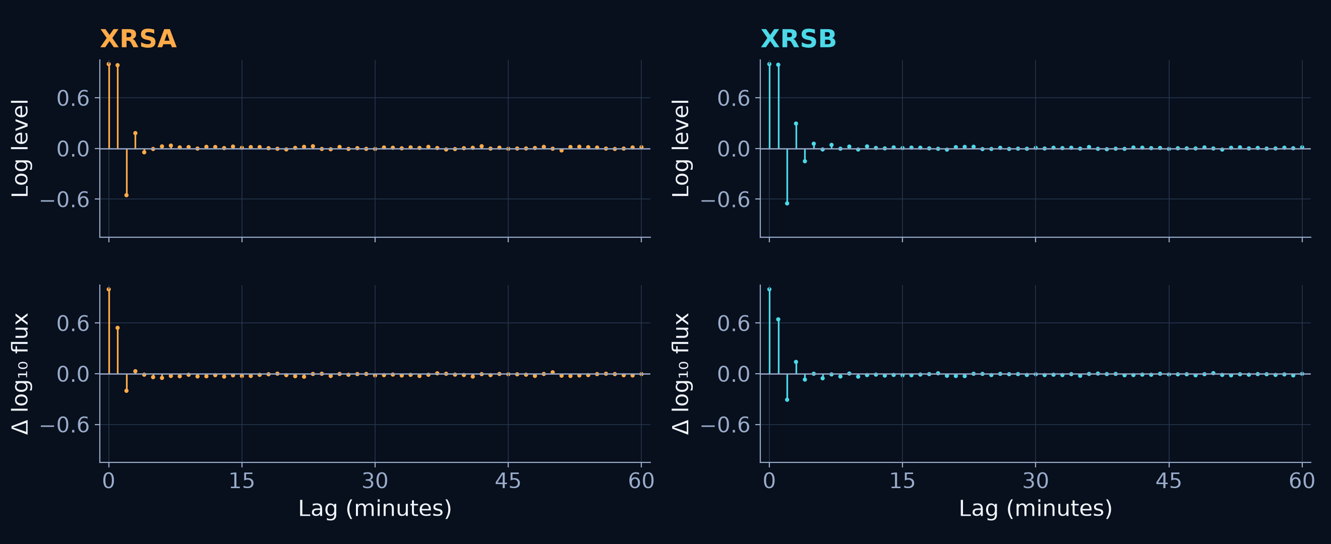
Partial autocorrelation and lag selection
PACF guides a bounded candidate set. Training BIC makes the order choice
XRS-A: (p, d, q) = (1, 1, 0)
XRS-B: (p, d, q) = (2, 1, 0)
SolarJEPA
12 / 20
Notes:
OBSERVED: PACF uses Yule–Walker MLE (ywm) and shows 60 minute lags for levels and first differences on the June segment. DOCUMENTED: p is the number of AR lags, d the number of differences, and q the number of innovation lags. d is not a time lag. ACF/PACF cutoff heuristics motivate candidate orders but do not determine a uniquely correct model in these transient data. The fixed candidates explore short AR/MA orders 1 and 2. Within the prespecified d=1 group, training BIC chooses p=1, d=1, q=0 for XRS-A and p=2, d=1, q=0 for XRS-B. q=0 reflects the candidate comparison and does not prove all innovation effects absent. A 120-bin inference context and 30-bin horizon are separate design choices and are not p or q.
Sources at pinned analysis commit abe4b79d2fe7549552b0a1f467be1cd949b652a7:
https://github.com/Neal-Salian/SolarJEPA/blob/abe4b79d2fe7549552b0a1f467be1cd949b652a7/docs/presentation/time_series_evidence.json
https://github.com/Neal-Salian/SolarJEPA/blob/abe4b79d2fe7549552b0a1f467be1cd949b652a7/docs/presentation/eda_evidence.json
https://github.com/Neal-Salian/SolarJEPA/blob/abe4b79d2fe7549552b0a1f467be1cd949b652a7/src/solar_flare_jepa/presentation/eda.py
https://github.com/Neal-Salian/SolarJEPA/blob/abe4b79d2fe7549552b0a1f467be1cd949b652a7/src/solar_flare_jepa/presentation/classical.py

Slide 13
Classical model identification
Seven fixed candidates per channel on the same 2,880 June training minutes
Family | Candidate specification | Role
AR | AR(1), AR(2) | Past observations
MA | MA(1), MA(2) | Past innovations
ARMA | ARMA(1,1) | Both components
ARIMA | (1,1,0), (2,1,0) | First log difference
SARIMA | Deferred | Stable period unestablished
All 14 nonseasonal fits converged. No seasonal fit or score is claimed
SolarJEPA
13 / 20
Notes:
DOCUMENTED: AR uses lagged observations, MA uses lagged innovations, ARMA combines both, and ARIMA includes differencing. MA(q) is not the same as smoothing observations with a moving-average window. OBSERVED: the existing statistical adapter fitted AR(1), AR(2), MA(1), MA(2), ARMA(1,1), ARIMA(1,1,0), and ARIMA(2,1,0) for each channel. All 14 fits converged. The fitting interval is June 11 16:38 through June 13 16:37 UTC. d=0 candidates include a constant. d=1 candidates have no deterministic trend and burn one observation in their likelihood. INFERRED: a stable seasonal period is unestablished, so a genuine seasonal SARIMA specification is deferred. There is no seasonal fit, AIC/BIC or forecast score. Under a literal rubric requiring every family to be fitted, requirement 8 remains partial. All applicable nonseasonal family demonstrations are covered.
Sources at pinned analysis commit abe4b79d2fe7549552b0a1f467be1cd949b652a7:
https://github.com/Neal-Salian/SolarJEPA/blob/abe4b79d2fe7549552b0a1f467be1cd949b652a7/docs/presentation/time_series_evidence.json
https://github.com/Neal-Salian/SolarJEPA/blob/abe4b79d2fe7549552b0a1f467be1cd949b652a7/src/solar_flare_jepa/presentation/classical.py
https://github.com/Neal-Salian/SolarJEPA/blob/abe4b79d2fe7549552b0a1f467be1cd949b652a7/src/solar_flare_jepa/presentation/time_series.py

Slide 14
AIC/BIC comparison and selection
Comparable d = 1 candidates only, ranked separately for each channel
Channel / order | AIC | BIC | ΔBIC within channel
A / (1,1,0) | -12311.066 | -12299.136 | 0.000
A / (2,1,0) | -12310.261 | -12292.365 | 6.771
B / (1,1,0) | -20616.476 | -20604.546 | 64.286
B / (2,1,0) | -20686.728 | -20668.832 | 0.000
AIC = −2ℓ + 2k
BIC = −2ℓ + k ln(nₑff)
Selected: A (1,1,0) and B (2,1,0) by training BIC
SolarJEPA
14 / 20
Notes:
DOCUMENTED: AIC = −2ℓ + 2k and BIC = −2ℓ + k ln(n_eff), balancing likelihood and parameter count. OBSERVED: this table compares the two d=1 candidates per channel. Within each channel the transformation, support, deterministic terms and likelihood burn are fixed: no trend, burn=1 and effective n=2879. Training BIC prefers A (1,1,0) by 6.7705 and B (2,1,0) by 64.2862. AIC also favors these orders within the displayed groups. The d=1 choice is a prespecified diagnostic decision. It is not obtained by globally ranking all seven model fits. Do not compare criteria across channels, transformations or incompatible d/trend/burn groups. The d=0 family fits have a separate constant/burn0/n2880 comparison support. Future August target values do not enter fitting or order selection. Lower BIC does not establish physical truth or guarantee lowest held-out error.
Sources at pinned analysis commit abe4b79d2fe7549552b0a1f467be1cd949b652a7:
https://github.com/Neal-Salian/SolarJEPA/blob/abe4b79d2fe7549552b0a1f467be1cd949b652a7/docs/presentation/time_series_evidence.json
https://github.com/Neal-Salian/SolarJEPA/blob/abe4b79d2fe7549552b0a1f467be1cd949b652a7/src/solar_flare_jepa/presentation/classical.py
https://github.com/Neal-Salian/SolarJEPA/blob/abe4b79d2fe7549552b0a1f467be1cd949b652a7/src/solar_flare_jepa/presentation/time_series.py

Slide 15
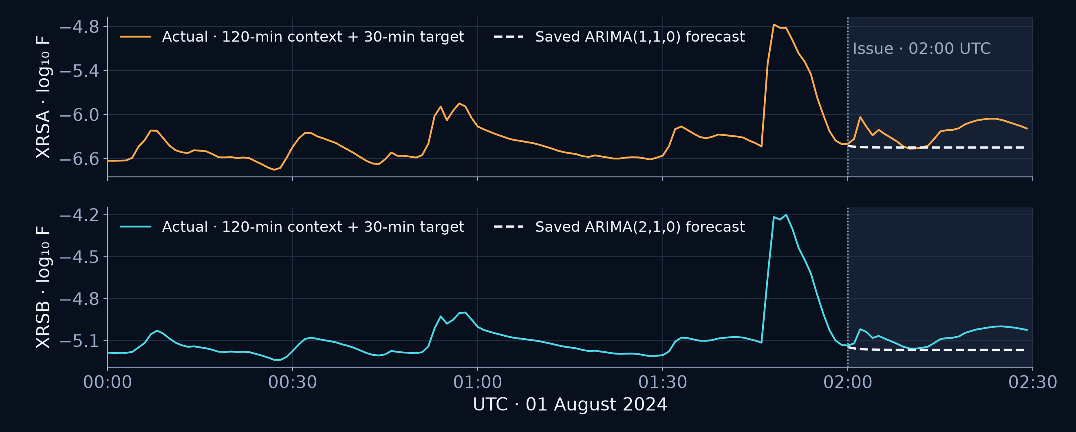
Actual versus predicted irradiance
1 August 2024, 02:00 UTC. Axes show log₁₀(F / (1 W m⁻²)) in dex
120 observed past minutes and a 30-minute forecast horizon
SolarJEPA
15 / 20
Notes:
OBSERVED: this chart uses saved native context, actual targets and inverse-log forecasts verified by a fresh saved-parameter replay. Context contains 120 completed minute bins with start times 00:00 through 01:59 UTC. Targets have start times 02:00 through 02:29. The issue line is 02:00 UTC. Parameters fitted in June remain frozen, while filtering uses only the supplied past context. Forecasts returned in native units are inverse-log conditional medians. No uncertainty intervals are supplied or claimed. Future target values do not enter fitting, selection or inference. The retrospective demonstration origin is the first chronological window with complete valid past context and target support, so target QC validity participates in choosing the scored window. This one example does not estimate general forecast skill.
Sources at pinned analysis commit abe4b79d2fe7549552b0a1f467be1cd949b652a7:
https://github.com/Neal-Salian/SolarJEPA/blob/abe4b79d2fe7549552b0a1f467be1cd949b652a7/docs/presentation/time_series_evidence.json
https://github.com/Neal-Salian/SolarJEPA/blob/abe4b79d2fe7549552b0a1f467be1cd949b652a7/src/solar_flare_jepa/presentation/classical.py
https://github.com/Neal-Salian/SolarJEPA/blob/abe4b79d2fe7549552b0a1f467be1cd949b652a7/src/solar_flare_jepa/presentation/time_series.py

Slide 16
Forecast demonstration results
One retrospective held-out 30-minute example
Channel | Selected order | Log MAE (dex) | Log RMSE (dex)
XRS-A | (1,1,0) | 0.218835 | 0.256635
XRS-B | (2,1,0) | 0.094347 | 0.109055
MAE = (1/n) Σ |eₜ|
RMSE = √[(1/n) Σ eₜ²]
n = 30 target minutes per channel. Errors use log₁₀ irradiance.
These values do not represent overall forecasting skill
SolarJEPA
16 / 20
Notes:
OBSERVED: exact log errors reproduced by fresh inference are A MAE 0.2188352957 and RMSE 0.2566354851, B MAE 0.0943474238 and RMSE 0.1090553488. The table rounds to six decimals. These are absolute and squared errors between log10 actual and log10 predicted flux, summarized across only 30 target minutes for each channel. Both values are in dex, not W/m² or a percentage. The formula uses n=30 and e_t = y_t − ŷ_t in log space. June training support has 2880 observations. The first eligible August example was selected chronologically using complete-case masks, not by lowest error. No aggregate evaluation, uncertainty interval or significance result follows from this single window. These selected models are BIC-preferred within the d=1 training groups, not necessarily the lowest-error models across all families at this one origin. Archived V1 multi-origin scores use a different protocol and are intentionally kept separate.
Sources at pinned analysis commit abe4b79d2fe7549552b0a1f467be1cd949b652a7:
https://github.com/Neal-Salian/SolarJEPA/blob/abe4b79d2fe7549552b0a1f467be1cd949b652a7/docs/presentation/time_series_evidence.json
https://github.com/Neal-Salian/SolarJEPA/blob/abe4b79d2fe7549552b0a1f467be1cd949b652a7/src/solar_flare_jepa/presentation/classical.py
https://github.com/Neal-Salian/SolarJEPA/blob/abe4b79d2fe7549552b0a1f467be1cd949b652a7/src/solar_flare_jepa/presentation/time_series.py

Slide 17
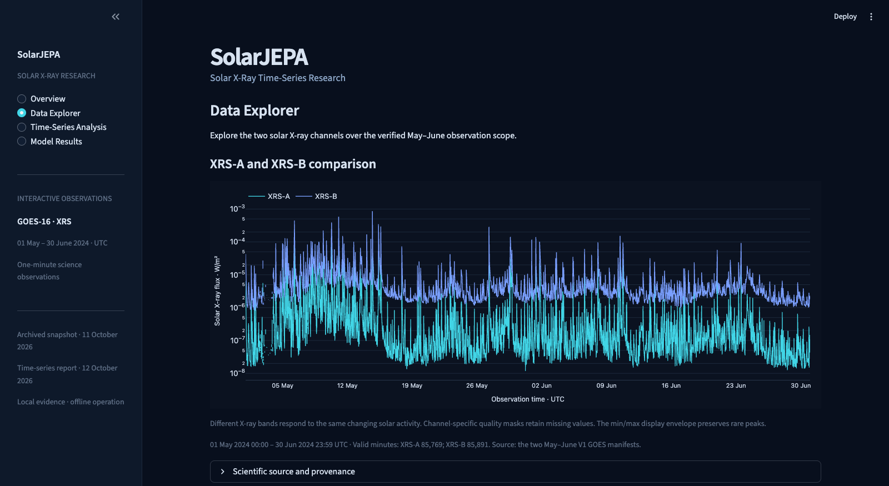
Local Streamlit deployment
Thin presentation layer over reusable scientific and inference modules
Scientific core
Pinned data and QC
Reusable diagnostics
Saved inference
Frozen parameters
Past context only
Streamlit views
Charts and tables
Screenshot: original interactive observation scope is May–June 2024
SolarJEPA
17 / 20
Notes:
OBSERVED: the local Streamlit app has Overview, Data Explorer, Time-Series Analysis and Model Results views. The actual screenshot shows the current application, not a design mockup. Native interactive observations on the original views cover May–June. The later evidence tables and decomposition use the full May–August collection or the stated June segment. The architecture keeps manifest verification, native loading, diagnostics, saved-parameter inference and evaluation in UI-independent modules. Streamlit loads verified outputs and displays Plotly charts and tables. Scientific fitting occurs in the offline builder. Dashboard rendering and saved-model replay do not refit the ARIMA model. This is a local offline demonstration, not public production hosting or an operational warning service. A future frontend can reuse the core, but this task does not implement React or FastAPI.
Sources at pinned analysis commit abe4b79d2fe7549552b0a1f467be1cd949b652a7:
https://github.com/Neal-Salian/SolarJEPA/blob/abe4b79d2fe7549552b0a1f467be1cd949b652a7/streamlit_app.py
https://github.com/Neal-Salian/SolarJEPA/blob/abe4b79d2fe7549552b0a1f467be1cd949b652a7/src/solar_flare_jepa/dashboard/time_series.py
https://github.com/Neal-Salian/SolarJEPA/blob/abe4b79d2fe7549552b0a1f467be1cd949b652a7/src/solar_flare_jepa/presentation/time_series.py
https://github.com/Neal-Salian/SolarJEPA/blob/abe4b79d2fe7549552b0a1f467be1cd949b652a7/src/solar_flare_jepa/presentation/classical.py

Slide 18
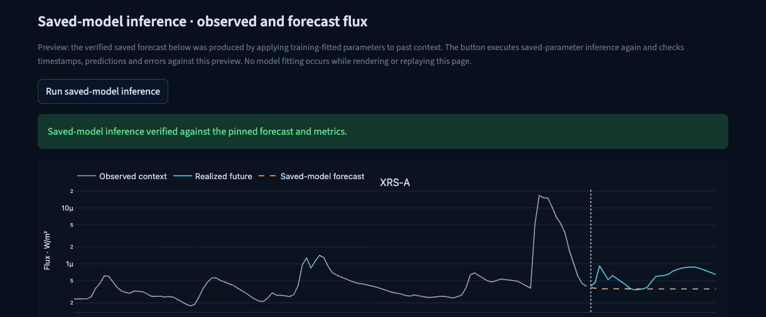
Saved-model inference in the dashboard
Detail of the actual Streamlit replay action and XRS-A forecast
Issue: 1 August 2024, 02:00 UTC. 120 past bins, 30 target bins
SolarJEPA
18 / 20
Notes:
OBSERVED: this screenshot comes from the running local Streamlit Model Results view after clicking Run saved-model inference. The app filters the selected frozen parameters on the saved 120-minute context, aligns all 30 forecast timestamps with the saved payload, and checks channel metrics before reporting replay success. No future target values enter infer(), and no fitting occurs when pressing this action. The displayed saved actual values support retrospective scoring. The screenshot and capture metadata identify the pinned source commit. The original archived V1 comparison appears elsewhere on the same long page and uses a different multi-origin protocol. It should not be conflated with the separate single-window classical teaching demonstration shown here. Local files and dependencies are required; operational uptime, delivery latency and live alerts remain outside the demonstrated scope.
Sources at pinned analysis commit abe4b79d2fe7549552b0a1f467be1cd949b652a7:
https://github.com/Neal-Salian/SolarJEPA/blob/abe4b79d2fe7549552b0a1f467be1cd949b652a7/streamlit_app.py
https://github.com/Neal-Salian/SolarJEPA/blob/abe4b79d2fe7549552b0a1f467be1cd949b652a7/src/solar_flare_jepa/dashboard/time_series.py
https://github.com/Neal-Salian/SolarJEPA/blob/abe4b79d2fe7549552b0a1f467be1cd949b652a7/tests/test_time_series_ui.py

Slide 19
Conclusion and future improvements
A reproducible classical analysis with explicit scientific boundaries
What the evidence supports
What needs further evaluation
Verified GOES data and diagnostics
Bounded classical model comparison
Reproducible local inference
Many chronological forecast origins
Residual checks and uncertainty
Regime robustness and delivery latency
SARIMA awaits a defensible stable period
Operational solar-flare forecasting remains unestablished
SolarJEPA
19 / 20
Notes:
OBSERVED: the project now has pinned GOES collection, EDA, quality analysis, complementary stationarity tests, transformations, exploratory STL, dependence analysis, bounded nonseasonal model identification, training IC selection and verified local inference. INFERRED: these support a defensible educational demonstration. UNKNOWN: overall operational forecasting skill, stable physical seasonality, real delivery latency and event-level flare warning performance. A four-month collection and one short demonstration cannot establish generalization across solar regimes. Future work should assess many held-out chronological origins against persistence baselines, use leakage-controlled tuning, evaluate residual dependence and changing variance, and calibrate uncertainty on separate support. Seasonal modeling should follow evidence for a stable period. Event-level forecasting requires an independently defined flare catalogue/label rule and operational evaluation. None of those future results is claimed here.
Sources at pinned analysis commit abe4b79d2fe7549552b0a1f467be1cd949b652a7:
https://github.com/Neal-Salian/SolarJEPA/blob/abe4b79d2fe7549552b0a1f467be1cd949b652a7/docs/PRESENTATION_TIME_SERIES_CHECKLIST.md
https://github.com/Neal-Salian/SolarJEPA/blob/abe4b79d2fe7549552b0a1f467be1cd949b652a7/docs/PRESENTATION_TIME_SERIES_VERIFICATION.md
https://github.com/Neal-Salian/SolarJEPA/blob/abe4b79d2fe7549552b0a1f467be1cd949b652a7/docs/PRESENTATION_TIME_SERIES_GUIDE.md

Slide 20
Professor’s 11-requirement summary
All topics covered, with the SARIMA applicability decision disclosed
Requirement | Slides | Coverage
1 Data collection | 2 | Verified
2 EDA and descriptive statistics | 3–7 | Actual plots and tables
3 Missing values | 7 | QC masks, no imputation
4 Stationarity testing | 8 | ADF + KPSS
5 Transformations | 9 | Log + first difference
6 Seasonal decomposition | 10 | Exploratory STL
7 ACF / PACF | 11–12 | Actual dependence plots
8 Model identification | 13–14 | Nonseasonal fits, SARIMA deferred
9 Lag selection | 12–14 | p, d, q and training BIC
10 AIC / BIC | 14 | Compatible comparisons
11 Model deployment | 17–18 | Local saved-model inference
Ten requirements complete. #8 remains partial under an all-family fitting rubric.
SolarJEPA
20 / 20
Notes:
This final matrix maps the professor’s eleven original requirements to the actual slides. The expanded fifteen-topic user request organizes the same content, with introduction, limitations and conclusion in addition. OBSERVED: collection, EDA, missing-value handling, stationarity, transformations, exploratory decomposition, ACF/PACF, lag selection, IC comparison and local deployment are implemented. Model identification covers AR, MA, ARMA and ARIMA. SARIMA is scientifically deferred because stable seasonality is not established. The repository therefore conservatively records ten requirements complete and requirement 8 partial under a literal rule requiring a fit of every family. Rubric acceptance of a justified SARIMA deferral is UNKNOWN and belongs to the assessor. Do not describe all eleven as unconditionally complete. The slides provide the available evidence and explain that remaining boundary.
Sources at pinned analysis commit abe4b79d2fe7549552b0a1f467be1cd949b652a7:
https://github.com/Neal-Salian/SolarJEPA/blob/abe4b79d2fe7549552b0a1f467be1cd949b652a7/docs/PRESENTATION_TIME_SERIES_CHECKLIST.md

