Slide 1
Lecture 6 – Web Services, ReST Services and Twitter demo
Professor Richard O. Sinnott, Farzad Khodadadi
University of Melbourne
rsinnott@unimelb.edu.au
Notes:
The University of Melbourne
MELBOURNE RESEARCH
www.research.unimelb.edu.au

Slide 2
Lecture 6.1 – Web Services
Professor Richard O. Sinnott
Director, eResearch
University of Melbourne
rsinnott@unimelb.edu.au
Notes:
The University of Melbourne
MELBOURNE RESEARCH
www.research.unimelb.edu.au

Slide 3
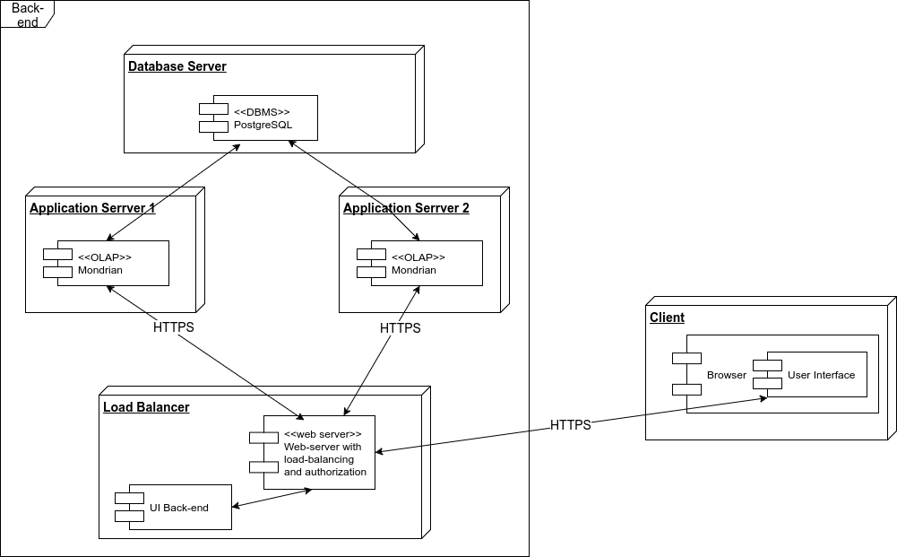
What's in an Architecture?
A (system) architecture, is just the way different software components are distributed on computers, and the way in which they interact with each other
Architectures are often difficult to describe in words, hence diagrams are often used. Many ways to document them, e.g. UML, …

Slide 4
Service-oriented Architectures?
When an architecture is completely contained within the same machine, components can communicate directly, e.g. through function calls or object instantiations.
However, when components are distributed such a direct approach typically cannot be used (e.g. Assignment 2!)
Therefore, components (more properly, systems) have to interact in more loosely-coupled ways.
Services are often used for this. Typically combinations and commonality of services can be used to form a Service-oriented Architecture (SoA).

Slide 5
SOA Core Goals
A Service-oriented Architecture can serve many goals:
  A set of externally facing services that a business wants to provide to external collaborators
  An architectural pattern based on service providers, one or more brokers, and service requestors based on agreed service descriptions
  A set of architectural principles, patterns and criteria that support modularity, encapsulation, loose coupling, separation of concerns, reuse and composability
  A programming model complete with standards, tools and technologies that supports development and support of services (note that there can be many flavours of services)
  A middleware solution optimized for service assembly, orchestration, monitoring, and management, e.g. as workflows.

Slide 6
SOA Design Principles
Standardized service contract: Services adhere to a communications agreement, as defined collectively by one or more service-description documents.
Service loose coupling: Services maintain a relationship that minimizes dependencies and only requires that they maintain an awareness of each other.
Service abstraction: Beyond descriptions in the service contract, services hide logic from the outside world.
Service reusability: Logic is divided into services with the intention of promoting reuse.
Service autonomy: Services have control over the logic they encapsulate.
Service statelessness: Services minimize resource consumption by deferring the management of state information when necessary.
Service discoverability: Services are supplemented with communicative meta data by which they can be effectively discovered and interpreted.
Service composability: Services are effective composition participants, regardless of the size and complexity of the composition.

Slide 7
SOA Design Principles…ctd
Service granularity: a design consideration to provide optimal scope at the right granular level of the business functionality in a service operation.
Service normalization: services are decomposed and/or consolidated to a level that minimizes redundancy, for performance optimization, access, and aggregation.
Service optimization: high-quality services that serve specific functions are generally preferable to general purpose low-quality ones.
Service relevance: functionality is presented at a level of granularity recognized by the user as a meaningful service.
Service encapsulation: many services are consolidated for use under a SOA and their inner workings hidden.
Service location transparency: the ability of a service consumer to invoke a service regardless of its actual location in the network.

Slide 8
SOA for the Web: Web Services
Web services used to implement service-oriented architectures
Two main flavours
  SOAP-based Web Services
  ReST-based Web Services
Both use HTTP, hence can run over the web
  (although SOAP/WS often run over other protocols as well)
There are MANY other flavours of web service:
  Geospatial services (WFS, WMS, WPS…)
  Health services (HL7)
  SDMX (Statistical Data Markup eXchange)

Slide 9
SOAP/WS vs ReST
Two patterns to call services over HTTP
  SOAP/WS is built upon the Remote Procedure Call paradigm;
    a language independent function call that spans another system
  ReST is centered around resources, and the way they can be manipulated (added, deleted, etc.) remotely
    (Examples later)
  Actually ReST is more of a style to use HTTP than a separate protocol
  ...while SOAP/WS is a stack of protocols that covers every aspect of using a remote service, from service discovery, to service description, to the actual request/response

Slide 10
WSDL
The Web Services Description Language (WSDL) is an XML-based interface description language that describes the functionality offered by a web service.
WSDL provides a machine-readable description of how the service can be called, what parameters it expects, and what results/data structures it returns:
  Definition – what it does
  Target Namespace – context for naming things
  Data Types – simple/complex data structures inputs/outputs
  Messages – messages and structures exchanged between client and server
  Port Type - encapsulate input/output messages into one logical operation
  Bindings - bind the operation to the particular port type
  Service - name given to the web service itself
  Language independence and location transparency…
WSDL
.NET Server
C++ client

Slide 11
Simple WSDL Example
<binding name = "Hello_Binding" type = "tns:Hello_PortType">
<soap:binding style = "rpc"
transport = "http://schemas.xmlsoap.org/soap/http"/>
<operation name = "sayHello">
<soap:operation soapAction = "sayHello"/>
<input>
<soap:body
encodingStyle="http://schemas.xmlsoap.org/soap/encoding/"
namespace="urn:examples:helloservice"
use = "encoded"/>
</input>
<output>
<soap:body
encodingStyle=http://schemas.xmlsoap.org/soap/encoding/"
namespace = "urn:examples:helloservice"
use = "encoded"/>
</output>
</operation>
</binding>
<service name = "Hello_Service">
<documentation>WSDL File for HelloService</documentation>
<port binding = "tns:Hello_Binding" name = "Hello_Port">
<soap:address
location = "http://www.examples.com/SayHello/" />
</port>
</service>
</definitions>
<definitions name = "HelloService"
targetNamespace = "http://www.examples.com/wsdl/HelloService.wsdl"
xmlns = "http://schemas.xmlsoap.org/wsdl/"
xmlns:soap = "http://schemas.xmlsoap.org/wsdl/soap/"
xmlns:tns = "http://www.examples.com/wsdl/HelloService.wsdl"
xmlns:xsd = "http://www.w3.org/2001/XMLSchema">
<message name = "SayHelloRequest">
<part name = "firstName" type = "xsd:string"/>
</message>
<message name = "SayHelloResponse">
<part name = "greeting" type = "xsd:string"/>
</message>
<portType name = "Hello_PortType">
<operation name = "sayHello">
<input message = "tns:SayHelloRequest"/>
<output message = "tns:SayHelloResponse"/>
</operation>
</portType>
Note
  SOAP for exchange of structured information
  Specific names for operations
  Specific data types
  Specific bindings
  …

Slide 12
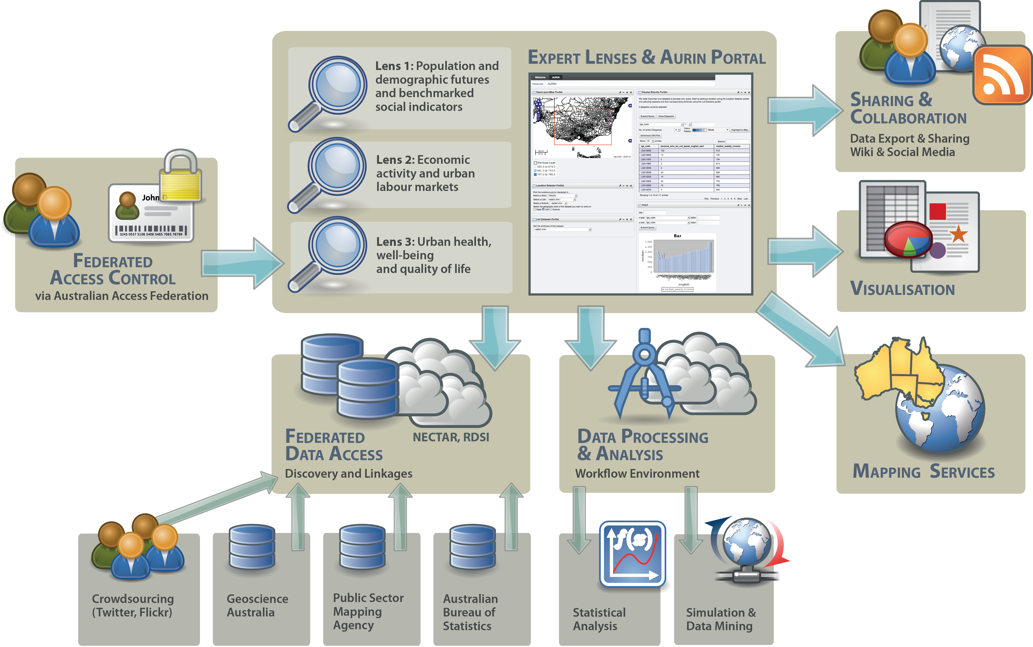
Remembering AURIN Simplified

Slide 13
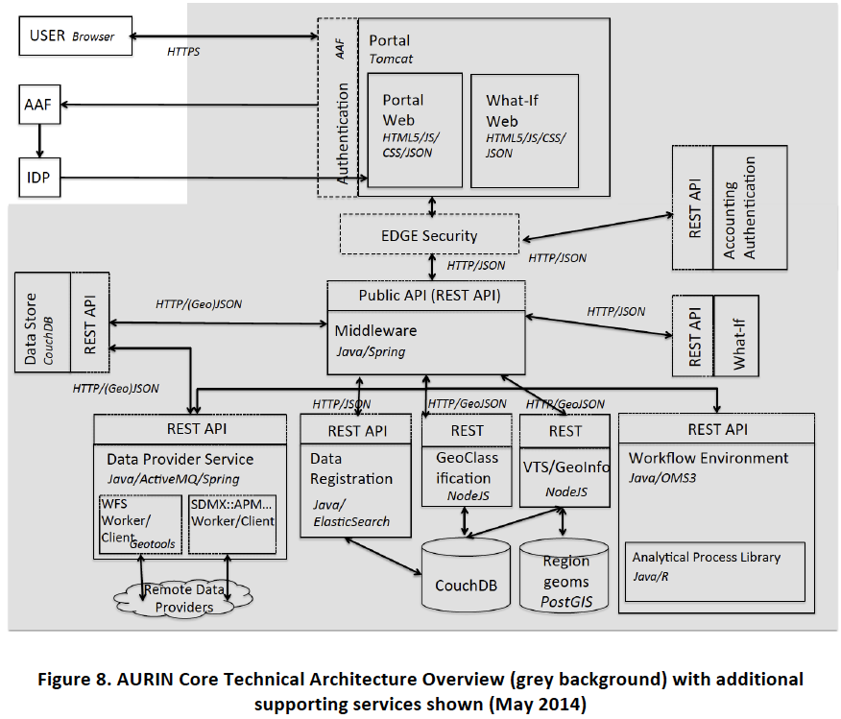
Example of AURIN SoA

Slide 14
Lecture 6.2 – ReST-based Services
Notes:
The University of Melbourne
MELBOURNE RESEARCH
www.research.unimelb.edu.au

Slide 15
What is ReST?
"Representational State Transfer (ReST) is intended to evoke an image of how a well-designed Web application behaves: a network of web pages (a virtual state-machine),
where the user progresses through an application
by selecting links (state transitions), resulting in the
next page (representing the next state of the application) being transferred to the user and rendered for their use."
- Roy Fielding

Slide 16
What's in a Name?
Clients requests Resource through Identifier (URL)
Server/proxy sends representation of Resource
This puts the client in a certain state.
Representation contains URLs allowing navigation.
Client follows URL to fetch another resource.
This transitions client into yet another state.
Representational State Transfer!
Resource
Client
http://amazon.com/product/123
Product.html

Slide 17
Resource-Oriented Architecture (ROA)
A ROA is a way of turning a problem into a RESTful web service: an arrangement of URIs, HTTP, and XML that works like the rest of the Web
A resource is anything that’s important enough to be referenced as a thing in itself.
If your users might
  - want to create a hypertext link to it
  - make or refute assertions about it
  - retrieve or cache a representation of it
  - include all or part of it by reference into another representation
  - annotate it
  - or perform other operations on it
  ...then you should make it a resource.

Slide 18
Resource and URL Examples
Resource | Potential URL
Version 1.0.3 of the software release | http://www.example.com/softwar e/releases/1.0.3.tar.gz
The latest version of the software release | http://www.example.com/software/releases/latest.tar.gz
The first weblog entry for October 24, 2006 | http://www.example.com/weblog/2006/10/24/0
A road map of Little Rock, Arkansas | http://www.example.com/map/roads/USA/AR/Little_Rock
Some information about jellyfish | http://www.example.com/wiki/Jellyfish
A list of the open bugs in the bug database | http://www.example.com/bugs/by-state/open
The relationship between two acquaintances, Alice and Bob | http://www.example.com/relationships/Alice;Bob

Slide 19
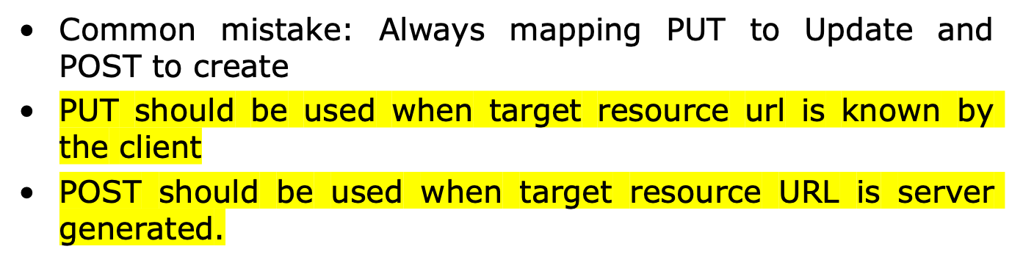
Mapping Actions to HTTP Methods
ACTION | HTTP METHOD
Create Resource | PUT to a new URI POST to an existing URI
Retrieve Resource | GET
Update Resource | POST to an existing URI
Delete Resource | DELETE

Slide 20
A Generic ROA Procedure
Figure out the data set
Split the data set into resources and for each kind of resource
Name the resources with URIs
Expose a subset of the uniform interface
Design the representation(s) accepted from the client
Design the representation(s) served to the client
Integrate this resource into existing resources, using hypermedia links and forms
Consider the typical course of events: what’s supposed to happen?
Consider error conditions: what might go wrong?

Slide 21
ReST Best Practices #1
Keep your URIs short – and create URIs that don’t change.
URIs should be opaque identifiers that are meant to be discovered by following hyperlinks, not constructed by the client.
Use nouns, not verbs in URLs
Make all HTTP GETs side-effect free. Doing so makes the request "safe".
Use links in your responses to requests! Doing so connects your response with other data. It enables client applications to be "self-propelled". That is, the response itself contains info about "what's the next step to take". Contrast this to responses that do not contain links. Thus, the decision of "what's the next step to take" must be made out-of-band.

Slide 22
ReST Best Practices #2
6) Minimize the use of query strings. For example:
Prefer:
http://www.amazon.com/products/AXFC
Over:
http://www.amazon.com/products?product-id=AXFC
7) Use HTTP status codes to convey errors/success
200 OK
201 Created
202 Accepted
203 Non-Authoritative
No Content
Reset Content
Partial Content
300 Multiple Choices
301 Moved Permanently
400 Bad Request
401 Unauthorized
402 Payment Required
403 Forbidden
404 Not Found
405 Method Not Allowed
406 Not Acceptable
407 Proxy Auth Required
408 Request Timeout
409 Conflict
500 Internal Server Error
501 Not Implemented
502 Bad Gateway
503 Service Unavailable
504 Gateway Timeout
505 Version Not Supported

Slide 23
ReST Best Practices #3
8) In general, keep the REST principles in mind.
In particular:
  Addressability
  Uniform Interface
  Resources and Representations instead of RPC
  HATEOAS

Slide 24
ReST – Uniform Interface
Uniform Interface has four more constraints:
Identification of Resources
  All important resources are identified by one (uniform) resource identifier mechanism (e.g. HTTP URL)
Manipulation of Resources through representations
  Each resource can have one or more representations. Such as application/xml, application/json, text/html, etc. Clients and servers negotiate to select representation.
Self-descriptive messages
  Requests and responses contain not only data but additional headers describing how the content should be handled. Such as if it should be cached, authentication requirements, etc. Access methods (actions) mean the same for all resources (universal semantics)
(HTTP GET, HEAD, OPTIONS, PUT, POST, DELETE, CONNECTION, TRACE, PATCH)

Slide 25
ReST – Uniform Interface - HATEOAS
HATEOAS – Hyper Media as the Engine of Application State
Resource representations contain links to identified resources
Resources and state can be used by navigating links
  - links make interconnected resources navigable
  - without navigation, identifying new resources is service-specific
RESTful applications navigate instead of calling
  - representations contain information about possible traversals
  - application navigates to the next resource depending on link semantics
  - navigation can be delegated since all links use identifiers

Slide 26
Making Resources Navigable
Essential for using Hypermedia Driven Application State
RPC-oriented systems need to expose the available functions
  - functions are essential for interacting with a service
  - introspection or interface descriptions make functions discoverable
ReSTful systems use a Uniform Interface
  - no need to learn about functions
  - but how to find resources?
  - find them by following links from other resources
  - learn about them by using URI Templates
  - understand them by recognizing representations

Slide 27
HTTP Methods
HTTP methods can be
  Safe
  Idempotent
  Neither
Safe methods
  Do not change repeating a call is equivalent to not making a call at all.
Idempotent methods
  Effect of repeating a call is equivalent to making a single call
GET, OPTIONS, HEAD – Safe
PUT, DELETE – Idempotent
POST – Neither safe nor idempotent

Slide 28
Demonstration

Slide 29
References
Restful Web Services, Leonard Richardson and Sam Ruby, 2007, O'Reilly.
Architectural Styles and the Design of Network-based Software Architectures. Fielding, Roy Thomas, UC - Irvine, 2000.

