Slide 1
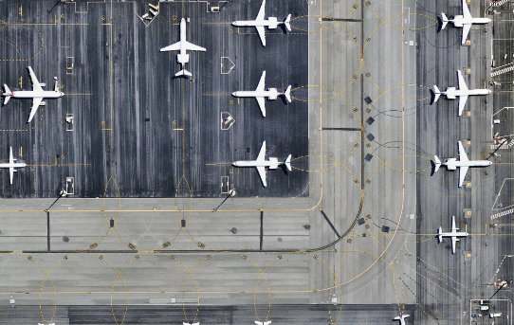
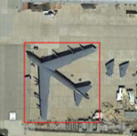
Text based on full chip
Text based on detection
Hypothesis
We can use models that generate captions or text for images to make object detection more robust
Questions/Experiments
Can we use image-to-text models to enhance object detection
Generate object detection results
Typical metrics
Generate image-to-text results
Bag of word / clustering / other to get metrics for TP/FP/FN/TN
Object detection results + image-to-text results
Does this enhance or make object detection worse?
Are image-to-text models susceptible to adversarial attacks in the same way as object detection models?
Generate adversarial images
Analyze impacts to object detection and image-to-text outputs
Large Input Image
Large Input Image
Model
Model
Image to Text
Model
An Airport with Planes
Image to Text
Model
A Plane

Slide 2
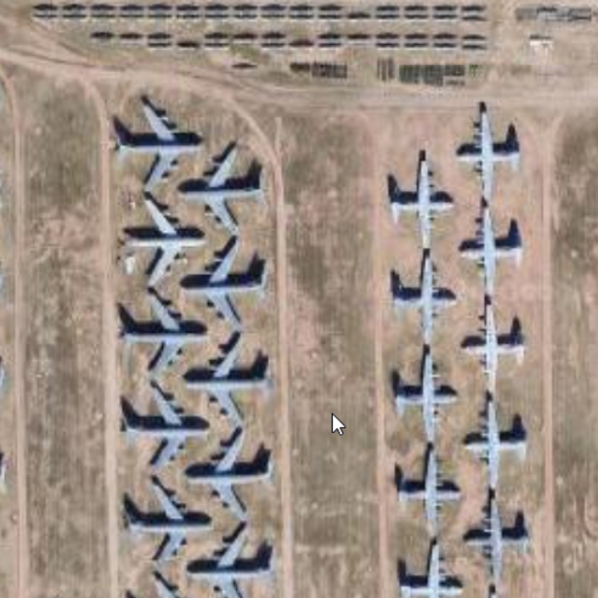
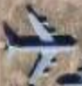
a photograph of a large group of airplanes parked in a field
a photograph of a plane is flying over a field of grass there is a small plane that is flying in the sky
Resources
https://huggingface.co/Salesforce/blip-image-captioning-large
https://arxiv.org/pdf/2303.17249
https://jair-neto.medium.com/a-powerful-method-for-explainability-of-object-detection-algorithms-ace0fe4623e7

