Slide 1
From Word2Vec to Code Migration Liu Qiming Li Ke

Slide 2
Contents
The idea of Word2Vec
Applications of Word2Vec
Notes:
2

Slide 3
1. The idea of Word2Vec
i.e. Representing words as discrete symbols
Words can be represented by one-hot vectors: motel = [0 0 0 0 0 0 0 0 0 0 1 0 0 0 0] hotel = [0 0 0 0 0 0 0 1 0 0 0 0 0 0 0]
Notes:
3

Slide 4
Representing words as discrete symbols
Words can be represented by one-hot vectors: motel = [0 0 0 0 0 0 0 0 0 0 1 0 0 0 0] hotel = [0 0 0 0 0 0 0 1 0 0 0 0 0 0 0]
Drawbacks: Vector dimension = number of words in vocabulary (e.g., 500,000)
Pairwise orthogonal
Notes:
4

Slide 5
Word2Vec
Dense vector for word embedding
# of Dimensions << |Vocabulary|
Notes:
5

Slide 6
Word2Vec
Dense vector for word embedding
# of Dimensions << |Vocabulary|
In BERT, a float32 tensor of shape (768, )
= 3kB
Benefits:
Allow us to calculate similarity between words
And much more!
Notes:
6

Slide 7
An impression of Word2Vec
[-7.92340040e-02 4.97796200e-03 -8.23487282e-01 5.17381579e-02 -3.13413590e-01 3.31664503e-01 -4.70242426e-02 8.89038324e-01 -4.35647935e-01 -5.54904103e-01 ······]
First ten float numbers in the last hidden layer, when ‘computer organization and design’ is put in to BERT(uncase base)
BERT, Bidirectional Encoder Representations from Transformers
A milestone in Natural Language Processing community, most evolved derivative of Word2Vec
Notes:
7

Slide 8

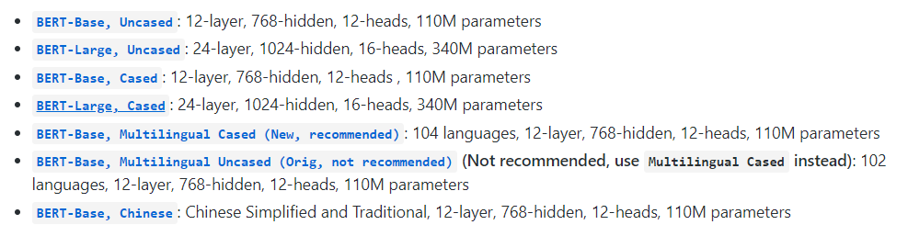
Word2Vec-Bert
Trained on TPUs for four days
16 64
Notes:
8

Slide 9
Word2Vec
cat -- 0.11996692419052124 – dog
cat -- 0.14831775426864624 – wood
cat -- 0.1980501413345337 – motorcycle
cat -- 0.23616260290145874 – computer
cat -- 0.3551083207130432 – philosophy
cat -- 0.4030646085739136 – ‘The Abyssinian is a breed of domestic short-haired cat with a distinctive ticked tabby coat, in which individual hairs are banded with different colors.’
Notes:
9

Slide 10
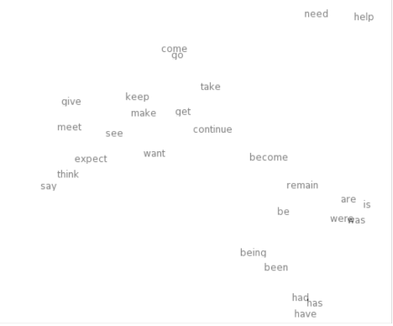
Word2Vec visualization
Similar words’ embeddings concentrate
An Improved Model of Semantic Similarity Based
on Lexical Co-Occurrence
(Communications of the Acm 2015)
Notes:
10

Slide 11
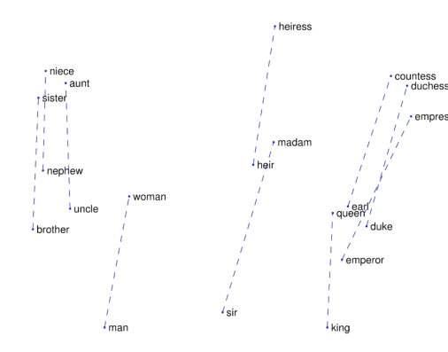
Word2Vec visualization
Lines connecting word pairs of opposite gender
GloVe: Global Vectors for Word Representation
(EMNLP 2014)
Notes:
11

Slide 12
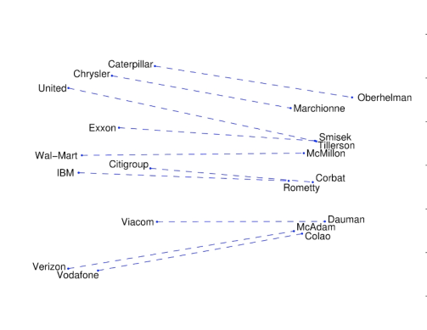
Word2Vec visualization
Lines connecting companies and their CEO
GloVe: Global Vectors for Word Representation
(EMNLP 2014)
Notes:
12

Slide 13
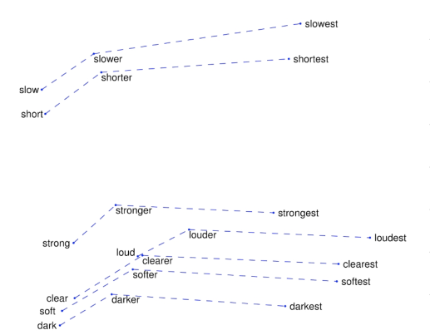
Word2Vec visualization
Original-comparative-superlative triples
GloVe: Global Vectors for Word Representation
(EMNLP 2014)
Notes:
13

Slide 14



Further reading
BERT: Pre-training of Deep Bidirectional Transformers for Language Understanding
BERT: Pre-training of Deep Bidirectional Transformers for Language Understanding
Attention is all you need
Adversarial Domain Adaptation for Duplicate Question Detection
Notes:
14

Slide 15
?
Question
Besides natural language, where else can Word2Vec be applied?
Notes:
15

Slide 16


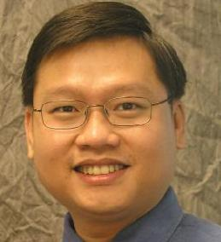
Application of Word2Vec
Trong Duc Nguyen
trong@iastate.edu
Anh Tuan Nguyen
anhnt@iastate.edu
Tien N. Nguyen
tien@iastate.edu
Mapping API Elements for Code Migration with Vector Representations
Iowa State University, USA http://home.eng.iastate.edu/~trong/projects/jv2cs/

Slide 17
Characterize API by its surrounding APIs
HashMap<String, Integer> dict = new HashMap<String, Integer>();
dict.put("A", 1);
FileWriter writer = new FileWriter("Vocabulary.txt");
for (String vocab : dict.keySet()) {
writer.append(vocab + " " + dict.get(vocab) + "\r\n");
}
writer.close();
Notes:
17

Slide 18


API Mapping
String
Integer
HashMap.put()
HashMap.keySet()
string
int
Dictionary.Add()
Dictionary.Keys
C#
Notes:
18

Slide 19
Key Insight
Characterize APIs by their usages instead of APIs’ names
API usages consist of the surrounding API elements
Derive API pairs based on the relation between them
Notes:
19

Slide 20
Key idea
ALU
Module ALU
CPU
Module Alu_control
Module Mips_cpu
Module CPU_control
Notes:
20

Slide 21
Approach
Java Code corpus
Java API sequences
Java API vector
Sequence Extraction
Java Word2Vec Modeling
</>
API
API
API
API
API
API
API
API
API
API
API
API
C# Code corpus
C# API vector
C# API sequences
Sequence Extraction
C# Word2Vec Modeling
</>
API
API
API
API
API
API
API
API
API
API
API
API
Notes:
21

Slide 22
Approach
Java to C#
Transformation Matrix
Java API vector
Java Word2Vec Modeling
Java APIs
Transformation Module
C# Word2Vec Modeling
C# APIs
$$d_{2}×d_{1}$$
C# API vector

Slide 23
Approach
Java to C#
Transformation Matrix
Java API vector
C# API vector
Java API
C# API
Notes:
23

Slide 24
Empirical Study
Goal:
The vector representation capture the relationship between API
The accuracy of mining the API mapping pairs
Data collection:
 | # Projects | # Classes | # Methods | # LOCs | #Vocab size
Java Dataset | 14,807 | 2.1 M | 7 M | 352 M | 123 K
C# Dataset | 7,724 | 900 K | 2.3 M | 292 M | 130 K
276 mapping pairs between Java APIs and C# APIs
Extracted from rule-based migration tool Java2CSharp http://sourceforge.net/projects/j2cstranslator/

Slide 25
API Mapping
80 %
Top 5 Accuracy
53 %
Top 1 Accuracy
Notes:
25

Slide 26

Application

Slide 27
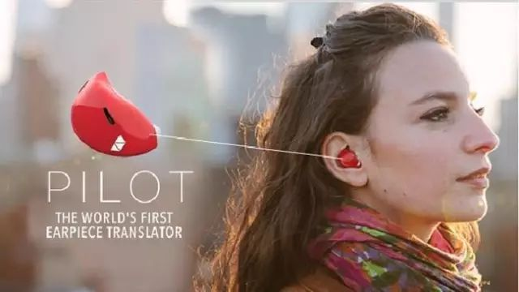
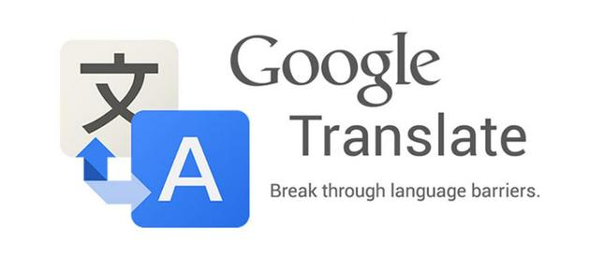
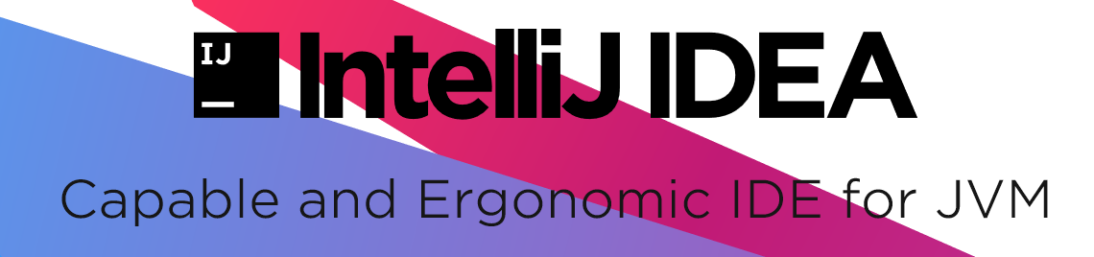

Slide 28
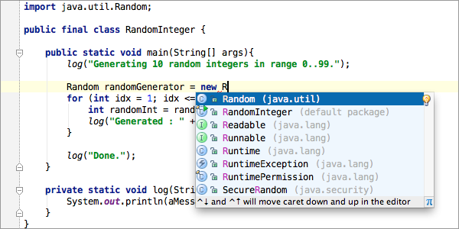

Slide 29
Takeaways
Word2Vec utilizes dense vectors to present each unique word to represent its linguistic information.
Besides natural language, Word2Vec could also be used in programming languages.

Slide 30
Thank you!

