Slide 1
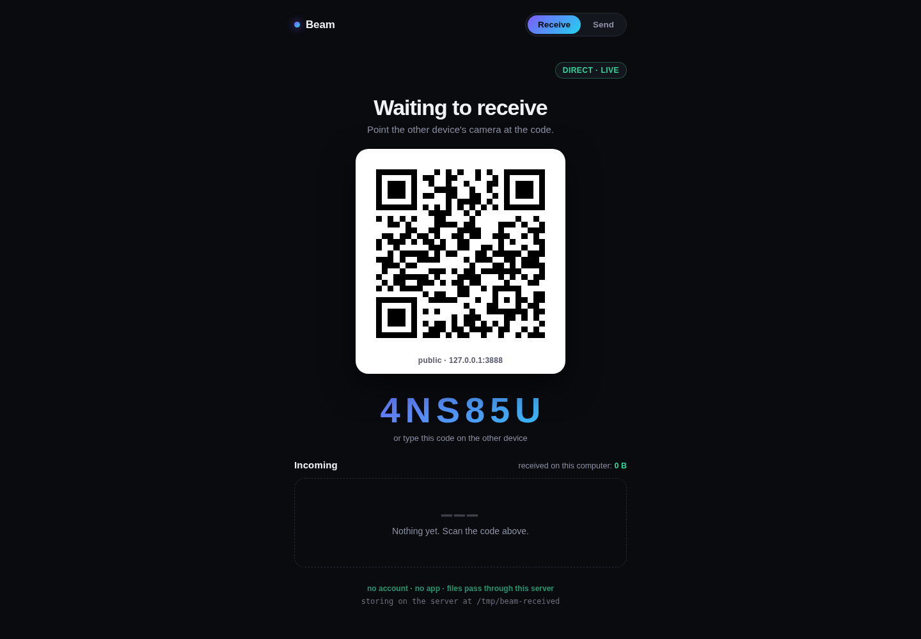
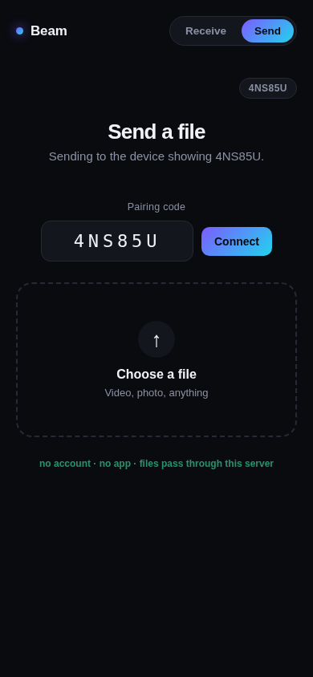
BEAM
Send a file to a computer running Beam. Scan a code or type one. No sender account, no sender app.
Sender needs only a browser | Receiver runs the Beam server (Node.js)
Dublin HacX
Notes:
Beam is a browser-based file transfer: QR or six-character code, no account and no app install.

Slide 2
THE PROBLEM
Mixed-device file sharing is still awkward
01
02
03
Pairing is the hard part
Mixed-device friction
Alternatives add steps
Sending bytes is easy. Getting two unrelated devices to find each other is where it falls apart.
A phone and a laptop from different makers often need a workaround to share one file.
Email, chat apps and cloud drives need an account, an app or a round trip through a service.
Beam aims for pairing with almost no thought: scan or type a code, then send.
Beam | Dublin HacX
Notes:
Frame as a familiar friction. No statistics are claimed.

Slide 3
HOW IT WORKS
Pair, send, receive: no sender setup
1
Start the receiver
2
Pair
3
Send
Run the Beam server (Node.js) on the receiving computer, reachable on the network by the other device. Open it: QR code and 6-character code appear.
On the sending device, scan the QR with the camera, or type the code on the Send tab. A browser is enough.
Choose a file. It uploads in chunks and appears on the receiver with live progress.
Two computers? Both computers open the same Beam server. Each screen has Receive and Send tabs, so one can show a code and the other can type it, with no camera. Connect checks the code with the server before you pick a file, so a typo fails immediately.
Beam | Dublin HacX
Notes:
Receive screen shows QR and code. Sender opens the link or types the code, picks a file.

Slide 4
LIVE PRODUCT
The receiving screen and the sending screen
Phone width view, paired to the code shown on the left
Receiver: QR, code, incoming list
Beam | Dublin HacX
Notes:
Captured from the running app in Chromium on one machine (localhost). Not a two-device or cross-network capture.

Slide 5
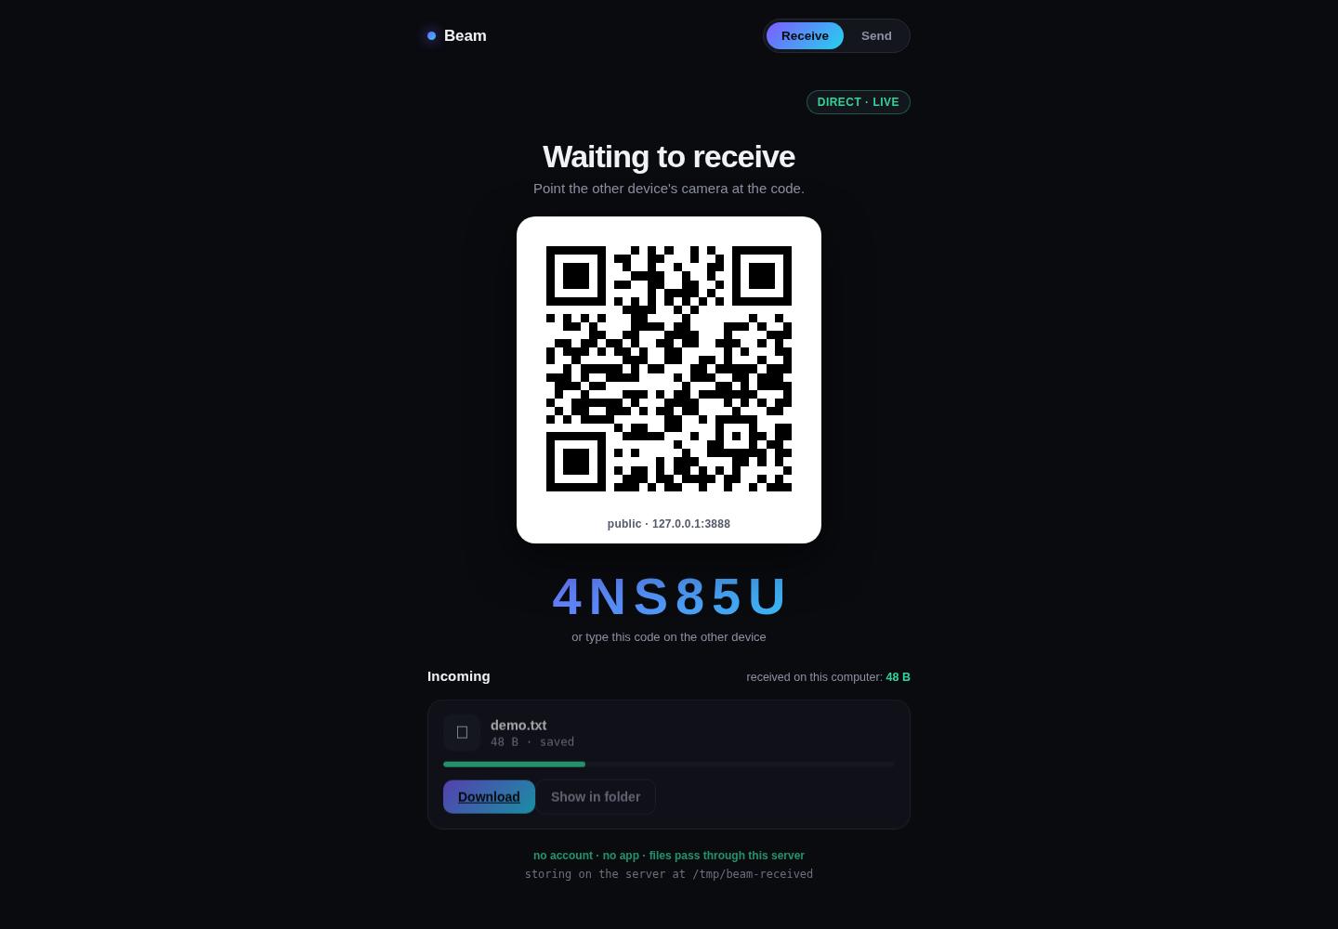
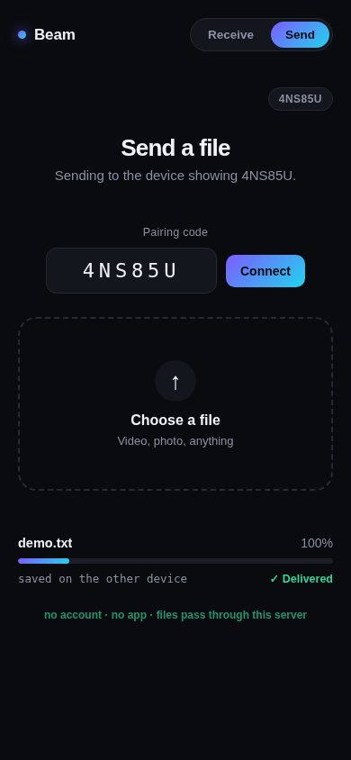
LIVE PRODUCT
A file goes in one side and lands on the other
Sender shows Delivered
Receiver: demo.txt saved, Download and Show in folder
Beam | Dublin HacX
Notes:
Test file demo.txt, 48 bytes; on-disk bytes verified equal to the source. Single-machine browser run.

Slide 6
TECHNICAL EXECUTION
Built to finish the transfer, not just start it
5 MB chunks, pipelined
Live progress
Safe filenames
Uploads go up in 5 MB chunks with several in flight at once, written at fixed offsets.
The receiver is updated through server-sent events (SSE). The sender’s progress comes from its own browser upload events.
Directory parts and characters that break paths are stripped; names are capped at 180 characters.
Short-lived sessions
Size cap
Image previews
Codes use 6 random characters from an alphabet without look-alikes. Sessions expire after 10 minutes.
A configurable limit, 2 GB by default, rejects oversized files before upload.
Image files get a thumbnail on the receiver. SVG is excluded from previews.
Beam | Dublin HacX
Notes:
All items below are read from the current source (server.js, public/app.js).

Slide 7
COMPLETENESS AND HONESTY
What we tested, and what we didn’t
Verified
Not yet verified
52 of 54 automated socket tests pass
Byte-exact chunked upload, including scrambled chunk order
SSE progress, download, image previews, filename safety
Browser run: QR and code created, phone-width send page opened, file delivered, bytes equal on disk
Unknown code rejected; valid code accepted in lower case
2 tests need a LAN network interface, absent in our test environment
Run was on one machine, not two physical devices
No real camera scan of the QR yet
No cross-network or tunnel test
Files pass through the server; no end-to-end encryption claim
Beam | Dublin HacX
Notes:
Do not overstate: loopback single-machine run, not physical phones. 2 failures are environment-only (no LAN interface in test container).

Slide 8
RUBRIC
How Beam maps to the judging criteria
Criterion | Pts | Our case
Technical execution | 20 | Chunked pipelined upload, live progress, path-safe names, size cap, session expiry, 52/54 tests
Innovation & Creativity | 15 | QR transfer is an existing category; our angle is account-free browser sending with a computer-controlled receiver and code fallback
Impact & Usefulness | 20 | A familiar problem with plausible users; fewer steps for the sender. Demand is not measured
Completeness & Working Demo | 15 | Real browser upload, saved file, bytes verified. Browser simulation, not physical phones
Design & UX | 10 | One screen per role, dark UI, large code, state always visible
Presentation | 10 | Live demo of the real flow; limits stated plainly
Judge’s Preference | 10 | Personal pick; our part is a direct, easy-to-follow demo
Beam | Dublin HacX
Notes:
Rubric: General Podium from the Dublin HacX doc. This is our argument with evidence, not a predicted score. Points: Tech 20, Innovation 15, Impact 20, Completeness 15, Design 10, Presentation 10, Judge preference 10.

Slide 9
Scan. Send. Done.
Browser-based sending: no sender account, no sender app. Runs from a Node.js server on the receiving computer.
github.com/the-X-alien/beam
Dublin HacX

