Slide 1
Reliability and Channel Coding

Slide 2
Transmission Errors
External electromagnetic signals can cause incorrect delivery of data
Data can be received incorrectly
Data can be lost
Unwanted data can be generated
Any of these problems are called transmission errors
Three main sources of transmission errors
Interference
Distortion
Attenuation

Slide 3
The main sources - Interference
Electromagnetic radiation – electric motors
background cosmic radiation – natural environment
Can disturb radio transmissions and signals traveling across wires

Slide 4
The main sources - Distortion
All physical systems distort signals
As a pulse travels along an optical fiber, the pulse disperses
Wires have properties of capacitance and inductance
large metal object affect the set of passable frequencies - can block some frequencies of radio waves

Slide 5
The main sources - Attenuation
As a signal passes across a medium, the signal becomes weaker
Signals become weaker over long distances

Slide 6
Approaches to reduce errors
Shannon's Theorem:
increase the signal-to-noise ratio
By increasing the signal or
By lowering noise
Shielded wiring
Noise/interference cannot be eliminated completely
transmission errors can be detected
Some errors can be corrected automatically
Error detection adds overhead
Error handling is a tradeoff, system designers
must decide whether a given error is likely to occur
Analyze the consequences

Slide 7
Effect of Transmission errors on data
Single bit error: often caused by very short-duration interference
Burst Error: multiple bits in a block of bits are changed – often caused by long-duration interference
Erasure (ambiguity): does not clearly correspond to either a logical 1 or a logical 0 – often caused by distortion or interference

Slide 8
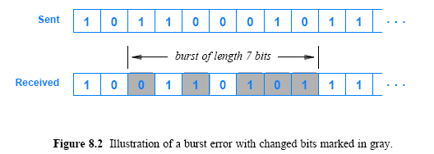
Effect or Transmission errors on data cont’
For a burst error, the burst size, or length, is defined as the number of bits from the start of the corruption to the end of the corruption
Figure 8.2 illustrates the definition

Slide 9
Two Strategies for Handling Channel Errors
Channel Coding
mathematical techniques designed to overcome errors during transmission and increase reliability
Two broad categories:
Forward Error Correction (FEC) mechanisms
Automatic Repeat reQuest (ARQ) mechanisms
The basic idea of FEC
add additional information to data to verify that data arrives correctly and to correct errors, if possible

Slide 10
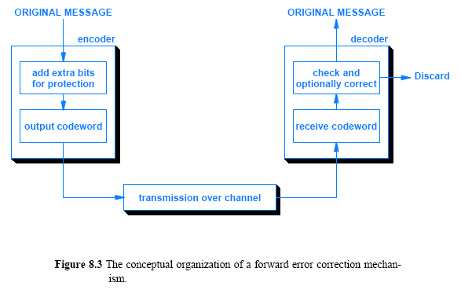
Two Strategies for Handling Channel Errors cont’

Slide 11
Block and Convolutional Error Codes
The two types of FEC techniques satisfy separate needs:
Block Error Codes
It divides the data to be sent into a set of blocks
It attaches redundancy to each block
the encoding mechanism does not carry state information across blocks -> no memory required
Convolutional Error Codes
It treats data as a series of bits, and computes a code over a continuous series
the code computed for a set of bits depends on
the current input and some of the previous bits in the stream
Convolutional codes need memory

Slide 12
Error detection and correction
Error detection –
Send additional information so incorrect data can be detected and rejected (Automatic Repeat reQuest (ARQ) mechanism)
Determine changed bits exactly and to compute correct values
Error correction –
Send additional information so incorrect data can be corrected and accepted ( Forward Error Correction (FEC) mechanism)
Sender and receiver exchange messages to insure that all data arrives correctly

Slide 13
Parity checking
Parity refers to the number of bits set to 1 in the data item
Even parity - an even number of bits are 1
Odd parity - an odd number of bits are 1
A parity bit is an extra bit transmitted with a data item, chose to give the resulting bits even or odd parity

Slide 14
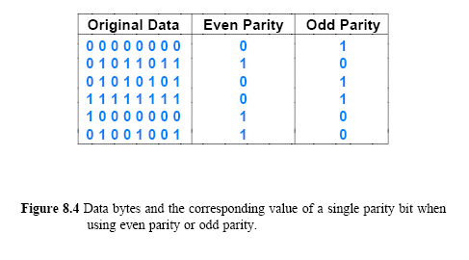
Example

Slide 15
The Mathematics of Block Error Codes and (n, k) Notation
Mathematically
we define the set of all possible messages to be a set of datawords -> k
and define the set of all possible encoded versions to be a set of codewords -> n
(n, k) encoding scheme
where n = k + r, r is additional bits
Error detection utilizes 2 valid codewords
The valid subset is known as a codebook

Slide 16
Example: Valid codewords
Consider 3 bit data with even parity
n = k + r = 3 + 1
0000
0011
0101
0110
1001
1010
1100
1111
out of 16 possible codewords, only 8 is valid

Slide 17
Hamming Distance
Given two strings of n bits each, the Hamming distance is defined as the number of differences
Exclusive OR can compute Hamming Distance
Example:
The XOR of the two strings is
110 + 011 = 101 => 2
d(000, 001) = 1, d(000, 101) = 2
d(101,100) = 1, d(001, 010) = 2

Slide 18
Hamming Distance cont’
When errors transform a valid codeword into another valid codeword
Use of Hamming distance
Consider Figure 8.6 that lists the four (4) possible datawords and Hamming distance
minimum Hamming distance, d_{min}
Determines the number of bit errors that can cause such transformation

Slide 19
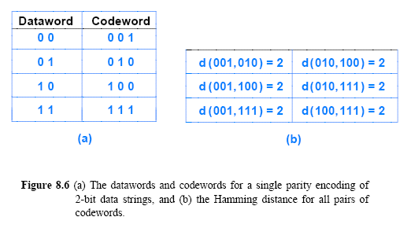
Hamming Distance cont’

Slide 20

The Tradeoff Between Error Detection and Overhead
A large value of d_{min} is desirable
fewer than d_{min} bits are changed -> error(s) occurred
the maximum number of bit errors, e, can be computed as:
A code with a higher value of d_{min} sends more redundant information than an error code with a lower value of d_{min}
Code rate R can be computed as:

Slide 21
Minimum Hamming Distance
The minimum Hamming distance for a code, D(min), determines its error detecting and error correcting capability.
For any code word, X, to be interpreted as a different valid code word, Y, at least D(min) single-bit errors must occur in X.
Thus, to detect k (or fewer) single-bit errors, the code must have a Hamming distance of D(min) = k + 1.

Slide 22
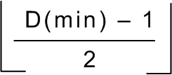
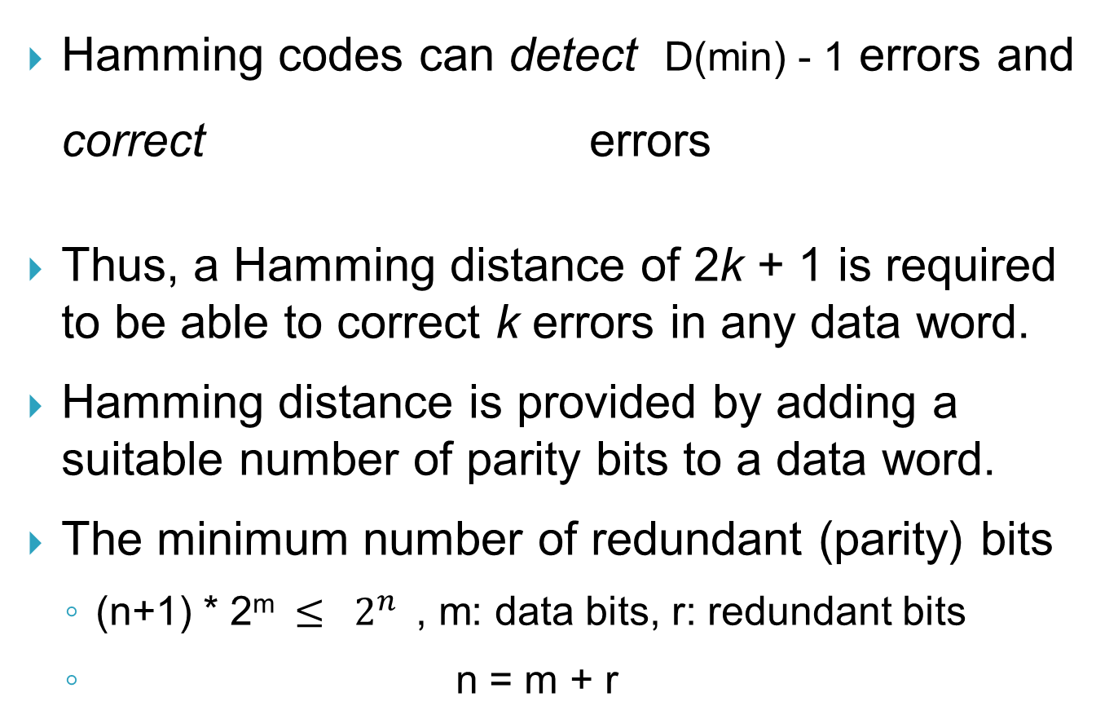
Minimum Hamming Distance cont’
Hamming codes can detect D(min) - 1 errors and correct errors
Thus, a Hamming distance of 2k + 1 is required to be able to correct k errors in any data word.
Hamming distance is provided by adding a suitable number of parity bits to a data word.
The minimum number of redundant (parity) bits
(n+1) * 2^{m} $≤ 2^{n}$, m: data bits, r: redundant bits
n = m + r

Slide 23
Error correction with Row and Column (RAC) parity
1 | 0 | 1 | 1 | 1
0 | 0 | 1 | 0 | 1
1 | 0 | 1 | 0 | 0
0 | 0 | 1 | 1 | 0
1 | 0 | 1 | 1 | 1
0 | 1 | 1 | 0 | 1
1 | 0 | 1 | 0 | 0
0 | 0 | 1 | 1 | 0
A RAC encoding allows a receiver to correct any single bit error
And to detect errors in which two or three bits are changed.

Slide 24
Error correction with Row and Column (RAC) parity cont’
The two disagreements correspond to the row and column position of the error
Correct the error
RAC can correct any single data error
When two or three bits are changed
RAC encoding detects an odd number of errors only

Slide 25
Alternative Error Detection Schemes
Many alternative schemes that:
Detect multi-bit errors
Correct errors through redundant information
Checksum and CRC are two widely used techniques

Slide 26
Checksum
Idea
Sender | Receiver
Adds the given number e.g. number (5, 12, 11, 9) Sum = 37 | Adds the received numbers and compares the result with the sum
The sum is sent in addition to the list of numbers e.g. (5, 12, 11, 9, 37) | If the two are the same, assume no error, else data are not accepted

Slide 27
Checksum con’t
If the sender sends negative (complement) of the sum, the computation would be easy
E.g. sends (5, 12, 11, 9, -37)
The receiver simply adds all the numbers including the checksum.
If the result is 0, no error is assumed
else data is discarded.

Slide 28
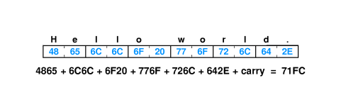
Checksums
Sum of data in message treated as array of integers
Can be 8-, 16- or 32-bit integers
Typically use 1’s-complement arithmetic
Example - 16-bit checksum with 1’s complement arithmetic
The size and easy of computation => requires addition only

Slide 29
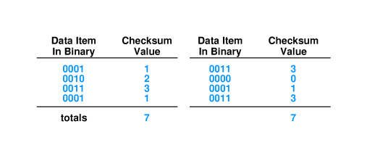
Limitations to checksums
May not catch all errors

Slide 30
Cyclic Redundancy Checks
Detect more errors without increasing additional info in each packet
Consider data in message as coefficients of a polynomial
Divide that coefficient set by a known polynomial e.g. 1011
Example: 1010 = x³ + x (known polynomial) → y
Preprocessing: data bits: m
1. add k zeros to the data → m + k → n
2. divide n with y
3. find remainder → r
4. subtract remainder from n → z
Transmit remainder as CRC
No error if z is divisible by y at the receiver
Easy to implement in hardware

Slide 31
Cyclic Redundancy Checks
Key Properties
Arbitrary Length Message
Excellent Error Detection
Fast Hardware Implementation

Slide 32
Cyclic Redundancy Checks
Modulo 2 arithmetic works like clock arithmetic.
In clock arithmetic, if we add 2 hours to 11:00, we get 1:00.
In modulo 2 arithmetic if we add 1 to 1, we get 0. The addition rules couldn’t be simpler:
0 + 0 = 0 0 + 1 = 1
1 + 0 = 1 1 + 1 = 0

Slide 33
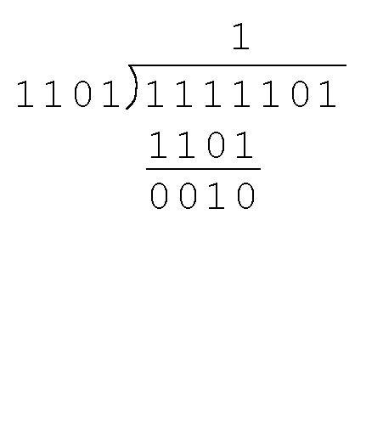
Cyclic Redundancy Checks
Find the quotient and remainder when 1111101 is divided by 1101 in modulo 2 arithmetic.
As with traditional division, we note that the dividend is divisible once by the divisor.
We place the divisor under the dividend and perform modulo 2 subtraction.

Slide 34
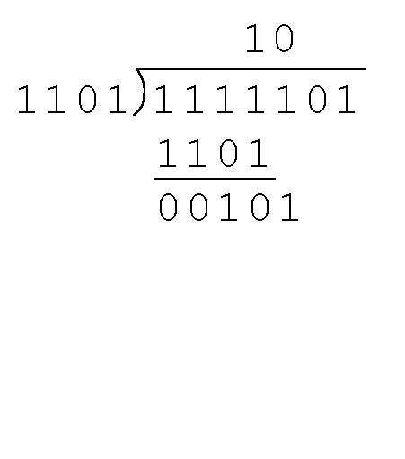
Cyclic Redundancy Checks
Find the quotient and remainder when 1111101 is divided by 1101 in modulo 2 arithmetic…
Now we bring down the next bit of the dividend.
We see that 00101 is not divisible by 1101. So we place a zero in the quotient.

Slide 35
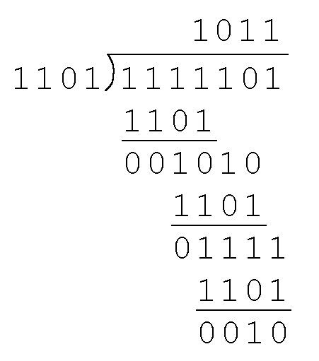
Cyclic Redundancy Checks
Find the quotient and remainder when 1111101 is divided by 1101 in modulo 2 arithmetic…
We find the quotient is 1011, and the remainder is 0010.
This procedure is very useful to us in calculating CRC syndromes.
Note: The divisor in this example corresponds to a modulo 2 polynomial: X 3 + X 2 + 1.

Slide 36
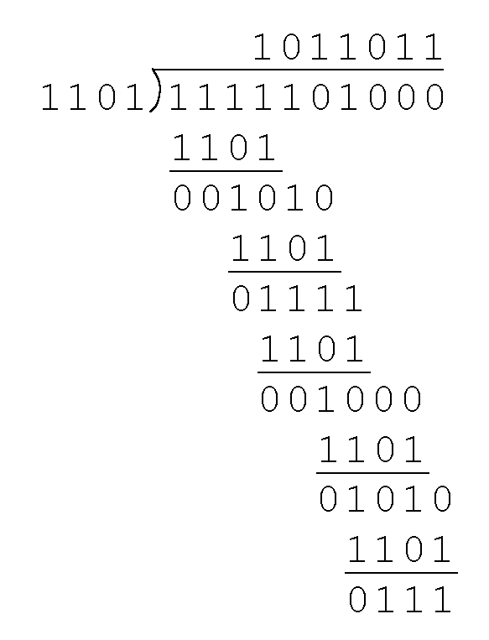
Cyclic Redundancy Checks
Suppose we want to transmit the information string: 1111101.
The receiver and sender decide to use the (arbitrary) polynomial pattern, 1101.
The information string is shifted left by one position less than the number of positions in the divisor.
The remainder is found through modulo 2 division (at right) and added to the information string: 1111101000 + 111 = 1111101111.

Slide 37
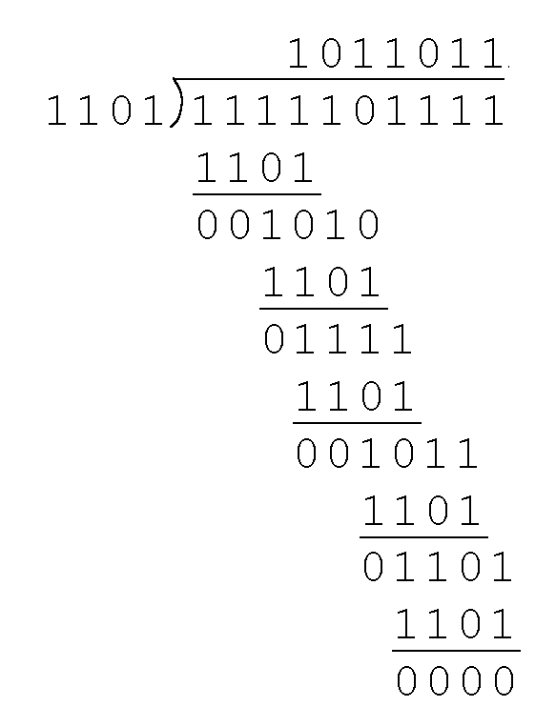
Cyclic Redundancy Checks
If no bits are lost or corrupted, dividing the received information string by the agreed upon pattern will give a remainder of zero.
We see this is so in the calculation at the right.
Real applications use longer polynomials to cover larger information strings.
Some of the standard polynomials are listed in the next slide

Slide 38
Most commonly used CRC Polynomials
CRC-8: 100000111 (9 bits)
CRC-10: 11000110011
CRC-12: 1100000001111
CRC-16: 11000000000000101
CRC-CCITT: 10001000000100001
CRC-32: 100000100110000010001110110110111
CRC-64

Slide 39
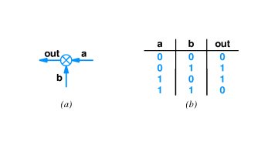
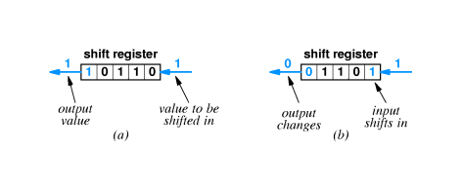
Hardware Components in CRC
XOR
Shift register

Slide 40
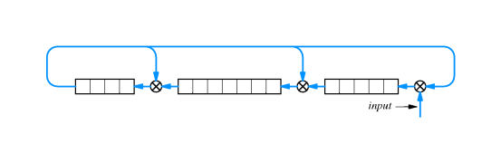
CRC Hardware
K bit shift register -> degree of polynomial
An example that computes 16-bit CRC

Slide 41
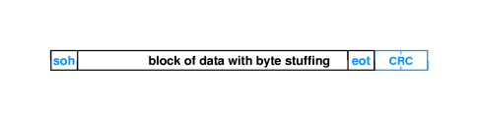
Error Detection and Frames
Error detection typically done for each frame
Error in frame typically causes receiver to discard frame
Example - CRC sent after end of frame computed on data in frame

