Slide 1
Math 263 Discrete Mathematics
Exam 1 is on Thursday 9/28 in class & will cover Sections 2.1-2.3, 3.1-3.2 where problems from 3.1-3.2 will be extra credit.
You are allowed to use a scientific calculator and the reference sheet posted on Blackboard under Review Material/Exam-1.
A review Session will be held on Wednesday 9/27 from
11:00am-1:30pm on Zoom. Please use the “REVEW SESSION EXAM 1 (MATH 263)” link on Zoom.
Review all PHW and Quiz-1-3 solutions posted on Blackboard under “Quizzes, PHW, & Exam Solutions”.
Problems in this review sheet are labeled (1, 2A, 2B, 3A, 3B etc.) such that problems of the same “type” have the same number.

Slide 2
Math 263: Discrete Mathematics
Agenda/Announcements/Reminders:
Dr. Walia Office Hours (on Zoom)
and by appointment.
On T,Th, I’ll also be available in-person in my office YR-353 and might be a few minutes late. On Fridays, I might be able to hold office hours from 3:30-4:30pm if requested ahead of time.
Please go to blackboard, click on “Zoom Meetings”, and then join the Zoom session “Office Hours” for the day. Recordings will be available soon after.
Online Tutoring Center link
Monday | Tuesday | Wednesday | Thursday
2:00-3:00pm | 3:30-4:30pm | 2:00-3:00pm | 3:30-4:30pm

Slide 3
Math 274 Calculus II
Index
Results and Formulae: Slides 04-15
Problems : Slides 16-21

Slide 4
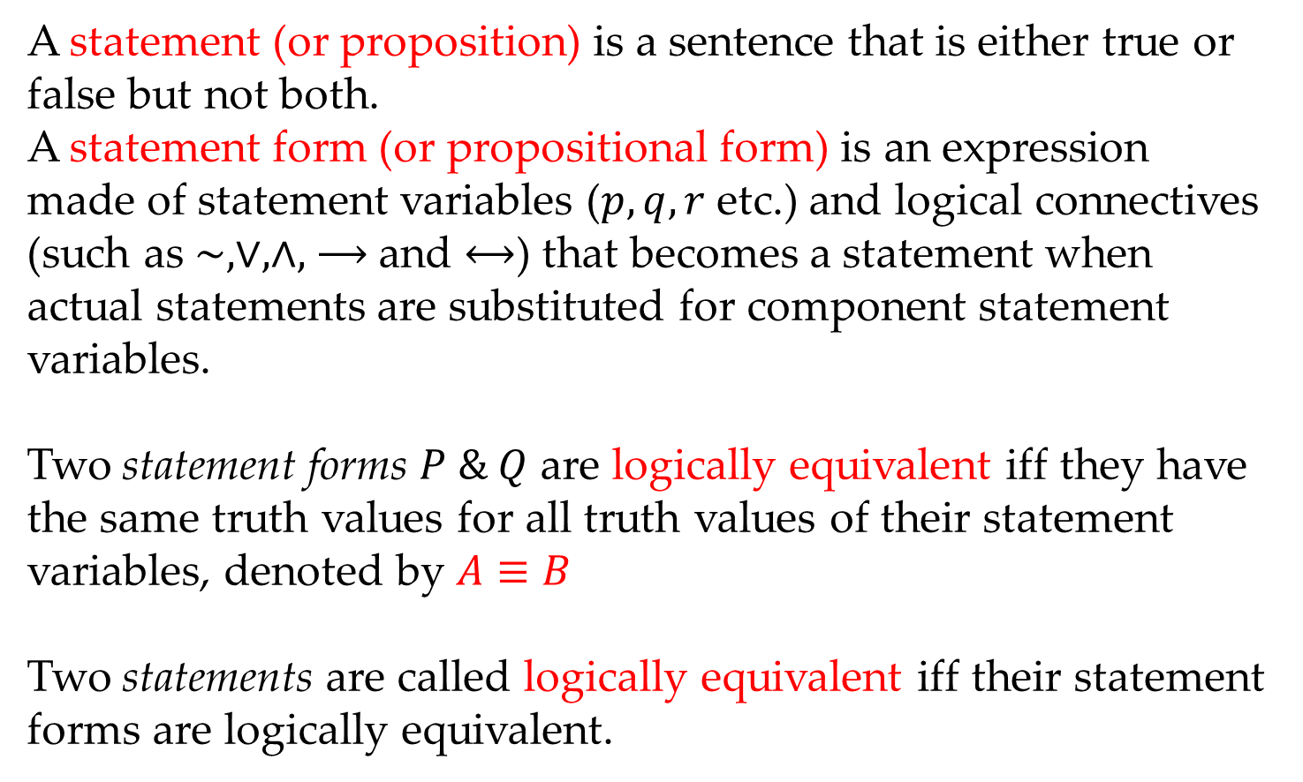
Math 263: Discrete Mathematics
2.1: Definitions
A statement (or proposition) is a sentence that is either true or false but not both.
A statement form (or propositional form) is an expression made of statement variables ($p,q, r$ etc.) and logical connectives (such as $\sim , ∨, ∧,$ $⟶$and $⟷$) that becomes a statement when actual statements are substituted for component statement variables.
Two statement forms $P \& Q$ are logically equivalent iff they have the same truth values for all truth values of their statement variables, denoted by $A≡B$
Two statements are called logically equivalent iff their statement forms are logically equivalent.

Slide 5
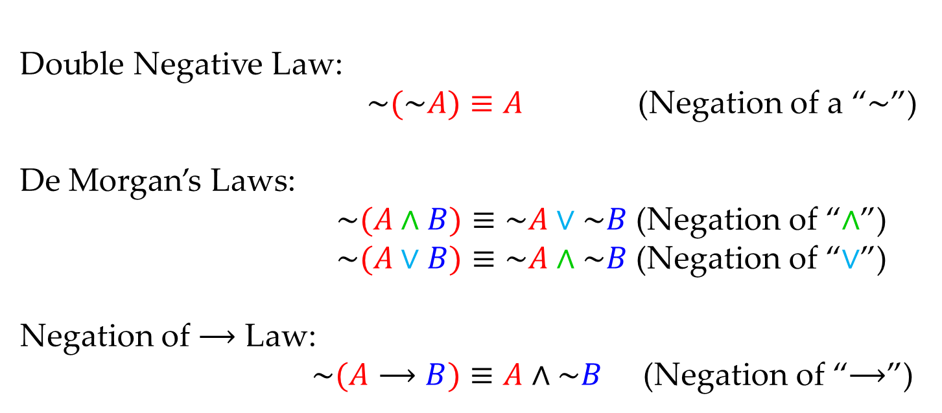
Math 263: Discrete Mathematics
2.1: Main Std. Logical Equivalences
Double Negative Law:
$\sim (\sim A)≡A$ (Negation of a “$\sim$”)
De Morgan’s Laws:
$\sim (A∧B)≡\sim A∨\sim B$ (Negation of “$∧$”)
$\sim (A∨B)≡\sim A∧\sim B$ (Negation of “$∨$”)
Negation of $⟶$ Law:
$\sim (A⟶B)≡A∧\sim B$ (Negation of “$⟶$”)

Slide 6
Math 263: Discrete Mathematics
2.1: Standard Logical Equivalences
Given any statement variables $A, B, \& C$, a tautology $t$, and a contradiction $c$, the following logical equivalences hold:
1. Commutative Laws:
$$A∧B≡B∧A A∨B≡B∨A$$
2. Associative Laws:
$$\left(A∧B\right)∧C≡A∧(B∧C) \left(A∨B\right)∨C≡A∨(B∨C)$$
3. Distributive Laws:
$$A∨\left(B∧C \right)≡\left(A∨B\right)∧\left(A∨C\right)$$
$$A∧\left(B∨C\right)≡\left(A∧B\right)∨(A∧C)$$
4. Identity Laws:
$$A∧t≡A A∨c≡A$$
5. Negation Laws:
$$A∧\sim A≡c A∨\sim A≡t$$
6. Double Negative Law:
$$\sim (\sim A)≡A$$

Slide 7
Math 263: Discrete Mathematics
2.1: Standard Logical Equivalences
Given any statement variables $A, B, \& C$, a tautology $t$, and a contradiction $c$, the following logical equivalences hold:
7. Idempotent Laws:
$$A∧A≡A A∨A≡A$$
8. Universal Bound Laws:
$$A∧c≡c A∨t≡t$$
9. De Morgan’s Laws:
$$\sim (A∧B)≡\sim A∨\sim B$$
$$\sim (A∨B)≡\sim A∧\sim B$$
10. Absorption Laws:
$$A∨\left(A∧B\right)≡A$$
$$A∧\left(A∨B\right)≡A$$
11. Negations of $t$ and $c$:
$$\sim t≡c \sim c≡t$$
12. Negation of “$⟶$” Law: $\sim (A⟶B)≡A∧\sim B$

Slide 8
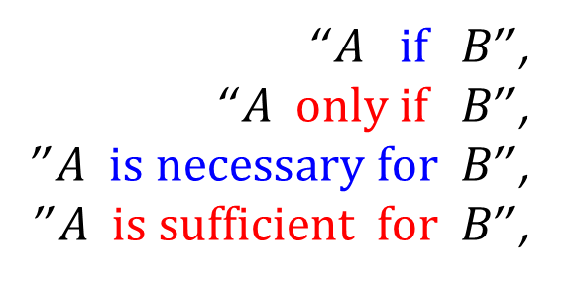
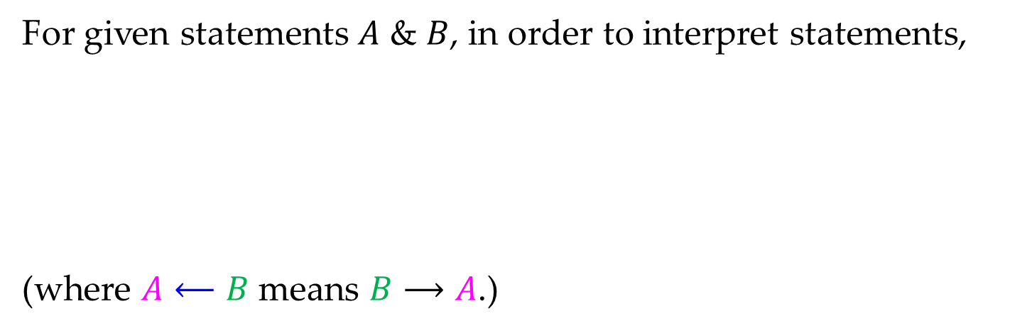
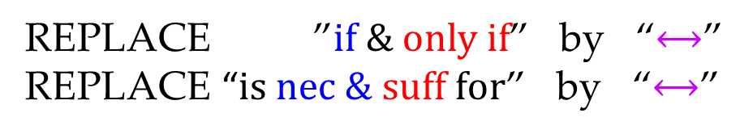
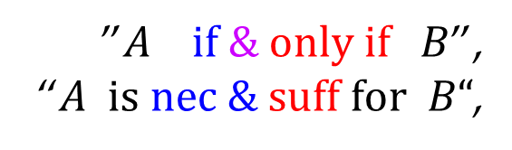
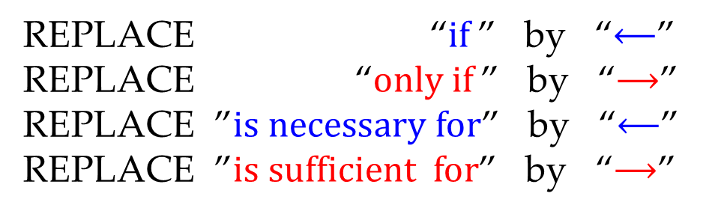
Math 263: Discrete Mathematics
2.2: If, Only if, Necessary & Sufficient
For given statements $A$ & $B$, in order to interpret statements,
(where $A⟵B$ means $B⟶A$.)
“$A if B$”,
“$A only if B$”,
”$A is necessary for B$”,
”$A is sufficient for B$”,
REPLACE “$if$” by “$⟵$”
REPLACE “$only if$” by “$⟶$” REPLACE ”$is necessary for$” by “$⟵$” REPLACE ”$is sufficient for$” by “$⟶$”
”$A if \& only if B$”,
“$A is nec \& suff for B“$,
REPLACE ”$if \& only if$” by “$⟷$”
REPLACE “$is nec \& suff for$” by “$⟷$”

Slide 9
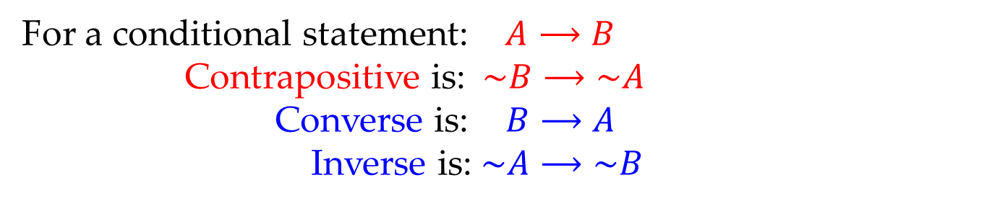
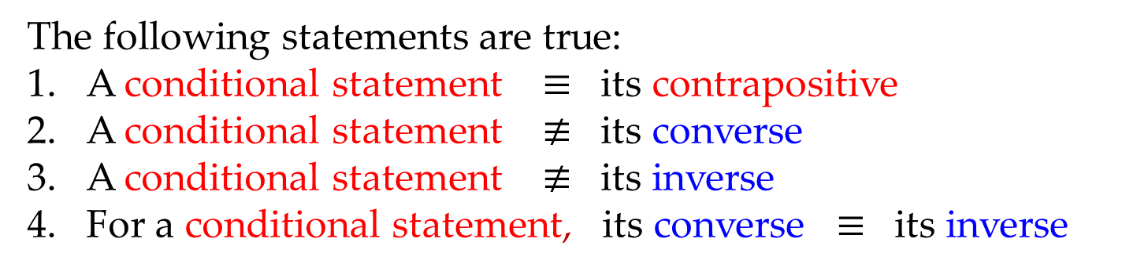
Math 263: Discrete Mathematics
2.2: Contrapositive, Converse, Inverse
For a conditional statement: $A⟶B$
Contrapositive is: $\sim B⟶\sim A$
Converse is: $B⟶A$
Inverse is: $\sim A⟶\sim B$
The following statements are true:
A conditional statement $≡$ its contrapositive
A conditional statement $≢$ its converse
A conditional statement $≢$ its inverse
For a conditional statement, its converse $≡$ its inverse

Slide 10
Math 263: Discrete Mathematics
2.3: Argument & Argument form
An argument is a sequence of statements where the last statement is called the conclusion and all other statements are called premises.
An argument form is a sequence of statement forms where the last statement form is called the conclusion and all other statements are called premises.

Slide 11
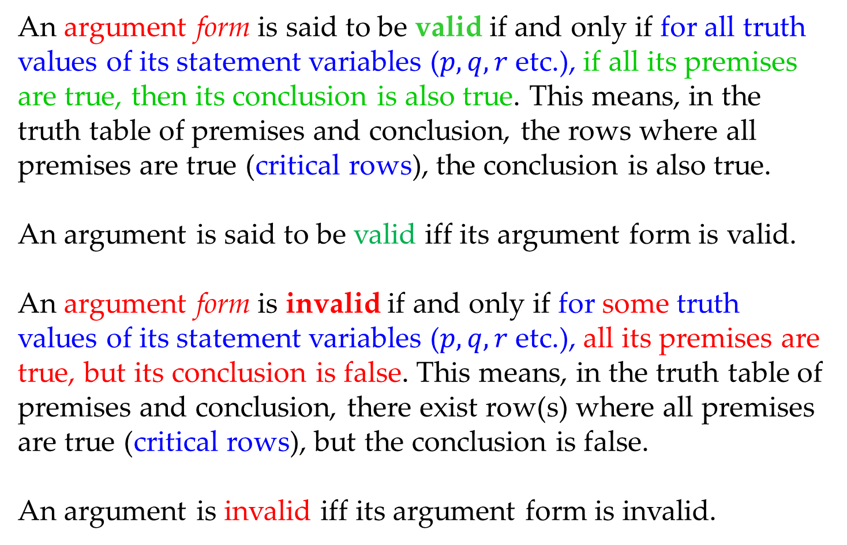
Math 263: Discrete Mathematics
2.3: Valid Argument & Argument form
An argument form is said to be valid if and only if for all truth values of its statement variables ($p, q, r$ etc.), if all its premises are true, then its conclusion is also true. This means, in the truth table of premises and conclusion, the rows where all premises are true (critical rows), the conclusion is also true.
An argument is said to be valid iff its argument form is valid.
An argument form is invalid if and only if for some truth values of its statement variables ($p, q, r$ etc.), all its premises are true, but its conclusion is false. This means, in the truth table of premises and conclusion, there exist row(s) where all premises are true (critical rows), but the conclusion is false.
An argument is invalid iff its argument form is invalid.

Slide 12
Math 263: Discrete Mathematics
2.3: Standard Valid Argument Forms
Modus Ponens
$$A⟶B$$
$$A$$
$$∴B$$
Elimination
$$a. A∨B$$
$$\sim B$$
$$∴A$$
$$b. A∨B$$
$$\sim A$$
$$∴B$$
Modus Tollens
$$A⟶B$$
$$\sim B$$
$$∴\sim A$$
Transitivity
$$A⟶B$$
$$B⟶C$$
$$∴A⟶C$$
Generalization
Proof by division into cases
$$a. A$$
$$∴A∨B$$
$$b. B$$
$$∴A∨B$$
$$A∨B$$
$$A⟶C$$
$$B⟶C$$
$$∴C$$
Specialization
$$a. A∧B$$
$$∴A$$
$$b. A∧B$$
$$∴B$$
Conjunction
$$A$$
$$B$$
$$∴A∧B$$
Contradiction
$$\sim A⟶c$$
$$∴A$$

Slide 13
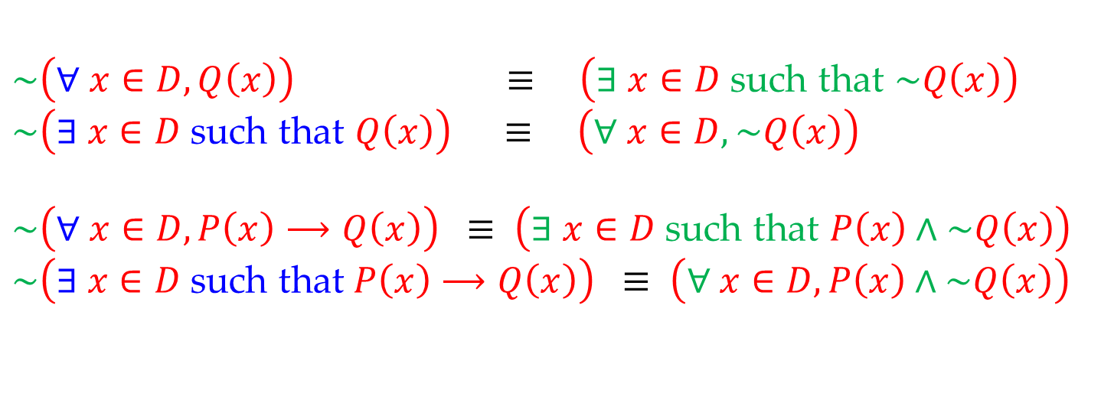
Math 263: Discrete Mathematics
3.2: Negation of Quantified Statements
$$\sim \left(∀ x∈D, Q\left(x\right)\right) ≡ \left(∃ x∈D \text{such} \text{that} \sim Q\left(x\right)\right)$$
$$\sim \left(∃ x∈D \text{such} \text{that} Q\left(x\right)\right) ≡ \left(∀ x∈D, \sim Q\left(x\right)\right)$$
$$\sim \left(∀ x∈D, P\left(x\right)⟶Q\left(x\right)\right) ≡ \left(∃ x∈D \text{such} \text{that} P\left(x\right)∧\sim Q\left(x\right)\right)$$
$$\sim \left(∃ x∈D \text{such} \text{that} P\left(x\right)⟶Q\left(x\right)\right) ≡ \left(∀ x∈D,P\left(x\right)∧\sim Q\left(x\right)\right)$$

Slide 14
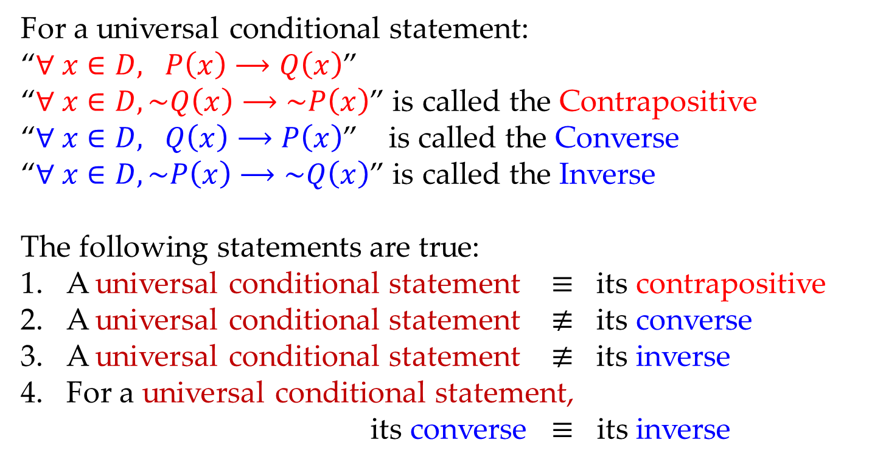
Math 263: Discrete Mathematics
3.2: Variants of Universal Conditional
For a universal conditional statement:
“$∀ x∈D, P\left(x\right)⟶Q\left(x\right)$”
“$∀ x∈D, \sim Q\left(x\right)⟶\sim P\left(x\right)$” is called the Contrapositive
“$∀ x∈D, Q\left(x\right)⟶P\left(x\right)$” is called the Converse
“$∀ x∈D, \sim P\left(x\right)⟶\sim Q\left(x\right)$” is called the Inverse
The following statements are true:
A universal conditional statement $≡$ its contrapositive
A universal conditional statement $≢$ its converse
A universal conditional statement $≢$ its inverse
For a universal conditional statement,
its converse $≡$ its inverse

Slide 15
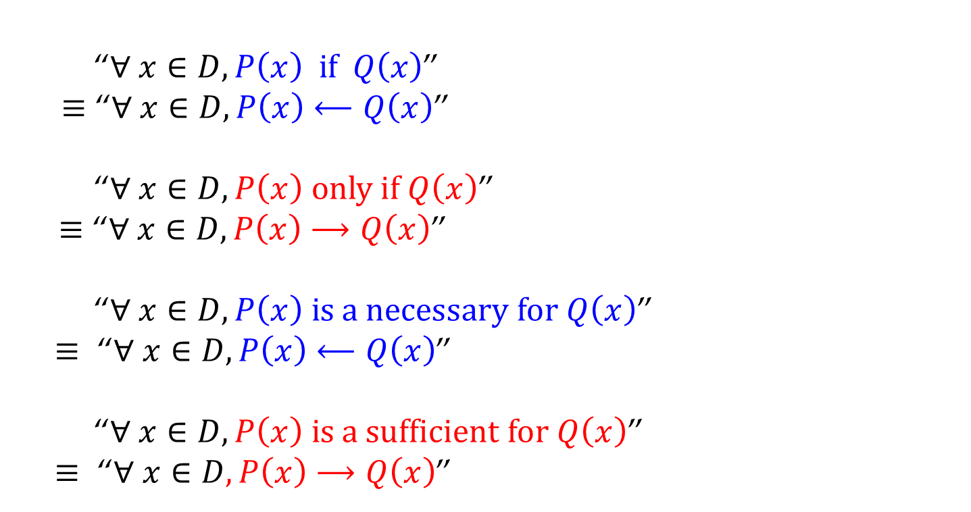
Math 263: Discrete Mathematics
3.2: If, Only IF, Necessary & Sufficient
“$∀ x∈D, P\left(x\right) if Q\left(x\right)$”
$≡$ “$∀ x∈D, P\left(x\right)⟵Q\left(x\right)$”
“$∀ x∈D, P\left(x\right) only if Q\left(x\right)$”
$≡$ “$∀ x∈D, P\left(x\right)⟶Q\left(x\right)$”
“$∀ x∈D, P\left(x\right) is a necessary for Q\left(x\right)$”
$≡$ “$∀ x∈D, P\left(x\right)⟵Q\left(x\right)$”
“$∀ x∈D, P\left(x\right) is a sufficient for Q\left(x\right)$”
$≡$ “$∀ x∈D, P\left(x\right)⟶Q\left(x\right)$”

Slide 16
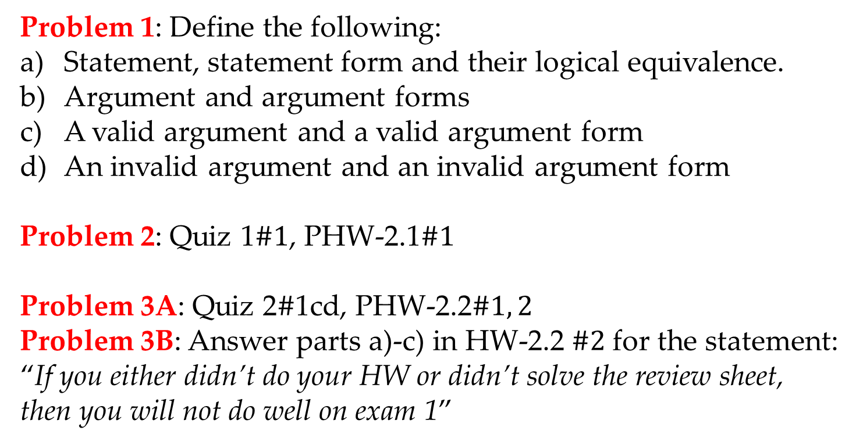
Math 263: Discrete Mathematics
Problems
Problem 1: Define the following:
Statement, statement form and their logical equivalence.
Argument and argument forms
A valid argument and a valid argument form
An invalid argument and an invalid argument form
Problem 2: Quiz 1$\#1$, PHW-2.1$\#1$
Problem 3A: Quiz 2$\#$1cd, PHW-2.2$\#1, 2$
Problem 3B: Answer parts a)-c) in HW-2.2 $\#2$for the statement:
“If you either didn’t do your HW or didn’t solve the review sheet, then you will not do well on exam 1”

Slide 17
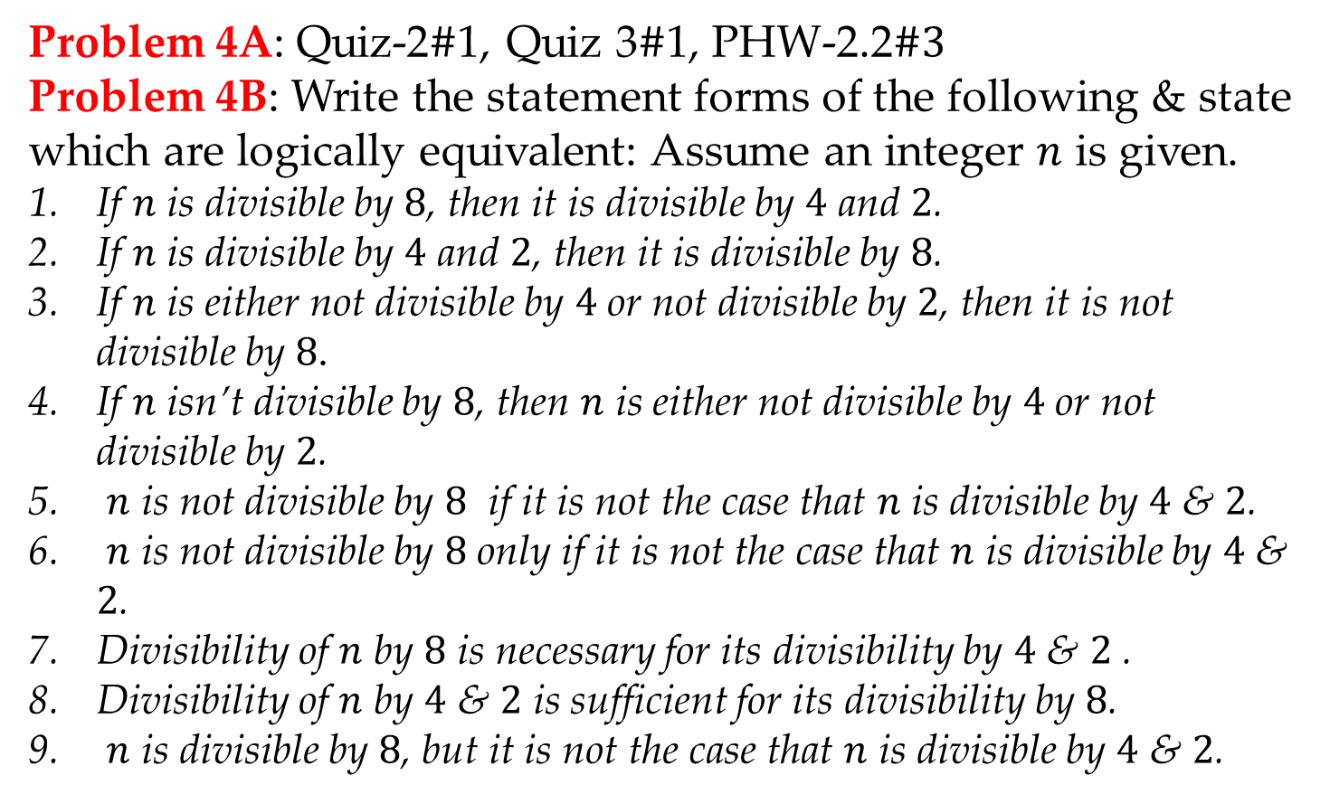
Math 263: Discrete Mathematics
Problems
Problem 4A: Quiz-2$\#$1, Quiz 3$\#$1, PHW-2.2$\#3$
Problem 4B: Write the statement forms of the following & state which are logically equivalent: Assume an integer $n$ is given.
If $n$ is divisible by $8$, then it is divisible by $4$ and $2$.
If $n$ is divisible by $4$ and $2$, then it is divisible by $8$.
If $n$ is either not divisible by $4$ or not divisible by $2$, then it is not divisible by $8$.
If $n$ isn’t divisible by $8$, then $n$ is either not divisible by $4$ or not divisible by $2$.
$n$ is not divisible by $8$ if it is not the case that $n$ is divisible by $4$ & $2$.
$n$ is not divisible by $8$ only if it is not the case that $n$ is divisible by $4$ & $2$.
Divisibility of $n$ by $8$ is necessary for its divisibility by $4$ & $2$ .
Divisibility of $n$ by $4$ & $2$ is sufficient for its divisibility by $8$.
$n$ is divisible by $8$, but it is not the case that $n$ is divisible by $4$ & $2$.

Slide 18
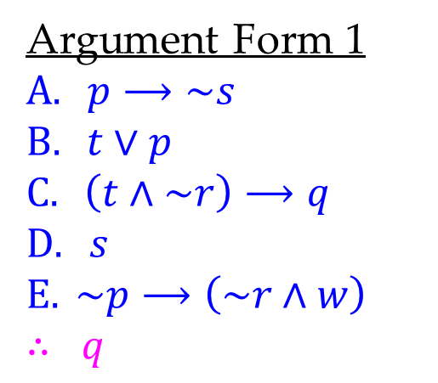
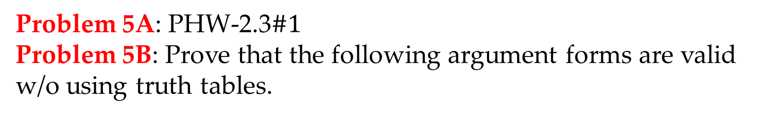
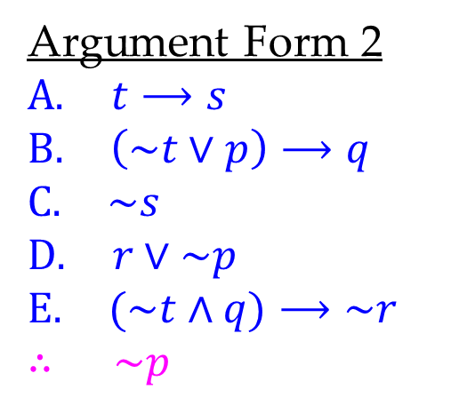
Math 263: Discrete Mathematics
Problems
Problem 5A: PHW-2.3$\#1$
Problem 5B: Prove that the following argument forms are valid w/o using truth tables.
Argument Form 1
$$A. p⟶\sim s$$
$$B. t∨p$$
$$C. \left(t∧\sim r\right)⟶q$$
$$D. s$$
$$E. \sim p⟶\left(\sim r∧w\right)$$
$$∴ q$$
Argument Form 2
$$A. t⟶s$$
$$B. \left(\sim t∨p\right)⟶q$$
$$C. \sim s$$
$$D. r∨\sim p$$
$$E. (\sim t∧q)⟶\sim r$$
$$∴ \sim p$$

Slide 19
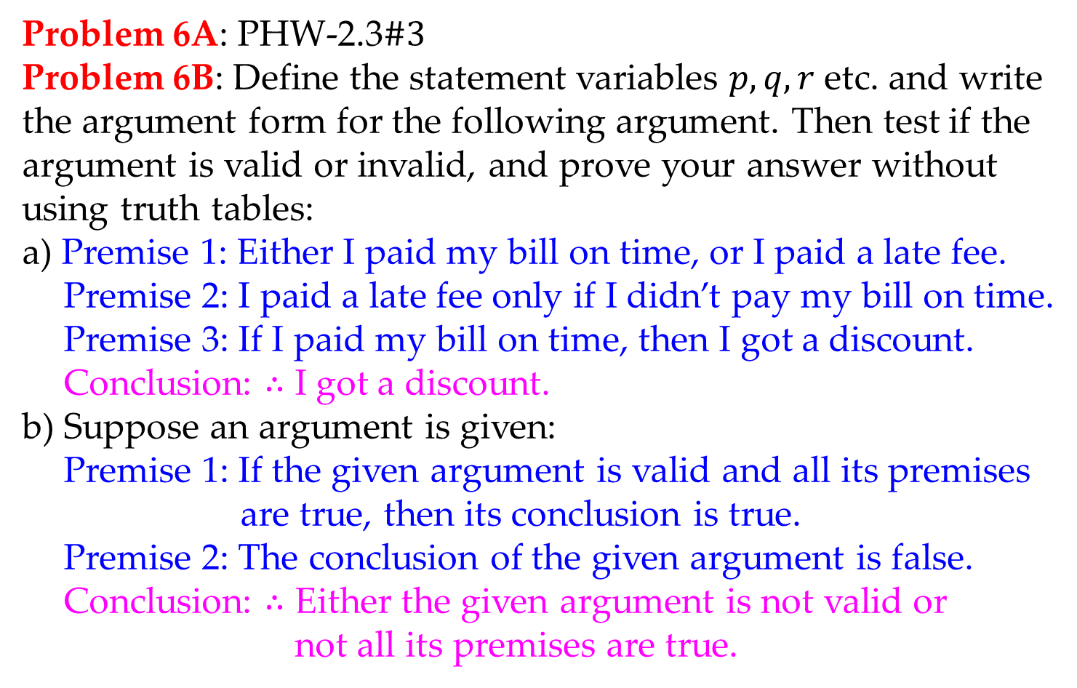
Math 263: Discrete Mathematics
Problems
Problem 6A: PHW-2.3$\#3$
Problem 6B: Define the statement variables $p,q, r$ etc. and write the argument form for the following argument. Then test if the argument is valid or invalid, and prove your answer without using truth tables:
a) Premise 1: Either I paid my bill on time, or I paid a late fee.
Premise 2: I paid a late fee only if I didn’t pay my bill on time.
Premise 3: If I paid my bill on time, then I got a discount.
Conclusion: $∴$ I got a discount.
b) Suppose an argument is given:
Premise 1: If the given argument is valid and all its premises
are true, then its conclusion is true.
Premise 2: The conclusion of the given argument is false.
Conclusion: $∴$ Either the given argument is not valid or
not all its premises are true.

Slide 20
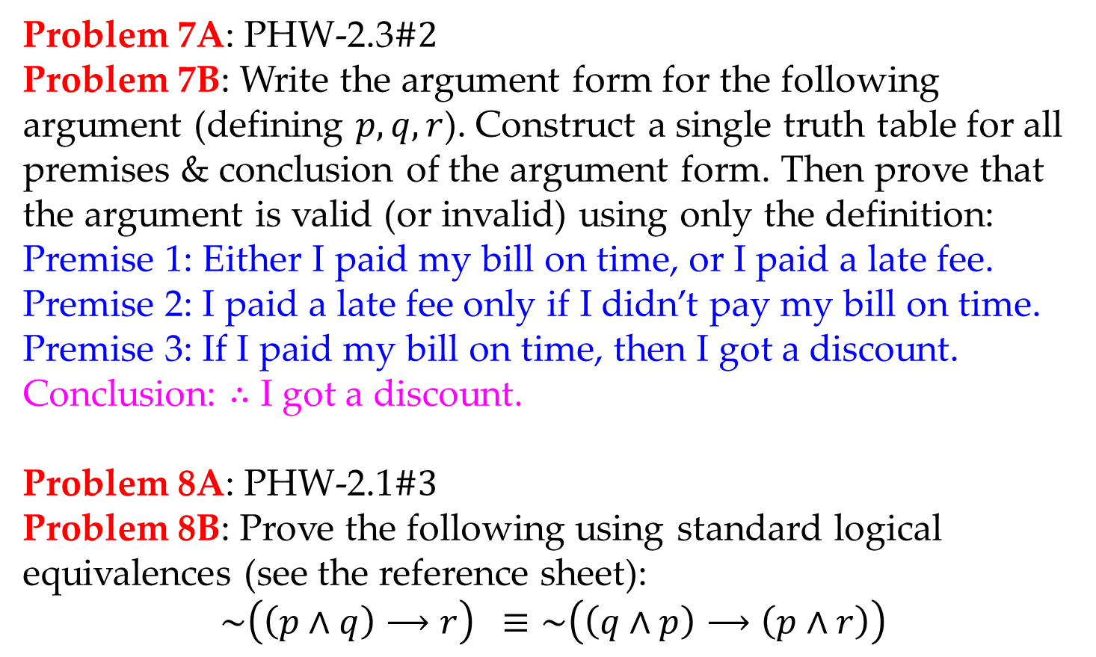
Math 263: Discrete Mathematics
Problems
Problem 7A: PHW-2.3$\#2$
Problem 7B: Write the argument form for the following argument (defining $p,q, r$). Construct a single truth table for all premises & conclusion of the argument form. Then prove that the argument is valid (or invalid) using only the definition:
Premise 1: Either I paid my bill on time, or I paid a late fee.
Premise 2: I paid a late fee only if I didn’t pay my bill on time.
Premise 3: If I paid my bill on time, then I got a discount.
Conclusion: $∴$ I got a discount.
Problem 8A: PHW-2.1$\#3$
Problem 8B: Prove the following using standard logical equivalences (see the reference sheet):
$$\sim \left(\left(p∧q\right)⟶r\right) ≡\sim \left(\left(q∧p\right)⟶\left(p∧r\right)\right)$$

Slide 21
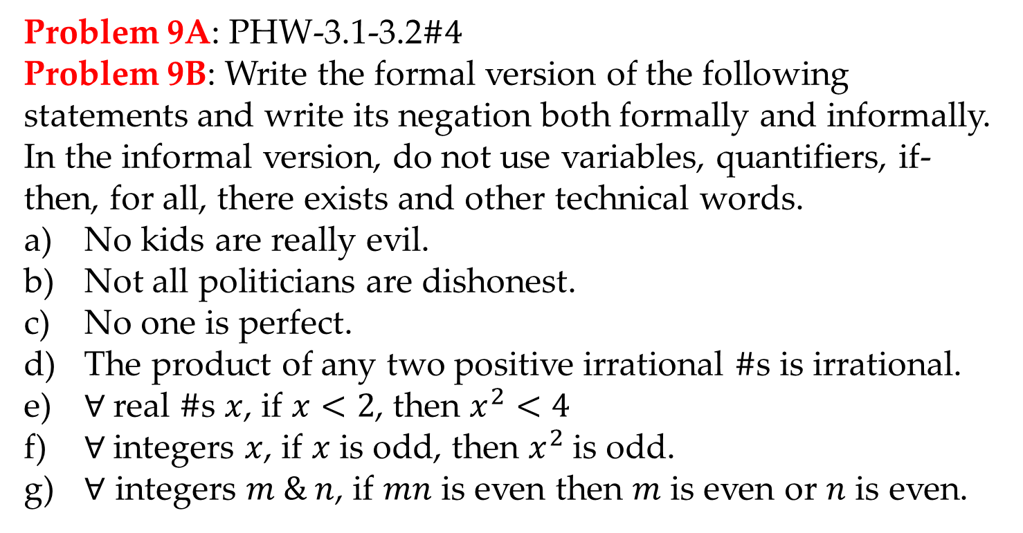
Math 263: Discrete Mathematics
Problems
Problem 9A: PHW-3.1-3.2$\#4$
Problem 9B: Write the formal version of the following statements and write its negation both formally and informally. In the informal version, do not use variables, quantifiers, if-then, for all, there exists and other technical words.
No kids are really evil.
Not all politicians are dishonest.
No one is perfect.
The product of any two positive irrational $\#$s is irrational.
$∀$real $\#$s $x$, if $x<2$, then $x^{2}<4$
$∀$integers $x$, if $x$ is odd, then $x^{2}$ is odd.
$∀$ integers $m \& n$, if $mn$ is even then $m$ is even or $n$ is even.

