Slide 1
COSC 290 Lab #10
Amaizu Gabriel
gamaizu1@students.towson.edu

Slide 2
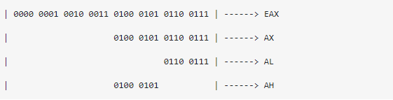

Output Intepretation

Slide 3
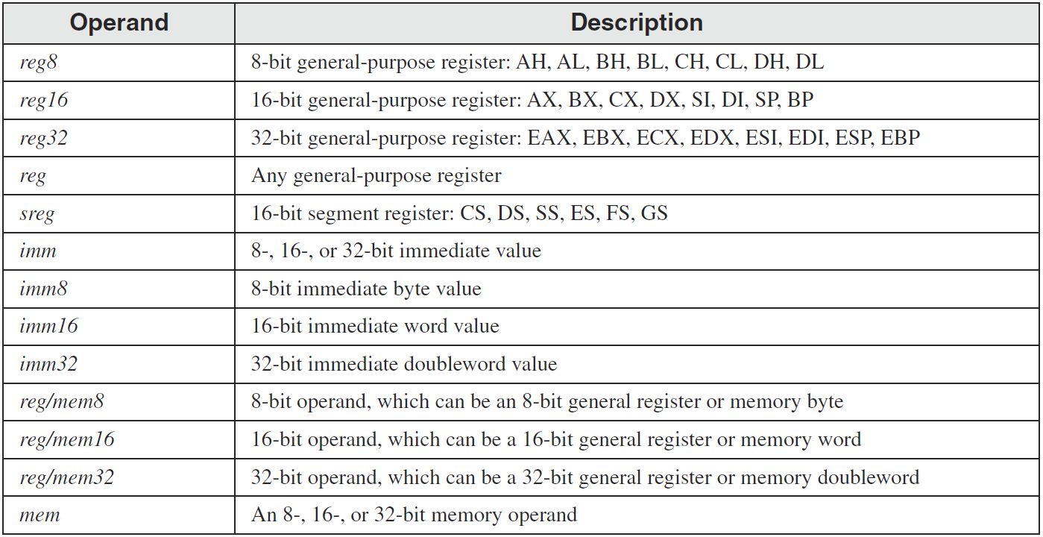
The x86 Instructions
Instruction Operand Notation

Slide 4
Intrinsic Data Types
BYTE, SBYTE
8-bit unsigned integer; 8-bit signed integer
WORD, SWORD
16-bit unsigned & signed integer
DWORD, SDWORD
32-bit unsigned & signed integer
QWORD
64-bit integer
TBYTE
80-bit integer

Slide 5
TYPE Operator
The TYPE operator returns the size, in bytes, of a single element of a data declaration(1byte =8bit)
.data
var1 BYTE ?
var2 WORD ?
var3 DWORD ?
var4 QWORD ?
.code
mov eax,TYPE var1 ; 1
mov eax,TYPE var2 ; 2
mov eax,TYPE var3 ; 4
mov eax,TYPE var4 ; 8

Slide 6
OFFSET Operator
The OFFSET Operator gets the number of address location
(Example) Let’s assume that the data segment begins at 00404000h:
.data
bVal BYTE ?
wVal WORD ?
dVal DWORD ?
dVal2 DWORD ?
.code
mov esi,OFFSET bVal ; ESI = 00404000
mov esi,OFFSET wVal ; ESI = 00404001
mov esi,OFFSET dVal ; ESI = 00404003
mov esi,OFFSET dVal2 ; ESI = 00404007

Slide 7
LENGTHOF Operator
The LENGTHOF operator counts the number of elements in a single data declaration
.data LENGTHOF
byte1 BYTE 10,20,30 ; 3
array1 WORD 30 DUP(?),0,0 ; 32
array2 WORD 5 DUP(3 DUP(?)) ; 15
array3 DWORD 1,2,3,4 ; 4
digitStr BYTE "12345678",0 ; 9
.code
mov ecx,LENGTHOF array1 ; 32

Slide 8
SIZEOF Operator
The SIZEOF operator returns a value that is equivalent to multiplying LENGTHOF by TYPE.
.data SIZEOF
byte1 BYTE 10,20,30 ; 3
array1 WORD 30 DUP(?),0,0 ; 64
array2 WORD 5 DUP(3 DUP(?)) ; 30
array3 DWORD 1,2,3,4 ; 16
digitStr BYTE "12345678",0 ; 9
.code
mov ecx,SIZEOF array1 ; 64

Slide 9
Addressing Mode (Direct)
Direct-Offset Operands: A constant offset is added to a data label to produce an effective address (EA). The address is dereferenced to get the value inside its memory location.
.data
ARRAY_A BYTE 10h,20h,30h,40h
.code
MOV al, ARRAY_A + 1 ; al = 20h
MOV al, ARRAY_A[1] ; al = 20h
MOV al,[ARRAY_A + 1] ; alternative notation
MOV al, ARRAY_A + 2 ; al = 30h

Slide 10
Indexed Addressing Mode
An indexed operand adds a constant to a register to generate an effective address. There are two notational forms:
[label + reg] label[reg]
.data
arrayW WORD 1000h,2000h,3000h
.code
mov esi,0
mov ax,[arrayW + esi] ; AX = 1000h
mov ax,arrayW[esi] ; alternate format
add esi,2
add ax,[arrayW + esi] ; AX = 3000h
etc.

Slide 11
Addressing Mode (Indirect)
An indirect operand holds the address of a variable, usually an array or string. It can be dereferenced.
.data
val1 BYTE 10h,20h,30h
.code
mov esi,OFFSET val1
mov al,[esi] ; dereference ESI (AL = 10h)
inc esi
mov al,[esi] ; AL = 20h
inc esi
mov al,[esi] ; AL = 30h

Slide 12
Zero Extension
When you copy a smaller value into a larger destination, the MOVZX instruction fills (extends) the upper half of the destination with zeros.
mov bl,10001111b
movzx ax,bl ; zero-extension
The destination must be a register.

Slide 13
Sign Extension
The MOVSX instruction fills the upper half of the destination with a copy of the source operand's sign bit.
mov bl,10001111b
movsx ax,bl ; sign extension
The destination must be a register.

Slide 14
LOOP Instruction
The LOOP instruction creates a counting loop
Syntax: LOOP target
Logic: ECX is used for a “loop counter”
ECX ← ECX – 1
if ECX != 0, jump to target
.code
mov eax,0h
mov ecx,5h
L1:
add eax, ecx
loop L1
; eax = 15h (5+4+3+2+1)

