Slide 1

Digital Technology
… and digital electronics allow us to manipulate all types of information as digits (1s and 0s) in order to store and manage the information more efficiently and effectively.
Links:
Video: What sets Curosity apart from other Mars Rovers?

Slide 2
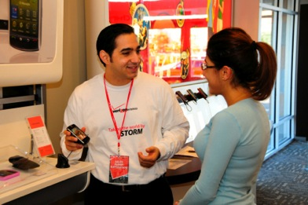
Digital Literacy
… refers to an understanding of how computers represent different types of data with digits and how the usefulness of that representation assists people in leading productive lives.
In this section:
Computer | Character Encoding
Computer Literacy | Value Encoding/Binary Number System
Bits and Bytes
Digitization
Links:
Video: One Laptop per Child

Slide 3
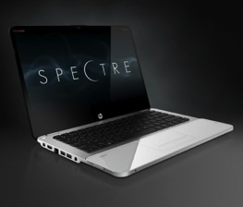
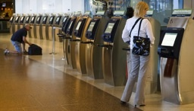
Computer
Collects data (input)
Processing
Produces information (output)
Information Processing Cycle
A computer is a digital electronics device that combines hardware and software to accept the input of data and then process and store the data to produce some useful output.
5 Primary Functions:
Computation
Automation
Communication
Entertainment
Managing Information
Links:
Video: Introducing Nokia Lumia 900

Slide 4
The Components of a Computer
A computer contains many electric, electronic, and mechanical components known as hardware
Input Device
Output Device
System Unit
Storage Device
Communications Device
Allows you to enter data and instructions into a computer
Hardware component that conveys information to one or more people
Case that contains the electronic components of the computer that are used to process data
Holds data, instructions, and information for future use
Enables a computer to send and receive data, instructions, and information to and from one or more computers or mobile devices
Pages 4 - 7

Slide 5
Advantages and Disadvantages of Using Computers
Advantages of Using Computers
Disadvantages of Using Computers
Speed
Reliability
Consistency
Storage
Communications
Violation of Privacy
Public Safety
Impact on Labor Force
Health Risks
Impact on Environment
Page 7

Slide 6

Computer Literacy
Computer literacy refers to a functional understanding of the fundamentals of computers and their uses.
Today’s college graduates are entering the workforce as knowledge workers expected to add value to the information economy. Computer fluency captures the essence of business expectations.
Notes:
Bullet 2 modified

Slide 7

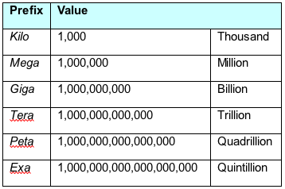
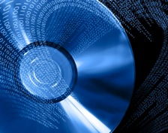
Bits and Bytes
Understanding bits and how they represent information is key to understanding the workings of computers and other digital electronic devices.
KB = Kilobyte
Kb = Kilobit
Bits are stored on CDs and DVDs by burning pits in the disk surface
A bit—short for binary digit—is a digit that can be 1 or 0. A bit is the smallest unit of information that a digital electronics device can manipulate. A group of eight bits is called a byte.
Computing> Digital Technology > Digital Literacy > Bits and Bytes

Slide 8

Digitization
Digitization, also called digitizing, is the process of transforming information, such as text, images, and sounds, into digital representation (1s and 0s) so that it can be stored and processed by computers.
The reason that computers have become a part of so many things that people do is because we have learned how to digitize so many different types of information.
Links:
Video: UP by Jawbone
Computing > Digital Technology > Digital Literacy > Digitization

Slide 9
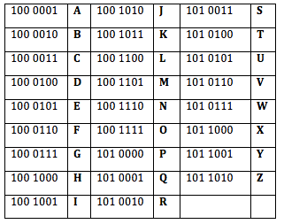
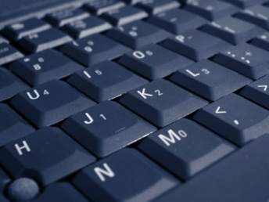
Character Encoding
Several standards have been designed for character encoding – the representation of characters on the keyboard with bytes, most having roots in the earliest standard, ASCII (American Standard Code for Information Interchange).
Links:
Video: Ascii Art Mandelbrot Fractal Zoom
Computing > Digital Technology > Digital Literacy > Character Encoding

Slide 10
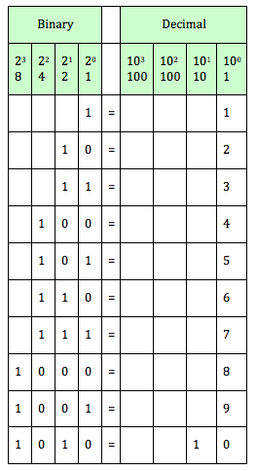
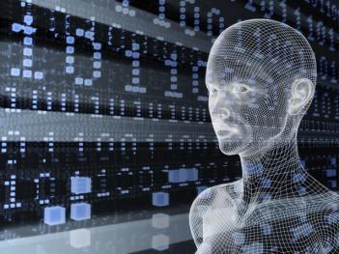
Value Encoding/Binary Number System
Many number systems are used for value encoding - the representation of values with numbers. The binary number system, which uses only two digits, 1 and 0, is commonly used for representing values in computers.
Links:
Video: Converting Binary to Decimal
Computing > Digital Technology > Digital Literacy > Value Encoding/Binary Number System

Slide 11
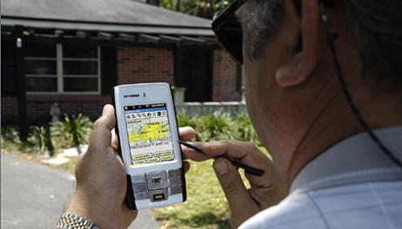
Computing Platforms
…. describes a computer’s architecture in terms of hardware and software.
In this section:
Server
Mobile Computing
Synchronization
Links:
Video: Ford Work Solutions
Computing > Digital Technology > Computing Platforms

Slide 12
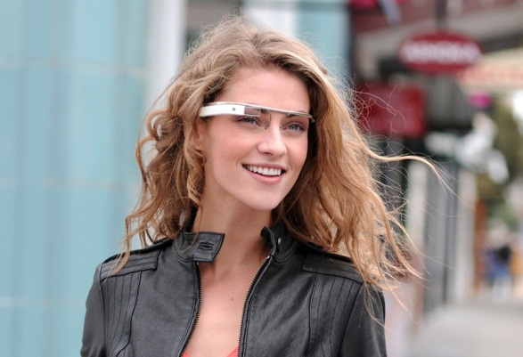
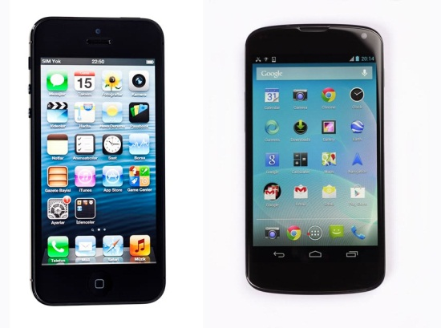
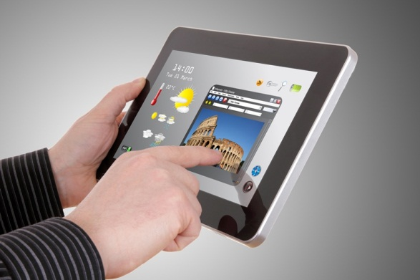
Mobile Computing
Mobile computing refers to the use of battery-powered mobile devices that provide access to computing, communication, information, and/or entertainment anywhere, anytime.
Mobile Computing Technologies are dependent on:
Wireless Networks | Storage | Rechargeable Batteries
Servers | Syncing
Links:
Video: Productivity Future Vision (2011)

Slide 13
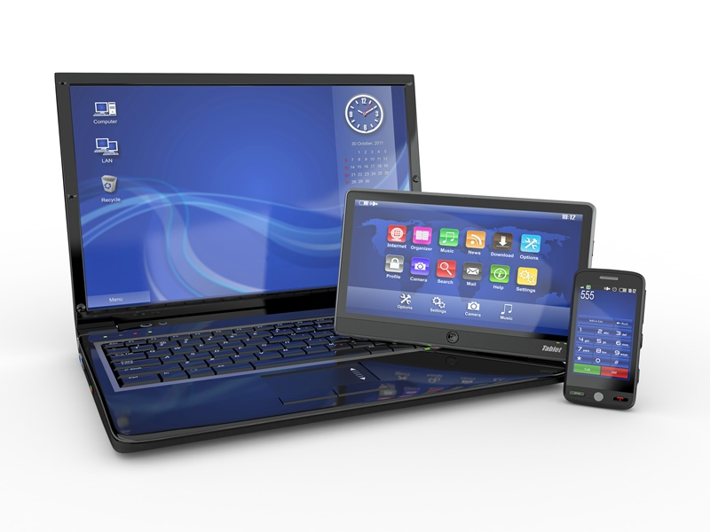
Synchronization
A big challenge for today’s “technorati” (technology enthusiasts) is keeping the data synchronized across all their devices.
Synchronization is the process of maintaining common files and data across multiple devices so that all copies are up to date.
Links:
Video: Introducing iCloud

Slide 14
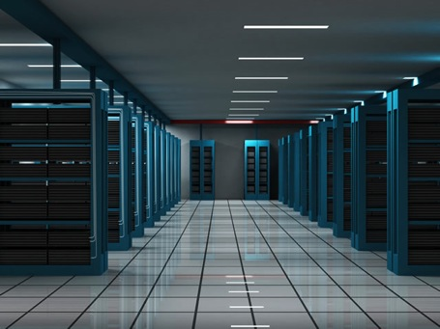
Server
Application server
Communications server
Database server
Email server
File server
Print server
Game server
Web server
A server is a powerful computer that often utilizes many processors to provide services to many users simultaneously over a network.
Links:
Video: Intel Greenfield Data Center Tour

Slide 15

Telecommunications
… refers to the electronic transmission and reception of signals for voice and data communications.
In this section:
Infrastructure | Wireless Data Communications
Cellular Network | Computer Network
Links:
Video: CNN: Obama promotes broadband expansion

Slide 16
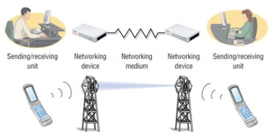
Infrastructure
… refers to the hardware, software, and protocols that support telecommunications.
In this section:
Telecommunications Signals | Telecommunications Devices
Telecommunications Media | Telecommunications Software
Radio Spectrum
Links:
Video: Visual History of Telecommunications

Slide 17
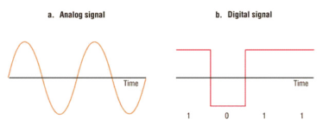
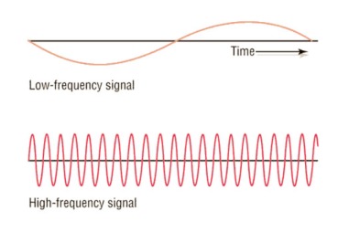
Telecommunications Signals
Telecommunications signals are analog or digital electronic transmissions for the purpose of communication.
The signals used to send information over voice and data networks can vary in speed and strength.
Links:
Video: Tower Climbers Working

Slide 18
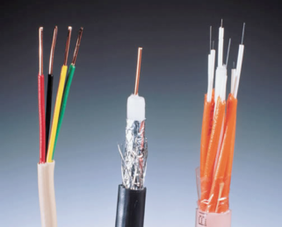
Telecommunications Media
Telecommunications media include anything that carries a signal and creates an interface between a sending device and a receiving device.
Twisted pair: telephone and computer networks.
Coaxial: cable TV and other applications.
Fiber-optic: backbones of telecom networks and in some local area networks.
Links:
Video: Fiber Optics

Slide 19
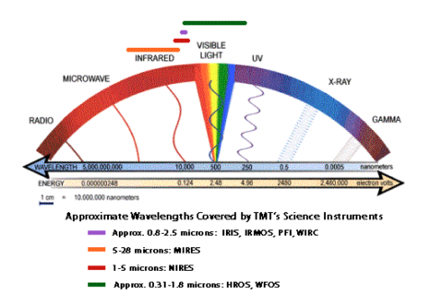
Radio Spectrum
Radio spectrum, part of the electromagnetic spectrum, refers to all of the frequencies available for radio waves from about 10 KHz to 300 GHz and their assigned uses.
The radio spectrum allows for many different uses of radio signals and attempts to safeguard those uses from interference.
Links:
Video: Electromagnetic Spectrum

Slide 20
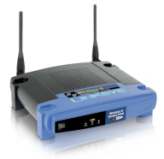
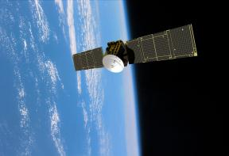
Telecommunications Devices
Telecommunications devices include the wide variety of computer hardware designed to support telecommunications activities for individuals and businesses.
Home networking and wireless networks provide a reason for everyone to acquire a basic understanding of modems, network adapters, access points, and others.
Links:
Video: Sprint Mifi Commercial
Networking > Telecommunications > Infrastructure > Telecommunications Devices

Slide 21
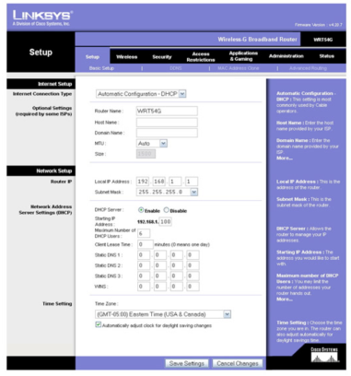
Telecommunications Software
Telecommunications software is software based on telecommunications protocols used to control, monitor, and troubleshoot data traveling over a telecommunications network.
Hardware is useless without the software necessary to drive it—and so it is with telecommunications and computer networks.
Links:
Video: GetConnected - Secure Wireless Router Set Up

Slide 22

Wireless Data Communications
… refers to telecommunications that take place over the air for data and Internet access.
In this section:
Wi-Fi | Bluetooth
WiMAX | Radio Frequency Identification (RFID)
Long Term Evolution (LTE) | Global Positioning System (GPS)

Slide 23
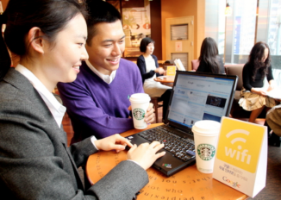
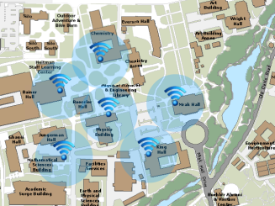
Wi-Fi
Wi-Fi (short for wireless fidelity) is wireless networking technology that uses access points to wirelessly connect users to networks within a range of 250–1000 feet (75–300 meters).
Wi-Fi is the dominant technology that provides wireless Internet access in households and businesses. Understanding Wi-Fi enables users to make the best use of the technology and make wise decisions in choosing an Internet service provider.
Links:
Video: The Early Show - Dangers of public Wi-Fi

Slide 24
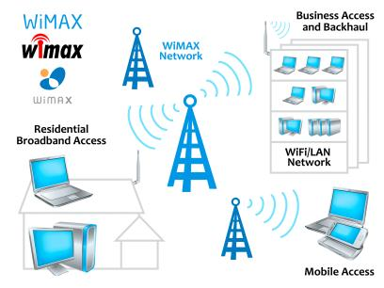
WiMAX
WiMAX has a 31-mile (50-kilometer) range, making it the perfect technology for providing citywide high-speed Internet access.
WiMAX, which stands for Worldwide Interoperability for Microwave Access, also known as IEEE 802.16, is a fourth-generation wireless broadband technology that evolved from Wi-Fi to provide faster Internet access at a longer range.
Links:
Video: WiMax: Next Generation Internet Revolution

Slide 25
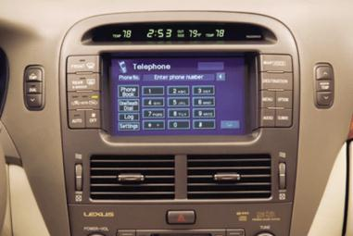
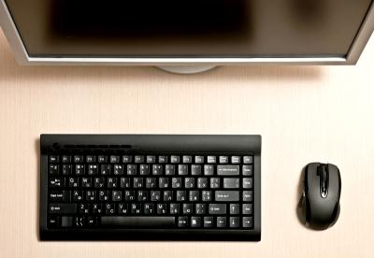
Bluetooth
Bluetooth (named after a 10th-century Danish king) enables a wide assortment of digital devices to communicate directly with each other wirelessly over short distances.
Links:
Video: Fancy Parrot Zik wireless Bluetooth headphones

Slide 26
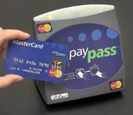
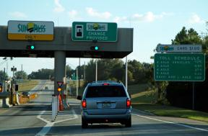
Radio Frequency Identification (RFID)
RFID, or radio frequency identification, uses tiny transponders in tags that can be attached to merchandise or other objects and read wirelessly using an RFID reader, typically for inventory and supply chain management or to facilitate commercial transactions.
RFID is embedded in products for identification and tracking purposes, and in credit cards, cell phones, and other devices for enabling wireless transactions at checkout counters and vending machines.
Links:
Video: RFID - Technology Video

Slide 27
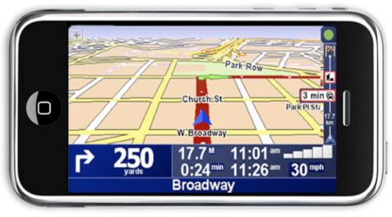
Global Positioning System (GPS)
Available in mobile phones, cars, aircraft, ships, and elsewhere, GPS provides a range of uses from necessary functions, such as staying on course at sea, to fun utilities, such as keeping track of where your friends are.
A GPS, or global positioning system, uses satellites to pinpoint the location of objects on earth.
Links:
Video: Google Maps Navigation (Beta)

Slide 28
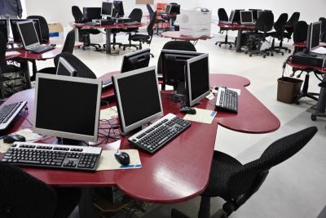
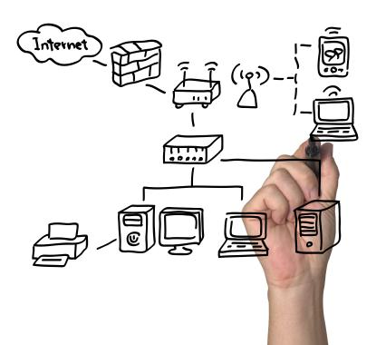
Computer Network
… is a collection of computing devices connected together to share resources such as files, software, processors, storage, printers, and Internet connections.
In this section:
Personal Area Network (PAN) | Local Area Network (LAN)
Home Network | Wide Area Network (WAN)

Slide 29
Networks
A network is a collection of computers and devices connected together via communications devices and transmission media
Advantages of a network include:
Facilitating communications
Sharing hardware
Sharing data and information
Sharing software

Slide 30
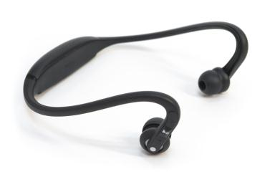
Personal Area Network (PAN)
A personal area network (PAN) is the interconnection of personal information technology devices, typically wirelessly, within the range of an individual.
Personal area network technologies allow personal devices to communicate with or without wires, sharing data, media streams, phone conversations, and all types of information.
Links:
Video: SCOTTEVEST/SeV Travel Vest

Slide 31
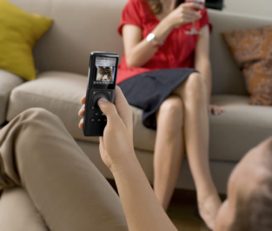
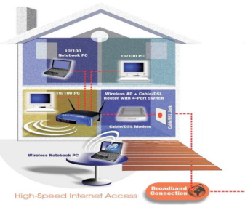
Home Network
A home network is a local area network designed for personal or business use in the home.
Home networks are used to share Internet access, media, files, printers, and other computing and media resources.
Links:
Video: Bill Gates Home

Slide 32


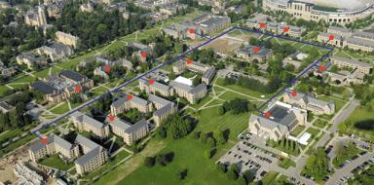
Local Area Network (LAN)
A local area network (LAN) is a privately owned computer network that connects computers and devices within the same building or local geographic area.
Local area networks are used in most businesses and organizations to provide network and Internet connectivity.

Slide 33
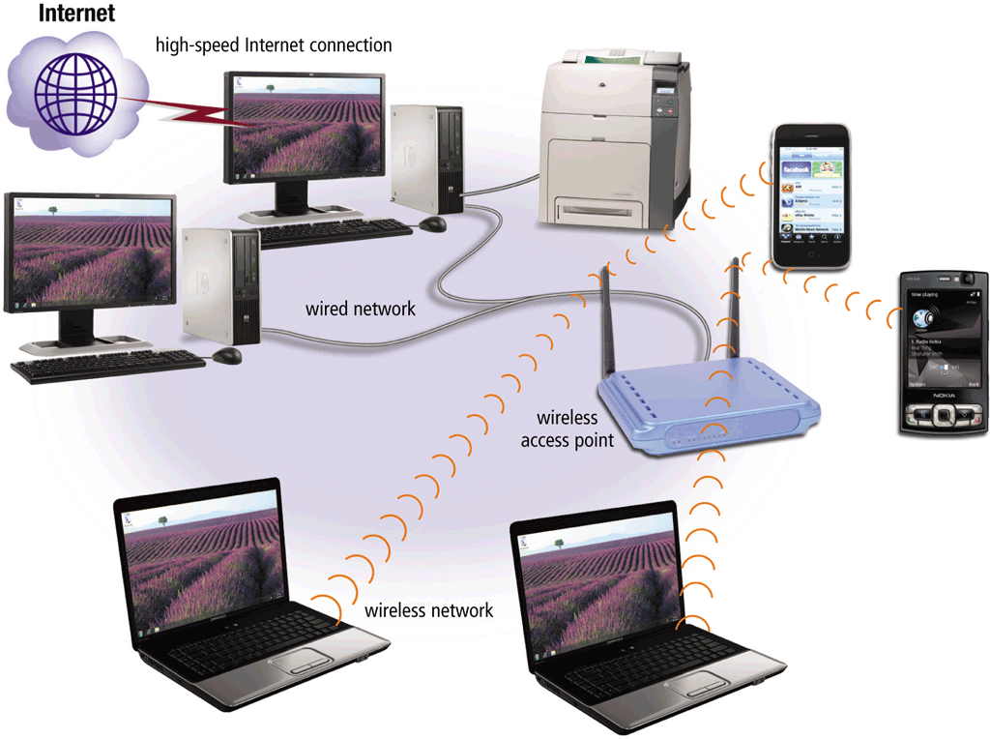
Networks
A local area network (LAN) is a network that connects computers and devices in a limited geographical area
A wireless LAN (WLAN) is a LAN that uses no physical wires

Slide 34
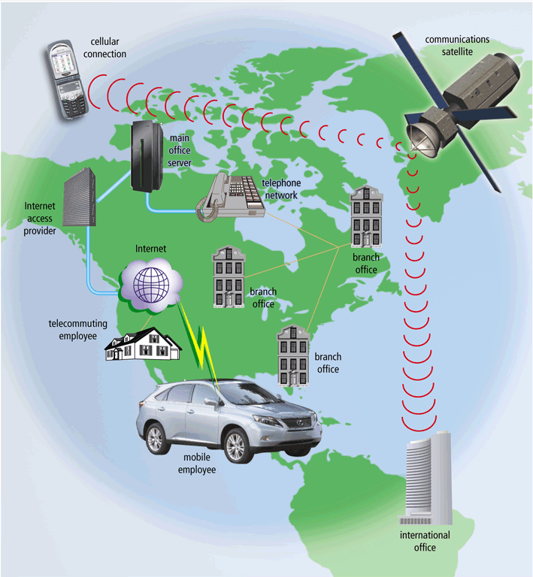
Networks
A metropolitan area network (MAN) connects LANs in a metropolitan area
A wide area network (WAN) is a network that covers a large geographical area

Slide 35
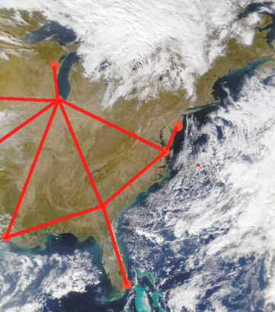
Wide Area Network (WAN)
A wide area network (WAN) connects LANs and MANs between cities, across countries, and around the world, using microwave and satellite transmission or telephone lines.
A LAN becomes a WAN when it extends beyond one geographic location to another geographic location.

Slide 36
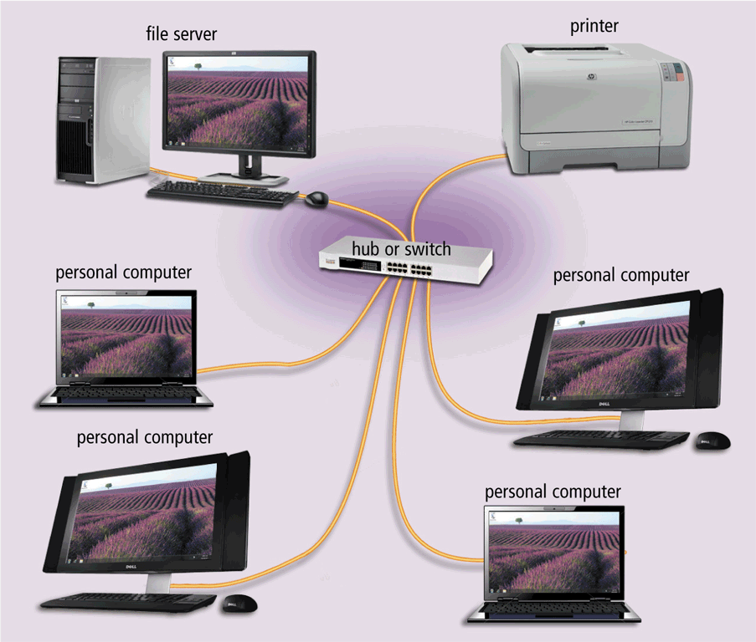
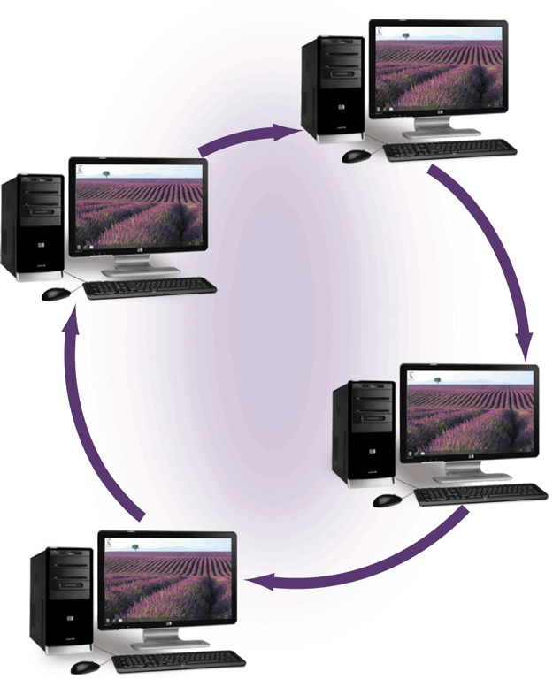
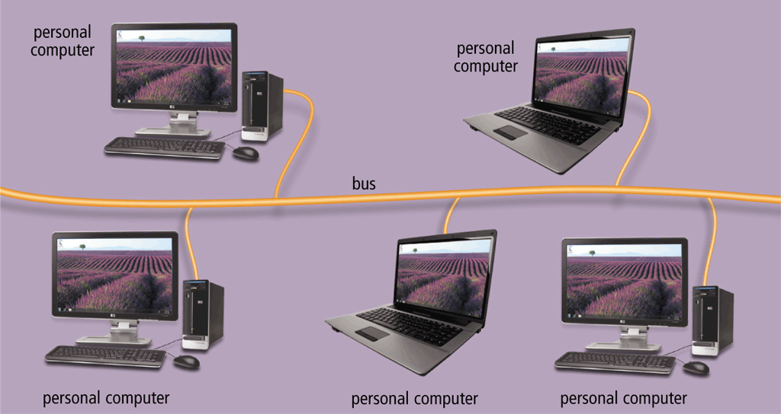
Networks
A network topology refers to the layout of the computers and devices in a communications network
Star network
Bus network
Ring network

Slide 37
Networks
An intranet is an internal network that uses Internet technologies
An extranet allows customers or suppliers to access part of its intranet

Slide 38
Network Communications Standards
Ethernet
Token ring
TCP/IP
Wi-Fi
Bluetooth
UWB
IrDA
RFID
WiMAX
WAP

Slide 39
Network Communications Standards
Ethernet is a network standard that specifies no computer controls when data can be transmitted
The token ring standard specifies that computers and devices on the network share or pass a special signal (token)
TCP/IP is a network standard that defines how messages are routed from one end of a network to another

