Slide 1
Local Area Networks: Packets, Frames, and Topologies

Slide 2
Circuit Switching
Circuit switching
Creates a path between sender and receiver
Guaranteed isolation between paths
Circuit switching networks use electronic devices to establish circuits
multiple circuits are multiplexed over shared media
the result is known as a virtual circuit
Improving reliability and reducing the chances of packet reordering or loss
Telephone technology uses circuit switching
They offer a dedicated connection between two telephones

Slide 3
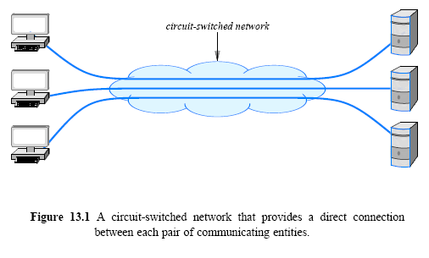
Circuit Switching

Slide 4
Circuit Switching
Three general properties:
Point-to-point communication
Three-steps:
circuit creation, use, and termination
switched or permanent
Performance equivalent to an isolated physical path
Established communication not affected by other
circuit switching must provide the illusion of an isolated path

Slide 5
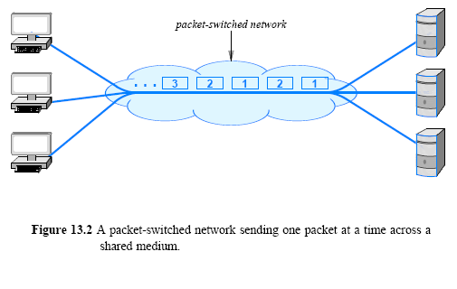
Packet Switching
A packet switching system uses statistical multiplexing
multiple sources compete for the use of shared media

Slide 6
Packet Switching
each message divided into packets
Variable size
maximum packet size for each packet-switching technology
Arbitrary, asynchronous communication
allows one-to-many communication
communication can occur at any time
No set-up required
system always in ready to deliver state
No need to notify termination
Performance varies
due to statistical multiplexing among packets
multiplexing occurs among packets

Slide 7
Packet Switching
Advantage: low cost due to resource sharing
To provide communication among N computers
With a circuit-switched network
at least N/2 independent paths
With packet switching, a network must have
Only one connection for each computer

Slide 8
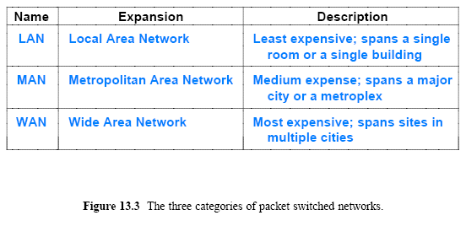
Local and Wide Area Packet Networks
Packet switching technologies classified by the distance
Short distance costs less (e.g., inside a single building)
Long distances more expensive (e.g., across several cities)

Slide 9
Standards for Packet Format and Identification
Each packet must have the identification of the intended recipient
Must agree on how to identify a recipient and where to place the identification in a packet
Standards organizations
Institute for Electrical and Electronic Engineers (IEEE)
In 1980, IEEE organized the Project 802 LAN/MAN Standards Committee to produce standards for networking

Slide 10
Standards for Packet Format and Identification
IEEE covers the lower two layers of the protocol
Figure 13.4 gives an illustration of a protocol as viewed by various standards organizations, such as
Institute for Electrical and Electronic Engineers (IEEE)
World Wide Web Consortium (W3C)
Internet Engineering Task Force (IETF)

Slide 11
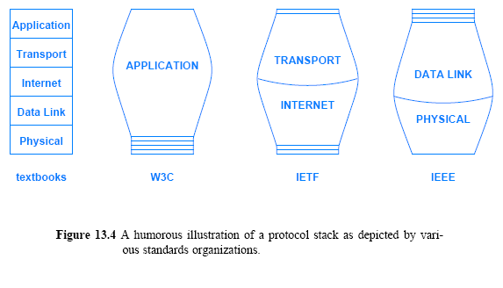
Standards for Packet Format and Identification

Slide 12
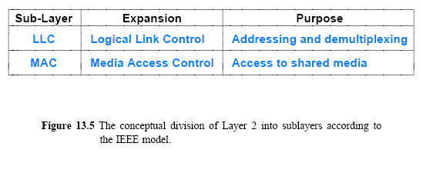
IEEE 802 Model and Standards
IEEE divides Layer 2 of the protocol stack into two conceptual sub-layers, as Figure 13.5 (below) illustrates
The Logical Link Control (LLC)
Provides flow control, error detection (use of checksum and CRC) to the frames, multiplexing, and addressing between higher and lower layers
Supports multiple network protocols by adding LLC headers and using service access points (DSAP and SSAP) – which network protocol the frame belongs to
The Media Access Control (MAC)
sublayer specifies how multiple computers share underlying medium

Slide 13
IEEE 802 Model and Standards
IEEE assigns a multi-part identifier of the form XXX.YYY.ZZZ
XXX denotes the category of the standard
YYY denotes a subcategory
IEEE has many working groups
Each working group consists of representatives from the industrial and academic communities
IEEE allows a working group to remain active provided the group makes progress and the technology is still deemed important
If a technology under investigation is no longer relevant, the group can decide to disband

Slide 14
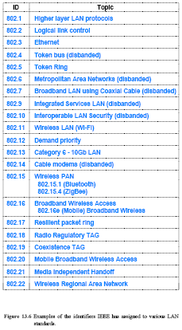
802.11ac (Wi-Fi 5)
5GHz, up to 3.5Gbps
MU-MIMO, 256-QAM
Figure 13.6
Examples of the identifiers IEEE has assigned to various LAN
standards

Slide 15
Summary of Key Wi-Fi Standards:
Standard | Frequency Band | Max Speed | Main Features | Use Cases
802.11ax (Wi-Fi 6/6E) - 2019 | 2.4 GHz, 5 GHz, 6 GHz (6E) | 9.6 Gbps | OFDMA, MU-MIMO, 1024-QAM, BSS Coloring, TWT | IoT, smart homes, high-density environments
802.11be (Wi-Fi 7) | 2.4 GHz, 5 GHz, 6 GHz | 46 Gbps (theoretical) | 320 MHz channels, 4K-QAM, Multi-Link Operation | AR/VR, 8K streaming, enterprise environments
802.11ad (WiGig) | 60 GHz | 7 Gbps | High-speed, short-range, ideal for point-to-point communication | Wireless VR, HD media streaming, docking stations
802.11ay | 60 GHz | 176 Gbps (theoretical) | Enhanced range and speed over 802.11ad | 8K streaming, wireless data centers, VR
802.11ah (HaLow) | Sub-1 GHz (900 MHz) | 347 Mbps | Low power, long-range, IoT-focused | IoT, smart cities, industrial automation
802.11af (White-Fi) | TV White Spaces | 568 Mbps | Long-range, uses TV broadcast frequencies | Rural broadband, smart agriculture, IoT

Slide 16
Point-to-Point and Multi-Access Networks
LAN technologies are for sharing
any computer on the LAN can communicate with any other
A LAN is a multi-access network
fair use of a network
LAN technologies can provide direct connection among communicating entities
LANs connect computers along with peripheral devices

Slide 17
LAN Topologies
Many LAN technologies exist
Each network is classified into a category according to its topology or general shape
This section describes four basic topologies that are used to construct
13.8.1 Bus Topology
13.8.2 Ring Topology
13.8.3 Mesh Topology
13.8.4 Star Topology
Tree topology – scalable & flexible but root node failure disrupts the network
Hybrid topology – combination of topologies, flexible, complex design and management

Slide 18
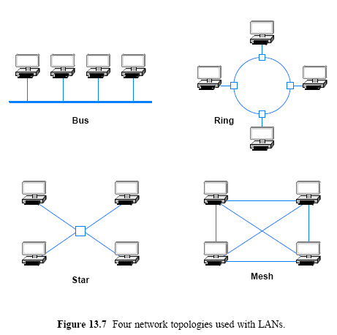
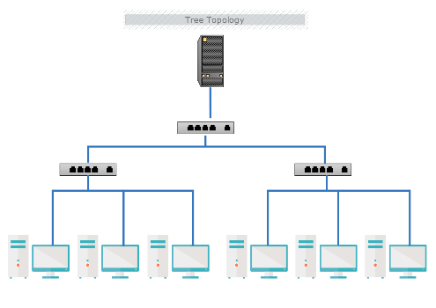
LAN Topologies
Tree

Slide 19
LAN Topologies Bus Topology
Bus topology usually consists of a single cable to which computers attach
The ends of a bus network must be terminated
to prevent electrical signals from reflecting back along the bus
Any computer attached to a bus can send on the cable
and all computers receive the signal
Because all computers attach directly to the cable
any computer can send data to any other computer
The computers attached to a bus network must coordinate
to ensure that only one computer sends a signal at any time

Slide 20
LAN Topologies Ring Topology
Ring topology arranges for computers to be connected in a closed loop
name ring arises because one can imagine the computers and the Ring topology requires a computer to connect to a small device that forms the ring
this is needed for the ring to continue operation even if some of the computers are disconnected

Slide 21

LAN Topologies Mesh Topology
A network that uses a mesh topology provides a direct connection between each pair of computers
The chief disadvantage of a mesh arises from the cost:
A mesh network connecting n computers requires:
The important point is that the number of connections needed for a mesh network grows faster than the number of computers
Because connections are expensive
few LANs employ a mesh topology in special circumstances

Slide 22
LAN Topologies Star Topology
In star topology, all computers attach to a central point
The center of a star network is often called a hub
A typical hub
accepts data from a sending computer and delivers it to the appropriate destination
Star networks seldom have a symmetric shape
a hub often resides in a location separate from the computers attached to it
For example, computers can be in offices, while the hub resides in a location where general access is not allowed

Slide 23
LAN Topologies The Reason for Multiple Topologies
A ring makes it easy for computers to coordinate access and to detect whether the network is operating correctly
One cut in the connection may disable entire network
A star helps protect the network from damage to a single cable because each cable connects only one machine
A bus requires fewer wires than a star, but has the same disadvantage as a ring

Slide 24
Summary Table of LAN Topologies
Topology | Description | Advantages | Disadvantages
Star | Central hub connects all devices | Easy to manage; failure of one device doesn't affect others | Central hub failure affects entire network
Bus | All devices on a single cable | Cost-effective; easy to install | Failure of main cable disrupts the network
Ring | Devices in a circular connection | Predictable transmission times | A single device or cable failure disrupts the network
Mesh | Multiple interconnections between devices | High redundancy and reliability | Expensive and complex to manage
Tree | Hierarchical structure | Scalable and easy to manage | Root node failure disrupts the network
Hybrid | Combination of topologies | Flexible and adaptable | Complex design and management

Slide 25
Packet Identification, Demultiplexing, MAC Addresses
IEEE has created a standard for addressing
Consider packets traversing a shared medium as Figure 13.2 (below) illustrates

Slide 26
Packet Identification, Demultiplexing, MAC Addresses
Each packet has a specific recipient
only the intended recipient should process the packet
Demultiplexing uses an identifier known as an address
Each computer is assigned a unique address
Each address consists of 48 bits; IEEE uses the term Media Access Control address (or simply MAC address)
Same as Ethernet address
IEEE allocates a unique address for each piece of interface
Each Network Interface Card (NIC) contains a unique IEEE address

Slide 27
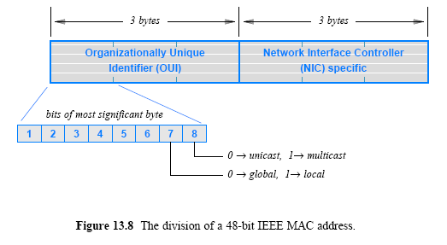
Packet Identification, Demultiplexing, MAC Addresses
IEEE assigns a block of addresses to each vendor
allows the vendor to assign a unique value to each device
there is a 3-byte Organizationally Unique ID (OUI)
OUI identifies the equipment vendor
a 3-byte block that identifies a particular NIC

Slide 28
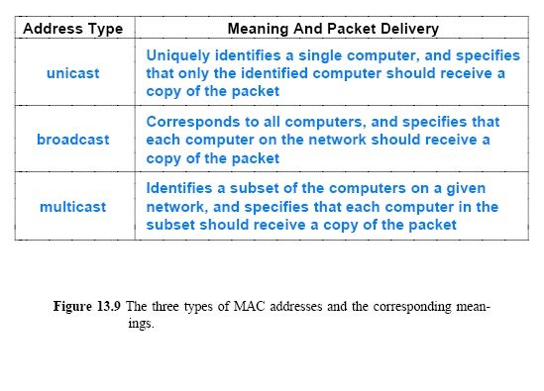
Unicast, Broadcast, and Multicast Addresses
The IEEE addressing supports three types of addresses

Slide 29
Unicast, Broadcast, and Multicast Addresses
the IEEE address format reserves a bit to distinguish between unicast and multicast
Nothing for a broadcast address
broadcast address consists of 48 bits that are all 1s
a broadcast address has the multicast bit set
Broadcast can be viewed as a special form of multicast
Each multicast address corresponds to a group of computers
Multicast addressing can be used in the link layer, such as Ethernet multicast, and the Internet layer for IP V4 and IP V6
Broadcast address corresponds to a group that includes all computers on the network

Slide 30
Broadcast, Multicast, and Efficient Multi-Point Delivery
Broadcast and multicast addresses permit efficient delivery to many computers
the efficiency comes from a shared medium
In a typical LAN
each computer on the LAN monitors the shared medium
extracts a copy of each packet and determines the address
determine whether the packet should be processed or ignored
Algorithm 13.1 gives the algorithm a computer uses to process packets

Slide 31
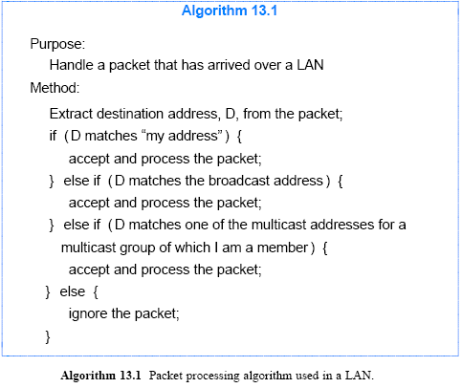
Broadcast, Multicast, and Efficient Multi-Point Delivery

Slide 32
Frame delivery
06-23-4c-f9-11-b4
MAC address: 06-23-4c-f9-11-b4
FFFFFFFFFFFF
06-23-4c-f9-11-b4
06-23-4c-13-f2-43
06-23-4c-f9-11-b4
06-23-4c-f9-3d-23
06-23-4c-13-f2-43
06-23-4c-65-d1-f7
FFFFFFFFFFFF
FFFFFFFFFFFF
FFFFFFFFFFFF
06-23-4c-13-f2-43
06-23-4c-f9-11-b4
For the listing of IEEE multicast address: http://standards.ieee.org/develop/regauth/grpmac/public.html

Slide 33
Frames and Framing
Framing
the structure added to a sequence of bits or bytes that allows a sender and receiver to agree on the exact format of the message
In a packet-switched network, each frame corresponds to a packet
A frame consists of two conceptual parts:
Header that contains metadata, such as an address
Information used to process the frame
Payload that contains the data being sent
The message being sent

Slide 34
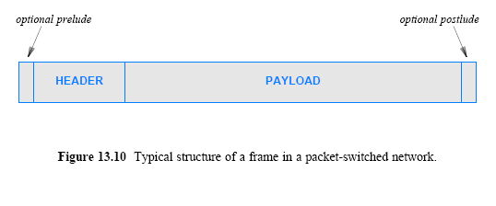
Frames and Framing
A message is opaque
The network only examines the frame header
The payload only meaningful to the sender and receiver
Some technologies delineate each frame by sending a short prelude before the frame and a short postlude after it

Slide 35
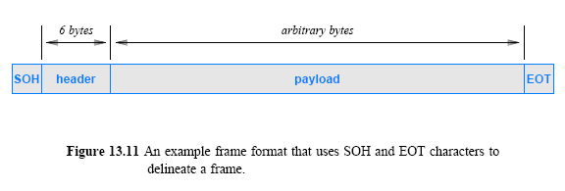
Frames and Framing
Assume that a packet header consists of 6 bytes
the payload consists of an arbitrary number of bytes
We can use ASCII character set to specify:
Beginning: the Start Of Header (SOH) character
End: the End Of Transmission (EOT) character

Slide 36
Byte and Bit Stuffing
In the ASCII character set
SOH has hexadecimal value 201
EOT has the hexadecimal value 204
An important question arises
what happens if the payload of a frame includes one or more bytes with value 201 or 204?
The answer lies in a technique known as byte stuffing
that allows transmission of arbitrary data without confusion

Slide 37
Byte and Bit Stuffing
To distinguish data from control information
Sender replaces each control byte with a sequence
Receiver replaces the sequence with the original one
the underlying system never confuses data with control information
Known as byte stuffing
the terms data stuffing and character stuffing are sometimes used
A related technique used with systems that transfer a bit stream is known as bit stuffing

Slide 38
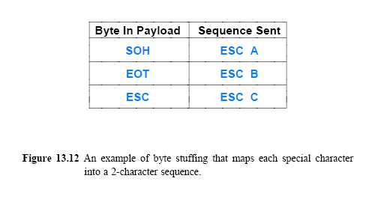
Byte and Bit Stuffing
SOH and EOT must not appear in the payload (reserved)
Byte stuffing reserves a third character to represent reserved characters in the data
E.g., the ASCII character ESC may be used as the third character
Each occurrence of the reserved <- replaced by two character sequence
One possible mapping can be:

Slide 39
Byte and Bit Stuffing
As the figure specifies
the sender replaces each occurrence of SOH by the two characters ESC + A
each occurrence of EOT by the characters ESC + B
and each occurrence of ESC by the two characters ESC + C
A receiver reverses the mapping
by looking for ESC followed by one of A, B, or C and replacing the 2-character combination with the appropriate single character
Figure 13.13 shows an example payload and the same payload after byte stuffing has occurred
Note that once byte stuffing has been performed, neither SOH nor EOT appears anywhere in the payload

Slide 40
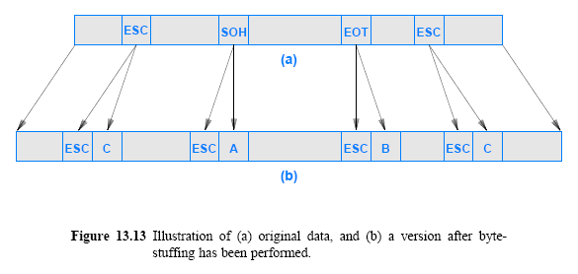
Byte and Bit Stuffing

Slide 41
Bit stuffing
Not to confused with control signals
Maintains synchronization: Prevent long sequences of the same bit value
Inserting extra, non-informational bits into the data stream to prevent misunderstanding, e.g., after 5 consecutive 1, insert one zero. Then the receiver removes it

