Slide 1
Multiplexing and Demultiplexing
COSC350

Slide 2
Multiplexing Concepts
Typically, two communicating stations will not utilize the full capacity of a data link
For efficiency, it should be possible to share that capacity
Such sharing is called multiplexing
Multiplexing to refer to the combination of information streams from multiple sources for transmission over a shared medium
Demultiplexing to refer to the separation of a combination back into separate information streams

Slide 3
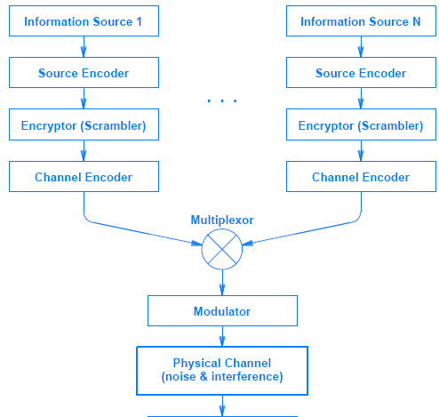
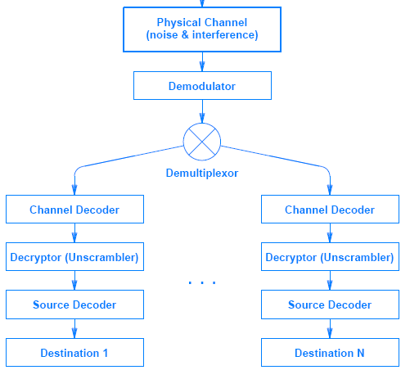
Multiplexing Concepts cont’

Slide 4
Multiplexing Concepts cont’
Multiple signals with data can be carried on the same medium without interference
Allows multiple simultaneous data streams
Dialup modems can carry full-duplex data on one voice channel
Example: multiple TV stations in air medium
Each separate signal is called channel

Slide 5
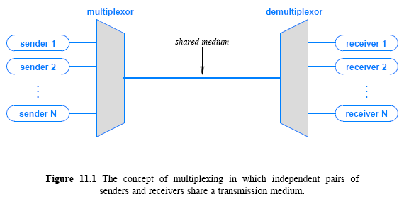

Slide 6
Types of Multiplexing
Major approaches
Frequency Division Multiplexing (FDM)
Orthogonal FDM (OFDM) : 4G/5G, Wi-Fi
Wavelength Division Multiplexing (WDM)
Time Division Multiplexing (TDM)
Code Division Multiplexing (CDM)
TDM supports legacy systems and telephony infrastructure
FDM is still widely used
WDM is a form of FDM used for optical fiber
CDM/CDMA is a mathematical approach used in cell phone mechanisms

Slide 7
Frequency Division Multiplexing
The most familiar method to anyone who ever used radio or television set – widely used, long-lived
Can be used with analog signals
Each carrier is assigned a separate channel
Modulation equipment is needed
move each signal to the required frequency band
Multiplexing equipment is needed
combine the modulated signals
Modulated signal requires a certain bandwidth called channel

Slide 8
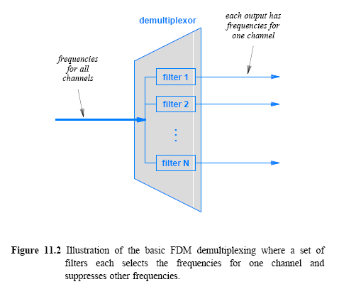

Slide 9
FDM cont’
Each communicating pair gets a private transmission path
some limitations in FDM
interference may occur if channels are too close
demultiplexer must divide the signal into separate carriers
FCC in USA regulates adequate spacing
Carrier frequencies must have a guard band
Figures 11.4 and 11.5 show an example
200 KHz allocated to each of 6 channels with a guard band of 20 KHz

Slide 10
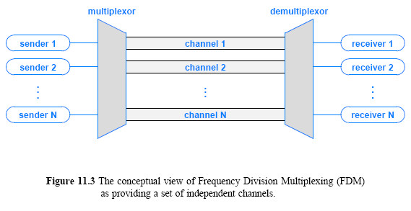

Slide 11
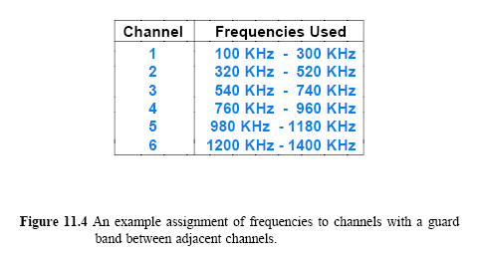
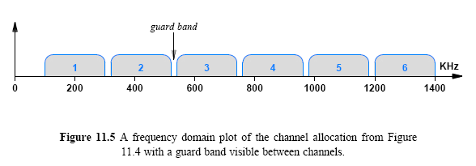

Slide 12
Range of Frequencies Per Channel
FDM susceptible to noise and distortion
Most FDM systems assign each sender and receiver pair a range of frequencies
FDM can choose how the frequencies are used
Two primary ways:
Increase the data rate
Increase immunity to interference
To increase the overall data rate
a sender divides the frequency range of the channel into K carriers
sends 1/K of the data over each carrier

Slide 13
Range of Frequencies Per Channel
A sender can perform FDM within an allocated channel
To increase immunity to interference
spread spectrum
basic idea
Divide the channel into K carriers
transmit the same data over multiple channels
a receiver choose one with fewest errors
Works well in noisy environment

Slide 14
Hierarchical FDM
FDM hardware can shift frequencies
A set of incoming signals with the range between 0 and 4 KHz
leave the first stage as is
the second onto the range 4 KHz to 8 KHz
the third onto the range 8 KHz to 12 KHz, and so on
Hierarchy in FDM multiplexors is that each maps its inputs to a larger, continuous band of frequencies
Figure 11.6 illustrates the concept of hierarchical FDM

Slide 15
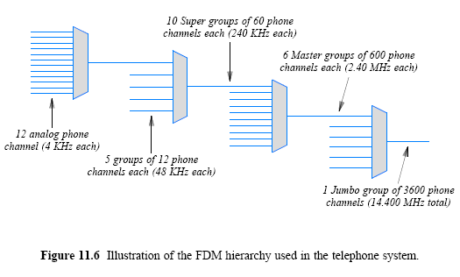

Slide 16
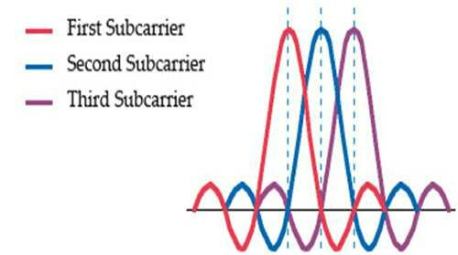
Orthogonal Frequency-Division Multiplexing
A type of digital transmission
How it works:
Incoming bitstream is divided into multiple streams
Multiple bits transmitted in parallel with overlapping spectra using multiple orthogonal subcarriers
Subcarriers are orthogonally arranged to avoid interferences
Fast Fourier transformation algorithm is used for demodulation
Application areas:
Digital television/audio broadcasting
DSL internet access
Wireless networks
4G/5G

Slide 17
Wavelength Division Multiplexing
A variation of FDM for fiber optic channels
Wavelength of light is used for multiplexing
Uses prism or diffraction grating to separate channels
Potentially many channels (hundreds) can be multiplexed together over long-haul routes
Example: DWDM: assign each source a specific wavelength (channel) and transmit all the lambdas on the same fiber optic (some successful configurations)
320 channels with 2.5Gbps (800 Gbps)
160 channels with 10Gbps (1.6 Tbps)
128 channels with 40Gbps (5.12 Tbps)
96 channels with 400Gbps (38Tbps)

Slide 18
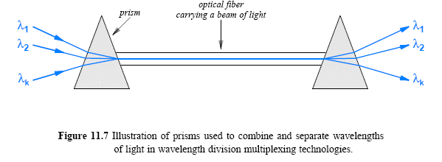

Slide 19
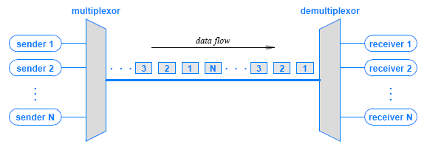
Time Division Multiplexing (TDM)
TDM does not rely on special properties of electromagnetic energy
multiplexing in time simply means transmitting an item from one source, then transmitting an item from another source, and so on

Slide 20
Synchronous Time Division Multiplexing
Can be used with digital signals or analog signals carrying digital data
When the achievable data rate of the medium exceeds the data rate of digital signals to be transmitted
Data from various sources are carried in repetitive frames and each frame consists of a set of time slots. Time slots are pre-assigned
The slot length equals to the transmitter buffer length, typically a bit or a character.
Items are sent in a round-robin fashion

Slide 21
Framing in TDM (Telephone System)
Multiplex digital streams from multiple phone calls
the specific form of TDM used to multiplex digital telephone calls
The phone system TDM
to insure that a demultiplexor stays synchronized with the multiplexor
Why synchronization?
Each slot doesn’t have any indication of the output
A demultiplexor cannot tell where a slot begins
a slight difference in the clocks can cause misinterpretation

Slide 22
Framing in TDM (Telephone System)
To prevent misinterpretation, an extra framing channel is used as input
A single bit is inserted as a framing bit
A demultiplexor extracts data from the framing channel and checks for alternating 0 and 1 bits
If an error causes a demultiplexor to lose a bit
Upon detecting an error -> allow the transmission to be restarted
Figure 11.10 illustrates the use of framing bits

Slide 23
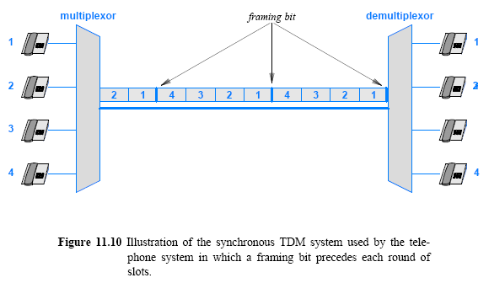

Slide 24
Hierarchical TDM
TDM hierarchy uses N times the bit rate
In FDM, each successive stage uses N times the frequencies
Additional framing bits are added to the data
the bit rate of each successive layer of hierarchy is slightly greater than the aggregate voice traffic
Compare the example TDM hierarchy
in Figure 11.11 with the FDM example in Figure 11.6

Slide 25
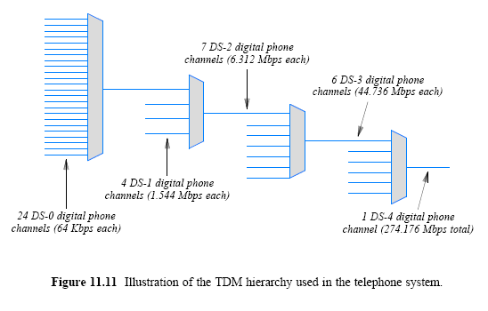

Slide 26
How to calculate T1 speed
T1 connections have 24 voice channels (24 DS0)
PCM takes 8000 samples per second
Each sample is represented by 8 bits (1 byte)
1 sample from 24 voice circuits would be 24 * 8 bits => 192 bits
All the samples will be placed into a frame
There will be 1 framing bit added in order to prevent misinterpretation
T1 transmits 8000 samples per second
8000 * 193bits => 1.544Mbps

Slide 27
Unfilled Slots with Synchronous TDM
Synchronous TDM works with uniform rate
Many sources generate data in bursts, with idle time between bursts
in Figure 11.12
sources on the left produce data items at random
the synchronous multiplexor leaves a slot unfilled
In practice, a slot cannot be empty
Empty slot is assigned a value (such as zero)
an extra bit is used to indicate invalid value

Slide 28
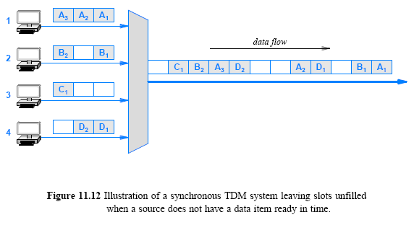

Slide 29
Statistical Time Division Multiplexing
In synchronous TDM, many of the time slots in a frame a usually wasted.
Assumption for this method is that the data rate of the output is less than the sum of the data rates of the inputs.
User data are buffered and transmitted as rapidly as possible using available time slots.
Address information is required to assure proper delivery.

Slide 30
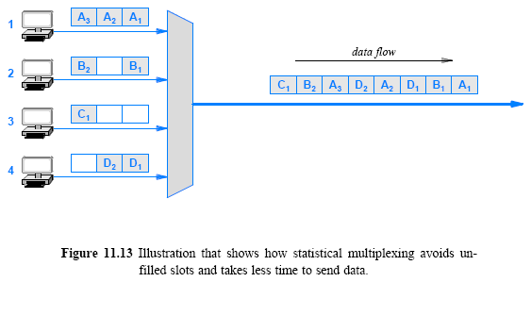
Statistical Time Division Multiplexing cont’

Slide 31
Statistical Time Division Multiplexing cont’
Statistical multiplexing incurs extra overhead
Consider demultiplexing:
In a synchronous TDM system a demultiplexor knows that every N slot corresponds to a given receiver
In a statistical multiplexing system, the data in a given slot can correspond to any receiver
Each slot must contain the identification of the receiver to which the data is being sent
Later chapters discuss identification mechanisms
that are used with statistical multiplexing in packet switching networks and the Internet

Slide 32
Inverse Multiplexing
Consider two points with multiple transmission media
no single medium’s bit rate is sufficient
To solve the problem, multiplexing is used in reverse
spread a high-speed digital input over multiple lower-speed circuits for transmission and combine the results at the receiving end

Slide 33
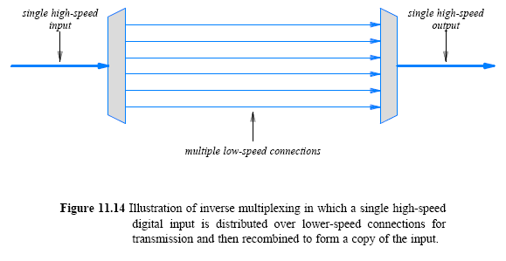
Inverse Multiplexing

Slide 34
Inverse Multiplexing
An inverse multiplexor requires special hardware
the sender and receiver agree on how data arriving from the input will be distributed over the lower-speed connections
Different delay may cause out of order arrival
the system must insure that the order is preserved
Despite its complexity, inverse multiplexing is widely used in the Internet

Slide 35
Code Division Multiplexing (CDM)
Several channels simultaneously share the same
Used in some cellular telephone system and some satellite communication
Cellular telephone version is called Code Division Multi-Access (CDMA)
When CDM is used to allow multiple users to share a single communications channel
Another important application of CDMA is the GPS

Slide 36
CDM (or spread spectrum)
Each sender is assigned a unique binary code C_{i}
that is known as a chip sequence
chip sequences are selected to be orthogonal vectors
(dot product of any two sequences are zero, e.g., U•V = 0)
CDM doesn’t rely on physical properties but on values from orthogonal vector spaces

Slide 37
CDM (or spread spectrum) cont’
At any point in time, each sender has a value to transmit, V_{i}
The senders each multiply C_{i} x V_{i} and transmit the results
Simultaneous transmission
the values are added together
over the same frequency band
To extract value V_{i}, a receiver multiplies the sum by C_{i}
Ex: c₁v₁, c₂v₂ -> c₁v₁+ c₂v₂ (transmission)
-> (c₁v₁+ c₂v₂ ) * c₁(extraction of v₁)

Slide 38
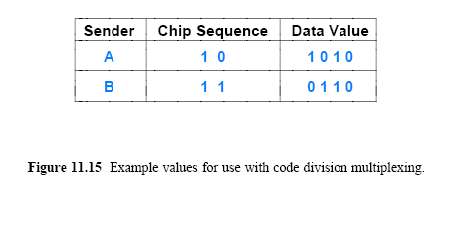
CDM

Slide 39
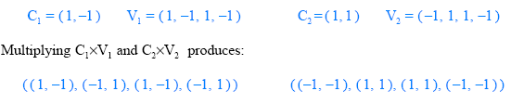
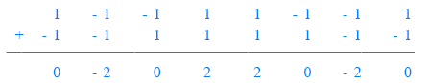
CDM
The first step consists of converting the binary values into vectors that use -1 to represent 0:
If we think of the resulting values as a sequence of signal strengths to be transmitted at the same time
the resulting signal will be the sum of the two signals

Slide 40
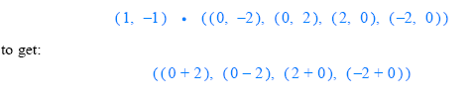
CDM
A receiver treats the sequence as a vector
computes the product of the vector and the chip sequence
treats the result as a sequence, and converts the result to binary by interpreting positive values as binary 1 and negative values as 0
Thus, receiver number 1 computes:
Interpreting the result as a sequence produces: (2 -2 2 -2)
which becomes the binary value: (1 0 1 0)
note that 1010 is the correct value of V₁
receiver 2 will extract V₂ from the same transmission

