Slide 1
Transmission Modes
COSC350

Slide 2
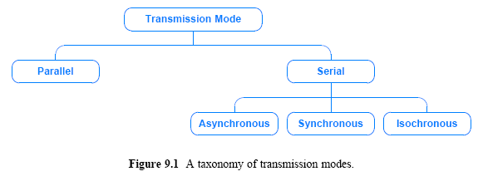
A Taxonomy of Transmission Modes
The way data is sent over the underlying medium
Serial: one bit is sent at a time
Parallel: multiple bits are sent at the same time

Slide 3
Parallel Transmission
Transfer data bits at the same time over separate media
Used with a wired medium that uses multiple, independent wires
The signals on all wires are synchronized
Advantages
High speed: it can send N bits at the same time
Match to underlying hardware

Slide 4
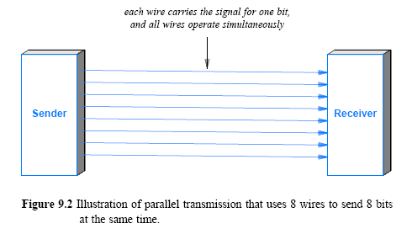

Slide 5
Serial Transmission
One bit at a time
Advantages
Can be extended with much less cost
No timing problem: only one wire
No electromagnetic noise at high data rate
To use serial communication
Convert between parallel form to the serial form used on the wire
Simple case:
A single chip known as Universal Asynchronous Receiver and Transmitter (UART) for conversion

Slide 6
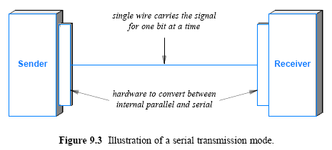

Slide 7
Transmission order: Bits and Bytes
MSB or LSB first?
Little-endian: LSB first
Big-endian: MSB first
Sender and receiver must agree
MSB and LSB can be used together
Byte: big-endian, bit: little-endian
E.g. 87654321 16 15 14 13 12 11 10 9 …..

Slide 8
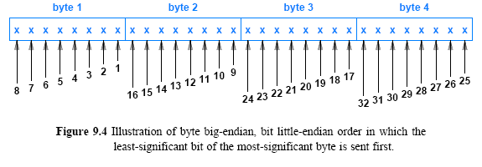

Slide 9
Universal Serial Bus
An industry standard developed in the mid-1990s
Designed to standardize the connection of computer peripherals to personal computers
Effectively replaced a variety of earlier interfaces such as serial and parallel ports, as well as power chargers for portable devices
The most recent USB specification is USB4 Version 2.0, which offers a significant bandwidth upgrade of up to 80 Gbps.

Slide 10
Universal Serial Bus
Up to 80Gbps (USB4. V2)
External GPU, 3D rendering,
VR, AR, enterprise edge computing
and cloud computing

Slide 11
Timing of Serial Transmission
Three categories:
Asynchronous transmission can occur at any time
Synchronous transmission occurs continuously with no gap between the transmission of two data items
Isochronous transmission occurs at regular intervals with a fixed gap

Slide 12
Encoding details
Several standard organizations specify the details:
IEEE
ITU
EIA
To be interoperable network hardware should conform to the standards

Slide 13
The RS-232C Standard
Example use
Connection to keyboard/mouse
Serial port on PC
Specified by EIA
Voltage is +15 or –15
Cable limited to < 50 feet
Uses asynchronous communication

Slide 14
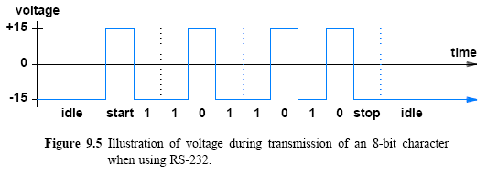

Slide 15
Asynchronous communication
Sender and receiver must agree on
Number of bits per character
Duration of each bit
Receiver
Does not know when a character will arrive
May wait forever
To ensure meaningful exchange send
Start bit before character
One or more stop bits after character

Slide 16
Synchronous Transmission
A synchronous mechanism transmits
back-to-back transmission
The sender and receiver must remain synchronized
RS-232 requires an extra start bit and stop bit
Requires 10 bit times
On a synchronous system
each character is sent without start or stop bits

Slide 17
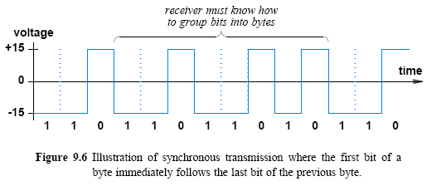

Slide 18
Duration of a bit in RS-232C
Determined by baud rate
Typical baud rate is 9.6Kbaud, 14.4Kbaud, 28.8Kbaud
Duration of bit is 1/baud_rate
Sender and receiver must agree on the details
Receiver examines signal
Disagreement results in framing error

Slide 19
Bytes, Blocks, and Frames
When sender sends bits continually with synchronous mechanism
Use of framing:
Frame is used in a synchronous mechanism to handle a block of bytes
For proper synchronization
a frame starts with a special sequence of bits
When no data to send
an idle sequence (or idle byte)

Slide 20
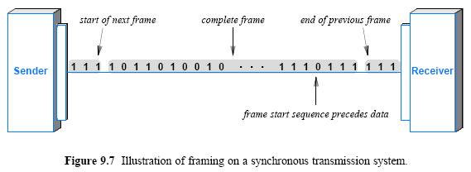

Slide 21
Isochronous Transmission
Isochronous transmission
Provides steady bit flow for multimedia applications
Reasoning for steady bit flow
To prevent jitter
At a fixed rate, R
Network interface handles transmission at exactly R bits per second

Slide 22
Simplex, Half-Duplex, and Full-Duplex Transmission
Type of communications channel:
Simplex
Full-Duplex
Half-Duplex
Simplex: transfer data in a single direction
analogous to broadcast radio or television
Full-Duplex: allows transmission in two directions simultaneously
analogous to a voice telephone conversation

Slide 23
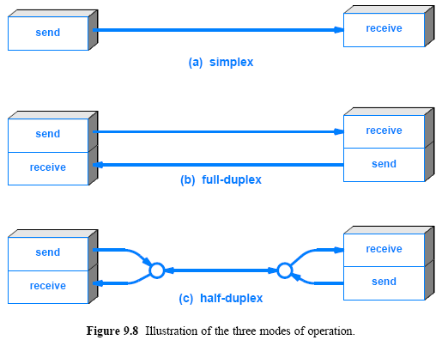

Slide 24
Simplex, Half-Duplex, and Full-Duplex Transmission
Half-Duplex: A half-duplex mechanism involves a shared transmission medium
The shared medium can be used for communication in each direction but not simultaneously
It is analogous to using walkie-talkies

Slide 25
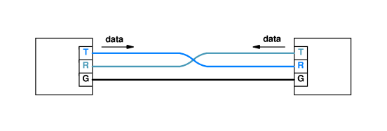
Two-way communication
Desirable in practice
Require each side to have transmitter and receiver
Called full-duplex
Transmitter on one side connected to receiver on other
Separate wires needed to carry current in each direction
Common ground wire
DB-25 connector (RS-232 defines it) used
Pin 2 is transmit
Pin 3 is receive

Slide 26
DCE and DTE Equipment
Terms Data Communications Equipment (DCE) and Data Terminal Equipment (DTE) - originally from AT&T
Communication equipment (circuit-terminating equipment)
DTE typically represents computers, terminals, or devices that originate or process data
DCE refers to devices like modems, routers, or network interfaces that provide a connection between DTE and a communication line e.g. modem <-> phone line
When a business leases a data circuit from a phone company
the phone company installs DCE equipment
the business attaches DTE equipment to the DCE equipment

Slide 27
DCE and DTE Equipment
Several standards for the interface between DCE and DTE
The RS-232 standard: lower than 20Kbps
the RS-449 standard: 2Mbps
The RS-485 standard: 10Mbps, up to 4000ft, half/full duplex
The RS-422 standard: 10Mbps, up to 4000ft, full duplex

Slide 28
