Slide 1
Operating Systems: Introduction
Dr. Orathai Sangpetch
Dr. Akkarit Sangpetch
Department of Computer Engineering
Faculty of Engineering, KMITL
January 13th,2017
Adapted from “Operating Systems: Principles and Practice” by Tom Anderson (University of Washington)
Notes:
I really like teaching this class – one of the most complex topics in all of CS, and one of the most important for your careers. You get to poke under the hood to see how things really work. And a lot of what you find in an OS, has an analogue in real life -- you’ll find you won’t be able to look at a traffic jam or a supermarket line the same way again.

Slide 2
Administrative Info
Dr. Orathai Sangpetch
Email: orathai.sa@kmitl.ac.th
Dr. Akkarit Sangpetch
Email: akkarit.sa@kmitl.ac.th
Office hour: Contact us after lectures or by appointment
Canvas: All announcements, grades, lectures and assignments
Use the following join code: J9F4MA for the enrollment (https://canvas.instructure.com/enroll/J9F4MA)

Slide 3
Grading Scheme
50% - 2 Exams: Midterm Exam + Final Exam
50% - 2 Programming Assessments (8-9 people per group)
Scoring
≥ 90% → at least A
≥ 85% → at least B+
≥ 80% → at least B
≥ 75% → at least C+
≥ 70% → at least C
≥ 65% → at least D+
≥ 60% → at least D

Slide 4
Academic Integrity
If you cheat on an exam,
1st time offender will get a zero grade for the assignment (both the author and the copier of duplicate works)
Repeated offender will get an F for the class + Expulsion
For project submissions,
Copying your friends’ code partially or fully will result in an F
Copying code from the Internet without proper attribution will result in an F
Anything else that could considered plagiarism will get you zero or F
We don’t give permission for emergency drops

Slide 5
How This Course Fits in CE Curriculum
Systems Programming
Project experience in C/C++
How to use the operating system interface
Operating Systems
How to make a single computer work reliably
How an operating system works internally
Distributed Systems
How to make a set of computers work reliably, despite failures of some nodes

Slide 6
Main Points
Operating system definition
Software to manage a computer’s resources for its users and applications
OS challenges
Reliability, security, responsiveness, portability, …
OS history
How are OS X, Windows 8, and Linux related?

Slide 7
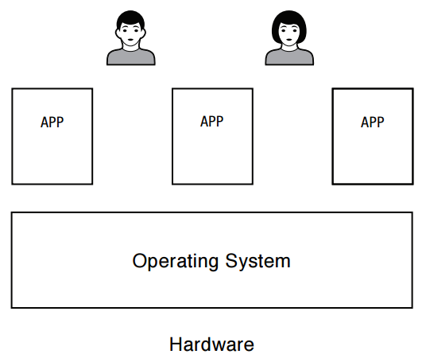
What is an operating system?
Software to manage a computer’s resources for its users and applications
Notes:
In some sense, OS is just a software engineering problem: how do you convert what the hardware gives you into something that the application programmers want?
For any OS area (file systems, virtual memory, networking, CPU scheduling), begin by asking two questions:
what’s the hardware interface? (the physical reality)
what’s the application interface? (the nicer abstraction)
We’ve broken it down a bit: we have users and their applications. You probably already know about libraries – that applications can be linked with code that helps them do their job, e.g., like the C library, with malloc and free and string operations.
But when you write an app, you write it as if it has the entire machine – you don’t need to worry about the fact that there are multiple other apps running at the same time. It doesn’t crash just because one of those other apps has a bug. This interface is an abstract virtual machine – an abstraction that allows programmers to ignore the OS.
Much of the OS runs in “kernel mode” – we’ll describe that in the next lecture. That code provides applications the abstraction of their own dedicated hardware. And under all of that is another abstraction, that allows the OS to run on a variety of different hardware – this is the HAL. That way, you can change the underlying hardware, without changing (much of) the OS.
Need to have the various layers coordinate – library makes calls into the kernel to do things, like write file data to the disk, or get a network packet. But they run in separate domains.
As you look at the code in OS/161, or if you look inside Linux (or any other OS you might find), you’ll see these three categories.
Kern – kernel code
Userland – system libraries
Kern/arch – machine dependent routines, specific to each different type of CPU
One of the first questions you’ll see in assignment 0 is: how does a system call work? Where do you find the code to read from a file in userland? Where do you find the code to read from a file in the kernel? Where do you find the machine-specific code to read from the physical disk?

Slide 8
Operating System Roles
Referee:
Resource allocation among users, applications
Isolation of different users, applications from each other
Communication between users, applications
Illusionist
Each application appears to have the entire machine to itself
Infinite number of processors, (near) infinite amount of memory, reliable storage, reliable network transport
Glue
Libraries, user interface widgets, …
Notes:
Each of these points is pretty complex! But we’ll see a lot of examples.
90% of the code in an OS is in the glue – but its mostly easy to understand, so we won’t spend any time on it.
Consider the illusion though – you buy a new computer, with more processors than the last one. But you don’t have to get all new software – the OS is the same, the apps are the same, but the system runs faster. How does it do that? You buy more memory – you don’t change the OS, you don’t change the apps, but the system runs faster. How does it do that?
Part of the answer is that the OS serves as the referee between applications. How much memory should everyone have? How much of the CPU?
The OS also has to isolate the different applications and users from each other – if one app crashes, you don’t want it to require a system reboot. If one user writes a buggy app on attu, you don’t want it to crash the system for everyone else. How is that even possible?

Slide 9
Example: File Systems
Referee
Prevent users from accessing each other’s files without permission
Even after a file is deleting and its space re-used
Illusionist
Files can grow (nearly) arbitrarily large
Files persist even when the machine crashes in the middle of a save
Glue
Named directories, printf, …
Notes:
Ask: Examples of OS as referee?
Examples of OS as illusionist?

Slide 10
Question
What (hardware, software) do you need to be able to run an untrustworthy application?
Notes:
Ask audience for ideas – they’ve taken machine structures.
Answer: need memory protection, but also ability to interrupt a running job. And to have a privileged mode – capable of changing the memory proection.

Slide 11
Question
How should an operating system allocate processing time between competing uses?
Give the CPU to the first to arrive?
To the one that needs the least resources to complete? To the one that needs the most resources?

Slide 12
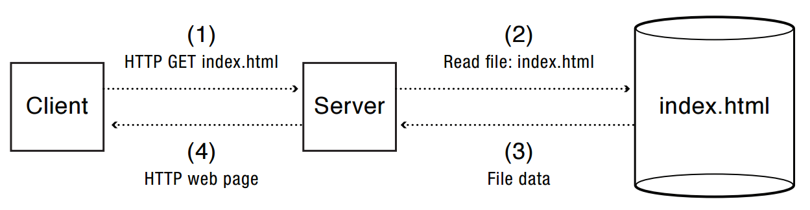
Example: web service
How does the server manage many simultaneous client requests?
How do we keep the client safe from spyware embedded in scripts on a web site?
How do make updates to the web site so that clients always see a consistent view?
Notes:
Other challenges: Server invokes helper apps. How does the operating system enable multiple applications to communicate with each other?
Synchronize access by multiple requests to shared state

Slide 13
OS Challenges
Reliability
Does the system do what it was designed to do?
Availability
What portion of the time is the system working?
Mean Time To Failure (MTTF), Mean Time to Repair
Security
Can the system be compromised by an attacker?
Privacy
Data is accessible only to authorized users
Notes:
An excuse to define some terms!

Slide 14
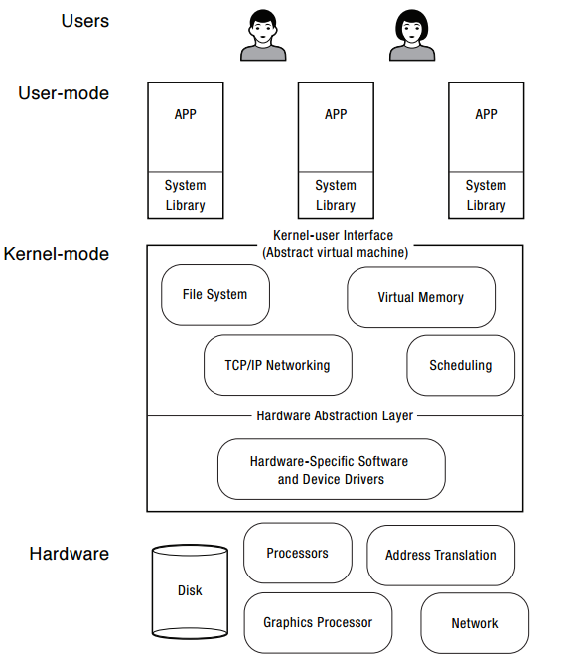
OS Challenges
Portability
For programs:
Application programming interface (API)
Abstract virtual machine (AVM)
For the operating system
Hardware abstraction layer

Slide 15
OS Challenges
Performance
Latency/response time
How long does an operation take to complete?
Throughput
How many operations can be done per unit of time?
Overhead
How much extra work is done by the OS?
Fairness
How equal is the performance received by different users?
Predictability
How consistent is the performance over time?

Slide 16
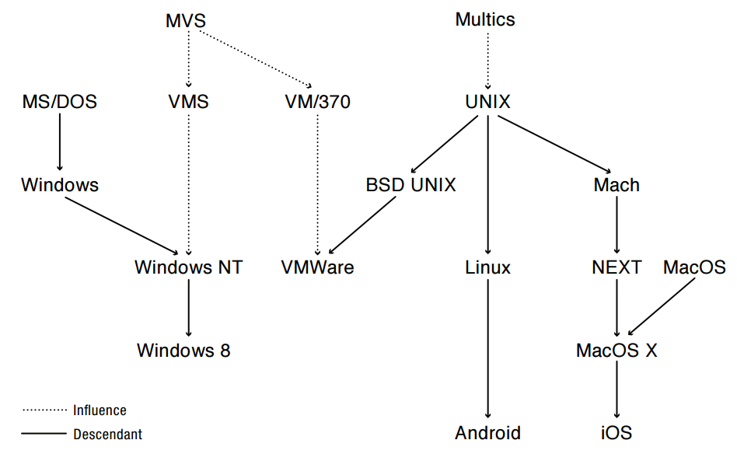
OS History
Notes:
Walk through some of the connections: Windows dragged in some tech from VMS and UNIX
If relevant, draw in Toy, Nachos, Pintos
Also: Pilot, Taos -> Nachos

Slide 17
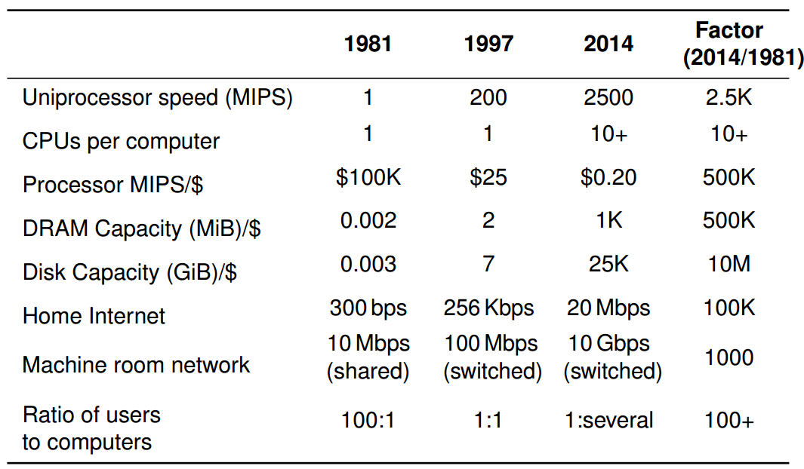
Computer Performance Over Time
Notes:
If the OS code base lasts for 20 years, it has to survive between at least two of these columns – that’s a huge amount of change; a couple orders of magnitude in CPU speed, cost/performance, DRAM, and disk capacity. You often hear about Moore’s Law – how CPU has sped up a huge amount. But memory and disk have gone up by even more!
A lot of hardware has sped up, but some hasn’t. These relative performance changes are pretty important. Its not listed here, but disks have become much bigger, but they haven’t gotten much faster – a disk access still takes almost as long as it did in 1981, so the relative speed of the CPU and the disk has become enormous.
Same thing for the network: the Internet backbone has sped up a lot, but a bit harder to see that difference per machine.
Perhaps most interesting is the # of users per machine – that ratio has changed dramatically, and it’s a consequence of the 500K times change in cost/performance of computing
Maybe things will suddenly stop, but more likely that we’ll see continued speed improvements. The right hand column – you’d find that so painfully slow that you wouldn’t be able to stand it. Yet that’s what we had when I was in college. Most of your professional life, you’ll be using this right hand column as the illustration of how slow things were when you were in college!

Slide 18
Early Operating Systems: Computers Very Expensive
One application at a time
Had complete control of hardware
OS was runtime library
Users would stand in line to use the computer
Batch systems
Keep CPU busy by having a queue of jobs
OS would load next job while current one runs
Users would submit jobs, and wait, and wait, and
Notes:
And wait…

Slide 19
Time-Sharing Operating Systems: Computers and People Expensive
Multiple users on computer at same time
Multiprogramming: run multiple programs at same time
Interactive performance: try to complete everyone’s tasks quickly
As computers became cheaper, more important to optimize for user time, not computer time

Slide 20
Today’s Operating Systems: Computers Cheap
Smart phones
Embedded systems
Laptops
Tablets
Virtual machines
Data center servers

Slide 21
Tomorrow’s Operating Systems
Giant-scale data centers
Increasing numbers of processors per computer
Increasing numbers of computers per user
Very large scale storage

