Slide 1
Operating Systems: Kernel Abstraction
January 13th,2016
Dr. Orathai Sangpetch
Dr. Akkarit Sangpetch
Department of Computer Engineering
Faculty of Engineering, KMITL
Adapted from “Operating Systems: Principles and Practice” by Tom Anderson (University of Washington)

Slide 2
Debugging as Engineering
Much of your time in this course will be spent debugging
In industry, 50% of software dev is debugging
Even more for kernel development
How do you reduce time spent debugging?
Produce working code with smallest effort
Optimize a process involving you, code, computer
Notes:
(Why to do research!)
Debugging. You’ll spend 50% of your time debugging. So get great at it. Think of it as a machine: how do you optimize the speed at which you can identify bugs and fix them? First, gain a clear understanding of the problem and the solution before you start coding.
I mention this here because you’ll start debugging with assignment 1, so good to shake off the rust this week.

Slide 3
Debugging as Science
Understanding -> design -> code
not the opposite
Form a hypothesis that explains the bug
Which tests work, which don’t. Why?
Add tests to narrow possible outcomes
Use best practices
Always walk through your code line by line
Module tests – narrow scope of where problem is
Develop code in stages, with dummy replacements for later functionality
Notes:
Form a hypothesis. You have inputs – what you typed. Outputs – what the program did. What possible hypotheses explain the problem? Can you develop a test to differentiate between those possibilities?
Its also helpful to step through your code, one instruction at a time. You wrote the control flow, does it follow your intent?
Module tests – develop ways of testing sub-sets, so that you can eliminate them from the possible hypotheses that would explain the program behavior.
Stubs – develop code in stages, with dummy replacements for certain

Slide 4
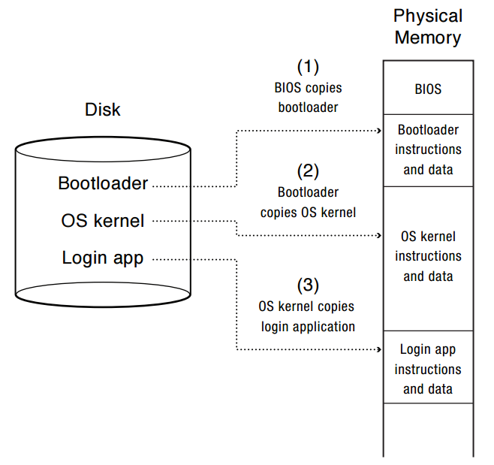
Booting
Notes:
When you power up a computer, what happens? Starts executing instructions. Why not start running the OS in step 1?
Why does the BIOS load the bootloader?
When the OS starts running, are interrupts enabled?
When will it be possible to start displaying things to the screen? Or console.
OS/161 – you start running the OS kernel after the bootloader has loaded it.
Why not just start running the app in the kernel?
Kind of inconvenient if you have to reboot all the time, just to change the app!
Also, could allow the app to access data on disk that it doesn’t have permission to do, etc.

Slide 5
Device Interrupts
OS kernel needs to communicate with physical devices
Devices operate asynchronously from the CPU
Polling: Kernel waits until I/O is done
Interrupts: Kernel can do other work in the meantime
Device access to memory
Programmed I/O: CPU reads and writes to device
Direct memory access (DMA) by device
Buffer descriptor: sequence of DMA’s
E.g., packet header and packet body
Queue of buffer descriptors
Buffer descriptor itself is DMA’ed
Notes:
OK, a quick tour of I/O. Without I/O, can’t do much of anything!

Slide 6
Device Interrupts
How do device interrupts work?
Where does the CPU run after an interrupt?
What is the interrupt handler written in? C? Java?
What stack does it use?
Is the work the CPU had been doing before the interrupt lost forever?
If not, how does the CPU know how to resume that work?
Notes:
I’m going to answer these questions, kind of as a side light to the rest of the discussion. But they are pretty important!

Slide 7
Challenge: Protection
How do we execute code with restricted privileges?
Either because the code is buggy or if it might be malicious
Some examples:
A script running in a web browser
A program you just downloaded off the Internet
A program you just wrote that you haven’t tested yet
Notes:
Not just about OS’es; not just bugs

Slide 8
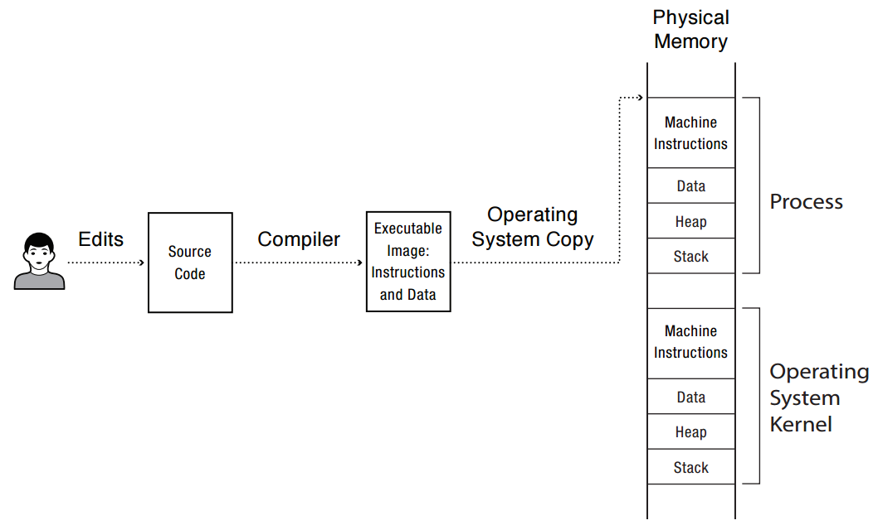
A Problem: How to run a program?
Notes:
OK, so you compile your program into an executable image with instructions and data.
Which of these is the program? How does it start running? Well, if its Javascript – no compilation step! Just interprets the source code.
If its Android, then its compiled into a byte code that is interpreted in software – well, actually, interpreted into short snippets of instructions, with jumps back into the interpreter when done.
If it’s attu, then compiled into x86 instructions.
What’s to keep the process from overwriting the OS kernel? Or some other process running at the same time?
What’s to keep it from overwriting the disk? From reading someone else’s files that are stored on disk?

Slide 9
Main Points
Process concept
A process is the OS abstraction for executing a program with limited privileges
Dual-mode operation: user vs. kernel
Kernel-mode: execute with complete privileges
User-mode: execute with fewer privileges
Safe control transfer
How do we switch from one mode to the other?

Slide 10
Process Abstraction
Process: an instance of a program, running with limited rights
Thread: a sequence of instructions within a process
Potentially many threads per process (for now 1:1)
Address space: set of rights of a process
Memory that the process can access
Other permissions the process has (e.g., which system calls it can make, what files it can access)

Slide 11
Thought Experiment
How can we implement execution with limited privilege?
Execute each program instruction in a simulator
If the instruction is permitted, do the instruction
Otherwise, stop the process
Basic model in Javascript and other interpreted languages
How do we go faster?
Run the unprivileged code directly on the CPU!
Notes:
Upsides? Downsides to this approach? Essentially what you do in Javascript in a browser – simulate the execution of the script, one line at a time.

Slide 12
Hardware Support: Dual-Mode Operation
Kernel mode
Execution with the full privileges of the hardware
Read/write to any memory, access any I/O device, read/write any disk sector, send/read any packet
User mode
Limited privileges
Only those granted by the operating system kernel
On the x86, mode stored in EFLAGS register
On the MIPS, mode in the status register
Notes:
Obviously, you need the part that has full rights to be really reliable!

Slide 13
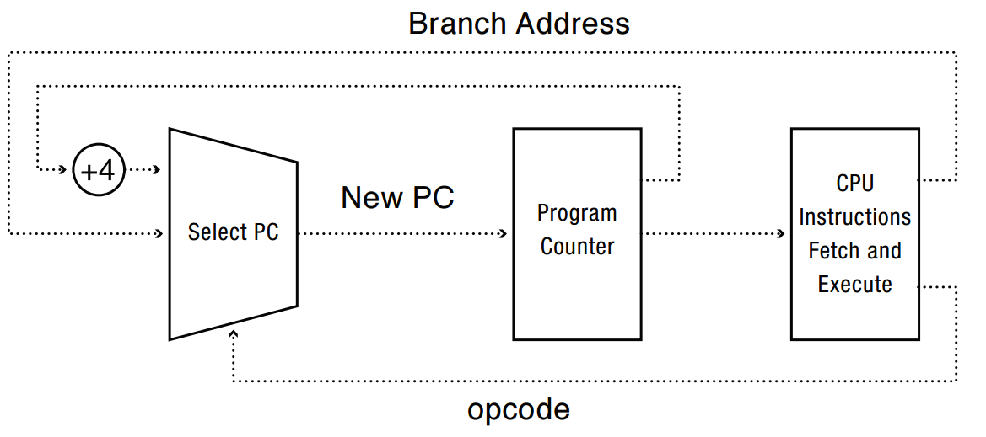
A Model of a CPU

Slide 14
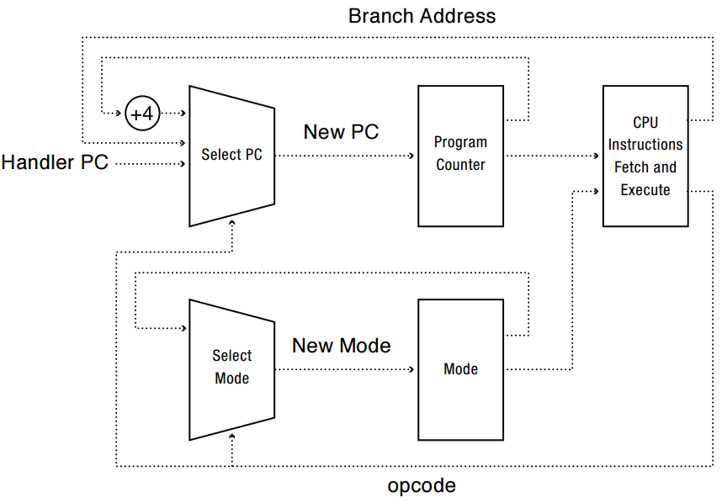
A CPU with Dual-Mode Operation
Notes:
Where do interrupts fit in?

Slide 15
Hardware Support: Dual-Mode Operation
Privileged instructions
Available to kernel
Not available to user code
Limits on memory accesses
To prevent user code from overwriting the kernel
Timer
To regain control from a user program in a loop
Safe way to switch from user mode to kernel mode, and vice versa

Slide 16
Privileged instructions
Examples?
What should happen if a user program attempts to execute a privileged instruction?
Notes:
Change mode bit in EFLAGs register!
Change which memory locations a user program can access
Send commands to I/O devices
Read data from/write data to I/O devices
Jump into kernel code
…

Slide 17
Question
For a “Hello world” program, the kernel must copy the string from the user program memory into the screen memory.
Why not allow the application to write directly to the screen’s buffer memory?

Slide 18
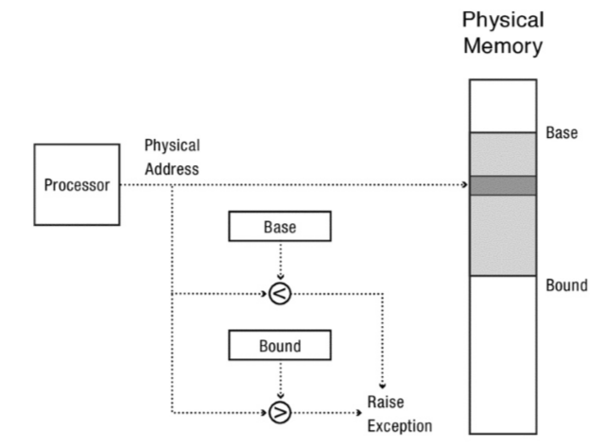
Simple Memory Protection
Notes:
Second thing

Slide 19
Towards Virtual Addresses
Problems with base and bounds?
Notes:
Expandable heap?
Expandable stack?
Memory sharing between processes?
Non-relative addresses – hard to move memory around
Memory fragmentation

Slide 20
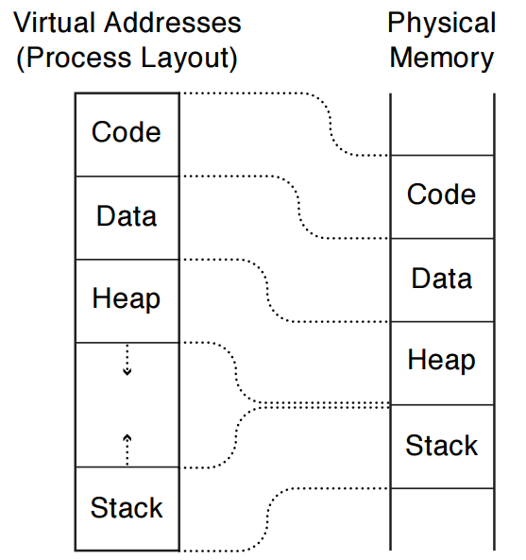
Virtual Addresses
Translation done in hardware, using a table
Table set up by operating system kernel
Notes:
On every instruction!
Table of instructions set up by the kernel: similar idea to buffer descriptor queue for I/O

Slide 21
Example
int staticVar = 0; // a static variable
main() {
staticVar += 1;
sleep(10); // sleep for x seconds
printf("static address: %x, value: %d\n", &staticVar, staticVar);
}
What happens if we run two instances of this program at the same time?
What if we took the address of a procedure local variable in two copies of the same program running at the same time?
Notes:
Because of stack address munging on modern systems (to prevent viruses), if you use a procedure local variable, won’t get the same result – different addresses used by different instances

Slide 22
Question
With an object-oriented language and compiler, only an object’s methods can access the internal data inside an object. If the operating system only ran programs written in that language, would it still need hardware memory address protection?
What if the contents of every object were encrypted except when its method was running, including the OS?

Slide 23
Hardware Timer
Hardware device that periodically interrupts the processor
Returns control to the kernel handler
Interrupt frequency set by the kernel
Not by user code!
Interrupts can be temporarily deferred
Not by user code!
Interrupt deferral crucial for implementing mutual exclusion
Notes:
How do I stop a runaway program? How do I know if a runaway program needs to be stopped, or its just taking a long time?

Slide 24
Mode Switch
From user mode to kernel mode
Interrupts
Triggered by timer and I/O devices
Exceptions
Triggered by unexpected program behavior
Or malicious behavior!
System calls (aka protected procedure call)
Request by program for kernel to do some operation on its behalf
Only limited number of very carefully coded entry points
Notes:
Might work better starting with interrupts!

Slide 25
Question
Examples of exceptions
Examples of system calls

Slide 26
Mode Switch
From kernel mode to user mode
New process/new thread start
Jump to first instruction in program/thread
Return from interrupt, exception, system call
Resume suspended execution
Process/thread context switch
Resume some other process
User-level upcall (UNIX signal)
Asynchronous notification to user program

Slide 27
How do we take interrupts safely?
Interrupt vector
Limited number of entry points into kernel
Atomic transfer of control
Single instruction to change:
Program counter
Stack pointer
Memory protection
Kernel/user mode
Transparent restorable execution
User program does not know interrupt occurred

Slide 28
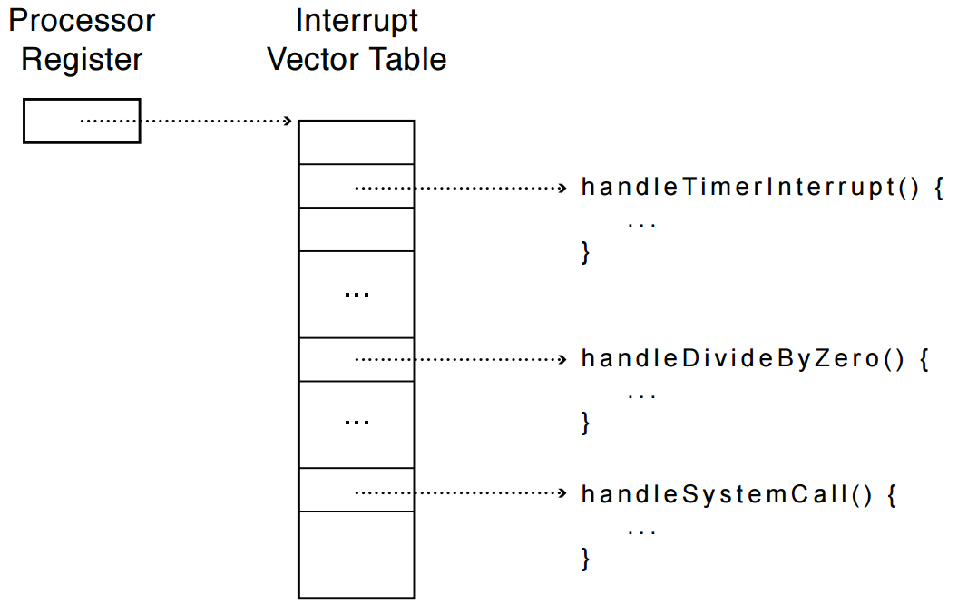
Interrupt Vector
Table set up by OS kernel; pointers to code to run on different events
Notes:
Note: by “processor register” I do not mean %eax. Rather – these are special purpose registers.

Slide 29
Interrupt Stack
Per-processor, located in kernel (not user) memory
Usually a process/thread has both: kernel and user stack
Why can’t the interrupt handler run on the stack of the interrupted user process?
Notes:
What goes in a stack frame?
Frame pointer
Locals
Return address

Slide 30
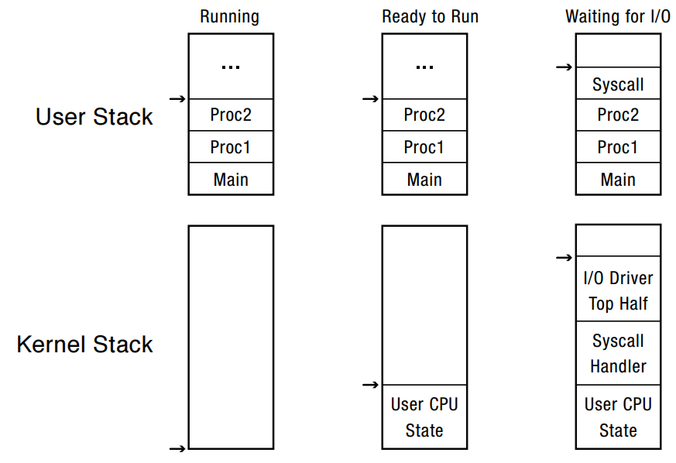
Per-Process Interrupt Stack
Notes:
Lots of complexity on this slide. Let’s unpack:
Every process/thread has two stacks. When the process is running, does the kernel stack have anything useful on it? You might think yes – it called into the user program. But actually no – the user program doesn’t return from main.
Need to change this to add “crt0.s” – main returns to crt0.s, and then calls exit.
Best to think of this as multiple personality disorder: sometimes we want to save context, other times not!
When a process is ready to run, but not running – it has its user stack as before, but now I also need a place to store the state that had been in the CPU when it stopped running
When a process is waiting for I/O, it had done a system call, etc.

Slide 31
Interrupt Masking
Interrupt handler runs with interrupts off
Re-enabled when interrupt completes
OS kernel can also turn interrupts off
E.g., when determining the next process/thread to run
On x86
CLI: disable interrupts
STI: enable interrupts
Only applies to the current CPU (on a multi-core)
We’ll need this to implement synchronization

Slide 32
Interrupt Handlers
Interrupt handlers are usually divided into two parts
Bottom half (Linux’s top half): Non-blocking, run to completion
Minimum necessary to allow device to take next interrupt
Any waiting must be limited duration
Wake up other threads to do any real work
Top half (Linux’s Bottom half)
Run as another kernel thread
Notes:
Skip this slide – too much for the students to get

Slide 33
Case Study: x86 Interrupt
Save current stack pointer (SP)
Save current program counter (PC)
Save current processor status word (PSW - condition codes)
Switch to kernel stack; put SP, PC, PSW on stack
Switch to kernel mode
Vector through interrupt table
Interrupt handler saves registers it might clobber

Slide 34
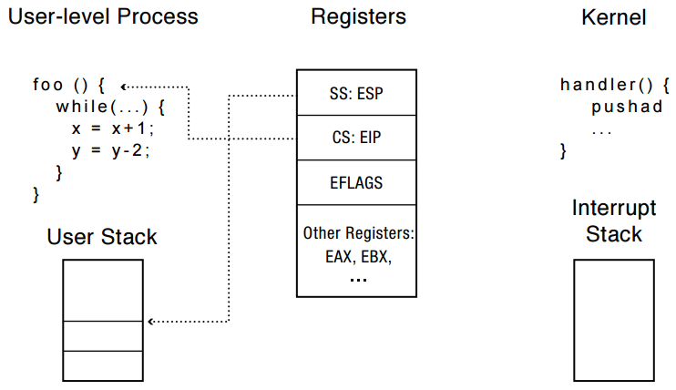
Before Interrupt
Notes:
Why does the stack pointer on the x86 have two components?
- x86 is segmented, the position is a combination of segment selector (SS) and stack pointer (ESP)
Likewise, the same goes for CS:EIP

Slide 35
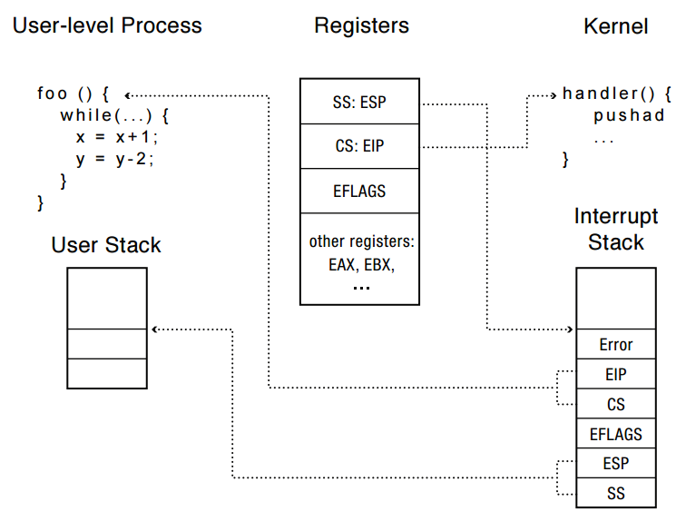
During Interrupt

Slide 36
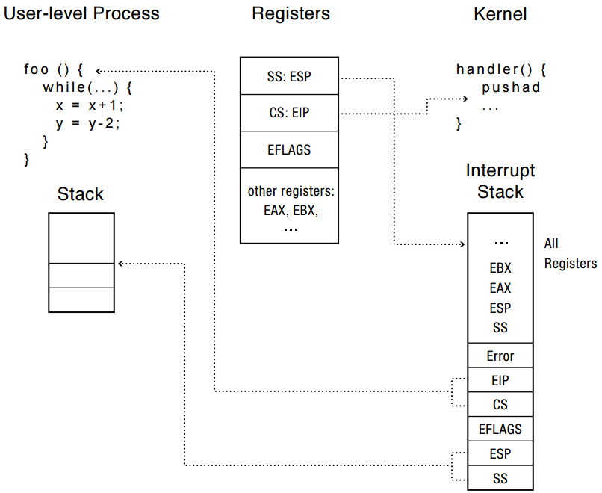
After Interrupt

Slide 37
Question
Why is the stack pointer saved twice on the interrupt stack?
Hint: is it the same stack pointer?
Notes:
No, the 1st one is user stack pointer, the 2nd one is the kernel stack pointer

Slide 38
At end of handler
Handler restores saved registers
Atomically return to interrupted process/thread
Restore program counter
Restore program stack
Restore processor status word/condition codes
Switch to user mode

Slide 39
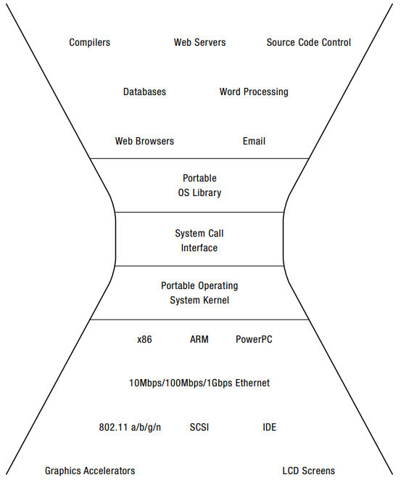
System Call
Performs action outside process’s protection domain
Implement Calling Convention
Specify name, arguments, return value
Use the same mode-switching mechanism (x86 uses int - software interrupt)
Defensive programming

Slide 40
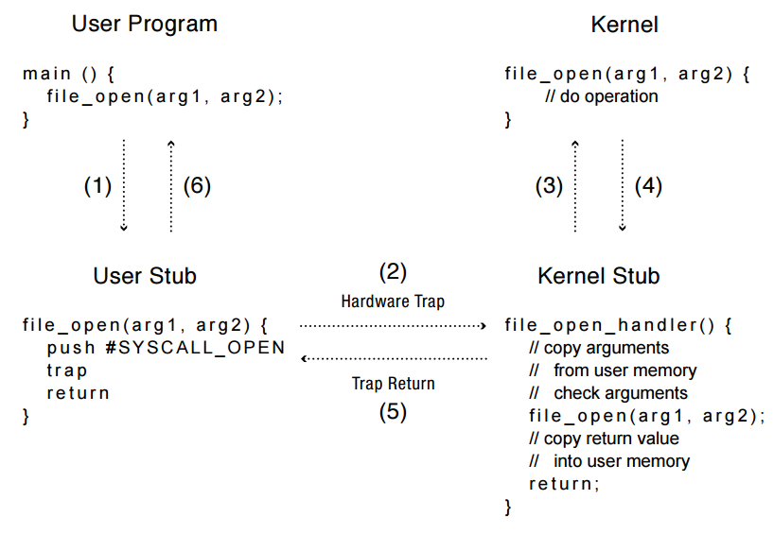
System call with a pair of stubs

Slide 41
Kernel System Call Handler
Locate arguments
In registers or on user stack
Translate user addresses into kernel addresses
Copy arguments
From user memory into kernel memory
Protect kernel from malicious code evading checks
Validate arguments
Protect kernel from errors in user code
Copy results back into user memory
Translate kernel addresses into user addresses

Slide 42
Upcall: User-level event delivery
Notify user process of some event that needs to be handled right away
Time expiration
Real-time user interface
Time-slice for user-level thread manager
Exception handling in user-level (e.g. Save this file before closing?)
Asynchronous I/O completion (async/await)
upcalls = UNIX signals = WINDOWS asynchronous events
How to implement a mechanism similar to syscall in a user level app?

Slide 43
Upcalls vs Interrupts
Signal handlers ←→ Interrupt vector
Signal stack ←→ Interrupt stack
Automatic save/restore registers ←→ transparent resume
Signal masking: signals disabled while in signal handler

Slide 44
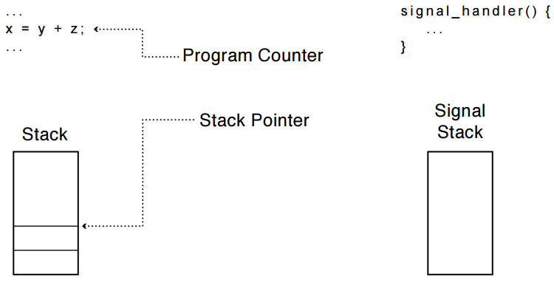
Upcall: Before

Slide 45
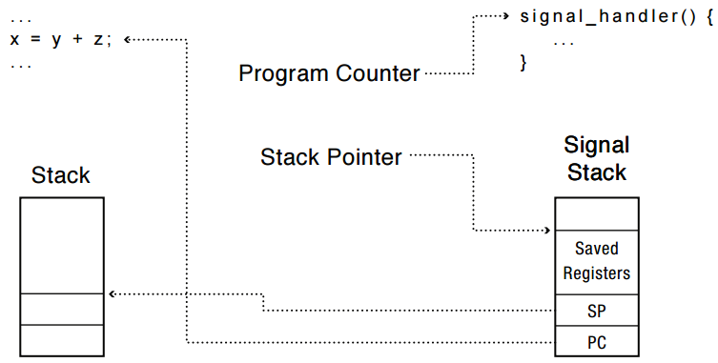
Upcall: During

Slide 46
User-Level Virtual Machine
How does VM Player work?
Runs as a user-level application
How does it catch privileged instructions, interrupts, device I/O?
Installs kernel driver, transparent to host kernel
Requires administrator privileges!
Modifies interrupt table to redirect to kernel VM code
If interrupt is for VM → upcall
If interrupt is for another process → reinstalls interrupt table and resumes kernel

Slide 47
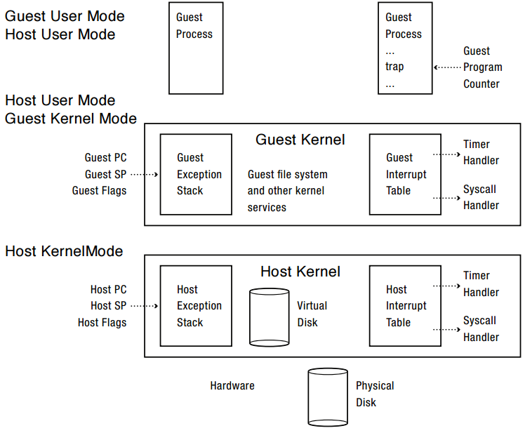

Slide 48
Hardware Timer
Hardware device that periodically interrupts the processor
Returns control to the kernel handler
Interrupt frequency set by the kernel
Not by user code!
Interrupts can be temporarily deferred
Not by user code!
Interrupt deferral crucial for implementing mutual exclusion
Notes:
How do I stop a runaway program? How do I know if a runaway program needs to be stopped, or its just taking a long time?

Slide 49
Mode Switch
From user mode to kernel mode
Interrupts
Triggered by timer and I/O devices
Exceptions
Triggered by unexpected program behavior
Or malicious behavior!
System calls (aka protected procedure call)
Request by program for kernel to do some operation on its behalf
Only limited number of very carefully coded entry points
Notes:
Might work better starting with interrupts!

Slide 50
Question
Examples of exceptions
Examples of system calls

Slide 51
Mode Switch
From kernel mode to user mode
New process/new thread start
Jump to first instruction in program/thread
Return from interrupt, exception, system call
Resume suspended execution
Process/thread context switch
Resume some other process
User-level upcall (UNIX signal)
Asynchronous notification to user program

Slide 52
How do we take interrupts safely?
Interrupt vector
Limited number of entry points into kernel
Atomic transfer of control
Single instruction to change:
Program counter
Stack pointer
Memory protection
Kernel/user mode
Transparent restorable execution
User program does not know interrupt occurred

Slide 53
Interrupt Vector
Table set up by OS kernel; pointers to code to run on different events
Notes:
Note: by “processor register” I do not mean %eax. Rather – these are special purpose registers.

Slide 54
Interrupt Stack
Per-processor, located in kernel (not user) memory
Usually a process/thread has both: kernel and user stack
Why can’t the interrupt handler run on the stack of the interrupted user process?
Notes:
What goes in a stack frame?
Frame pointer
Locals
Return address

Slide 55
Per-Process Interrupt Stack
Notes:
Lots of complexity on this slide. Let’s unpack:
Every process/thread has two stacks. When the process is running, does the kernel stack have anything useful on it? You might think yes – it called into the user program. But actually no – the user program doesn’t return from main.
Need to change this to add “crt0.s” – main returns to crt0.s, and then calls exit.
Best to think of this as multiple personality disorder: sometimes we want to save context, other times not!
When a process is ready to run, but not running – it has its user stack as before, but now I also need a place to store the state that had been in the CPU when it stopped running
When a process is waiting for I/O, it had done a system call, etc.

Slide 56
Interrupt Masking
Interrupt handler runs with interrupts off
Re-enabled when interrupt completes
OS kernel can also turn interrupts off
E.g., when determining the next process/thread to run
On x86
CLI: disable interrupts
STI: enable interrupts
Only applies to the current CPU (on a multi-core)
We’ll need this to implement synchronization

Slide 57
Interrupt Handlers
Interrupt handlers are usually divided into two parts
Bottom half (Linux’s top half): Non-blocking, run to completion
Minimum necessary to allow device to take next interrupt
Any waiting must be limited duration
Wake up other threads to do any real work
Top half (Linux’s Bottom half)
Run as another kernel thread
Notes:
Skip this slide – too much for the students to get

Slide 58
Case Study: x86 Interrupt
Save current stack pointer (SP)
Save current program counter (PC)
Save current processor status word (PSW - condition codes)
Switch to kernel stack; put SP, PC, PSW on stack
Switch to kernel mode
Vector through interrupt table
Interrupt handler saves registers it might clobber

Slide 59
Before Interrupt
Notes:
Why does the stack pointer on the x86 have two components?
- x86 is segmented, the position is a combination of segment selector (SS) and stack pointer (ESP)
Likewise, the same goes for CS:EIP

Slide 60
During Interrupt

Slide 61
After Interrupt

Slide 62
Question
Why is the stack pointer saved twice on the interrupt stack?
Hint: is it the same stack pointer?
Notes:
No, the 1st one is user stack pointer, the 2nd one is the kernel stack pointer

Slide 63
At end of handler
Handler restores saved registers
Atomically return to interrupted process/thread
Restore program counter
Restore program stack
Restore processor status word/condition codes
Switch to user mode

Slide 64
System Call
Performs action outside process’s protection domain
Implement Calling Convention
Specify name, arguments, return value
Use the same mode-switching mechanism (x86 uses int - software interrupt)
Defensive programming

Slide 65
System call with a pair of stubs

Slide 66
Kernel System Call Handler
Locate arguments
In registers or on user stack
Translate user addresses into kernel addresses
Copy arguments
From user memory into kernel memory
Protect kernel from malicious code evading checks
Validate arguments
Protect kernel from errors in user code
Copy results back into user memory
Translate kernel addresses into user addresses

Slide 67
Upcall: User-level event delivery
Notify user process of some event that needs to be handled right away
Time expiration
Real-time user interface
Time-slice for user-level thread manager
Exception handling in user-level (e.g. Save this file before closing?)
Asynchronous I/O completion (async/await)
upcalls = UNIX signals = WINDOWS asynchronous events
How to implement a mechanism similar to syscall in a user level app?

Slide 68
Upcalls vs Interrupts
Signal handlers ←→ Interrupt vector
Signal stack ←→ Interrupt stack
Automatic save/restore registers ←→ transparent resume
Signal masking: signals disabled while in signal handler

Slide 69
Upcall: Before

Slide 70
Upcall: During

Slide 71
User-Level Virtual Machine
How does VM Player work?
Runs as a user-level application
How does it catch privileged instructions, interrupts, device I/O?
Installs kernel driver, transparent to host kernel
Requires administrator privileges!
Modifies interrupt table to redirect to kernel VM code
If interrupt is for VM → upcall
If interrupt is for another process → reinstalls interrupt table and resumes kernel

