Slide 1
The programming interface
January 20th,2017
Dr. Orathai Sangpetch
Dr. Akkarit Sangpetch
Department of Computer Engineering
Faculty of Engineering, KMITL
Adapted from “Operating Systems: Principles and Practice” by Tom Anderson (University of Washington)

Slide 2
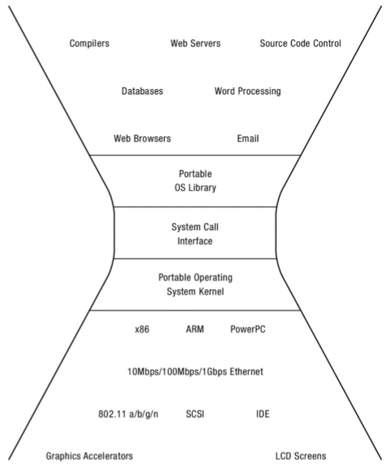

Slide 3
Main Points
Process
Creating and managing processes
fork, exec, wait
Performing I/O
open, read, write, close
Communicating between processes
pipe, dup, select, connect
Example: implementing a shell

Slide 4
Shell
A shell is a job control system
Allows programmer to create and manage a set of programs to do some task
Windows, MacOS, Linux all have shells
Example: to compile a C program
cc –c sourcefile1.c
cc –c sourcefile2.c
ln –o program sourcefile1.o sourcefile2.o

Slide 5
Question
If the shell runs at user-level, what system calls does it make to run each of the programs?
Ex: cc, ln

Slide 6
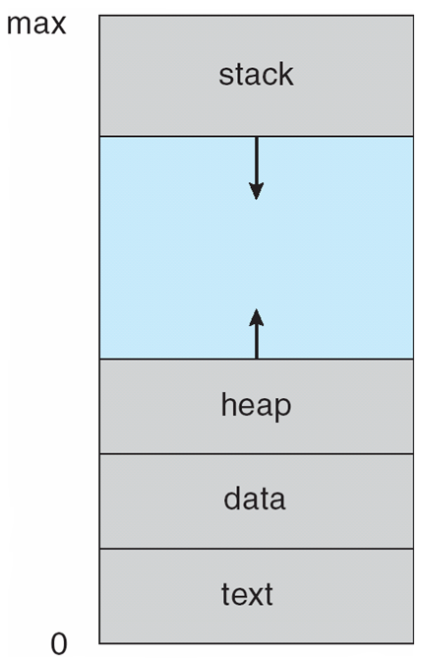
Process
An operating system executes a variety of programs:
Batch system – jobs
Time-shared systems – user programs or tasks
Textbook uses the terms job and process almost interchangeably
Process – a program in execution; process execution must progress in sequential fashion
Multiple parts
The program code, also called text section
Current activity including program counter, processor registers
Stack containing temporary data
Function parameters, return addresses, local variables
Data section containing global variables
Heap containing memory dynamically allocated during run time
Program is passive entity stored on disk (executable file), process is active
Program becomes process when executable file loaded into memory
Execution of program started via GUI mouse clicks, command line entry of its name, etc

Slide 7
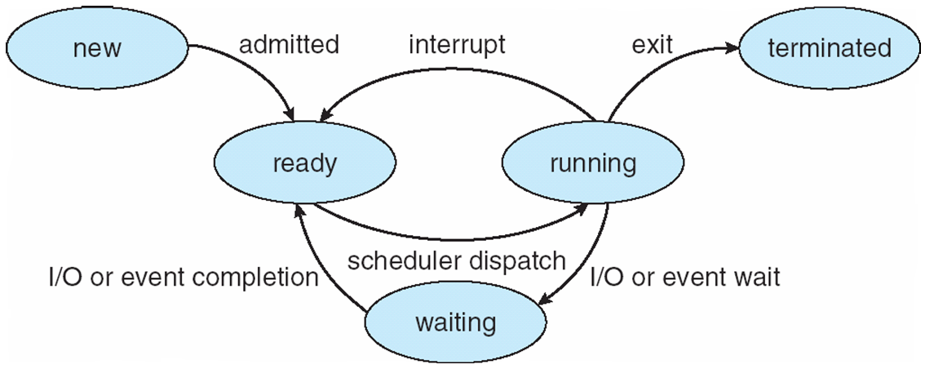
Process State
As a process executes, it changes state
new: The process is being created
running: Instructions are being executed
waiting: The process is waiting for some event to occur
ready: The process is waiting to be assigned to a processor
terminated: The process has finished execution

Slide 8
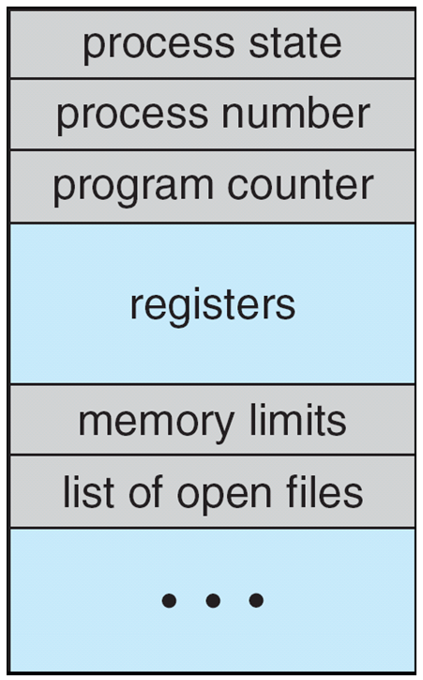
Process Control Block (PCB)
Information associated with each process
(also called task control block, task struct)
Process state – running, waiting, etc
Program counter – location of instruction to next execute
CPU registers – contents of all process-centric registers
CPU scheduling information- priorities, scheduling queue pointers
Memory-management information – memory allocated to the process
Accounting information – CPU used, clock time elapsed since start, time limits
I/O status information – I/O devices allocated to process, list of open files

Slide 9
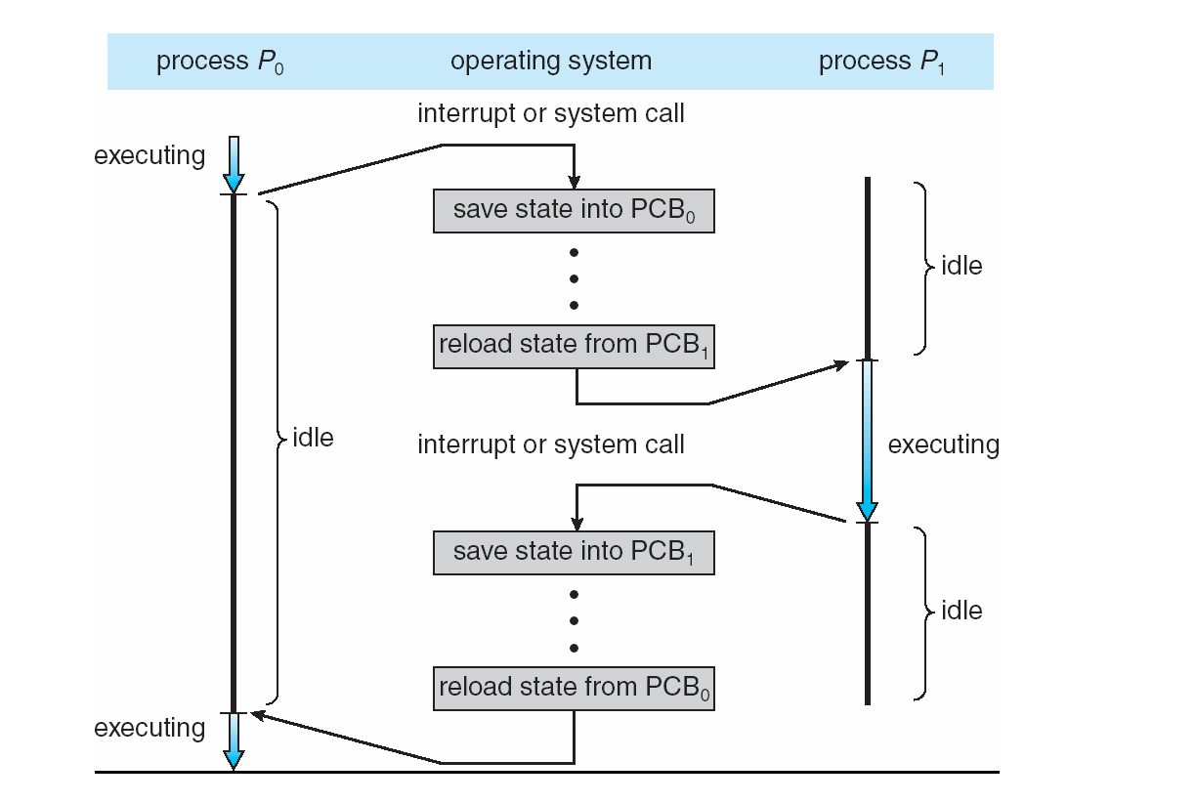
CPU Switch From Process to Process

Slide 10
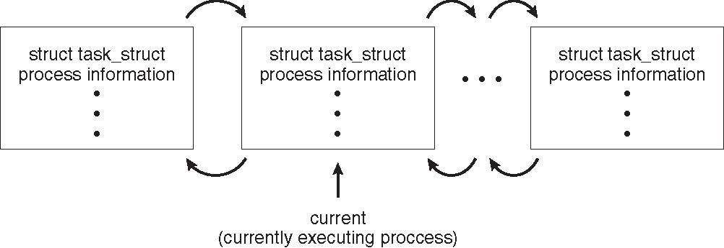
Process Representation in Linux
Represented by the C structure task_struct
pid t_pid; /* process identifier */ long state; /* state of the process */ unsigned int time_slice /* scheduling information */ struct task_struct *parent; /* this process’s parent */ struct list_head children; /* this process’s children */ struct files_struct *files; /* list of open files */ struct mm_struct *mm; /* address space of this process */

Slide 11
Windows CreateProcess
System call to create a new process to run a program
Create and initialize the process control block (PCB) in the kernel
Create and initialize a new address space
Load the program into the address space
Copy arguments into memory in the address space
Initialize the hardware context to start execution at ``start'’
Inform the scheduler that the new process is ready to run
Simple in theory, complex in practice

Slide 12
Windows CreateProcess API
if (!CreateProcess(
NULL, // No module name (use command line)
argv[1], // Command line
NULL, // Process handle not inheritable
NULL, // Thread handle not inheritable
FALSE, // Set handle inheritance to FALSE
0, // No creation flags
NULL, // Use parent's environment block
NULL, // Use parent's starting directory
&si, // Pointer to STARTUPINFO structure
&pi ) // Pointer to PROCESS_INFORMATION structure
)
Notes:
Ok, pretty complex! But its because there are a lot of aspects to a process

Slide 13
UNIX Process Management
UNIX fork – system call to create a copy of the current process, and start it running
No arguments!
UNIX exec – system call to change the program being run by the current process
UNIX wait – system call to wait for a process to finish
UNIX signal – system call to send a notification to another process
Notes:
UNIX splits creating a process into two steps, each of them a lot simpler.

Slide 14
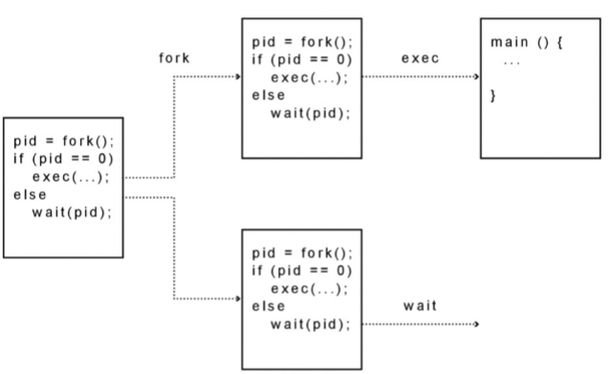
UNIX Process Management
Notes:
How is this used – typically, fork a process, child and parent are now both running the same program. One sets up the child program, and runs exec – becoming the new program
The parent, usually, waits for the child to finish

Slide 15
Question: What does this code print?
int child_pid = fork();
if (child_pid == 0) { // I'm the child process
printf("I am process #%d\n", getpid());
return 0;
} else { // I'm the parent process
printf("I am parent of process #%d\n", child_pid);
return 0;
}
Notes:
Parent could print first, or child could print first – you don’t know!

Slide 16
Questions
Can UNIX fork() return an error? Why?
Can UNIX exec() return an error? Why?
Can UNIX wait() ever return immediately? Why?

Slide 17
Implementing UNIX fork
Steps to implement UNIX fork
Create and initialize the process control block (PCB) in the kernel
Create a new address space
Initialize the address space with a copy of the entire contents of the address space of the parent
Inherit the execution context of the parent (e.g., any open files)
Inform the scheduler that the new process is ready to run

Slide 18
Implementing UNIX exec
Steps to implement UNIX exec
Load the program into the current address space
Copy arguments into memory in the address space
Initialize the hardware context to start execution at ``start''

Slide 19
UNIX I/O
Uniformity
All operations on all files, devices use the same set of system calls: open, close, read, write
Open before use
Open returns a handle (file descriptor) for use in later calls on the file
Byte-oriented
Kernel-buffered read/write
Explicit close
To garbage collect the open file descriptor

Slide 20
UNIX File System Interface
UNIX file open is a Swiss Army knife:
Open the file, return file descriptor
Options:
if file doesn’t exist, return an error
If file doesn’t exist, create file and open it
If file does exist, return an error
If file does exist, open file
If file exists but isn’t empty, nix it then open
If file exists but isn’t empty, return an error
…

Slide 21
Interface Design Question
Why not separate syscalls for open/create/exists?
if (!exists(name))
create(name); // can create fail?
fd = open(name); // does the file exist?

Slide 22
Implementing a Shell
char *prog, **args;
int child_pid;
// Read and parse the input a line at a time
while (readAndParseCmdLine(&prog, &args)) {
child_pid = fork(); // create a child process
if (child_pid == 0) {
exec(prog, args); // I'm the child process. Run program
// NOT REACHED
} else {
wait(child_pid); // I'm the parent, wait for child
return 0;
}
}

