Slide 1
Concurrency
January 20th,2017
Dr. Orathai Sangpetch
Dr. Akkarit Sangpetch
Department of Computer Engineering
Faculty of Engineering, KMITL
Adapted from “Operating Systems: Principles and Practice” by Tom Anderson (University of Washington)

Slide 2
Motivation
Operating systems (and application programs) often need to be able to handle multiple things happening at the same time
Process execution, interrupts, background tasks, system maintenance
Humans are not very good at keeping track of multiple things happening simultaneously
Threads are an abstraction to help bridge this gap

Slide 3
Why Concurrency?
Servers
Multiple connections handled simultaneously
Parallel programs
To achieve better performance
Programs with user interfaces
To achieve user responsiveness while doing computation
Network and disk bound programs
To hide network/disk latency

Slide 4
Definitions
A thread is a single execution sequence that represents a separately schedulable task
Single execution sequence: familiar programming model
Separately schedulable: OS can run or suspend a thread at any time
Protection is an orthogonal concept
Can have one or many threads per protection domain

Slide 5
Threads in the Kernel and at User-Level
Multi-threaded kernel
multiple threads, sharing kernel data structures, capable of using privileged instructions
Multiprocess kernel
Multiple single-threaded processes
System calls access shared kernel data structures
Multiple multi-threaded user processes
Each with multiple threads, sharing same data structures, isolated from other user processes

Slide 6
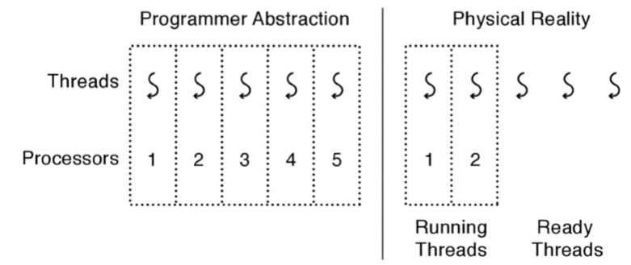
Thread Abstraction
Infinite number of processors
Threads execute with variable speed
Programs must be designed to work with any schedule
Notes:
Execution model: each thread runs on a dedicated virtual processor with unpredictable and variable speed.

Slide 7
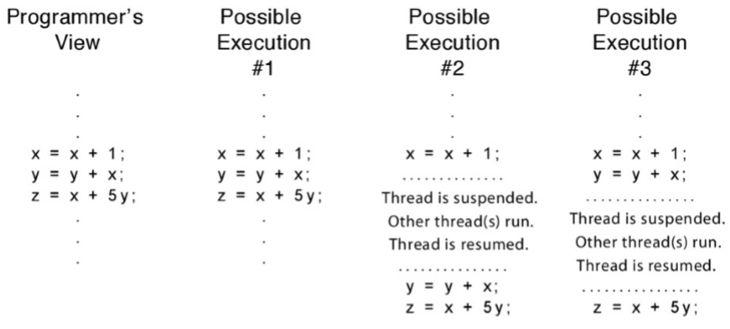
Programmer vs. Processor View

Slide 8
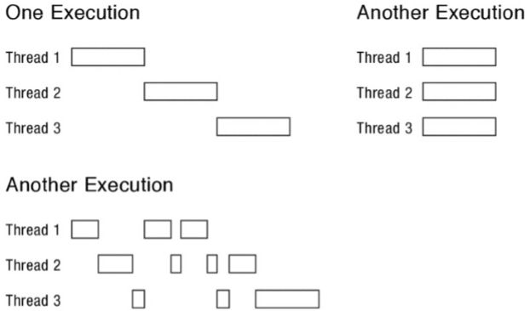
Possible Executions

Slide 9
Thread Operations
thread_create(thread, func, args)
Create a new thread to run func(args)
thread_yield()
Relinquish processor voluntarily
thread_join(thread)
In parent, wait for forked thread to exit, then return
thread_exit
Quit thread and clean up, wake up joiner if any
Notes:
UNIX fork and thread fork are not the same thing

Slide 10
Example: threadHello
#define NTHREADS 10
thread_t threads[NTHREADS];
main() {
for (i = 0; i < NTHREADS; i++)
thread_create(&threads[i], &go, i);
for (i = 0; i < NTHREADS; i++) {
exitValue = thread_join(threads[i]);
printf("Thread %d returned with %ld\n", i, exitValue);
}
printf("Main thread done.\n");
}
void go (int n) {
printf("Hello from thread %d\n", n);
thread_exit(100 + n);
// REACHED?
}

Slide 11
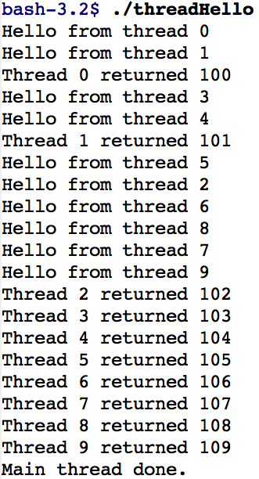
threadHello: Example Output
Why must “thread returned” print in order?
What is maximum # of threads running when thread 5 prints hello?
Minimum?

Slide 12
Fork/Join Concurrency
Threads can create children, and wait for their completion
Data only shared before fork/after join
Examples:
Web server: fork a new thread for every new connection
As long as the threads are completely independent
Merge sort
Parallel memory copy

Slide 13
bzero with fork/join concurrency
void go (struct bzeroparams *p) {
memset(p->buffer, 0, p->length);
}
void blockzero (unsigned char *p, int length) {
int i, j;
thread_t threads[NTHREADS];
struct bzeroparams params[NTHREADS];
// For simplicity, assumes length is divisible by NTHREADS.
for (i = 0, j = 0; i < NTHREADS; i++, j += length/NTHREADS) {
params[i].buffer = p + i * length/NTHREADS;
params[i].length = length/NTHREADS;
thread_create_p(&(threads[i]), &go, &params[i]);
}
for (i = 0; i < NTHREADS; i++) {
thread_join(threads[i]);
}
}

Slide 14
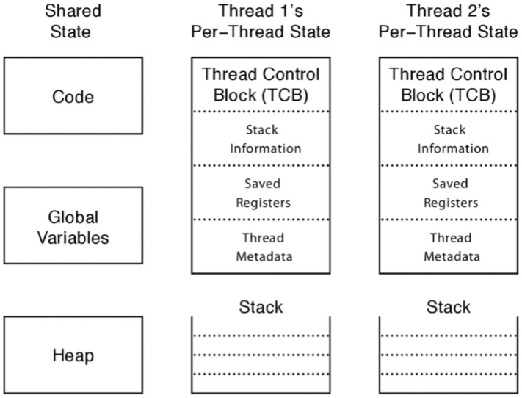
Thread Data Structures

Slide 15
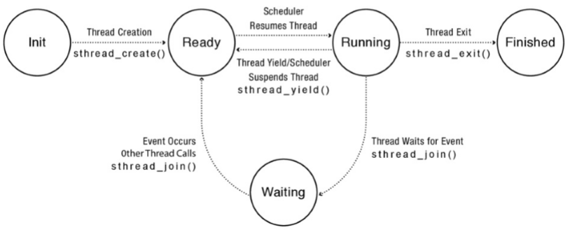
Thread Lifecycle
Notes:
Labels should be thread_create() not sthread_create, etc.

Slide 16
Implementing Threads: Roadmap
Kernel threads
Thread abstraction only available to kernel
To the kernel, a kernel thread and a single threaded user process look quite similar
Multithreaded processes using kernel threads (Linux, MacOS)
Kernel thread operations available via syscall
User-level threads
Thread operations without system calls

Slide 17
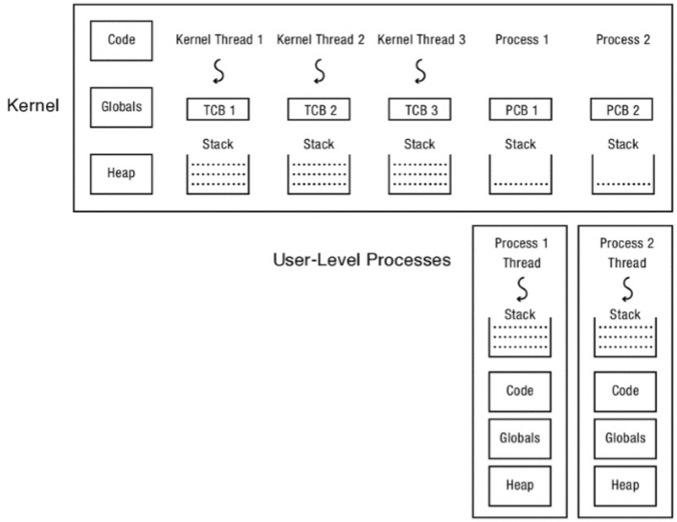
Multithreaded OS Kernel

Slide 18
Implementing threads
Thread_fork(func, args)
Allocate thread control block
Allocate stack
Build stack frame for base of stack (stub)
Put func, args on stack
Put thread on ready list
Will run sometime later (maybe right away!)

Slide 19
Thread Stack
What if a thread puts too many procedures on its stack?
What happens in Java?
What happens in the Linux kernel?
What should happen?

Slide 20
Thread Context Switch
Voluntary
Thread_yield
Thread_join (if child is not done yet)
Involuntary
Interrupt or exception
Some other thread is higher priority

Slide 21
Voluntary thread context switch
Save registers on old stack
Switch to new stack, new thread
Restore registers from new stack
Return
Exactly the same with kernel threads or user threads

Slide 22
x86 switch_threads
# Save caller’s register state
# NOTE: %eax, etc. are ephemeral
pushl %ebx
pushl %ebp
pushl %esi
pushl %edi
# Get offsetof (struct thread, stack)
mov thread_stack_ofs, %edx
# Save current stack pointer to old thread's stack, if any.
movl SWITCH_CUR(%esp), %eax
movl %esp, (%eax,%edx,1)
# Change stack pointer to new thread's stack
# this also changes currentThread
movl SWITCH_NEXT(%esp), %ecx
movl (%ecx,%edx,1), %esp
# Restore caller's register state.
popl %edi
popl %esi
popl %ebp
popl %ebx
ret

Slide 23
A Subtlety
Thread_create puts new thread on ready list
When it first runs, some thread calls switchframe
Saves old thread state to stack
Restores new thread state from stack
Set up new thread’s stack as if it had saved its state in switchframe
“returns” to stub at base of stack to run func

Slide 24
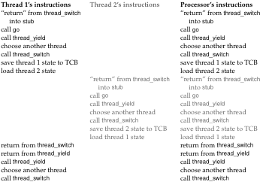
Two Threads Call Yield

Slide 25
Involuntary Thread/Process Switch
Timer or I/O interrupt
Tells OS some other thread should run
Simple version
End of interrupt handler calls switch()
When resumed, return from handler resumes kernel thread or user process
Thus, processor context is saved/restored twice (once by interrupt handler, once by thread switch)

Slide 26
Faster Thread/Process Switch
What happens on a timer (or other) interrupt?
Interrupt handler saves state of interrupted thread
Decides to run a new thread
Throw away current state of interrupt handler!
Instead, set saved stack pointer to trapframe
Restore state of new thread
On resume, pops trapframe to restore interrupted thread

Slide 27
Multithreaded User Processes (Take 1)
User thread = kernel thread (Linux, MacOS)
System calls for thread fork, join, exit (and lock, unlock,…)
Kernel does context switch
Simple, but a lot of transitions between user and kernel mode

Slide 28
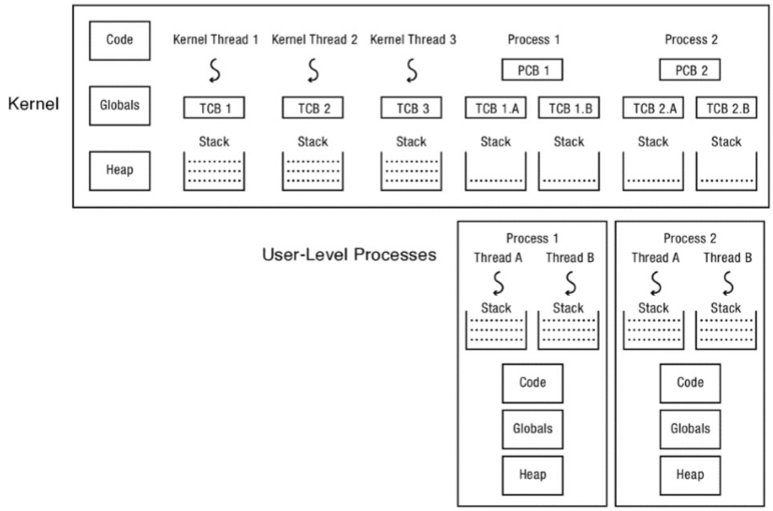
Multithreaded User Processes (Take 1)

Slide 29
Multithreaded User Processes (Take 2)
Green threads (early Java)
User-level library, within a single-threaded process
Library does thread context switch
Preemption via upcall/UNIX signal on timer interrupt
Use multiple processes for parallelism
Shared memory region mapped into each process

Slide 30
Multithreaded User Processes (Take 3)
Scheduler activations (Windows 8)
Kernel allocates processors to user-level library
Thread library implements context switch
Thread library decides what thread to run next
Upcall whenever kernel needs a user-level scheduling decision
Process assigned a new processor
Processor removed from process
System call blocks in kernel

Slide 31
Question
Compare event-driven programming with multithreaded concurrency. Which is better in which circumstances, and why?

