Slide 1
Exploring Bangla Emotion Recognition using BERT: A Transformer-Based Approach
Presented by
Neaz mahmud
Abdullah Al Fahad
Fahiba akter
Supervised by
AL Imtiaz
Assistant Professor & Head, CSE
University of Information technology & Science

Slide 2
1
Introduction
2
Objective
3
CONTENTS
Related work
4
Methodology
5
Result and discussion
6
Comparative Analysis
7
Future work & conclusion

Slide 3

Introduction
Sentiment Analysis (SA) gains popularity for its real-life applications in emotion research.
Exploring people's feelings, perspectives, and emotions about entities, individuals, and their qualities using various languages is crucial.
NLP is artificial intelligence focusing on human-computer interaction using natural language.

Slide 4

Challenges
Less number of research works in Bangla Language.
Insufficient information on implementing Bengali Language data publicly.
Comparatively complicated to pre-process the data.
Less number of datasets.

Slide 5

Objective
To implement a low-cost deep learning model for emotion classification in Bengali text using Transformer-based BERT architecture with optimized hyperparameters..
To analyze the impact of different factors, such as dataset size, model architecture, hyperparameters, and training strategies, on the performance of the proposed model.
To evaluate the performance of the proposed model using various evaluation metrics, such as accuracy, precision, recall, and F1-score, and compare it with the existing baseline models.

Slide 6
LITERATURE REVIEW
LITERATURE REVIEW
E. A. Emon et al.[1]
Md S. U. Sourav et. al.[2]
Md. S. S. Khan et. al.[3]
Used LSTM model for 7 class 4700 data
Used m-BERT pre trined model 6 class
Used machine learning based SVM model for 7 classes & 1000
N. I. Tripto et. al.[4]
R. A. Tuhin et. al.[5]
Used LSTM for 6 classes, emoon
Topical approach 6 classes & 7500+ data
Training 7400, tesng 100

Slide 7

LITERATURE OVERVEIW
Most of the studies focus on binary sentiment classification .
There is a lack of comprehensive comparative evaluations specifically in context of sentiment.
Studies lack discussion on computational requirements and efficiency of proposed approaches.
Some studies use relatively small datasets

Slide 8
METHODOLOGY

Slide 9
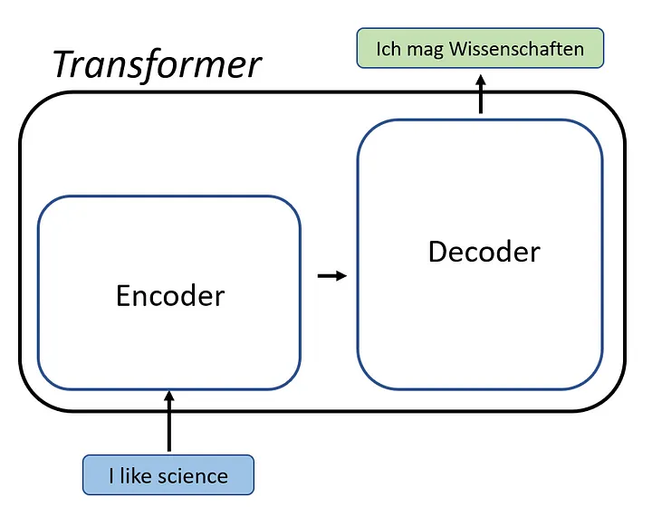
Transformer model
A transformer is an encoder-decoder model that can.....
Massive advantage over RNN based
encoder-decoder architecture since
it allows us to:
Take advantage of parallelization GPU/TPU.
Process much more data in the same amount of time.
process all token at once!

Slide 10
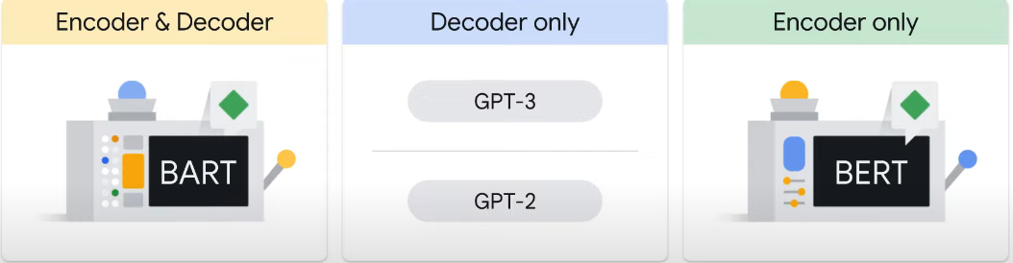
Pre-Trained Tranformer model

Slide 11

BERT Overview
Trained in two variations
Able to handle long input context
Trained on entire Wikipedia and BookCorpus
Trained for one million steps
Targeted at multi-task objective
Works at both sentence-level and token-level tasks
Be fine-tuned for many different tasks
Fine-tuning

Slide 12
How BERT models works
The man went to the [Mask] to buy a [Mask] of milk.
It works by 2 way:
Masked language modeling (MLM)
Next Sentence prediction (NSP)
gallon
store
Fig: Masked language modeling
0
0.5
0.9
1
He didn’t receive fair treatment.
Fun fair in new York city this summer.
Fig: Contextualized embedding

Slide 13
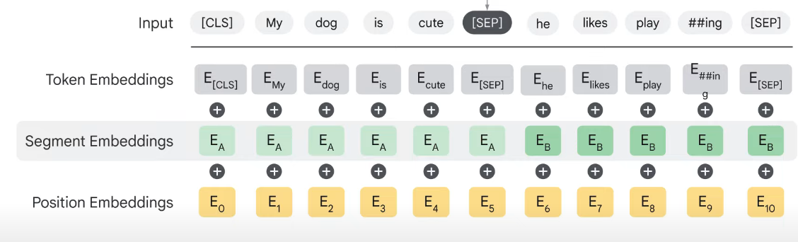
BERT input embeddings
Separator

Slide 14
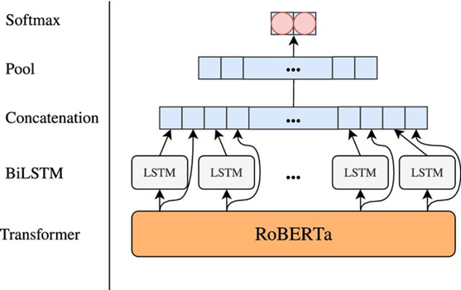
Four type of BERT model we used
1
RoBERTa
125 million parameters in Base model & large model has 355 million.
outperforms BERT on benchmark tasks and Optimized pretraining process
Dynamically changing the masking pattern in training samples
High performance on tasks like GLUE, SQuAD, and RACE

Slide 15
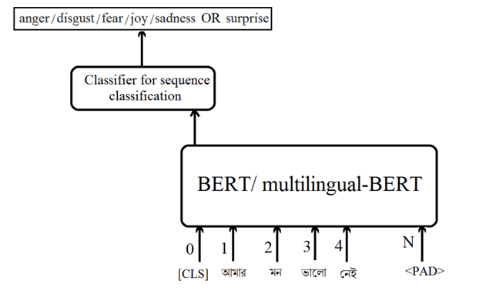
Four type of BERT model we used
2
Multilingual BERT
Contains ~110 million parameters
Trained on Wikipedia articles from 104 languages
High performance on cross-lingual benchmarks (XNLI, MLQA)
Some challenges with languages having less training data

Slide 16
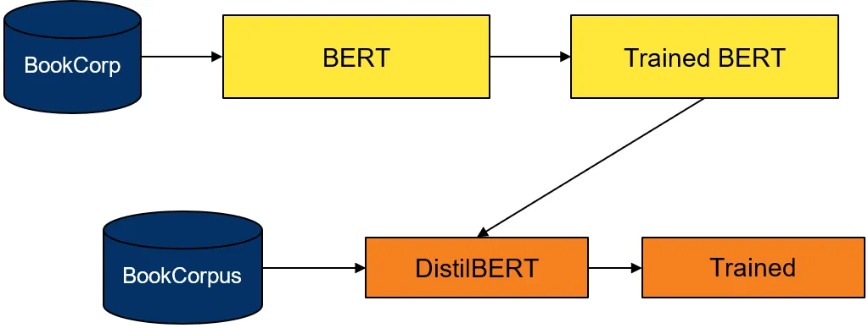
Four type of BERT model we used
3
DistilBERT
Contains about 66 million parameters,
faster training and inference time due to its smaller size
learns from a BERT model that has already been trained
Performance 5% degradation from BERT

Slide 17
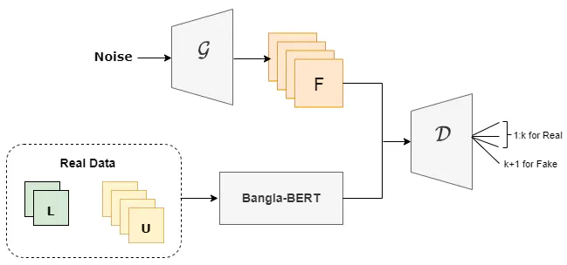
Four type of BERT model we used
4
Bangla BERT
State-of-the-art model for many NLP tasks
Benchmarks on tasks like sentiment analysis, text classification
Uses the same architecture as original BERT
Likely performs well on Bengali language tasks

Slide 18
Result and discussion

Slide 19
Raw Dataset
Data Analysis
Data Preprocessing
WorkFlow
OF
OUR
Approach
Training and Testing The
Model
Split Dataset into Train-
Validation test
Cleaned Data
Evaluate The Performance with Other Models

Slide 20
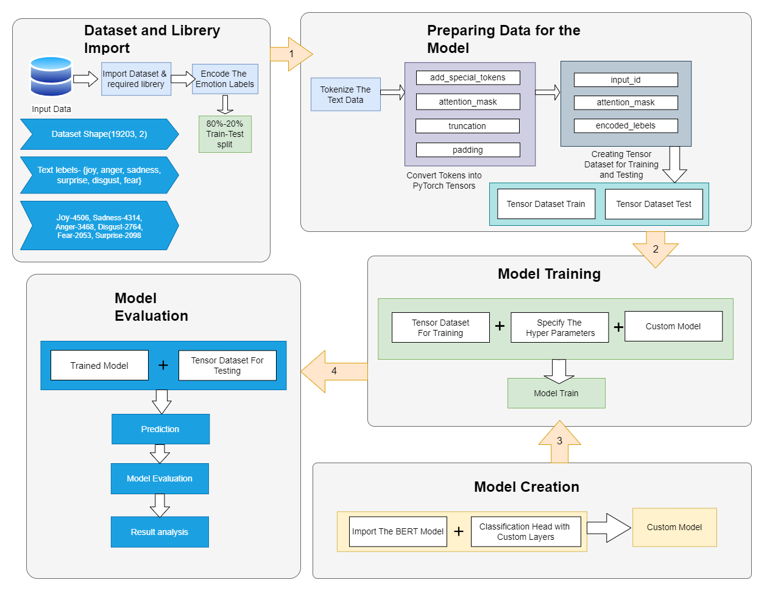
Details of workflow

Slide 21
Text Preprocessing
Bangla Text from Dataset
Before inputting the data into model, we do
some initial preprocessing.
We use the Tokenization method to tokenize
(transform the data into numbers) the data.
Then we convert the tokens into sequence,
similar to the given text.
Then we do padding in the sequence for better understanding of the model.
Tokenization and converting to sequence
Padding the sentence
Figure: Text Preprocessing

Slide 22
HyperParameters
Primary Goal: To have lower number of parameters with a higher accuracy and F1-Score, which are two of the measurement metrics available for this task. (Higher the value, the better.)
Input: Processed Data from the dataset.
We reduced the tensor size from 512 to 64 to reduce computation time.
Number of Layer-12(roBERTa)
Optimizer- AdamW, Learning rate- 2e-5
Number of Epoch-20

Slide 23
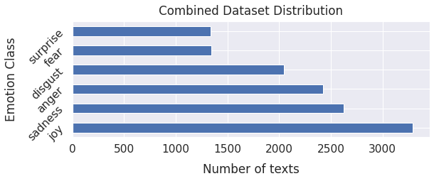
Dataset(UBMEC)
Introduced by: Md S. U. Sourav et al.[2]
[Dataset Link]
The dataset labels Bangali sentences based on Ekman’s 6 emotion class.
Lebeled classes are: joy, sadness, surprise, fear, disgust, anger
This data set is not balanced
Total Data: 13436

Slide 24
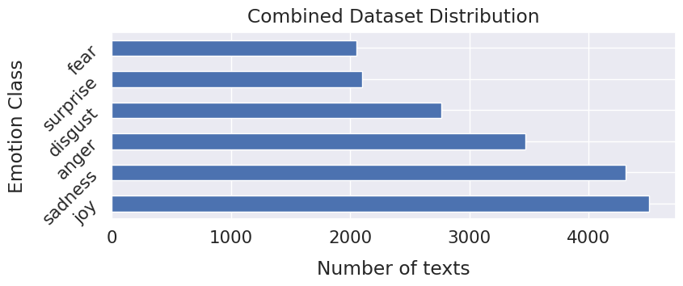
Dataset(Combined)
It combines the dataset of Md S. U. Sourav et al.[2] and Kaggle dataset[7]
[Dataset Link]
The dataset labels Bangali sentences based on Ekman’s 6 emotion class.
Lebeled classes are: joy, sadness, surprise, fear, disgust, anger
This data set is not balanced
Total Data: 19203

Slide 25
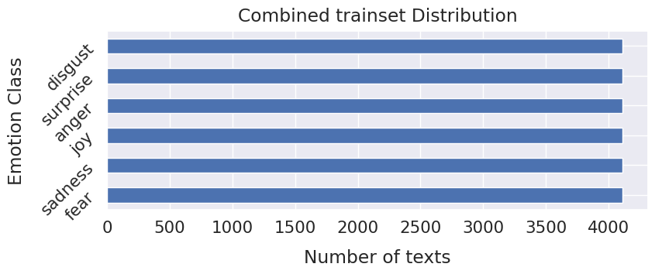
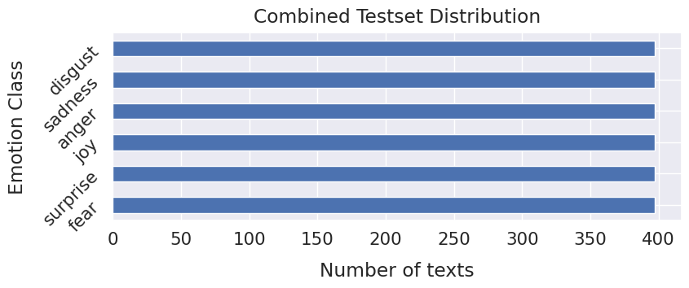
Dataset(Balanced)
To create a balanced dataset, the test and train dataset was created manually from the combined dataset.[Trainset, Testset]
After randomly picking 20% of data from the primary dataset, we moved back the excess data of the majority classes to the training dataset to match the number of minority class.
In the training dataset, we matched the class with the highest data by adding duplicate data of the low-class data
Total Data: Train-24654, Test- 2382

Slide 26
Results Comparision
UBMEC_Dataset (13436, 2)
Model | Accuracy | Loss rate | macro avg |  |  | weighted avg
 |  |  | precision | recall | f1- score | precision | recall | f1- score
Roberta | 38.39 | 1.95 | 35.63 | 34.81 | 34.90 | 37.26 | 38.39 | 37.50
mBERT | 50.41 | 2.43 | 47.62 | 47.19 | 47.16 | 50.12 | 50.41 | 50.08
distilBERT | 44.31 | 1.57 | 42.18 | 42.63 | 42.06 | 43.53 | 44.31 | 43.64
BanglaBERT | 53.64 | 2.63 | 51.03 | 50.99 | 50.85 | 53.33 | 53.65 | 53.35
mBERT(Previ ous) | 43.35 | 1.45 |  |  | 43.35

Slide 27
Results Comparision
Combined_Dataset (19203, 2)
Model | Accuracy | Loss rate | macro avg |  |  | weighted avg
 |  |  | precision | recall | f1- score | precision | recall | f1- score
Roberta | 55.77 | 1.13 | 58.72 | 52.18 | 53.60 | 57.67 | 55.77 | 55.26
mBERT | 51.52 | 2.00 | 50.31 | 49.26 | 49.67 | 51.27 | 51.52 | 51.30
distilBERT | 52.12 | 1.29 | 52.91 | 49.15 | 50.25 | 52.85 | 52.12 | 51.81
BanglaBERT | 48.97 | 2.96 | 47.55 | 46.59 | 46.95 | 48.72 | 48.97 | 48.73
mBERT(Previ ous) | 41.47 | 1.50 |  |  | 41.47

Slide 28
Results Comparision
Balanced_Dataset (19203, 2)
Model | Accuracy | Loss rate | macro avg |  |  | weighted avg
 |  |  | precision | recall | f1- score | precision | recall | f1- score
Roberta | 55.12 | 1.29 | 57.17 | 55.12 | 55.39 | 55.17 | 55.12 | 55.39
mBERT | 51.60 | 2.81 | 53.25 | 51.60 | 51.50 | 53.25 | 51.60 | 51.50
distilBERT | 52.06 | 1.70 | 52.55 | 52.06 | 52.08 | 52.55 | 52.06 | 52.08
BanglaBERT | 47.40 | 3.60 | 49.21 | 47.40 | 47.28 | 49.21 | 47.40 | 47.28
mBERT(Previ ous) | 37.86 | 1.44 |  |  | 37.86

Slide 29
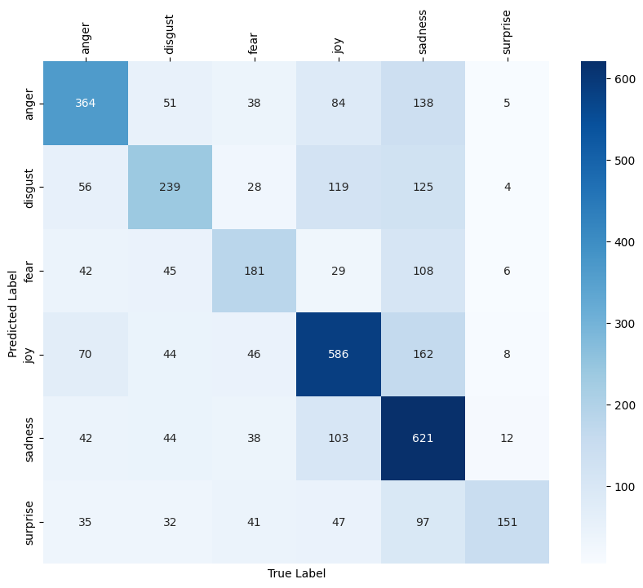
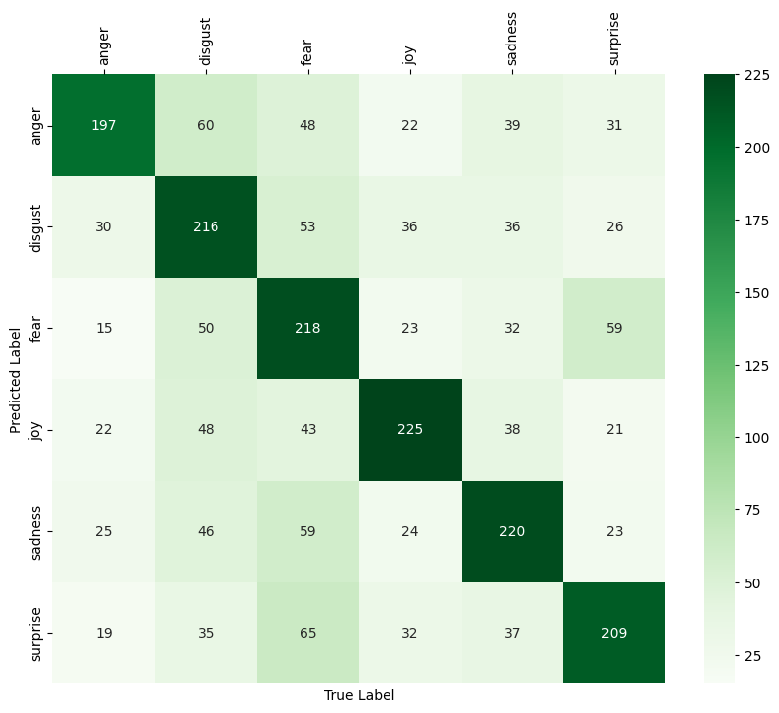
Results Comparision
Comparison Between Balanced and Unbalanced Datasets
Confusion Matrix of Roberta on Unbalanced Dataset
Confusion Matrix of Roberta on balanced Dataset

Slide 30

Future work
To extend this work towards multimodal emotion recognition such as audio and visual data along.
Handling Sarcasm and Ambiguity
Extend to Other Low-resource Languages
improve the model's robustness to Language variations.

Slide 31

Conclusions
Our exploration of Bangla Emotion Recognition using BERT, Transformer-Based Approach, has confirmed the efficacy of deep learning models in understanding the emotional sentiment in the Bangla language

Slide 32

THANKS
Does anyone have any questions?

Slide 33
REFERENCES
E. A. Emon, S. Rahman, J. Banarjee , A. K. Das, T. Mittra, “A Deep Learning Approach to Detect Abusive Bengali Text”, 2019 7th International Conference on Smart Computing & Communications
N. I. Tripto, Md. E. Ali, “Detecting Multilabel Sentiment and Emotions from Bangla YouTube Comments”, International Conference on Bangla Speech and Language Processing(ICBSLP), 21-22 September 2018.
Md S. U. Sourav, H. Wang, “Transformer-based Text Classification on Unified Bangla Multi-class Emotion Corpus”. 2023
Md. S. Haydar, M. A. Helal, S. A. Hossain,” Sentiment Extraction From Bangla Text : A Character Level Supervised Recurrent Neural Network Approach.”
R. A. Tuhin, B. K. Paul, F. Nawrine, M. Akter, A. K. Das, “An Automated System of Sentiment Analysis from Bangla Text using Supervised Learning Techniques”, 2019 IEEE 4th International Conference on Computer and Communication Systems (ICCCS).

