Slide 1

Partitioning and the small-files problem
Topic:
To let queries skip irrelevant data, a dataset can be partitioned: stored in one directory per value of a column (for example, per day).
Every file opened has a fixed cost, so partitioning too finely creates many tiny files, and a query spanning many partitions can end up slower than with a coarser partition.
In this presentation, we will see where that time is lost and how to choose a partition granularity that fits the way the data is queried.
Questions:
How does partitioning speed up a query?
Why can partitioning make a query slower?
How to choose the right partition granularity?
Demo:
We will partition the MeteoSwiss measurements in two ways, per day and per year.
Then run a single-day query and a three-year query on both, and compare the read times and number of files opened.

Slide 2
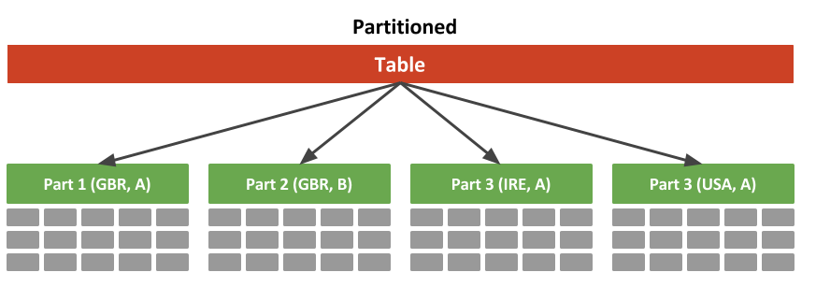
What is partitioning and why use it
Divide a big dataset into multiple smaller files
A selected Dataset column becomes part of the file path
Partition pruning: the engine can look at the path instead of the data to decide what to skip, and only use relevant files to the request.
Less I/O, less data shipped over the network/disk, faster query

Slide 3
What takes time in a Spark query
1. File listing + pruning : find every partition directory, keep only the ones matching the filter, list the files inside.
2. Prepare the tasks: build the physical plan, then one task per surviving file/split is shipped to executors.
3. Run the tasks on files: executors open the file, decompress, read the columns, (shuffle partial results back for a final reduce).

Slide 4
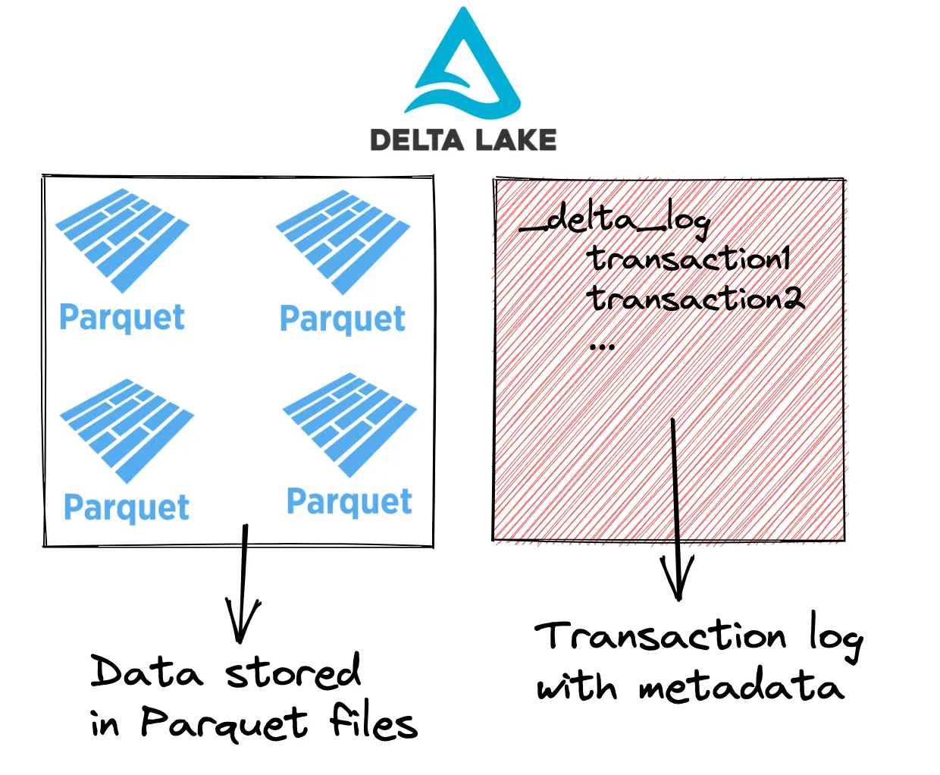
Delta lake
Delta transaction log on top of parquet files
Instead of listing files for every request, simply read the log
Fixes listing cost, but not file opening cost

Slide 5
Demo
MeteoSwiss data, partitioned in two delta lakes (by day/by year)
Two queries: query on a day, query on 3 years

Slide 6
Demo results
1-day query on day-partitioned data: query matches partitioning: perfect pruning
Same query on year-partitioned: weaker pruning, bigger file to filter on but smaller delta log to read -> still about the same time
3-year query on day-partitioned data: opens about 1000 tiny files -> big per-file open cost.
Same query on year-partitioned data opens 3 files: fast, correctly pruned

Slide 7
How to choose the right partitioning
Matching partitioning size to intended queries is optimal
If different range of queries: partition at the coarsest level that still lets common queries skip most of the data
Target file sizes: 1GB, (down to 200 MB for very small lakes).
Compact small files into larger files with delta optimize
Use delta data skipping to handle fine-grained pruning inside a coarse partition

Slide 8
Thanks for listening
Any questions ?

