Slide 1

By: Matt Baker, Parker Spires, Jason Fantl, Jarek Brown, and Jacob Hendricks

Slide 2
ChronoNet is a social media site with a new twist
Our platform offers something different
Each post is created with a timer.
Once that timer reaches 0, the post is removed.
ChronoNet is a social media site with a new twist
Our platform offers something different
Each post is created with a timer.
Once that timer reaches 0, the post is removed.

Slide 3

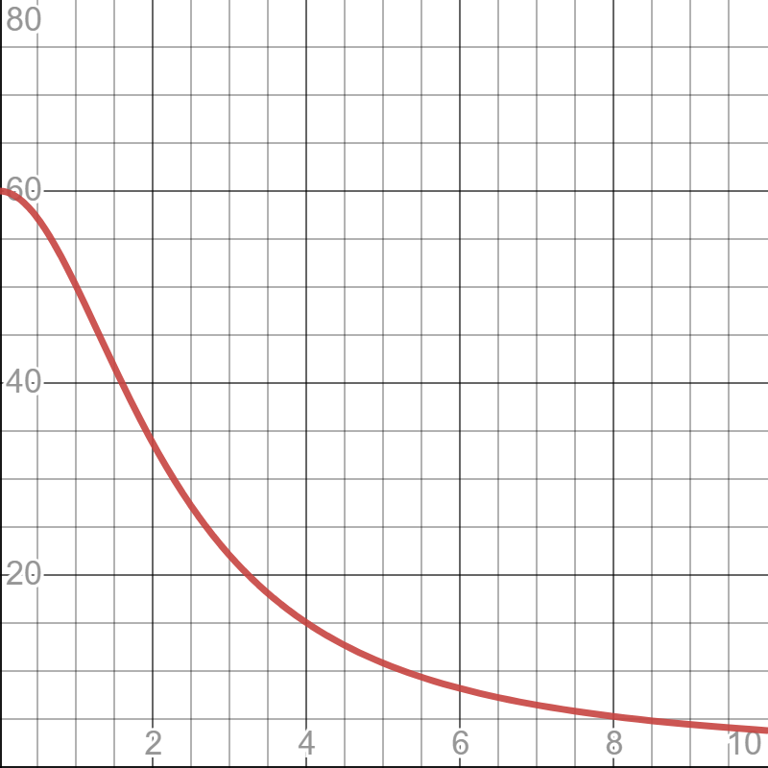

Time Function
Liking increases time
Disliking decreases time
Effectiveness of interacting decreases nonlinearly
Formula: $\frac{r_max−r_min}{1−\frac{x^{2}}{t_decay}}+r_min$
Effect
Time Elapsed

Slide 4
Features
Account creation deletion
Following
Personalized Feed
Profile editing
Hovering
Markdown
Post timer

Slide 5
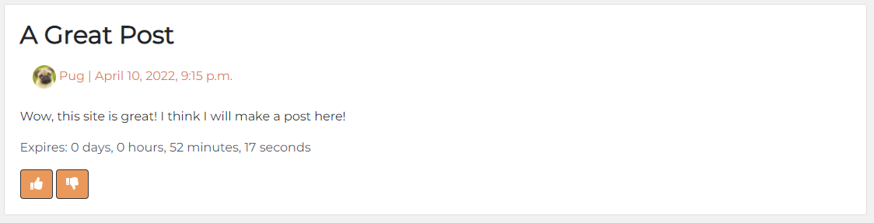
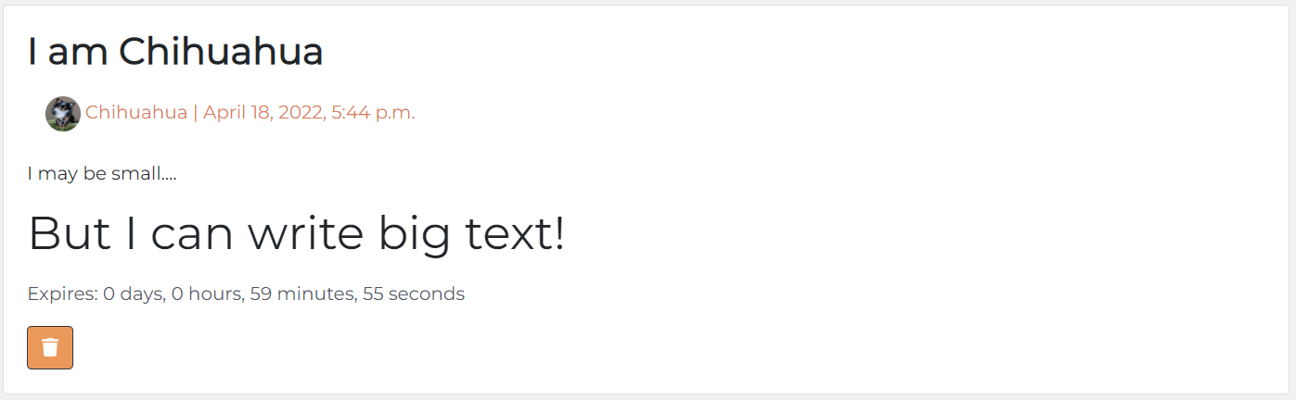
Posts
Title
Username and Profile Picture
Time Created
Post body
Plain text
Markdown
Time Remaining
Logged in users
Like/Dislike button on other posts
Delete Button on own posts

Slide 6
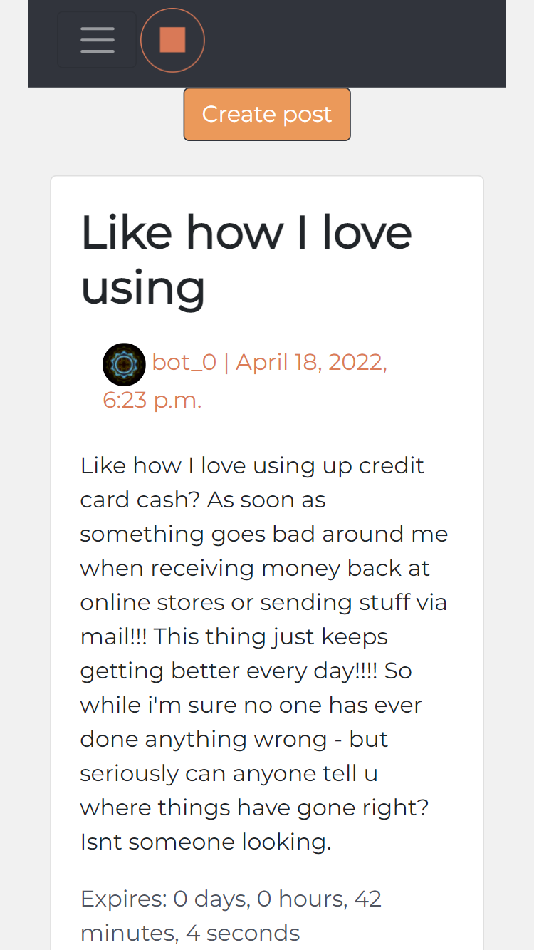
Front end Design
We designed our front end to be easy to access and mobile friendly
The posts are all located in the center of the screen
The top of the page allows users to login, register, and switch between the different pages of the site

Slide 7
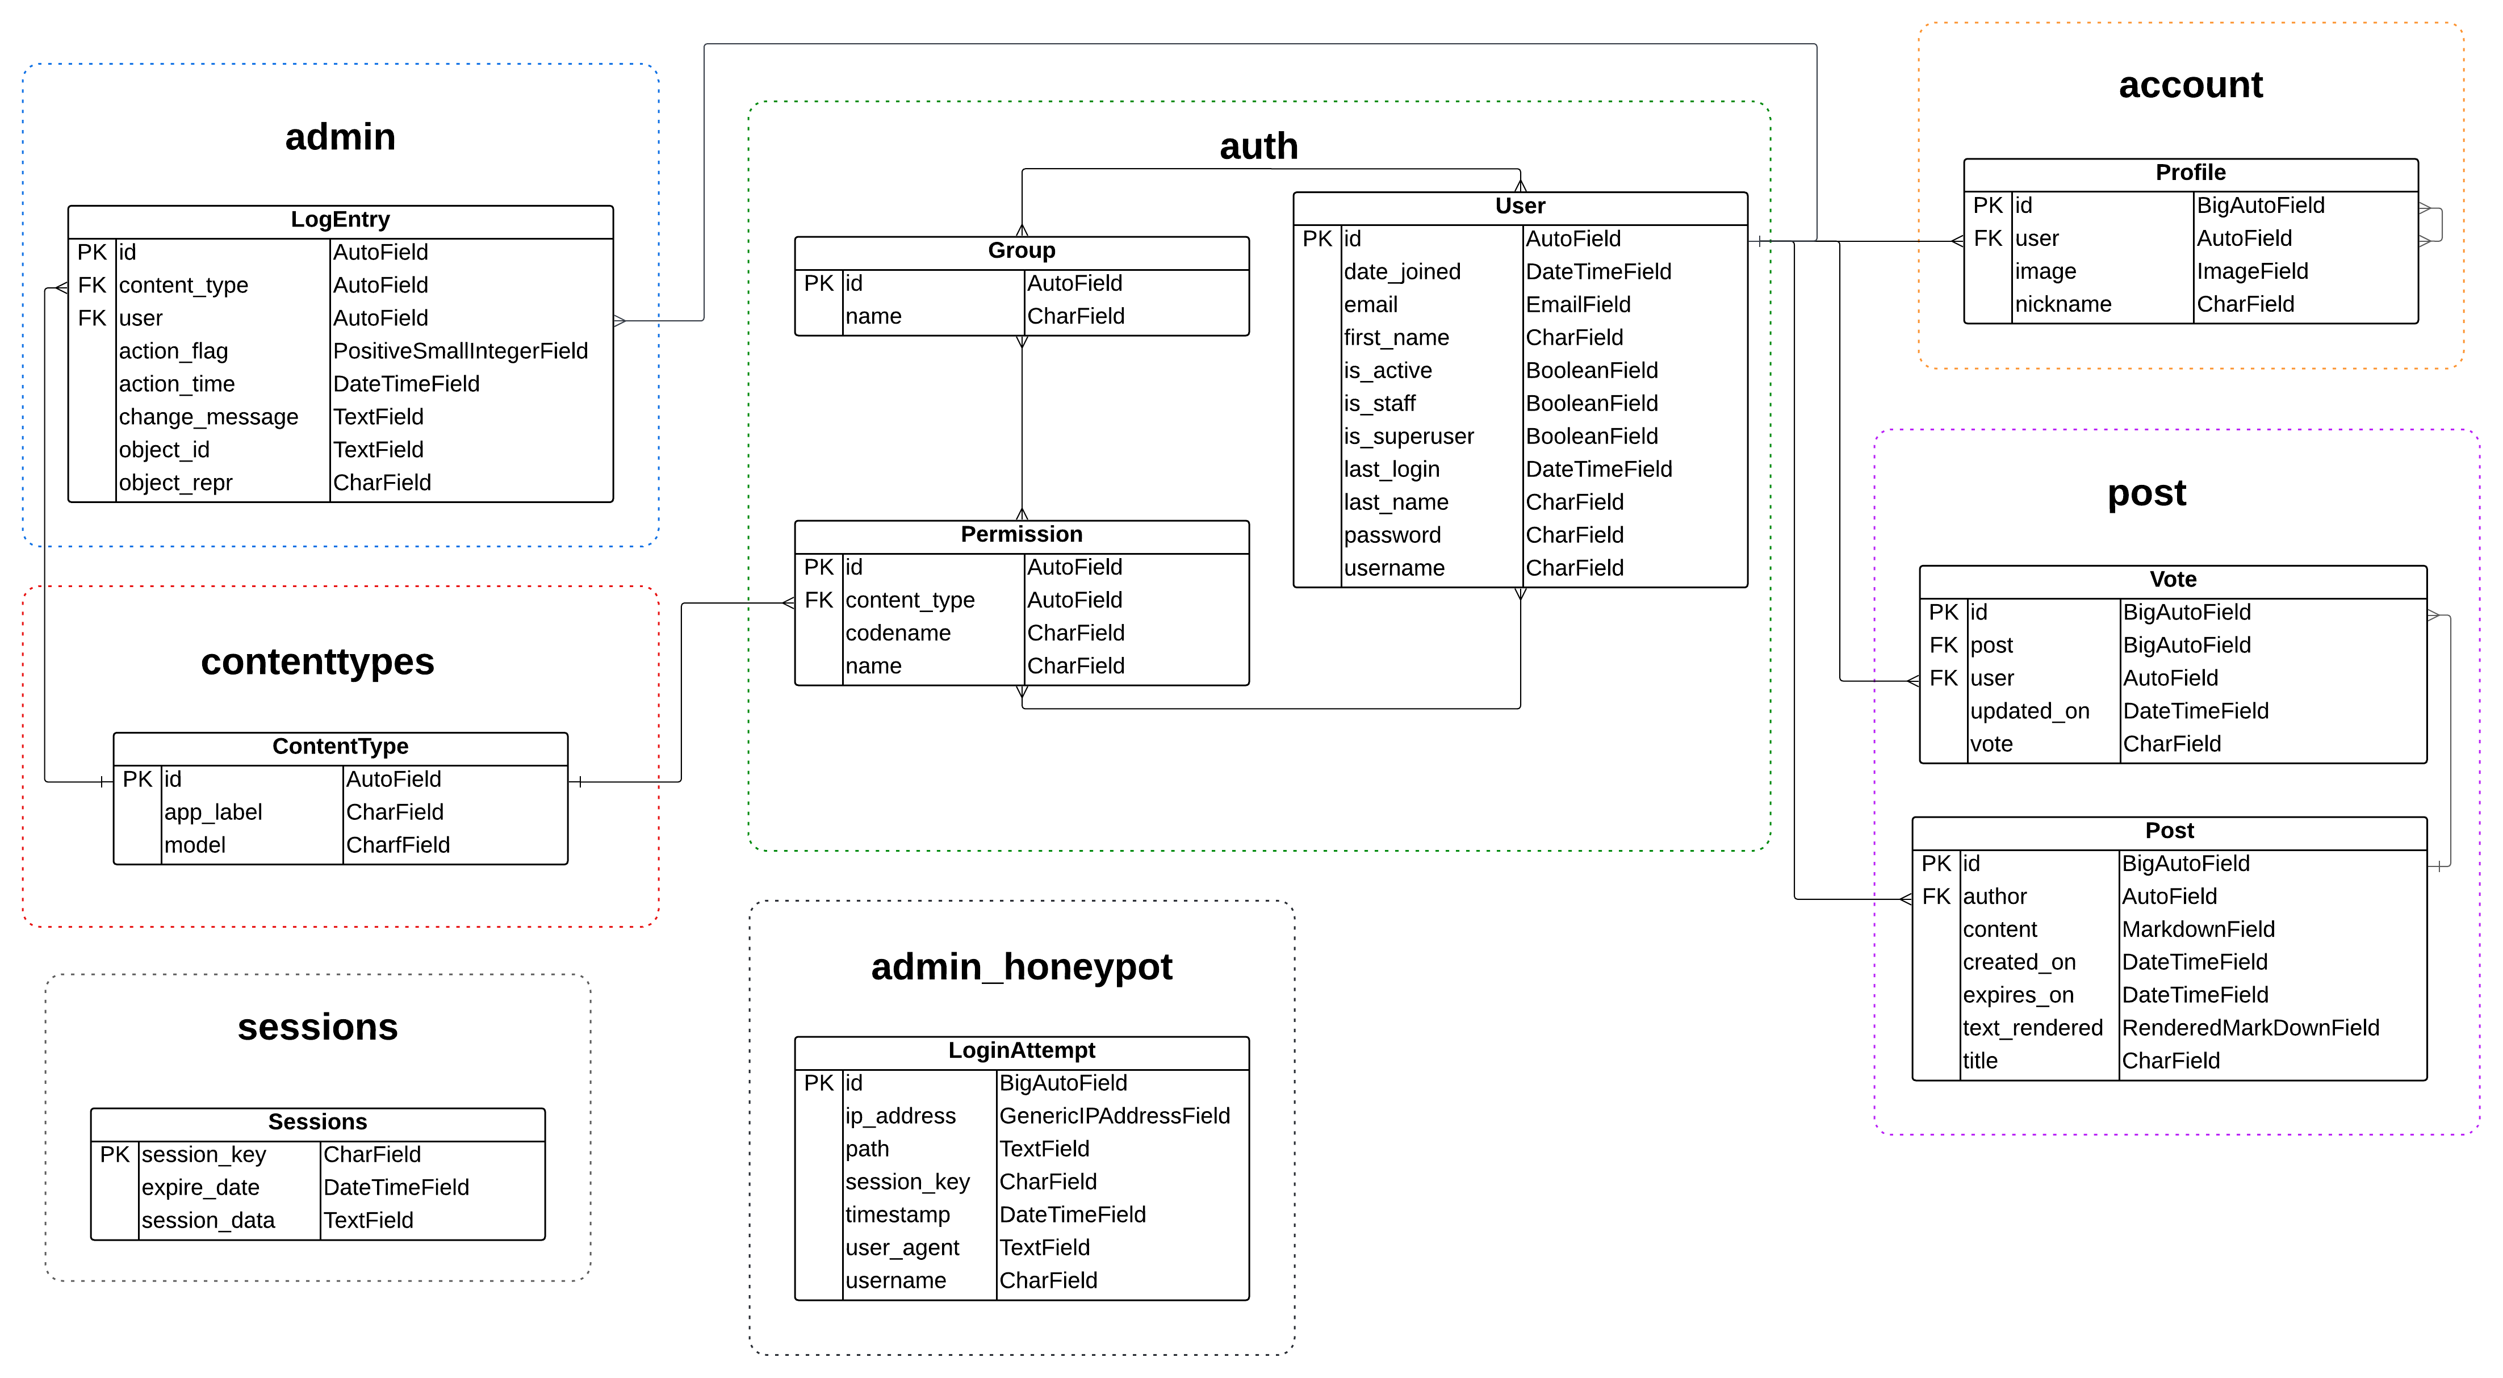
Database

Slide 8
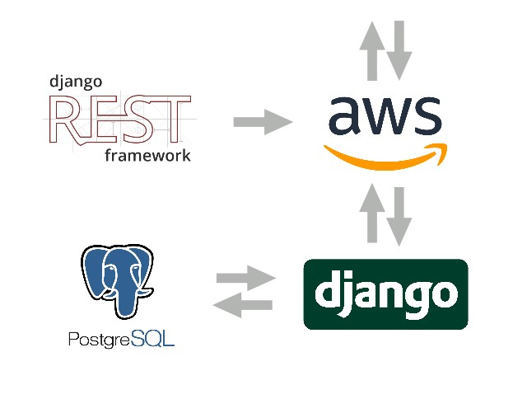
Tech Stack
Django
Python
HTML/CSS
REST
PostgreSQL
AWS
Apache

Slide 9

Security
Passwords are secure – PBKDF2 with a SHA256 hash
Password requirements when registering an account
HTTPS is strictly enforced – redirects and HSTS headers
The connection to the site is encrypted – TLS 1.3 and AES-128/256
Input sanitization and validation
For login fields and post creation fields

Slide 10


Security Cont.
Admin honeypot for the default admin endpoint
Actual endpoint relocated
Cross Site Request Forgery protections (CSRF token)
Valid host/domain explicitly specified

Slide 11
Bots
We created bots to test our site and make it feel alive
They caught a bug that we missed
Generate text with GPT-2
Start with three random posts
Every other post is made with the context of the previous posts
This gives each bot their own personality

Slide 12

DEMO
Website: https://khrono.space/

Slide 13
Future Implementations
Once we have real users on the platform, we can add a more sophisticated post ordering and recommendations.
We also have the option of adding more social features such as comments and direct messages.

