Slide 1
Are sports awards about sports?
Anshumaan Shankar, Gowtham Rajasekaran, Jacob Hendricks, jared Schlak, parichit sharma, madhavan K R, hasan kurban, and mehmet dalkilic
Notes:
Good afternoon. Thanks for coming to our presentation which is based on our predictions for Individual NBA Awards. Before we get started, I want to ask a question. Are there any NBA fans here today. I have a free candy bar for anyone that can name one of the three NBA MVP Finalists for this year? Congrats, here is a candy bar!!! Now just imagine if you could predict who would win MVP with near 100% accuracy and place a sports bet, think of all the money you could earn, which I guarantee you is much more than just that small candy bar!!

Slide 2
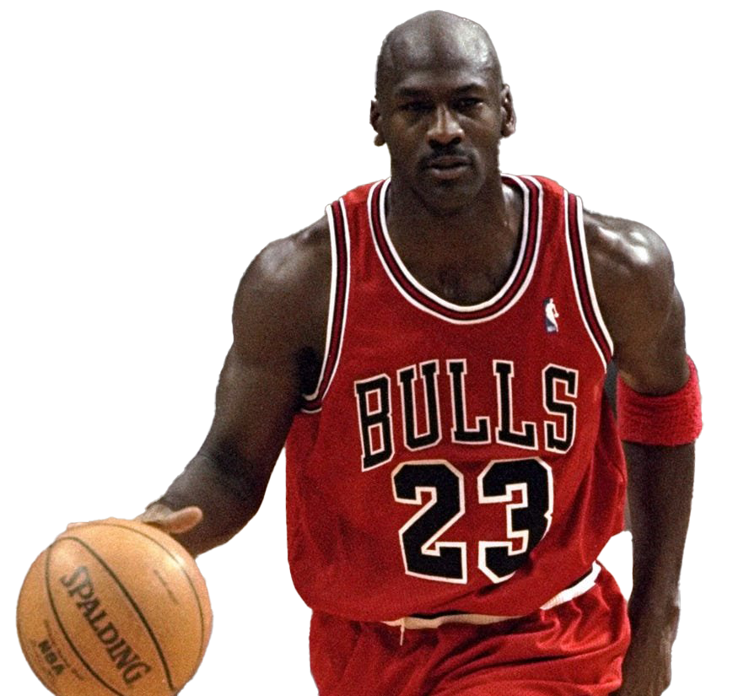
Contents
Problem and Motivation
Data Summary
Data Preprocessing
Experiments
Results
Conclusion
Notes:
Today we will give you our reason for picking this problem! WHY it should matter to you! Some background and analysis of the data, along with models we used and of course the most important part: the results, and how we all can become sports betting millionaires!

Slide 3
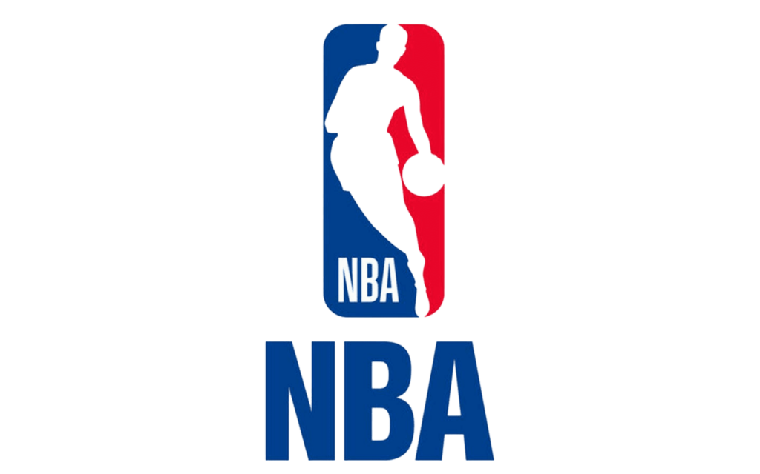
Problem statement
Predict Individual NBA Awards
Most Valuable Player (MVP)
Rookie of the Year (ROY)
Most Improved Player (MIP)
Defensive Player of the Year (DPOY)
Voted on by 100 sportswriters with 5 votes each
Lack of Models/Products that predict NBA Awards/especially non-MVP awards
Are Awards based ONLY on Statistics or are there other underlying Biases?
Notes:
One of my favorite things to do is watch sports. In my spare time, I think, man I am wasting all my time watching sports...how can I turn this knowledge into money!?!?! So naturally I go to sports betting website and see that I can place bets on pretty much anything, to include individual awards such as MVP. I did research to see how many other people are trying to solve this problem, and found very little resources for predicting individual awards such as MVP much less the other awards such as ROY, MIP, and DPOY. I figured, if we could make a model that would predict these four NBA awards, with a high degree of accuracy, we could try our hands at placing some informed bets and making a considerable amount of money!
The biggest Issue that I foresaw going into our problem was this: Are the awards based ONLY on the statistics, which in turn would create a models with near perfect accuracy, or would our models not fair very well, because the awards are based on other underlying biases that are not captured in our data. Well, our ultimate goal was to find the answer!

Slide 4
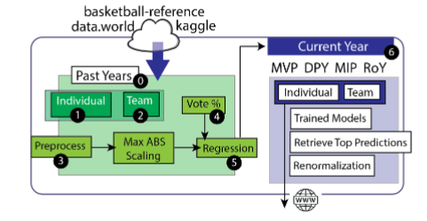
Data summary
Data from ESPN.COM, Basketball-Reference.com, and Kaggle.com
Incorporated Data from 1981-2023 (Including this season!)
Before 1980, MVP was voted on by other NBA players
Over 30 Different Features
~20,000 Rows of Data
Notes:
The first thing we needed to do was gather our data. And of course without good data, like our professor has said many times, our model would not give good results! Luckily, we were able to find our data fairly easily from ESPN.com, basketball-reference.com and of course like everyone else Kaggle.com
We were able to get over 30 different features such as points scored per game, assists per game, etc. and over 20k rows of data which included every single NBA Players season statistics from 1981 season to 2023 season that just finished last week. Now I will hand it over to my teammate for the data preprocessing part of the project.

Slide 5
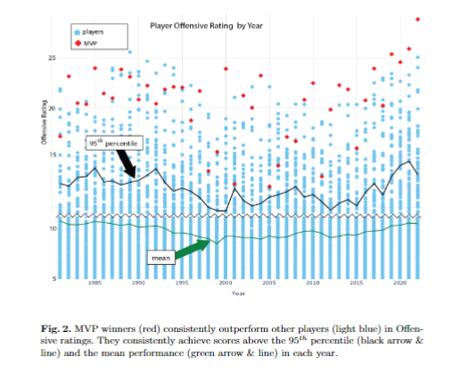
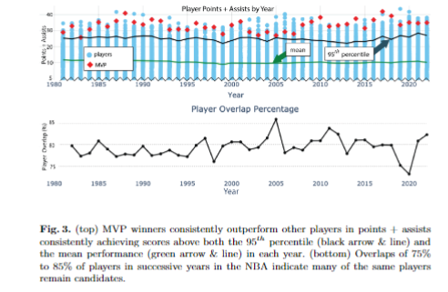
Exploratory data analysis
Notes:
As you can see from the above plots, it shows that most players that garner a lot of votes for MVP have a high average in points per game and also their team also usually has a high win percentage.

Slide 6
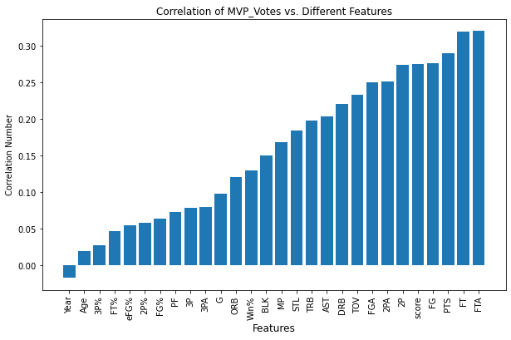
Exploratory data analysis

Slide 7
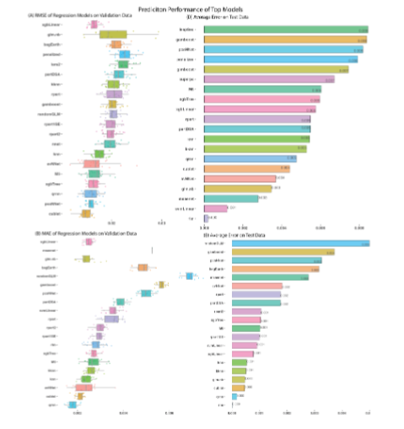
Model selection
Had to find a model that works well on unbalanced data
Used many different type of regression models
Compared results for each data set

Slide 8
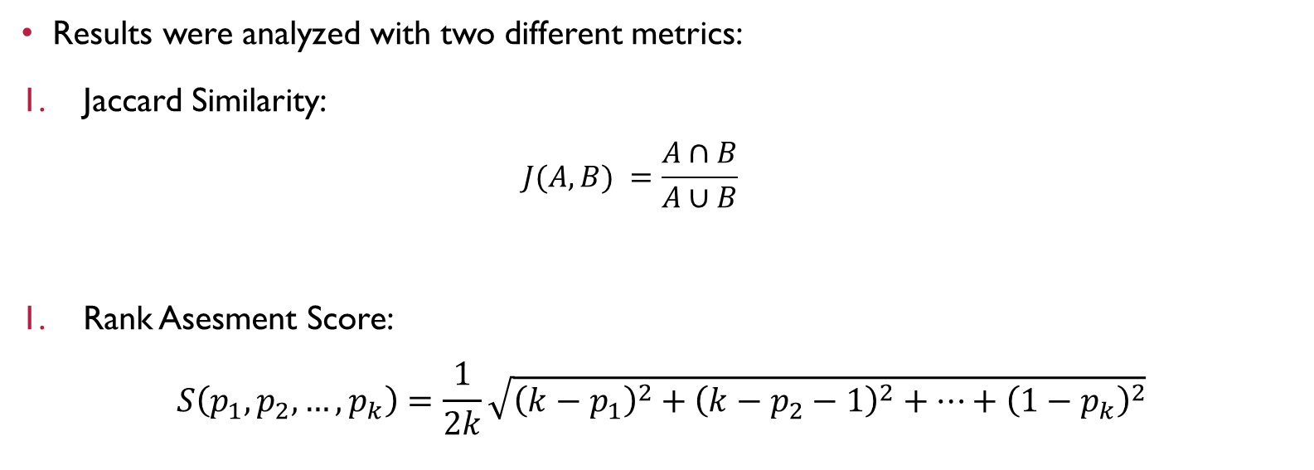
Results
Results were analyzed with two different metrics:
Jaccard Similarity:
$$J(A,B) =\frac{A∩B}{A∪B}$$
Rank Asesment Score:
$$S\left(p_{1}, p_{2},…,p_{k}\right)=\frac{1}{2k}\sqrt{{\left(k−p_{1}\right)}^{2}+{\left(k−p_{2}−1\right)}^{2}+…+{\left(1−p_{k}\right)}^{2}}$$

Slide 9
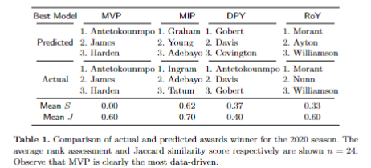
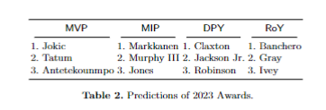
Results

Slide 10
Conclusion
We plan to expand this model to include the WNBA, as well as explore other professional sports.
Overall, we consider the model to be successful.
It can provide reasonable predictions in most cases. Especially on MVP and RotY awards.
Notes:
Which player pictured here has won back to back MVP’s the past 2 years? Pass out a candybar for the winning answer!

Slide 11
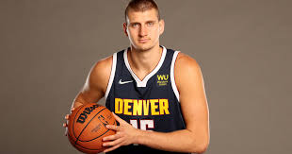
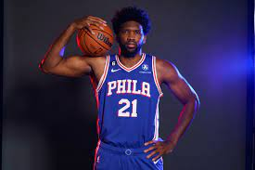
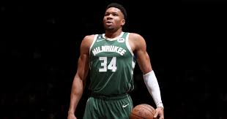
Thank you!
Notes:
Which player pictured here has won back to back MVP’s the past 2 years? Pass out a candybar for the winning answer!

