Slide 1
Anime Watch
Technical Presentation
By: Benjamin Lawson

Slide 2
Features
HTML5
CSS3
JavaScript
Kitsu API

Slide 3
Kitsu API
Public API
API path: https://kitsu.io/api/edge
Implements JSON API specification

Slide 4
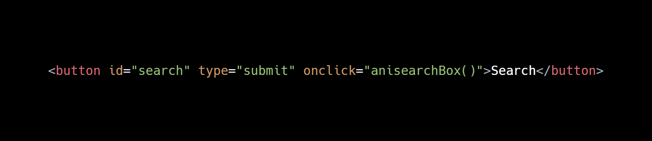
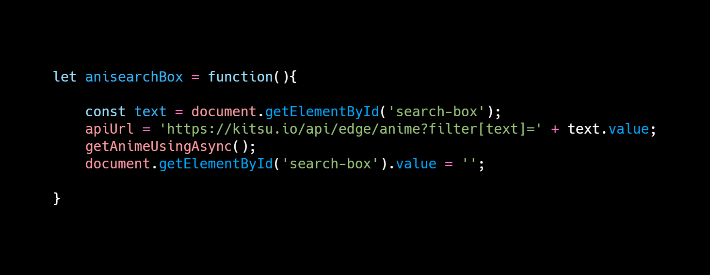
Search Function Call

Slide 5
Kitsu API Call and Response
API Call
anime?filter[text]= + text.value
characters?filter[name]= text.value
API Data
Searches database using call filter URL
Returns array of database information
Data Retrieval
Searches through returned array for fields data
Outputs data on webpage

Slide 6
Sources
Kitsu API · Apiary. Retrieved from https://kitsu.docs.apiary.io/#
Background Image Retrieved from https://az616578.vo.msecnd.net/files/responsive/cover/main/desktop/2016/05/22/6359949242235344891413001074_All%20the%20anime.jpeg

Slide 7

Questions?

