Slide 1
AI in Mathematics
Lecture 10
Reinforcement Learning
Bar-Ilan University
Nebius Academy | Stevens Institute of Technology
May 27, 2025

Slide 2
About This Course
1 week: Intro
2 weeks: Classic ML
2 weeks: Deep Learning in Mathematics
4 weeks: Math as an NLP problem (LLMs etc.)
4 weeks: Reinforcement Learning (RL) in Math

Slide 3
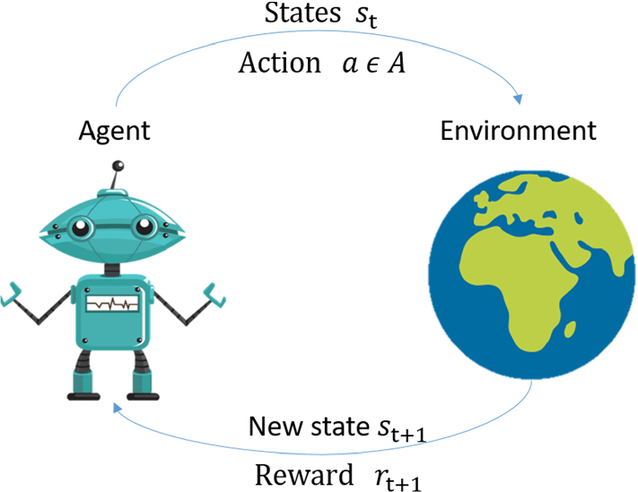
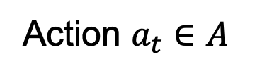
Reinforcement Learning
Action $a_{t}∈A$

Slide 4
Reinforcement Learning
ML algorithms, etc.
Action $a_{t}∈A$
What action to pick?

Slide 5
Reinforcement Learning
ML algorithms, etc.
What action to pick?

Slide 6
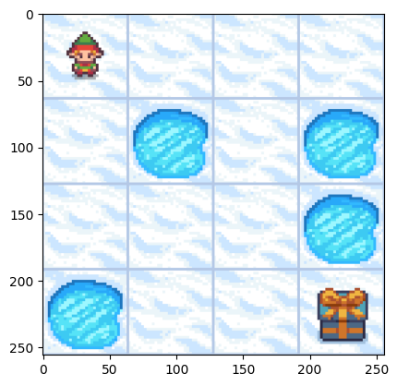
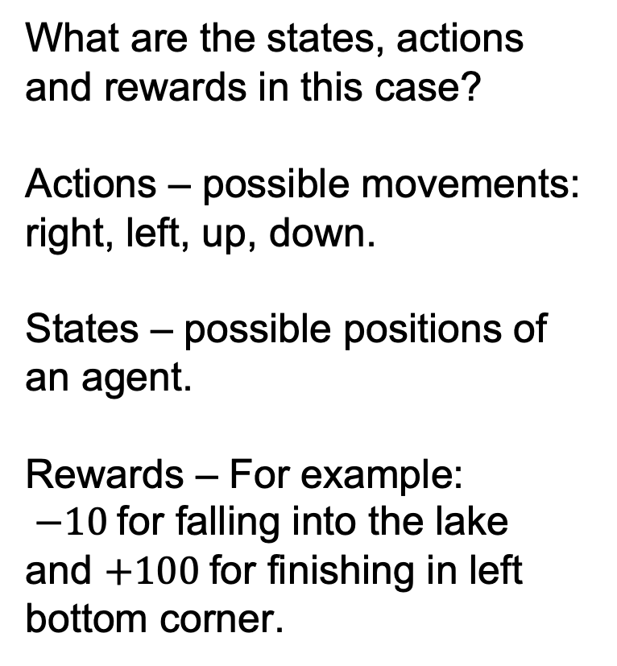
Example
What are the states, actions and rewards in this case?
Actions – possible movements: right, left, up, down.
States – possible positions of an agent.
Rewards – For example:
$−10$for falling into the lake and $+100$for finishing in left bottom corner.

Slide 7
Frozen Lake
❓ Does the agent see the layout?
❓ How can it avoid holes if it doesn’t see them?

Slide 8
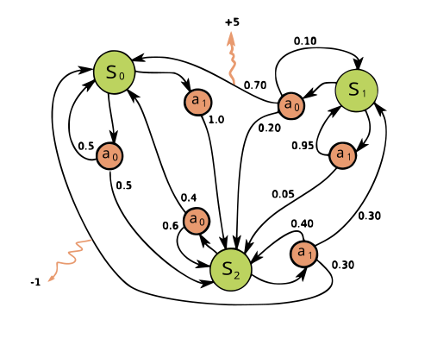
Markov Decision Process

Slide 9
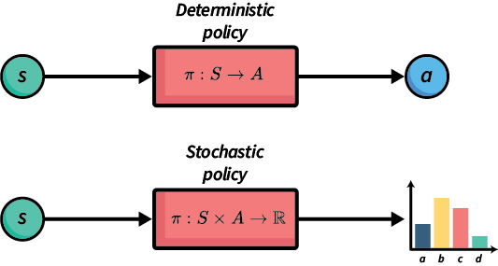
Policy
A policy is the agent’s strategy for choosing actions.

Slide 10
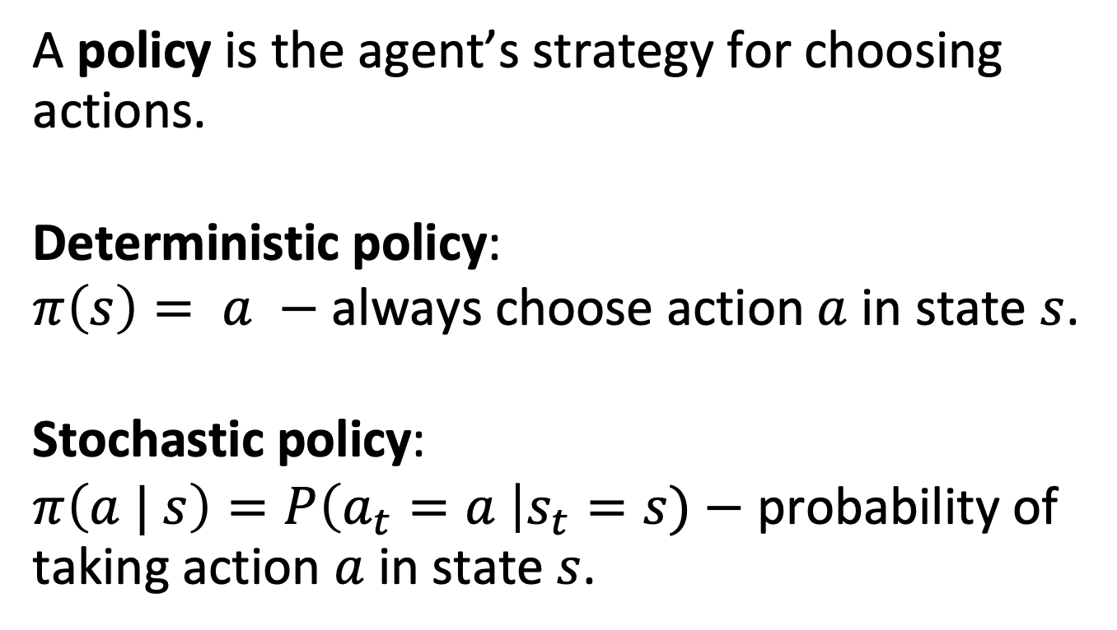
Policy
A policy is the agent’s strategy for choosing actions.
Deterministic policy:
$π\left(s\right)= a −$ always choose action$a$in state $s$.
Stochastic policy:
$π\left(a | s\right)=P\left(a_{t}=a \right|s_{t}=s)−$ probability of taking action $a$ in state $s$.

Slide 11
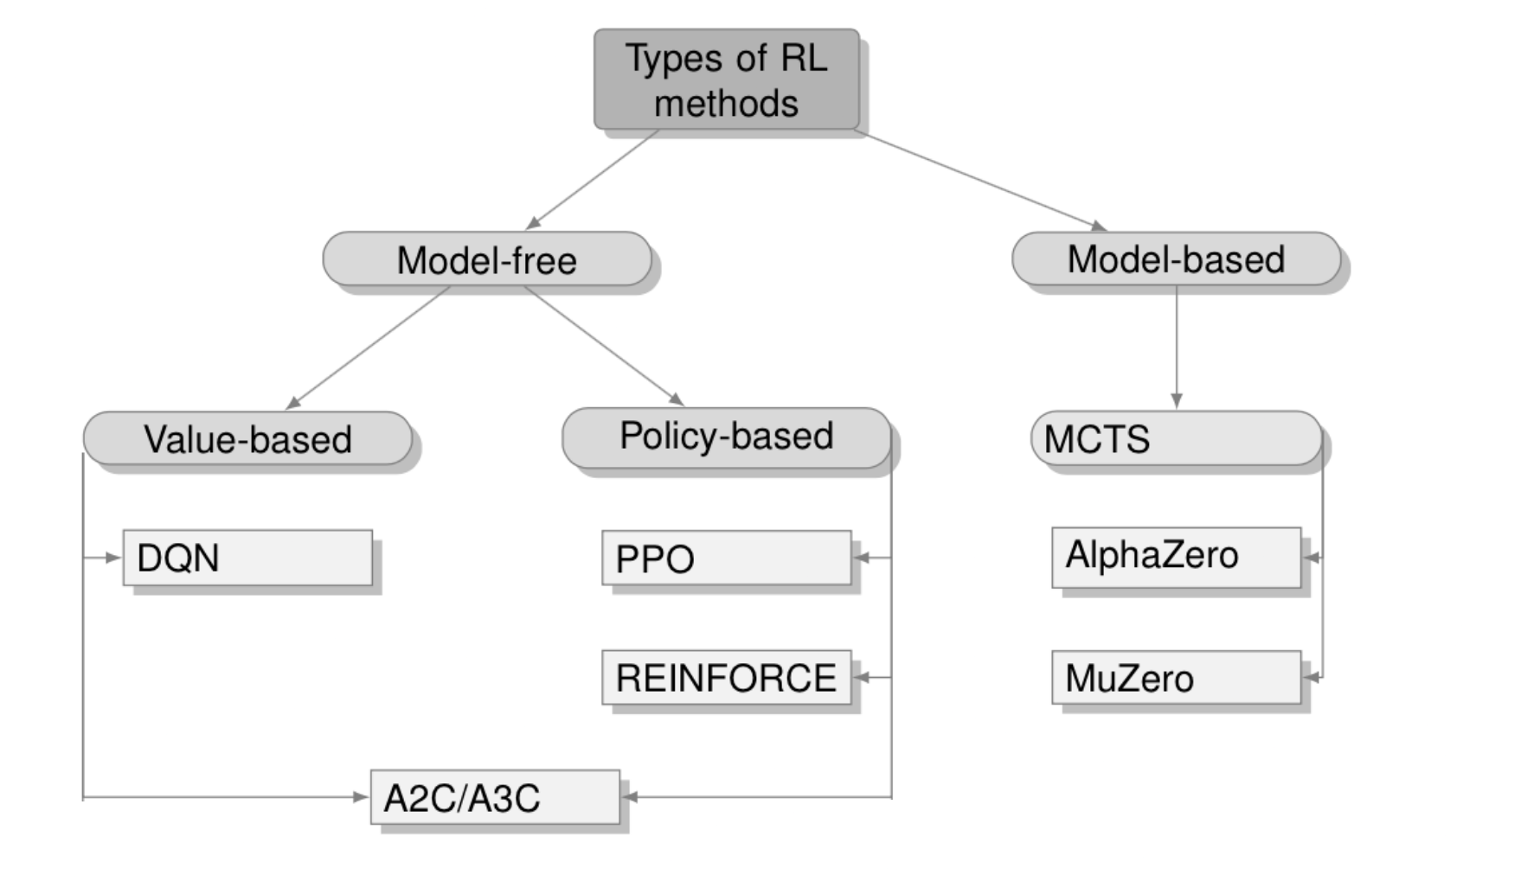
RL Algorithms

Slide 12
Model based methods
The agent explicitly learns or uses a model of the environment’s dynamics, meaning we have intentionally designed it to do so.
If the agent discovers a way to represent probabilities on its own without being guided to build or use a model, it is still considered model-free.

Slide 13
Example
The difference between model free and model based algorithms in the Frozen Lake problem is as follows:
Model free:
The agent only observes its current position (as a state index) and the reward after each move.
Model based:
Either know or learn how likely the agent is to slip when moving in a given direction. They also have access to or reconstruct the entire state space and update a transition model P(s’|s,a).

Slide 14
RL Algorithms
3 lectures
Last lecture

Slide 15
CEM (Cross Entropy Method)
The Cross Entropy Method (CEM) is an optimization algorithm that iteratively refines a probability distribution over candidate solutions. At each step, it samples solutions from the current distribution, evaluates their performance, and then updates the distribution to focus more on the best-performing samples.
Over time, this process increases the likelihood of generating high-quality solutions, effectively guiding the search toward optimal or near-optimal outcomes.

Slide 16
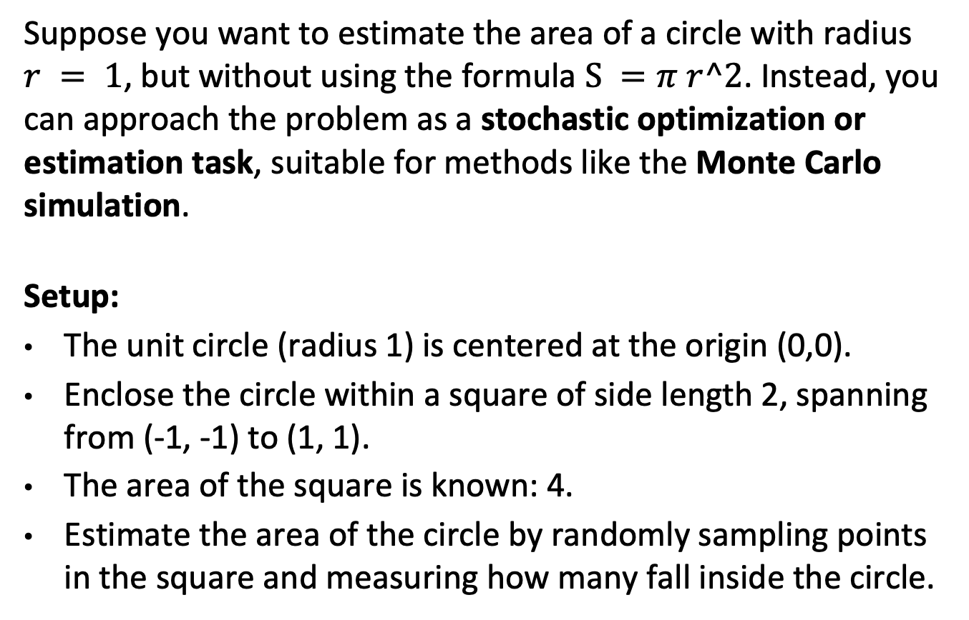
Example
Suppose you want to estimate the area of a circle with radius $r = 1$, but without using the formula $S =π r^2$. Instead, you can approach the problem as a stochastic optimization or estimation task, suitable for methods like the Monte Carlo simulation.
Setup:
The unit circle (radius 1) is centered at the origin (0,0).
Enclose the circle within a square of side length 2, spanning from (-1, -1) to (1, 1).
The area of the square is known: 4.
Estimate the area of the circle by randomly sampling points in the square and measuring how many fall inside the circle.

Slide 17
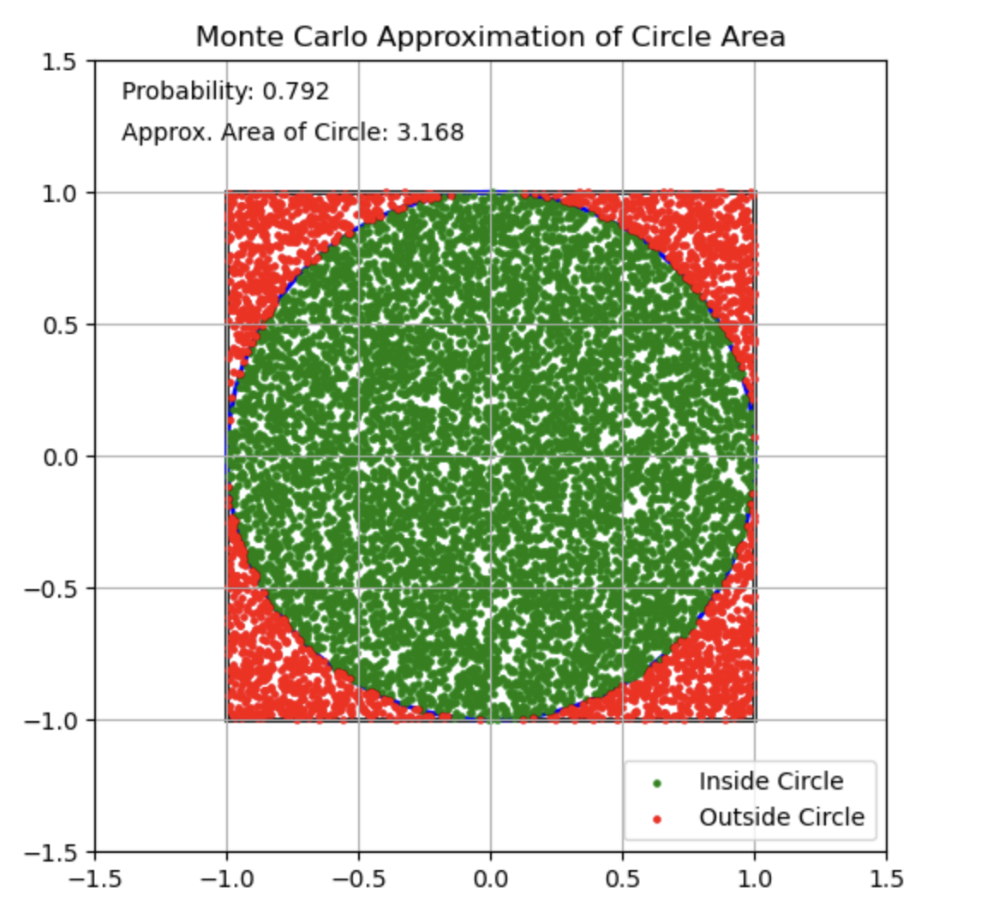
Example

Slide 18
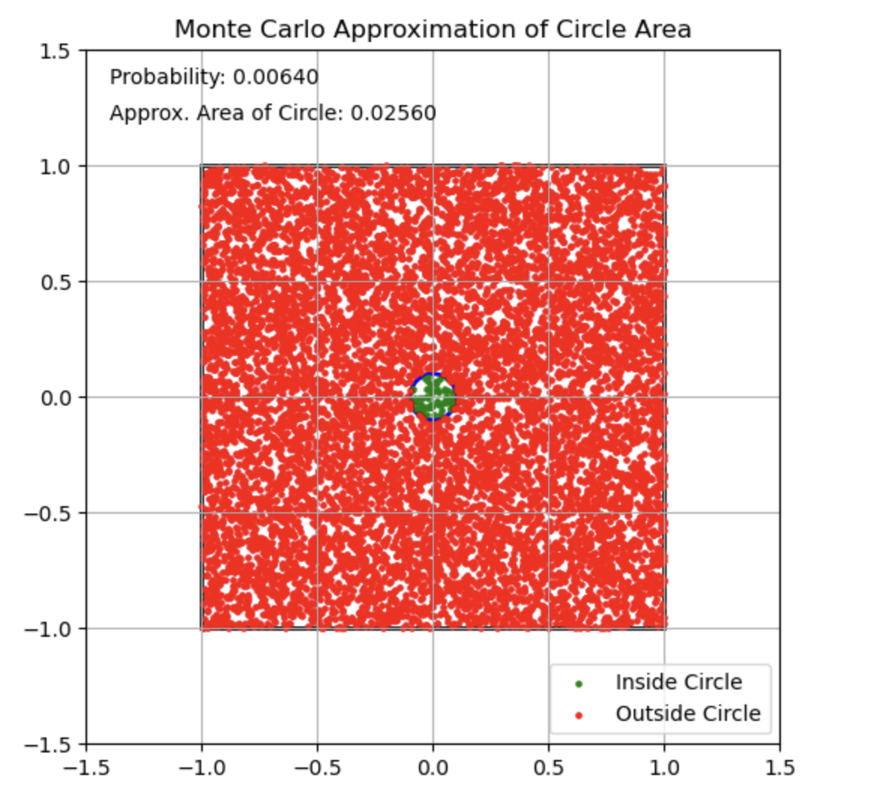
Circle with radius 0.1

Slide 19
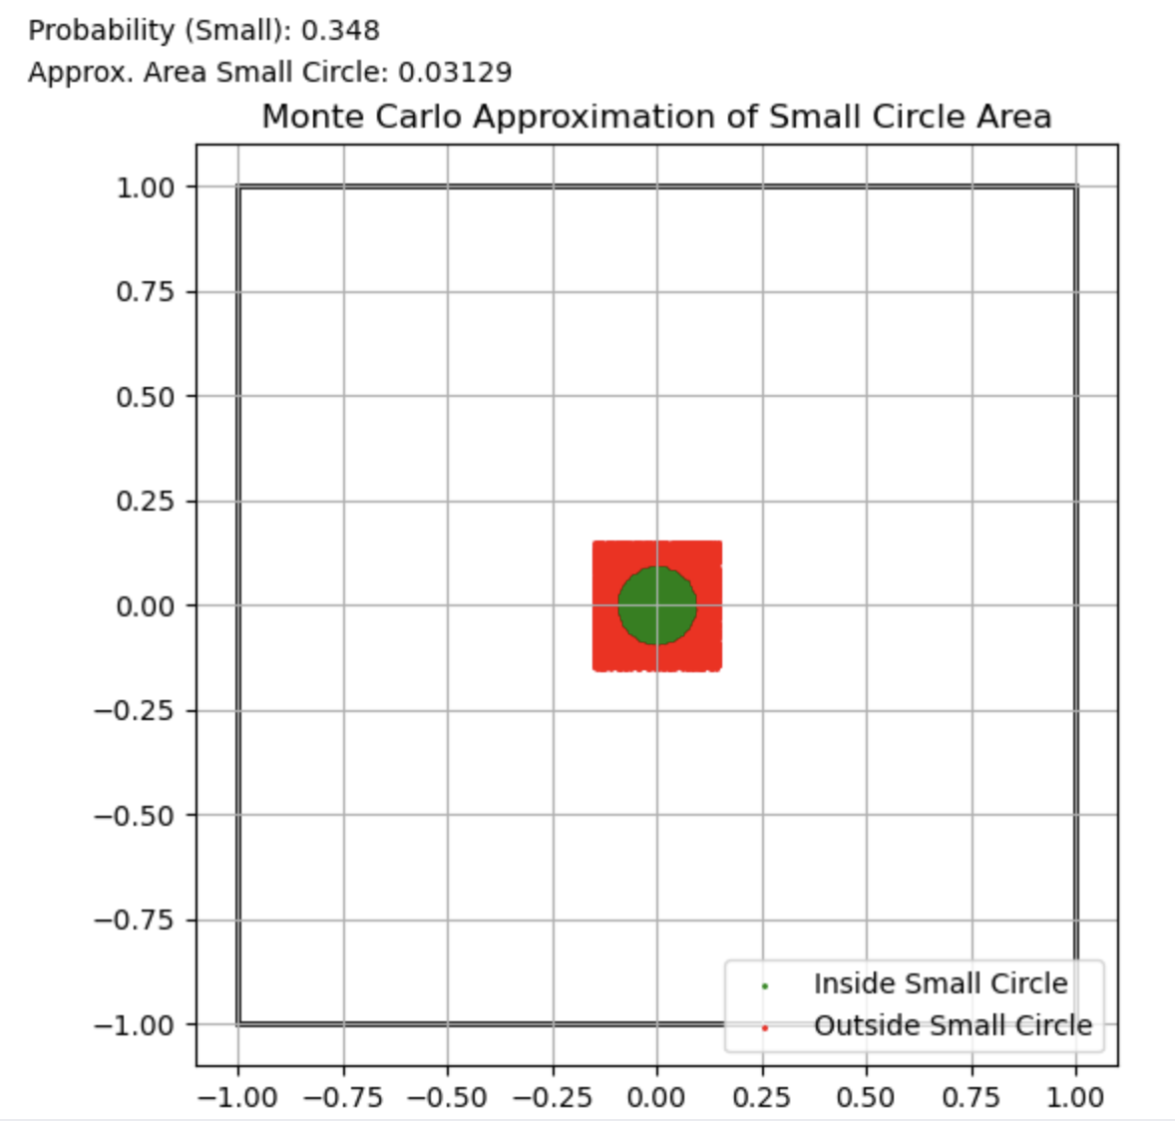
Example
Seems like for smaller circle we need to select randomly from a smaller square uniformly, right?

Slide 20
Idea
Let’s update
probability distribution after first step, such that samples
Inside will have a larger probability.

Slide 21
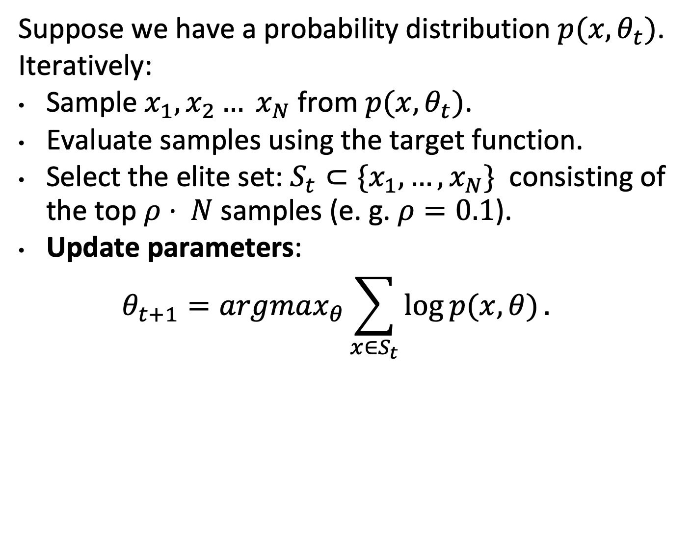
Formally CEM
Suppose we have a probability distribution $p(x, θ_{t})$.
Iteratively:
Sample $x_{1}, x_{2}… x_{N}$ from $p(x, θ_{t})$.
Evaluate samples using the target function.
Select the elite set: $S_{t}⊂\{x_{1}, …, x_{N}\}$consisting of the top $ρ⋅ N$samples (e. g. $ρ=0.1$).
Update parameters:
$$θ_{t+1}=argmax_{θ}\sum_{x∈S_{t}}{\log{p(x, θ)}.}$$

Slide 22
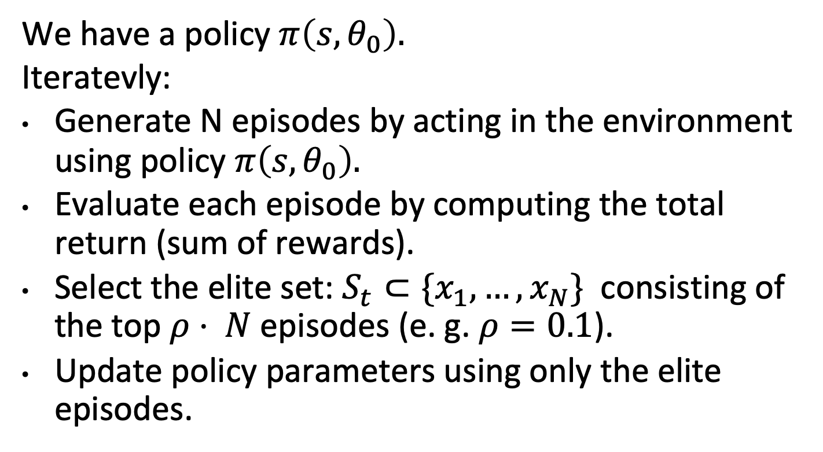
How to apply in RL?
We have a policy $π\left(s, θ_{0}\right).$
Iteratevly:
Generate N episodes by acting in the environment using policy $π\left(s, θ_{0}\right).$
Evaluate each episode by computing the total return (sum of rewards).
Select the elite set: $S_{t}⊂\{x_{1}, …, x_{N}\}$consisting of the top $ρ⋅ N$episodes (e. g. $ρ=0.1$).
Update policy parameters using only the elite episodes.

Slide 23
Example
Suppose we are interested in such an unusual
graph property:
What is the largest possible ratio between the smallest and largest eigenvalues of a graph’s adjacency matrix?
This is a challenging combinatorial question, and we can approach it using reinforcement learning techniques.

Slide 24
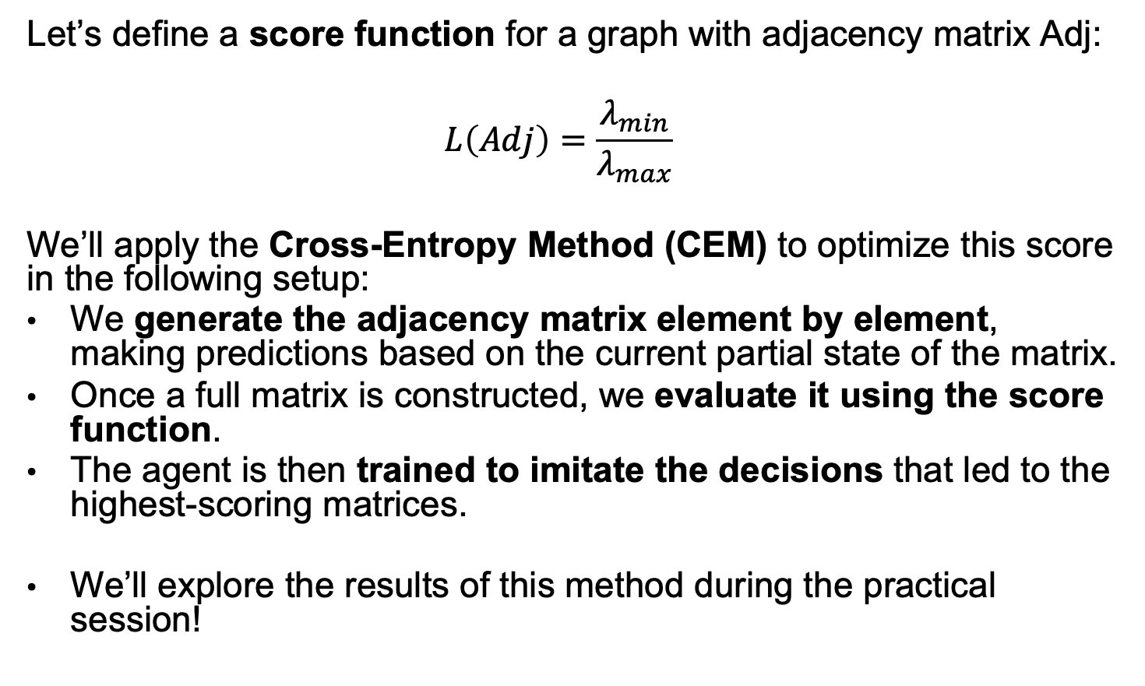
Example
Let’s define a score function for a graph with adjacency matrix Adj:
$$L\left(Adj\right)=\frac{λ_{min}}{λ_{max}}$$
We’ll apply the Cross-Entropy Method (CEM) to optimize this score in the following setup:
We generate the adjacency matrix element by element, making predictions based on the current partial state of the matrix.
Once a full matrix is constructed, we evaluate it using the score function.
The agent is then trained to imitate the decisions that led to the highest-scoring matrices.
We’ll explore the results of this method during the practical session!

