Slide 1
AI in Mathematics
Lecture 12
Reinforcement Learning
Bar-Ilan University
Nebius Academy | Stevens Institute of Technology
June 17, 2025

Slide 2
About This Course
1 week: Intro
2 weeks: Classic ML
2 weeks: Deep Learning in Mathematics
4 weeks: Math as an NLP problem (LLMs etc.)
4 weeks: Reinforcement Learning (RL) in Math

Slide 3
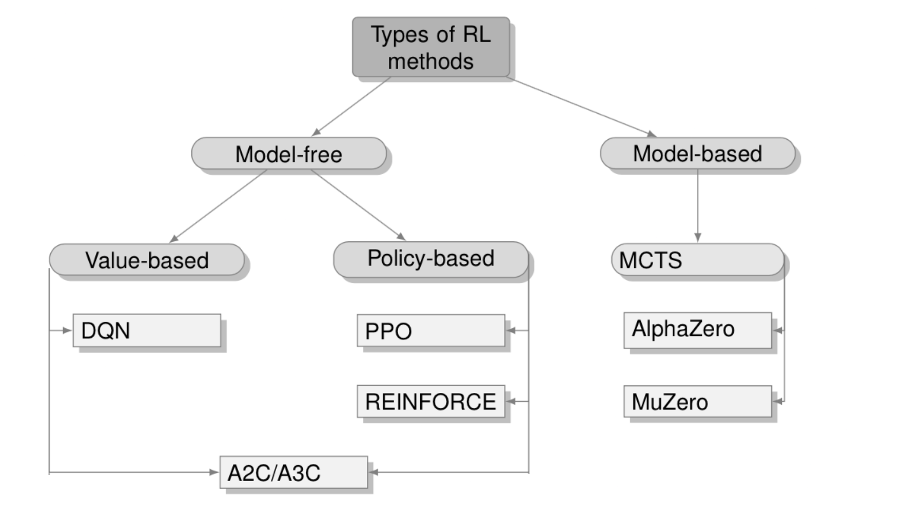
RL Algorithms

Slide 4
RL Algorithms
3 lectures
Last lecture

Slide 5
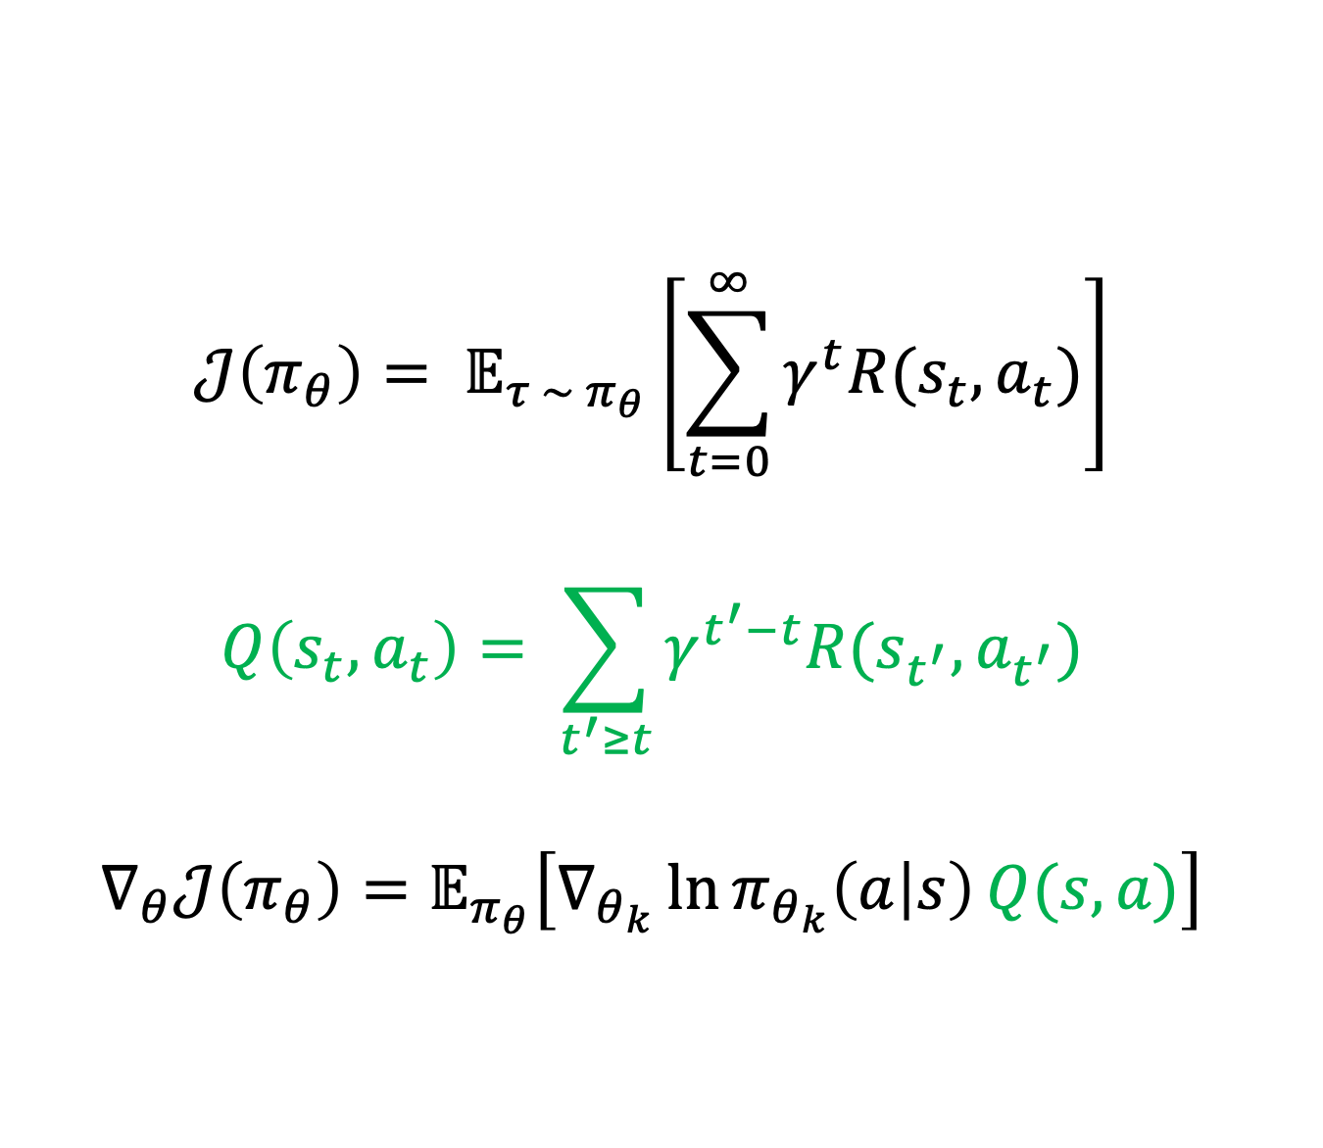
Policy Gradient
$$𝒥\left(π_{θ}\right)= 𝔼_{τ \sim π_{θ}}\left[\sum_{t=0}^{∞}{γ^{t}R(s_{t}, a_{t})}\right]$$
$$Q\left(s_{t}, a_{t}\right)= \sum_{t^{′}≥t}{γ^{t^{′}−t}R(s_{t^{′}}, a_{t^{′}})}$$
$$∇_{θ}𝒥\left(π_{θ}\right)=𝔼_{π_{θ}}\left[∇_{θ_{k}}\ln{π_{θ_{k}}\left(a | s\right)}Q(s, a)\right]$$

Slide 6
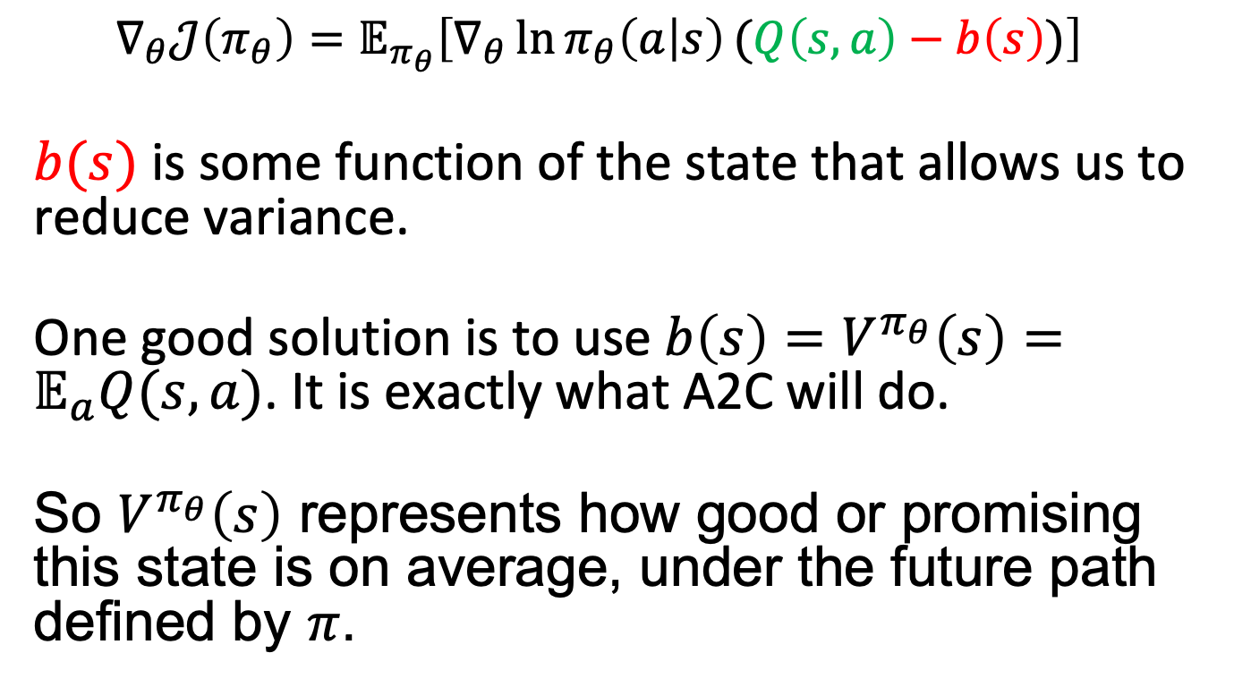
Variance problem
$$∇_{θ}𝒥\left(π_{θ}\right)=𝔼_{π_{θ}}\left[∇_{θ}\ln{π_{θ}\left(a | s\right)}(Q\left(s, a\right)−b\left(s\right))\right]$$
$b(s)$ is some function of the state that allows us to reduce variance.
One good solution is to use $b\left(s\right)=V^{π_{θ}}\left(s\right)=𝔼_{a}Q(s,a)$. It is exactly what A2C will do.
So $V^{π_{θ}}\left(s\right)$ represents how good or promising this state is on average, under the future path defined by $π$.

Slide 7
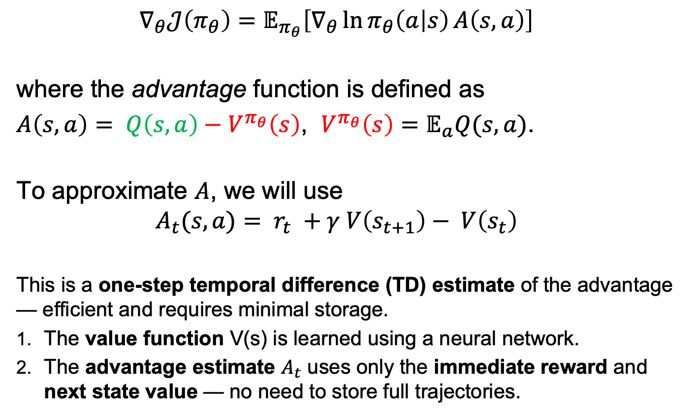
A2C
$$∇_{θ}𝒥\left(π_{θ}\right)=𝔼_{π_{θ}}\left[∇_{θ}\ln{π_{θ}\left(a | s\right)}A\left(s,a\right)\right]$$
where the advantage function is defined as
$A\left(s,a\right)= Q\left(s, a\right)−V^{π_{θ}}\left(s\right)$, $V^{π_{θ}}\left(s\right)=𝔼_{a}Q(s,a)$.
To approximate $A$, we will use
$$A_{t}(s,a)= r_{t} +γ V\left(s_{t+1}\right)− V\left(s_{t}\right)$$
This is a one-step temporal difference (TD) estimate of the advantage — efficient and requires minimal storage.
The value function V(s) is learned using a neural network.
The advantage estimate $A_{t}$ uses only the immediate reward and next state value — no need to store full trajectories.

Slide 8
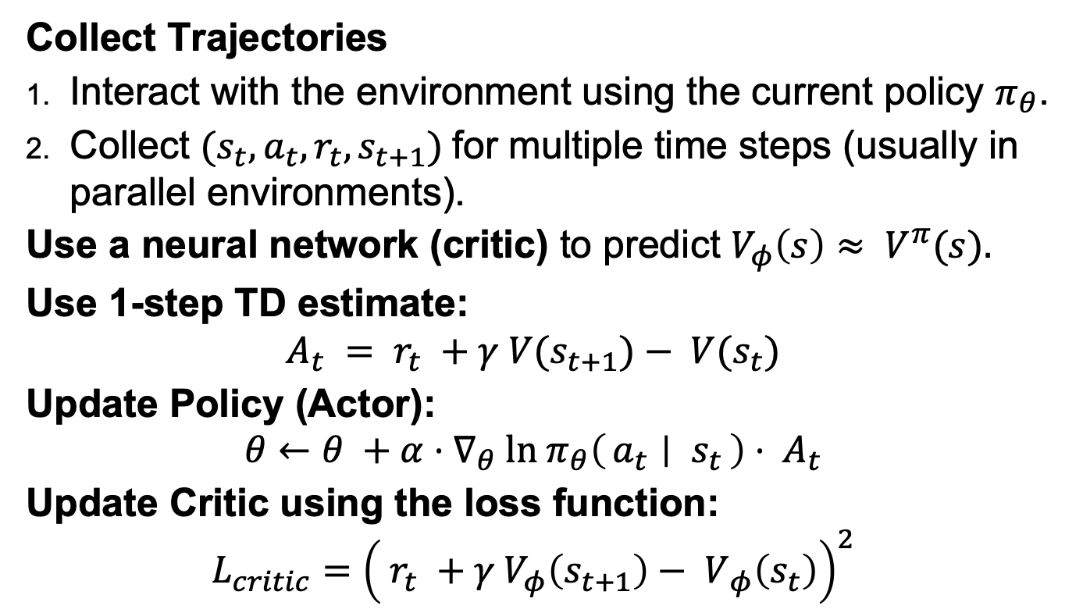
A2C
Collect Trajectories
Interact with the environment using the current policy $π_{θ}$.
Collect $(s_{t}, a_{t}, r_{t}, s_{t+1})$for multiple time steps (usually in parallel environments).
Use a neural network (critic) to predict $V_{φ}\left(s\right)≈ V^{π}(s).$
Use 1-step TD estimate:
$$A_{t} = r_{t} +γ V(s_{t+1})− V(s_{t})$$
Update Policy (Actor):
$$θ←θ +α⋅∇_{θ} ln π_{θ}\left(a_{t} ∣ s_{t}\right)⋅ A_{t}$$
Update Critic using the loss function:
$$L_{critic}={\left( r_{t} +γ V_{φ}\left(s_{t+1}\right)− V_{ φ}\left(s_{t}\right)\right)}^{2}$$

Slide 9
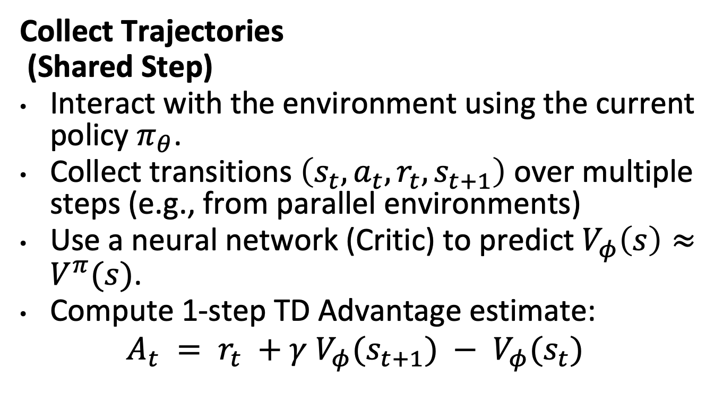
A2C (Detailed)
Collect Trajectories
(Shared Step)
Interact with the environment using the current policy $π_{θ}$.
Collect transitions $\left(s_{t}, a_{t}, r_{t}, s_{t+1}\right)$ over multiple steps (e.g., from parallel environments)
Use a neural network (Critic) to predict $V_{φ}\left(s\right)≈V^{π}(s)$.
Compute 1-step TD Advantage estimate:
$$A_{t} = r_{t} +γ V_{φ}(s_{t+1}) − V_{φ}(s_{t})$$

Slide 10
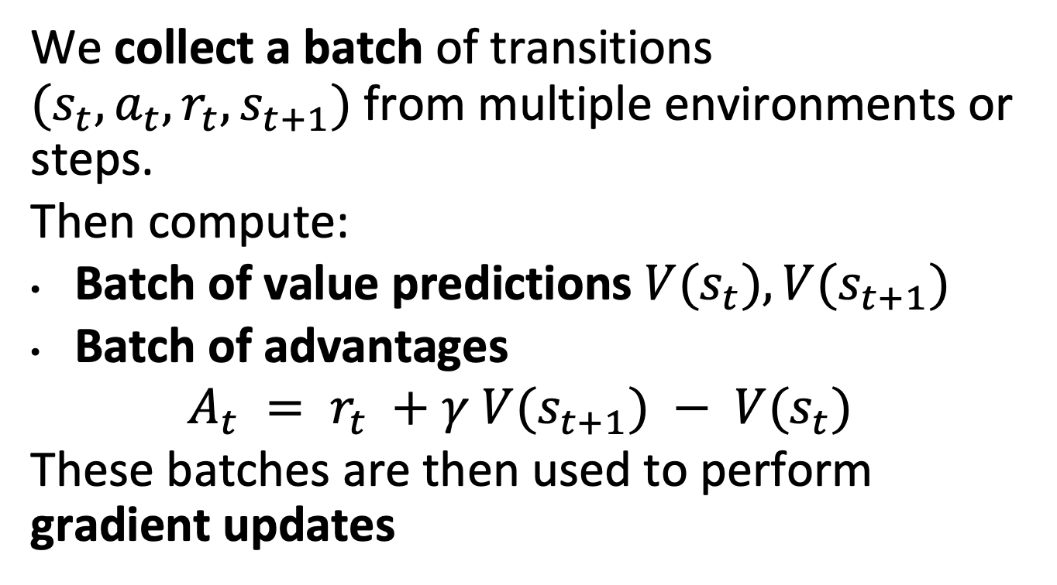
What Actually Happens:
We collect a batch of transitions $(s_{t}, a_{t}, r_{t}, s_{t+1})$from multiple environments or steps.
Then compute:
Batch of value predictions $V(s_{t}), V(s_{t+1})$
Batch of advantages
$$A_{t} = r_{t} +γ V(s_{t+1}) − V(s_{t})$$
These batches are then used to perform gradient updates

Slide 11
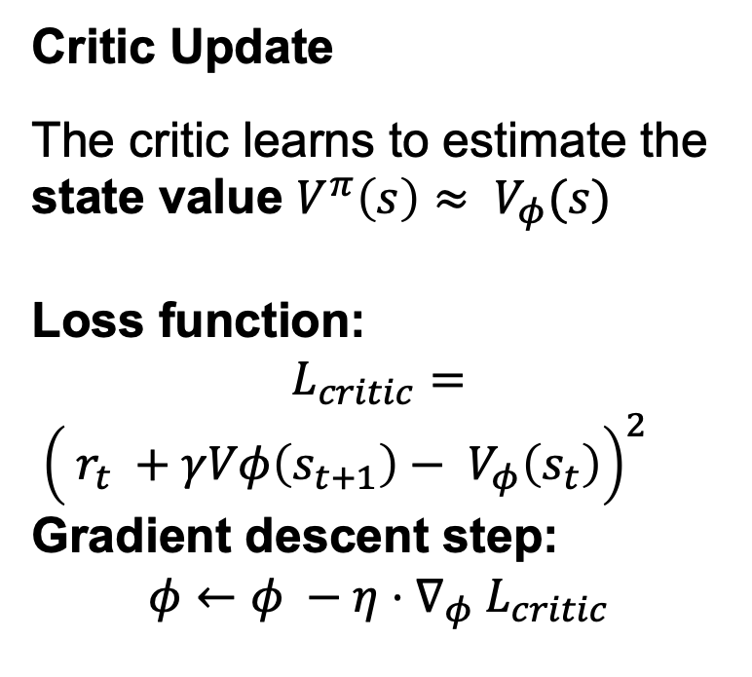
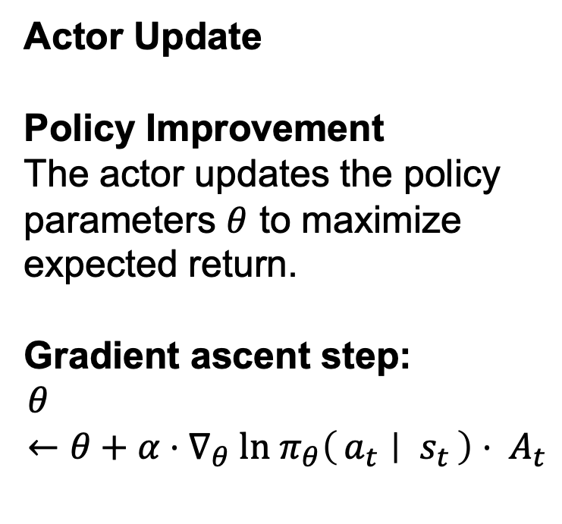
A2C (Detailed)
Actor Update
Policy Improvement
The actor updates the policy parameters $θ$ to maximize expected return.
Gradient ascent step:
$$θ←θ+α⋅∇_{θ} ln π_{θ}\left(a_{t} ∣ s_{t}\right)⋅ A_{t}$$
Critic Update
The critic learns to estimate the state value $V^{π}\left(s\right)≈ V_{φ}(s)$
Loss function:
$$L_{critic}=$$
${\left( r_{t} +γVφ\left(s_{t+1}\right)− V_{φ}\left(s_{t}\right)\right)}^{2}$
Gradient descent step:
$$φ←φ −η⋅∇_{φ} L_{critic}$$
In both cases we can use stochastic gradient descent to update parameters.

Slide 12
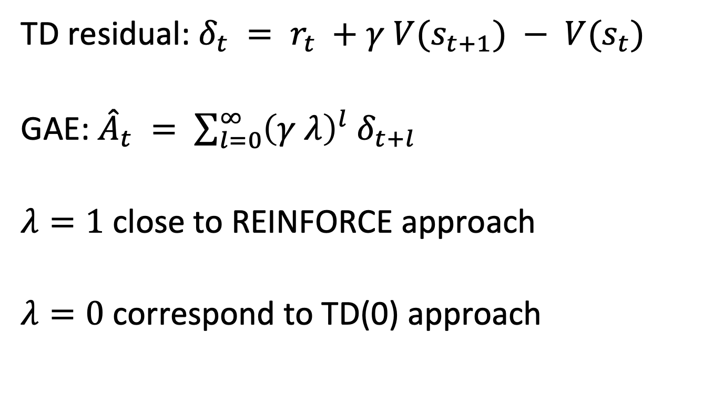
Reducing Variance: Generalized Advantage Estimation (GAE)
TD residual: $δ_{t} = r_{t} +γ V(s_{t+1}) − V(s_{t})$
GAE: ${\hat{A}}_{t} = \sum_{l=0}^{∞}{{\left(γ λ\right)}^{l} δ_{t+l}}$
$λ=1$ close to REINFORCE approach
$λ=0$ correspond to TD(0) approach

Slide 13
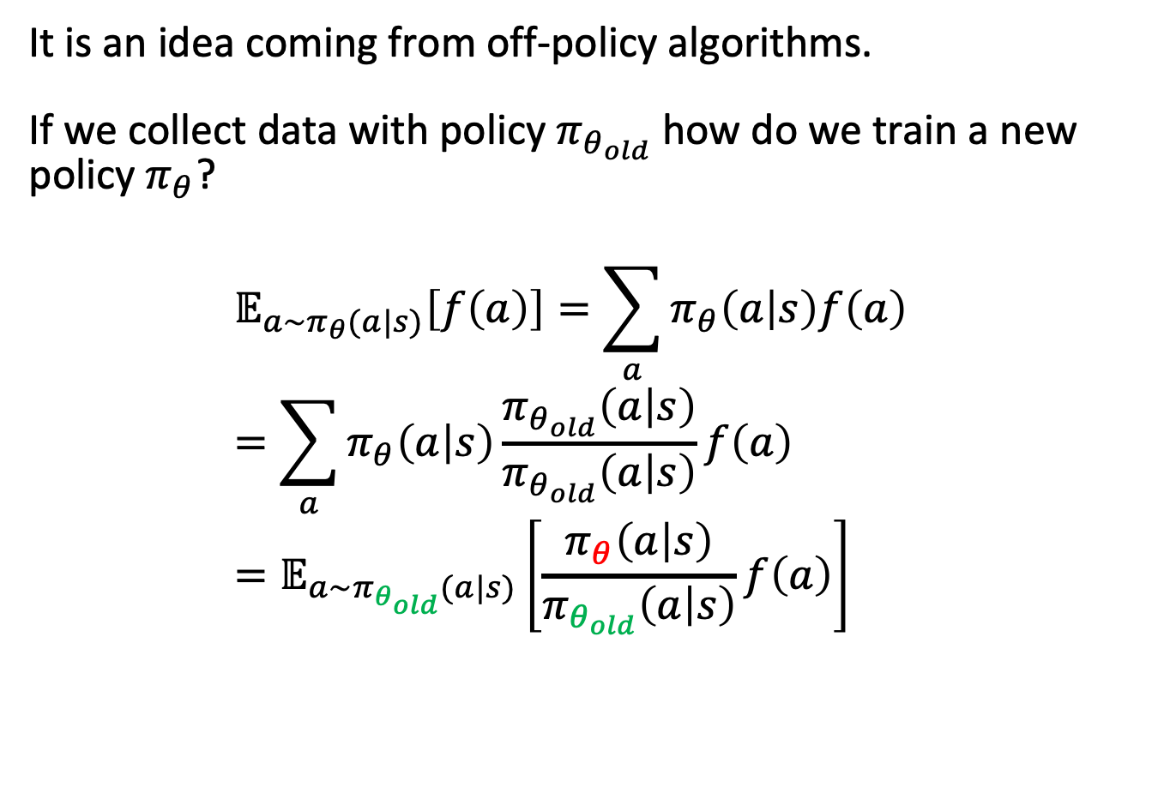
Importance Sampling
It is an idea coming from off-policy algorithms. If we collect data with policy $π_{θ_{old}}$ how do we train a new policy $π_{θ}$?
$$𝔼_{a\sim π_{θ}(a|s)}\left[f\left(a\right)\right]=\sum_{a}{π_{θ}\left(a | s\right)f\left(a\right)}=\sum_{a}{π_{θ}\left(a | s\right)\frac{π_{θ_{old}}\left(a | s\right)}{π_{θ_{old}}\left(a | s\right)}f\left(a\right)}=𝔼_{a\sim π_{θ_{old}}(a|s)}\left[\frac{π_{θ}\left(a | s\right)}{π_{θ_{old}}\left(a | s\right)}f\left(a\right)\right]$$

Slide 14
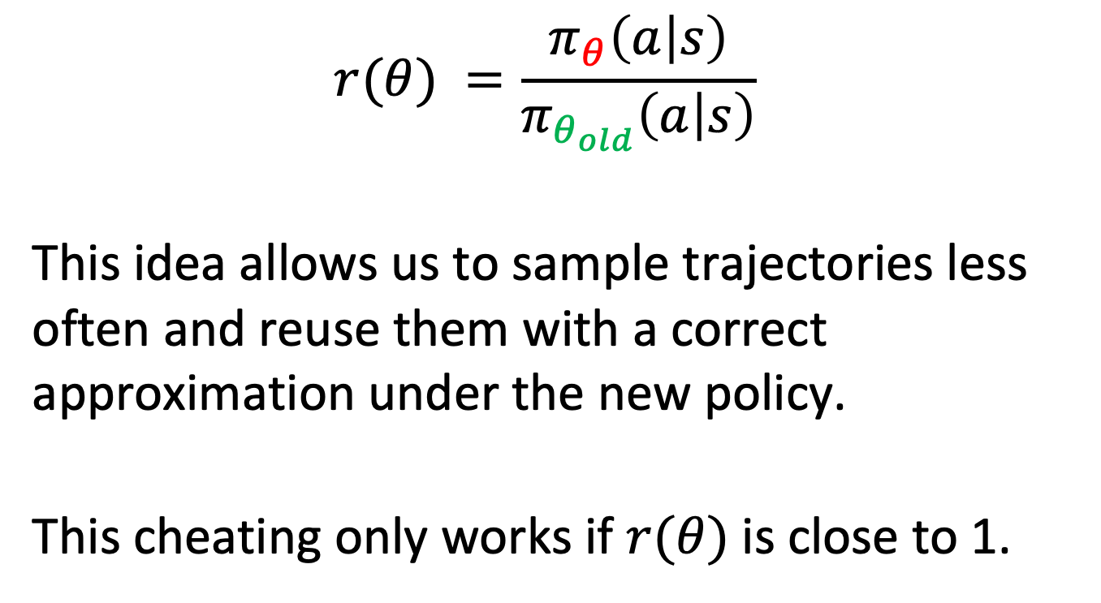
Importance Ratio
$$r(θ) =\frac{π_{θ}\left(a | s\right)}{π_{θ_{old}}\left(a | s\right)}$$
This idea allows us to sample trajectories less often and reuse them with a correct approximation under the new policy.
This cheating only works if $r(θ)$is close to 1.

Slide 15
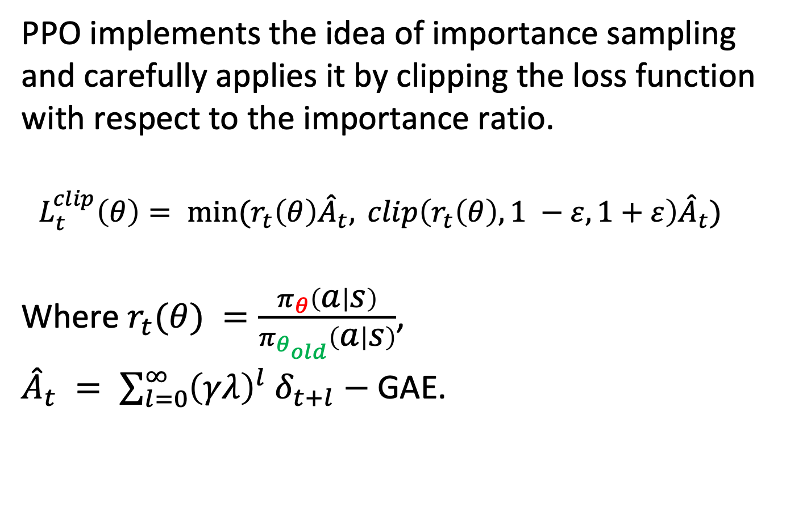
PPO (Proximal Policy Optimization)
PPO implements the idea of importance sampling and carefully applies it by clipping the loss function with respect to the importance ratio.
$$L_{t}^{clip}\left(θ\right)= min(r_{t}\left(θ\right){\hat{A}}_{t}, clip\left(r_{t}\left(θ\right), 1 −ε,1+ε\right){\hat{A}}_{t})$$
Where $r_{t}(θ) =\frac{π_{θ}\left(a | s\right)}{π_{θ_{old}}\left(a | s\right)}$,
${\hat{A}}_{t} = \sum_{l=0}^{∞}{{\left(γλ\right)}^{l} δ_{t+l}}−$GAE.

Slide 16
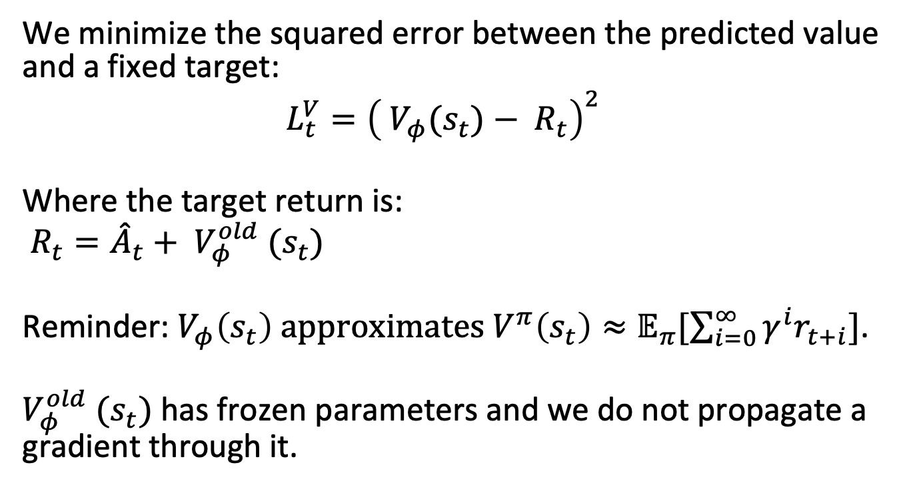
Value function update
We minimize the squared error between the predicted value and a fixed target:
$$L_{t}^{V}={\left( V_{φ}(s_{t})− R_{t}\right)}^{2}$$
Where the target return is:
$R_{t}={\hat{A}}_{t}+ V_{φ}^{old} (s_{t})$
Reminder:${ V}_{φ}\left(s_{t}\right) approximates V^{π}\left(s_{t}\right)≈𝔼_{π}[\sum_{i=0}^{∞}{γ^{i}r_{t+i}}]$.
$V_{φ}^{old} (s_{t})$ has frozen parameters and we do not propagate a gradient through it.

Slide 17
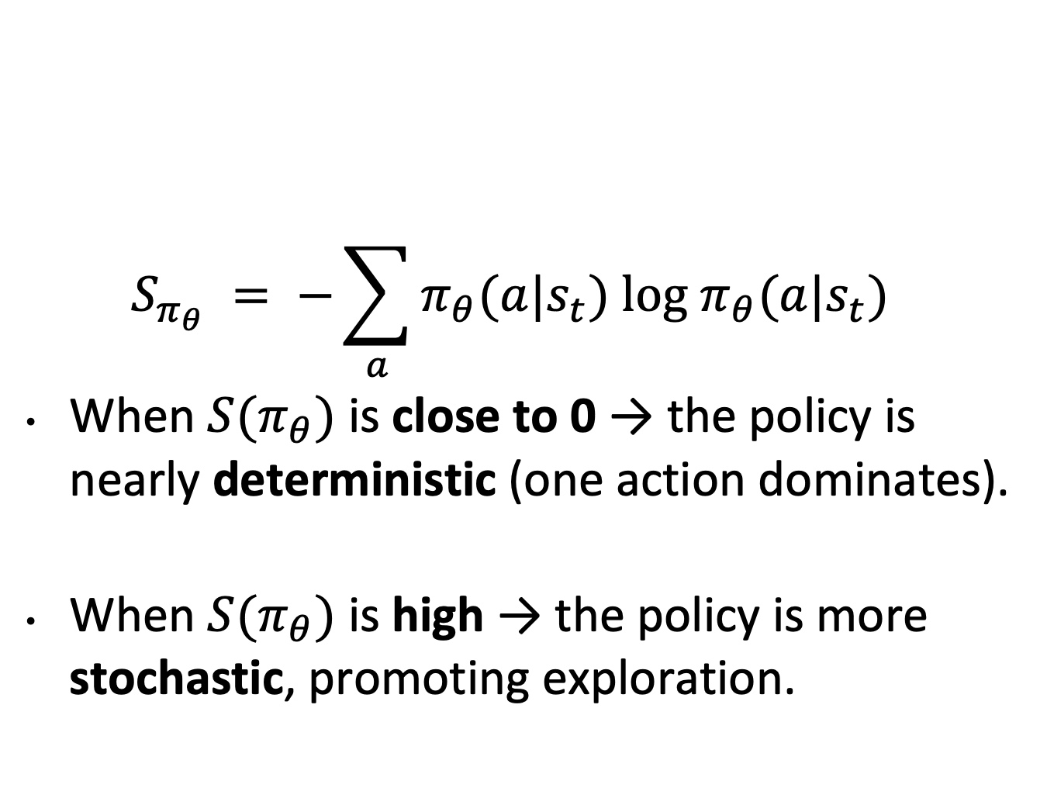
Entropy bonus (Optional)
$$S_{π_{θ}} = −\sum_{a}{π_{θ}(a|s_{t}) log π_{θ}(a|s_{t}) }$$
When $S(π_{θ})$ is close to 0 → the policy is nearly deterministic (one action dominates).
When $S(π_{θ})$ is high → the policy is more stochastic, promoting exploration.

Slide 18
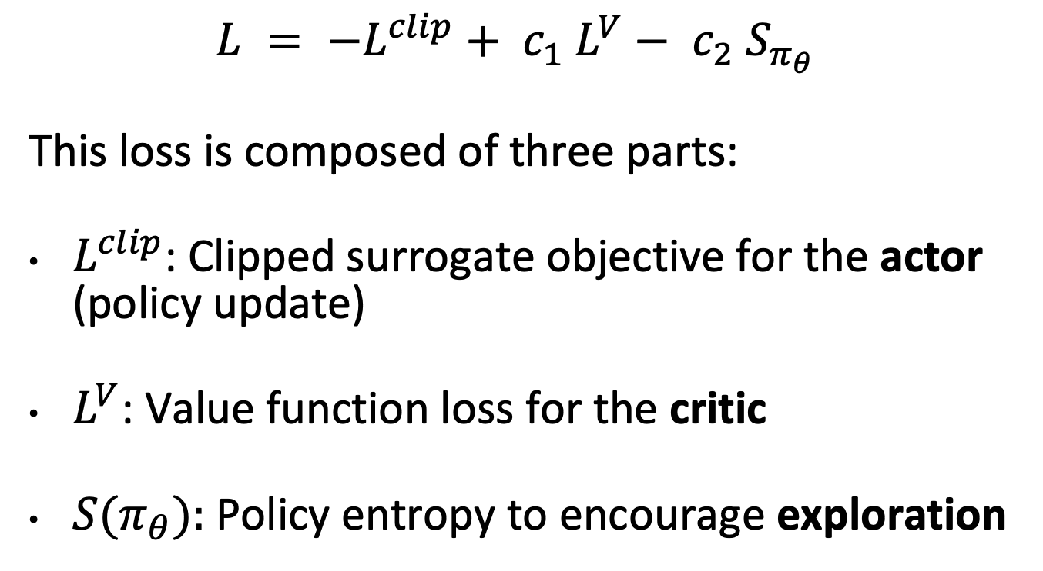
Total Loss
$$L = −L^{clip}+ c_{1} L^{V}− c_{2} S_{π_{θ}}$$
This loss is composed of three parts:
$L^{clip}$: Clipped surrogate objective for the actor (policy update)
$L^{V}$: Value function loss for the critic
$S(π_{θ}):$Policy entropy to encourage exploration

Slide 19
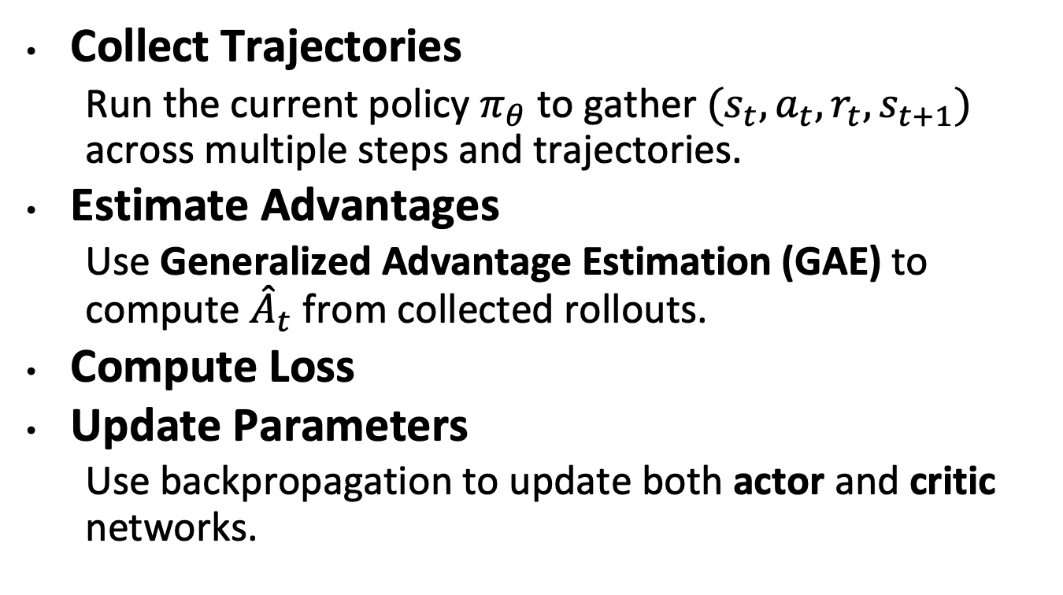
Algorithm
Collect Trajectories
Run the current policy $π_{θ}$ to gather $(s_{t}, a_{t}, r_{t}, s_{t+1})$ across multiple steps and trajectories.
Estimate Advantages
Use Generalized Advantage Estimation (GAE) to compute ${\hat{A}}_{t}$ from collected rollouts.
Compute Loss
Update Parameters
Use backpropagation to update both actor and critic networks.

Slide 20
Application
Gukov et al. (2025) – “What Makes Math Problems Hard for Reinforcement Learning: A Case Study”
A paper that advances and deepens the application of reinforcement learning to mathematics, while also delivering concrete results.

Slide 21
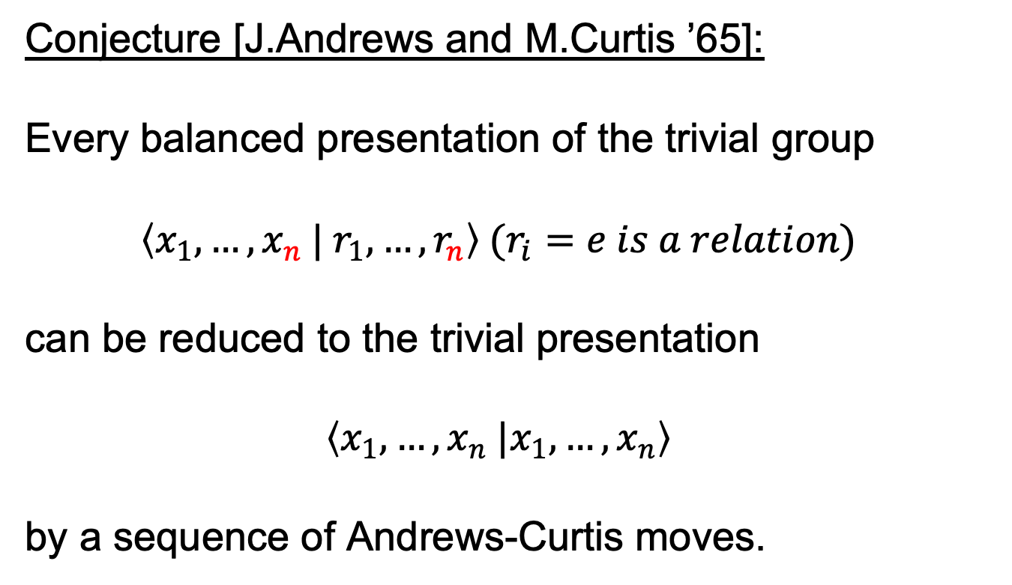
Andrews-Curtis Conjecture
Conjecture [J.Andrews and M.Curtis ’65]:
Every balanced presentation of the trivial group
$$\left\langle x_{1},…, x_{n} | r_{1}, …, r_{n}\right\rangle (r_{i}=e is a relation)$$
can be reduced to the trivial presentation
$$\left\langle x_{1},…, x_{n} |x_{1},…, x_{n}\right\rangle$$
by a sequence of Andrews-Curtis moves.

Slide 22
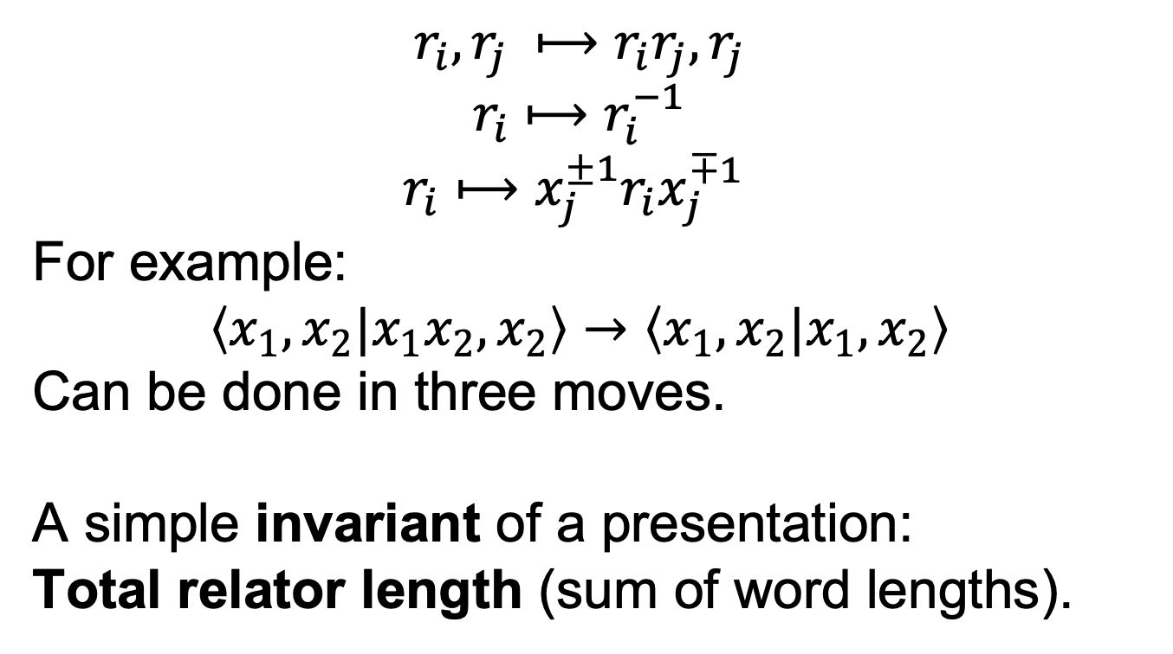
AC moves
$$r_{i}, r_{j} ⟼r_{i}r_{j}, r_{j}$$
$$r_{i}⟼r_{i}^{−1}$$
$$r_{i}⟼x_{j}^{±1}r_{i}x_{j}^{∓1}$$
For example:
$$\left\langle x_{1}, x_{2}|x_{1}x_{2},x_{2}\right\rangle →\left\langle x_{1}, x_{2}|x_{1},x_{2}\right\rangle$$
Can be done in three moves.
A simple invariant of a presentation:
Total relator length (sum of word lengths).

Slide 23
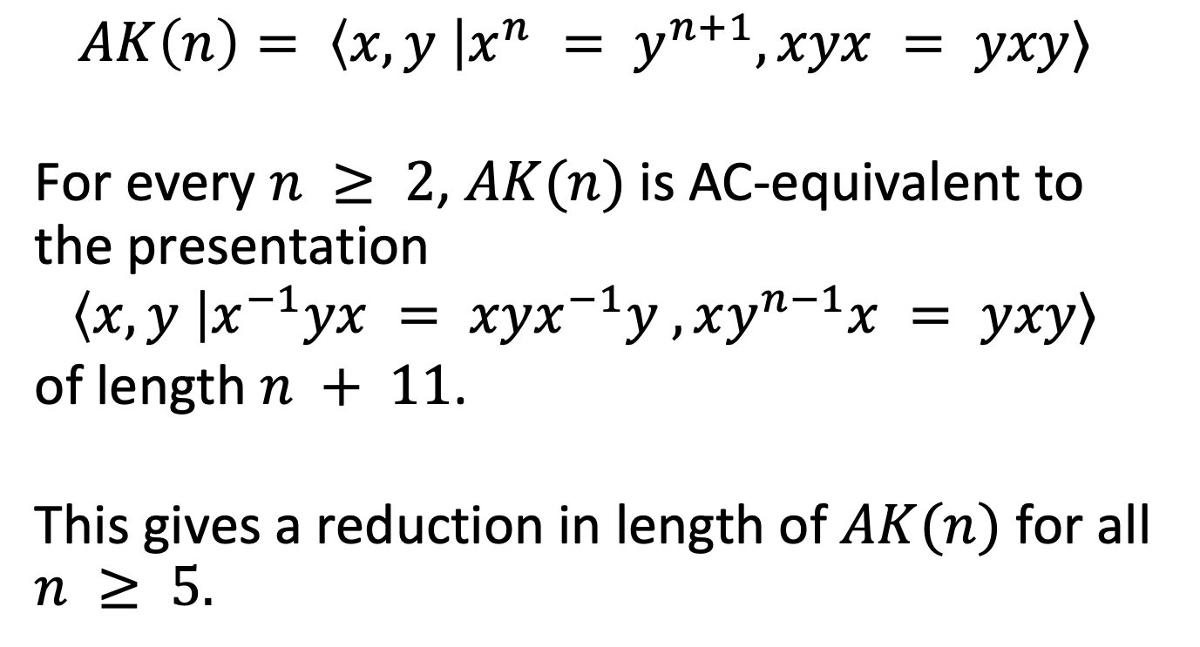
Result #1
$$AK\left(n\right)= \left\langle x, y \right|x^{n} = y^{n+1}, xyx = yxy⟩$$
For every $n ≥ 2$, $AK(n)$ is AC-equivalent to the presentation
$$\left\langle x, y \right|x^{−1}yx = xyx^{−1}y , xy^{n−1}x = yxy⟩$$
of length $n + 11$.
This gives a reduction in length of $AK(n)$ for all $n ≥ 5.$

Slide 24
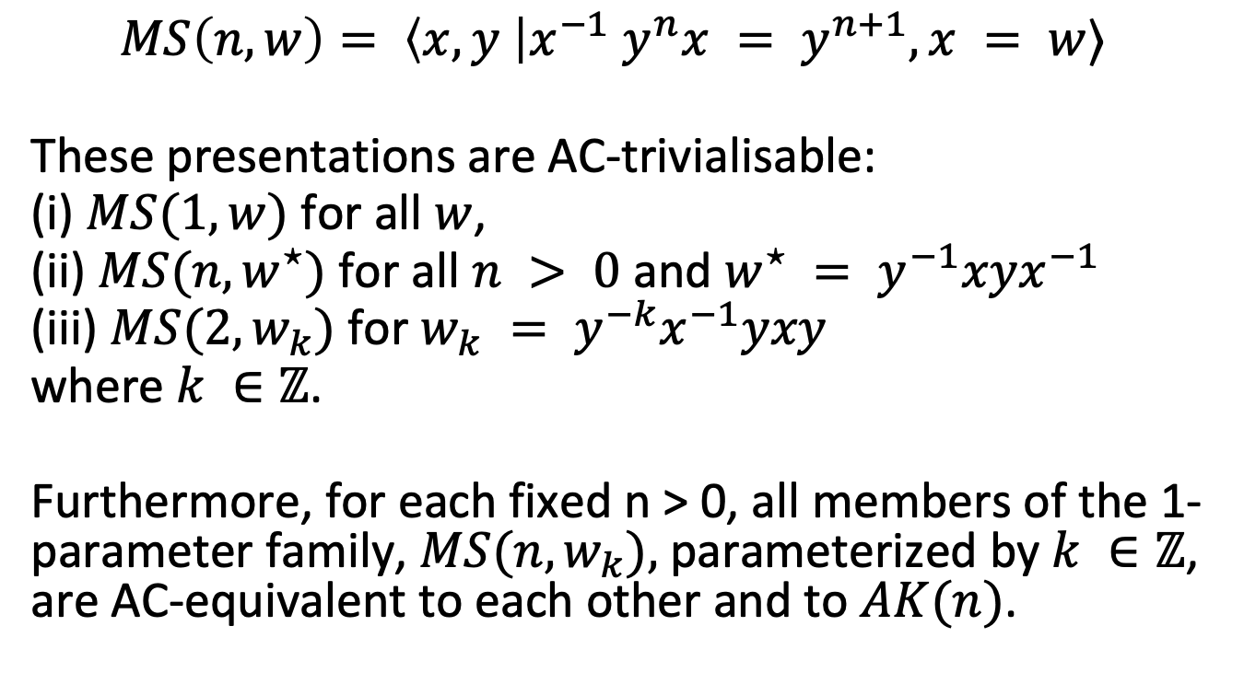
Result #2
$$MS\left(n, w\right)= \left\langle x, y \right|x^{−1} y^{n}x = y^{n+1}, x = w⟩$$
These presentations are AC-trivialisable:
(i) $MS(1, w)$for all $w$,
(ii) $MS(n, w^{⋆})$for all $n > 0$and $w^{⋆} = y^{−1}xyx^{−1}$
(iii) $MS(2, w_{k})$for $w_{k} = y^{−k}x^{−1}yxy$
where $k ∈ℤ$.
Furthermore, for each fixed n > 0, all members of the 1-parameter family, $MS(n, w_{k}),$parameterized by $k ∈ℤ$, are AC-equivalent to each other and to $AK(n)$.

Slide 25
Hard AC presentations

Slide 26
Challenge
Trivializing These Presentations
We cannot rely on naive search.
We need to develop clever strategies,
structure-aware heuristics, or even machine learning to attack this problem.

Slide 27
Supermoves
To overcome this challenge, it is natural to introduce supermoves—compositions of multiple elementary moves—so that, in terms of supermoves, the distance between presentations becomes significantly shorter.

Slide 28
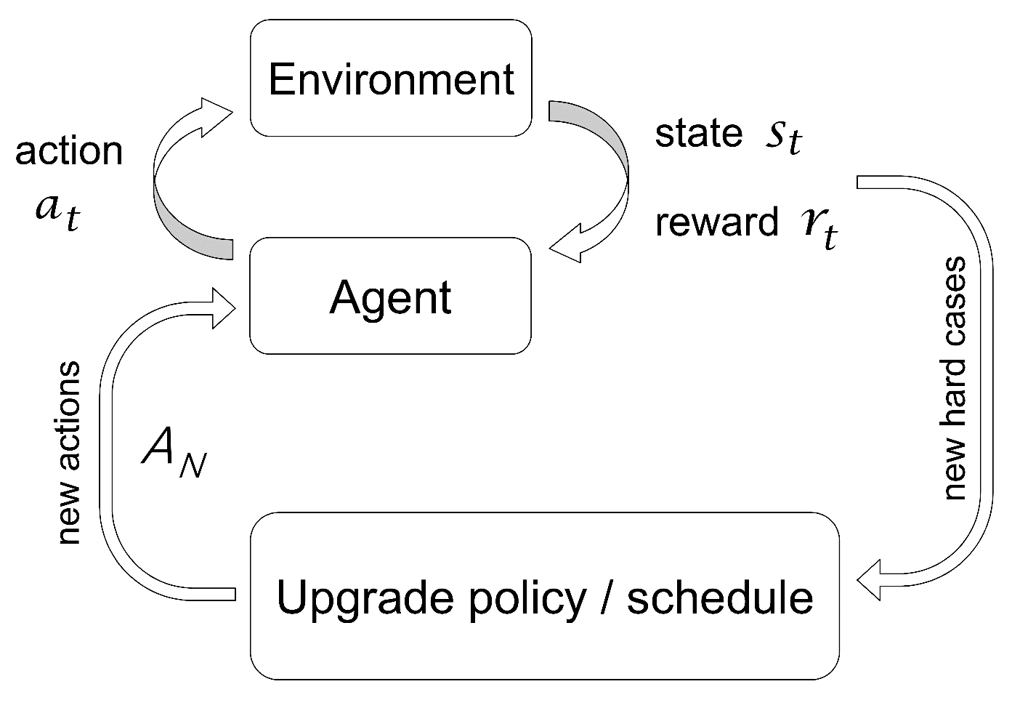
Adaptive / Dynamic Action Space

Slide 29
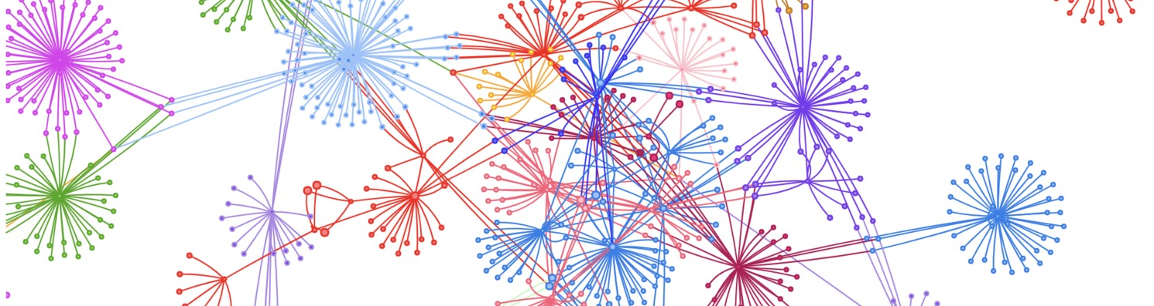
AC graph:
5-step neighborhood sizes:

Slide 30
AC graph:
5-step neighborhood sizes:
[89,573 -- 89,575] [89,715 -- 89,731] [89,859 -- 89,872]
contain 90% of hard AC-presentations
complement of these three bands contains 77.2% of easy presentations
54% of easy presentations have neighborhood sizes smaller
than 89,573

Slide 31
easy
hard

