Slide 1
AI in Mathematics
Lecture 4
Deep Learning in Mathematics
Bar-Ilan University
Nebius Academy | Stevens Institute of Technology
April 8, 2025

Slide 2
About This Course
1 week: Intro
2 weeks: Classic ML
2 weeks: Deep Learning in Mathematics
3 weeks: Math as an NLP problem (LLMs etc.)
3 weeks: Reinforcement Learning (RL) in Math
1 week: Advanced AI topics
1 week: Project Presentations

Slide 3
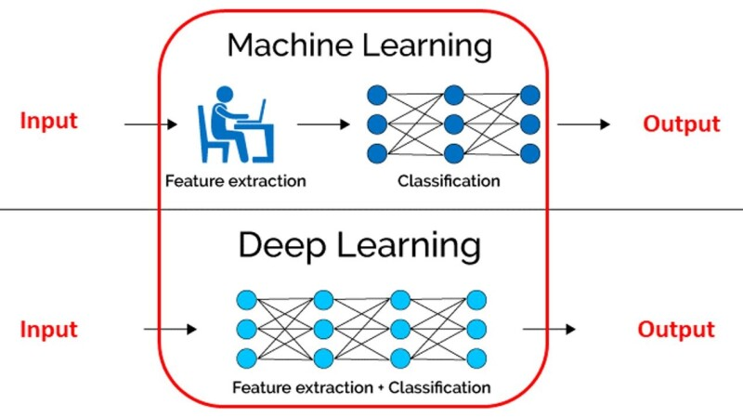
What is deep learning?

Slide 4
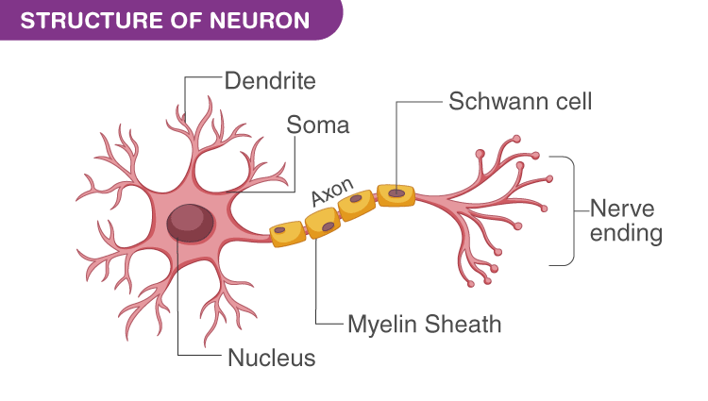
Neural Network Inspiration

Slide 5

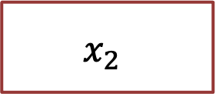
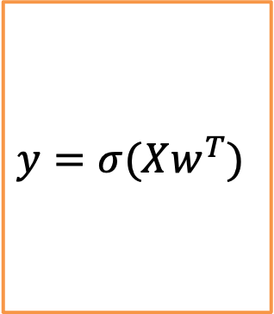
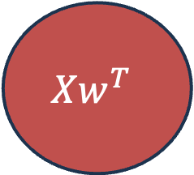

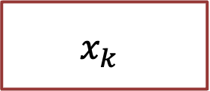
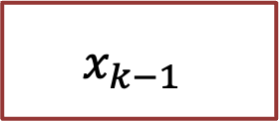
Neuron Inspiration
Dendrite
Inputs
Nerve ending
Output
$$x_{1}$$
Soma
Aggregation
$$x_{2}$$
$$y=σ(Xw^{T})$$
Axon
Activation function
$$Xw^{T}$$
…
$$σ$$
$$x_{k−1}$$
$$x_{k}$$
This is an example of an activation function; we will see more examples later.

Slide 6
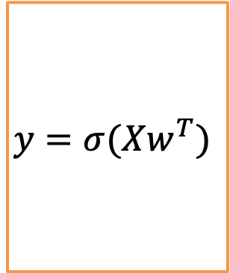
Neuron Inspiration
$$x_{1}$$
$$x_{2}$$
$$y=σ(Xw^{T})$$
$$Xw^{T}$$
…
$$σ$$
$$x_{k−1}$$
$$x_{k}$$

Slide 7
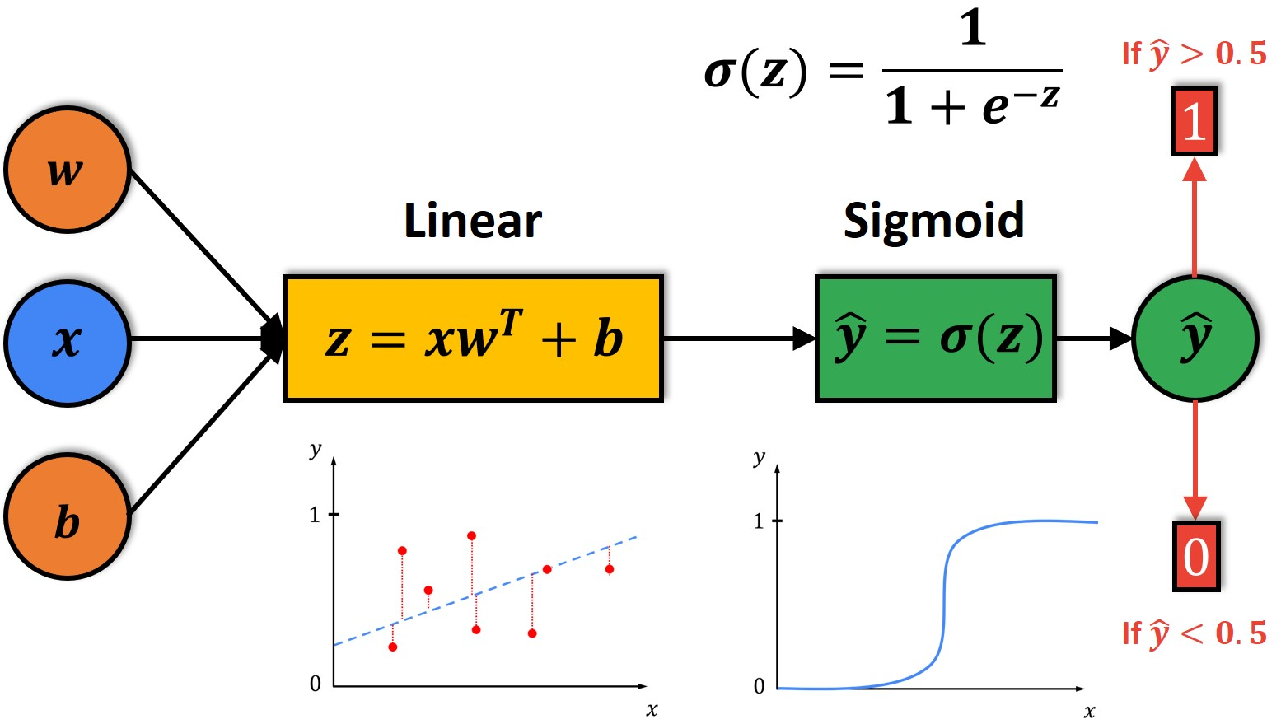
Logistic Regression
Seems like it was a neuron

Slide 8
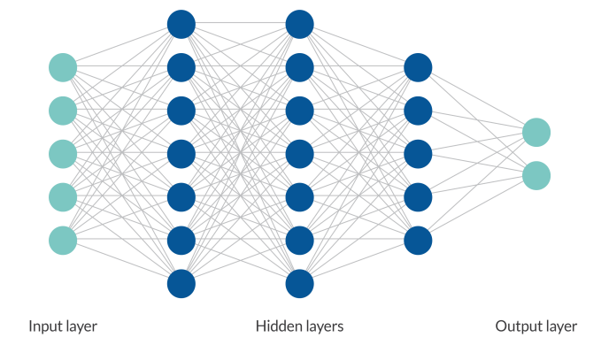
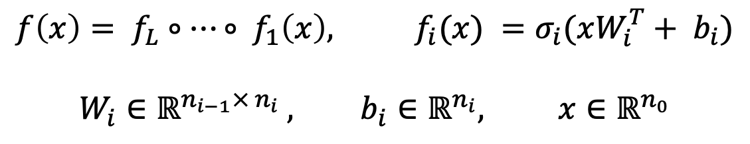
Neural Network
$$f\left(x\right)= f_{L}∘…∘ f_{1}\left(x\right), f_{i}(x) =σ_{i}(xW_{i}^{T}+ b_{i})$$
$$W_{i}∈ℝ^{n_{i−1}× n_{i}} , b_{i}∈ℝ^{n_{i}}, x∈ℝ^{n_{0}}$$

Slide 9
Neural Network
Input layer neurons take features as inputs and pass them inside the model.
Output layer neurons return values. It is our prediction.
Hidden layer neurons (and calculation of Output layer) are what we considered a black box previously.

Slide 10
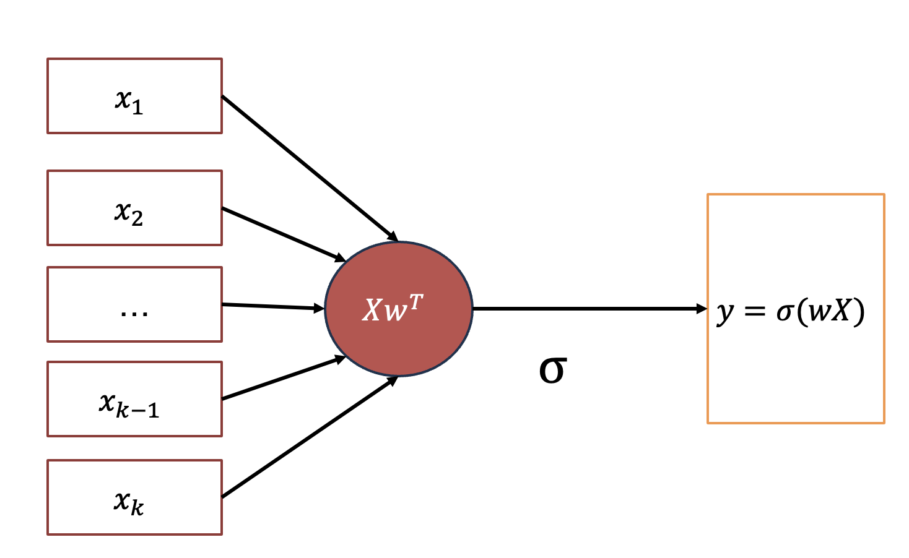
Neural Network
What if we do not have activation function?
Then neural network reduces to linear model

Slide 11
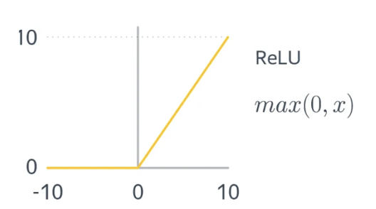
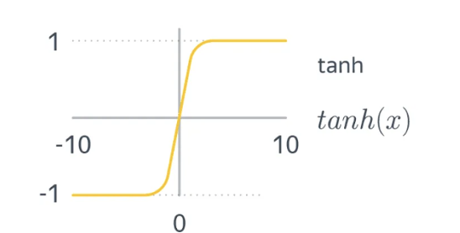
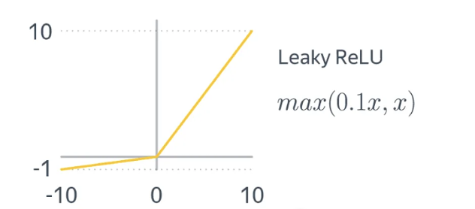
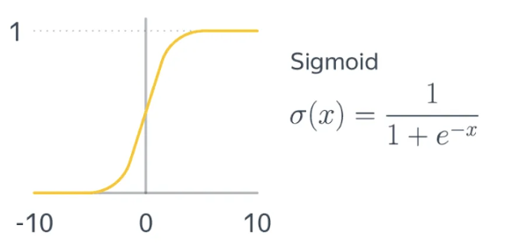
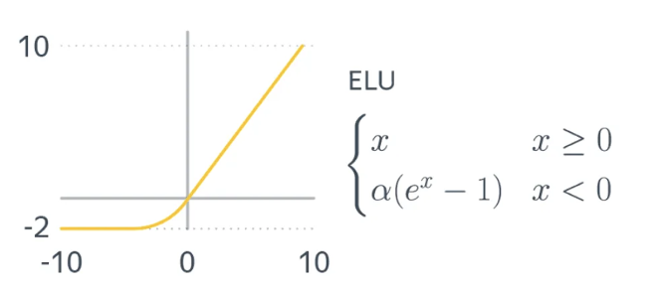
Activation Functions

Slide 12

Functional Analysis
Neural network with one hidden-layer and non-polynomial activation function is capable of always approximating a multi-variant continuous function.
Cybenko theorem (1989)
$∀ continious f:ℝ^{m} →ℝ and ε>0 ∃N>0$and parameters $w_{1}…w_{N}∈ℝ^{m}, b_{1}…b_{N}, α_{1} …α_{N}∈ℝ$ such that:
$$\left| f\left(x\right)−\sum_{i=1}^{N}{α_{i}σ\left(w_{i}x −b_{i}\right)}\right|<ε$$
Why is a non-polynomial activation function essential in neural networks?
What limitations do polynomial activation functions have in function approximation?

Slide 13


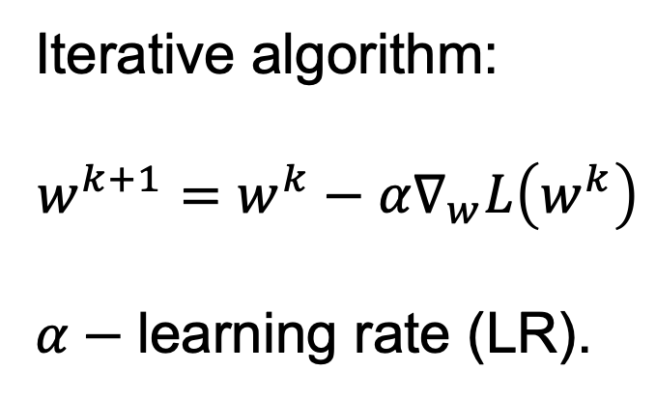

Gradient Descent Recap
Iterative algorithm:
$$w^{k+1}=w^{k}−α∇_{w}L\left(w^{k}\right)$$
$α−$learning rate (LR).
$$w^{2}$$
$$w^{1}$$
$$w^{0}$$

Slide 14
Backpropagation Overview
We want to update weights of a model, we can do it by a chain rule for each weight of a model.

Slide 15
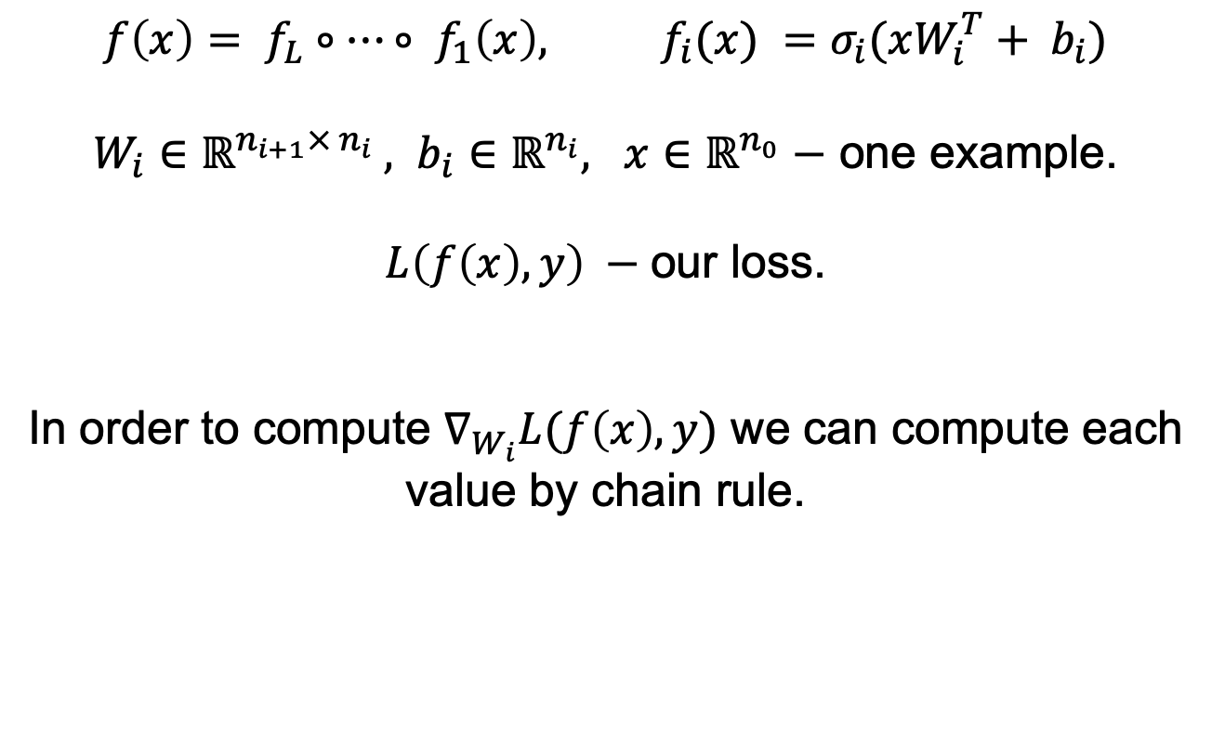
Backpropagation Motivation
$$f\left(x\right)= f_{L}∘…∘ f_{1}\left(x\right), f_{i}(x) =σ_{i}(xW_{i}^{T}+ b_{i})$$
$W_{i}∈ℝ^{n_{i+1}× n_{i}} , b_{i}∈ℝ^{n_{i}}, x∈ℝ^{n_{0}}−$ one example.
$L\left(f\left(x\right), y\right) −$our loss.
In order to compute $∇_{W_{i}}L(f\left(x\right), y)$ we can compute each value by chain rule.

Slide 16
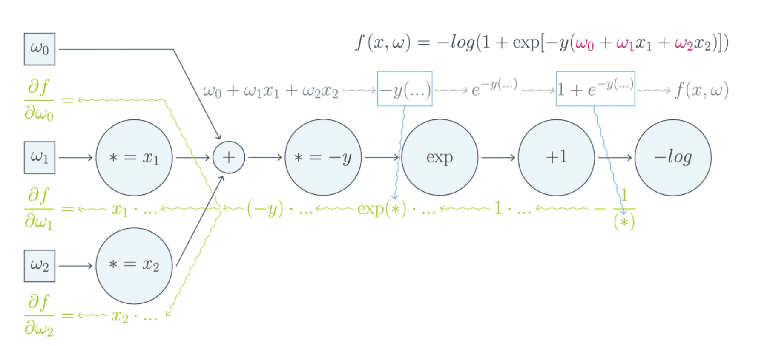
Backpropagation Motivation

Slide 17
Backpropagation Motivation
In a neural network, we have many variables and many paths through which a weight can influence the final output.
A simple application of the chain rule
doesn’t tell us:
• In what order to compute derivatives,
• Which intermediate values to store,
• How to avoid redundant calculations.

Slide 18
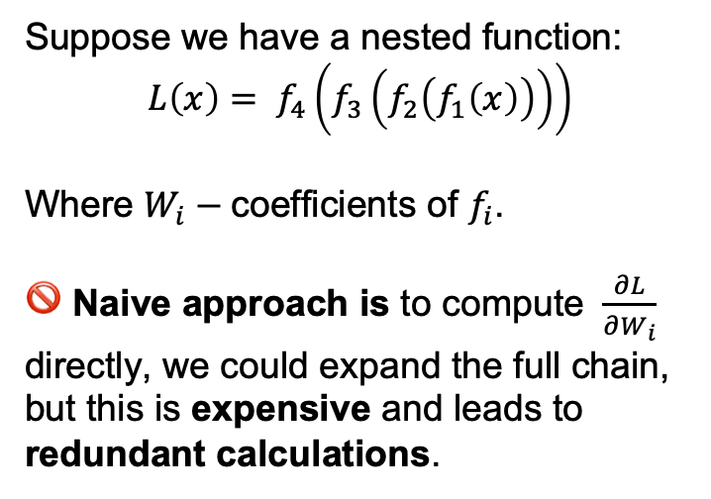
Backpropagation Motivation
Suppose we have a nested function:
$$L\left(x\right)= f_{4}\left(f_{3}\left(f_{2}\left(f_{1}\left(x\right)\right)\right)\right)$$
Where $W_{i}−$coefficients of $f_{i}$.
🚫 Naive approach is to compute $\frac{∂L}{∂W_{i}}$ directly, we could expand the full chain, but this is expensive and leads to redundant calculations.
Backpropagation does a reverse in some sense:
The application of the chain rule in the correct order, with caching of intermediate results, to compute all gradients efficiently in linear time.

Slide 19
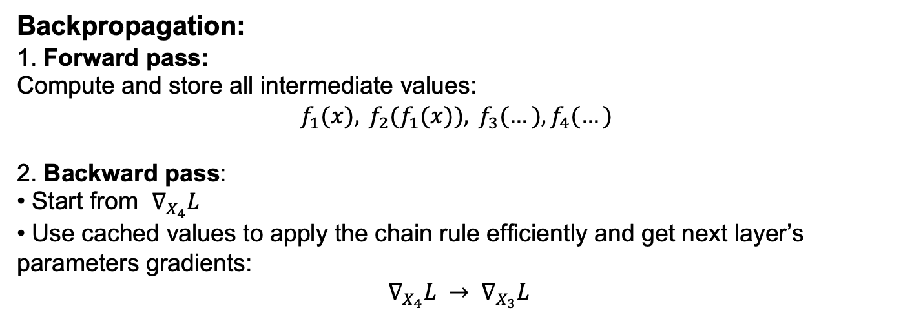
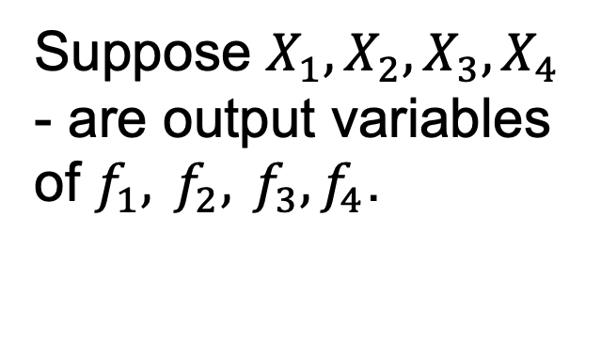
Backpropagation
Suppose $X_{1},X_{2},X_{3},X_{4}$ - are output variables of $f_{1}, f_{2}, f_{3},f_{4}$.
Backpropagation:
1. Forward pass:
Compute and store all intermediate values:
$$f_{1}(x), f_{2}(f_{1}(x)), f_{3}(…),f_{4}(…)$$
2. Backward pass:
• Start from $∇_{X_{4}}L$
• Use cached values to apply the chain rule efficiently and get next layer’s parameters gradients:
$$∇_{X_{4}}L → ∇_{X_{3}}L$$

Slide 20
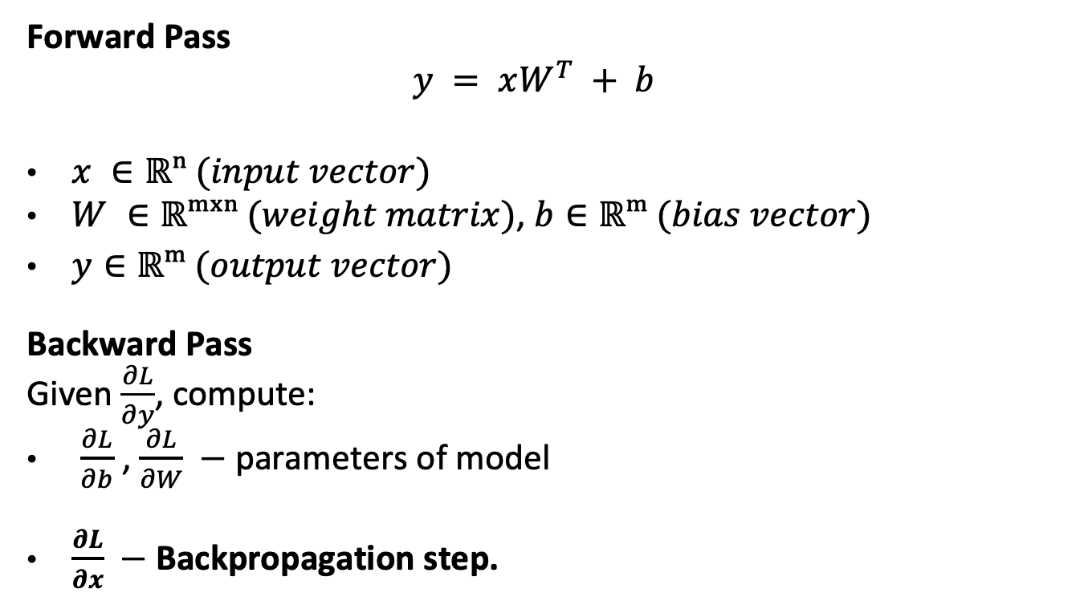
Linear Layer Example
Forward Pass
$$y = xW^{T} + b$$
$x ∈ℝⁿ (input vector)$
$W ∈ℝᵐˣⁿ (weight matrix)$, $b∈ℝᵐ (bias vector)$
$y∈ℝᵐ (output vector)$
Backward Pass
Given $\frac{∂L}{∂y}$, compute:
$\frac{∂L}{∂b}$ , $\frac{∂L}{∂W} −$ parameters of model
$\frac{∂L}{∂x} −$ Backpropagation step.

Slide 21
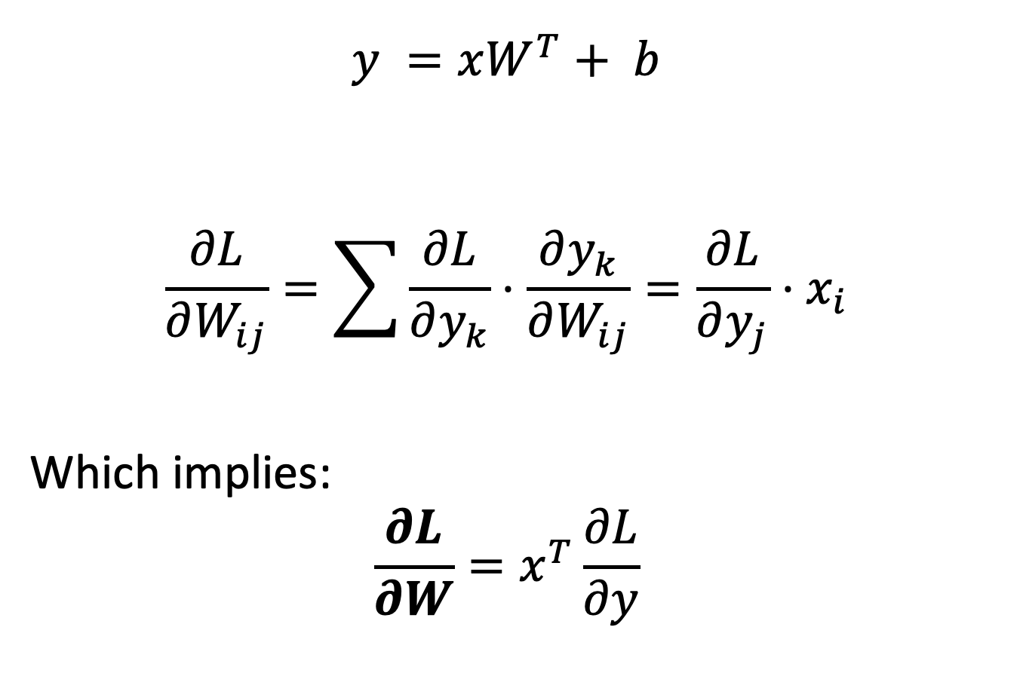
Linear Layer Example
$$y =xW^{T}+ b$$
$$\frac{∂L}{∂W_{ij}}=\sum{\frac{∂L}{∂y_{k}}⋅\frac{∂y_{k}}{∂W_{ij}}}=\frac{∂L}{∂y_{j}}⋅x_{i}$$
Which implies:
$$\frac{∂L}{∂W}=x^{T}\frac{∂L}{∂y}$$

Slide 22
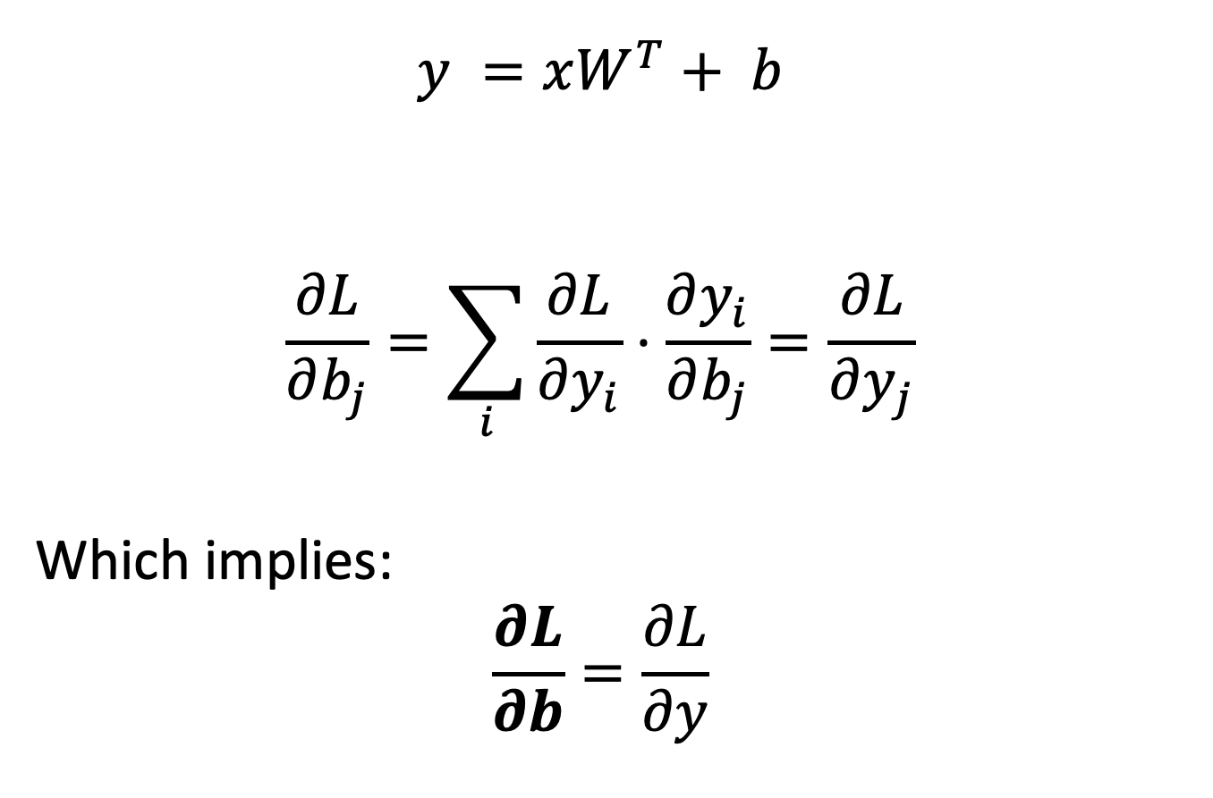
Linear Layer Example
$$y =xW^{T}+ b$$
$$\frac{∂L}{∂b_{j}}=\sum_{i}{\frac{∂L}{∂y_{i}}⋅\frac{∂y_{i}}{∂b_{j}}}=\frac{∂L}{∂y_{j}}$$
Which implies:
$$\frac{∂L}{∂b}=\frac{∂L}{∂y}$$

Slide 23
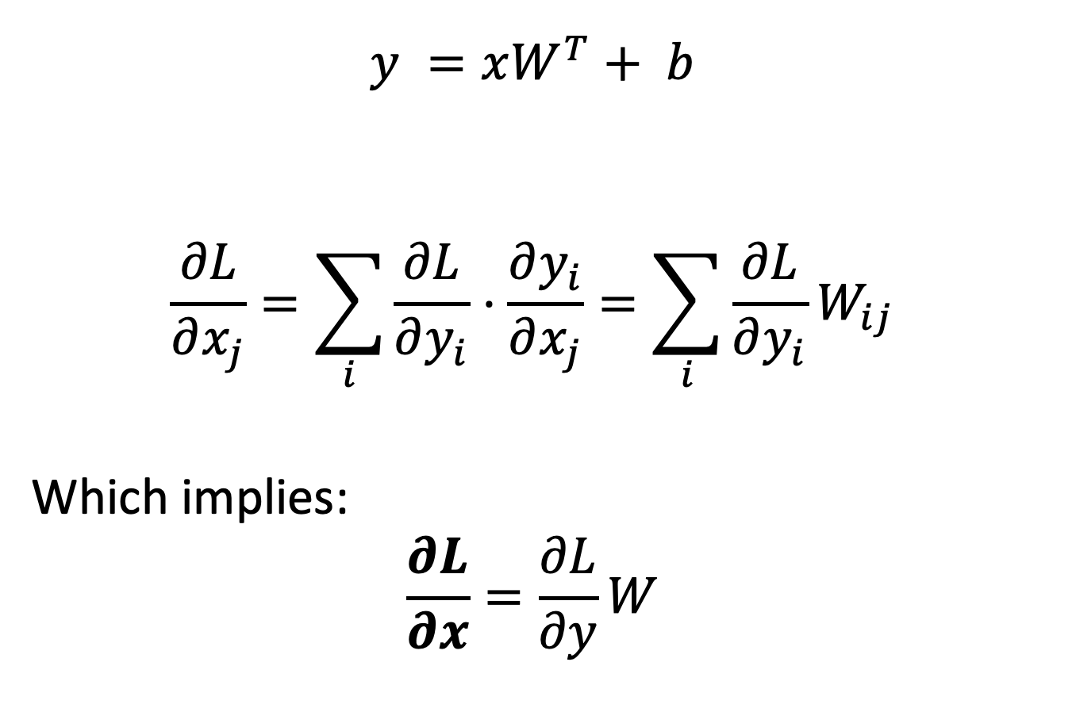
Linear Layer Example
$$y =xW^{T}+ b$$
$$\frac{∂L}{∂x_{j}}=\sum_{i}{\frac{∂L}{∂y_{i}}⋅\frac{∂y_{i}}{∂x_{j}}}=\sum_{i}{\frac{∂L}{∂y_{i}}W_{ij}}$$
Which implies:
$$\frac{∂L}{∂x}=\frac{∂L}{∂y}W$$

Slide 24
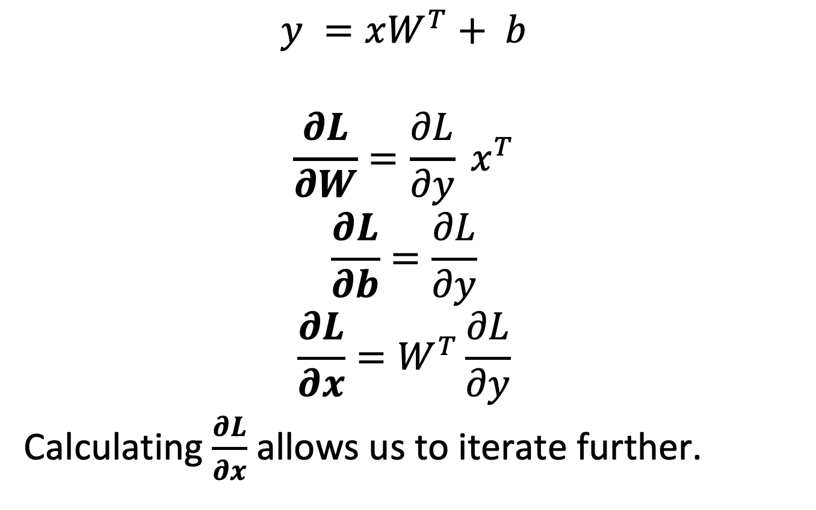
Linear Layer Example
$$y =xW^{T}+ b$$
$$\frac{∂L}{∂W}=\frac{∂L}{∂y} x^{T}$$
$$\frac{∂L}{∂b}=\frac{∂L}{∂y}$$
$$\frac{∂L}{∂x}=W^{T}\frac{∂L}{∂y}$$
Calculating $\frac{∂L}{∂x}$ allows us to iterate further.

Slide 25
Optimization
Calculating each iteration of Backpropagation is costly for large datasets.
So we need to have a good
Stochastic Gradient Descent techniques.

Slide 26
Reminder: SGD
SGD is erratic; Smaller batches make it worse.
Use SGD only when full GD is impractical.
Vanilla SGD is rarely used nowadays, people prefer modified versions. We will discuss them next time. Next time has come!

Slide 27
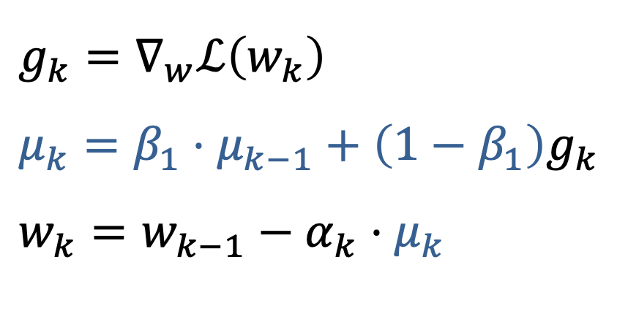
Momentum
$$g_{k}=∇_{w}ℒ\left(w_{k}\right)$$
$$μ_{k}=β_{1}⋅μ_{k−1}+\left(1−β_{1}\right)g_{k}$$
$$w_{k}=w_{k−1}−α_{k}⋅μ_{k}$$
Accumulates previous directions
Makes GD less erratic

Slide 28
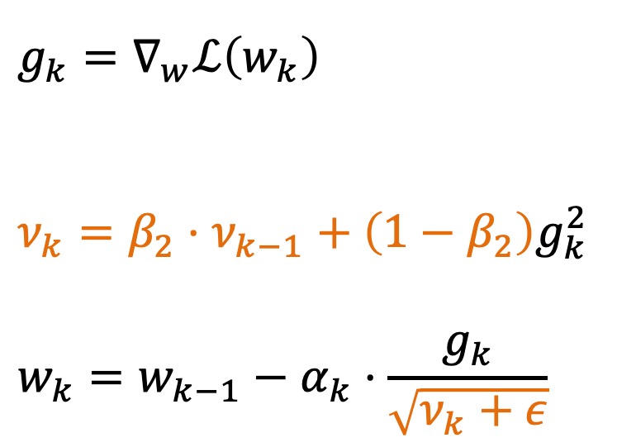
RMSProp (Root Mean Square Propagation)
$$g_{k}=∇_{w}ℒ\left(w_{k}\right)$$
$$ν_{k}=β_{2}⋅ν_{k−1}+\left(1−β_{2}\right)g_{k}^{2}$$
$$w_{k}=w_{k−1}−α_{k}⋅\frac{g_{k}}{\sqrt{ν_{k}+ε}}$$
Adaptive step
for each coordinate
(second-order methods)

Slide 29
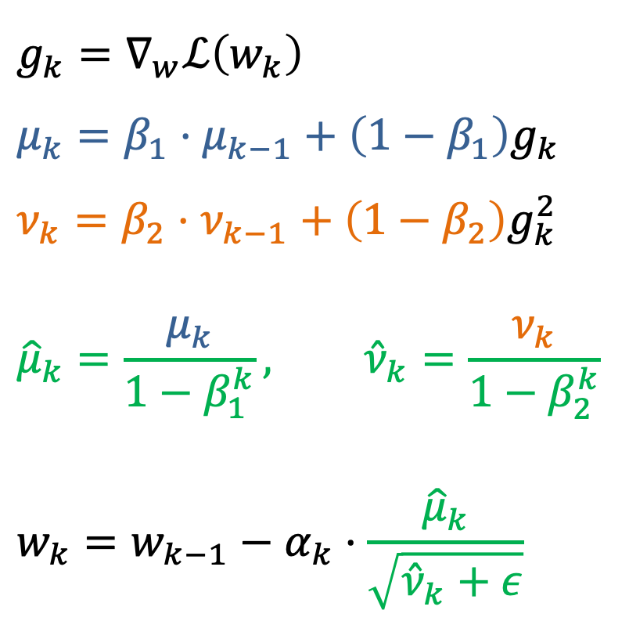
Adam (Adaptive Moment Estimation)
$$g_{k}=∇_{w}ℒ\left(w_{k}\right)$$
$μ_{k}=β_{1}⋅μ_{k−1}+\left(1−β_{1}\right)g_{k}$
$$ν_{k}=β_{2}⋅ν_{k−1}+\left(1−β_{2}\right)g_{k}^{2}$$
$${\hat{μ}}_{k}=\frac{μ_{k}}{1−β_{1}^{k}}, {\hat{ν}}_{k}=\frac{ν_{k}}{1−β_{2}^{k}}$$
$$w_{k}=w_{k−1}−α_{k}⋅\frac{{\hat{μ}}_{k}}{\sqrt{{\hat{ν}}_{k}+ε}}$$

