Slide 1
AI in Mathematics
Lecture 11
Reinforcement Learning
Bar-Ilan University
Nebius Academy | Stevens Institute of Technology
June 10, 2025

Slide 2
About This Course
1 week: Intro
2 weeks: Classic ML
2 weeks: Deep Learning in Mathematics
4 weeks: Math as an NLP problem (LLMs etc.)
4 weeks: Reinforcement Learning (RL) in Math

Slide 3
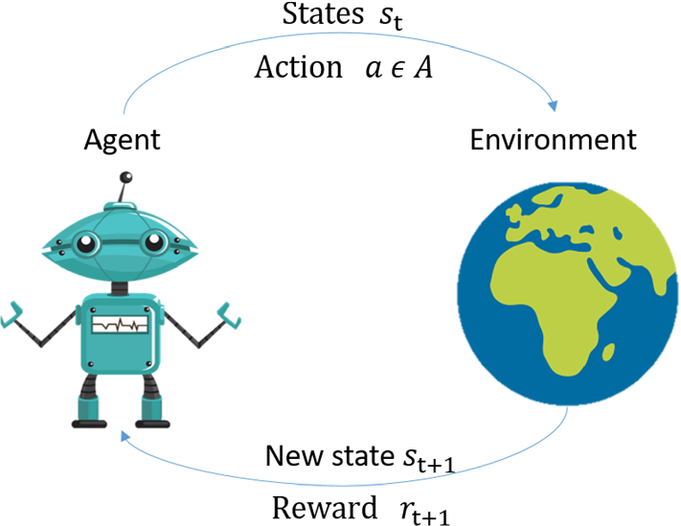
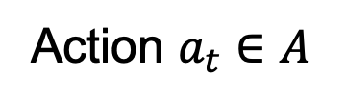
Reinforcement Learning
Action $a_{t}∈A$

Slide 4
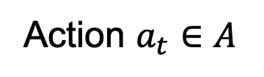
Reinforcement Learning
ML algorithms, etc.
Action $a_{t}∈A$
Which action to pick?

Slide 5
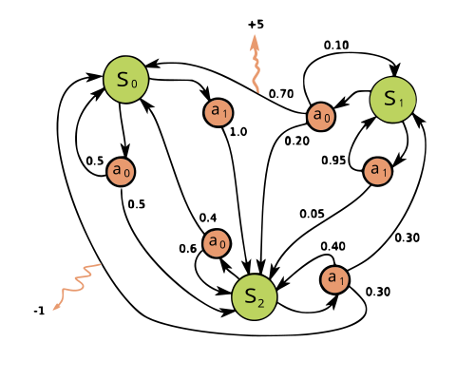
Markov Decision Process

Slide 6
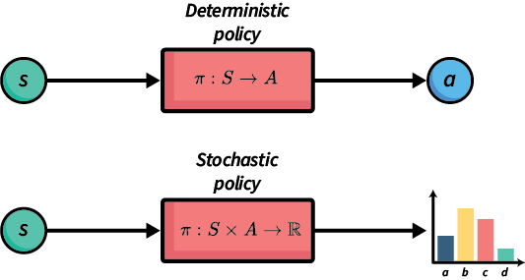
Policy
A policy is the agent’s strategy for choosing actions.

Slide 7
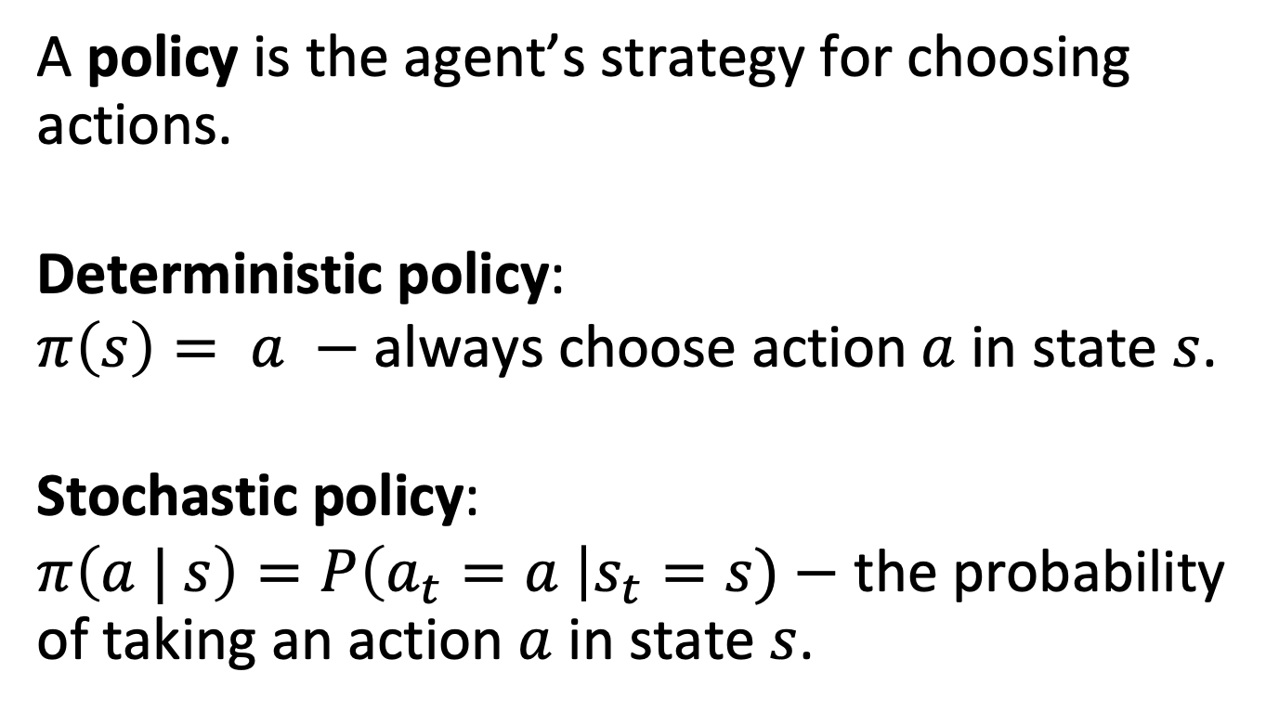
Policy
A policy is the agent’s strategy for choosing actions.
Deterministic policy:
$π\left(s\right)= a −$ always choose action$a$in state $s$.
Stochastic policy:
$π\left(a | s\right)=P\left(a_{t}=a \right|s_{t}=s)−$ the probability of taking an action $a$ in state $s$.

Slide 8
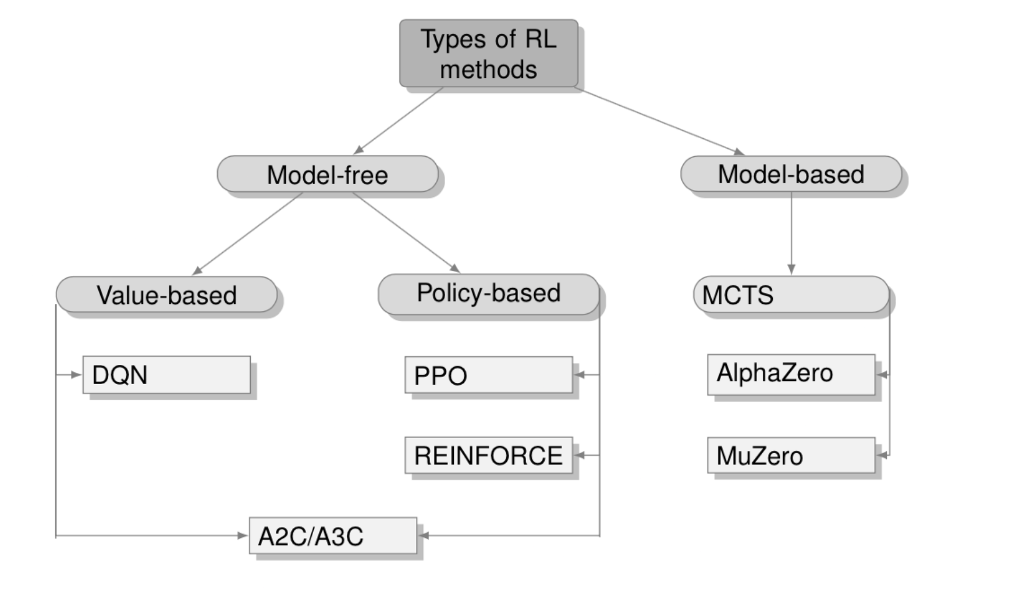
RL Algorithms

Slide 9
RL Algorithms
3 lectures
Last lecture

Slide 10
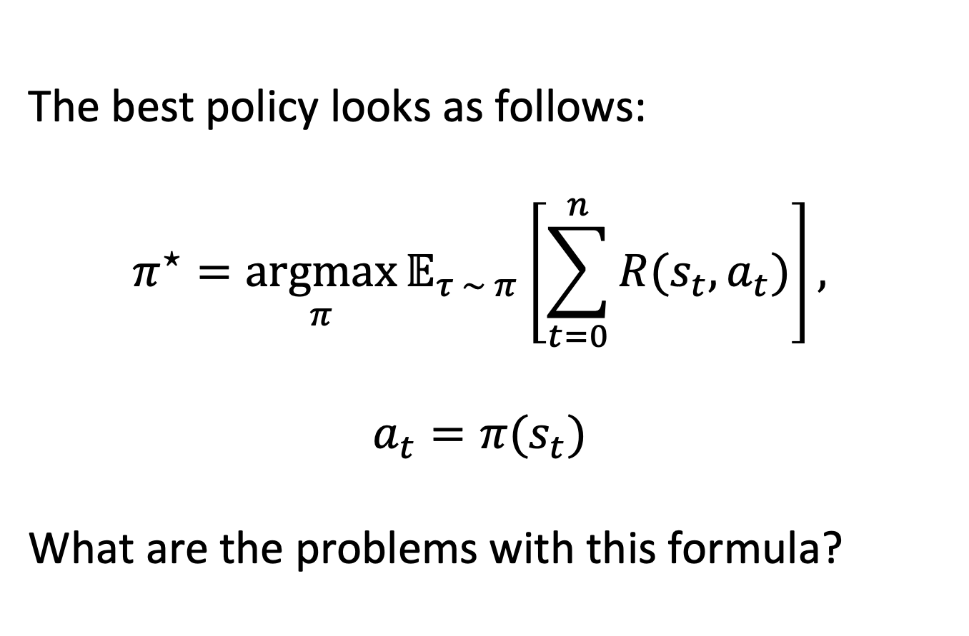
Best Policy
The best policy looks as follows:
$$π^{⋆}=\underset{π}{argmax}{𝔼_{τ \sim π}\left[\sum_{t=0}^{n}{R(s_{t}, a_{t})}\right]},$$
$$a_{t}=π(s_{t})$$
What are the problems with this formula?

Slide 11
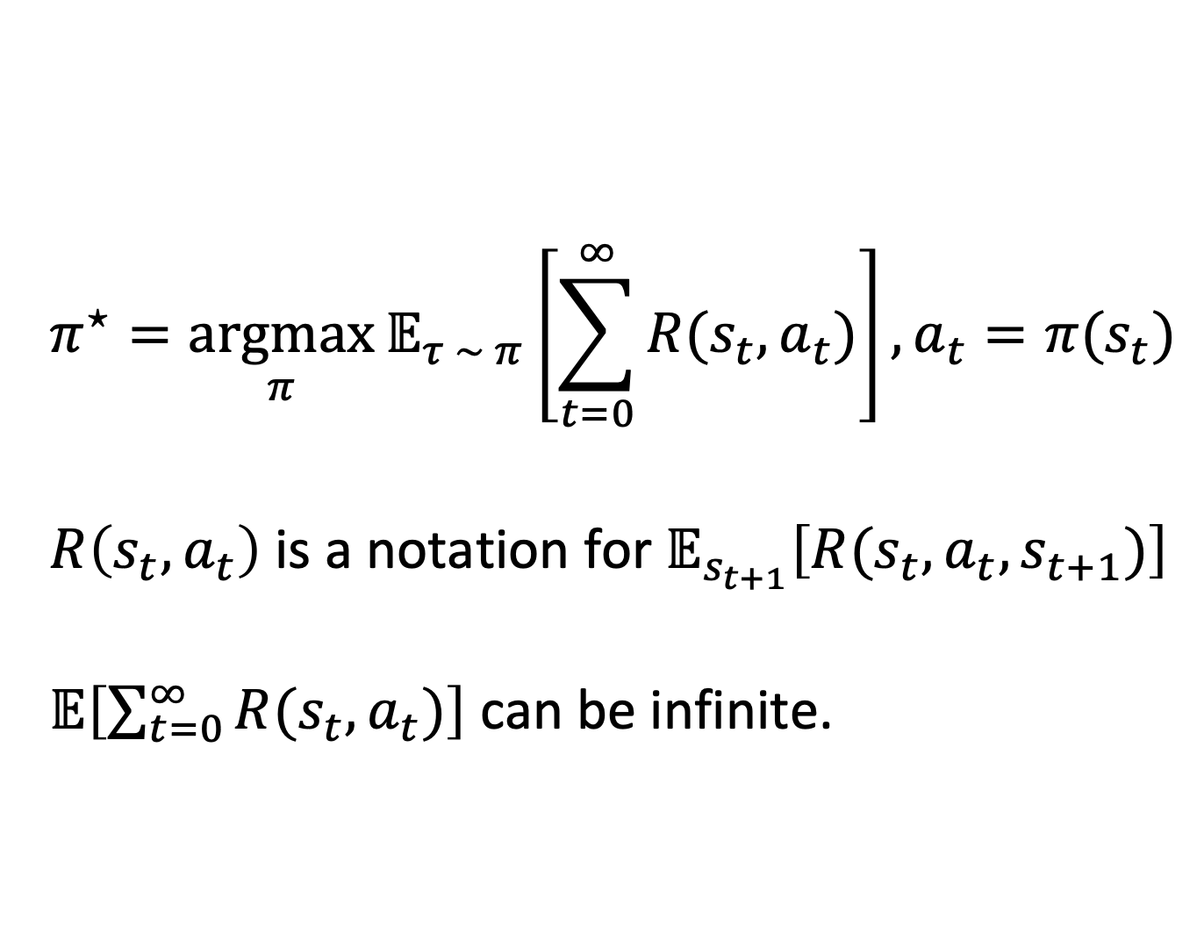
Best Policy
$$π^{⋆}=\underset{π}{argmax}{𝔼_{τ \sim π}\left[\sum_{t=0}^{∞}{R(s_{t}, a_{t})}\right]}, a_{t}=π(s_{t})$$
$R\left(s_{t}, a_{t}\right)$ is a notation for $𝔼_{s_{t+1}}\left[R(s_{t}, a_{t}, s_{t+1})\right]$
$𝔼\left[\sum_{t=0}^{∞}{R(s_{t}, a_{t})}\right]$ can be infinite.

Slide 12
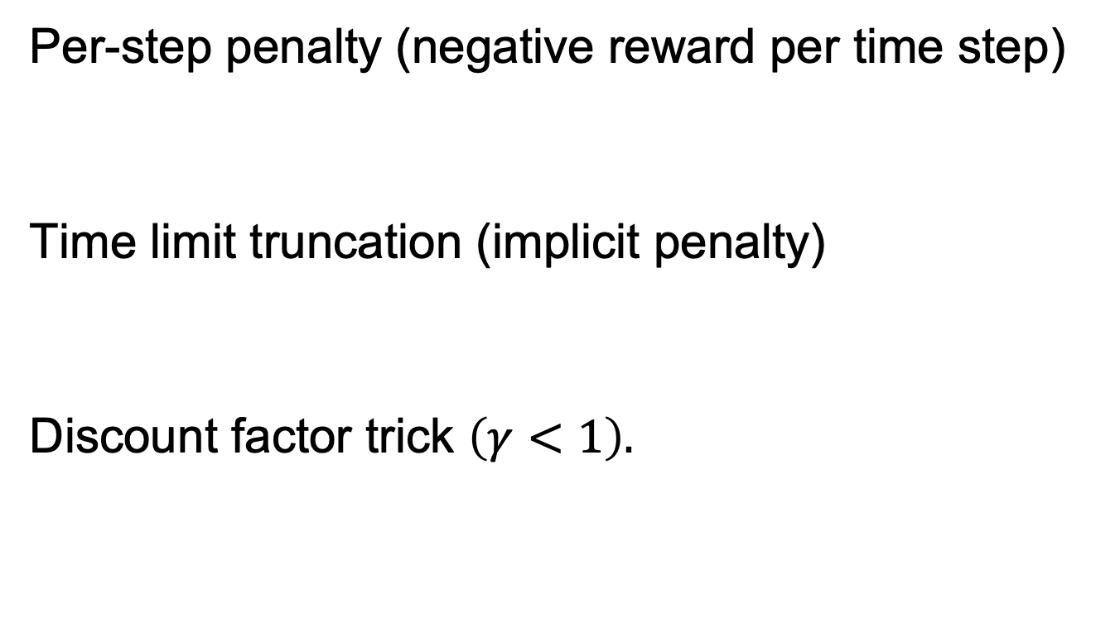
Methods to Penalize Agent
Per-step penalty (negative reward per time step)
Time limit truncation (implicit penalty)
Discount factor trick $\left(γ<1\right).$

Slide 13
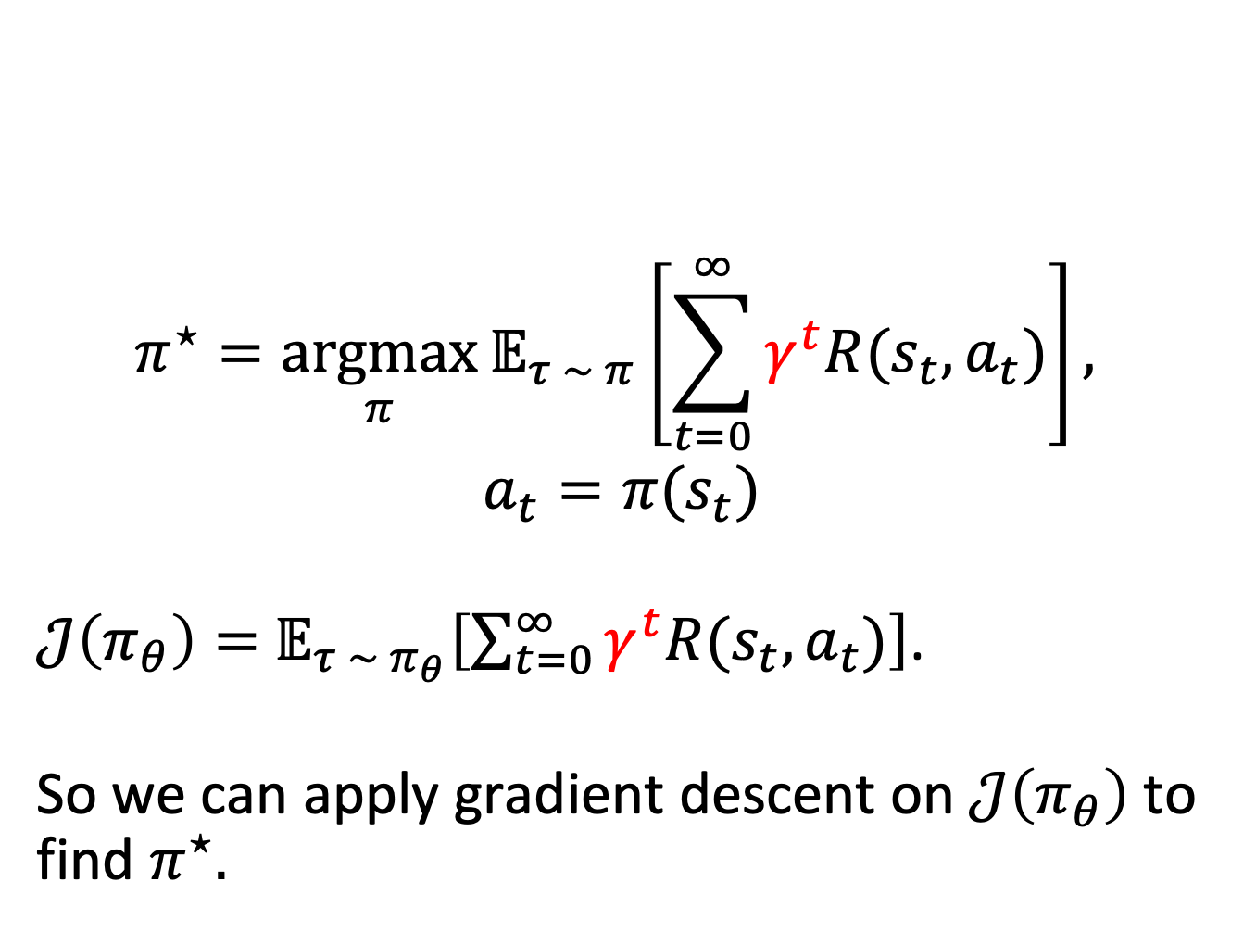
Best Policy
$$π^{⋆}=\underset{π}{argmax}{𝔼_{τ \sim π}\left[\sum_{t=0}^{∞}{γ^{t}R(s_{t}, a_{t})}\right]},$$
$$a_{t}=π(s_{t})$$
$𝒥\left(π_{θ}\right)=$ $𝔼_{τ \sim π_{θ}}\left[\sum_{t=0}^{∞}{γ^{t}R(s_{t}, a_{t})}\right]$.
So we can apply gradient descent on $𝒥\left(π_{θ}\right)$ to find $π^{⋆}.$

Slide 14
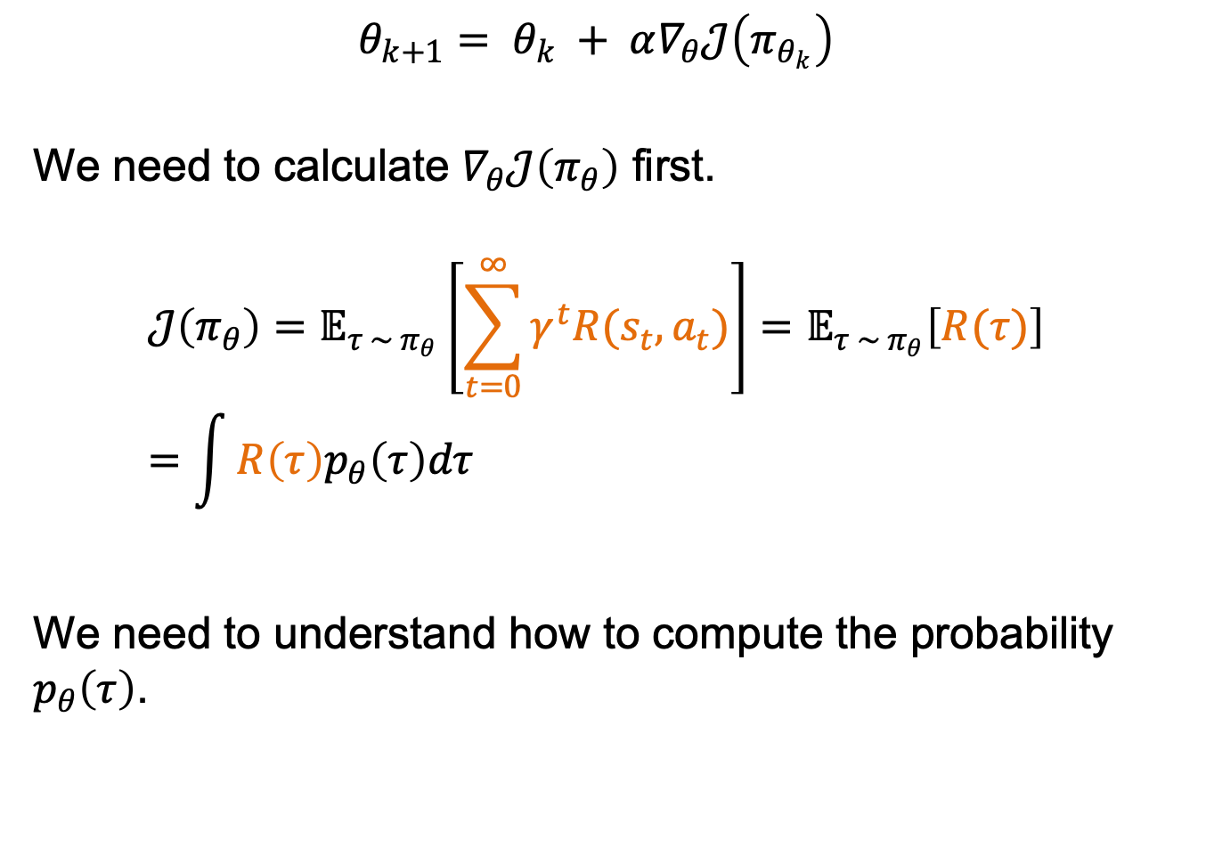
Policy Gradient
$$θ_{k+1}= θ_{k} + α∇_{θ}𝒥\left(π_{θ_{k}}\right)$$
We need to calculate $∇_{θ}𝒥\left(π_{θ}\right)$ first.
$$𝒥\left(π_{θ}\right)=𝔼_{τ \sim π_{θ}}\left[\sum_{t=0}^{∞}{γ^{t}R(s_{t}, a_{t})}\right]=𝔼_{τ \sim π_{θ}}\left[R(τ)\right]=\int{R\left(τ\right)p_{θ}\left(τ\right)dτ}$$
We need to understand how to compute the probability $p_{θ}\left(τ\right)$.

Slide 15
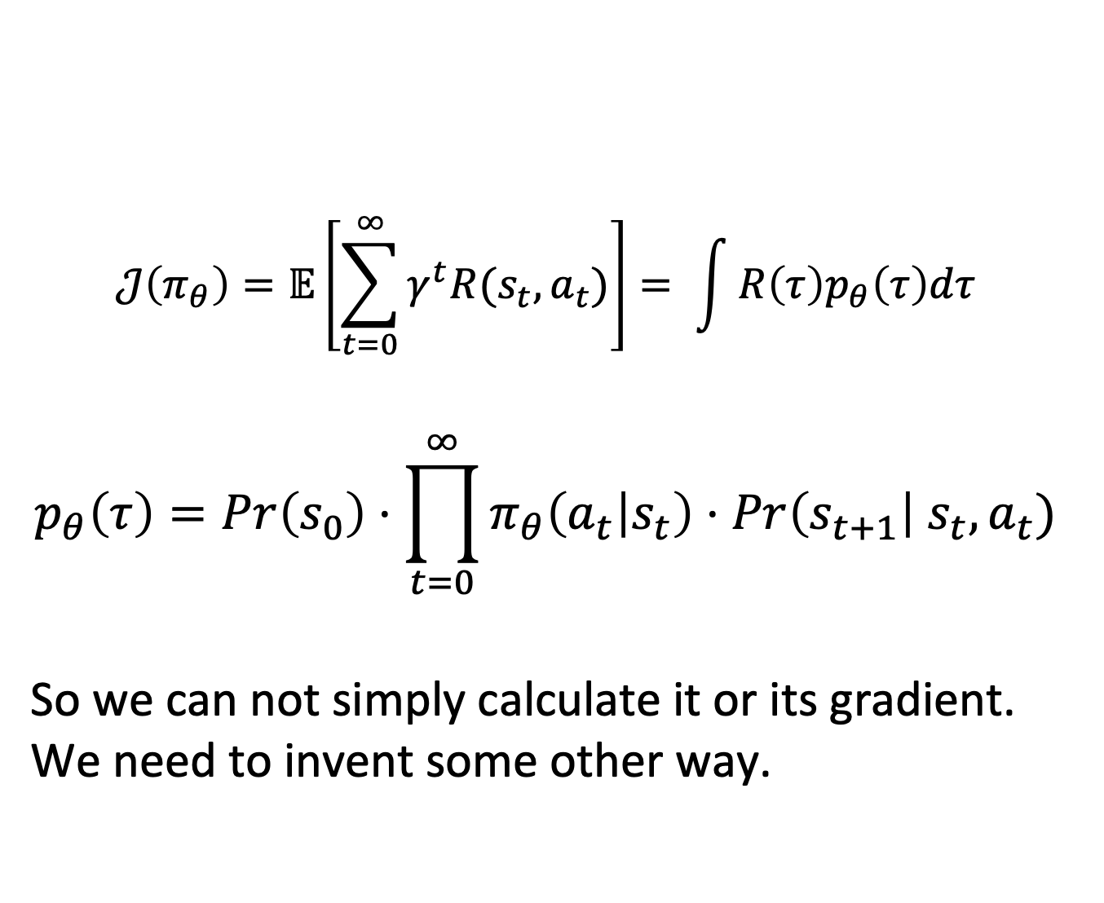
Policy Gradient
$$𝒥\left(π_{θ}\right)=𝔼\left[\sum_{t=0}^{∞}{γ^{t}R(s_{t}, a_{t})}\right]= \int{R\left(τ\right)p_{θ}\left(τ\right)dτ}$$
$$p_{θ}\left(τ\right)=Pr\left(s_{0}\right)⋅\prod_{t=0}^{∞}{π_{θ}\left(a_{t} | s_{t}\right)⋅Pr\left(s_{t+1}\right|{ s}_{t}, a_{t})}$$
So we can not simply calculate it or its gradient. We need to invent some other way.

Slide 16
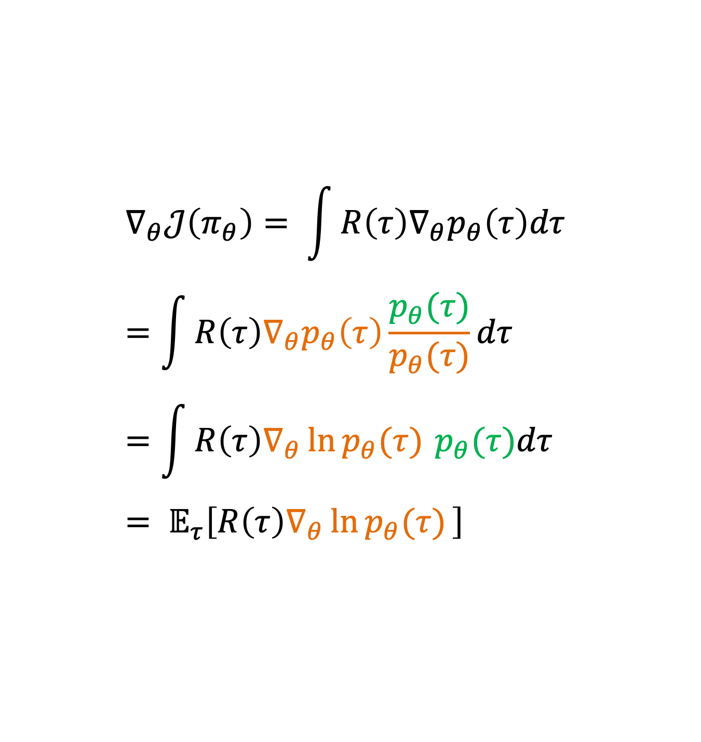
Policy Gradient
$$∇_{θ}𝒥\left(π_{θ}\right)= \int{R\left(τ\right){∇_{θ}p}_{θ}\left(τ\right)dτ}=\int{R\left(τ\right){∇_{θ}p}_{θ}\left(τ\right)\frac{p_{θ}(τ)}{p_{θ}(τ)}dτ}=\int{R\left(τ\right){∇_{θ}\ln{p_{θ}(τ)}}_{ }p_{θ}(τ)dτ}= 𝔼_{τ}\left[R\left(τ\right){∇_{θ}\ln{p_{θ}(τ)}}_{ }\right]$$

Slide 17
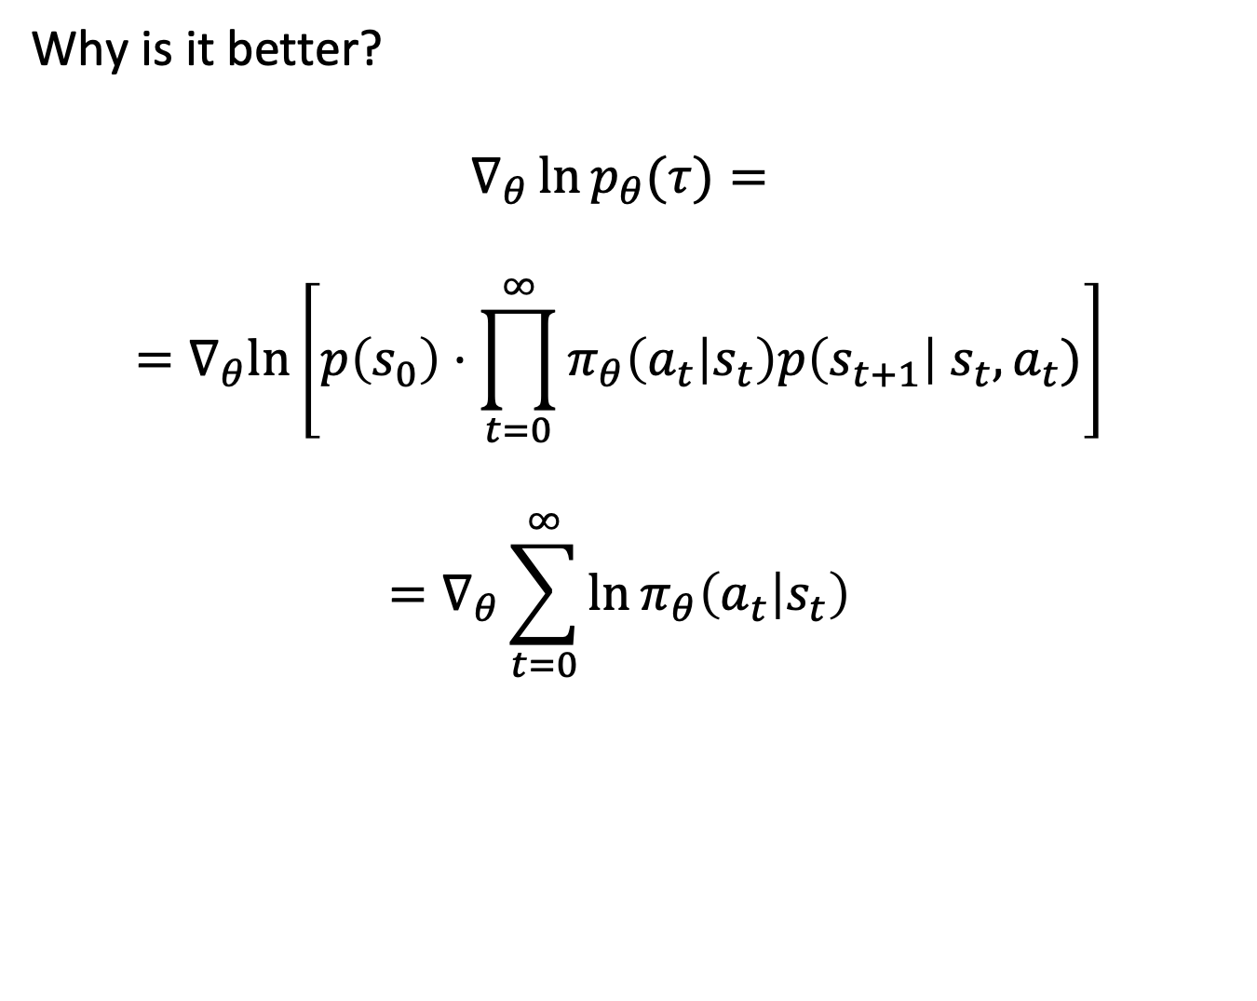
Policy Gradient
Why is it better?
$$∇_{θ}\ln{p_{θ}(τ)}=$$
$$=∇_{θ}ln\left[p\left(s_{0}\right)⋅\prod_{t=0}^{∞}{π_{θ}\left(a_{t} | s_{t}\right)p\left(s_{t+1}\right|{ s}_{t}, a_{t})}\right]$$
$$=∇_{θ}\sum_{t=0}^{∞}{\ln{π_{θ}\left(a_{t} | s_{t}\right)}}$$

Slide 18
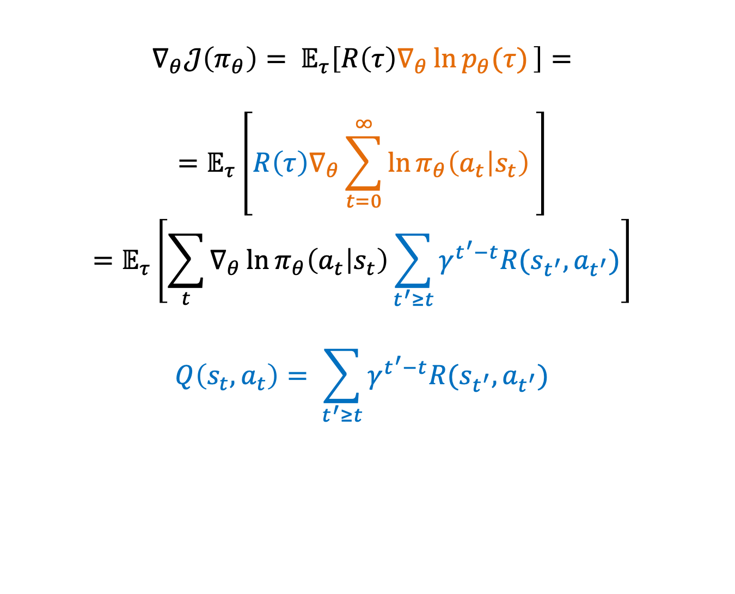
Policy Gradient
$$∇_{θ}𝒥\left(π_{θ}\right)= 𝔼_{τ}\left[R\left(τ\right){∇_{θ}\ln{p_{θ}(τ)}}_{ }\right]=$$
$$=𝔼_{τ}\left[R\left(τ\right){∇_{θ}\sum_{t=0}^{∞}{\ln{π_{θ}\left(a_{t} | s_{t}\right)}}}_{ }\right]$$
$$=𝔼_{τ}\left[\sum_{t}{∇_{θ}\ln{π_{θ}\left(a_{t} | s_{t}\right)}}\sum_{t^{′}≥t}{γ^{t^{′}−t}R(s_{t^{′}}, a_{t^{′}})}\right]$$
$$Q\left(s_{t}, a_{t}\right)= \sum_{t^{′}≥t}{γ^{t^{′}−t}R(s_{t^{′}}, a_{t^{′}})}$$

Slide 19
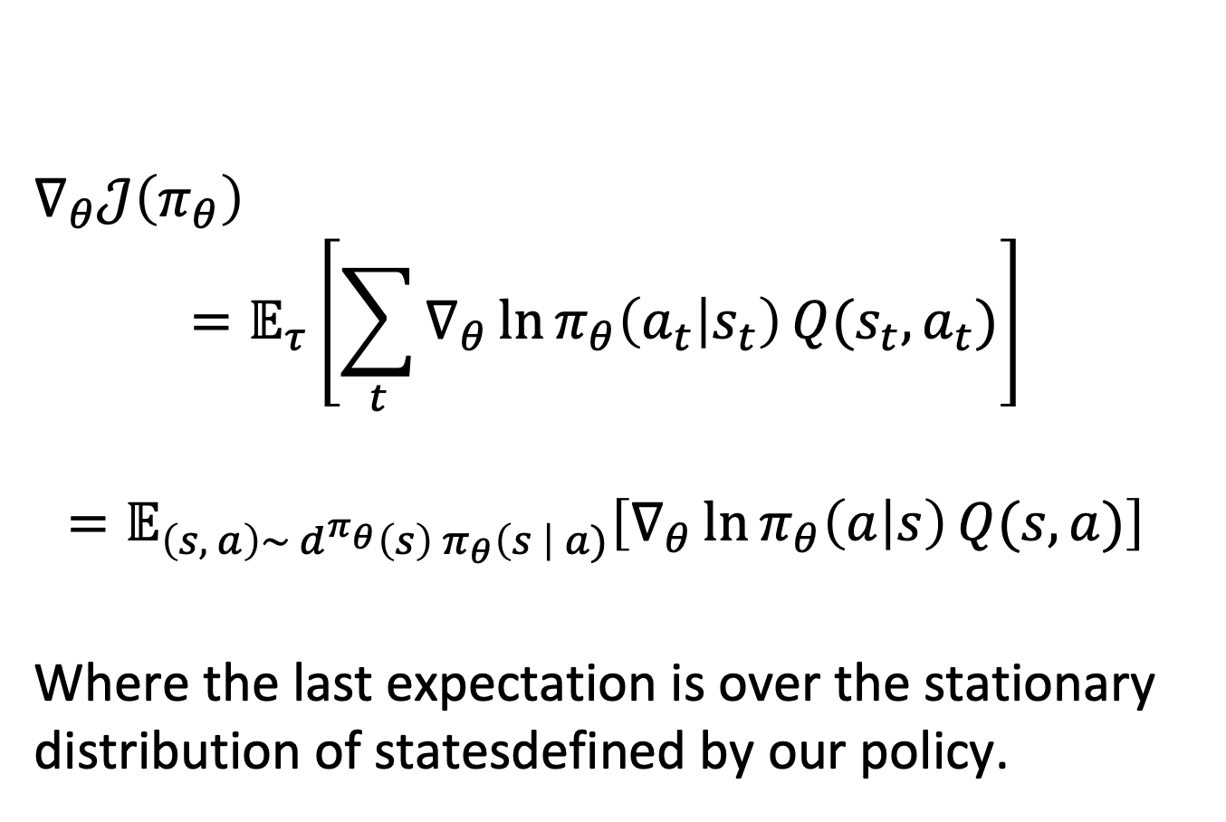
Policy Gradient
$∇_{θ}𝒥\left(π_{θ}\right)$
$$=𝔼_{τ}\left[\sum_{t}{∇_{θ}\ln{π_{θ}\left(a_{t} | s_{t}\right)}}Q(s_{t}, a_{t})\right]$$
$$=𝔼_{\left(s, a\right)\sim {d^{π_{θ}}\left(s\right) π}_{θ}\left(s \right| a)}\left[∇_{θ}\ln{π_{θ}\left(a | s\right)}Q(s, a)\right]$$
Where the last expectation is over the stationary distribution of statesdefined by our policy.

Slide 20
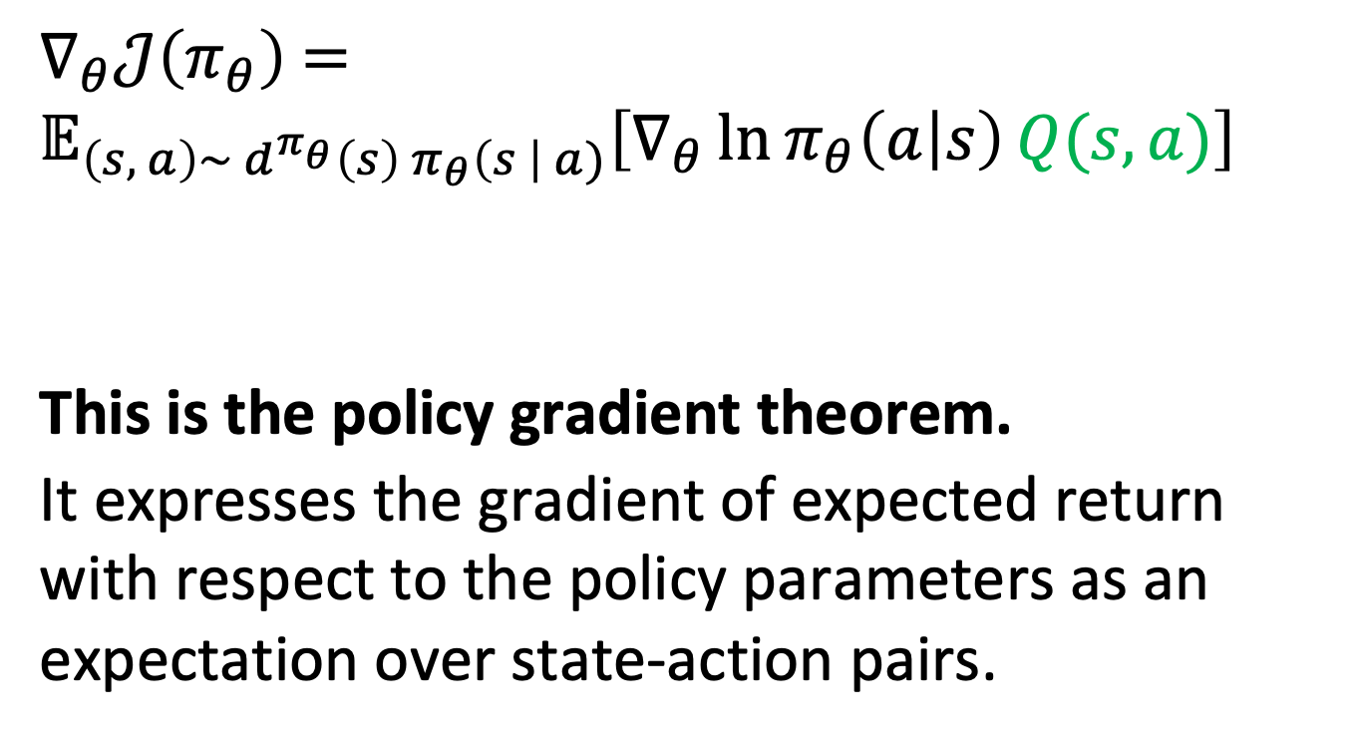
Policy Gradient
$∇_{θ}𝒥\left(π_{θ}\right)$ $=𝔼_{\left(s, a\right)\sim {d^{π_{θ}}\left(s\right) π}_{θ}\left(s \right| a)}\left[∇_{θ}\ln{π_{θ}\left(a | s\right)}Q(s, a)\right]$
This is the policy gradient theorem.
It expresses the gradient of expected return with respect to the policy parameters as an expectation over state-action pairs.

Slide 21
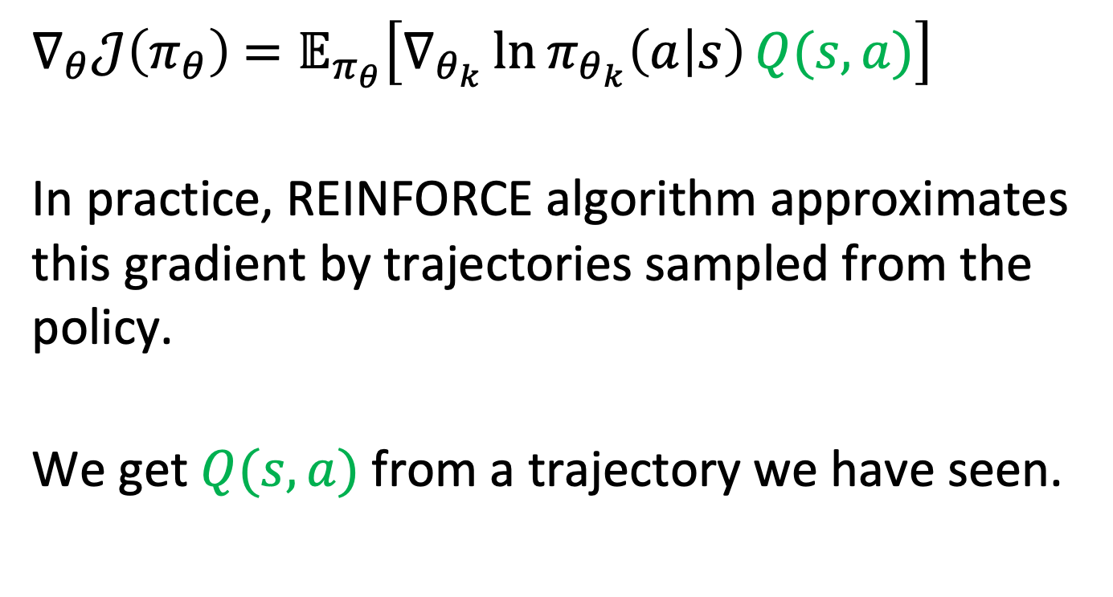
REINFORCE
$∇_{θ}𝒥\left(π_{θ}\right)$ $=𝔼_{π_{θ}}\left[∇_{θ_{k}}\ln{π_{θ_{k}}\left(a | s\right)}Q(s, a)\right]$
In practice, REINFORCE algorithm approximates this gradient by trajectories sampled from the policy.
We get $Q(s, a)$ from a trajectory we have seen.

Slide 22
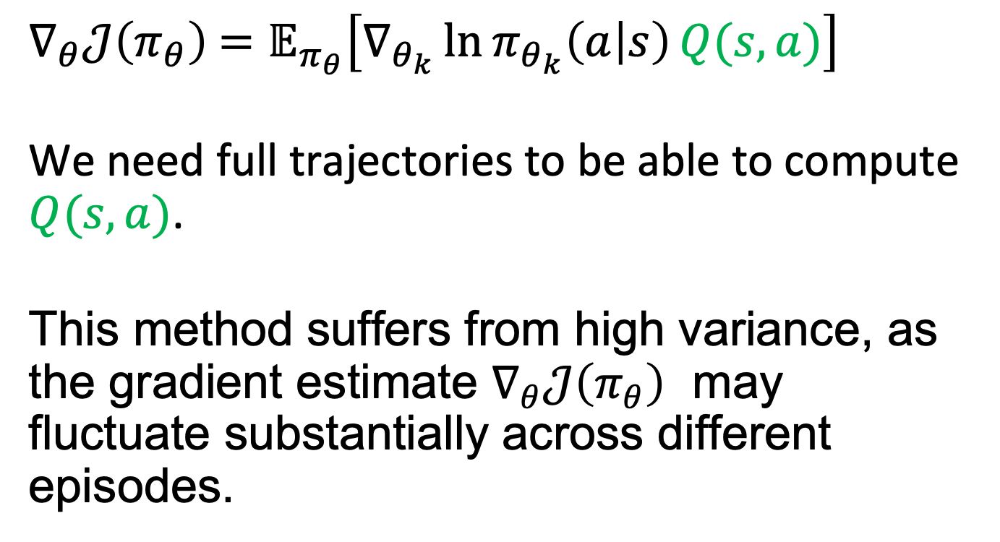
REINFORCE
$∇_{θ}𝒥\left(π_{θ}\right)$ $=𝔼_{π_{θ}}\left[∇_{θ_{k}}\ln{π_{θ_{k}}\left(a | s\right)}Q(s, a)\right]$
We need full trajectories to be able to compute $Q(s, a)$.
This method suffers from high variance, as the gradient estimate $∇_{θ}𝒥\left(π_{θ}\right)$ may fluctuate substantially across different episodes.

Slide 23
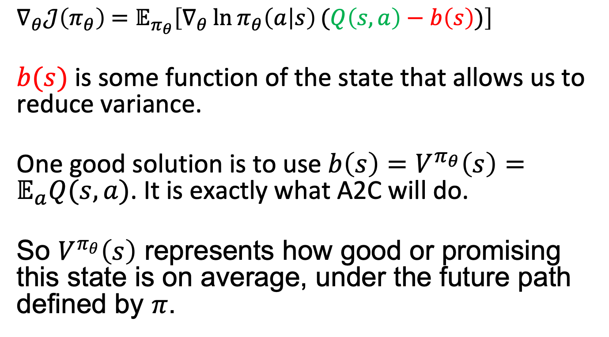
Variance problem
$∇_{θ}𝒥\left(π_{θ}\right)$ $=𝔼_{π_{θ}}\left[∇_{θ}\ln{π_{θ}\left(a | s\right)}(Q\left(s, a\right)−b\left(s\right))\right]$
$b(s)$ is some function of the state that allows us to reduce variance.
One good solution is to use $b\left(s\right)=V^{π_{θ}}\left(s\right)=𝔼_{a}Q(s,a)$. It is exactly what A2C will do.
So $V^{π_{θ}}\left(s\right)$ represents how good or promising this state is on average, under the future path defined by $π$.

Slide 24
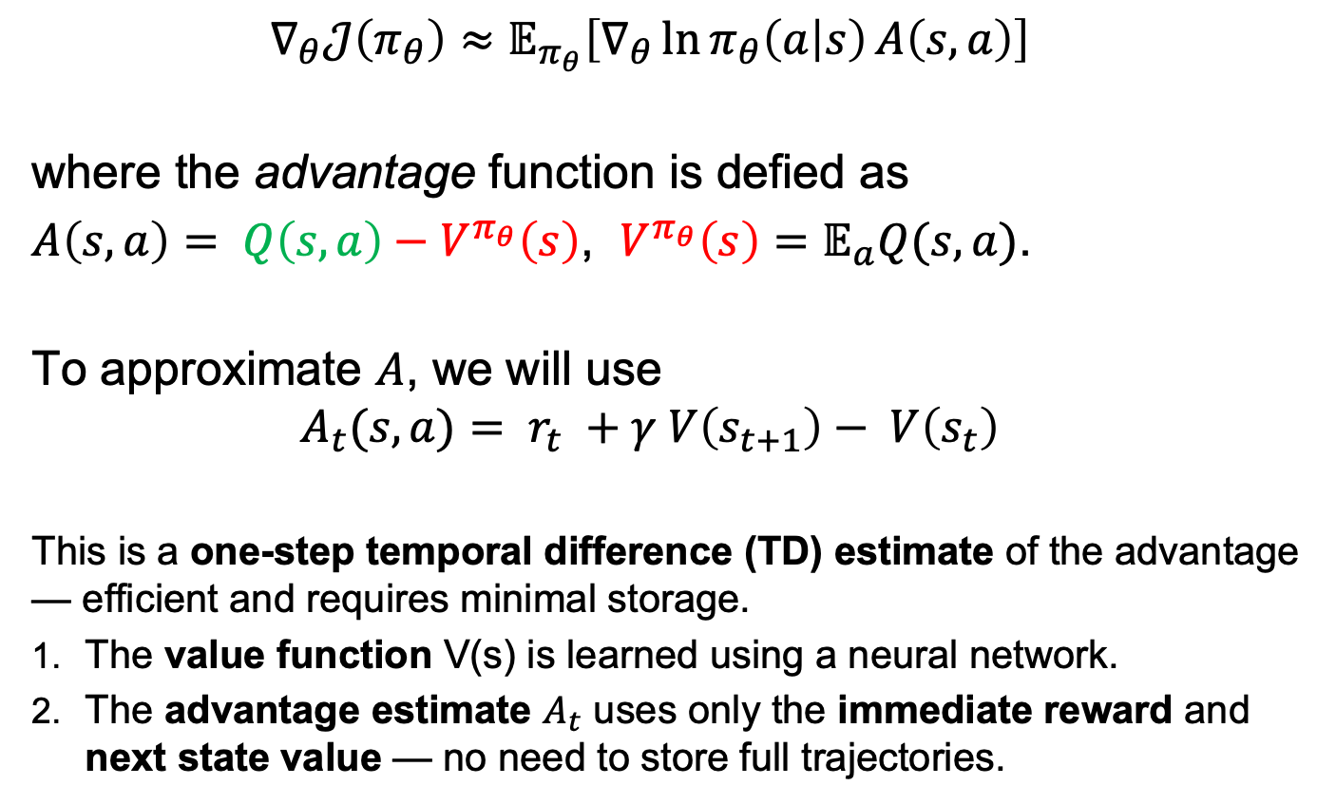
A2C
$$∇_{θ}𝒥\left(π_{θ}\right)≈𝔼_{π_{θ}}\left[∇_{θ}\ln{π_{θ}\left(a | s\right)}A\left(s,a\right)\right]$$
where the advantage function is defied as
$A\left(s,a\right)= Q\left(s, a\right)−V^{π_{θ}}\left(s\right)$, $V^{π_{θ}}\left(s\right)=𝔼_{a}Q(s,a)$.
To approximate $A$, we will use
$$A_{t}(s,a)= r_{t} +γ V\left(s_{t+1}\right)− V\left(s_{t}\right)$$
This is a one-step temporal difference (TD) estimate of the advantage — efficient and requires minimal storage.
The value function V(s) is learned using a neural network.
The advantage estimate $A_{t}$ uses only the immediate reward and next state value — no need to store full trajectories.

Slide 25
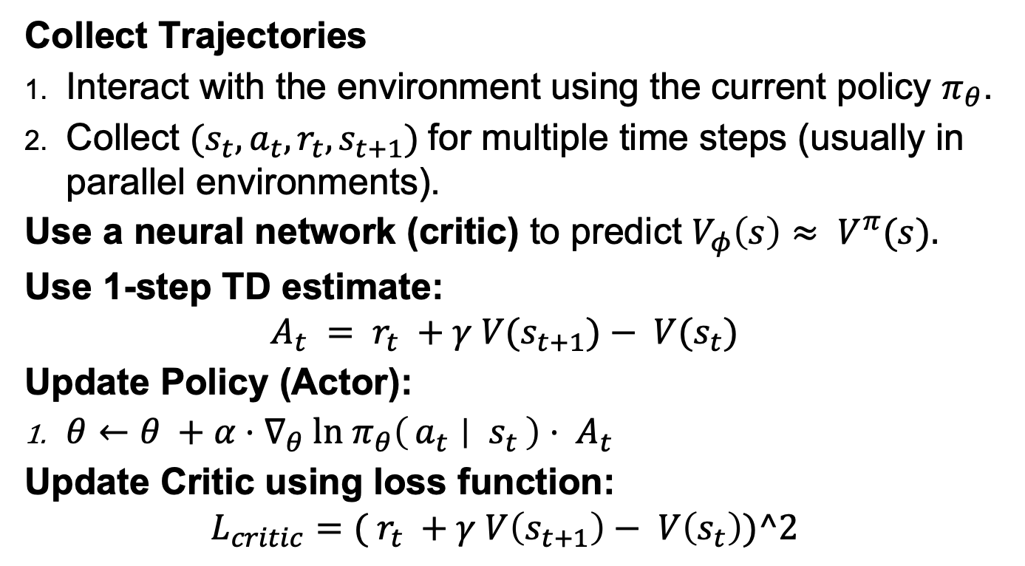
A2C
Collect Trajectories
Interact with the environment using the current policy $π_{θ}$.
Collect $(s_{t}, a_{t}, r_{t}, s_{t+1})$for multiple time steps (usually in parallel environments).
Use a neural network (critic) to predict $V_{φ}\left(s\right)≈ V^{π}(s).$
Use 1-step TD estimate:
$$A_{t} = r_{t} +γ V(s_{t+1})− V(s_{t})$$
Update Policy (Actor):
$θ←θ +α⋅∇_{θ} ln π_{θ}\left(a_{t} ∣ s_{t}\right)⋅ A_{t}$
Update Critic using loss function:
$$L_{critic}=( r_{t} +γ V\left(s_{t+1}\right)− V\left(s_{t}\right))^2$$

Slide 26
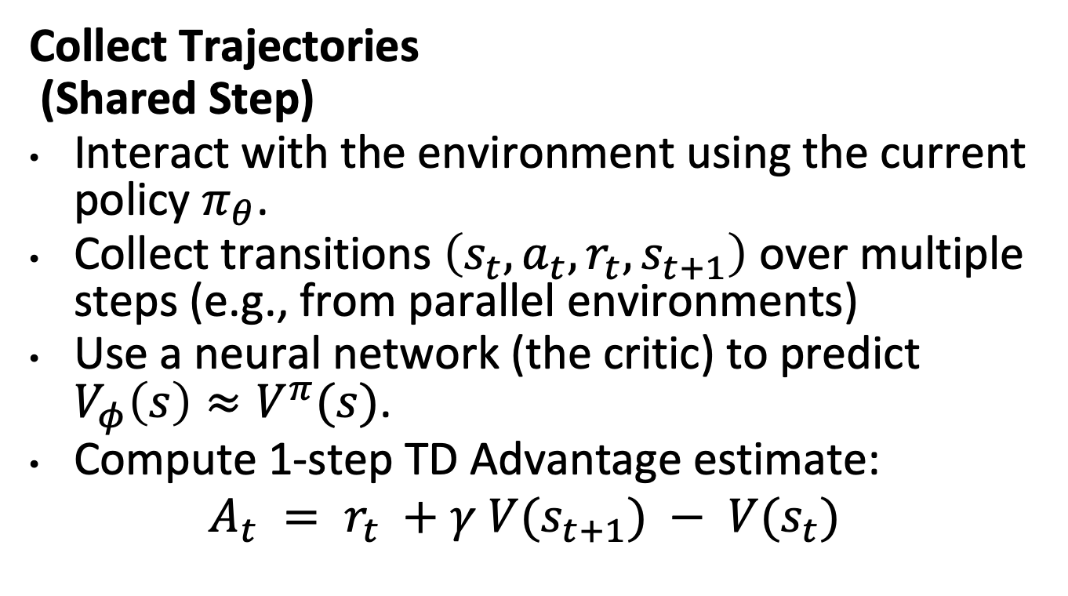
A2C (Detailed)
Collect Trajectories
(Shared Step)
Interact with the environment using the current policy $π_{θ}$.
Collect transitions $\left(s_{t}, a_{t}, r_{t}, s_{t+1}\right)$ over multiple steps (e.g., from parallel environments)
Use a neural network (the critic) to predict $V_{φ}\left(s\right)≈V^{π}(s)$.
Compute 1-step TD Advantage estimate:
$$A_{t} = r_{t} +γ V(s_{t+1}) − V(s_{t})$$

Slide 27
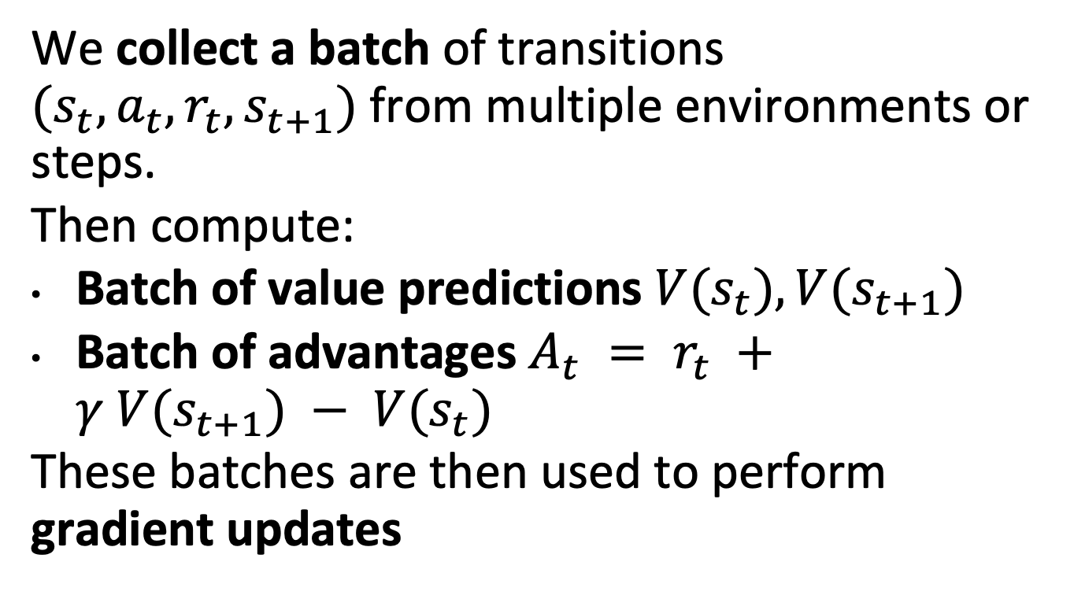
What Actually Happens:
We collect a batch of transitions $(s_{t}, a_{t}, r_{t}, s_{t+1})$from multiple environments or steps.
Then compute:
Batch of value predictions $V(s_{t}), V(s_{t+1})$
Batch of advantages $A_{t} = r_{t} +γ V(s_{t+1}) − V(s_{t})$
These batches are then used to perform gradient updates

Slide 28
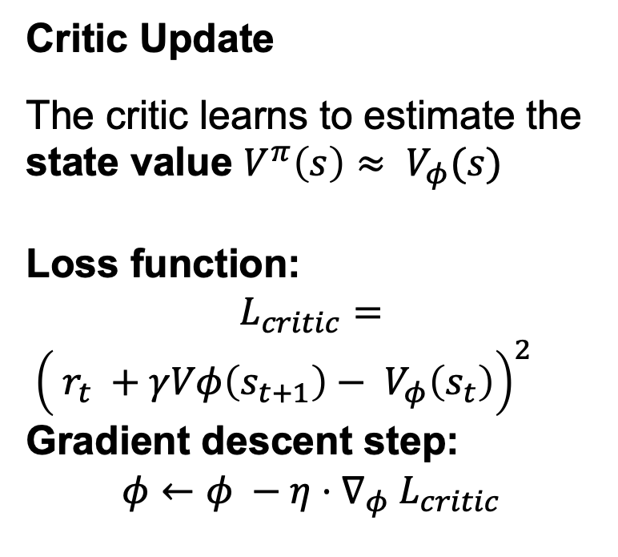
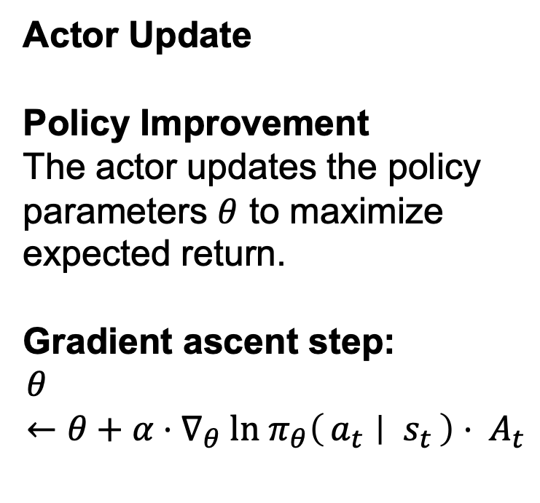
A2C (Detailed)
Actor Update
Policy Improvement
The actor updates the policy parameters $θ$ to maximize expected return.
Gradient ascent step:
$$θ←θ+α⋅∇_{θ} ln π_{θ}\left(a_{t} ∣ s_{t}\right)⋅ A_{t}$$
Critic Update
The critic learns to estimate the state value $V^{π}\left(s\right)≈ V_{φ}(s)$
Loss function:
$$L_{critic}=$$
${\left( r_{t} +γVφ\left(s_{t+1}\right)− V_{φ}\left(s_{t}\right)\right)}^{2}$
Gradient descent step:
$$φ←φ −η⋅∇_{φ} L_{critic}$$
In both cases we can use stochastic gradient descent to update parameters.

