Slide 1
AI in Mathematics
Lecture 13
Reinforcement Learning
Bar-Ilan University
Nebius Academy | Stevens Institute of Technology
June 24, 2025

Slide 2
About This Course
1 week: Intro
2 weeks: Classic ML
2 weeks: Deep Learning in Mathematics
4 weeks: Math as an NLP problem (LLMs etc.)
4 weeks: Reinforcement Learning (RL) in Math Last lecture!!!

Slide 3
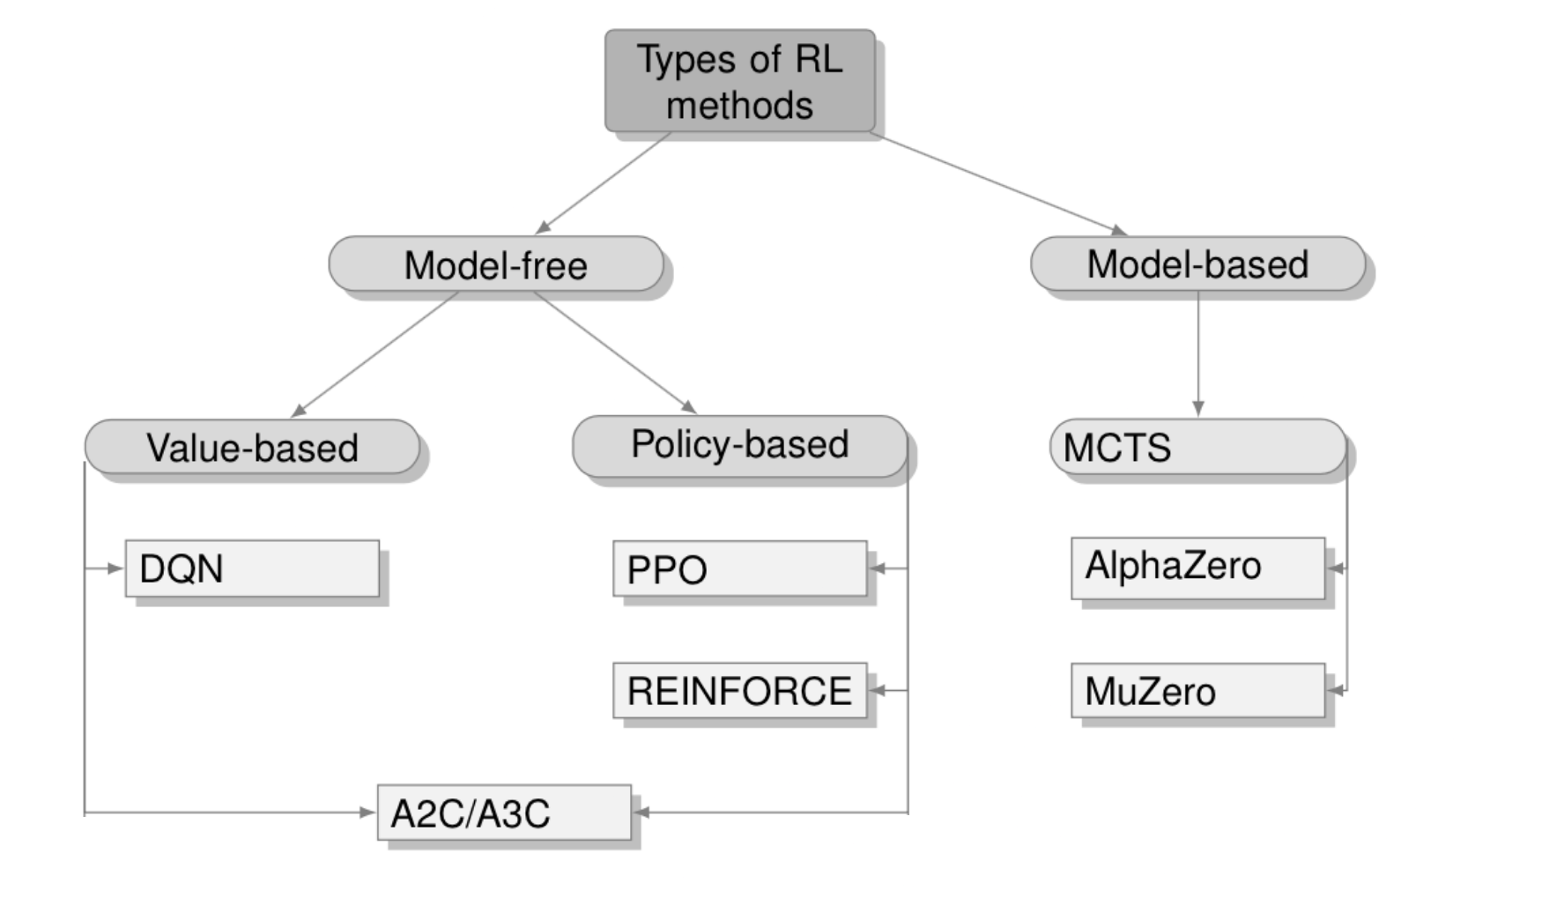
RL Algorithms

Slide 4
RL Algorithms
Last lecture

Slide 5
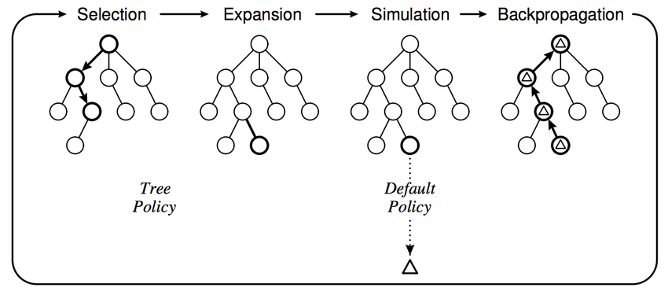
Monte Carlo Tree Search (MCTS)

Slide 6
Idea
The Challenge:
Traversing the full action tree is exponential in depth — impossible in most real-world problems.
We want to explore without visiting every node.
What we need:
A method that selectively explores the tree
Visits the most promising nodes more often
Still guarantees that every part of the tree is explored on average

Slide 7
MCTS
What is MCTS?
Tree search guided by simulation
Builds tree incrementally using Monte Carlo samples
Repeats 4 steps:
Select → Expand → Simulate → Backpropagate

Slide 8
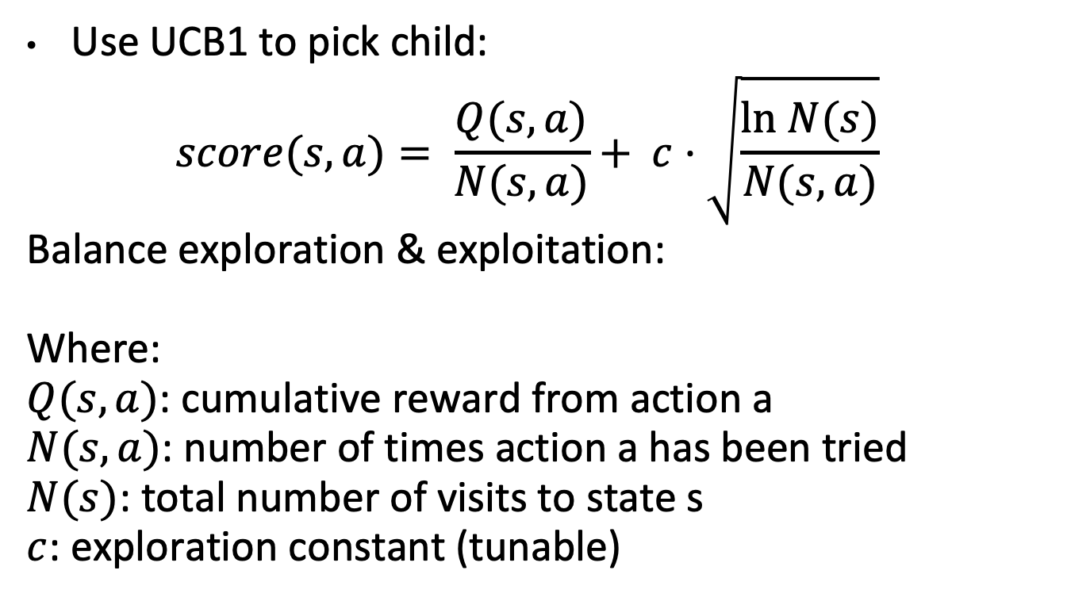
Selection
Use UCB1 to pick child:
$$score(s, a)= \frac{Q(s, a)}{N(s,a)}+ c⋅\sqrt{\frac{ln N(s)}{N(s,a)}}$$
Balance exploration & exploitation:
Where:
$Q(s, a)$: cumulative reward from action a
$N(s, a)$: number of times action a has been tried
$N(s)$: total number of visits to state s
$c$: exploration constant (tunable)

Slide 9
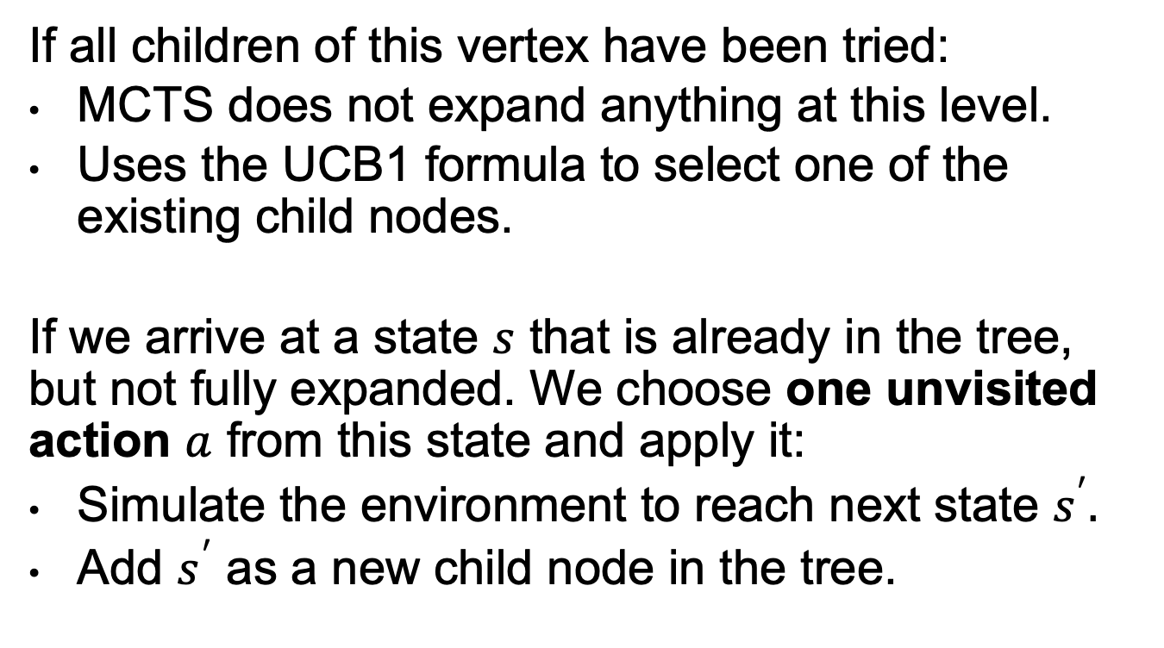
Expansion
If all children of this vertex have been tried:
MCTS does not expand anything at this level.
Uses the UCB1 formula to select one of the existing child nodes.
If we arrive at a state $s$ that is already in the tree, but not fully expanded. We choose one unvisited action $a$ from this state and apply it:
Simulate the environment to reach next state $s^{′}.$
Add $s^{′}$ as a new child node in the tree.

Slide 10
Simulation
We reach a new node s’ that has just been added to the tree. From this node, we simulate a full trajectory.
We use a default policy, often:
A random policy (uniformly choose legal actions)
Or a simple heuristic policy (e.g., favor central moves in a game)
This policy should be fast and lightweight.

Slide 11
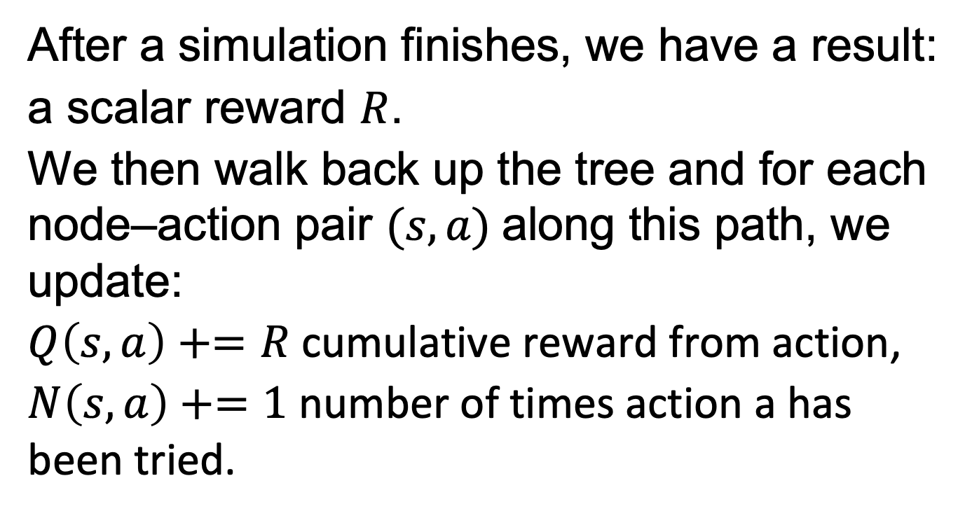
Backpropagation
After a simulation finishes, we have a result:
a scalar reward $R$.
We then walk back up the tree and for each node–action pair $(s, a)$along this path, we update:
$Q\left(s, a\right)+=R$cumulative reward from action,
$N\left(s, a\right)+=1$ number of times action a has been tried.

Slide 12
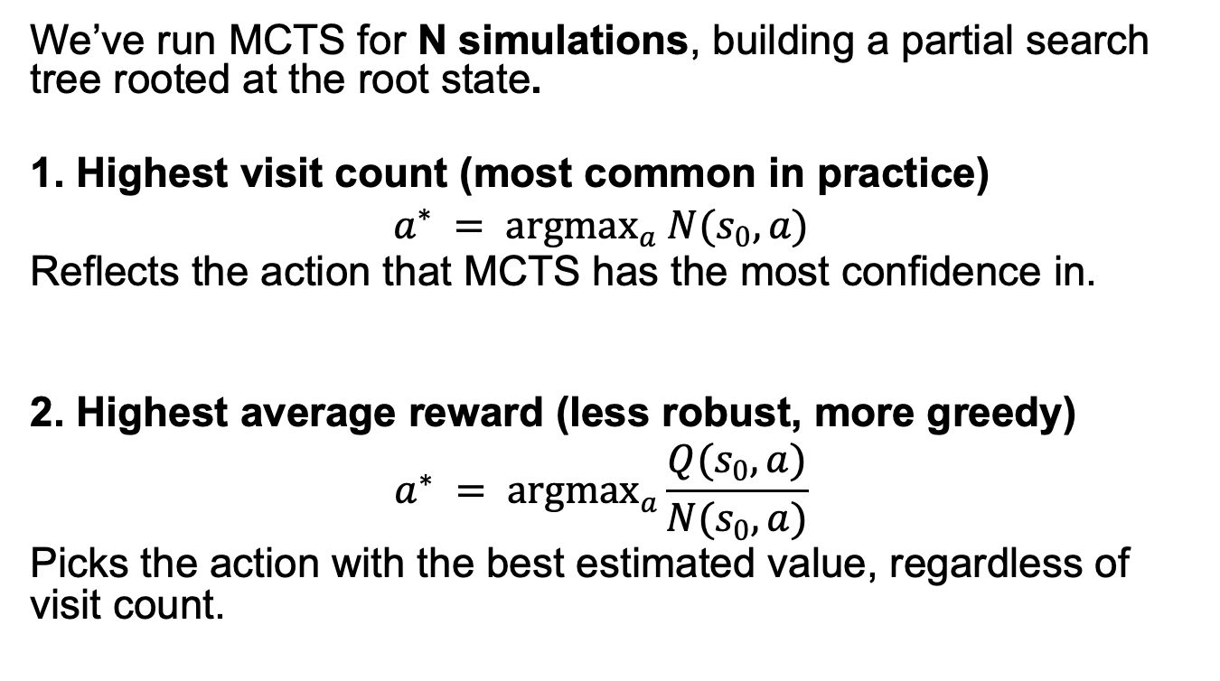
Final Action Selection
We’ve run MCTS for N simulations, building a partial search tree rooted at the root state.
1. Highest visit count (most common in practice)
$$a^{∗} = {argmax}_{a} N(s_{0}, a)$$
Reflects the action that MCTS has the most confidence in.
2. Highest average reward (less robust, more greedy)
$$a^{∗} = {argmax}_{a}\frac{Q(s_{0}, a)}{N(s_{0},a)}$$
Picks the action with the best estimated value, regardless of visit count.

Slide 13
Monte Carlo Tree Search (MCTS)

