Slide 1
AI in Mathematics
Lecture 7
Deep Learning in Mathematics
Bar-Ilan University
Nebius Academy | Stevens Institute of Technology
May 6, 2025

Slide 2
About This Course
1 week: Intro
2 weeks: Classic ML
2 weeks: Deep Learning in Mathematics
4 weeks: Math as an NLP problem (LLMs etc.)
3 weeks: Reinforcement Learning (RL) in Math
1 week: Advanced AI topics or Project Presentations

Slide 3
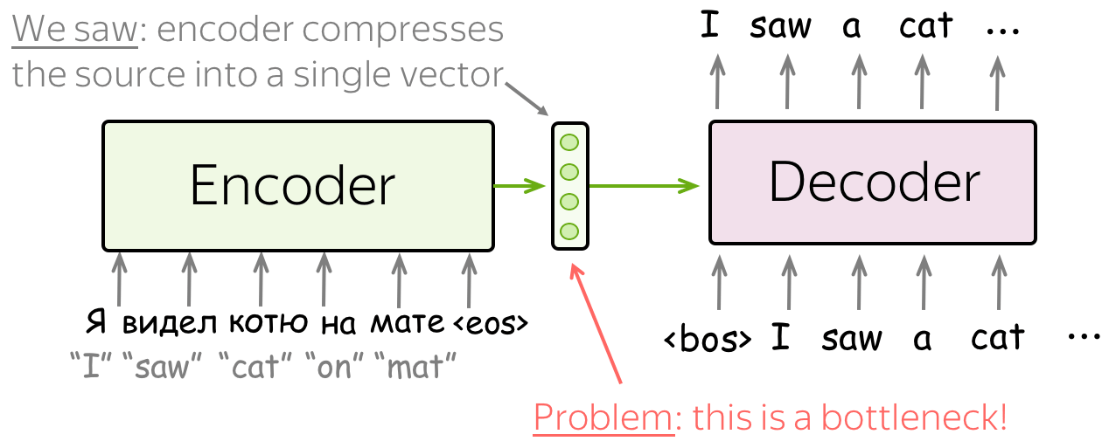
Seq2Seq
Pictures here and further from NLP Course by Lena Voita

Slide 4
Seq2Seq

Slide 5

Seq2Seq
Teacher forcing during train:
We provide ground-truth tokens on a train.

Slide 6
Seq2Seq

Slide 7
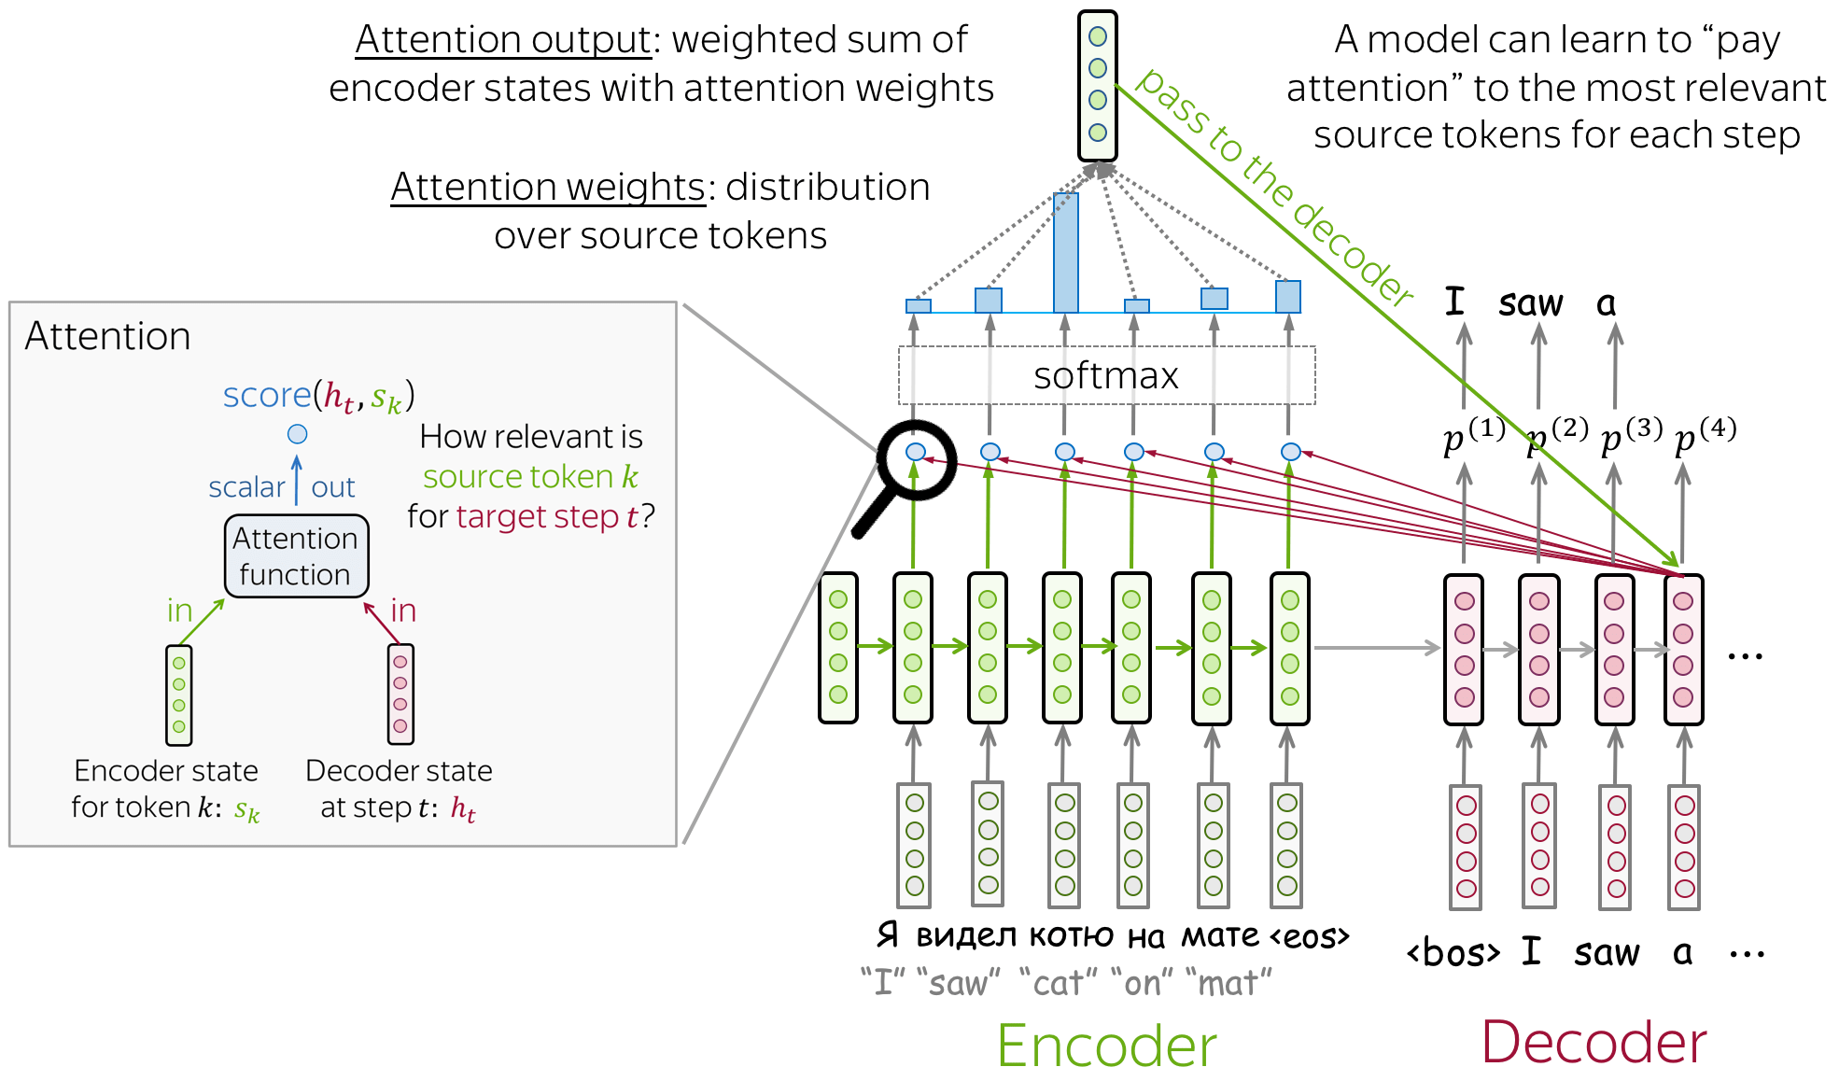
Attention!!!!

Slide 8
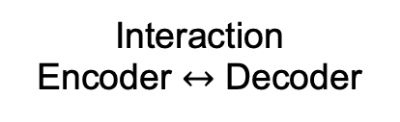
Structure
Seq2Seq
Seq2Seq +Attention
Transformer
Encoder
RNN
RNN
Attention
Decoder
RNN
RNN
Attention
Interaction
Encoder $↔$ Decoder
Vector
N Vectors (Attention)
Attention

Slide 9
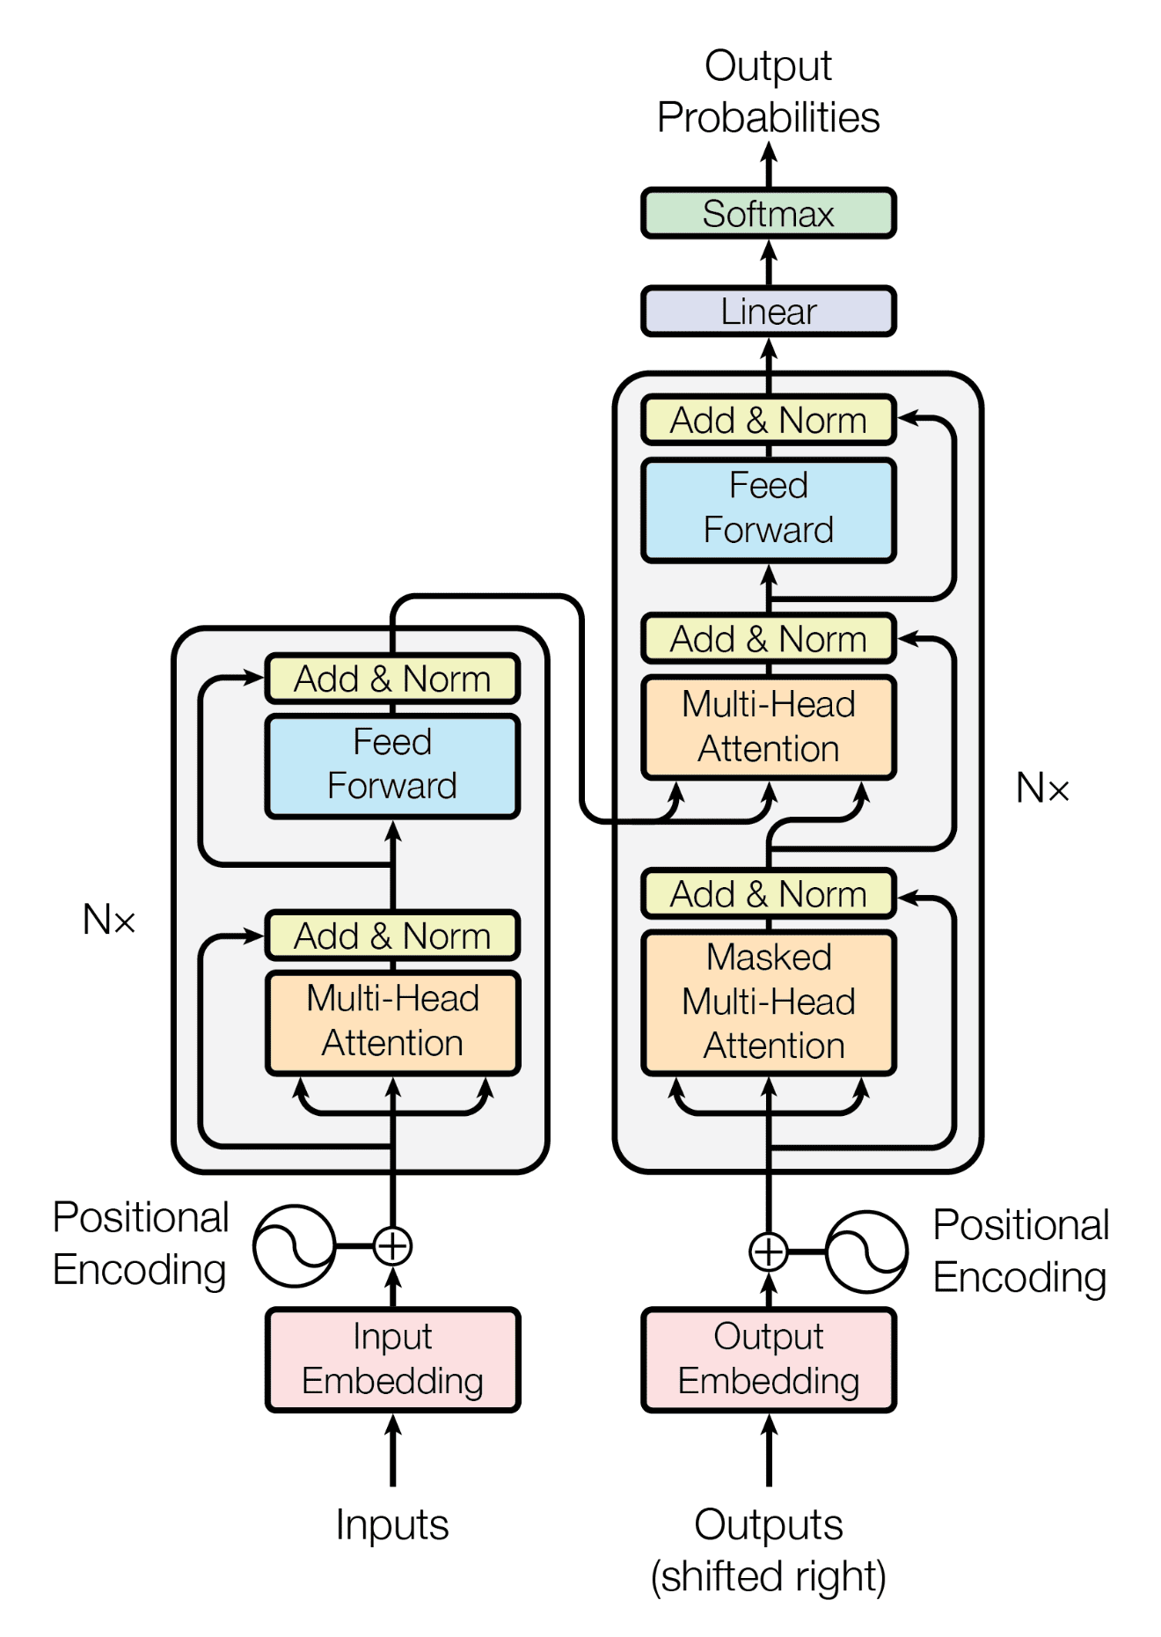
Transformer architecture

Slide 10
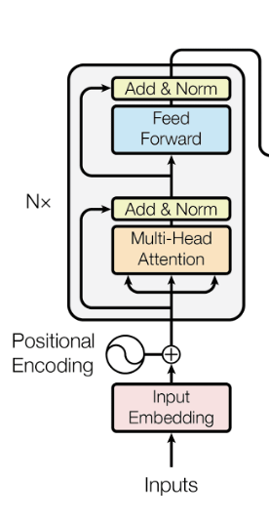
Encoder
N consequative blocks.
Multihead attention is concatination of attention outputs
Add & Norm is a summation of previous information
Feed forward is a fully connected neural network.
Let’s take a closer look at multi-head attention.

Slide 11
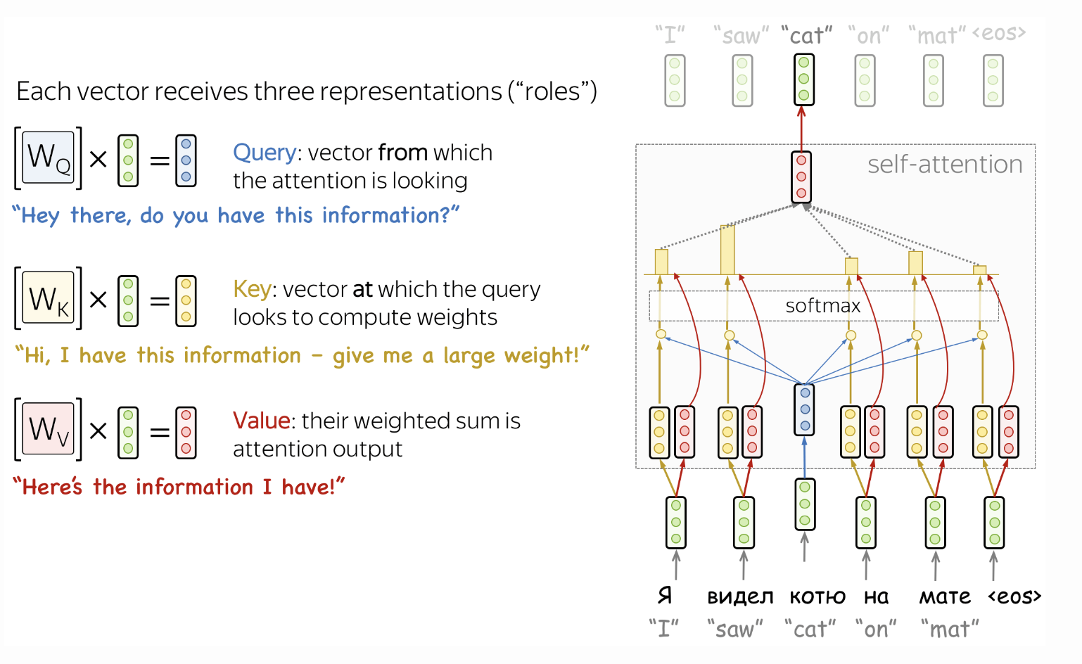

QKV$−$Attention.
This version of attention won the hearts of all ML people.

Slide 12
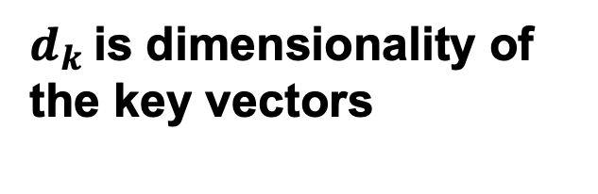
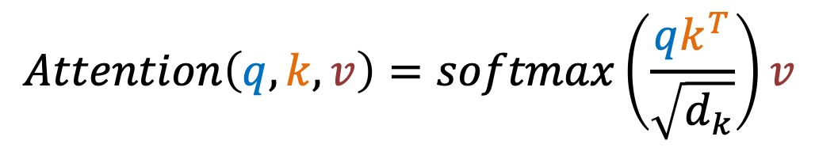
Attention
Attention weights
$$Attention\left(q, k, v\right)=softmax\left(\frac{qk^{T}}{\sqrt{d_{k}}}\right)v$$
$d_{k}$is dimensionality of the key vectors

Slide 13
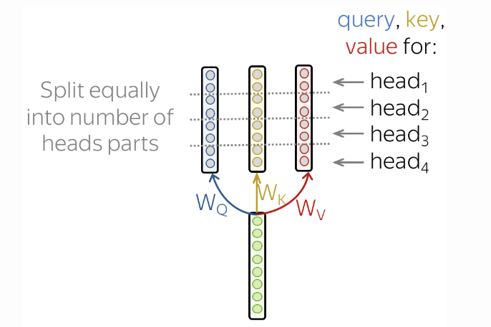
Attention

Slide 14
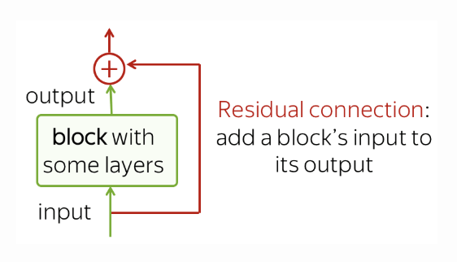
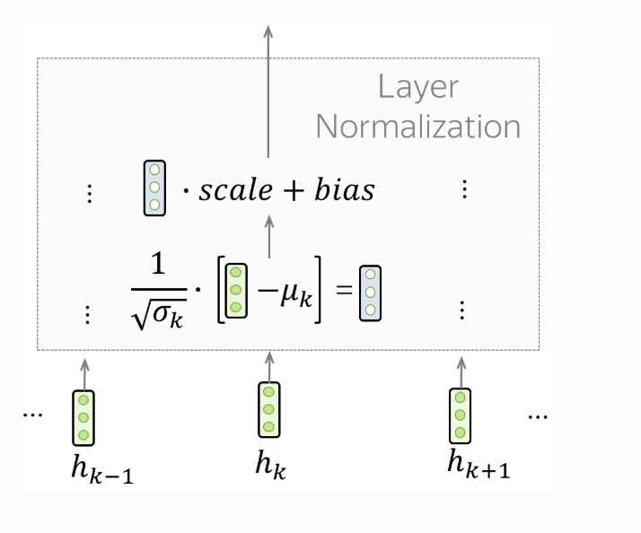
Add & Norm
Residial connection:
Addresses vanishing gradient.
Layer normalization: Stabilize learning

Slide 15
Transformer

Slide 16
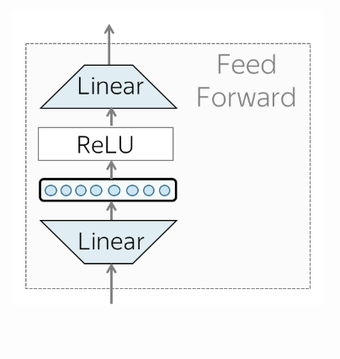
Feed Forward

Slide 17
Decoder

Slide 18
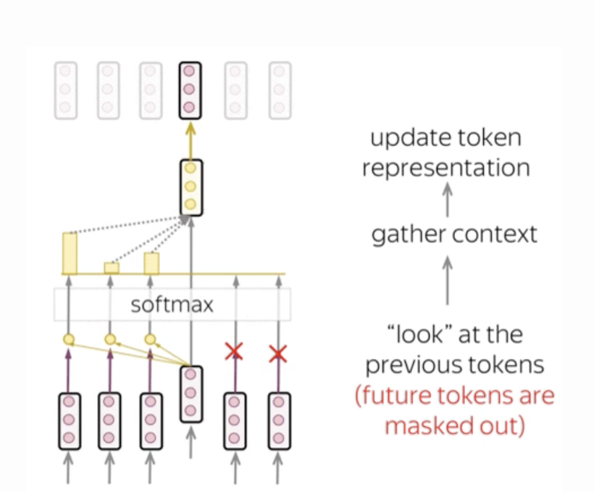
Masked Self-Attention

Slide 19
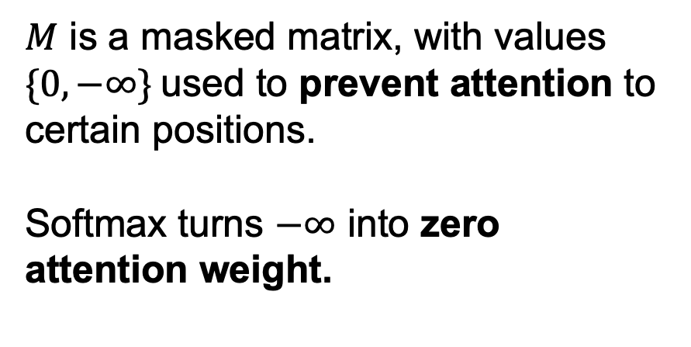
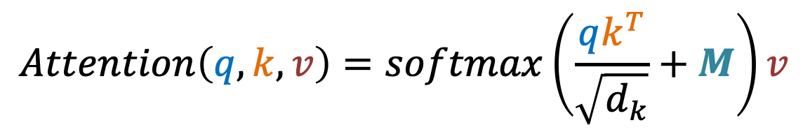
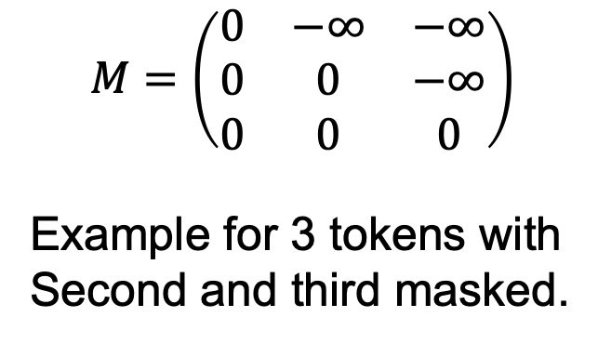
Masked attention
$$Attention\left(q, k, v\right)=softmax\left(\frac{qk^{T}}{\sqrt{d_{k}}}+M\right)v$$
$$M=\left(\begin{matrix}0 & −∞ & −∞ \\ 0 & 0 & −∞ \\ 0 & 0 & 0\end{matrix}\right)$$
Example for 3 tokens with
Second and third masked.
$M$ is a masked matrix, with values $\{0, −∞\}$used to prevent attention to certain positions.
Softmax turns $−∞$ into zero attention weight.

Slide 20
Masked Self-Attention
But why we need masked attention? How can we look in the future?
During training! Since we want to emitate a generation on a training set.
Don’t we have a simmilar problem in Encoder because all the words are considered in the same time?

Slide 21
Decoder

Slide 22
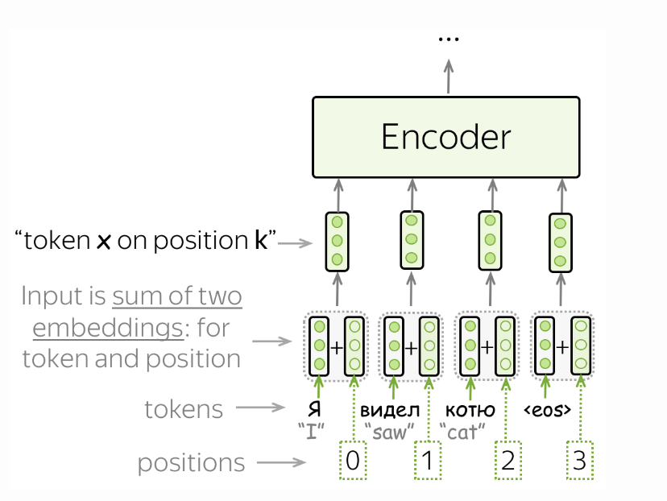
Positional Encoding

Slide 23
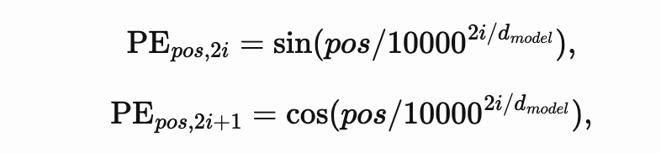
Positional Encoding
Originally used:
Currently in use are Rotary embeddings, and you can read about them in this brilliant longread.

Slide 24
Decoder

Slide 25
Attention

Slide 26
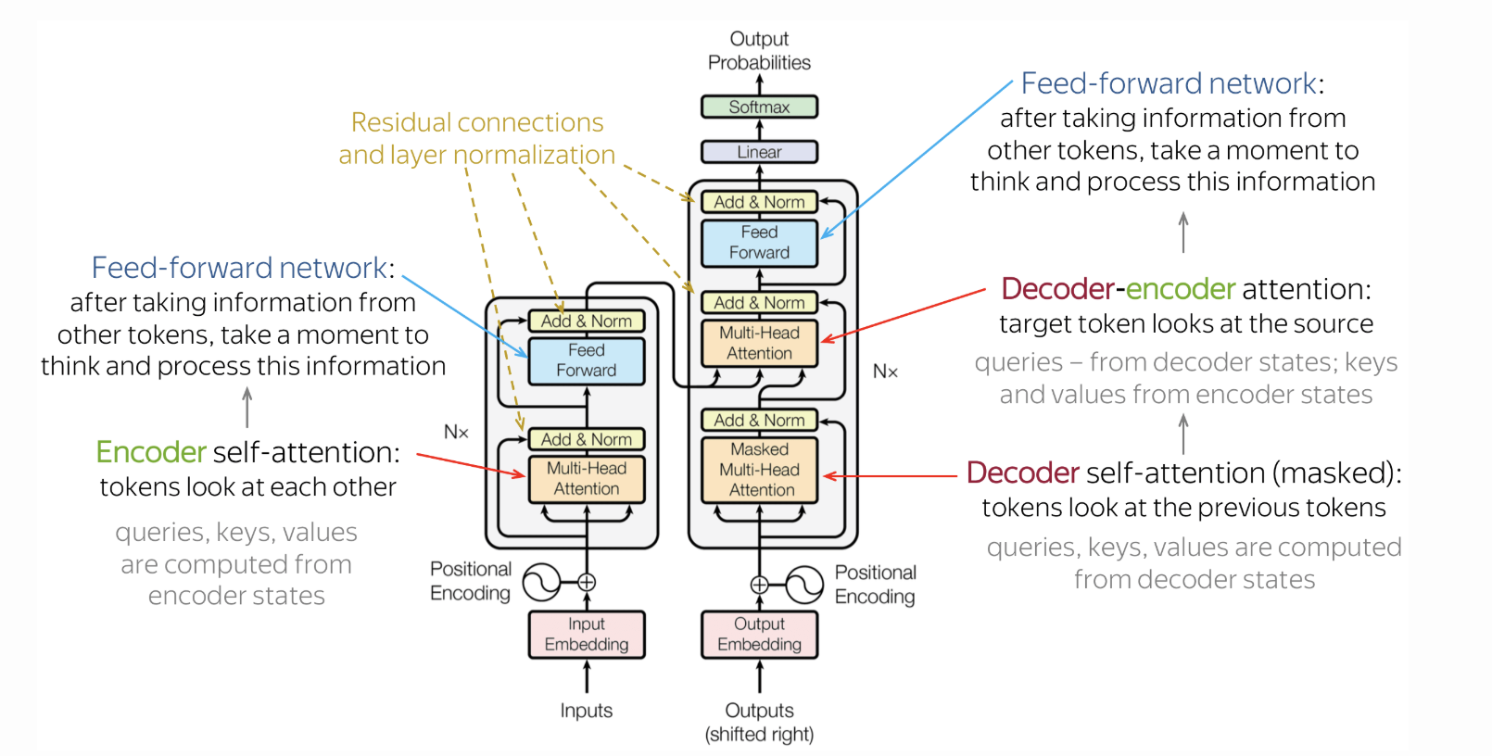
Transformer
Cross attention:

Slide 27
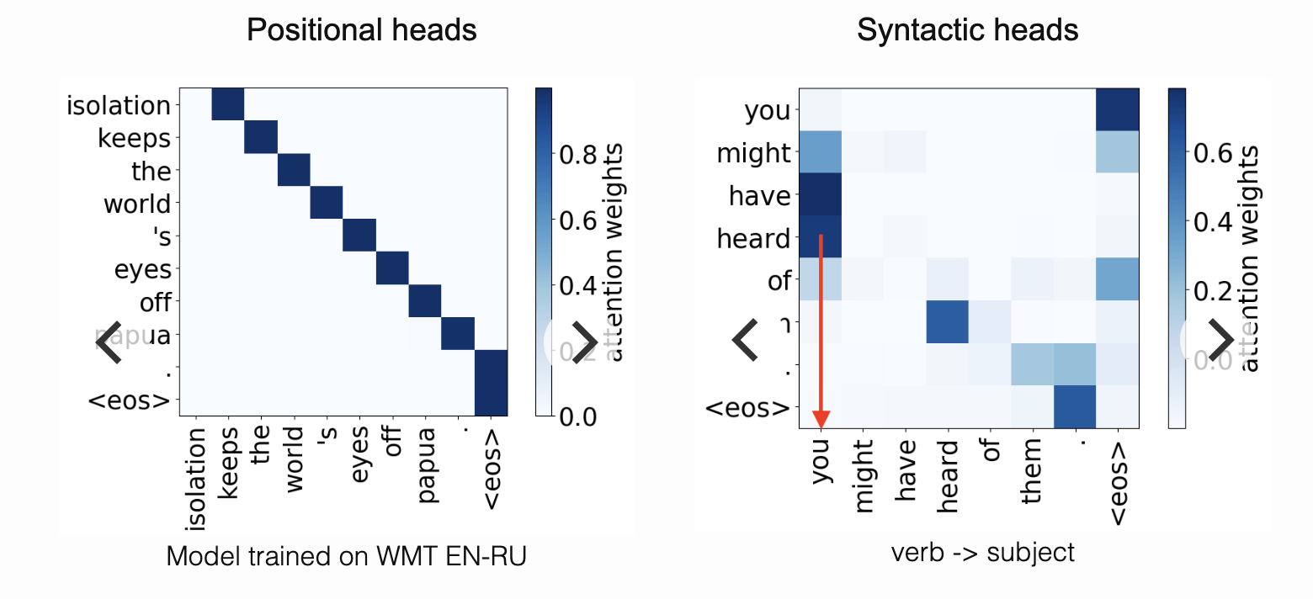
Interpretation of heads

Slide 28
Encoder-only vs Decoder-only Models
Encoder only
Decoder only
Example:
BERT(Bidirectional Encoder Representations from Transformers)
Sentiment analysis
Named entity recognition
Question answering (extractive)
Sentence similarity
Example:
GPT (Generative Pre-trained Transformer)
Text generation
Code completion
Chatbots
Story writing

Slide 29
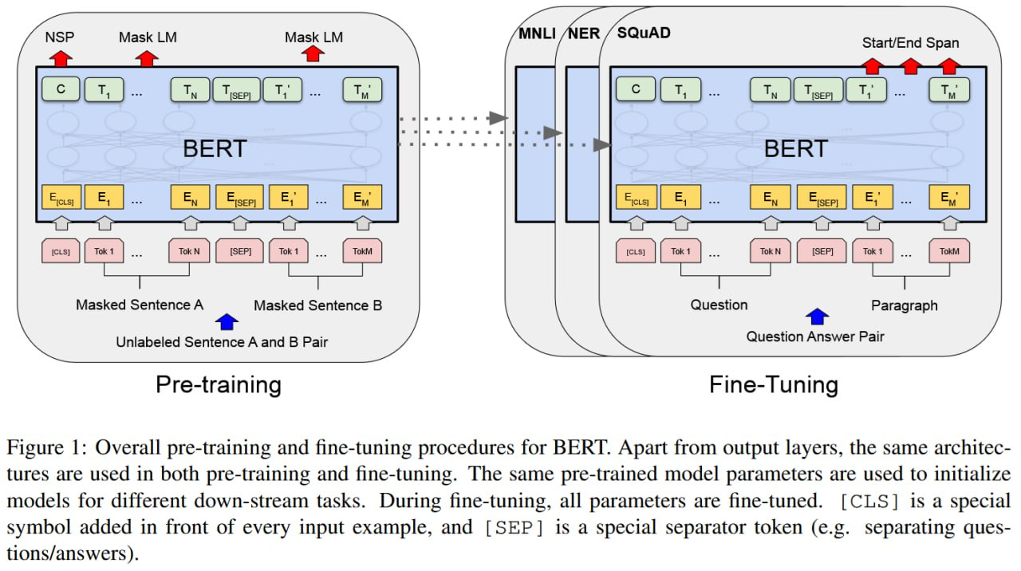
BERT

Slide 30
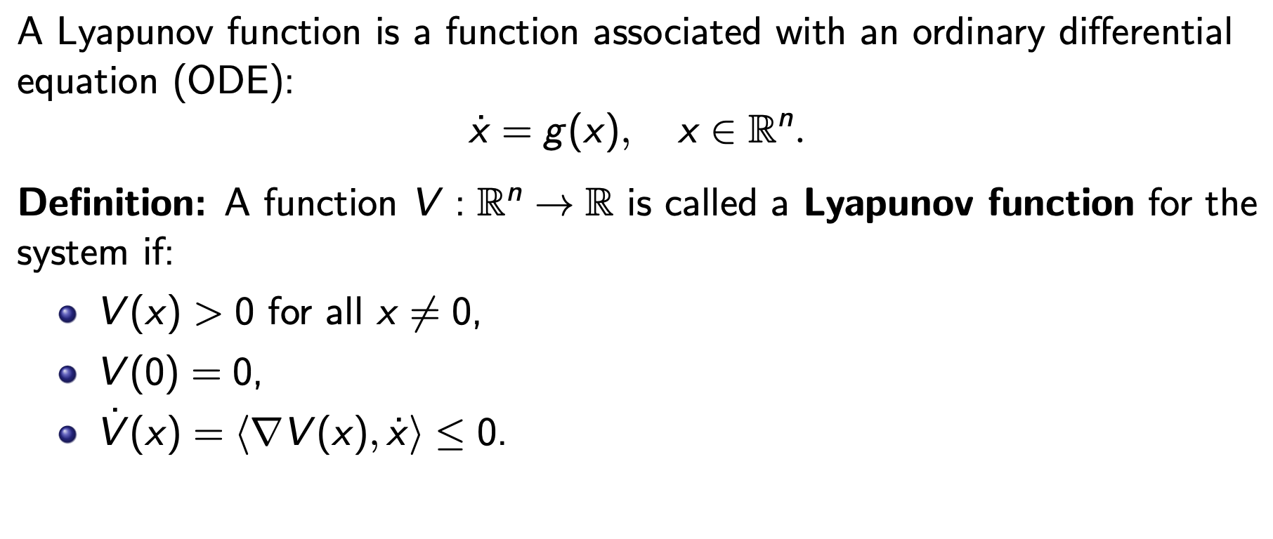
Lyapunov Functions
Why are they important?
Lyapunov function ⇔ Stable system

Slide 31
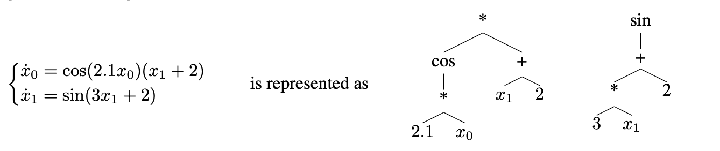
Lyapunov Functions
The problem of predicting Lyapunov function naturally states the question: How to represent functions as features or provide them as an answer?

Slide 32
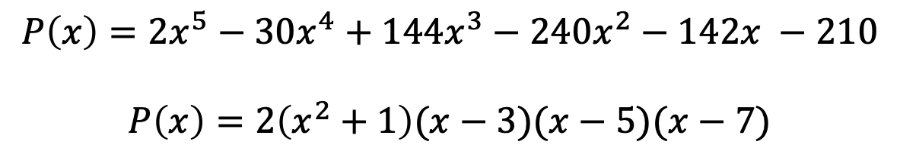
Dataset Generation
Generation of a dataset is important task:
For example for predicting the roots of polynomial, we can create a dataset of polynomials in different forms:
$$P\left(x\right)=2x^{5}−30x^{4}+144x^{3}−240x^{2}−142x −210$$
$$P\left(x\right)=2\left(x^{2}+1\right)(x−3)(x−5)(x−7)$$
What will be the difference in terms of teaching transformers?

Slide 33
Dataset Generation
Forward generation:
Generate systems and find Lyapunov function for them.
Hard to do.
Backward generation:
Start with generating a Laypunov function, generate a system with such Lyapunov function.
May reduce the problem.

Slide 34
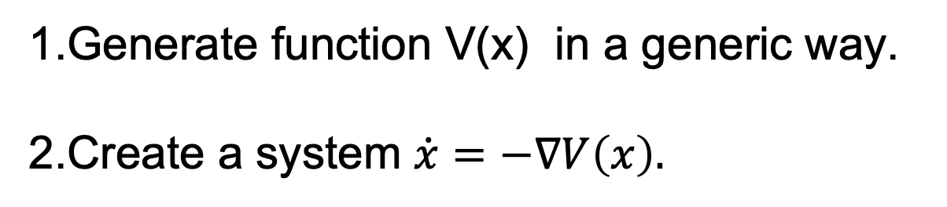
Dataset Generation
For Lyapunov Functions we can use a backward approach:
1.Generate function V(x) in a generic way.
2.Create a system $\dot{x}=−∇V\left(x\right).$
What are potential problems of such backward generation?

Slide 35
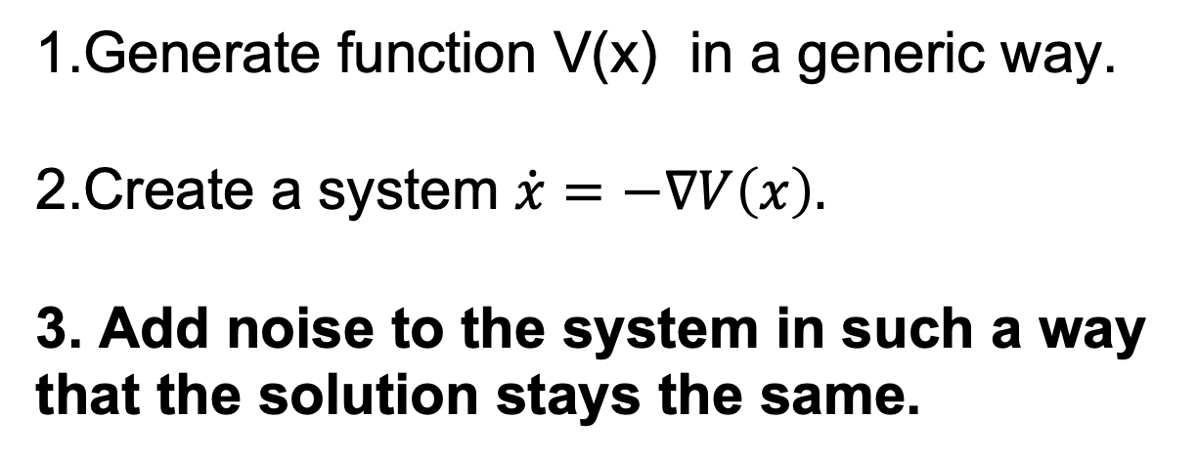
Dataset Creation
We will probably learn a different task: integration.
Authors address this problem by adding additional step.
1.Generate function V(x) in a generic way.
2.Create a system $\dot{x}=−∇V\left(x\right).$
3. Add noise to the system in such a way that the solution stays the same.
Still we can not be sure that we won’t solve subtask of our problem!

Slide 36
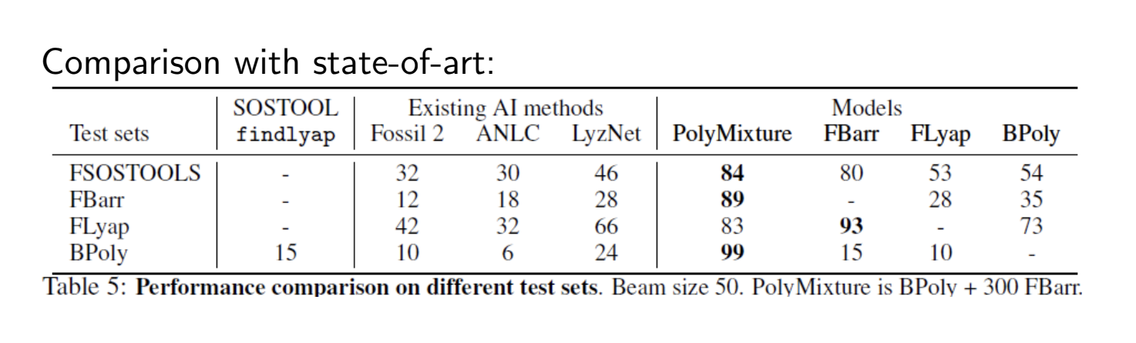
Results

Slide 37
Lyapunov functions
We train transformers with 8 layers, 10 attention heads and an embedding dimension of 640 (ablation studies on different model sizes can be found in Appendix C), on batches of 16 examples, using the Adam optimizer [Kingma and Ba, 2014] with a learning rate of 10−4, an initial linear warm-up phase of 10,000 optimization steps, and inverse square root scheduling.

Slide 38
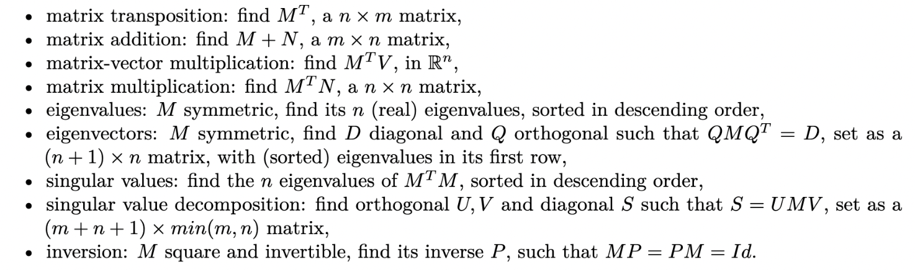
Math Application
Can we train transformers to predict results of mathematical operations?
It may look like an overkill, but this process can create a usefull intuition regarding subtasks: embedding, preprocessing. We will see an example on the seminar.

