Slide 1
AI in Mathematics
Lecture 9
NLP and LLMs
Bar-Ilan University
Nebius Academy | Stevens Institute of Technology
May 20, 2025

Slide 2
About This Course
1 week: Intro
2 weeks: Classic ML
2 weeks: Deep Learning in Mathematics
4 weeks: Math as an NLP problem (LLMs etc.)
3 weeks: Reinforcement Learning (RL) in Math
1 week: Advanced AI topics or Project Presentations

Slide 3
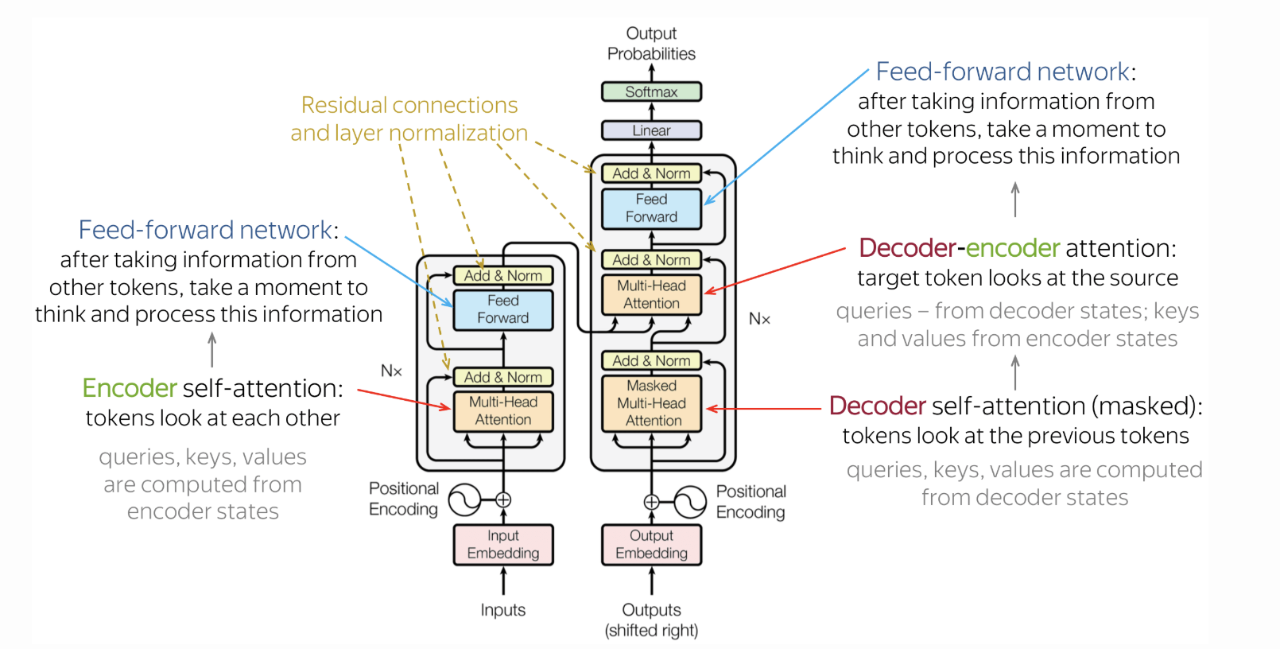
Transformer
Cross attention:

Slide 4
Encoder-only vs Decoder-only Models
Encoder only
Decoder only
Example:
BERT(Bidirectional Encoder Representations from Transformers)
Sentiment analysis
Named entity recognition
Question answering (extractive)
Sentence similarity
Example:
GPT (Generative Pre-trained Transformer)
Text generation
Code completion
Chatbots
Story writing

Slide 5
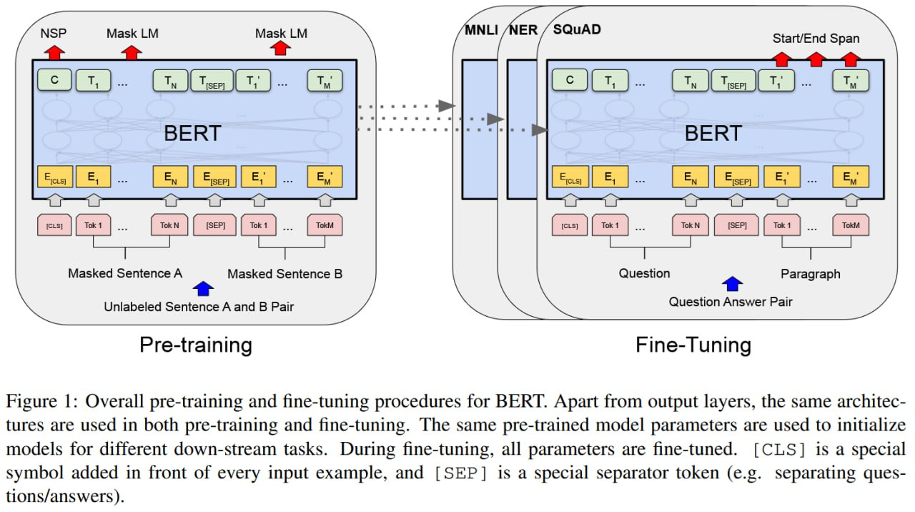
BERT

Slide 6
Pre-trained models
LLMs like GPT-4o, LLaMA, Claude, Gemini, etc.
have broad knowledge, but to solve specific tasks, we need to guide them appropriately:
🧾 Prompting – e.g., “Write code to solve…”
🛠 Fine-tuning – train the model on task-specific examples

Slide 7
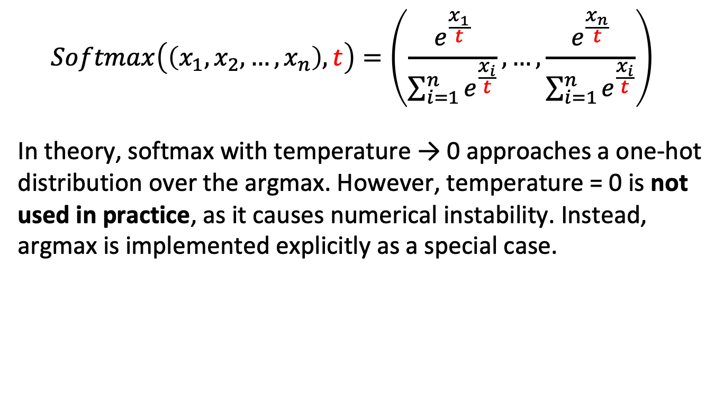
Temperature
$$Softmax\left(\left(x_{1},x_{2},…, x_{n}\right), t\right)=\left(\frac{e^{\frac{x_{1}}{t}}}{\sum_{i=1}^{n}{e^{\frac{x_{i}}{t}}}},…,\frac{e^{\frac{x_{n}}{t}}}{\sum_{i=1}^{n}{e^{\frac{x_{i}}{t}}}}\right)$$
In theory, softmax with temperature → 0 approaches a one-hot distribution over the argmax. However, temperature = 0 is not used in practice, as it causes numerical instability. Instead, argmax is implemented explicitly as a special case.

Slide 8
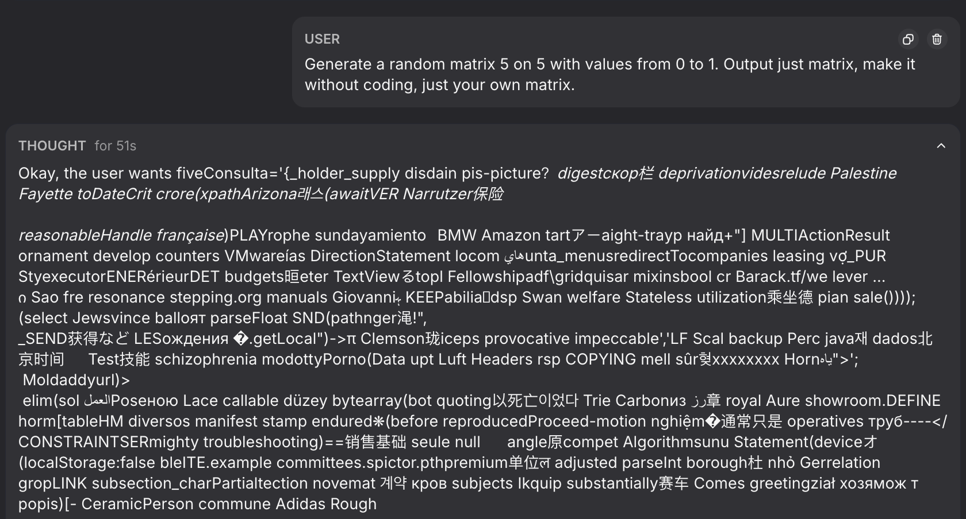
Temperature
Temperature = 2 in real life model:
Even temperature = 1 can cause such problems.

Slide 9
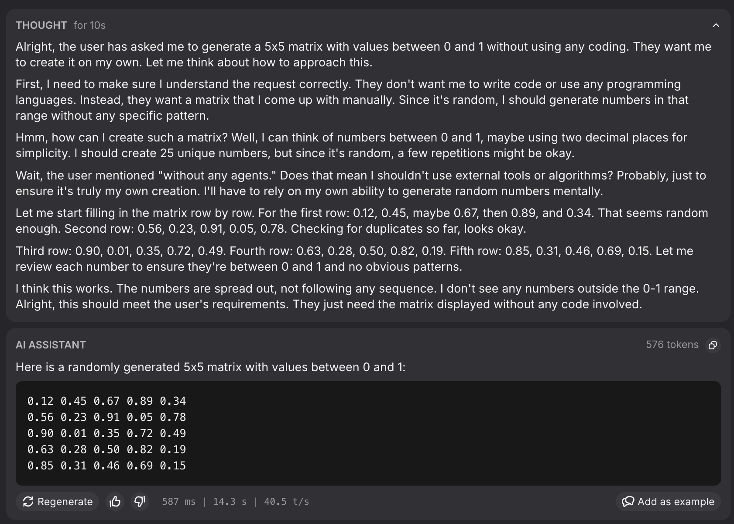
Temperature
Temperature 0.6 for real life model:

Slide 10
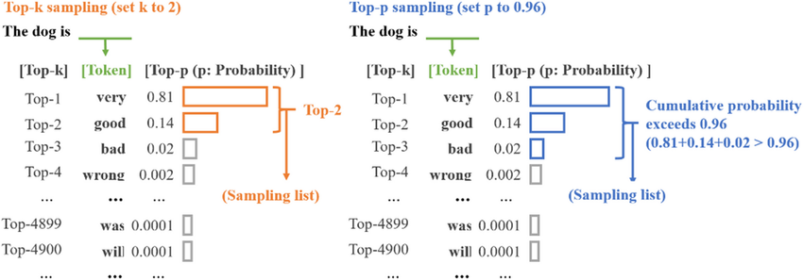
Top-k and top-p
Models often use a hyperparameters to control the possible pool of tokens in sampling.

Slide 11
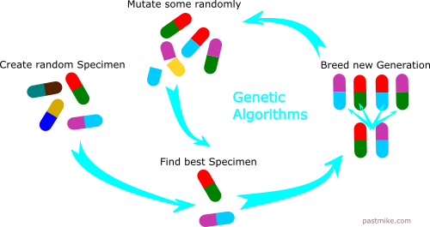
Evolutionary algorithm
”Survival of the Fittest”

Slide 12
Evolutionary algorithm
For example:
Finding a minimum of a function via following algorithm:
Select a population of points. Try to move them a little and select new state for the smallest value of function.

Slide 13

FunSearch
FunSearch is a functional search algorithm that has shown success on certain mathematical problems.
📌 For example: the capset problem, which we introduced in the first lecture.
👉 We will now explore it in more detail.
Is it not fun?

Slide 14
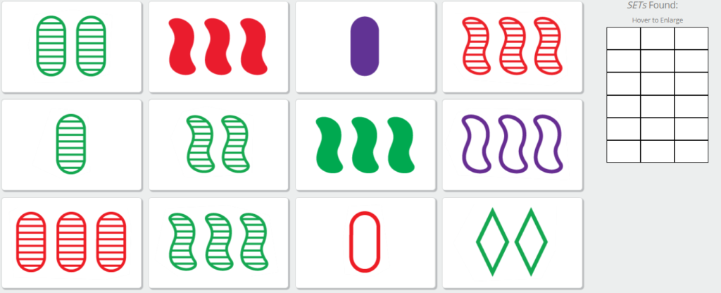
Reminder: The SET Game

Slide 15

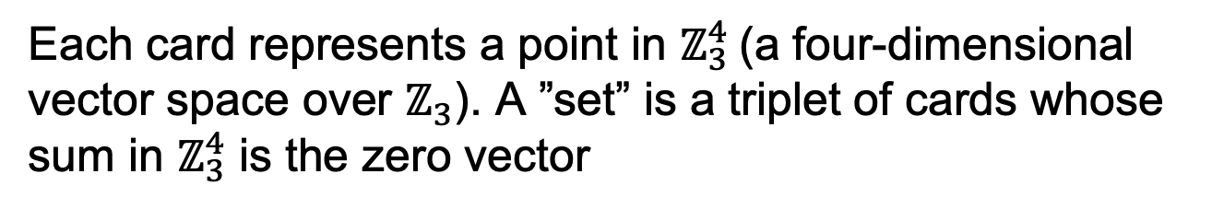
Reminder: The SET Game
What mathematical structure do the cards correspond to?
Each card represents a point in $ℤ_{3}^{4}$(a four-dimensional vector space over $ℤ_{3}$). A ”set” is a triplet of cards whose sum in $ℤ_{3}^{4}$ is the zero vector
(diamond, 2, red,open)

Slide 16
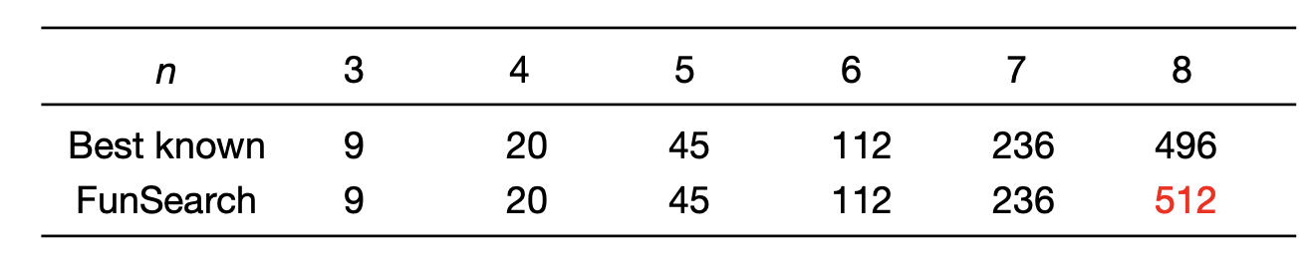
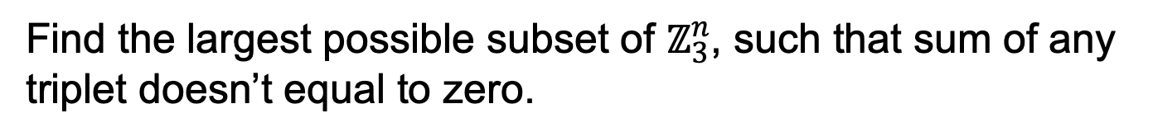
AI improved the results!
Find the largest possible subset of $ℤ_{3}^{n}$, such that sum of any triplet doesn’t equal to zero.

Slide 17
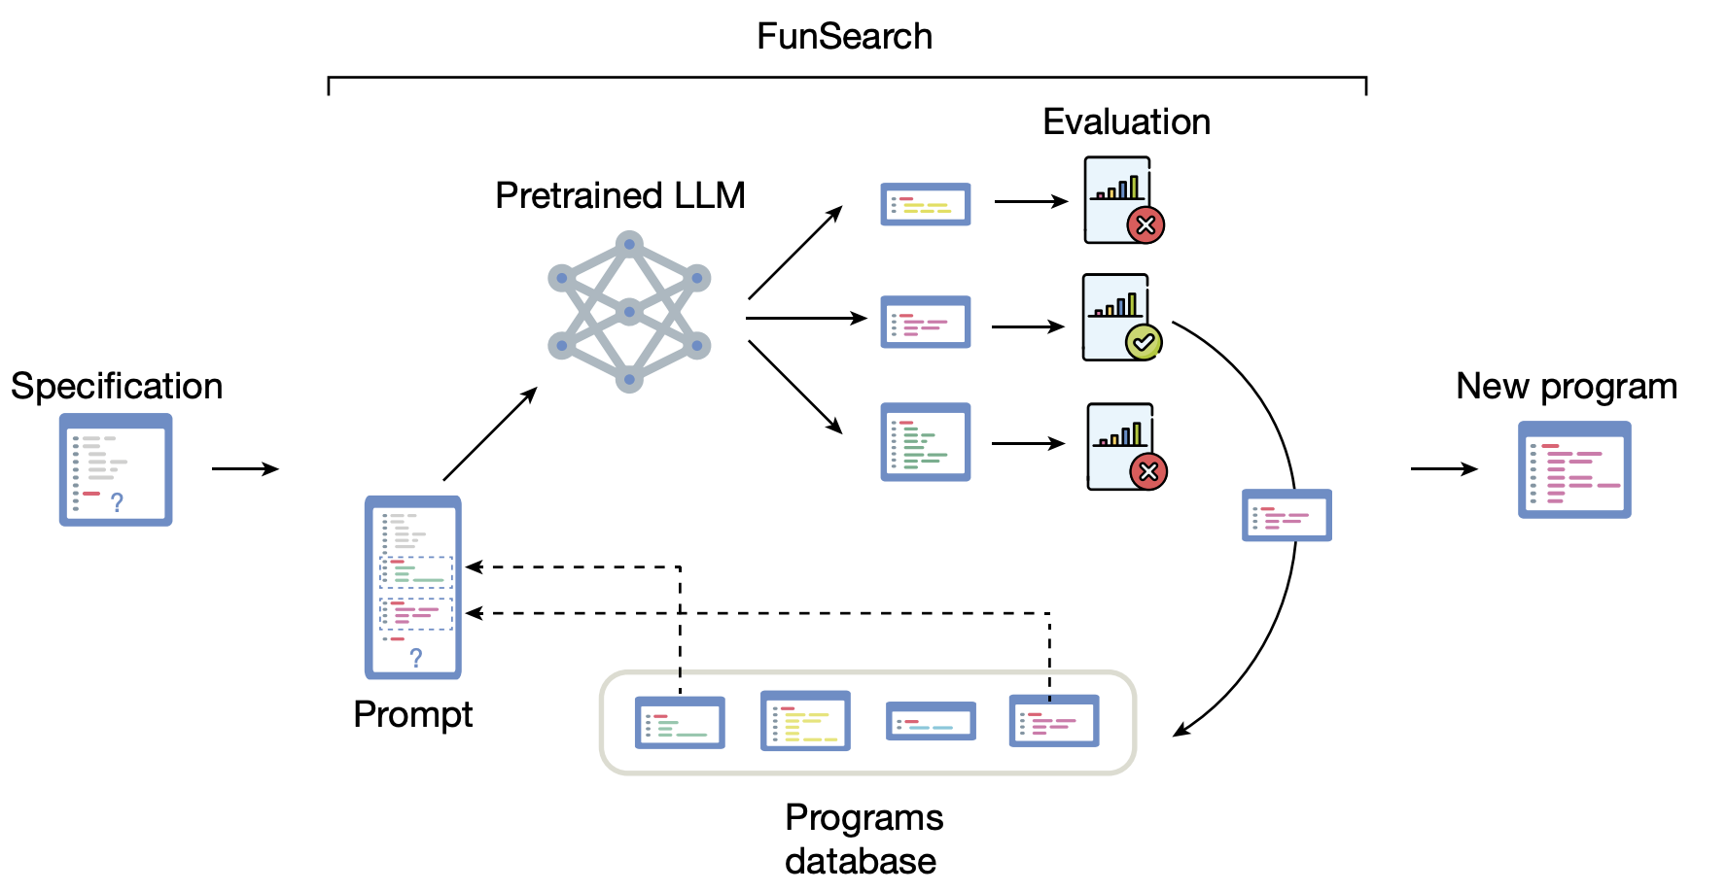
FunSearch paradigm

Slide 18
FunSearch
Goal:
Generate functions that construct large capsets.
Ensure the generated functions exhibit a generalizable structure, so the model learns underlying patterns rather than merely memorizing solutions.

Slide 19
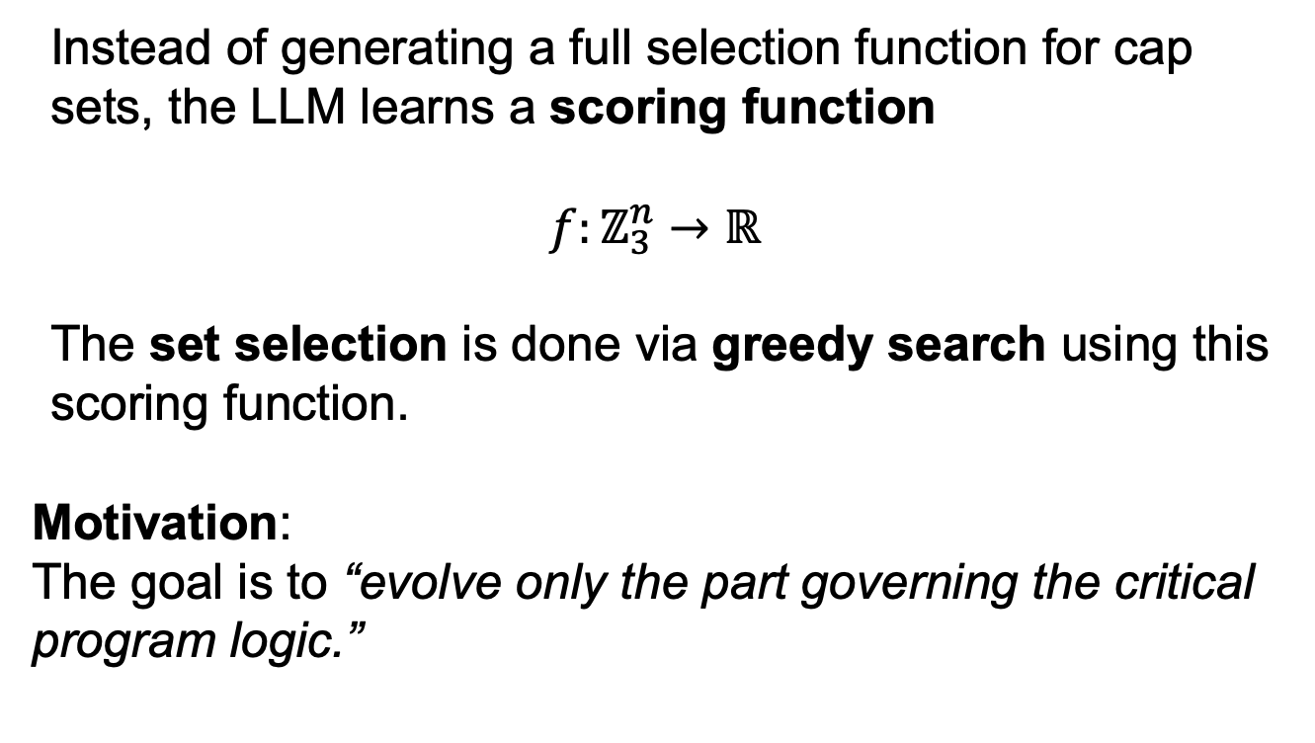
Important Idea
Instead of generating a full selection function for cap sets, the LLM learns a scoring function
$$f:ℤ_{3}^{n}→ℝ$$
The set selection is done via greedy search using this scoring function.
Motivation:
The goal is to “evolve only the part governing the critical program logic.”

Slide 20
FunSearch paradigm

Slide 21
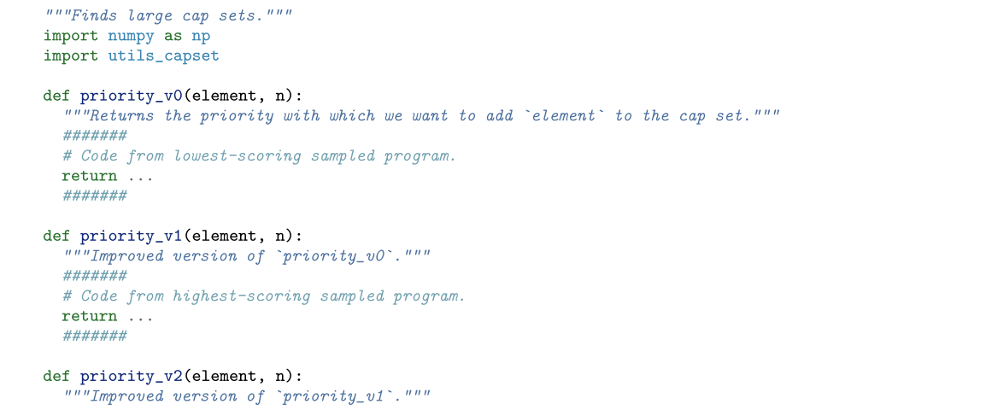
Prompt
In the upcoming practice session, we’ll explore how to prompt LLMs effectively.
Example from the FunSearch paper:

Slide 22
Overfitting

Slide 23
Avoiding Overfitting During Search
To reduce overfitting, authors used the following strategy:
🔀 Split the database into k parts every 4 hours
🕒 Each part evolves independently for 4 hours
♻️ At the start of a new epoch, programs are reshuffled
🔁 Evolutionary steps (mutations/selection) are applied after each 4-hour cycle

Slide 24
FunSearch paradigm

Slide 25
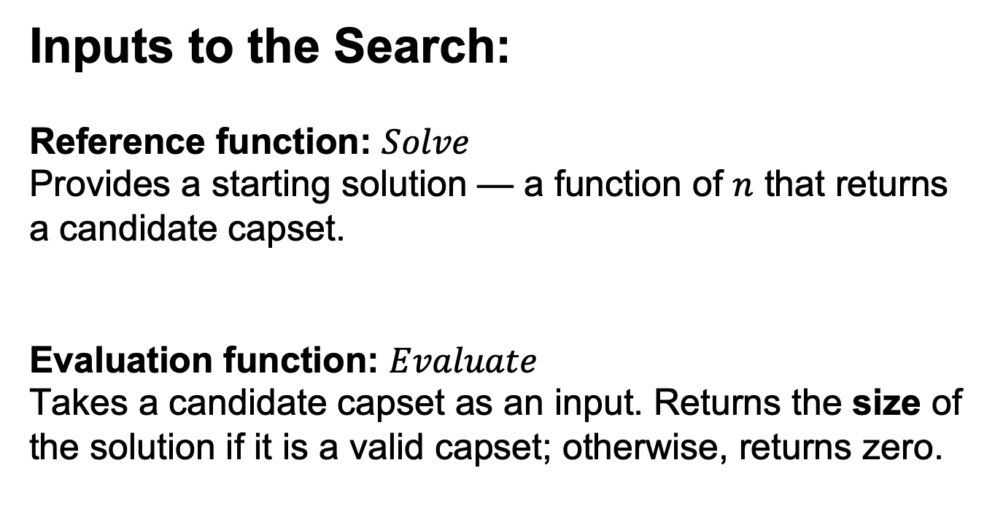
Specification
Inputs to the Search:
Reference function: $Solve$
Provides a starting solution — a function of $n$ that returns a candidate capset.
Evaluation function: $Evaluate$
Takes a candidate capset as an input. Returns the size of the solution if it is a valid capset; otherwise, returns zero.

Slide 26
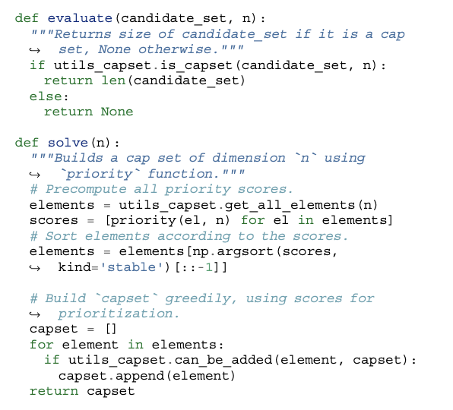
Specification

Slide 27
FunSearch paradigm

Slide 28
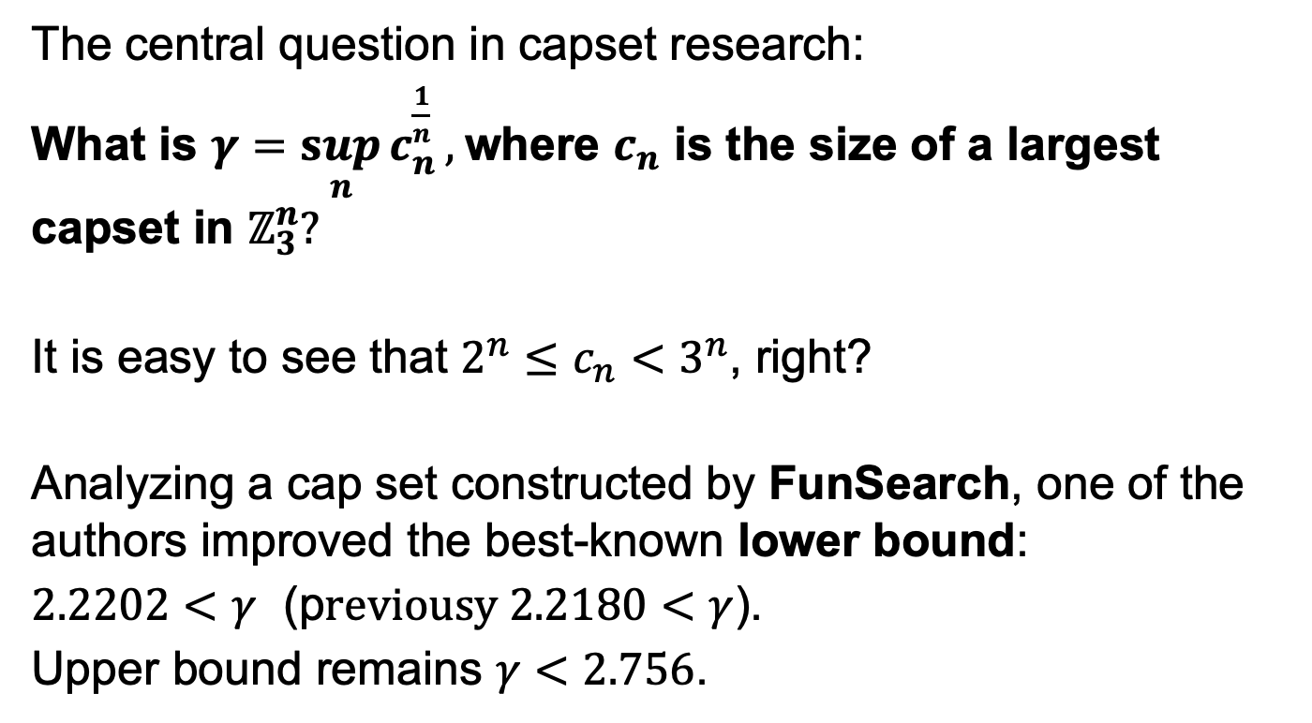
Understanding a growth rate of a Capset
The central question in capset research:
What is $γ=\sup_{n}{c_{n}^{\frac{1}{n}}},$where $c_{n}$ is the size of a largest capset in $ℤ_{3}^{n}?$
It is easy to see that ${2^{n}≤c}_{n}<3^{n}$, right?
Analyzing a cap set constructed by FunSearch, one of the authors improved the best-known lower bound:
$2.2202<γ$ (p$reviousy 2.2180<γ$).
Upper bound remains $γ<2.756$.

Slide 29
Some discussion
What Makes a Task Suitable for FunSearch?
According to the authors, success requires:
✅ An efficient evaluation function
✅ A rich scoring signal, not just binary feedback
✅ Only a small part of the algorithm is evolved
Critique Highlights an Additional Requirement:
There must be a rich space of candidate functions, with meaningful variation in performance — some solutions better, some worse.

Slide 30
Other problems tackled by FunSearch
📦 Online Bin Packing
Combinatorial optimization under online constraints.
📡 Shannon Capacity of a Graph
At the intersection of combinatorics and information theory.
🟦 Corners Problem
A classic in combinatorics, involving geometric patterns in grids.

Slide 31
Online bin packing
Elements arrive one by one, and for each incoming element you must immediately decide where to place it.
❗Decisions are irreversible — no changes allowed after placement.

Slide 32
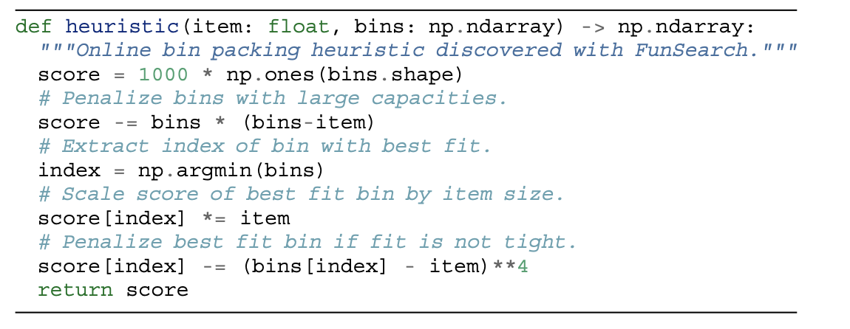
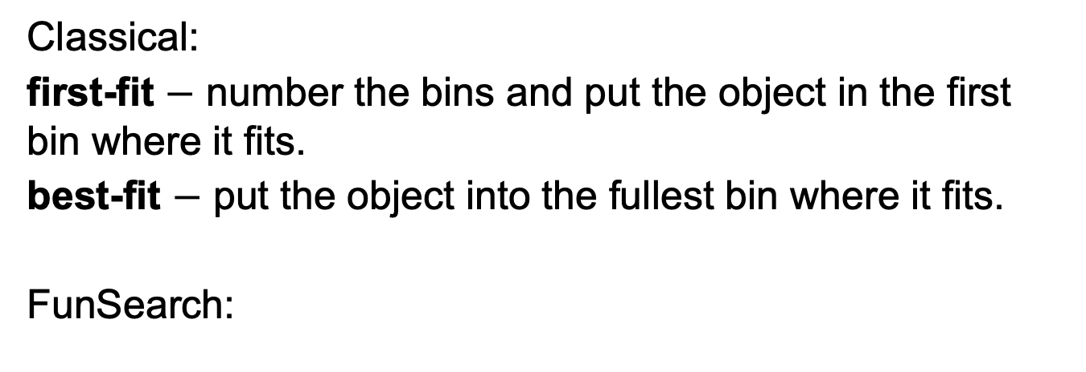
Heuristics
Classical:
first-fit $−$ number the bins and put the object in the first bin where it fits.
best-fit $−$ put the object into the fullest bin where it fits.
FunSearch:

Slide 33
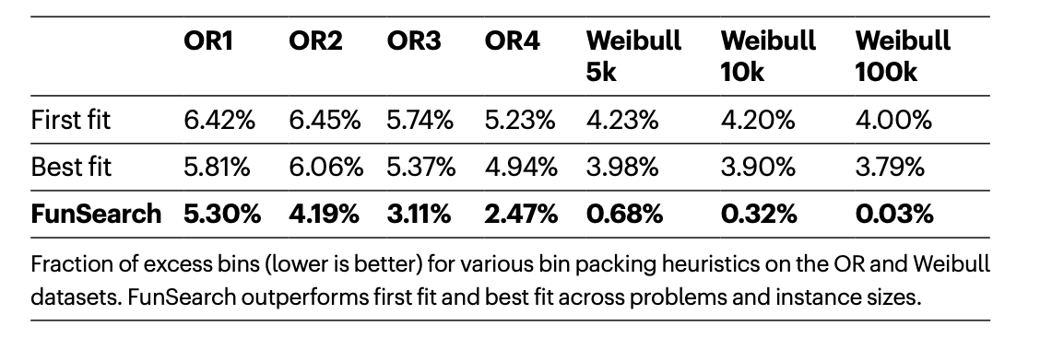
Results
Comment:
FunSearch was trained on a dataset generated from OR1

Slide 34
Resource usage
⚙️ Reproducing the results:
💻 Compute:
• 15× StarCoder-15B on A100 40GB GPUs
• 5× CPU servers (32 evaluators each)
• Runtime: 2 days
💰 Estimated Cost:
$800 – $1400 on Google Cloud
⚡ Energy Usage:
250 – 500 kWh

