Slide 1


CAPSTONE PROJECT · A TEAM
Komunitas
Find activities. Meet people. Build community.
The whole project: aim, how to use it, how it's built, where data lives, and what we delivered.
komunitasa.vercel.app · Universitas Terbuka · September 2026
Notes:
Welcome. We're A Team, and this is Komunitas, our capstone project. This deck covers the whole project from the bottom up: why we built it, how people use it, how it's built, where the data is stored, and what we ended up delivering.

Slide 2

AGENDA
What this deck covers
01
Aim & goals
The problem and what we set out to do
02
How to use it
Participants, organizers and admins
03
How it's built
Architecture, stack and delivery pipeline
04
Data stores
Where every piece of data lives, and how it's protected
05
End results
What we shipped, by the numbers, and what's next
Komunitas · Capstone Project · A Team
2 / 24
Notes:
Five parts: aim and goals, how to use the app, how it's built, where the data lives, and the end results.

Slide 3
01
Aim & goals
Why Komunitas exists
Notes:
Part one: why we built Komunitas.

Slide 4




THE PROBLEM
Local activities are hard to find and hard to run
Scattered
Runs, book clubs and games are announced in private WhatsApp groups and social posts. If you're not in the group, you never hear about them.
Hard to join
OUR AIM
Newcomers don't know who to ask, whether there's room, or whether it's even open to them.
One place to discover, create and join social activities near you, based on your interests and location, while keeping your exact location private.
Manual work
Organizers track sign-ups, capacity and contact numbers by hand, in chats and spreadsheets.
Komunitas · Capstone Project · A Team
4 / 24
Notes:
Today, local activities live in closed WhatsApp groups and scattered posts. Newcomers can't find them, and organizers do everything by hand. Our aim is one place to discover, create and join activities nearby, based on your interests and location, without ever storing your exact position.

Slide 5
GOALS
Five goals the product had to meet
20 km
1 tap
4 ways
0
EN · ID
Nearby first
Easy to join
Easy to share
GPS stored
Bilingual
The dashboard shows open activities within 20 km of you, matched to your hobbies.
Join open activities instantly, or request a spot when the organizer approves joiners.
Invite link, WhatsApp, QR code and a ready-made flyer for every activity.
Your live location is used in the moment only and never saved to the database.
Every screen in English and Bahasa Indonesia, switchable at any time.
Komunitas · Capstone Project · A Team
5 / 24
Notes:
We turned the aim into five concrete goals: nearby-first discovery within 20 kilometres, joining in one tap, four ways to share, zero stored GPS positions, and full English and Indonesian support.

Slide 6
02
How to use it
For participants, organizers and admins
Notes:
Part two: how people actually use Komunitas.

Slide 7
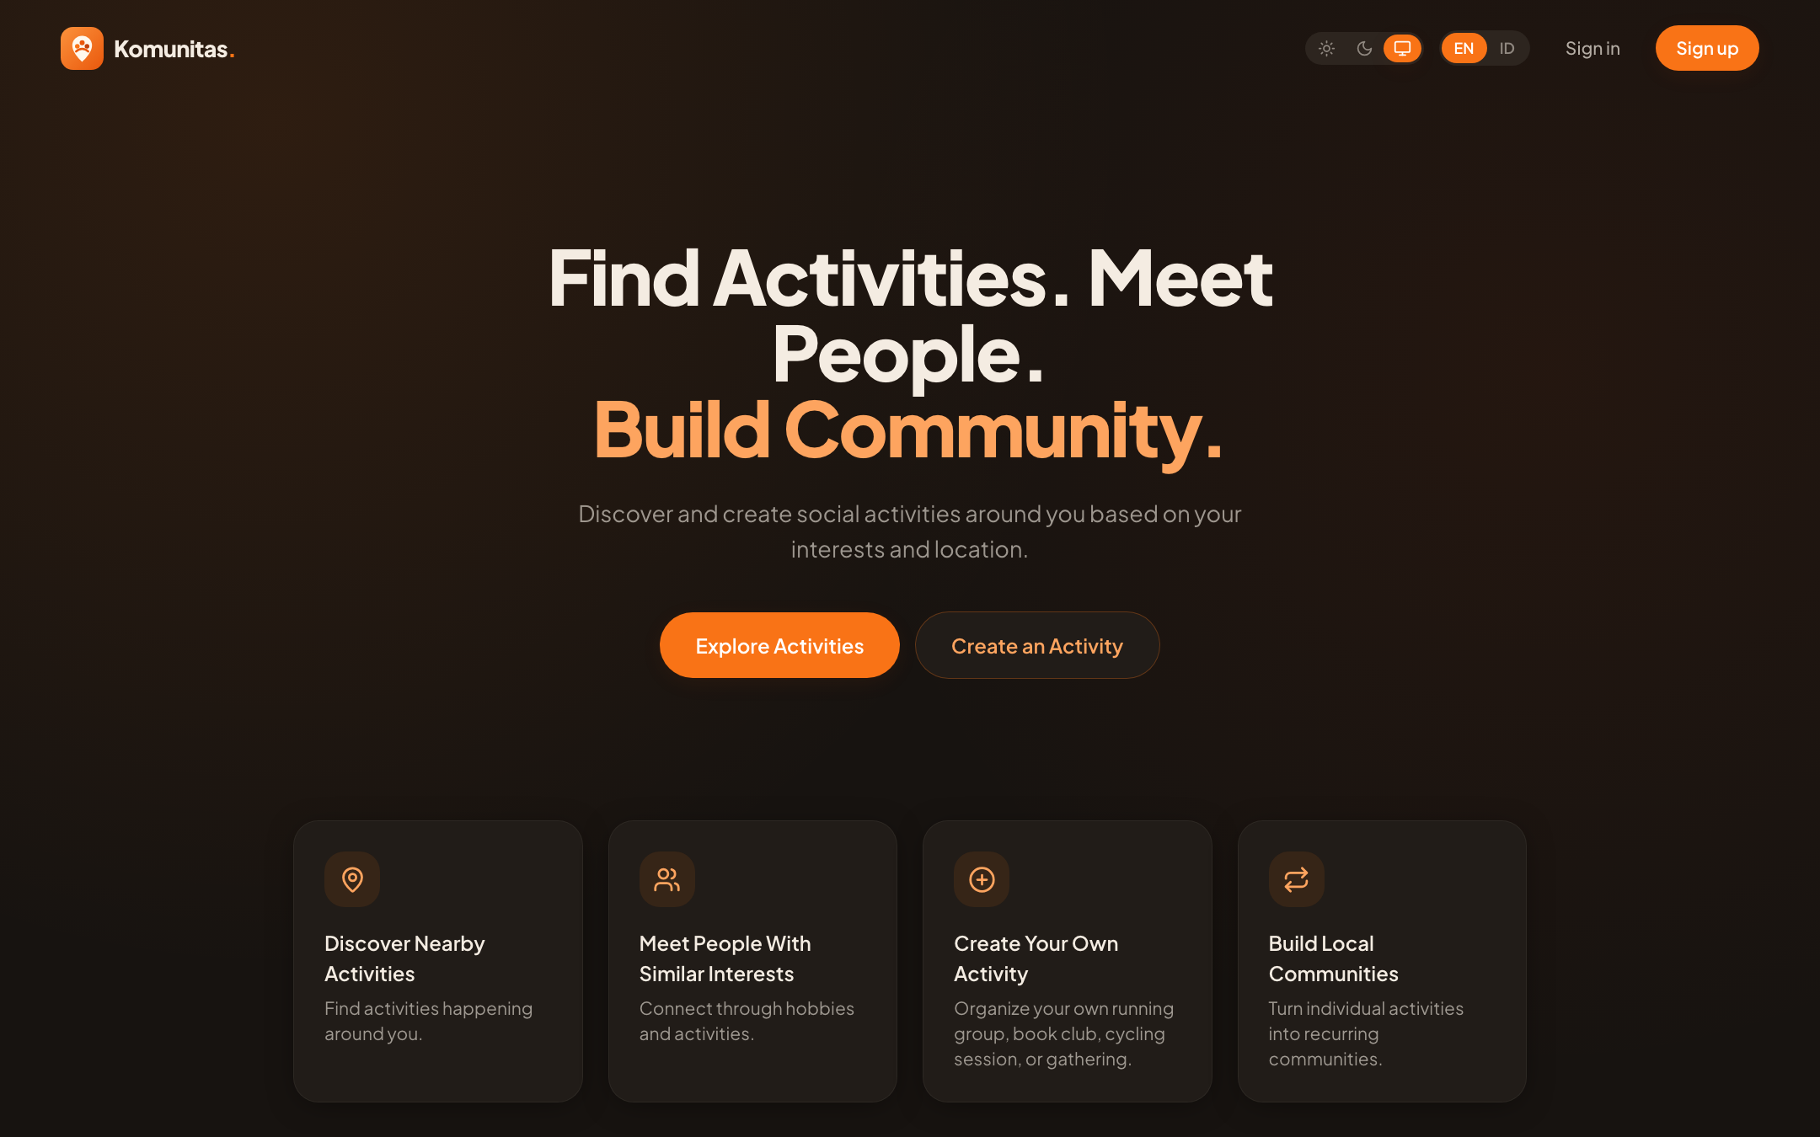




MEET THE APP
A mobile-first web app, no install needed
Works in any browser
Phone first, with a bottom nav on mobile and a sidebar on desktop.
Light, dark or system
Warm orange and cream design, Plus Jakarta Sans.
English / Indonesian
Switch language from the header on any page.
Always up to date
Live at komunitasa.vercel.app, updated on every release.
Komunitas · Capstone Project · A Team
7 / 24
Notes:
This is the live landing page. Komunitas is a web app, so there's nothing to install. It's designed for phones first, has light and dark themes, and every screen is available in English and Indonesian.

Slide 8





WHO USES IT
Five roles, each with clear permissions
Participant
Organizer
Moderator
Admin
Super admin
Discovers, joins, comments and messages. Every new member starts here.
Any participant who creates an activity: edits it, approves joiners, shares it, makes flyers.
Handles complaints and reported comments or messages.
Also manages users, events, categories, settings and data exports.
Also changes roles and anonymizes users. Every admin action is audited.
Komunitas · Capstone Project · A Team
8 / 24
Notes:
There are five roles. Participants and organizers are the same people: anyone who creates an activity becomes its organizer. Moderators, admins and super admins work in the admin area, with more power at each level. Permissions are enforced in the database, not only in the screens.

Slide 9






HOW TO USE · PARTICIPANTS
From sign-up to showing up in five steps
01
02
03
04
05
Sign up
Pick hobbies
Find nearby
Join
Meet up
Email, password and a 6-digit code sent by email. Then set a 6-digit PIN for quick sign-in.
Choose interests such as running, reading, cycling, badminton or basketball.
Use live GPS or pick your area. The dashboard lists activities within 20 km.
Join in one tap, or request a spot. Get notified when you're approved.
Ask questions in comments, message people privately, and add friends.
Komunitas · Capstone Project · A Team
9 / 24
Notes:
A participant signs up with email, a password and an emailed code, then sets a PIN for quick sign-in. They choose hobbies, then share their location or pick their area to see activities within 20 kilometres. They join in one tap or request a spot, and then use comments, private messages and friends to connect.

Slide 10




HOW TO USE · ORGANIZERS
Create, share and run an activity
Create
Set the rules
Share
Manage
Title, category, date and time, fee, capacity, and a pin on the map. Upload and crop a banner.
Public or private. Open joining, or approval required. Add a contact person and WhatsApp.
Invite link, WhatsApp, QR code, or a flyer in 9:16, 1:1 or 16:9 as PNG or JPG.
Approve or decline requests, answer comments, edit details, or cancel.
The status updates itself as people join and time passes:
Open
Almost full
Full
Ongoing
Completed
(or Cancelled)
Komunitas · Capstone Project · A Team
10 / 24
Notes:
Organizers fill in the activity details, drop a pin on the map and crop a banner. They choose whether it's public or private and whether joiners need approval. Then they share it by link, WhatsApp, QR code or a generated flyer, and manage requests and comments. The status moves from open to almost full, full, ongoing and completed by itself.

Slide 11







EVERYTHING IN THE APP
Feature map
Nearby dashboard
Explore & search
My activities
Activities within 20 km, matched to your hobbies
Any distance; search by name, place or event code
What you organize and join, with check-in and ratings
Share & invite
Comments
Private messages
Link, WhatsApp, QR code and flyer generator
Questions and replies on each activity, with reporting
Realtime 1:1 chat, mute, archive and block
Community
Notifications
Help & support
Profiles, friends, groups, and which friends are going
Reminders, alerts and approvals, by email and push
Complaint tickets with attachments, emailed to admins
Komunitas · Capstone Project · A Team
11 / 24
Notes:
Here's everything in the app on one slide: the nearby dashboard, explore and search, my activities with check-in and ratings, sharing, comments, private messages, community profiles, friends and groups, notifications by email and phone push, and help and support tickets.

Slide 12
03
How it's built
Architecture, stack and delivery
Notes:
Part three: how it's built.

Slide 13





ARCHITECTURE
Three layers, with security in the database
Browser
Vercel · Next.js 16
Supabase
React 19 pages and forms
Live GPS read on the device
Leaflet maps (OpenStreetMap)
Flyer and chart images drawn here
Server-rendered pages (App Router)
5 API routes: PIN sign-in, PIN recovery, alert emails
Login check on every request
Secrets kept server-side
Postgres + row-level security
Auth: accounts, sessions, email codes
Storage: banners, attachments
Realtime: live messages
HTTPS
SQL · RPC
OpenStreetMap
SMTP email
GitHub
Map tiles and area lookup
Sign-in codes, complaint alerts
Code, history, triggers deploys
Komunitas · Capstone Project · A Team
13 / 24
Notes:
The app has three layers. The browser runs the React interface, reads GPS on the device and draws maps and images. Vercel runs Next.js: it renders pages on the server, checks the login on every request, and hosts five small API routes. Supabase holds the database, sign-in, file storage and realtime messaging. Around it we use OpenStreetMap for maps, an SMTP service for emails, and GitHub for the code.

Slide 14




TECH STACK
Modern, free-tier friendly tools
Next.js 16 · React 19 · TypeScript
Tailwind CSS 3
App Router, server components; one typed codebase for pages and API routes.
Design tokens for the Orange/Cream palette, light and dark themes.
Supabase
Leaflet + OpenStreetMap
Postgres, Auth, Storage, Realtime. Rules live in SQL: RLS and security-definer functions.
Maps and place lookup with no API key and no cost.
Recharts · ExcelJS · docx
qrcode.react · html-to-image
Admin charts, and Excel and Word exports built in the browser.
QR codes, and PNG/JPG export for charts and flyers.
Komunitas · Capstone Project · A Team
14 / 24
Notes:
The stack: Next.js 16 with React 19 and TypeScript, Tailwind for styling, Supabase for the backend, Leaflet and OpenStreetMap for maps, Recharts and ExcelJS for admin reports, and qrcode.react plus html-to-image for QR codes and flyers.

Slide 15





HOW WE BUILD & SHIP
Every change is checked before it goes live
Code locally
Check
Push to main
Auto-deploy
Live
npm run dev at localhost:3000
Lint (0 errors), type check, production build
GitHub: NebsPutra/Capstone-Dummy
Vercel builds and publishes in about a minute
Everyone gets the new version
Database changes follow their own path
Each change is a numbered SQL file (schema.sql, then migrations 002 to 010). Every file is safe to run twice, and a team member runs it by hand, in order, in the Supabase SQL Editor. Secrets live only in Vercel and on the developer's machine, never in GitHub.
Komunitas · Capstone Project · A Team
15 / 24
Notes:
We code locally, then run three checks: lint, type check and a full production build. Pushing to the main branch on GitHub makes Vercel build and publish automatically, so a push is a release. Database changes are separate: numbered SQL migrations, each safe to re-run, applied by hand in the Supabase SQL editor.

Slide 16
04
Data stores
Where data lives and how it's protected
Notes:
Part four: the data.

Slide 17




DATA STORES
Five places data lives
Supabase Postgres
Supabase Auth
Supabase Storage
The user's device
Vercel environment
41 tables · 2 views
Accounts & sessions
2 file buckets
Cookie & browser
Server secrets
Profiles, activities, participants, comments, messages, complaints, notifications, audit log. Row-level security on every table.
Email and password, 6-digit email codes, sessions. The sign-in PIN is stored separately, bcrypt-hashed.
event-banners (public images) and complaint-attachments (private, staff and reporter only).
Language choice and the chosen area or GPS preference. Live GPS stays on the device.
Service-role key, SMTP password and the push-notification key. Server-only, never sent to browsers or committed.
Komunitas · Capstone Project · A Team
17 / 24
Notes:
Data lives in five places. The main one is the Supabase Postgres database with 41 tables, all protected by row-level security. Supabase Auth holds accounts and sessions. Supabase Storage holds banner images and complaint attachments. The user's own device keeps their language and location preference; live GPS never leaves it. And Vercel holds the few server secrets.

Slide 18



DATA MODEL
41 tables in five groups
People
Activities
Groups & chat
Support
Admin & safety
10 tables
9 tables
8 tables
8 tables
6 tables
profiles
interests
user_interests
user_pins
privacy_settings
social_links
friendships
user_blocks
username_history
reserved_usernames
events
categories
event_participants
event_contacts
event_waitlist
event_checkin_codes
event_ratings
event_comments
comment_reports
groups
group_members
play_requests
play_request_interests
conversations
conversation_members
messages
message_reports
complaints
complaint_messages
complaint_attachments
complaint_status_history
notifications
notification_prefs
push_subscriptions
calendar_tokens
audit_logs
security_events
admin_events
platform_settings
saved_views
export_jobs
Komunitas · Capstone Project · A Team
18 / 24
Notes:
The 41 tables fall into five groups: people and their settings, activities with participation, waiting lists, check-in and ratings, groups and private messaging, support and notifications, and admin and safety records such as the audit log. Views like my_profile expose only what each user is allowed to see.

Slide 19






SECURITY & PRIVACY
Rules enforced in the database, not just the screens
Row-level security everywhere
Location privacy
All 41 tables have RLS. 190+ SQL functions check roles before acting.
Live GPS is used per request and never stored. Profiles keep only an area's centre.
PIN sign-in
Private profile data
bcrypt-hashed, 15-minute lockout after failed tries, and throttling per network.
Full name, WhatsApp, age and exact area can't be read by other members.
Audit trail
Community safety
Every admin change goes into an append-only audit log; security events are recorded.
Report comments and messages, block users, and file complaints to staff.
Komunitas · Capstone Project · A Team
19 / 24
Notes:
Security is enforced in the database. Every table has row-level security, and over 190 SQL functions check the caller's role. GPS is never stored. PINs are hashed with bcrypt and lock after repeated failures. Other members can't read private profile fields. Admin actions are written to an audit log, and members can report, block and file complaints.

Slide 20
05
End results
What we delivered, and what's next
Notes:
Part five: the results.

Slide 21
END RESULTS
What we delivered
52
74
25.6k
screens
UI components
lines of TypeScript
Member app, admin and sign-in
Shared building blocks
Across 194 source files, 43 unit tests
5.9k
41
1,700+
lines of SQL
database tables
strings × 2 languages
Schema plus 26 migrations
All with row-level security
English and Bahasa Indonesia
Komunitas · Capstone Project · A Team
21 / 24
Notes:
By the numbers: 52 screens, 74 shared components, about 25,600 lines of TypeScript with 43 unit tests, 5,900 lines of SQL across 26 migrations, 41 database tables all protected by row-level security, and more than 1,700 interface strings in both English and Indonesian.

Slide 22




END RESULTS · LATEST
Newest features
Waiting list & alerts
Full activities keep a waiting list that moves up by itself. Alerts for new activities in your hobbies and groups.
Check-in & ratings
Organizers show a QR code at the venue; people who came rate the activity, which builds the organizer's score.
Reminders & push
A reminder the day before and a "How was it?" prompt after, by email and phone notification.
Try it now
Organizer tools
komunitasa.vercel.app
Duplicate, edit a weekly series at once, export to CSV, a big-screen QR, friends going and a calendar feed.
Komunitas · Capstone Project · A Team
22 / 24
Notes:
The newest features: full activities keep a waiting list that moves up automatically, and people get alerts for new activities that match their hobbies. Organizers can check people in with a QR code, and attendees rate the activity afterwards. Reminders and rating prompts go out by email and phone push. And organizers get time-savers: duplicate, edit a whole weekly series, CSV export and a big-screen QR so a room can join live. Scan this code to try it now.

Slide 23
WHAT'S NEXT
Known gaps and next steps
1
Stronger second factor
2
Scheduled reports
Move the email-code step into a server-side login endpoint, or use Supabase MFA.
The scheduler now runs reminders; weekly admin emails can build on it.
3
Payments
4
Full account deletion
Paid activities are settled outside the app today; in-app payment comes later.
Anonymizing works today; removing the login needs a server-side step.
5
Big exports
6
Group chat & photos
Exports run in the browser and cap at 10,000 rows per dataset.
A chat per activity and shared photo albums after it.
Komunitas · Capstone Project · A Team
23 / 24
Notes:
We're open about what's left: a stronger second sign-in factor, scheduled admin reports, in-app payments, full account deletion, larger exports, and a group chat and photo albums per activity.

Slide 24
Thank you
Find activities. Meet people. Build community.
komunitasa.vercel.app
A Team · Capstone Project · Universitas Terbuka
Notes:
Thank you from A Team. We're happy to take questions, and please try Komunitas on your phone.

