Slide 1


CAPSTONE PROJECT
A Team
Komunitas: our community activity platform is set up, secured and live.
komunitasa.vercel.app · 28 September 2026
Notes:
Welcome. We're A Team, and this is our capstone project, Komunitas. This short deck covers how we set up our new workspace, secured and checked the app, and put the latest version live.

Slide 2







MEET KOMUNITAS
Find, create and join local activities
Komunitas helps people discover social activities happening near them, or start their own.
Browse what's on within 20 km, join in one tap, and share events by link, WhatsApp or QR code.
Your exact location is used only in the moment. It is never stored.
Running
Reading
Cycling
Badminton
Basketball
Gatherings
Capstone Project · A Team
2
Notes:
Komunitas is a mobile-first web app for local social activities: running, reading, cycling, badminton, basketball and community gatherings. Location privacy is built in; live GPS is only used at request time.

Slide 3





THE UPDATE AT A GLANCE
Four steps from a new laptop to a live site
01
02
03
04
Set up
Secured
Checked
Live
A fresh workspace, connected to GitHub and Vercel.
Latest Next.js with its security fixes applied.
Code checks, type checks and a full build, all passing.
Redeployed to production on 28 September 2026.
Capstone Project · A Team
3
Notes:
The whole update in four steps. We'll go through each one briefly.

Slide 4




01 · SET UP
A new device, ready to build in one session
Git + GitHub
Full project history on the new laptop, signed in and in sync with our GitHub repository.
4
Node.js 24 (LTS)
The runtime that builds and runs the app locally, installed from the official release.
Vercel
tools connected
Linked to the live project, with its settings pulled down securely.
From an empty laptop to a working copy of the live app, checked end to end.
Private keys
Stored only on this machine and on Vercel. Never committed to GitHub.
Capstone Project · A Team
4
Notes:
On the new device we installed Git and Node.js, connected GitHub and Vercel, and pulled the project's settings securely. Secret keys stay on this machine and on Vercel only.

Slide 5
02 · SECURED · 03 · CHECKED
Safer and verified before release
16.3.6
0
0
100%
Next.js version
critical or high issues
code-check errors
of pages built
Upgraded from 16.2.6 to pick up the latest security fixes.
All serious dependency warnings resolved.
Linting restored and its two real issues fixed.
Full production build tested before going live.
Capstone Project · A Team
5
Notes:
We upgraded Next.js from 16.2.6 to 16.3.6, which cleared the critical and high security warnings. Two moderate warnings remain inside a spreadsheet library and don't affect how we use it. We also restored code checks, which the framework upgrade had broken, and fixed the two real errors they found. Then we built and tested the full site before deploying.

Slide 6
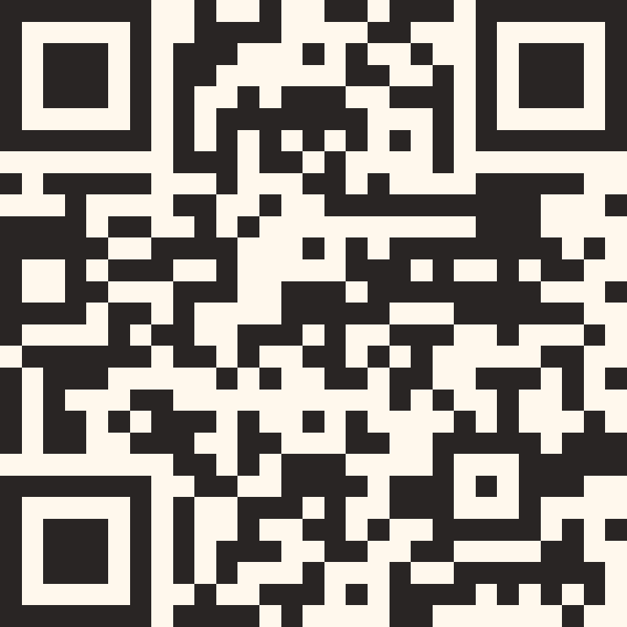
04 · LIVE
The latest version is live now
Ready · Production · 28 Sep 2026
Visit
komunitasa.vercel.app
Sign up with your email, pick your hobbies, and see what's happening near you.
Every new change now goes through the same checks before it reaches the live site.
Scan to open the app
Capstone Project · A Team
6
Notes:
The new version is live on komunitasa.vercel.app. Scan the QR code to try it on your phone.

Slide 7
Ready for what's next
Thank you from A Team
komunitasa.vercel.app
Notes:
Thank you. Questions are welcome, and please give Komunitas a try.

