Slide 1
DATA ANALYSIS ON EXTENT OF AIR POLLUTION IN BANGALORE
Ravi Vats 1MS14CS100
Shikhar Srivastava 1MS14CS116
Vibha Karanth 1MS14CS136
Mipsa Patel 1MS14CS148

Slide 2
Objectives Met
Plot of levels of different pollutants versus idnum
To obtain linear and polynomial regression curve for CO₂ versus idnum.
Linear regression curves for other pollutants AN, CO, NH3.
Prediction of CO₂ level based on idnum value with respect to linear and polynomial regression, polynomial regression being better.
Prediction of different CO2 levels for a range of idnum values.

Slide 3
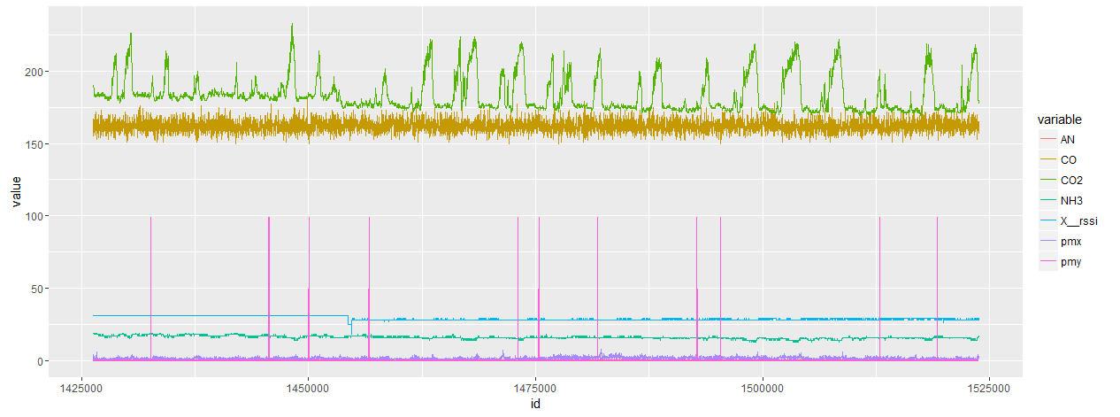
Plot of levels of different pollutants versus idnum

Slide 4
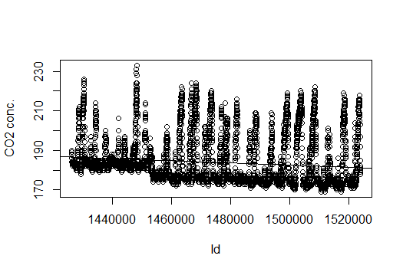
Linear Regression:CO₂ versus idnum

Slide 5
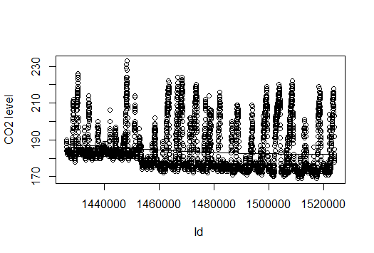
Polynomial Regression:CO₂ versus idnum

Slide 6
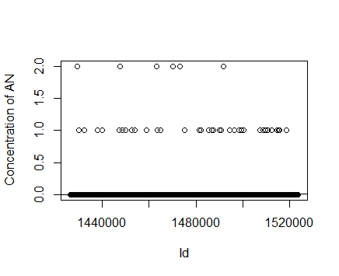
Linear Regression: AN versus idnum

Slide 7
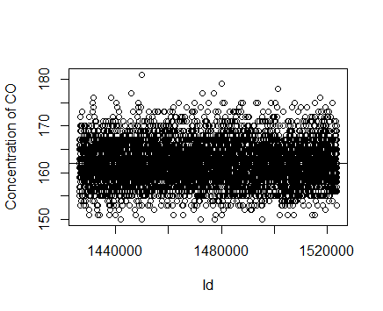
Linear Regression: CO versus idnum

Slide 8
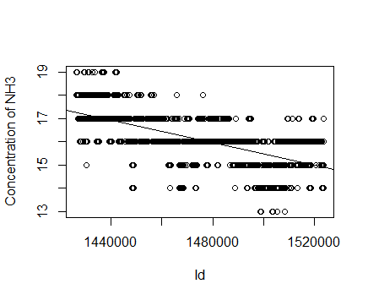
Linear Regression:NH₃ versus idnum

Slide 9
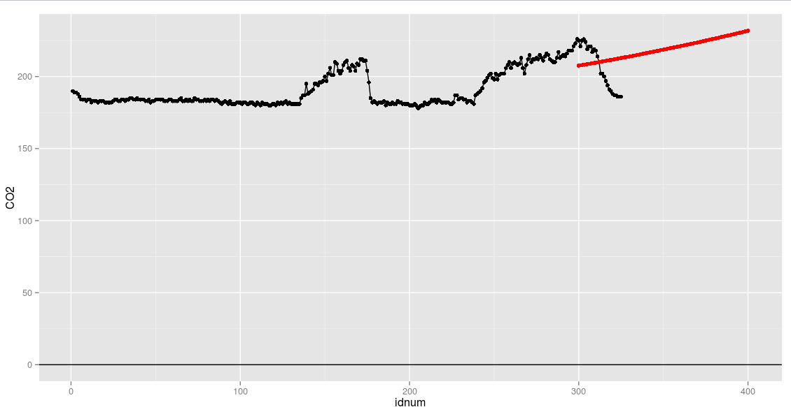
Prediction of CO₂ level based on idnum Range

Slide 10
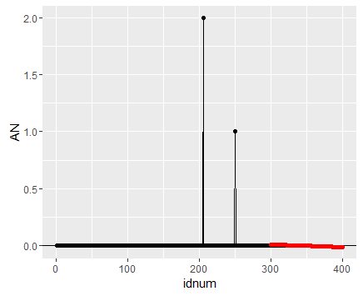
Prediction of AN level based on idnum Range

Slide 11
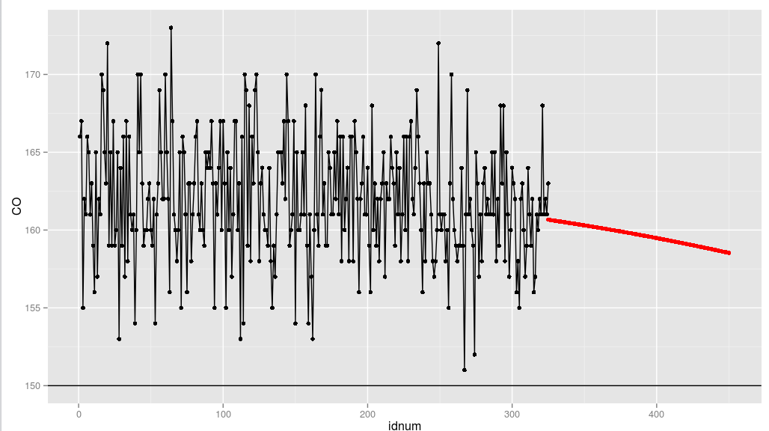
Prediction of CO level based on idnum Range

Slide 12
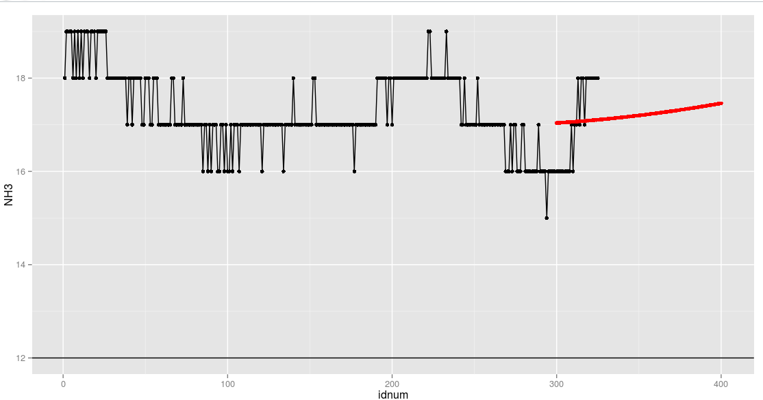
Prediction of NH₃ level based on idnum Range

Slide 13
Objectives to be met:
To obtain level of different pollutants and overall pollution of that area
Grade system that tells us overall pollution level for given idnum

Slide 14
THANK YOU

