Slide 1
PDM PROJECT
20 – SCHOOL MANAGEMENT SYSTEM

Slide 2
GROUP MEMBER
Trang Thanh Mai Duyen(leader) –ITITUN17007
Le Thanh – ITITIU17070
Tran Minh Ngoc – ITITIU17068

Slide 3
DATABASE

Slide 4
ENTITY-RELATIONAL DIAGRAM

Slide 5
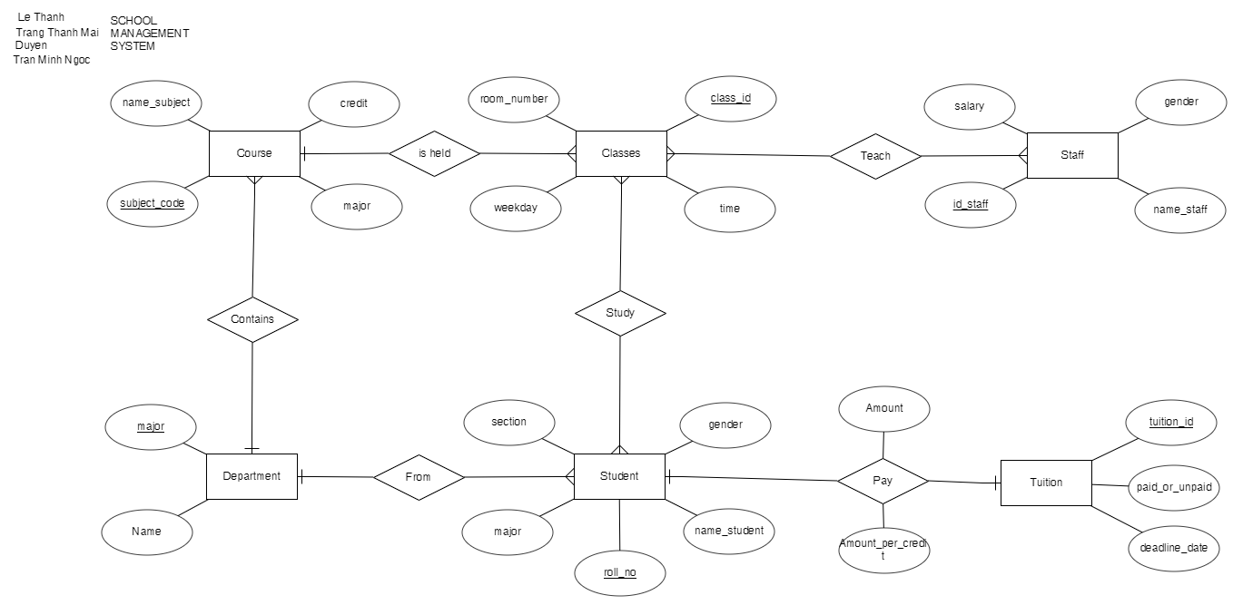

Slide 6
DATABASE DIAGRAM

Slide 7
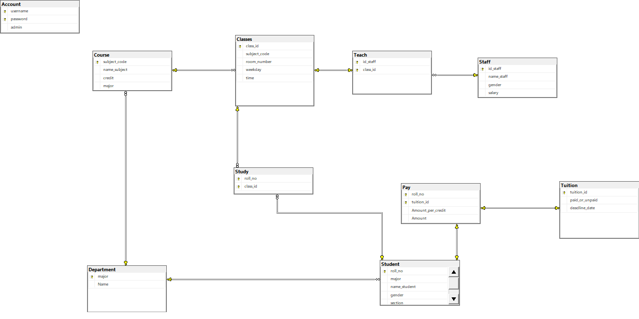

Slide 8
QUERY

Slide 9
SELECT

Slide 10
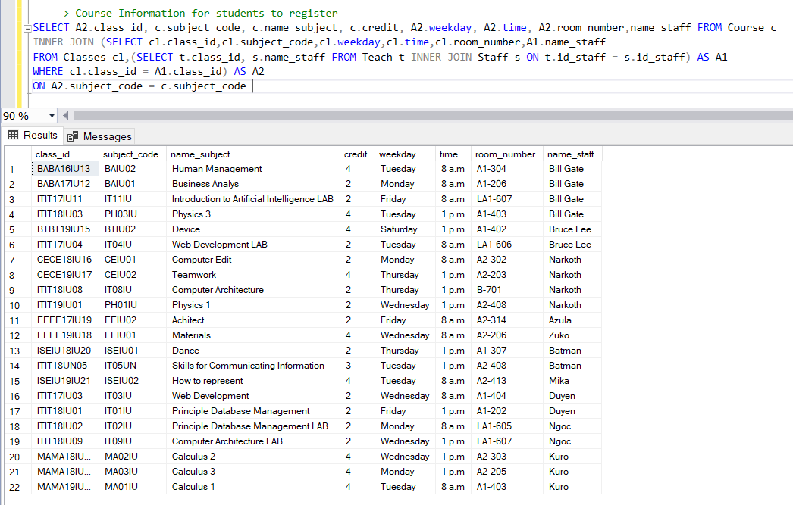

Slide 11
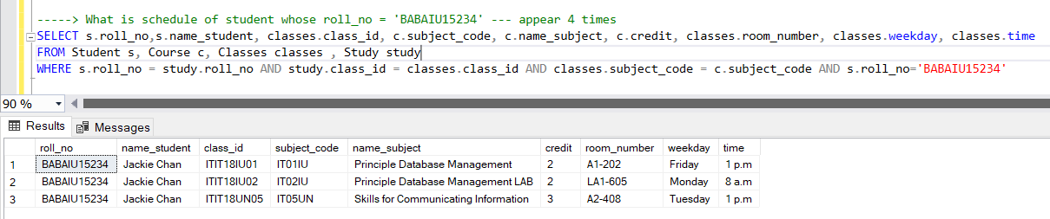

Slide 12
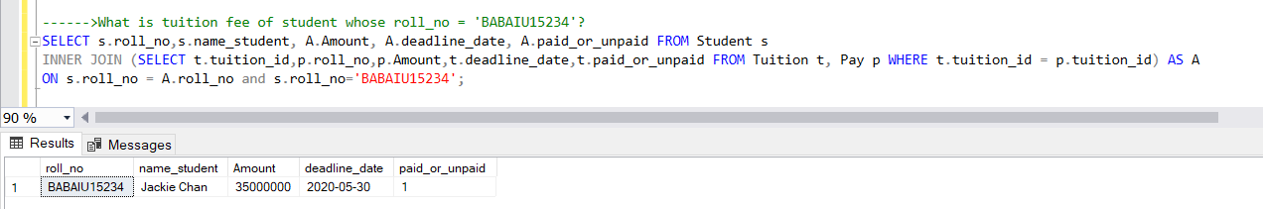

Slide 13
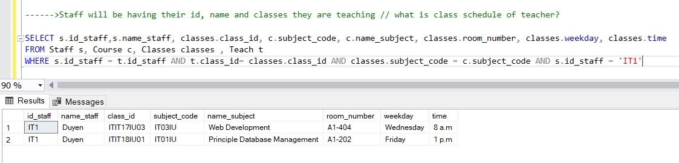

Slide 14
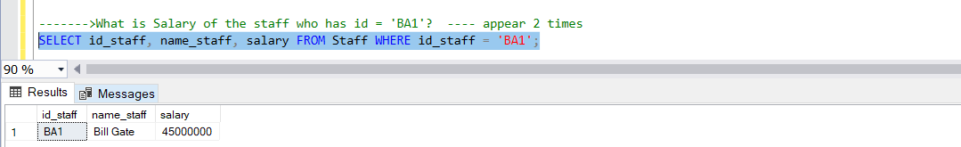

Slide 15
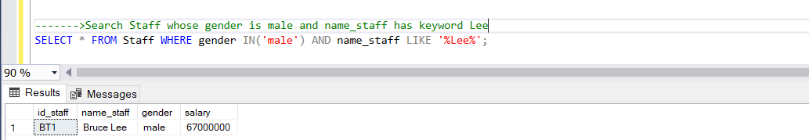

Slide 16
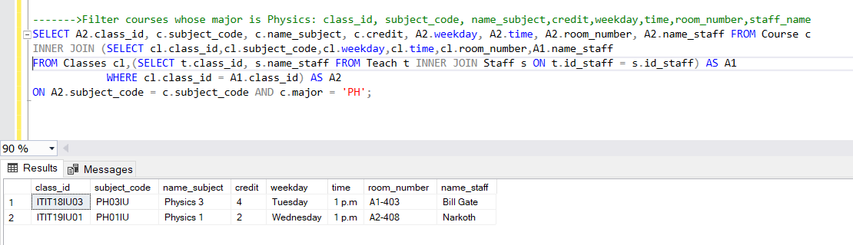

Slide 17
UPDATE

Slide 18
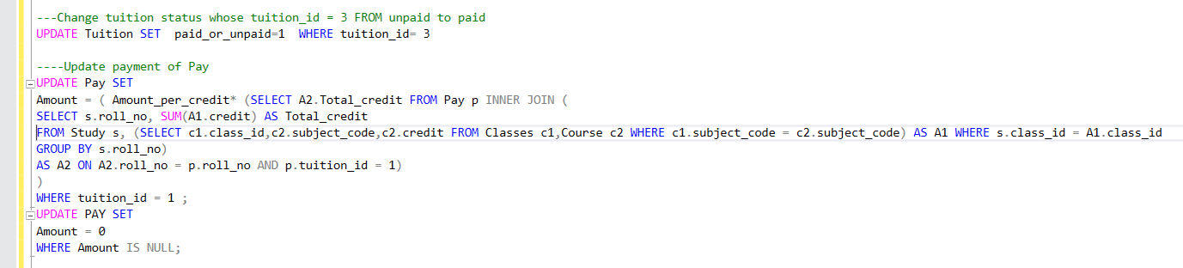

Slide 19
DELETE

Slide 21
GUI

Slide 22
Thanks For Watching

