Slide 2
Imagine...

Slide 3




Notes:
“Imagine this. Kakauwi mo lang. Mainit, may assignment pa ang kapatid mo, and everybody is trying to finish the day."

Slide 4


Slide 5
“Kaya mo bang magbawas ng kuryente for two hours to prevent this?”

Slide 6
Pero walang nagtanong.

Slide 7
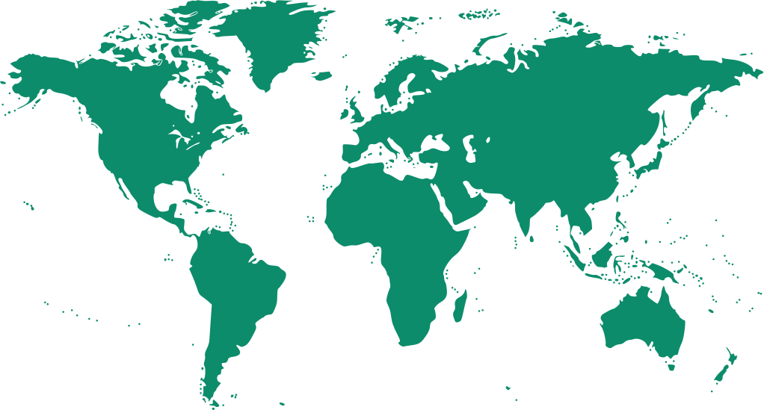
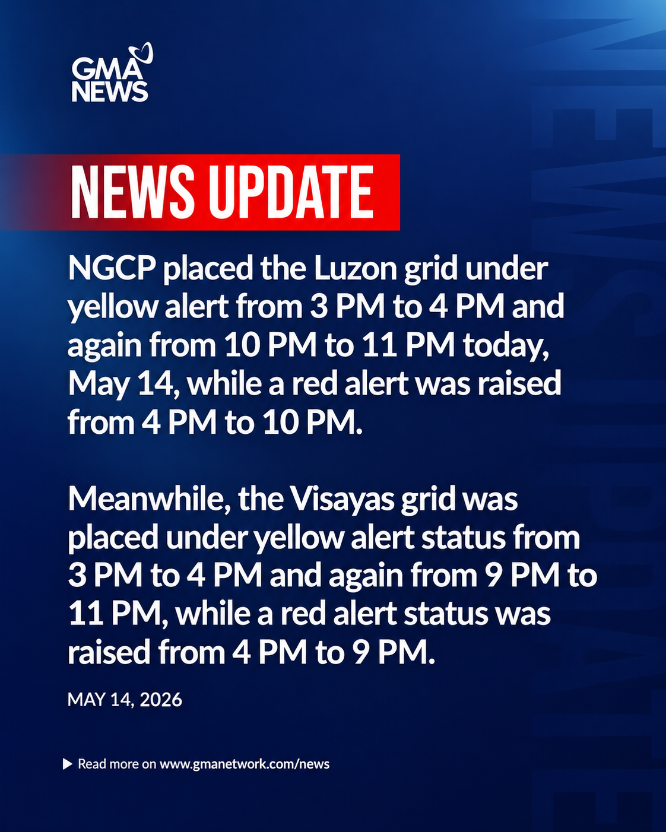
On May 14, 2026

Slide 8
SHORTAGE OF
413 megawatts

Slide 9
SHORTAGE OF
413 megawatt
1.9M Meralco Customers

Slide 10

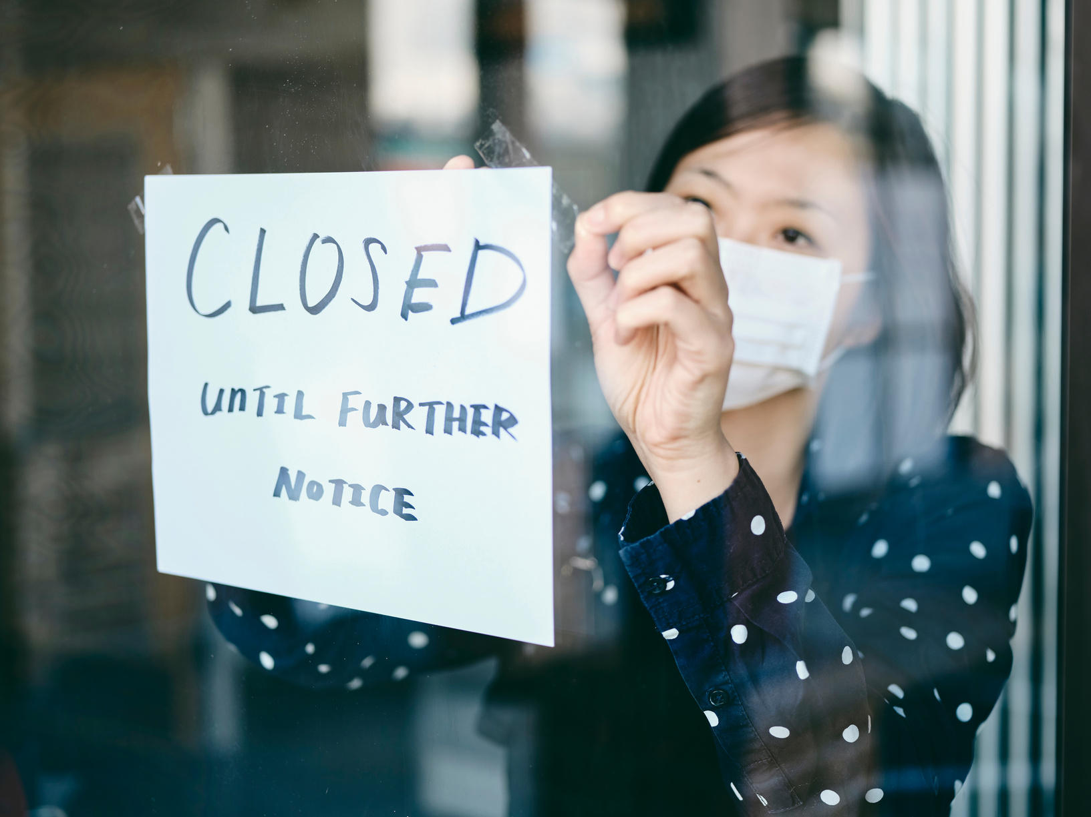
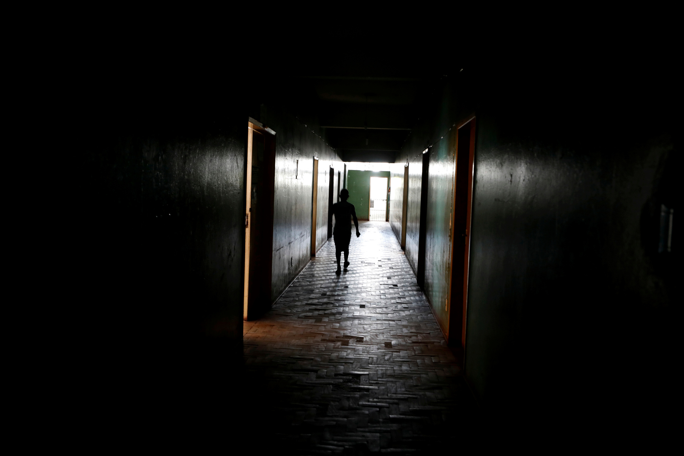
SHORTAGE OF
413 megawatt
1.9M Meralco Customers

Slide 11
INTERRUPTIBLE LOAD PROGRAM (ILP)

Slide 12
Pero paano ang ordinary households?

Slide 13
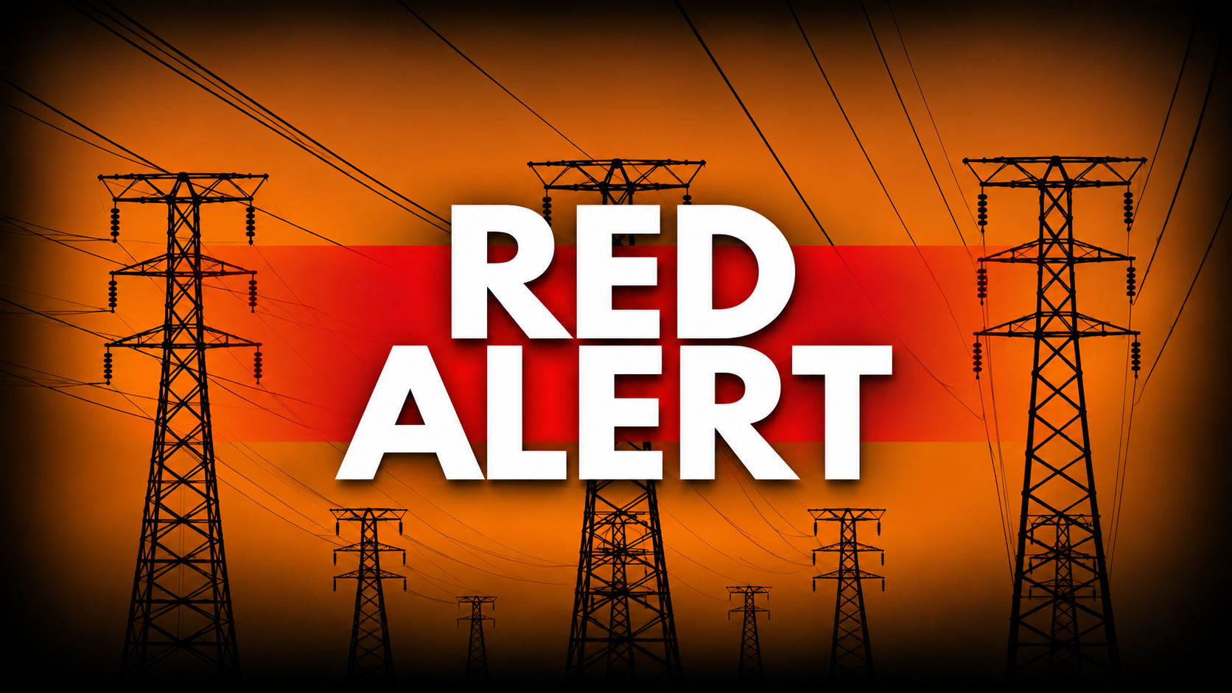
GRID ALERTS

Slide 14
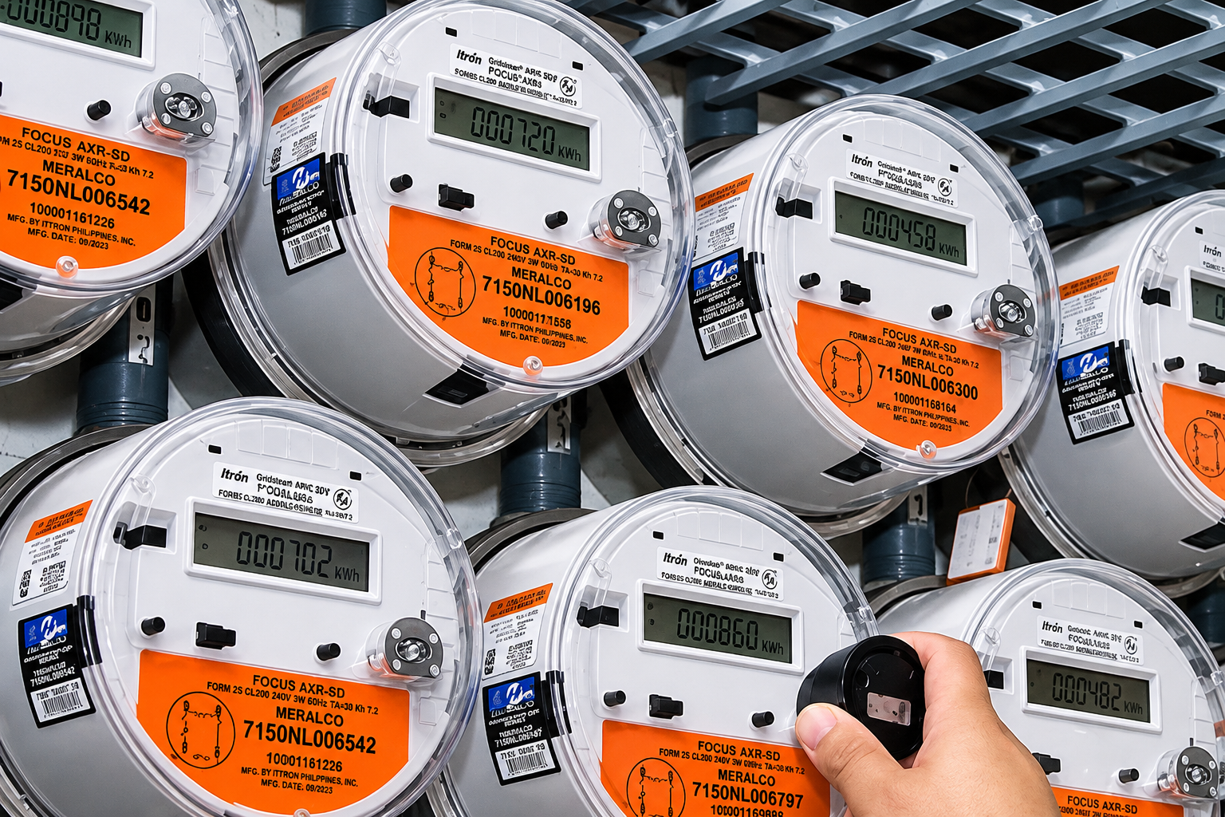
SMART METER
ROLLOUT

Slide 15

ILP PRECEDENT

Slide 16
A bridge between the grid and the community.

Slide 17



Slide 18

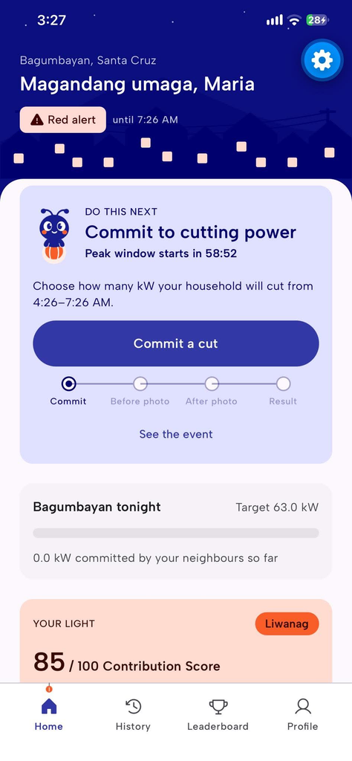
ALERT

Slide 19

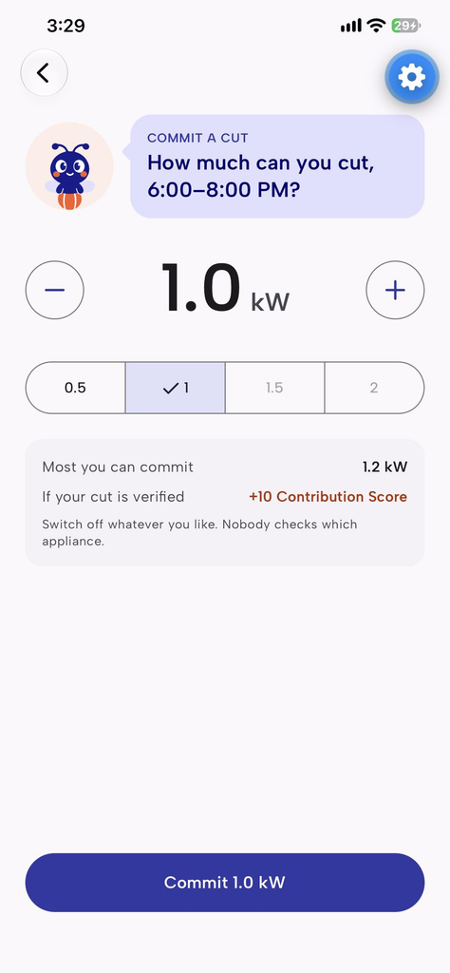
COMMIT

Slide 20

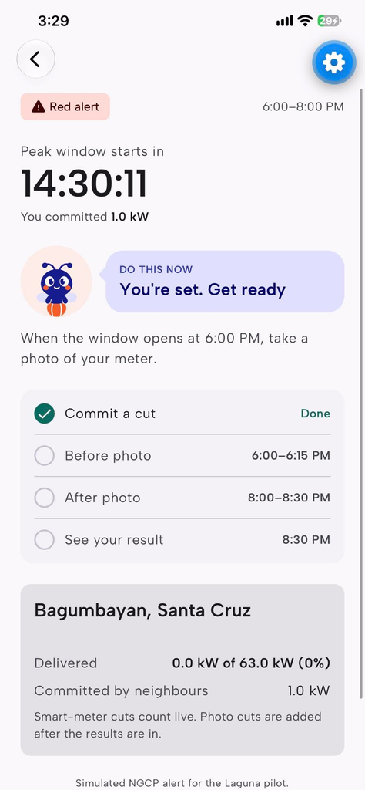
SHIFT

Slide 21

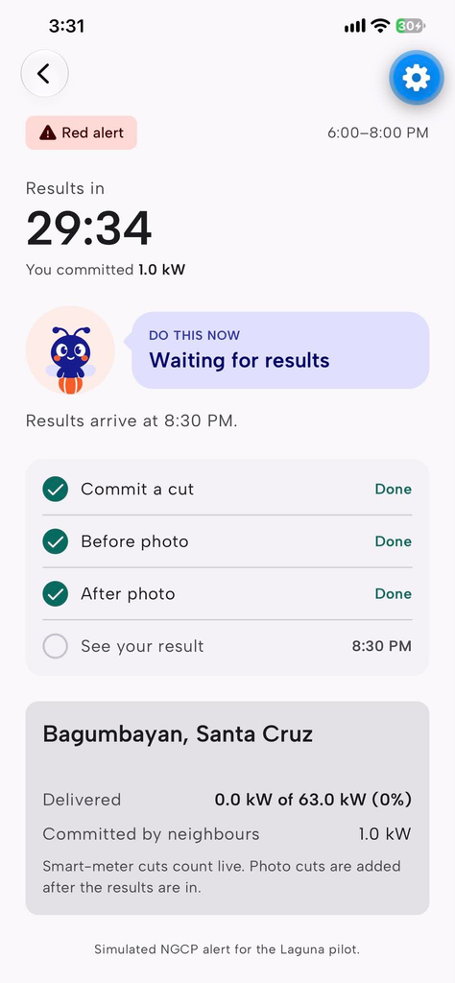
MEASURE

Slide 22

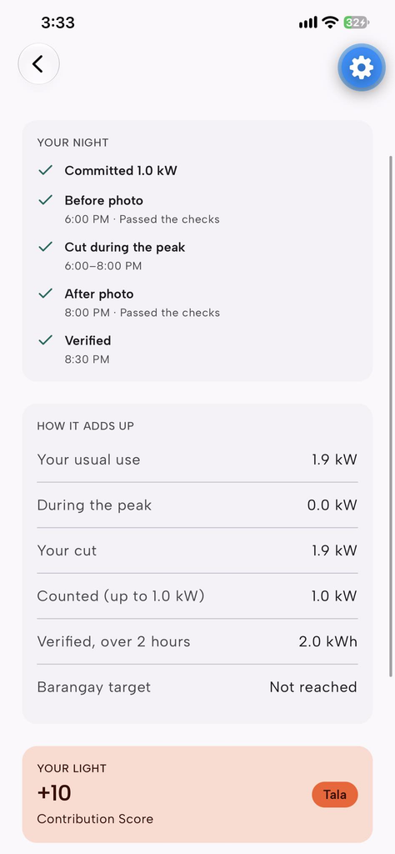
REWARD

Slide 23
Paano natin malalaman kung talagang nakatulong?

Slide 24
‘Kaya mo bang tumulong?’

Slide 25
Kapit-bisig. Bawat watt, may ambag.

Slide 27


