Slide 1
Using Fixed-Point Approximations to Accelerate Integer Division
SONAD 2026
Lucas Dutton (McMaster University)
with Christopher Anand (McMaster University)
with IBM Collaborators:
Robert Enenkel (IBM Toronto)
Silvia Melitta Müller (IBM Böblingen)
Curtis D’Alves (IBM Toronto)
May 1, 2026
Notes:
Add Curtis

Slide 2
Elementary Functions
Scientific Computation
Tradeoff between
Precision + Accuracy
Efficiency
Example: sin/cos
ML & AI Applications
Less Precision + Accuracy
More Efficient
Example: Activation functions (sigmoid)
Database & Cryptographic Kernels
Exact Computations
Fixed Precision
Constant-time execution: Cannot use floating-point
Notes:
Constant-time: Cannot use FP + Have to read the entire table into memory (no single-element access)

Slide 3
SRT (HW)
Division Techniques
+ Fast Recurrence
+ Bit-level redundant representation
+ Space-Efficient
– Linear Convergence
Newton
Raphson
(HW/SW)
+ Quadratic Convergence
- Done with Floating-Point?

Slide 4
What I’ll Show (32-Bit Int Div)
(1) Multi-Table Lookup + Normalization
- Converting Integers to Fixed-Point Numbers
- ~14 bits of accuracy
(2) Assembling the Reciprocal
- NR iteration
- 14 bits of accuracy -> ~28 bits
(3) Calculating Quotient
Trial Quotient + Remainder
“Last-bit” Correction
(4) Implementation + Extensions
RISC-V
Other Integer Precisions

Slide 5
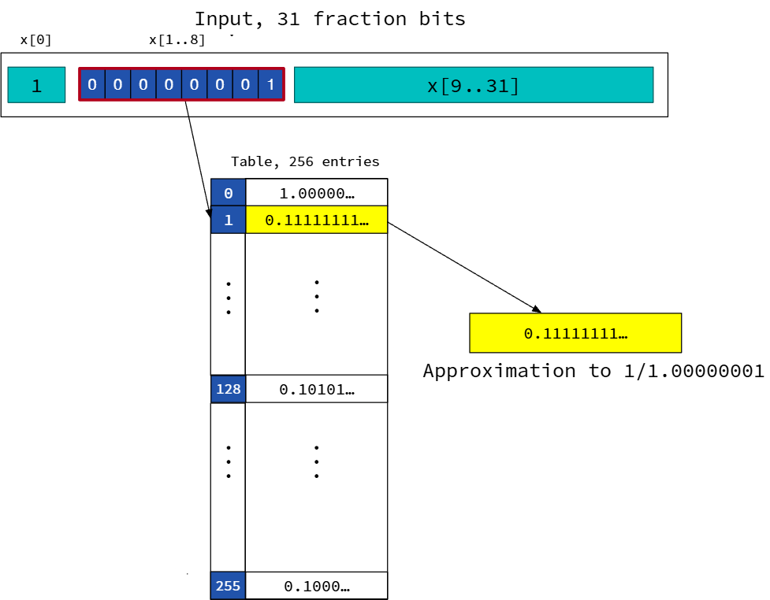
Lookup Tables
Quick way of obtaining initial approximation of a function
Use most-significant fraction bits of input as index into table

Slide 6
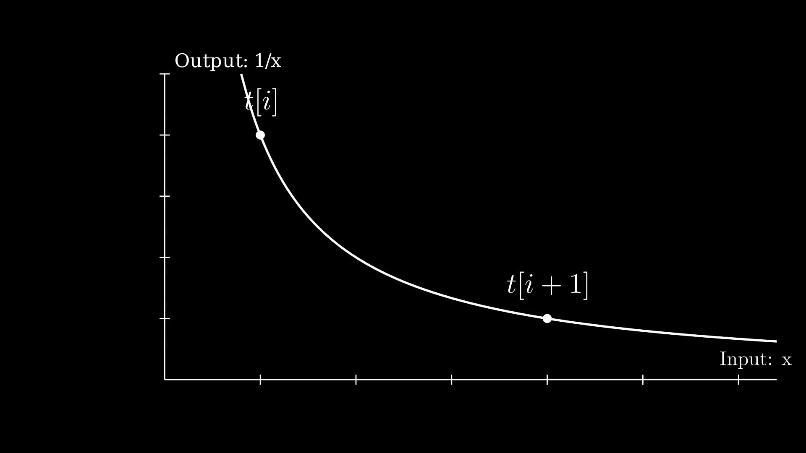


Start with a “standard” table
The T-table: regularly-spaced fixed-point values of the function interval
Notes:
x-axis: Individual input values in an interval. There are 2^15 = 32768 values in total
y-axis: The ulp error of each value

Slide 7
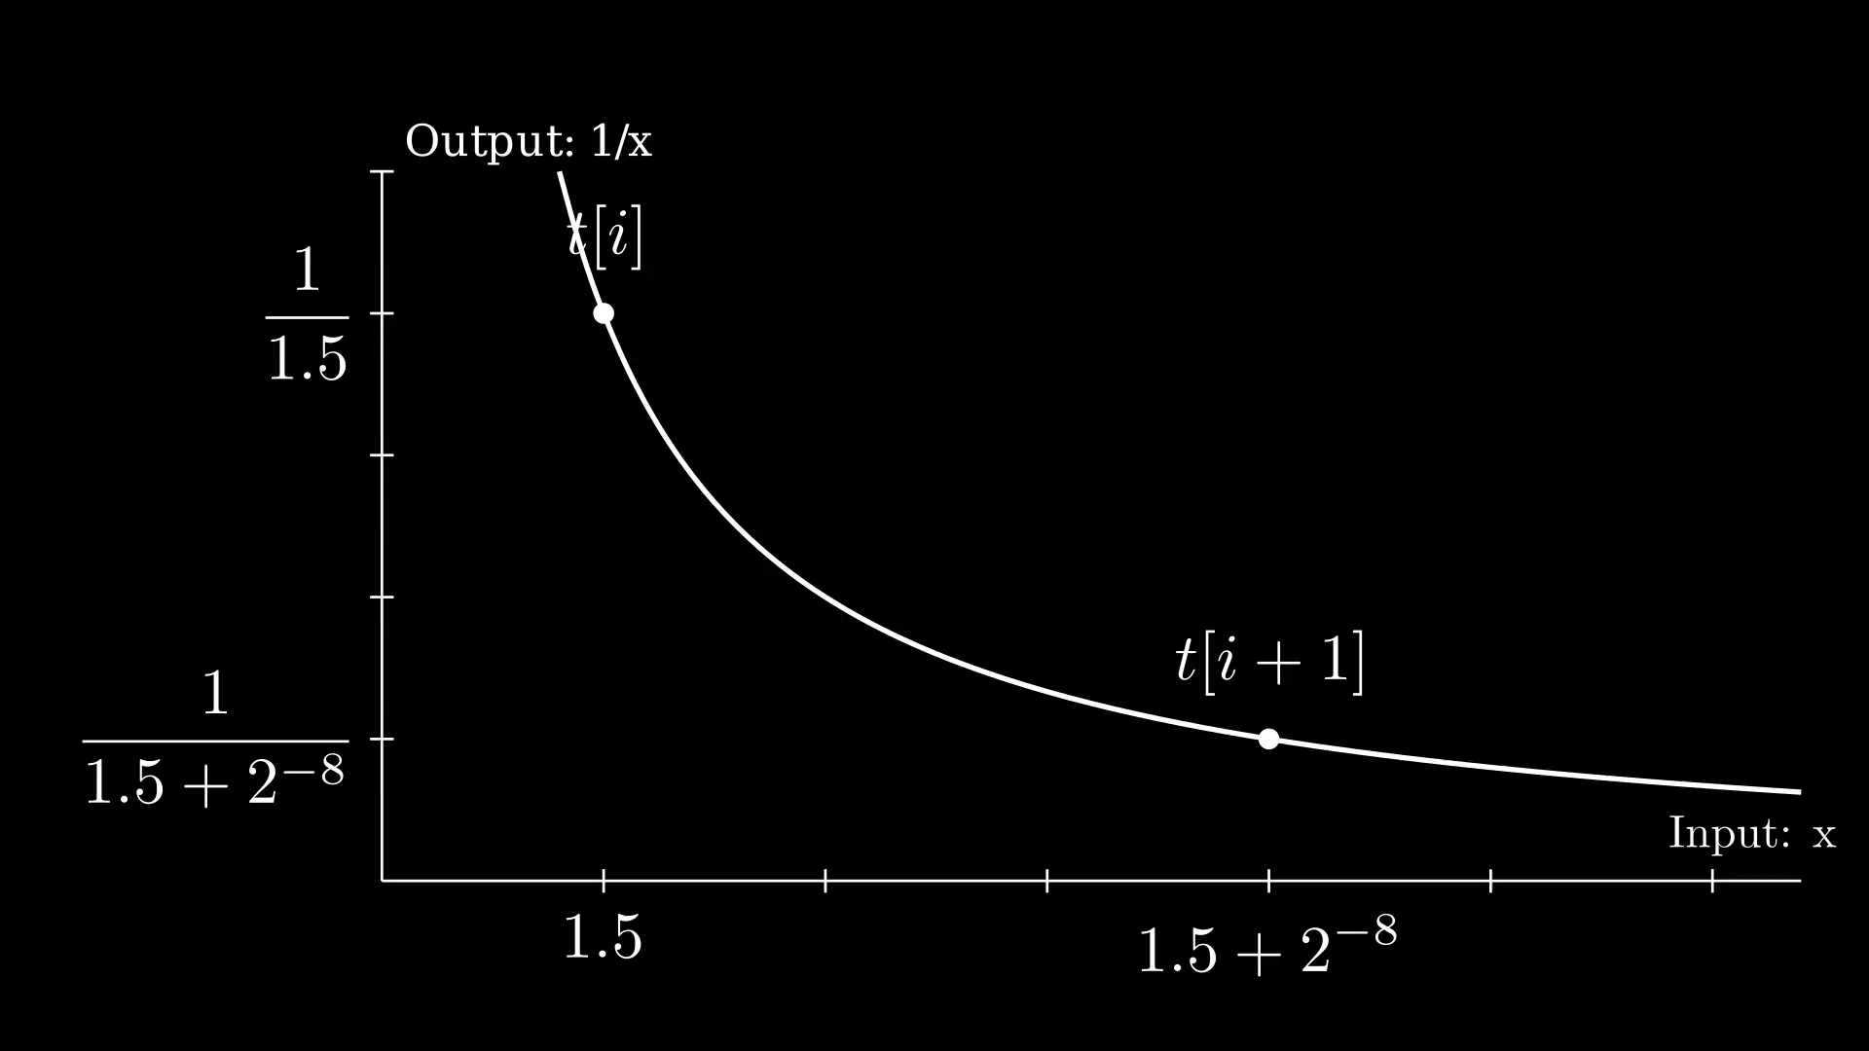
Start with a “standard” table
The T-table: regularly-spaced fixed-point values of the function interval
Notes:
x-axis: Individual input values in an interval. There are 2^15 = 32768 values in total
y-axis: The ulp error of each value

Slide 8
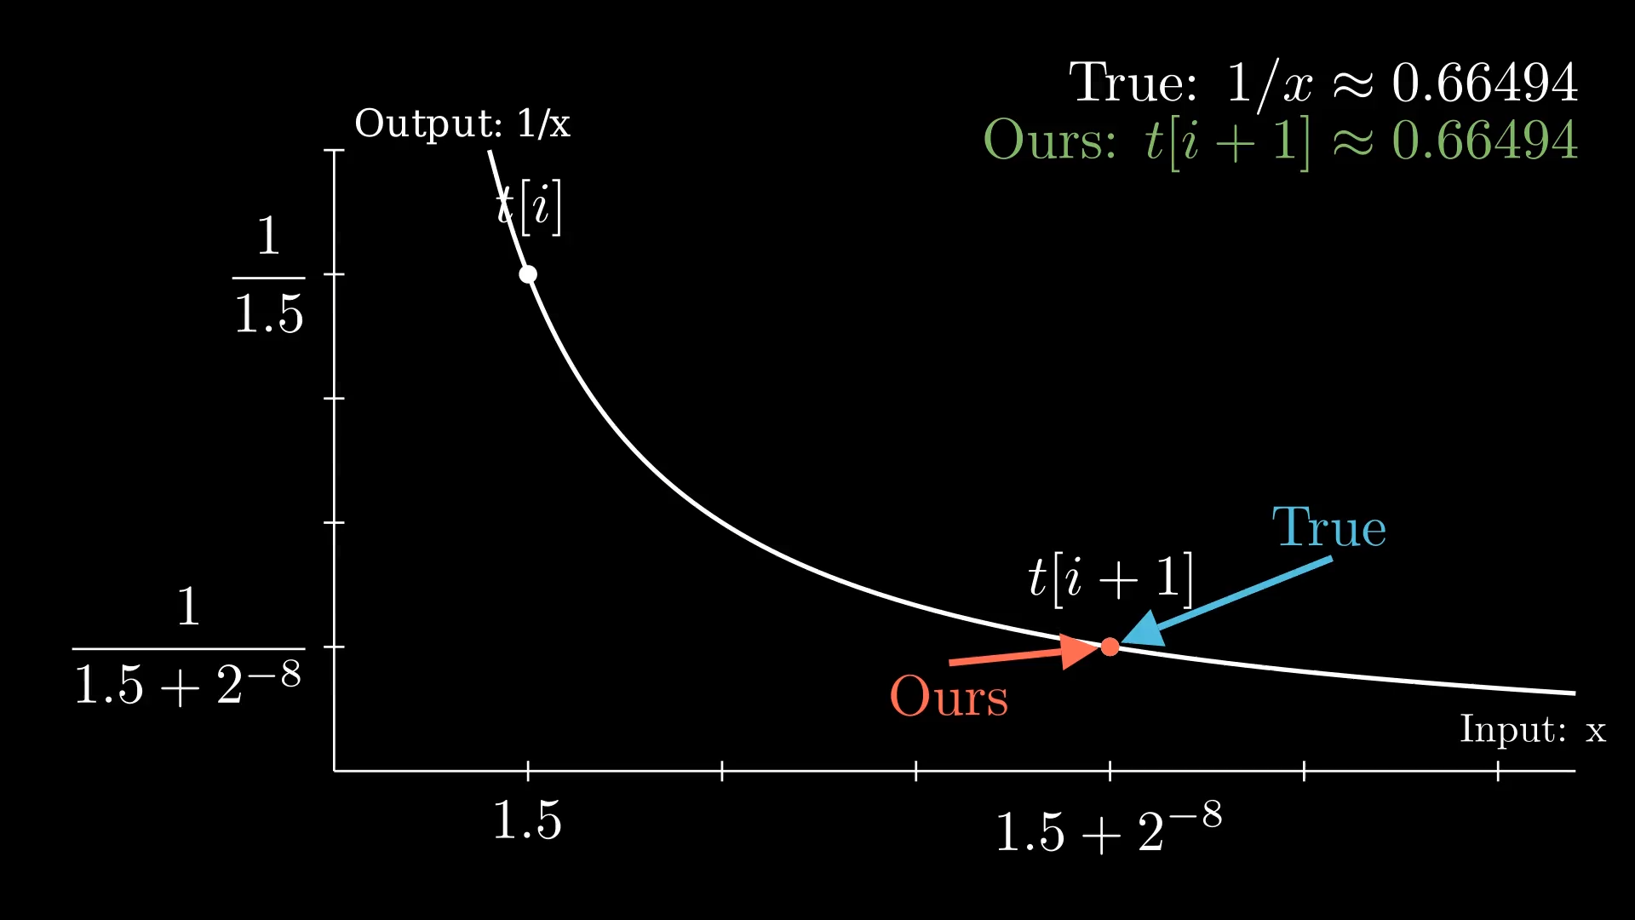
Add a linear correction
S-table: Linear correction values relative to the T-table
Notes:
x-axis: Individual input values in an interval. There are 2^15 = 32768 values in total
y-axis: The ulp error of each value

Slide 9
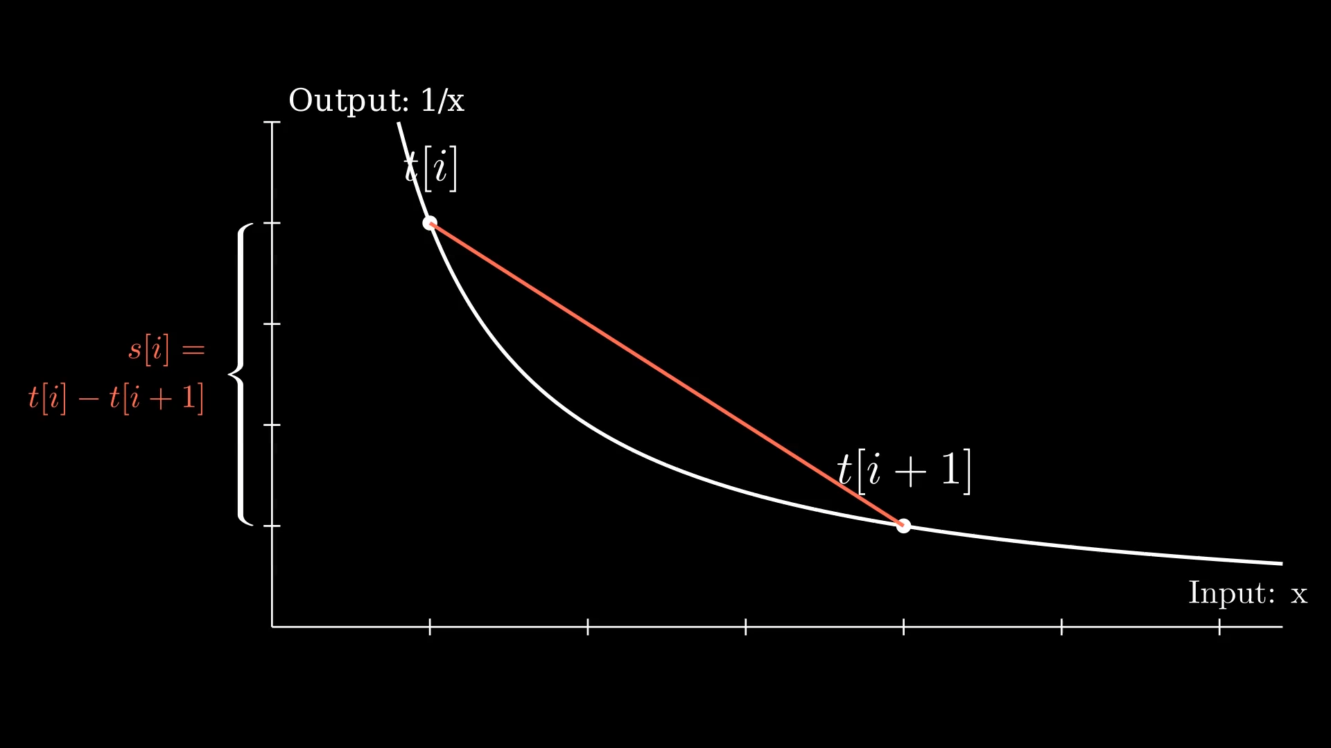
Add a linear correction
S-table: Linear correction values relative to the T-table
Notes:
x-axis: Individual input values in an interval. There are 2^15 = 32768 values in total
y-axis: The ulp error of each value

Slide 10
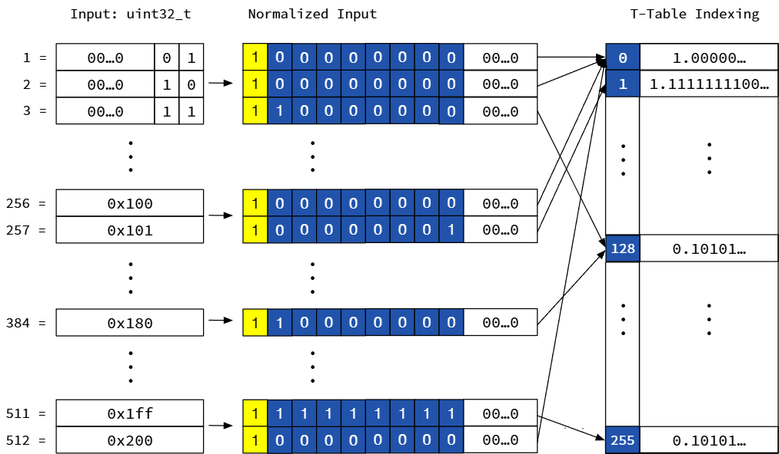
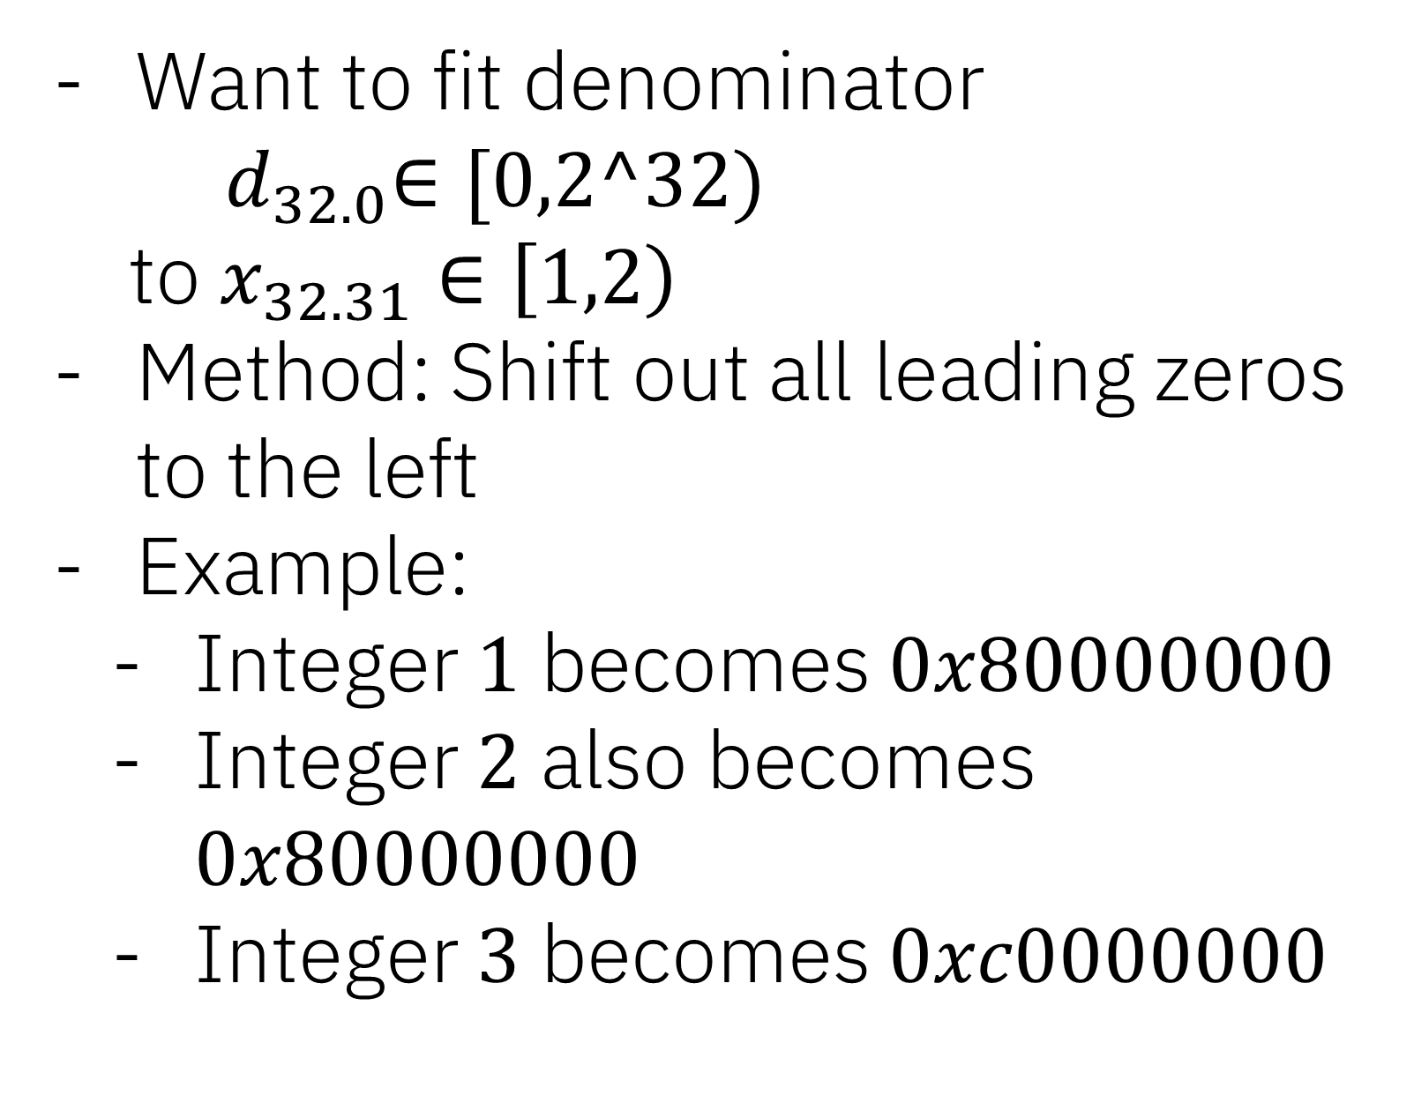

Normalization: Integers -> Fixed-Point as input to recip
$$x_{32.31}$$
Precision: 32 bits
Fraction: 31 bits
Want to fit denominator ${ d}_{32.0}∈[0,2^32)$
to $x_{32.31}∈\left[1,2\right)$
Method: Shift out all leading zeros to the left
Example:
Integer $1$ becomes $0x80000000$
Integer $2$ also becomes $0x80000000$
Integer $3$ becomes $0xc0000000$

Slide 11
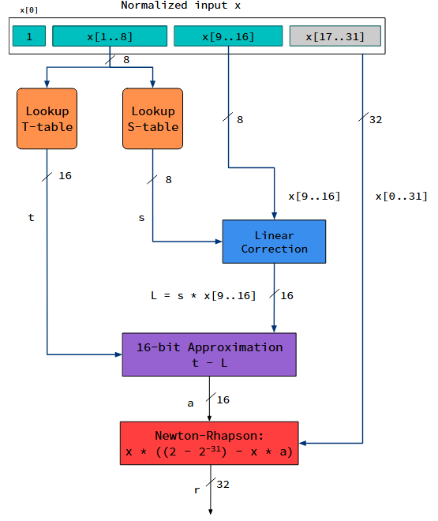
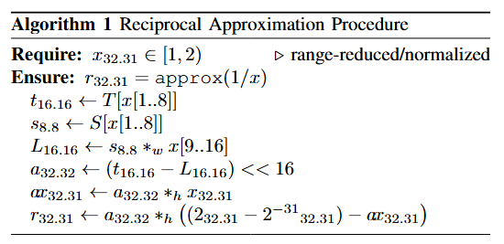
Recip Computation

Slide 12
Recip Computation
(1) Table Lookups

Slide 13
Recip Computation
(2) Calculate + Subtract Linear Correction
Notes:
- Element-width selection: Allows for mixed-precision performance

Slide 14
Recip Computation
(3) Fixed-Point NR Iteration

Slide 15
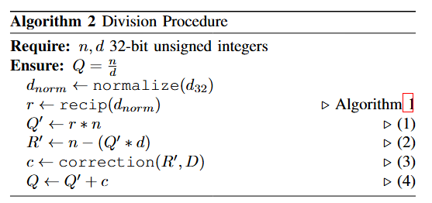
Now for the Quotient

Slide 16

Now for the Quotient
We have:
$d_{norm}$ the normalized denominator
$r$ the computed recip approx

Slide 17
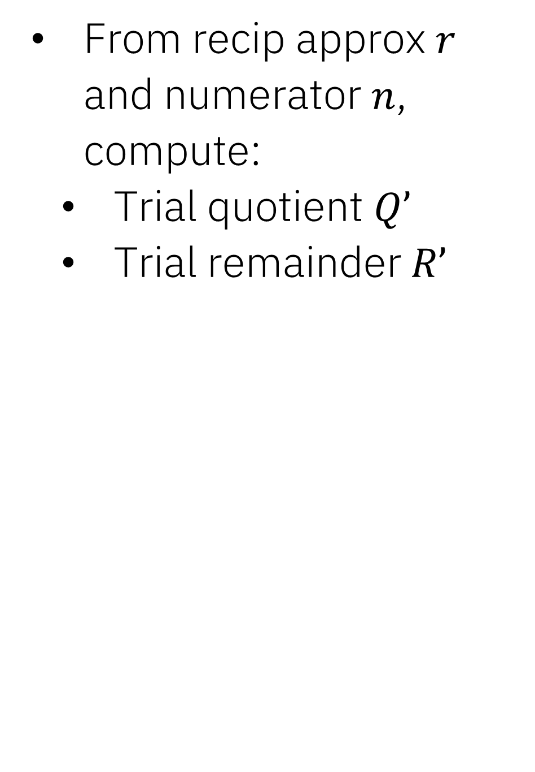

Now for the Quotient
From $r$ and numerator $n$, compute:
Trial quotient $Q’$
Trial remainder $R’$

Slide 18

Now for the Quotient
$R’$ is our error
Compute a correction $c$
Add correction to $Q’$
What are the bounds on $c$?

Slide 19

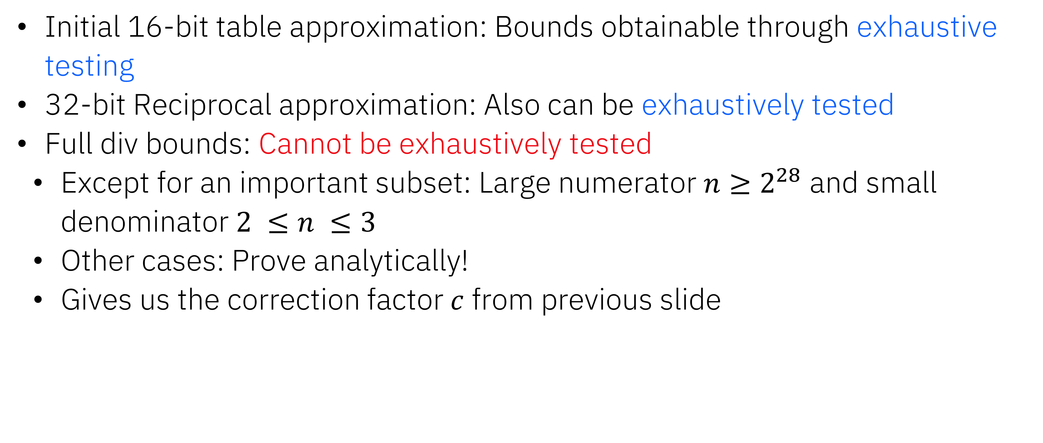
Outline: Proof of Correctness
Initial 16-bit table approximation: Bounds obtainable through exhaustive testing
32-bit Reciprocal approximation: Also can be exhaustively tested
Full div bounds: Cannot be exhaustively tested
Except for an important subset: Large numerator $n≥2^{28}$ and small denominator $2 ≤n ≤3$
Other cases: Prove analytically!
Gives us the correction factor $c$ from previous slide

Slide 20
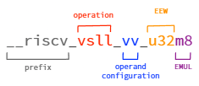
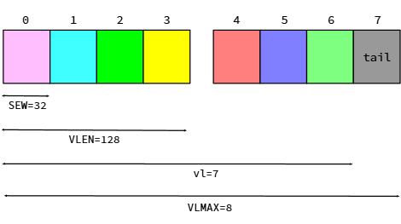
RISC-V ISA + Vector Extension
Implementation parameter
32 vector registers, VLEN-bit wide
Global parameters:
vl: #elements per vector op
SEW (Selected Element Width): size of input/output elements
LMUL: Group Multiplier; size of vector group
VLMAX = LMUL * VLEN / SEW (limit of vl)
Example:
VLEN=128, LMUL=2, vl=7, SEW=32b: A vadd.vv op performs 32-bit integer add on 7 element vectors

Slide 21
RISC-V Implementation (Constant time for Crypto)
Procedure | # SIMD Instructions
Recip: Approx | 25
Div: Correction procedure | 18
8-way unrolled, working with 8 instruction groups + wide register groups
Implemented in C using RVV intrinsics
Operations done with max group size (EMUL m8) for highest throughput.
Only integer operations used.
Extensions
8-bit, 16-bit: Lookup + 1-bit correction. Fast!
64-bit: Use 32-bit recip + 3 extra trial quotient+remainder iterations.
Notes:
SIMD (Internal) Ops
Look into ARM/POWER (not constant time div)
Select a certain subset of RISCV instructions to ensure constant time
Implementor can freely change parameters and the software will adapt; But only works for matrix ops/dot product etc.
Doesn’t quite work with operations like table lookups
The bulk of numerical computations is becoming more hardware independent, but performance-critical elementary functions are going the opposite way – need to optimize for architecture (in our experience)

Slide 22
FP32 Single-Instruction Recip Estimate
Using same algorithmic approach as this talk for FP32 recip
Proposed HW
x86
RISC-V
POWER
VRCPSS
Accurate to
12 bits
#Instructions for DP:
10
vfrec7
Accurate to
7 bits
#Instructions for DP:
13
xvresp
Accurate to
14 bits
#Instructions for DP:
10
Accurate to
20 bits
#Instructions for DP:
7
See “A Multi-Table Approach to Floating-Point Function Approximation”
Notes:
No direct comparison, but this is the closest comparison relative to other FP recip estimates

Slide 23
Conclusions + Future Work
Have an efficient, constant-time integer divide
Implemented in RISC-V
Future work:
Hardware implementations for further acceleration
Related paper:
Inexactness and Correction of Floating-Point Reciprocal, Division and Square Root

Slide 24
Thanks!
Questions?

Slide 25
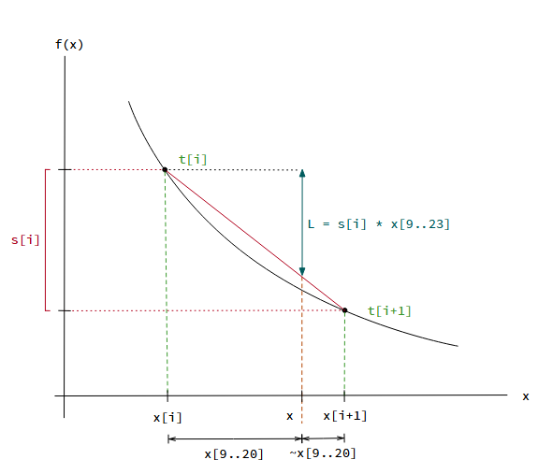
Detailed T-Table & S-Table
Notes:
x-axis: Individual input values in an interval. There are 2^15 = 32768 values in total
y-axis: The ulp error of each value

