Slide 1
FOCUS / GUARD
An Intelligent Study Session Monitor
Computer Vision · Data Structures · Statistics
RAMAZAN KARAGOZ
Integrated Course Project · 2026

Slide 2



◆ THE PROBLEM
Studying in the age of infinite distractions.
47%
The challenges
Phone at reach
Notifications break focus every 11 minutes on average.
of waking hours spent on digital devices by the average student
Passive fatigue
Drowsiness and eye-strain reduce comprehension silently.
Social media pull
Tab switching steals hours of productive study time.
What if the computer itself could be the monitor?
FOCUSGUARD
02 / 15

Slide 3



◆ THE SOLUTION
Introducing FocusGuard.
FocusGuard is a Python desktop application that silently observes a study session through the webcam and the operating system, detects distractions in real time, and produces a detailed statistical report on completion.
SEES
REMEMBERS
REPORTS
Tracks face, eyes, head orientation, and phone presence.
Stores events in custom data structures indexed by time.
Produces an editorial-style statistical report on finish.
FOCUSGUARD
03 / 15

Slide 4
◆ ARCHITECTURE
Three cooperating layers.
01
02
03
Detection Layer
Data Structures Layer
Analysis Layer
Computer Vision
Statistics & reporting
→ MediaPipe face mesh
→ YOLOv8 phone detector
→ Active window monitor
→ Deque sliding window
→ Hash map per-minute stats
→ Min-heap alert priority
→ Interval tree ranges
→ Descriptive statistics
→ Shapiro-Wilk normality
→ Pearson correlation
→ HTML report generator
FOCUSGUARD
04 / 15

Slide 5



◆ LAYER 01 · DETECTION
What the system sees.
Face + Head Pose
Phone Detection
MediaPipe Face Mesh · 468 landmarks
YOLOv8n · COCO class 67
Calculates yaw/pitch via solvePnP to detect if the user is looking at the screen. Eye Aspect Ratio (EAR) tracks eye closure for fatigue detection.
Pretrained object detection runs every 2 seconds, flagging any phone visible in frame above 45% confidence threshold.
Active Window
Real-Time Alerts
pygetwindow · keyword matching
Min-heap priority queue
Polls the foreground window title every 1.5 seconds and classifies it as productive, social media, or unknown via keyword heuristics.
Distractions enter a priority queue; the most urgent surface as desktop notifications with a 20-second cooldown.
FOCUSGUARD
05 / 15

Slide 6
◆ LAYER 02 · ALGORITHM
How the focus score is computed.
WEIGHTED AVERAGE
EVENT CONTRIBUTIONS
Each event contributes a focus value to a 60-second sliding window. The score is the arithmetic mean of these contributions.
Focused / Productive
100
Other app (unknown)
70
Looking away
55
score = Σ contribution(eᵢ) / |window|
Eyes closed
40
Not at desk
30
✓ Frame-rate independent (no penalty accumulation)
✓ Naturally bounded to [0, 100]
✓ Recovers quickly when user returns to focus
Phone visible
15
Social media
0
FOCUSGUARD
07 / 15

Slide 7




◆ LAYER 03 · STATISTICS
From raw events to meaningful insight.
Descriptive Statistics
Trend Analysis
Mean, median, standard deviation, IQR, and min-max range of focus scores across all minutes.
Linear regression on per-minute scores reveals warm-up or fatigue curves during the session.
Correlation Matrix
Hypothesis Testing
Pearson correlation between distraction types identifies which disruptions tend to co-occur.
Shapiro-Wilk test verifies whether the focus score distribution is normal — informing further analysis.
FOCUSGUARD
08 / 15

Slide 8
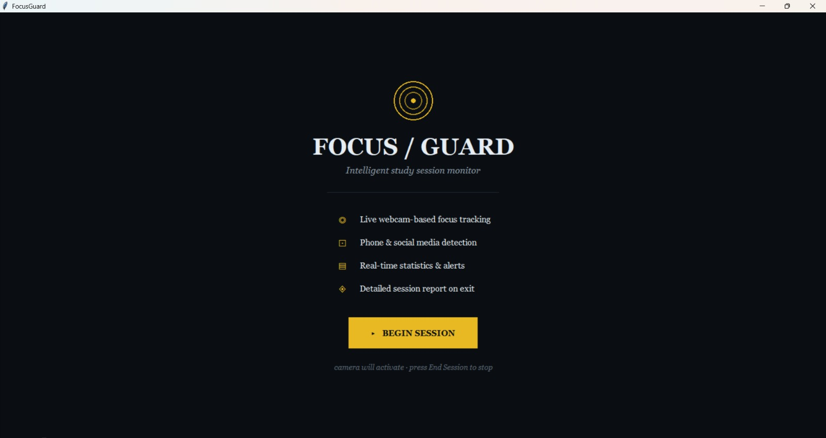
◆ THE APP · STEP 1
The welcome screen.
FIRST IMPRESSION
A clean opening
The welcome screen presents the four core capabilities and a single primary action — Begin Session. No clutter, no settings to configure.
STARTUP
Camera & models load on Begin
PRIVACY
Everything runs locally — no cloud
SETUP
Single click to start a session
FOCUSGUARD
09 / 15

Slide 9
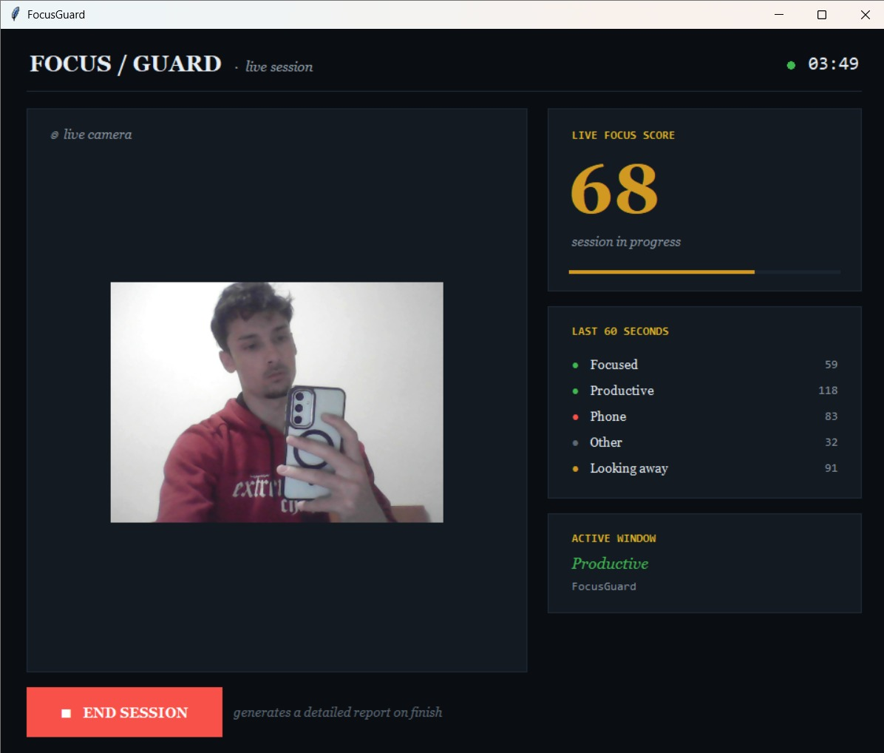
◆ THE APP · STEP 2
Live monitoring — phone detected.
CAUGHT IN THE ACT
Phone visible.
YOLOv8 detects the phone in the webcam frame and registers an event each time.
68
FOCUS SCORE
Score reflects the disruption immediately.
83
PHONE EVENTS
Detected in the last 60 seconds.
91
LOOKING AWAY
Head pose shows attention drift.
FOCUSGUARD
10 / 15

Slide 10
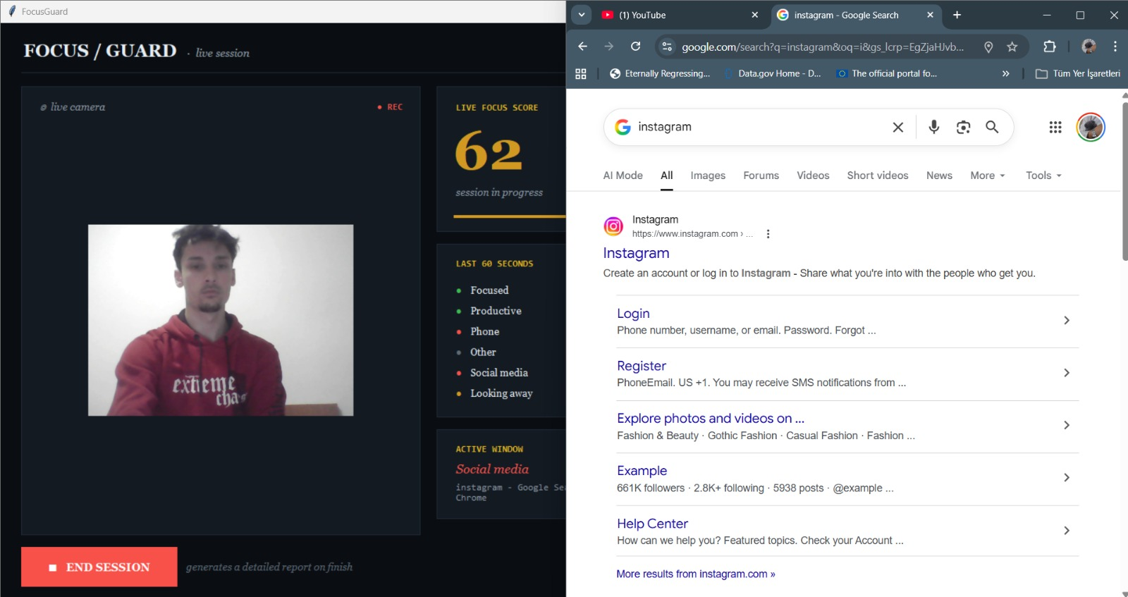
◆ THE APP · STEP 3
Distraction caught beyond the camera.
When the user opens Instagram, FocusGuard reads the active window title, classifies it as Social media, and the score reflects the disruption immediately. No webcam — no escape.
FOCUSGUARD
11 / 15

Slide 11
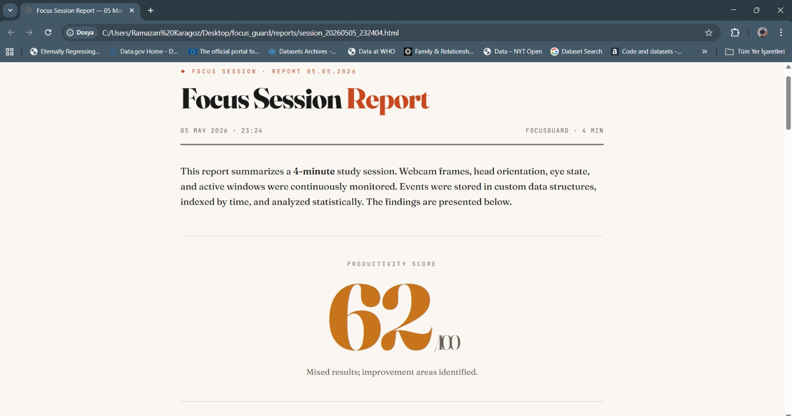


◆ THE APP · STEP 4
An editorial-style session report.
REPORT INCLUDES
Time series
Per-minute focus scores with 5-min moving average.
Event distribution
Breakdown of time spent in each category.
Correlation matrix
Which distractions co-occur, by Pearson r.
Normality test
Shapiro-Wilk p-value for distribution analysis.
Recommendations
Data-driven suggestions tailored to the session.
FOCUSGUARD
12 / 15

Slide 12




◆ TECHNOLOGY
Built with.
LANGUAGE
COMPUTER VISION
OBJECT DETECTION
Python 3.11
MediaPipe
YOLOv8
Core application runtime.
Real-time face mesh & landmark detection.
Pretrained model for cell phone detection.
IMAGE PROCESSING
STATISTICS
VISUALIZATION
OpenCV
pandas + SciPy
Matplotlib
Frame capture, color conversion, solvePnP.
DataFrame operations & statistical tests.
Chart rendering with custom editorial theme.
FOCUSGUARD
13 / 15

Slide 13
◆ REFLECTION
Challenges and learnings.
CHALLENGES
LEARNINGS
01
Frame-rate instability
01
Big-O in practice
Early scoring algorithm accumulated penalties; score collapsed to 0 quickly. Solved via weighted-average over the sliding window.
Choosing O(1) deque over O(n) list for the sliding window is the difference between a stable 10Hz and dropped frames.
02
Threading & UI synchronization
02
Algorithms matter less than formulation
Camera loop runs in a worker thread; GUI updates every 150ms on the main thread with lock-protected shared state.
The biggest quality leap came from reformulating the scoring function, not from changing algorithms or tuning constants.
03
Cross-platform webcam access
03
Design = decision compression
Windows required DirectShow backend; a fallback chain handles varying camera setups including phone-link virtual cameras.
A well-chosen color palette and font pairing eliminates a thousand tiny decisions down the road.
FOCUSGUARD
14 / 15

Slide 14
Thank you.
Questions welcome.
FOCUSGUARD · RAMAZAN KARAGOZ · 2026

