Slide 1
ETH Quantum Hackathon 2026: QCentroid Challenge
Detecting DDoS using quantum-inspired machine learning

Slide 2
Overview
Already have detection of malicious IPs through provided solution with classical implementation and elegant incorporation of quantum-inspired methods.
Focus on detecting time windows of DDoS attacks using provided metrics
For each dataset, generate a 2-dimensional dataset (image)
Use quantum-inspired convolutional step (quanvolution) to detect distinct intensity peaks in the produced images

Slide 3
From time series to images
For each dataset, string all flows together to create time series
Compute baseline mean and standard deviation from normal datasets
For each provided metric, compute z-score (deviation from baseline mean normalized by the standard deviation)

Slide 4
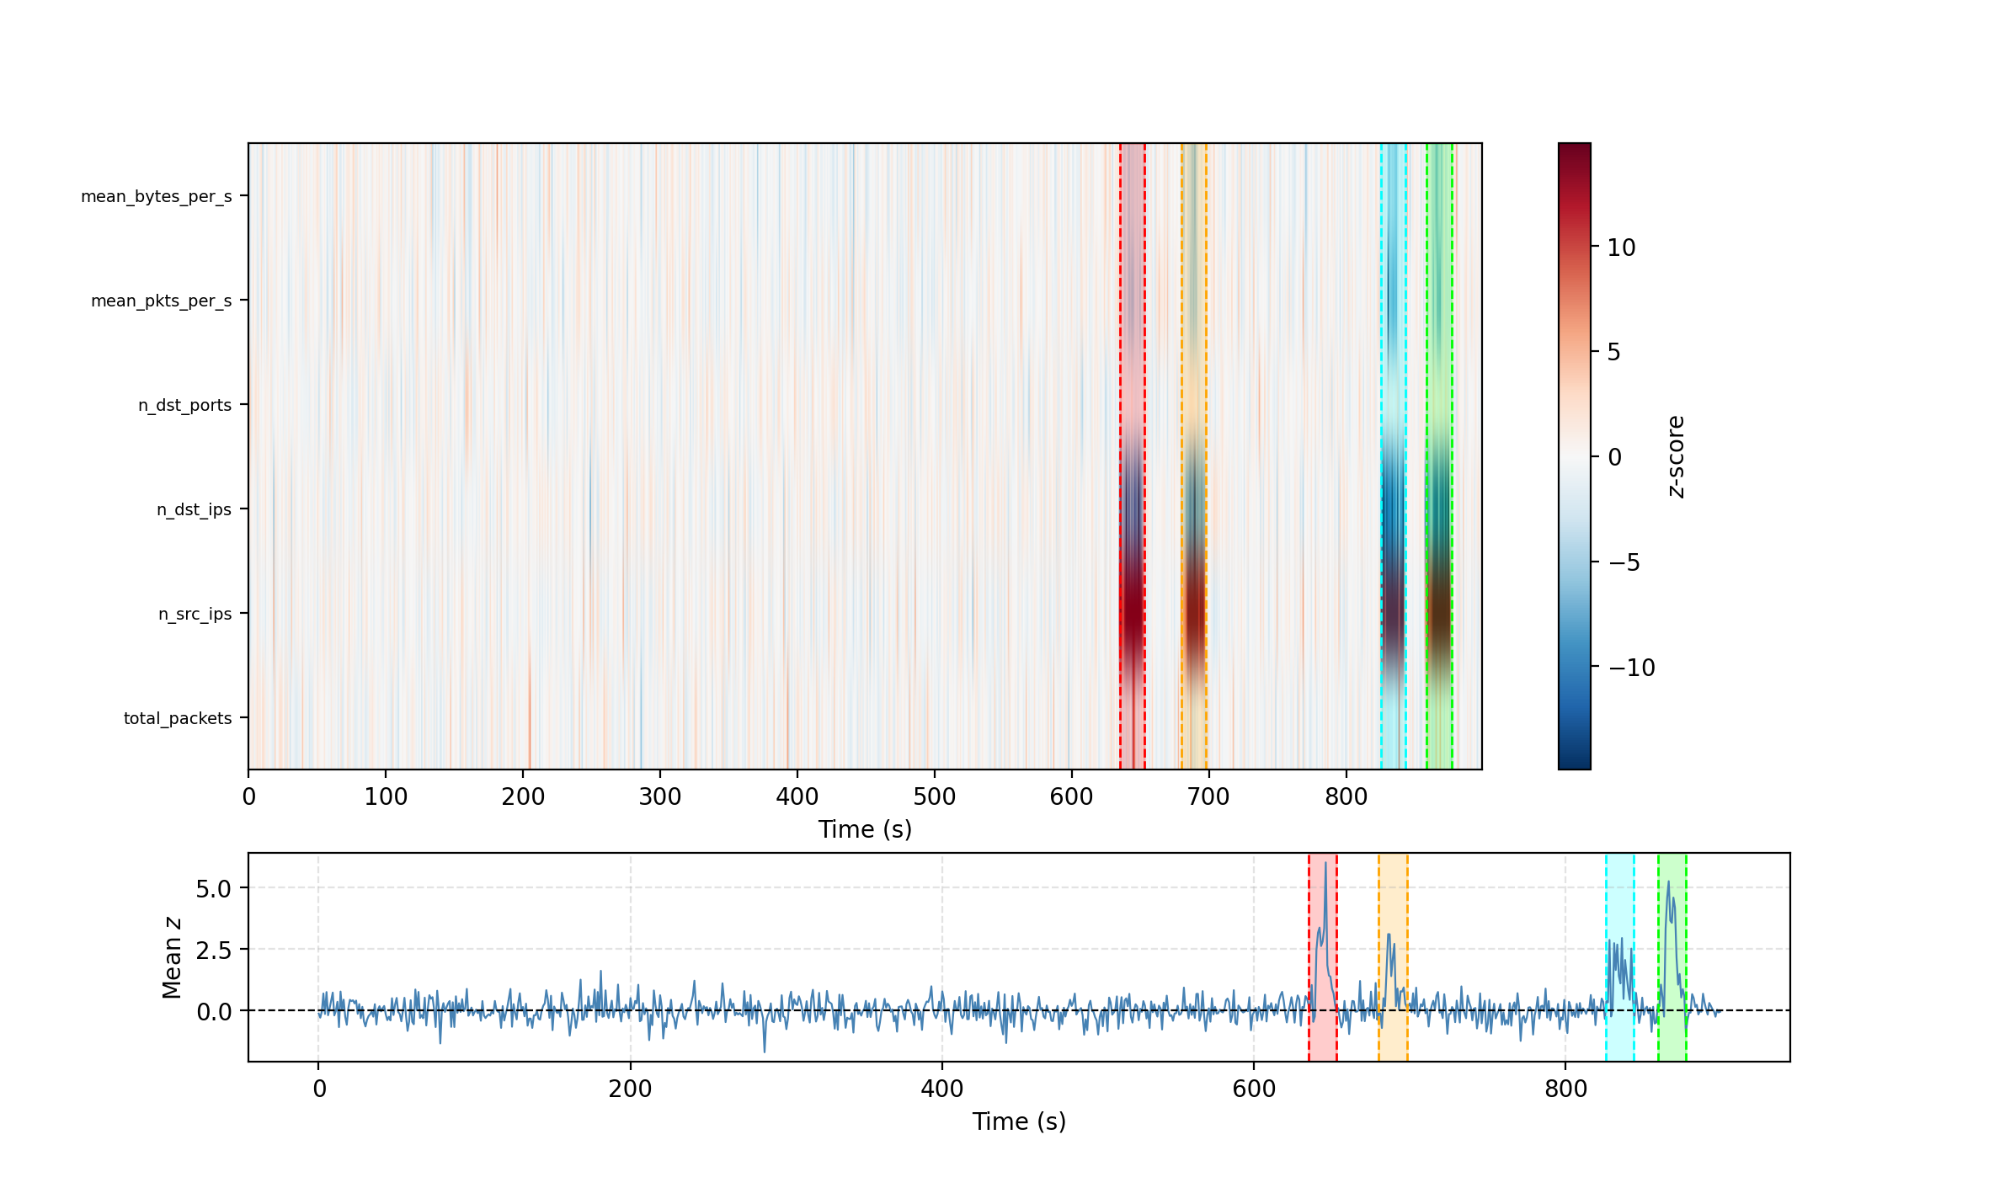

Slide 5
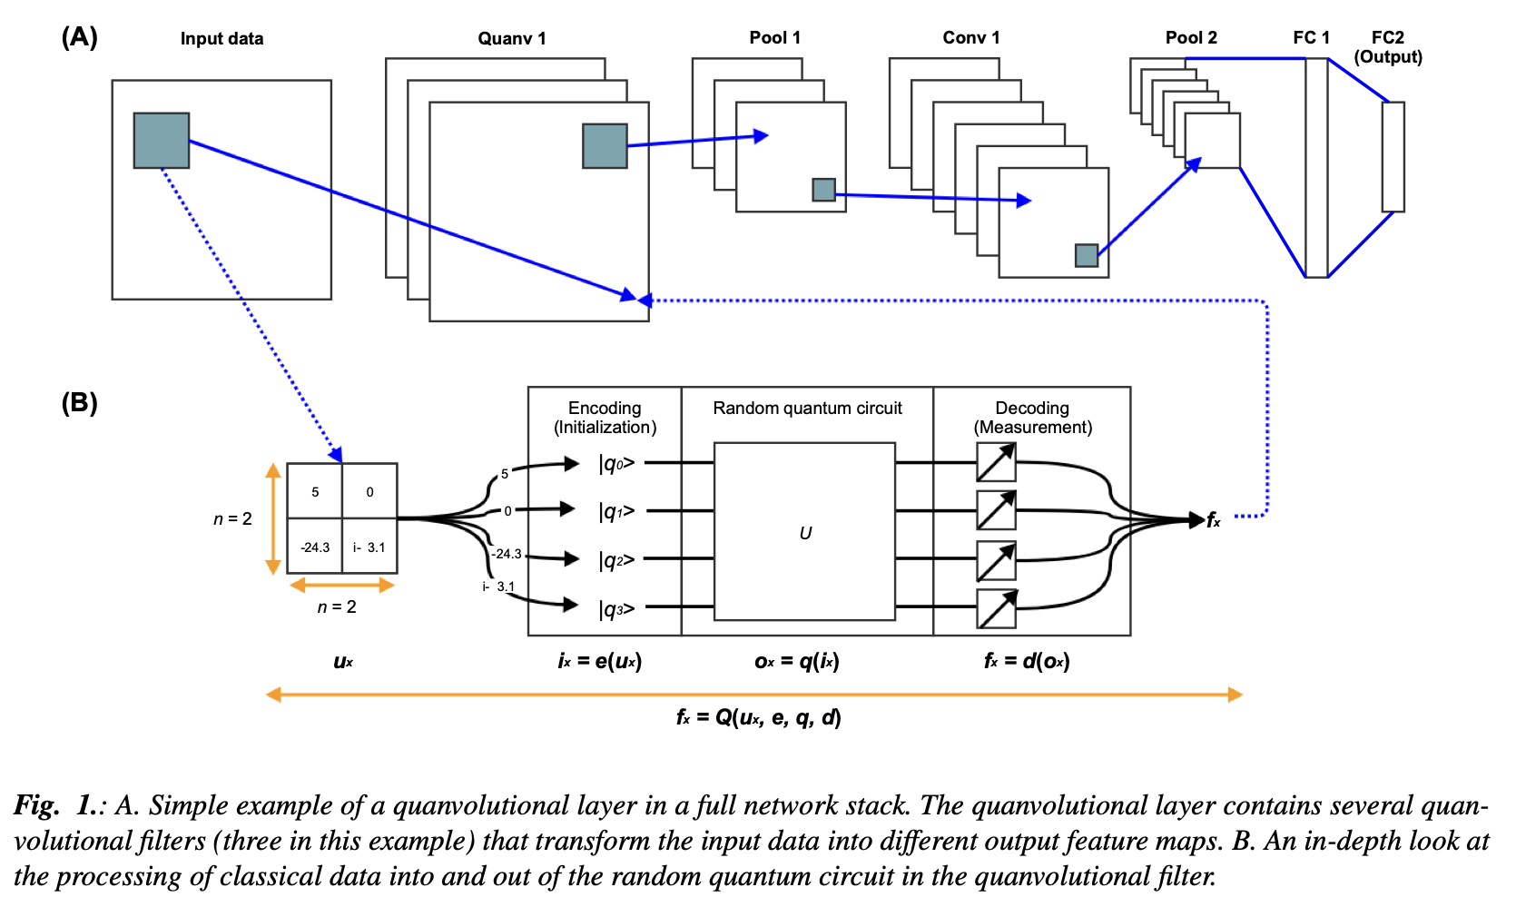
Quanvolutional Layer
To detect the “intensity” peaks (which correspond to the DDoS time windows), we use a random quanvolutional layer.
Based on “classical” convolutional layer

Slide 6
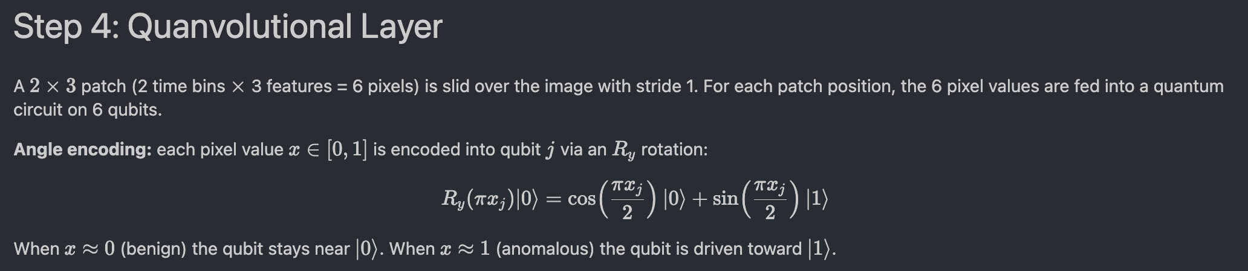
Implementation of Quanvolution Part 1
For circuit structure, see write-up in notebook and paper by Henderson et al. (2020)

Slide 7
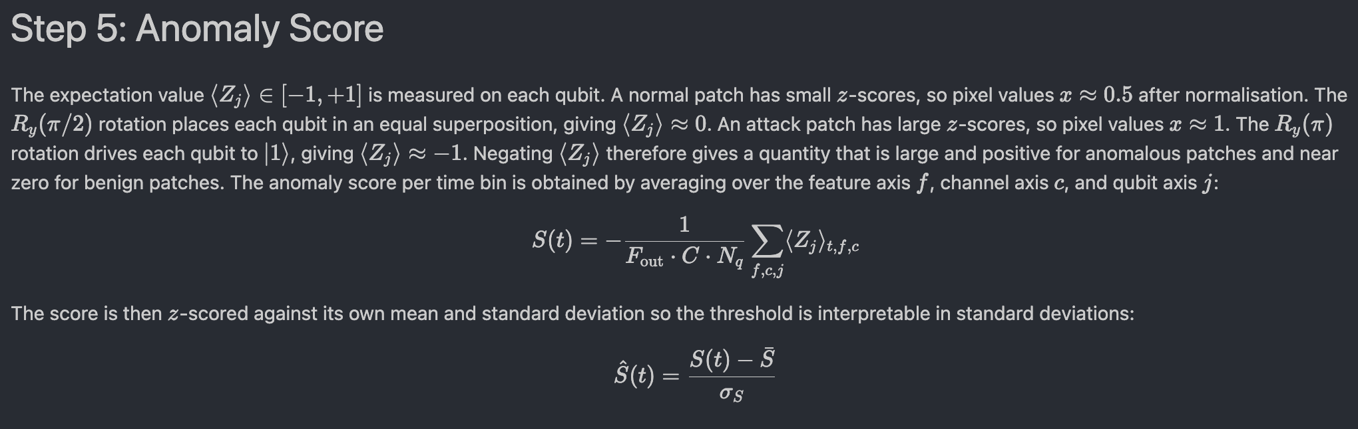
Implementation of Quanvolution Part 2

Slide 8
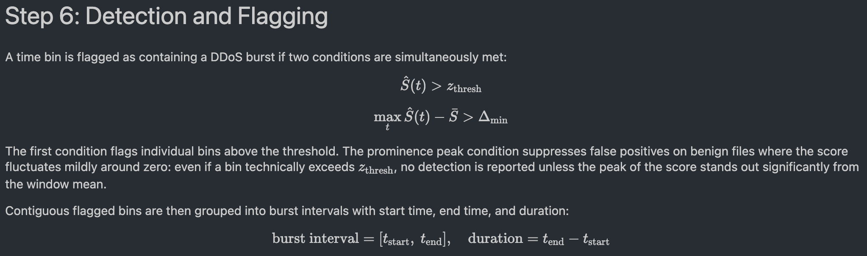
Implementation of Quanvolution Part 3

Slide 9
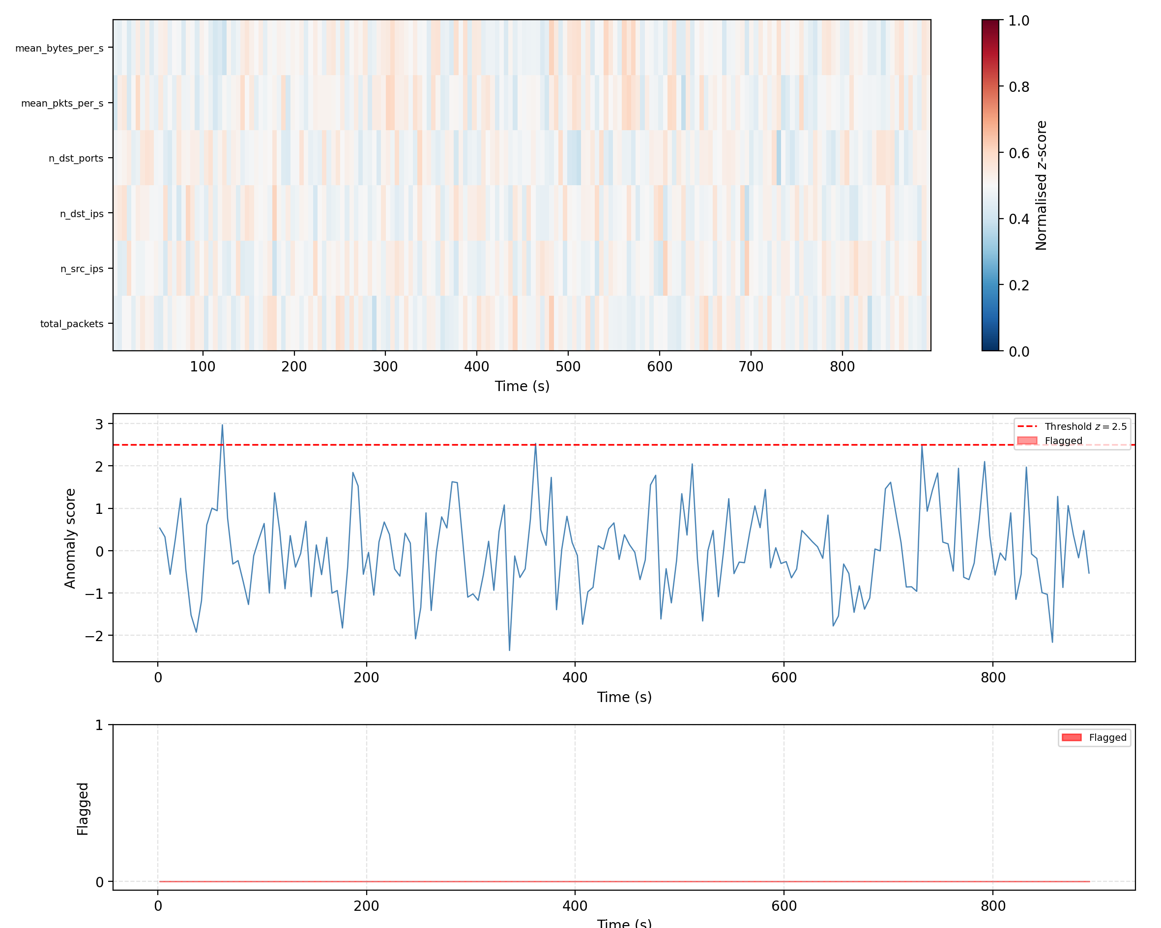
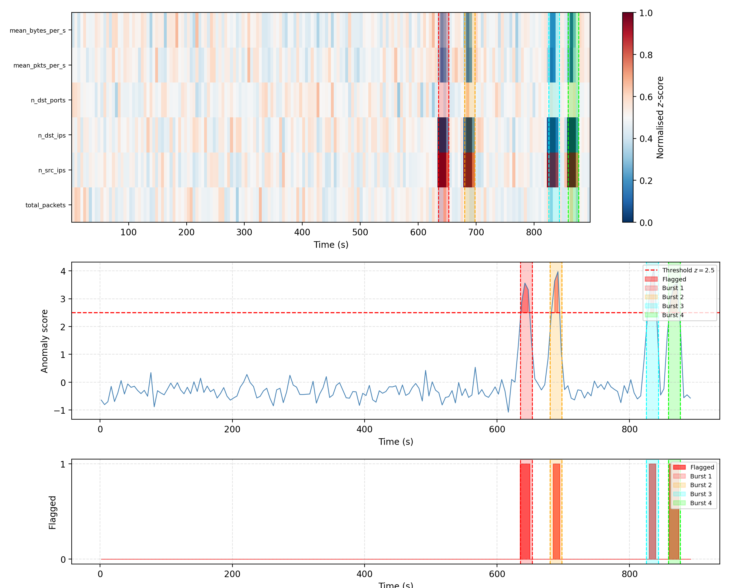

Slide 10
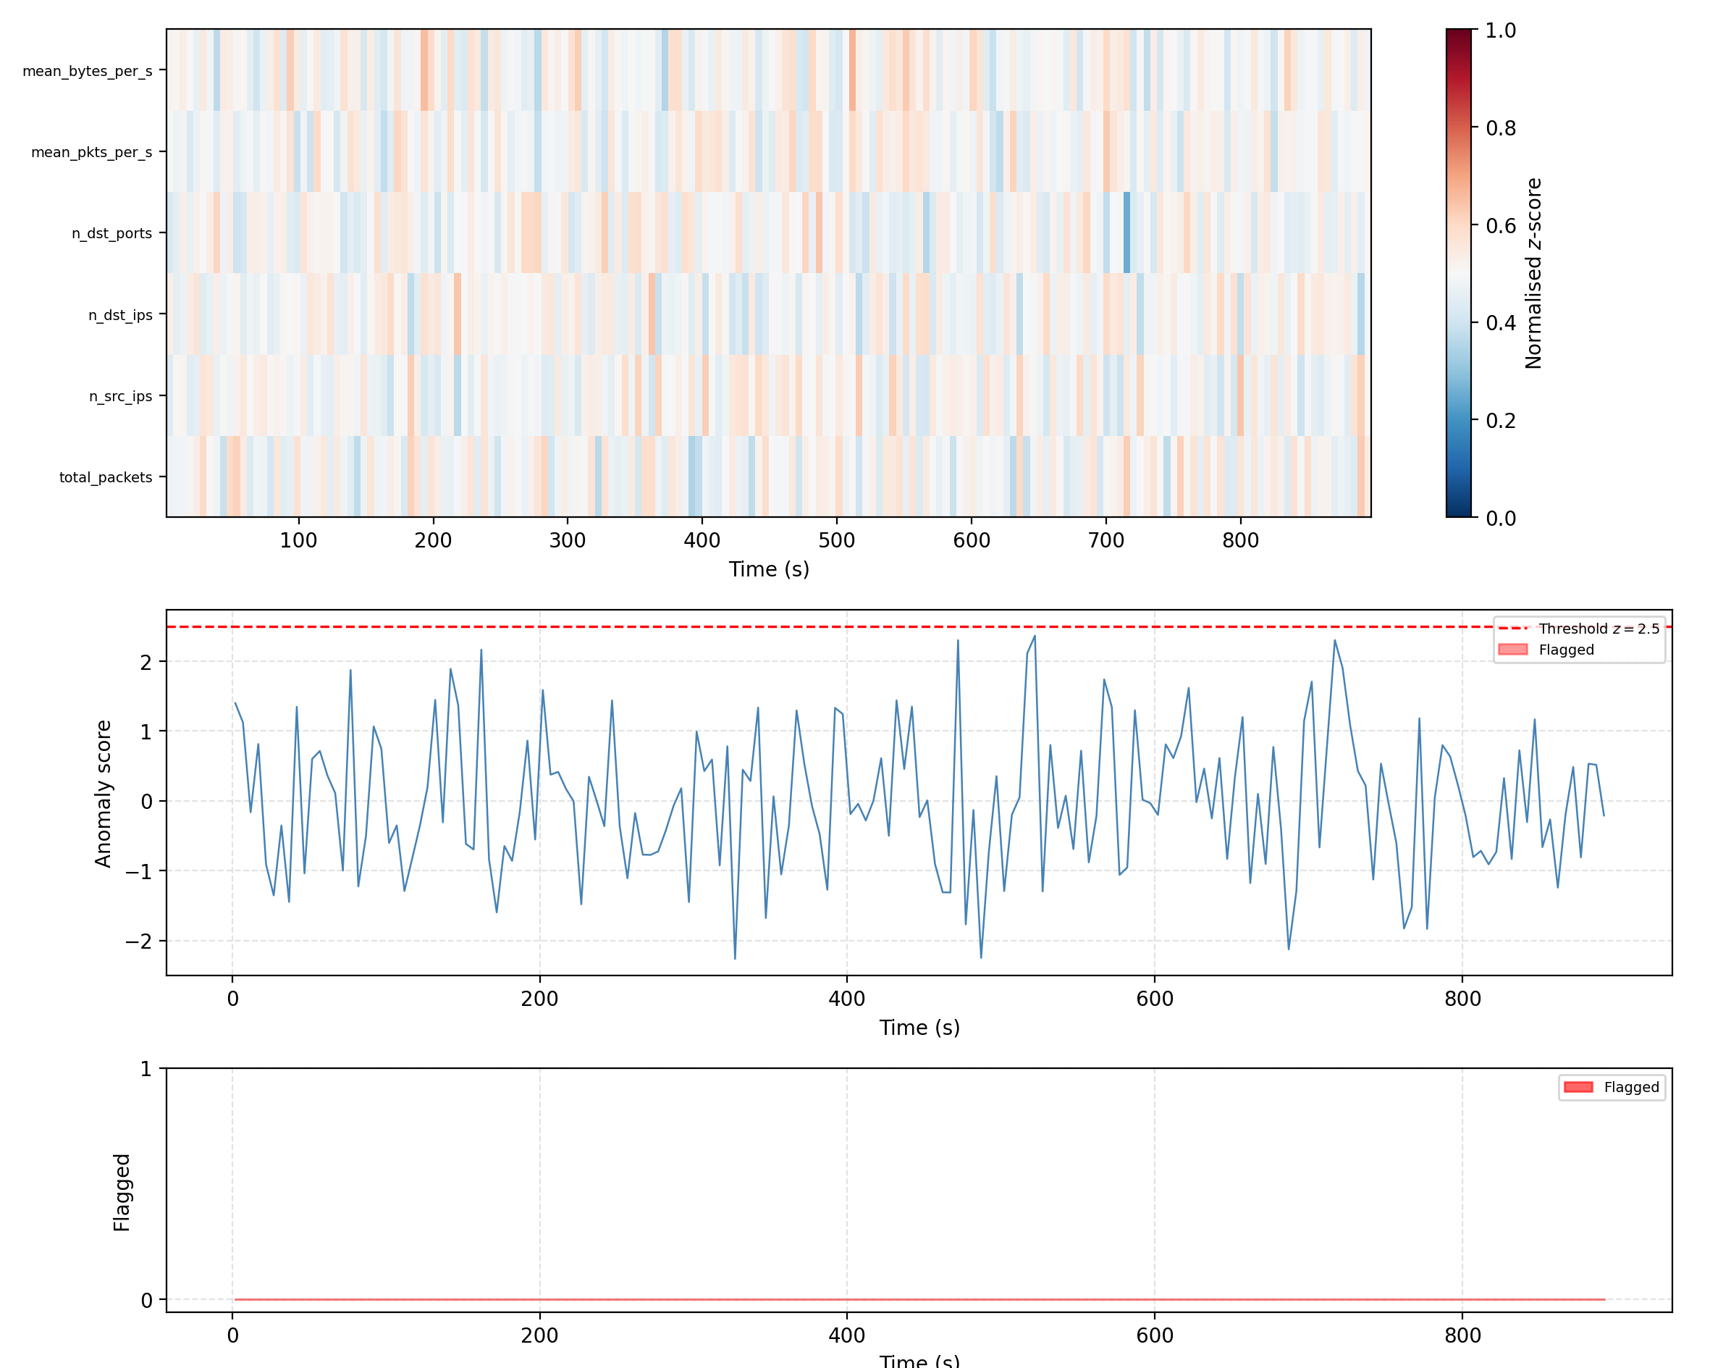
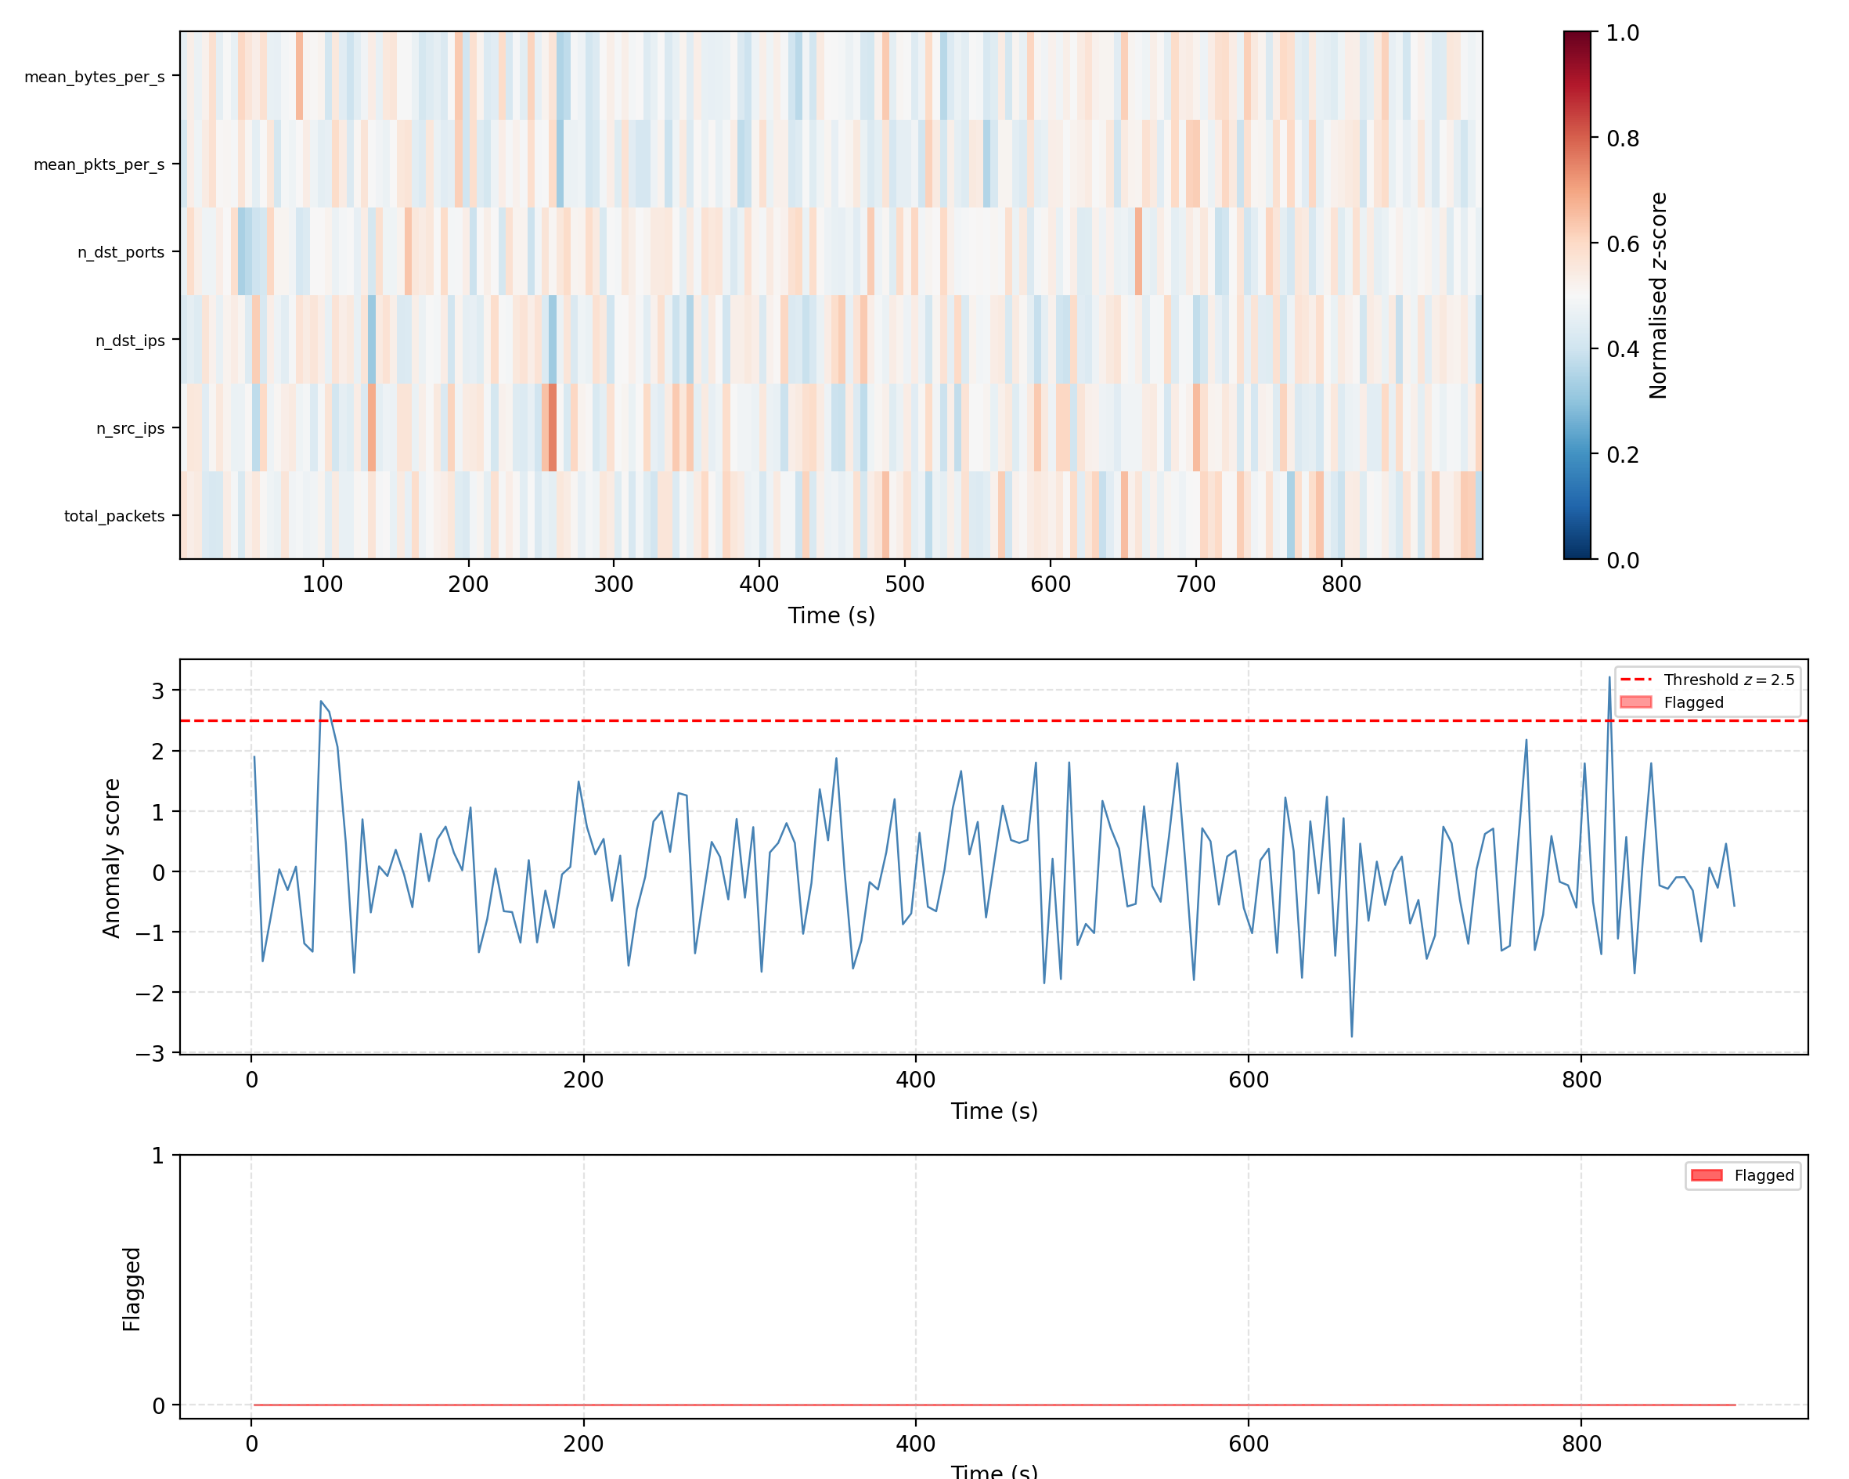

Slide 11
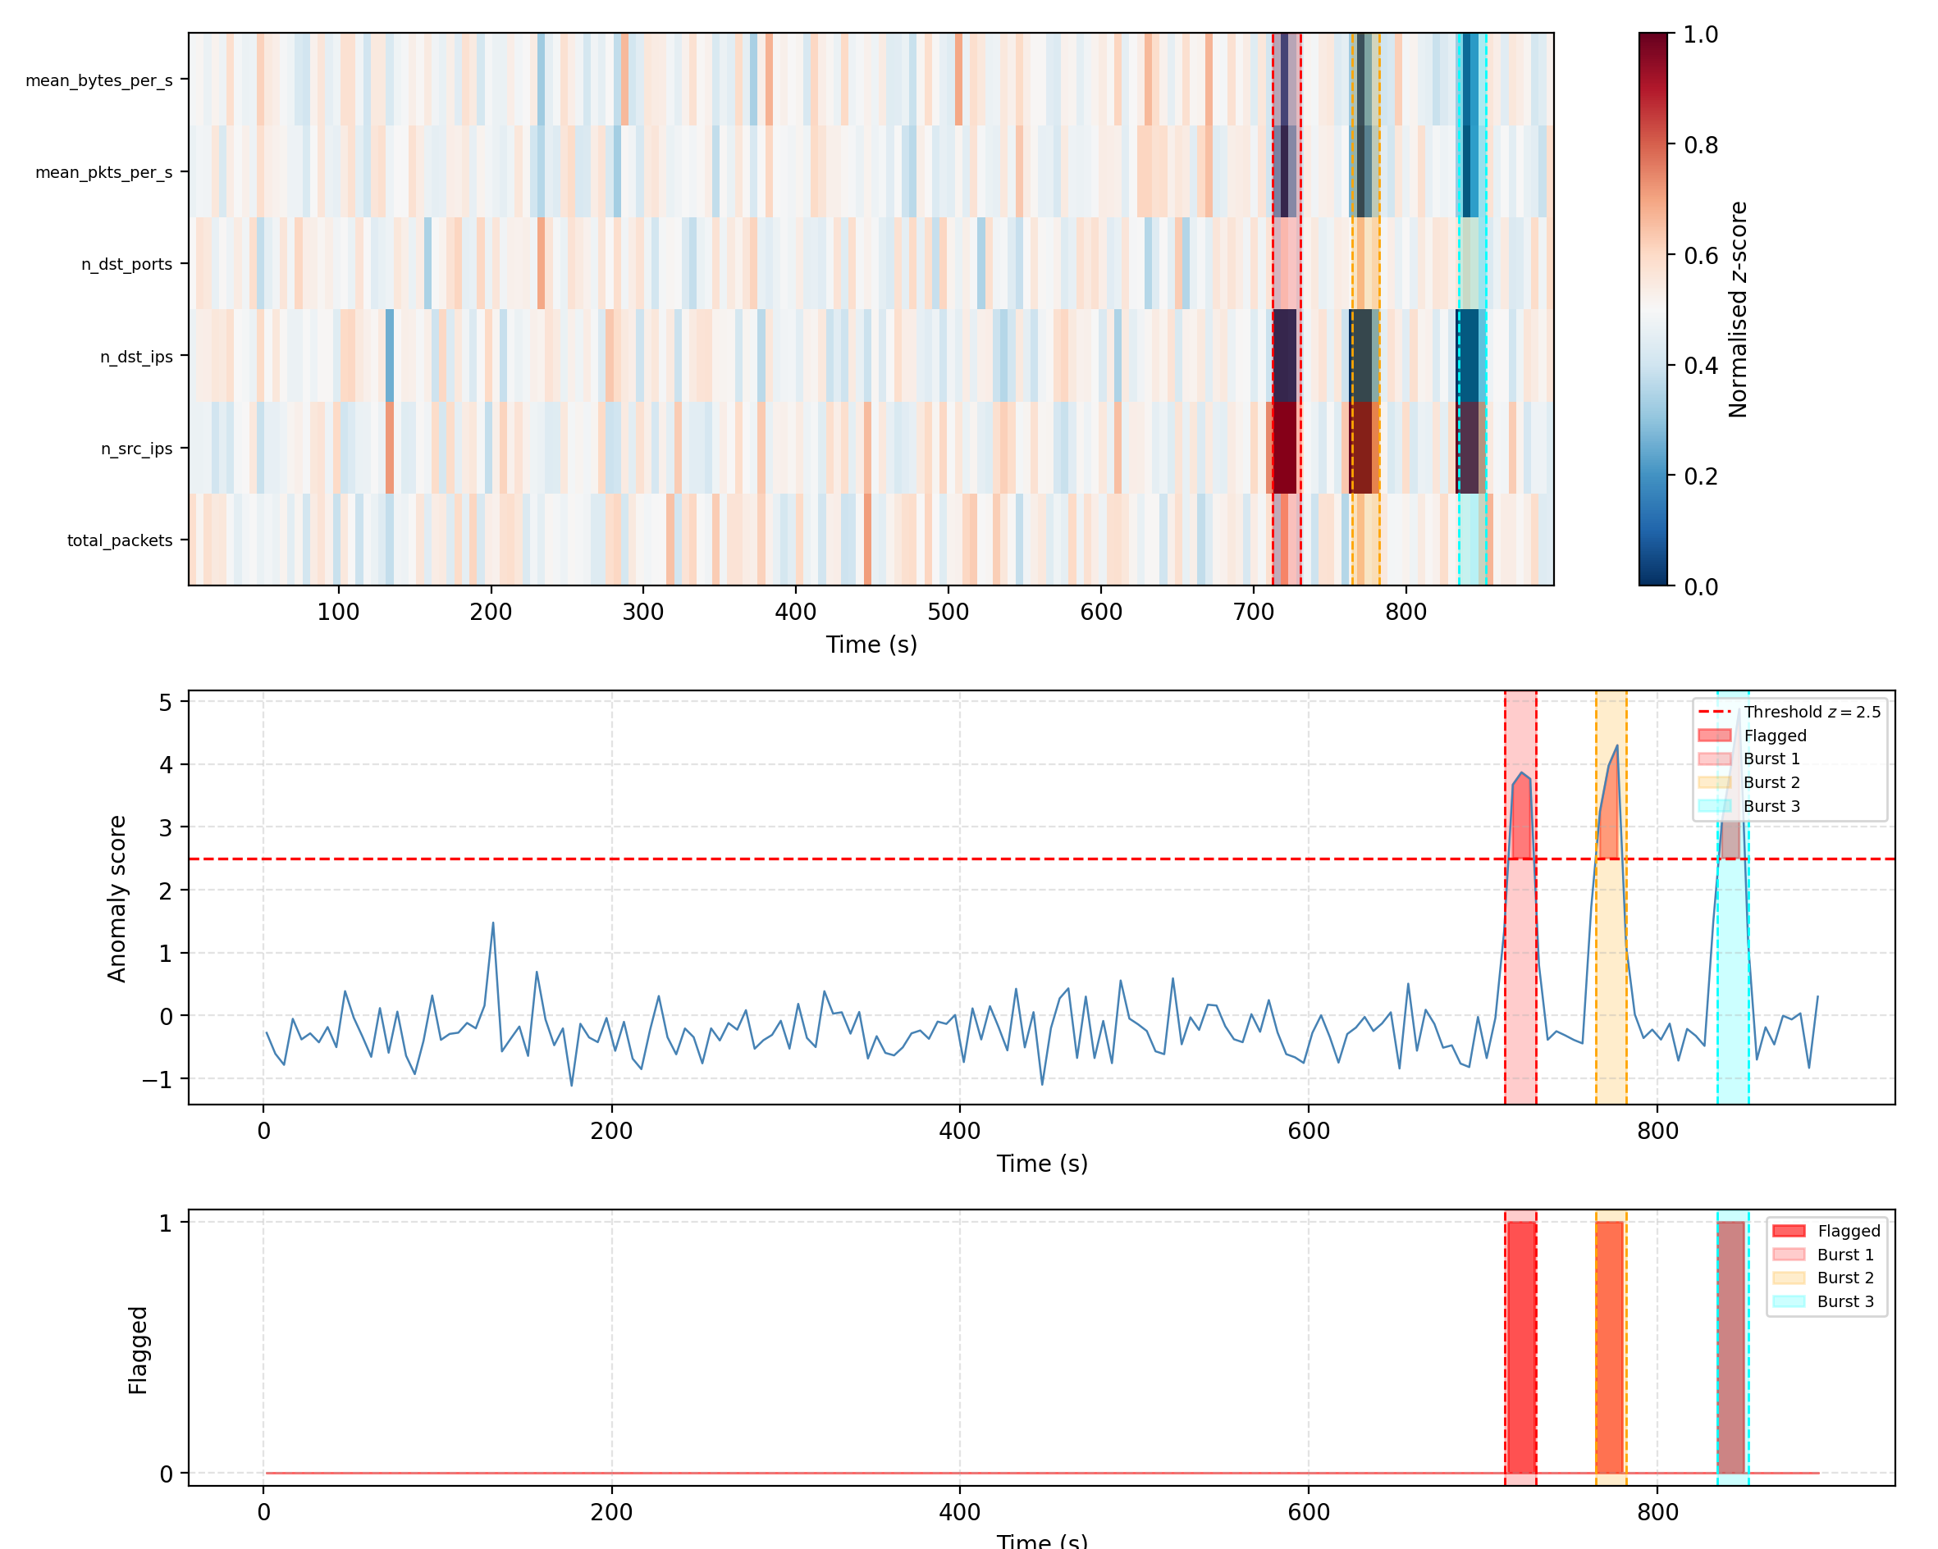
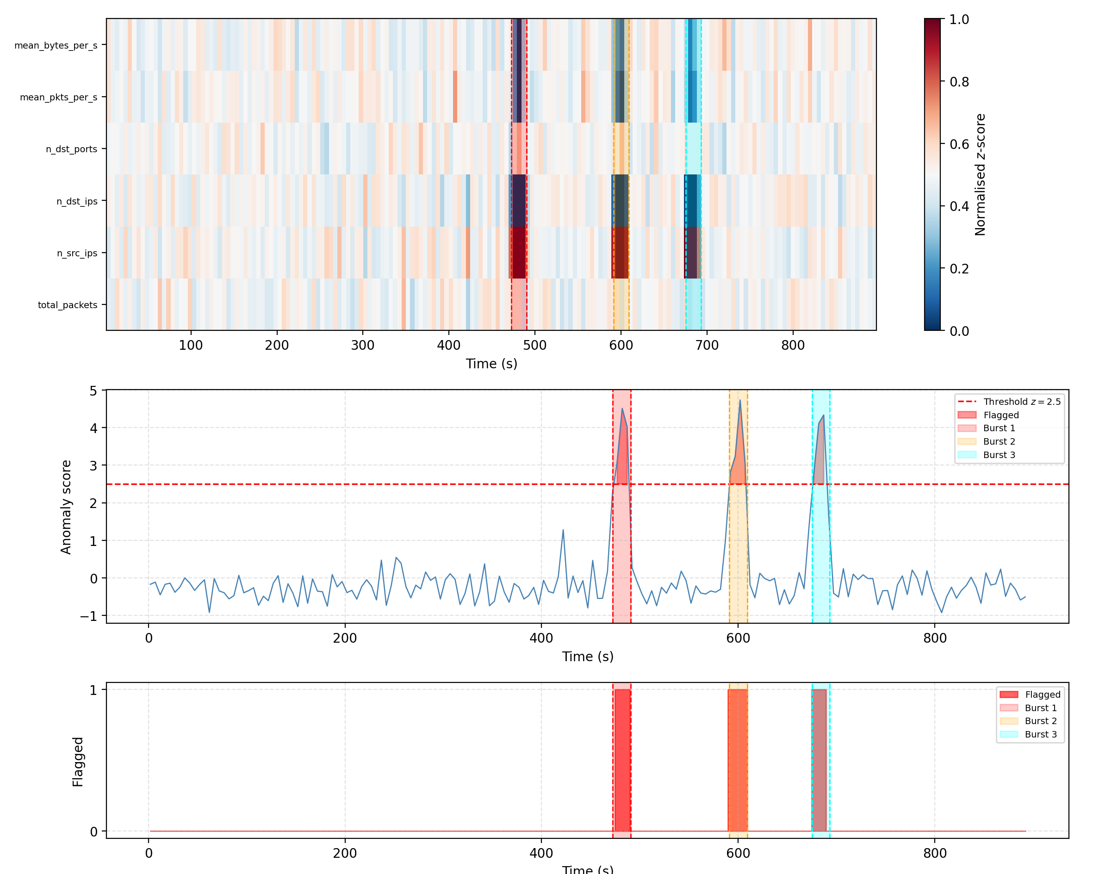

Slide 12
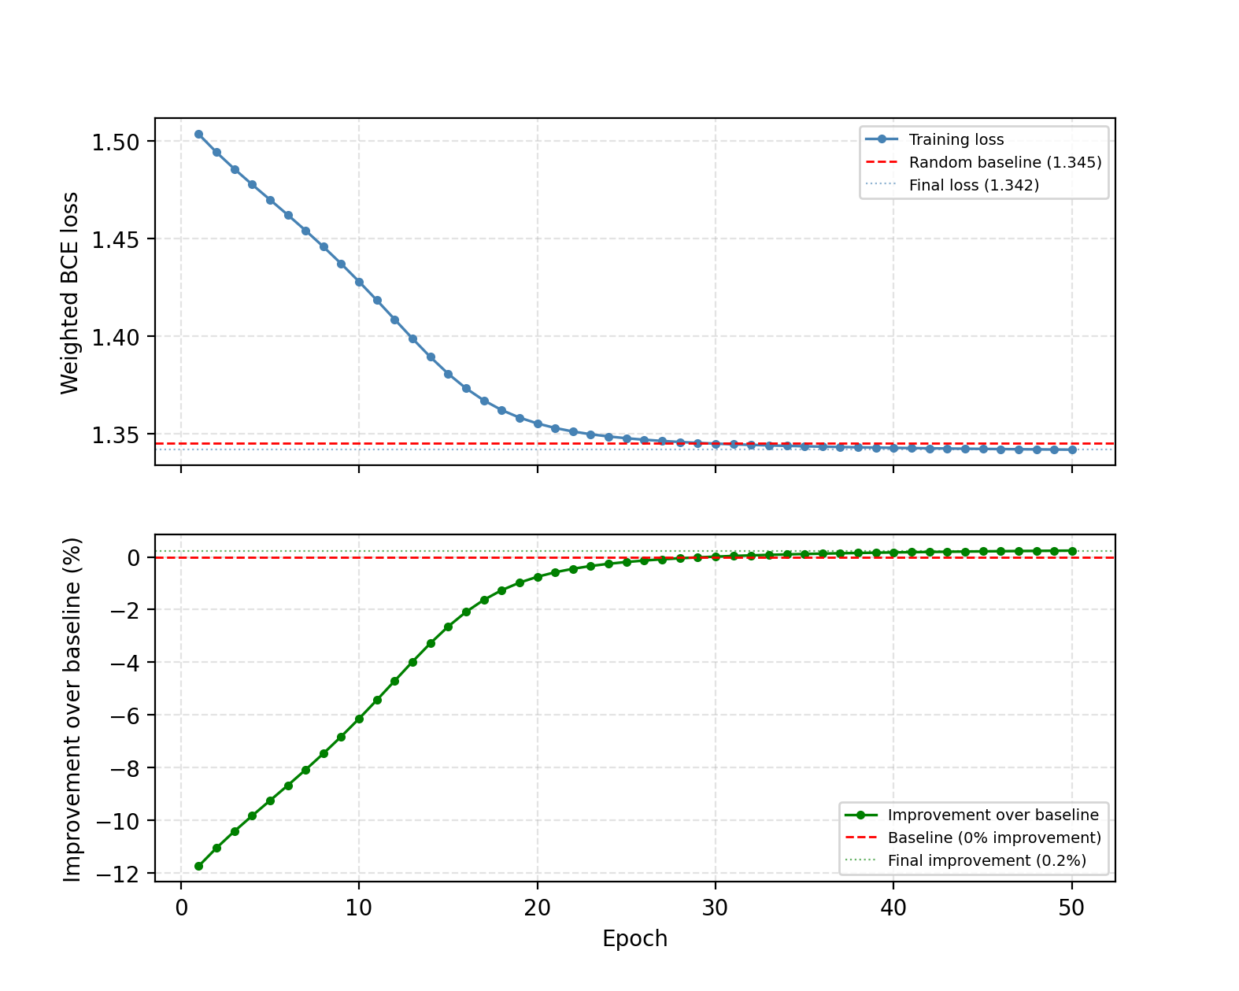
Training…
Paper suggests a random layer works very well, but theoretically one could train the quanvolutional layers
BUT: what circuit to pick if not randomized?
We picked an arbitrary circuit we found online and tried to train it
Very slow and doesn’t work (yet)

Slide 13
WIP Feature
Using Attack time frames to collect data about active connections
-> More weights to classify IPs
Using a quantum kernel in the classification
Correctly implement training of quanvolutional layers (potentially in ”classical” convolution neural network)

