Slide 1
Book A travel
Group Members- Hao Nguyen, Alexander Gould, Pritam Roy

Slide 2
Work Distribution
PHP, Cart - Hao Nguyen
Database, Credit card- Alexander Gould
Idea, Frontend- Pritam Roy

Slide 3
Our Project
-Our project name Book a Travel
-Book your next travel destination with us.
-We've got you from Atlanta to Paris, Sydney to London, Mumbai to Amsterdam. No matter where you want to go, we've got you covered.

Slide 4
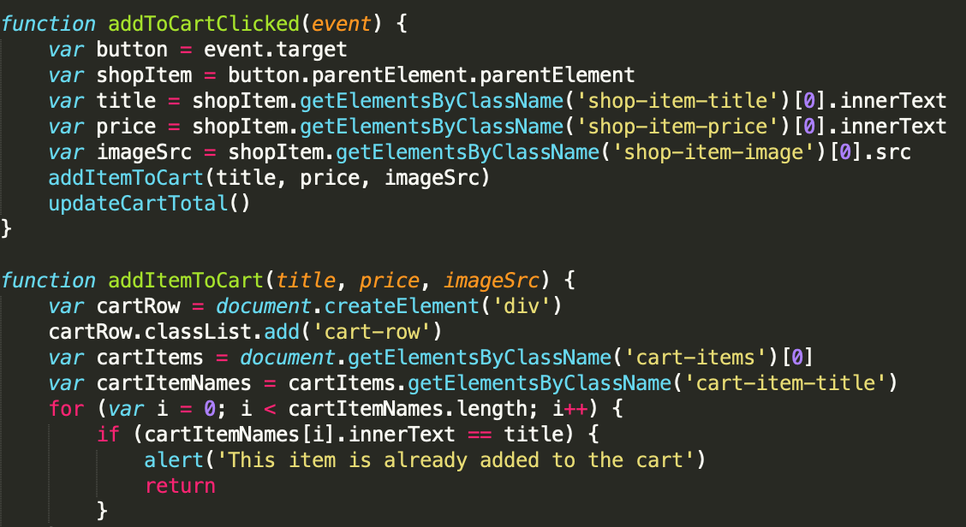
Cart.js

Slide 5
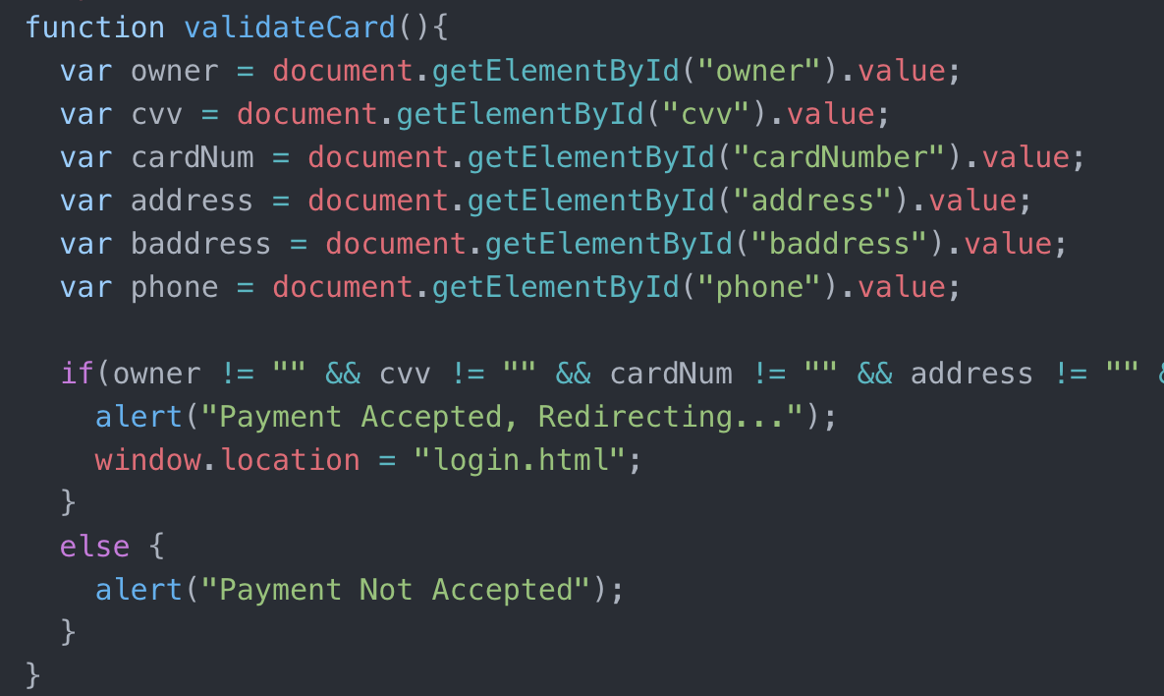
Credit.php

Slide 6
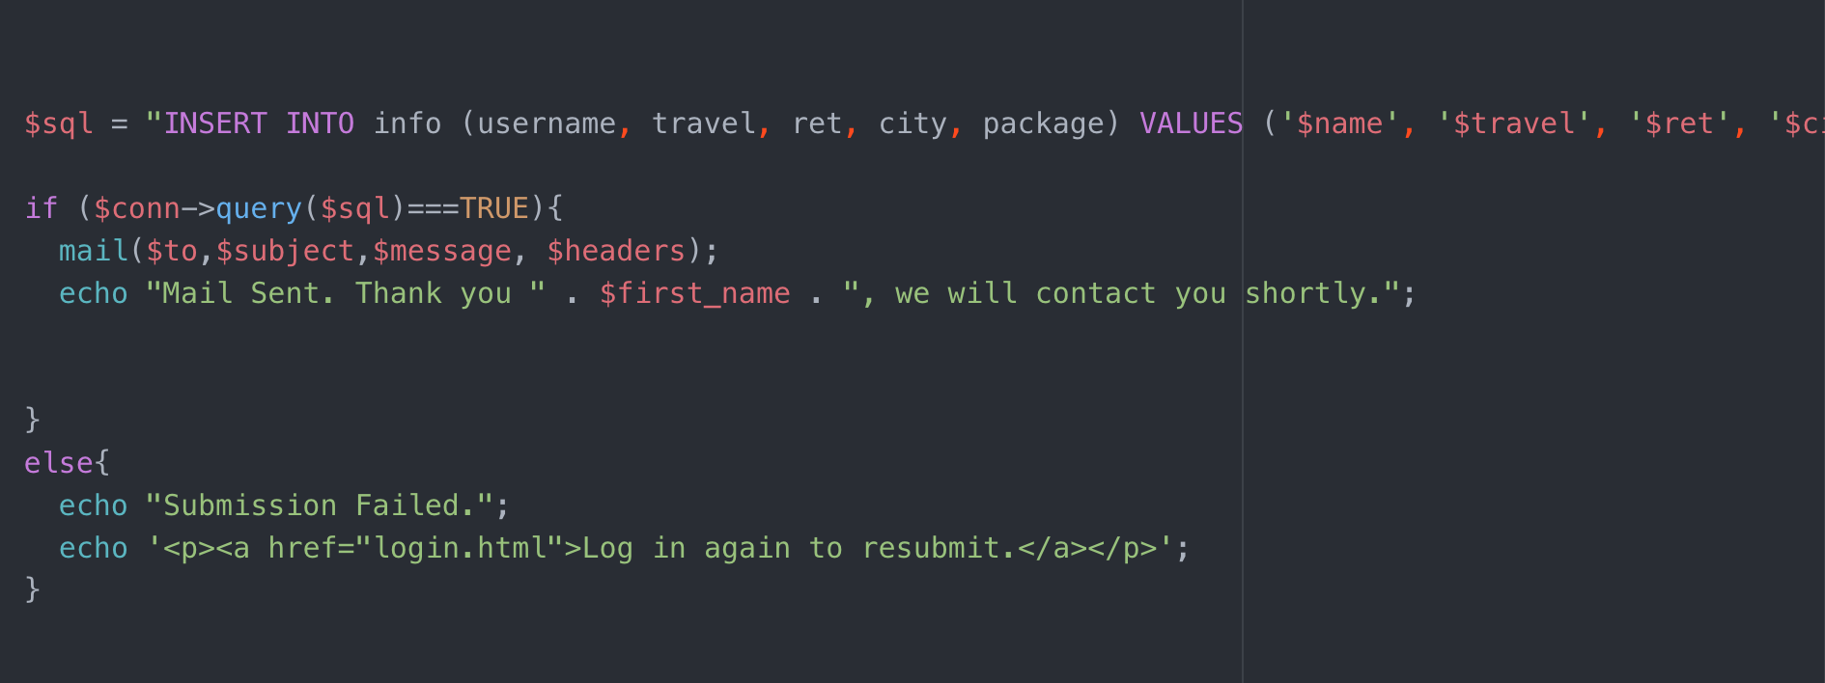
Itinerary.php

Slide 7

Demo
http://codd.cs.gsu.edu/~proy3/Project3/about.html

Slide 8

Q&A

