Slide 1
Christmas Presentation
Happy Holidays!

Slide 2
Winter Facts
1. Snow is white
2. It's cold
3. People build snowmen

Slide 3
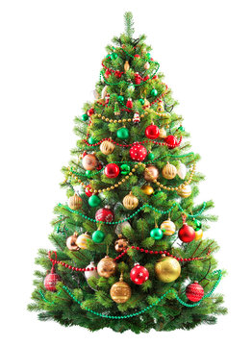
Christmas Tree

