Slide 1


Application of WASP principles for FluxBB
Security in Software Applications - Project 2018/2019
Matteo Mariani 1815188
Serena Ferracci 1649134
Riccardo Chiaretti 1661390
Notes:
{Serena}
Good morning everybody.
Our group is in charge of talking about V3 category that is session management.

Slide 2
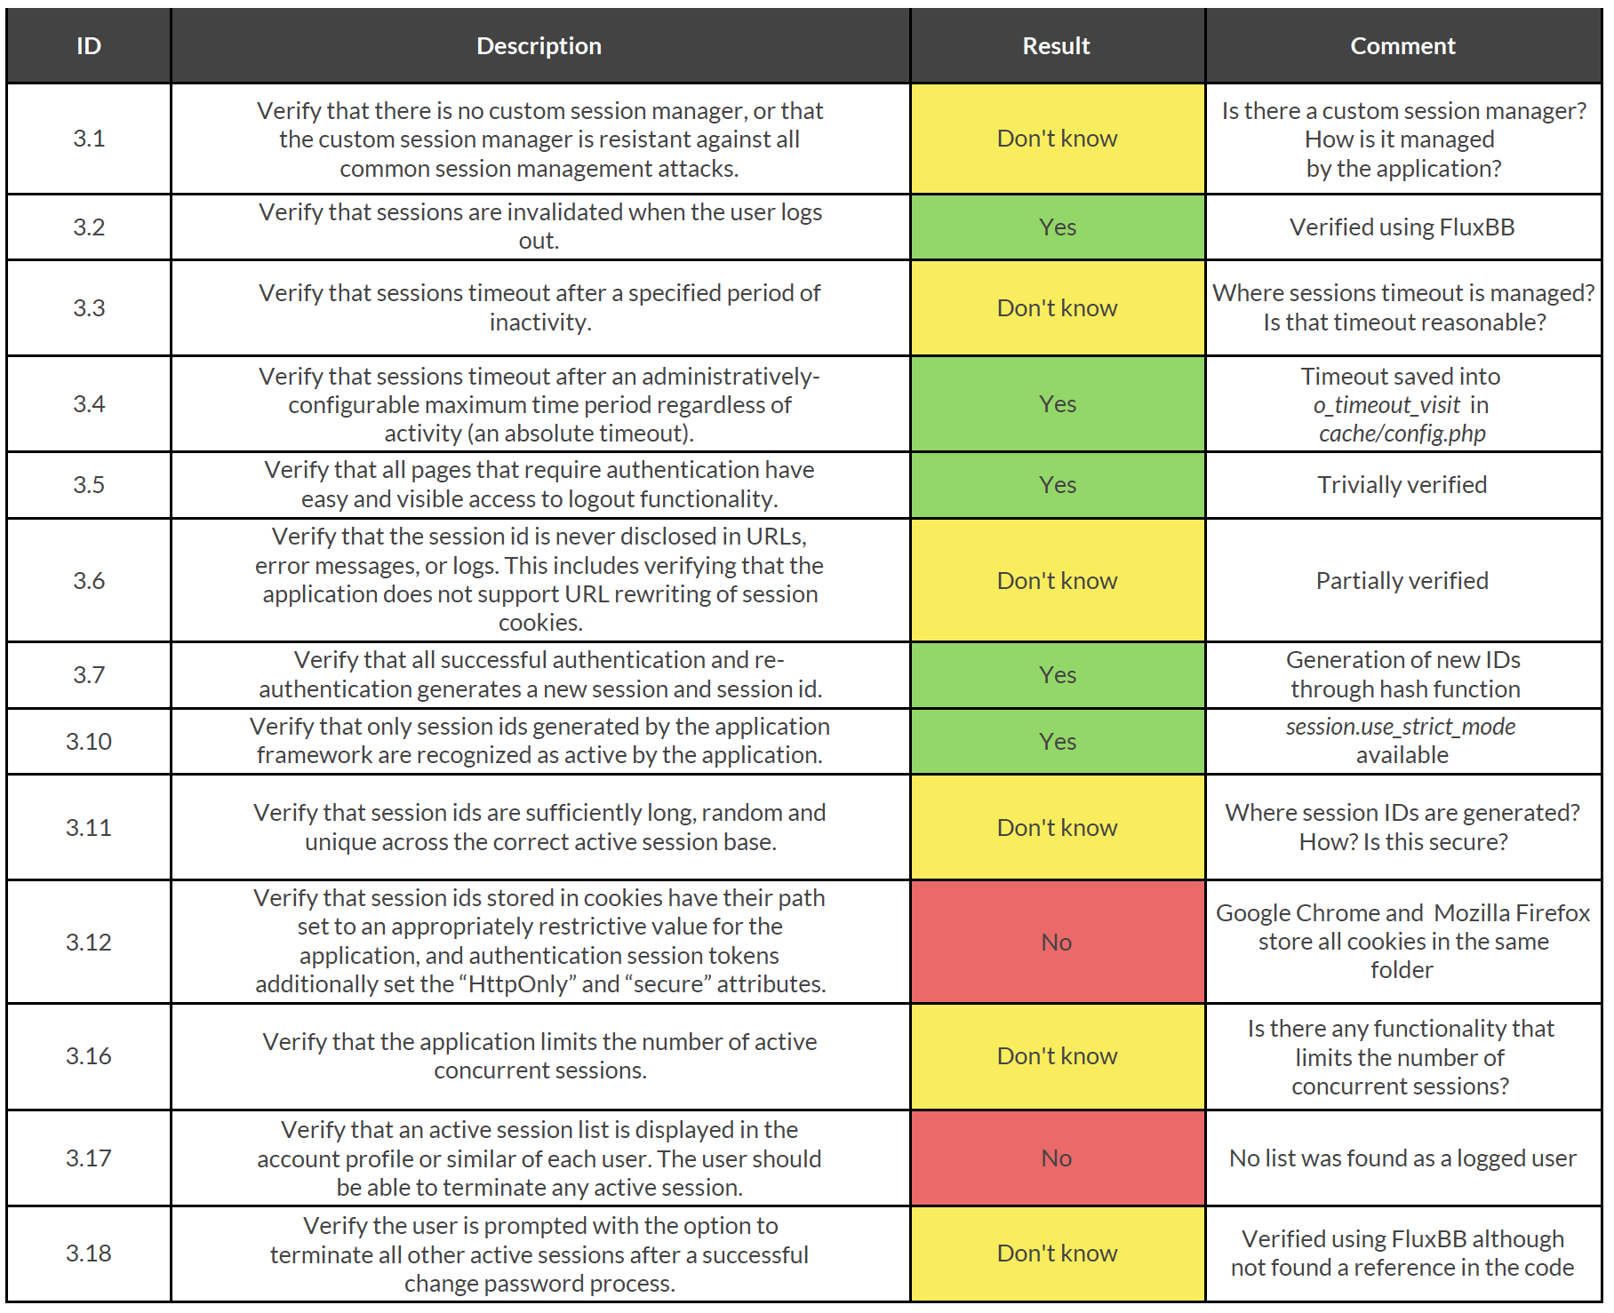
v3: Session Management
Session Management defines the set of all controls governing state-full interaction between a user and the web-based application
The disclosure of the session ID will lead to session hijacking attacks
The goal of v3 is to minimize the risk of leaking users’ information
Notes:
{Serena}
Session Management describes the mechanism according to which a web-based application controls and maintains the state of a user.
Modern web applications require to maintain information about each user for the duration of multiple requests. Therefore, session provide the ability to keep variables that will be used any time the user interacts with the application.
In order to introduce the concept of a session, it is required to implement session management capabilities that link both the authentication and access control modules.
The disclosure, prediction or brute force of the session ID will lead to session hijacking attacks, where an attacker is able to fully impersonate a victim user in the web application.
The goal of v3 requirements is to minimize the risk of leaking users' information.
[after click]
We’ll focus on these requirements: 3.1, 3.3, 3.11 and 3.16.
We chose these ones because we found them more interesting and strongly related to V3’s main goal.
(1:10 min)

Slide 3

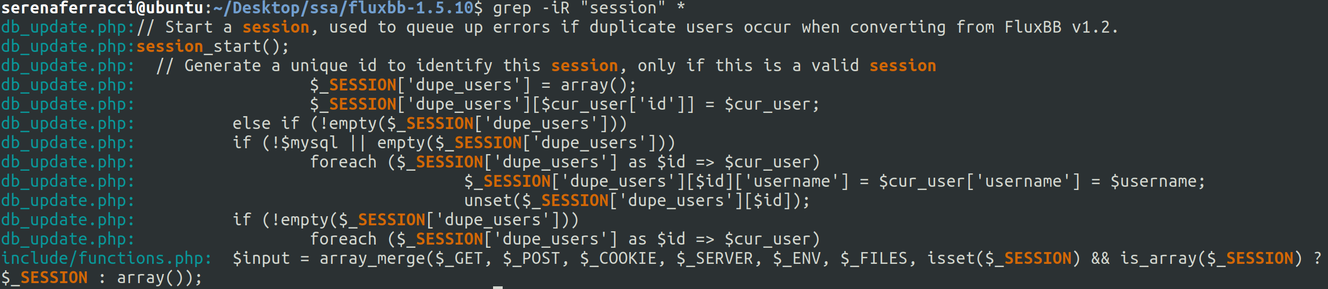
v3.1 : Verify that there is no custom session manager, or that the custom session manager is resistant against all common session management attacks.
The result of grep shows a call to session_start().
It is used to wrap the default server session management initialization.
The default built-in save handler is declared in php.ini.
Notes:
{Serena}
The session manager is the module in charge of securing multiple requests to a service from the same user or entity.
Since this is a critical task, implementing a custom session manager may introduce exploitable vulnerabilities.
A session manager can be either a default built-in save handler declared in php.ini configuration file or a custom handler defined by a call to session_set_save_handler().
For this reason, we manually searched for session related keywords inside the code. As you can see, there were few results but there is a call to session_start() that implies that no custom session manager was used. This is a well-known and well-defined php function that it is used to start a new session or resume an existing one.
[after click]
For this reason, we marked the test as passed.
(2 min)

Slide 4
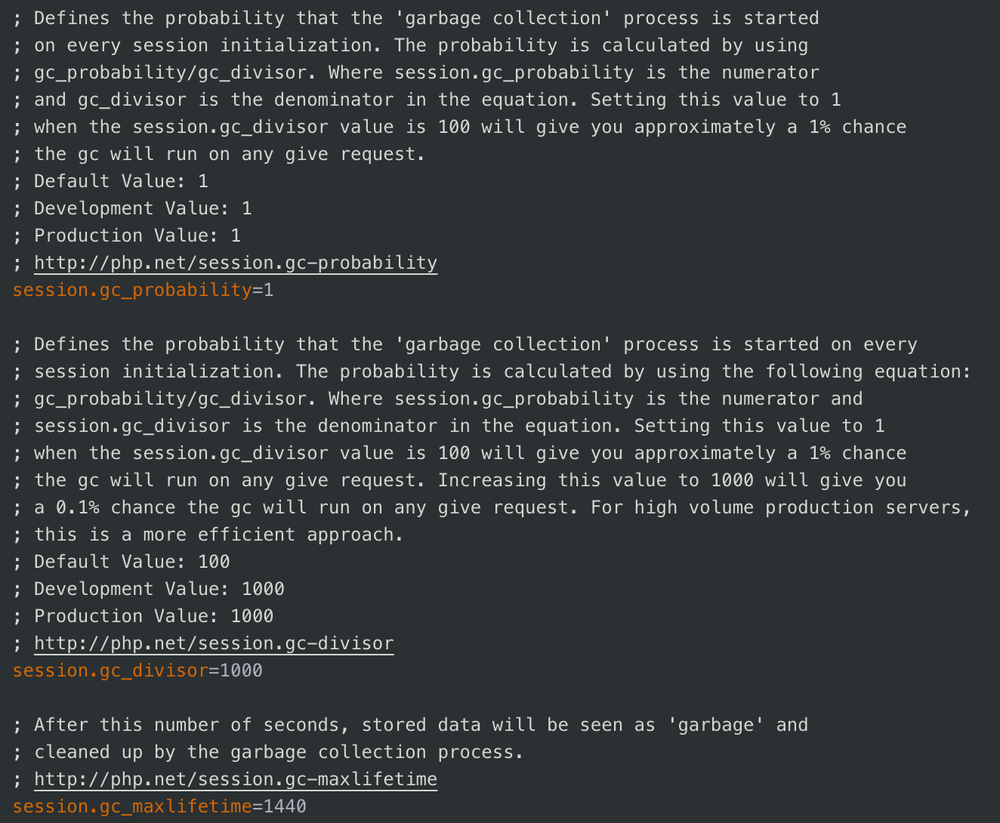
v3.3 : Verify that sessions timeout after a specified period of inactivity.
session.gc_maxlifetime defines the amount of time (∼1440 seconds) after which the stored data will be seen as garbage.
The garbage collector is run with a certain probability computed using the values of session.gc_probability and session.gc_divisor
(usually the probability is equal to 1%).
Notes:
{Riccardo}
In order to minimize the time period in which an adversary can perform session hijacking attacks over active sessions, it is mandatory to set some expiration timeouts.
Indeed, the shorter is the session interval, the lesser is the time an attacker has, to use a valid session IDs. Obviously, the interval must be set accordingly to the purpose and nature of the web application.
In this requirement it is asked to establish whether an idle timeout is present or not. This timeout represents the amount of time a session will remain valid in case there is no activity in the session itself.
In the application the idle timeout is defined in the configuration file php.ini. In particular there are three fundamental parameters:
session.gc_maxlifetime that defines the amount of time (∼24 minutes) after which the stored data will be seen as garbage, but not deleted. The deletion process is carried out by the garbage collector, that is run with a certain probability computed using the other two parameters: session.gc_probability and session.gc_divisor. The default probability, which is adopted by the application, is 1%.
[after click]
For this reason, we marked the test as passed.
However, if the attacker is able to hijack a session, the idle timeout does not limit the attacker’s actions, as he can generate activity on the session periodically to keep the session active for longer periods of time.
(4 min) → (3.50 min)

Slide 5
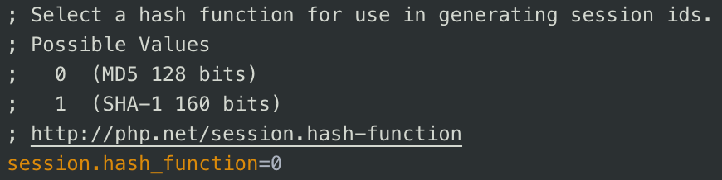

v3.11 : Verify that session ids are sufficiently long, random and unique across the correct active session base.
The session ID must be unpredictable (random enough) to prevent guessing attacks.
The application uses MD5 to generate the session ID. The MD5 message-digest algorithm is a widely used hash function producing a 128-bit hash value.
Notes:
{Matteo}
Since a session ID is temporarily equivalent to the strongest authentication factor associated to a user once it’s created, a well-defined application has to guarantee that this is properly generated. This means that all session IDs must be sufficiently long, random and unique across all active sessions.
If these properties don’t hold, then an adversary might be able to fully impersonate a user in the web application.
In php.ini configuration file, session.hash_function allows to specify which hashing algorithm use to generate session IDs. By default it’s used MD5 message-digest algorithm, producing a 128-bit hash value.
This is well-know to be a weak one-way hashing algorithm and cryptographically broken but it can still be considered fine for session IDs generation since they will have a short lifetime. If devélopers were paranoid enough they would have used SHA-1 hash algorithm, but realistically speaking nobody will ever try to break session ID with 30 minutes expiration timeout especially for the examined application.
Despite this requirement is classified as an L1 recommendation, OWASP standard was not so precise in describing how 3.11 should be guaranteed. We would like to have seen a kind of list of sub-requirements that should be met according to the area of interest of the examined application.
[after click]
Since it was too vague (veig), we marked this as unknown.
(6 min)

Slide 6

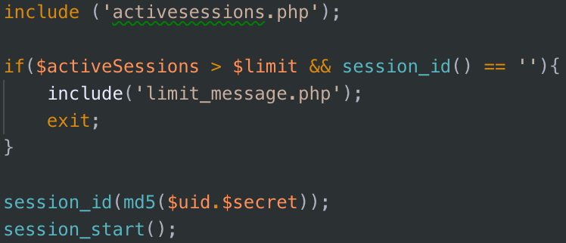
v3.16 : Verify that the application limits the number of active concurrent sessions.
Nothing similar was found, so it was assumed that there is no limit of active concurrent sessions at application level.
In any case, there is always a physical limit:
The random id generated for each session is of a fixed length
Number of files which can be stored
in a single directory
The size of the disk on which the session data are stored
Notes:
{Matteo}
Considering 3.16, limiting the number of concurrent sessions is fundamental for security reasons, especially for DoS attack avoidance.
A common way to achieve this restriction is to keep track of the number of active sessions in the system and comparing it with the maximum number of admissible ones. An example can be the one shown in figure.
Unfortunately, manually checking the code in search for meaningful keywords like active, limit, concurrent doesn’t produce anything that was either interesting or similar to the code in figure. Hence, we have assumed that there is no limit of active concurrent sessions at application level, but there are some physical level.
[after click]
Reasoning about the most probable physical restrictions we get:
First of all, the length of the session ID is machine dependent, for example it can be 8 - 16 bits. Thus, the maximum number of session IDs that can be generated are 2^8 or 2^16. Even if this limit might not occur, the file system is still susceptible to saturation since there is a limit to the number of files that can be stored within a single directory. Lastly, the final constraint that can be met is related to the limited size of the disk in which session data are stored.
(7:25 min)

Slide 7
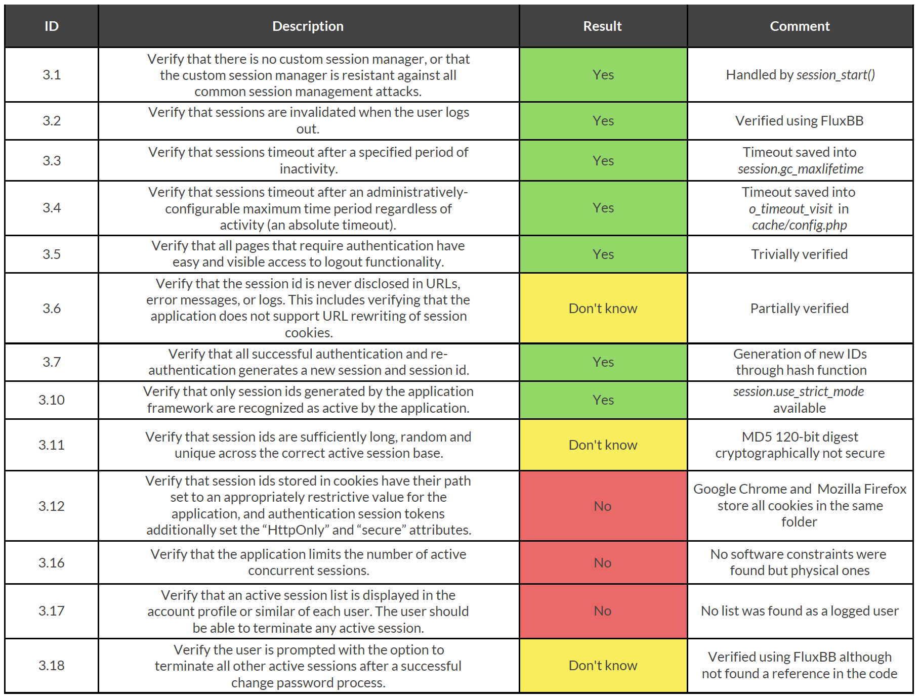
Conclusions
Tools were useless for the entire category
Overall, OWASP requirements were too vague
Notes:
{Riccardo}
For the entire category, all the tools we used were not helpful since most of them are mainly concerned about searching vulnerabilities related to well-know attacks like SQL Injection and XSS.
We found out that OWASP principles were too vague, especially for outsiders analysts that need to understand how to evaluate an application without having any contact with its developers.
A final note about these unknown results: they are susceptible to future changes since we are still analyzing the application to verify V1 requirements.
(8:10 min)

Slide 8
Thank you!
GOD BLESS TORVALDS FOR GREP-ING MY HEART
Notes:
{Riccardo}
The presentation about some more interesting point of V3 category ends here so...
Thank you for your attention!
(8:30 min)

